Slide 2
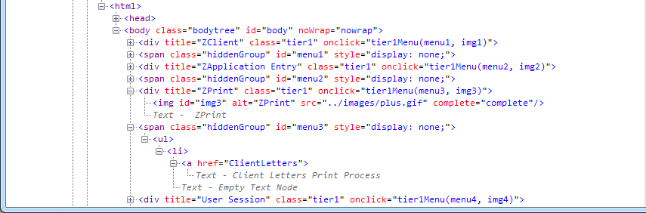
Locators
WebElement element = driver.findElement(By.cssSelector("div[title=’ZClient’]"));
WebElement element = driver.findElement(By.xpath("//div[@title=’ZClient’]"));

Slide 3
Locators
WebElement element = driver.findElement(By.id("menu1"));

Slide 4
Locators
WebElement element = driver.findElement(By.cssSelector("img"));
WebElement element = driver.findElement(By.xpath("//img"));

Slide 5
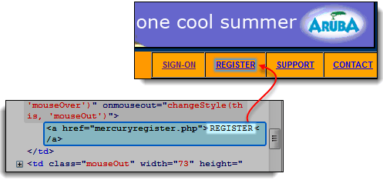
Locators
WebElement element = driver.findElement(By.linkText("REGISTER"));

Slide 6
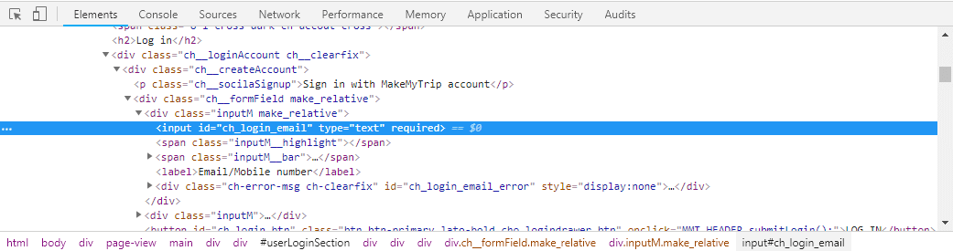
Locators
WebElement element = driver.findElement(By.xpath("//label[text()=‘Email/Mobile number’]"));

Slide 7
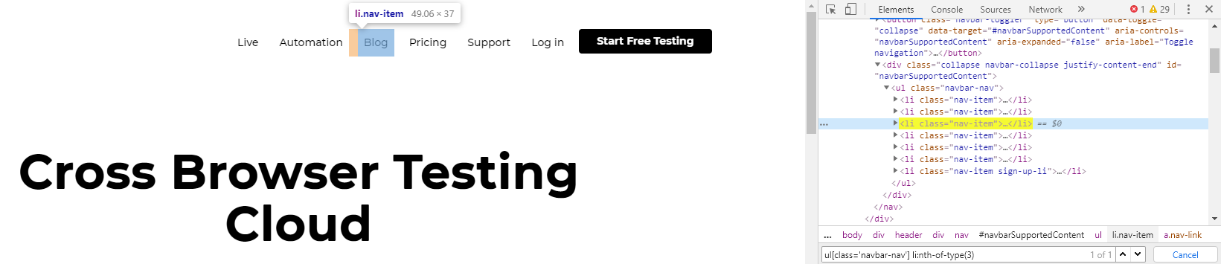
Locators
css = "ul[class='navbar-nav']"
css = "ul.navbar-nav"

Slide 8
Locators
css = "ul.navbar-nav li:nth-of-type(3)"
xpath = "//ul[@class='navbar-nav']/li[3]"

Slide 9
Selenium WebDriver Commands

Slide 10
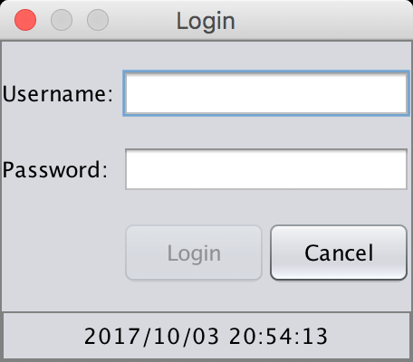
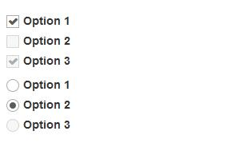
WebElement Commands
getText()
isDisplayed()
isEnabled()
isSelected()

Slide 11
Selenium Wait Commands
Thread.sleep(3000);
driver.manage().timeouts().pageLoadTimeout(60, TimeUnit.SECONDS);
driver.manage().timeouts().implicitlyWait(10, TimeUnit.SECONDS);
Wait<WebDriver> wait = new WebDriverWait(driver, 5, 1000);
wait.until(ExpectedConditions.visibilityOf(driver.findElement(By.id("table"))));

Slide 12
TestNG

Slide 13
Annotations
@Test
@Test
public void googleTest(){
...
}

Slide 14
Annotations
@BeforeClass
@AfterClass
@BeforeMethod
@AfterMethod

Slide 15
public class AnnotationsTestNG {
@BeforeClass
public void appSetup() {
}
@BeforeMethod
public void login() {
}
@Test
public void testCurrentUrl() {
}
@Test
public void testReport() {
}
@AfterMethod
public void screenShot(){
}
@AfterClass
public void closeUp() {
}
}
appSetup()
login()
testCurrentUrl()
screenShot()
login()
testReport()
screenShot()
closeUp()

Slide 16
Assertions
assertTrue(logo.isDisplayed(), “Logo is not displayed”);
assertFalse(message.isDisplayed(), “Message is displayed”);
assertEquals(“Actual text”, “Expected text”, “Strings are not matching”)
assertNotEquals(“Actual text”, “Expected text”, “Strings are matching”)
assertNull(value)
assertNotNull(value)

Slide 17
Page Object Pattern

Slide 18
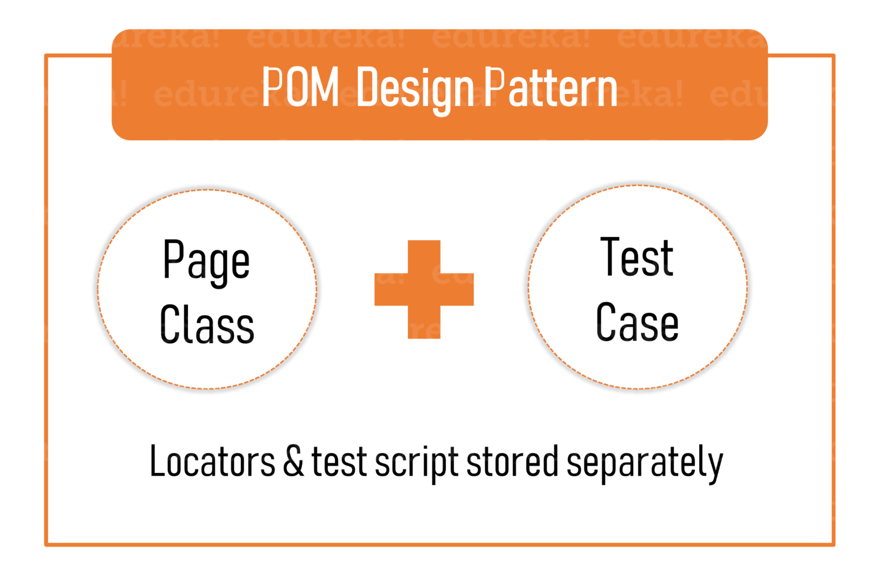
Page Object Model
Automation pattern to split the logic and realization.

Slide 19
Page Factory

Slide 20
Page Factory
public void search(String query) {
driver.findElement(By.id("text")).sendKeys(query); driver.findElement(By.cssSelector("input[type=’submit’]")).click();
}
@FindBy(id = "text")
private WebElement searchField;
@FindBy(css = "input[type=’submit’]")
private WebElement searchButton;

Slide 21
Home task
assertTrue(logo.isDisplayed(), “Logo is not displayed”);
assertFalse(message.isDisplayed(), “Message is displayed”);
assertEquals(“Actual text”, “Expected text”, “Strings are not matching”)
assertNotEquals(“Actual text”, “Expected text”, “Strings are matching”)
assertNull(value)
assertNotNull(value)

Slide 22
Home task
Design automated tests (10 test scenarios) for smoke testing of the application https://qa2019.itschool.kherson.dataart.com/events. Use Page Object and Page Factory.
Deadline – 3rd of December.
Credentials:
Lecturer1 - lectureralexey@mailinator.com password: QASchool2019!
Lecturer2 - lectureranton@mailinator.com password: QASchool2019!
Candidate1 - roman2019@mailinator.com password: QASchool2019!
Candidate2 - sergey2019@mailinator.com password: QASchool2019!

Slide 23
Thank you! Any questions?

