Slide 1

Renewable power plant

Slide 2
The problem
Renewable powerplant with windturbines and solar panels
Constant supply of 6MW
Lowest possible cost
Simulink simulation

Slide 3
Our solution
Call simulink simulation from python
Calculate the cost of the setup
Minimize the cost with a genetic algorithm

Slide 4
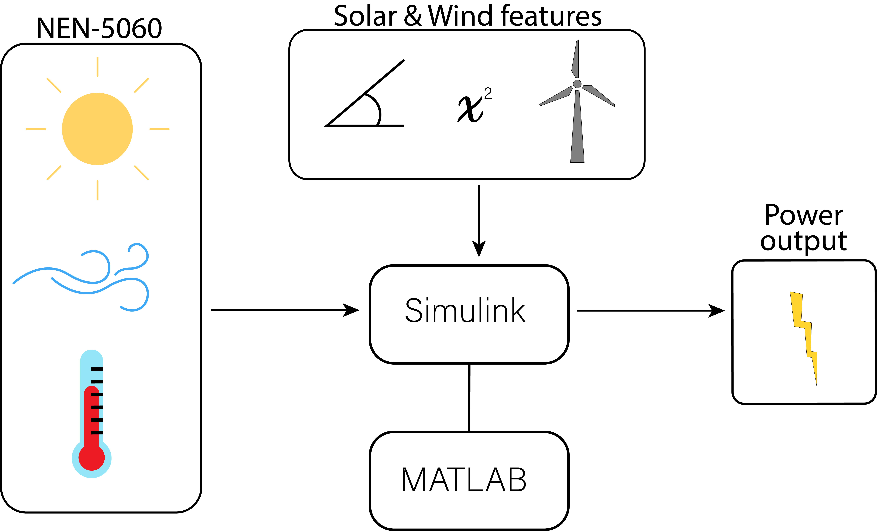
Simulation

Slide 5
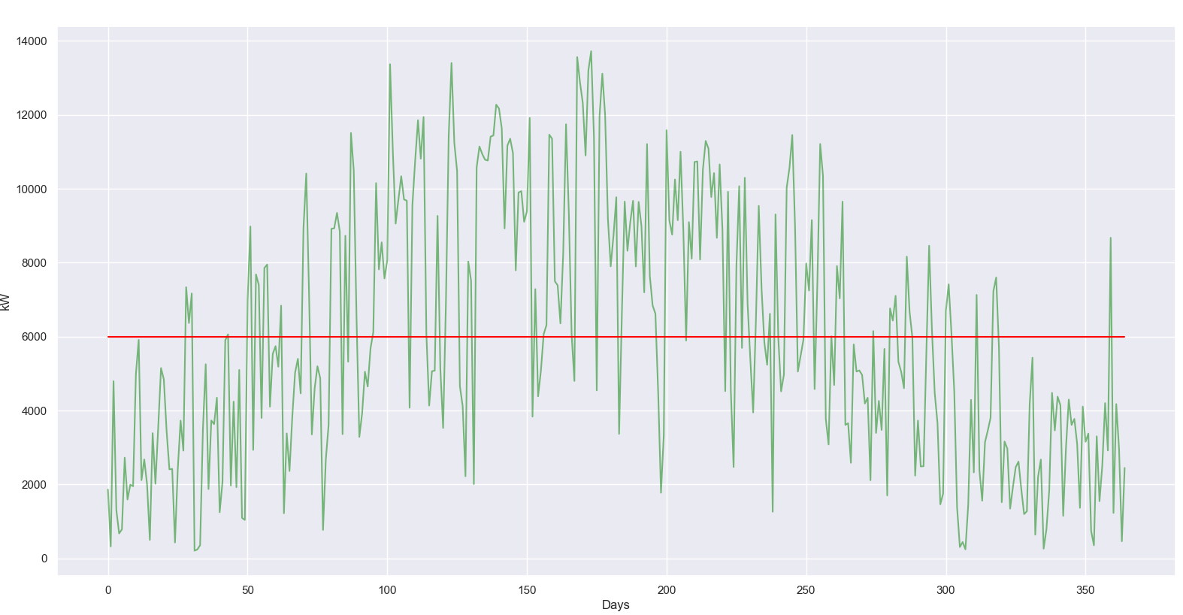
Simulation output

Slide 6
Cost calculation
Solar panels
Windturbines
Required storage
Extra high cost when not producing at least 6 MW

Slide 7
Genetic algorithm
Start with pool of 100 setups
Run simulations and calculate costs
Keep ones with lowest cost
Make new pool setups based on these ones
Add random mutations
Repeat

Slide 8
Questions

