Slide 1

Renewable power plant

Slide 2
Introductie
Aanpak
Power output analyses
voortgang
Demonstratie GUI
Notes:
We need to find the find the best configuration for a hybrid solar/wind energy powerplant to power danone factory that has a constant demand of 6MW. This configuration must be the lowest cost or close to the lowest cost configuration for a specific scenario. We also need to use the Simulink simulation that will provide us with the the power output based on the weather data and the configuration that is given.

Slide 3
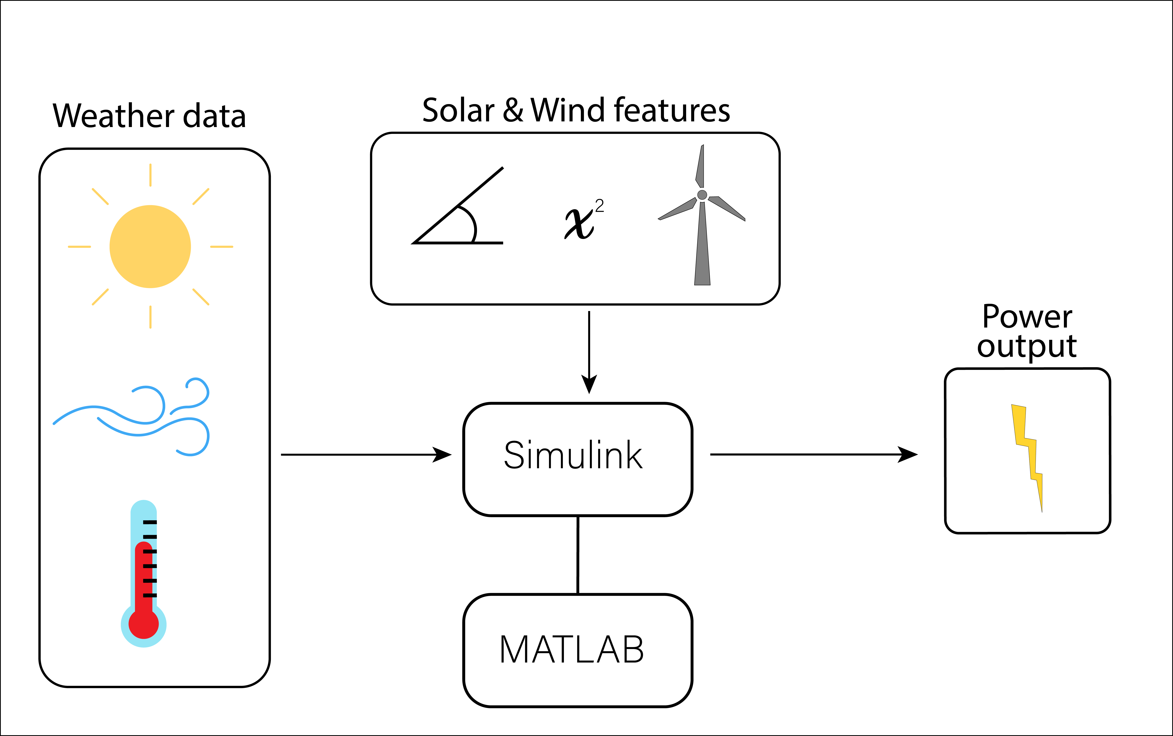

Slide 4
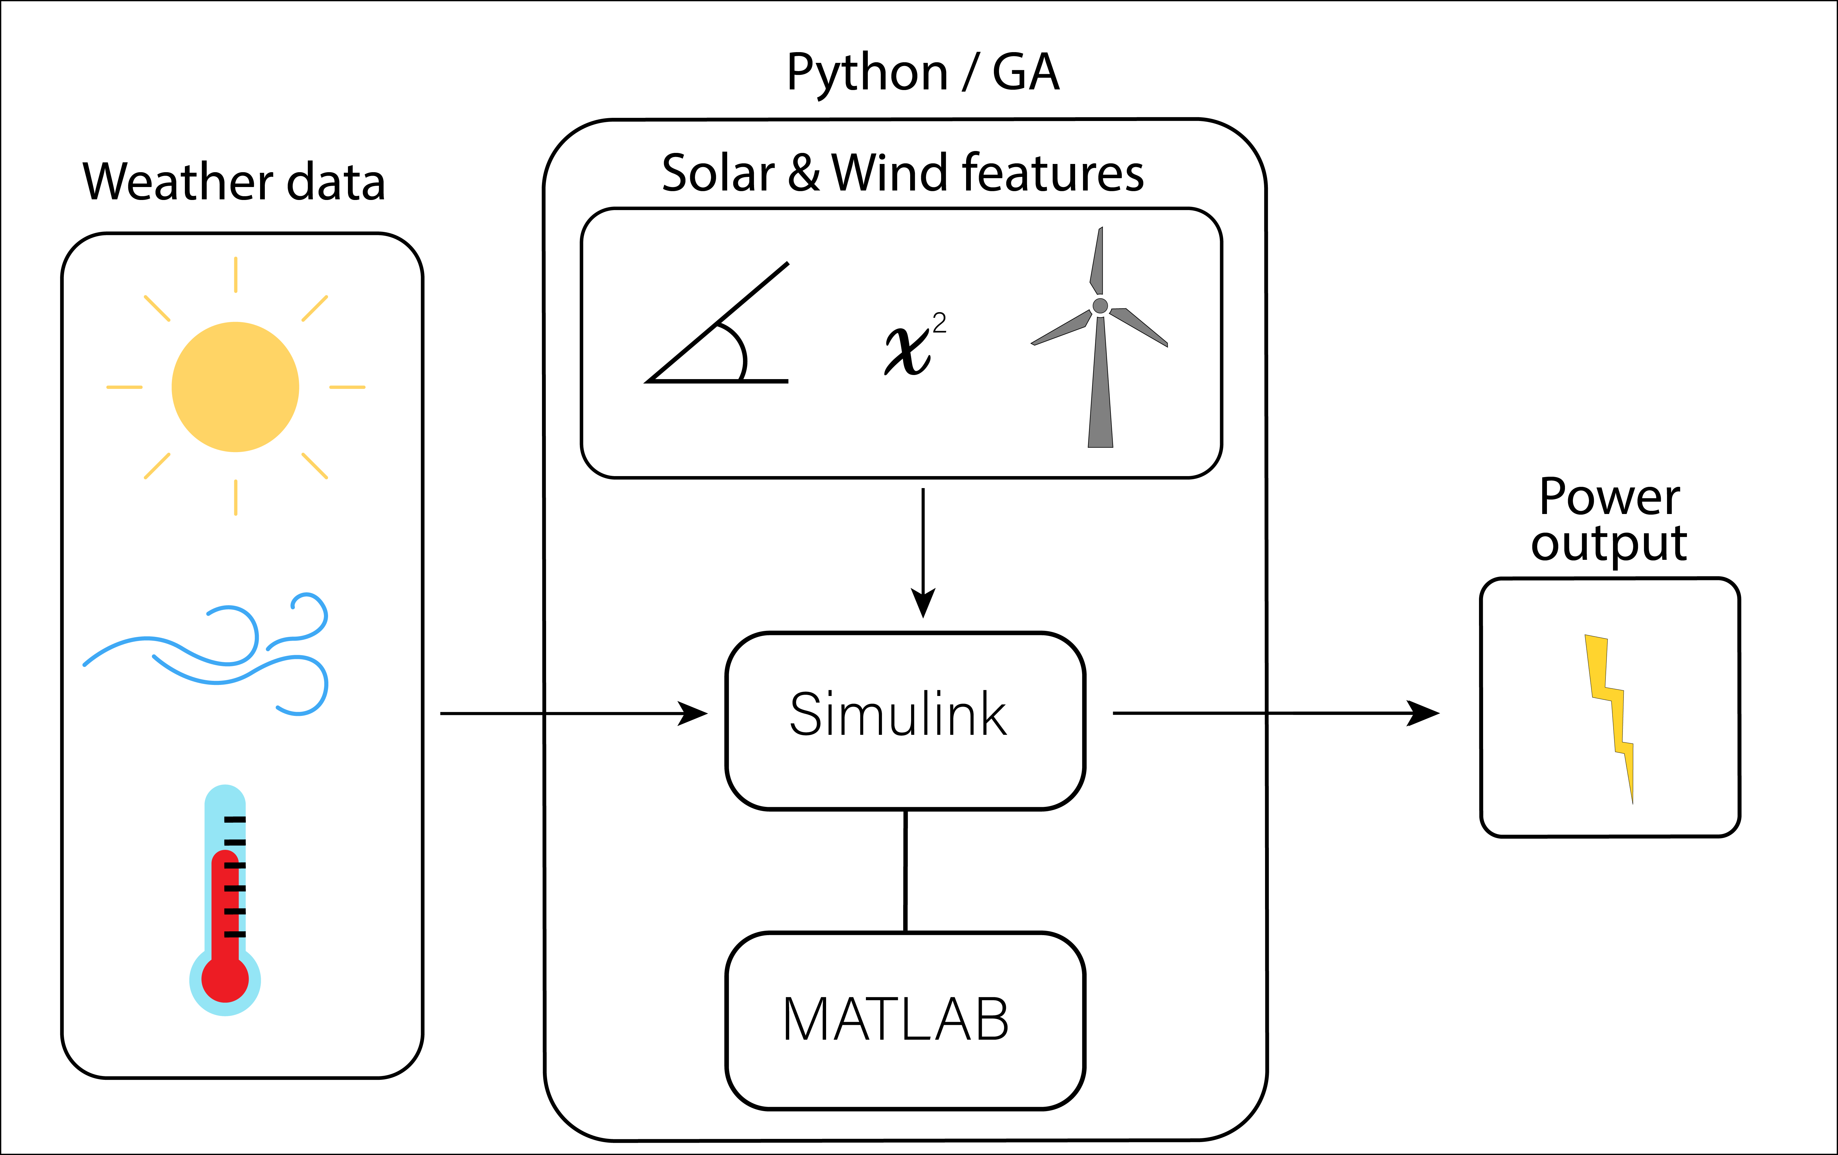

Slide 5
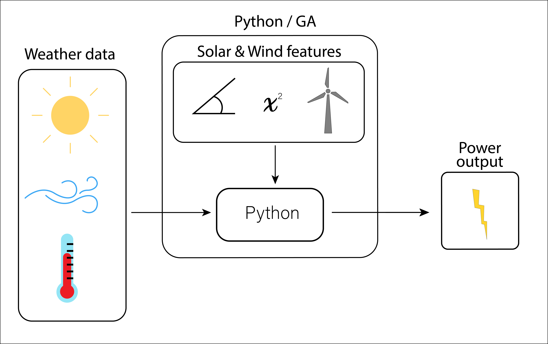

Slide 6
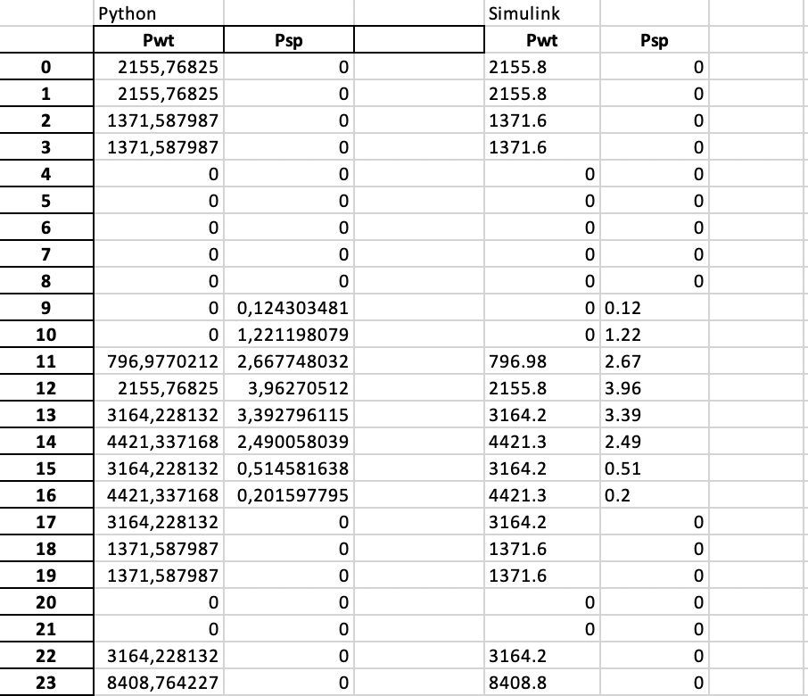
Python out vs Simulink out

Slide 7
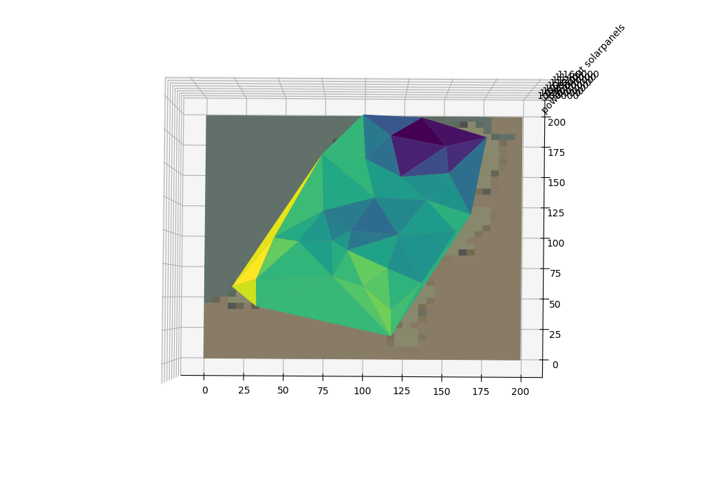
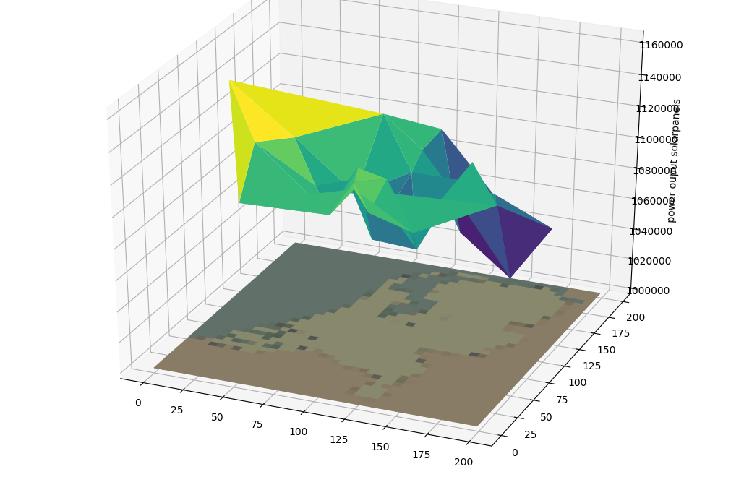
Power output per PV-paneel
PV-panelen naar het zuiden met een hoek van 37 graden

Slide 8
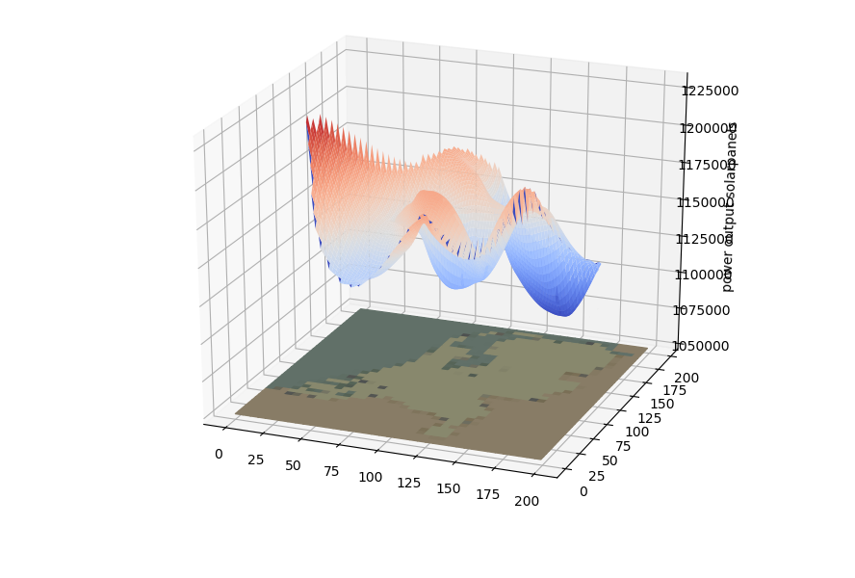
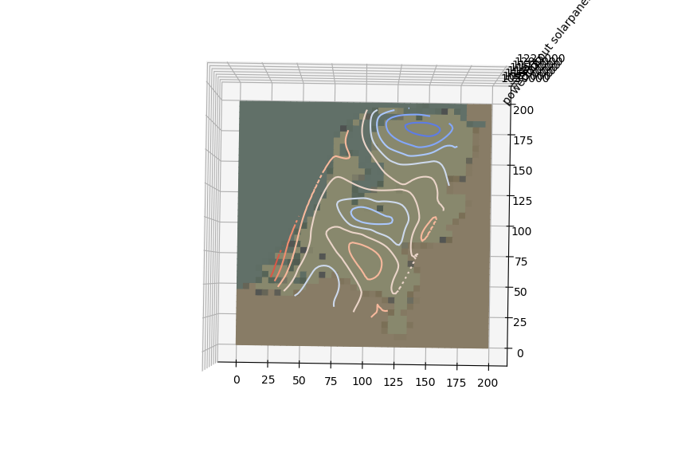
Power output per PV-paneel
Bicubic Interpolation

Slide 9
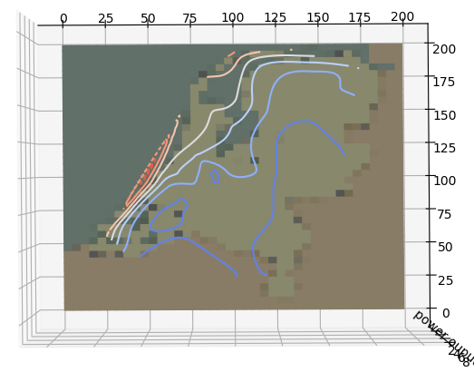
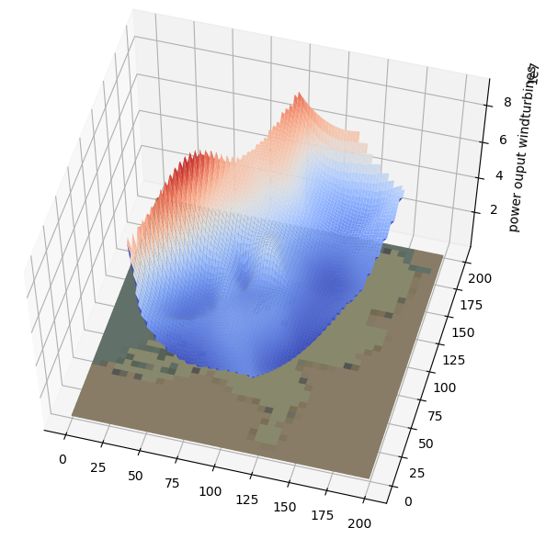
Power output per windturbine

Slide 10
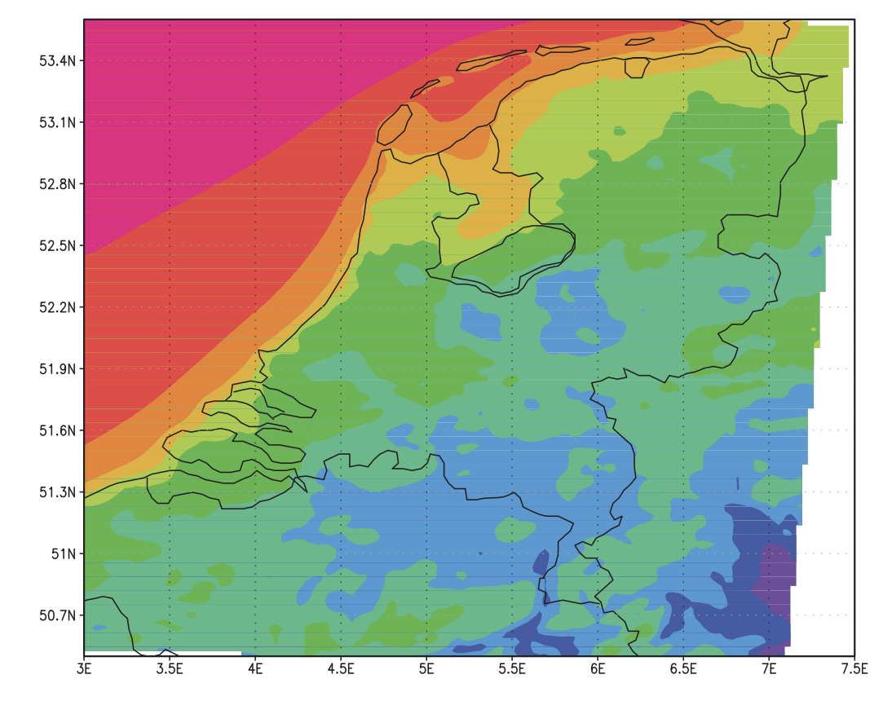
vergelijking KNMI data met wind turbine power output

Slide 11
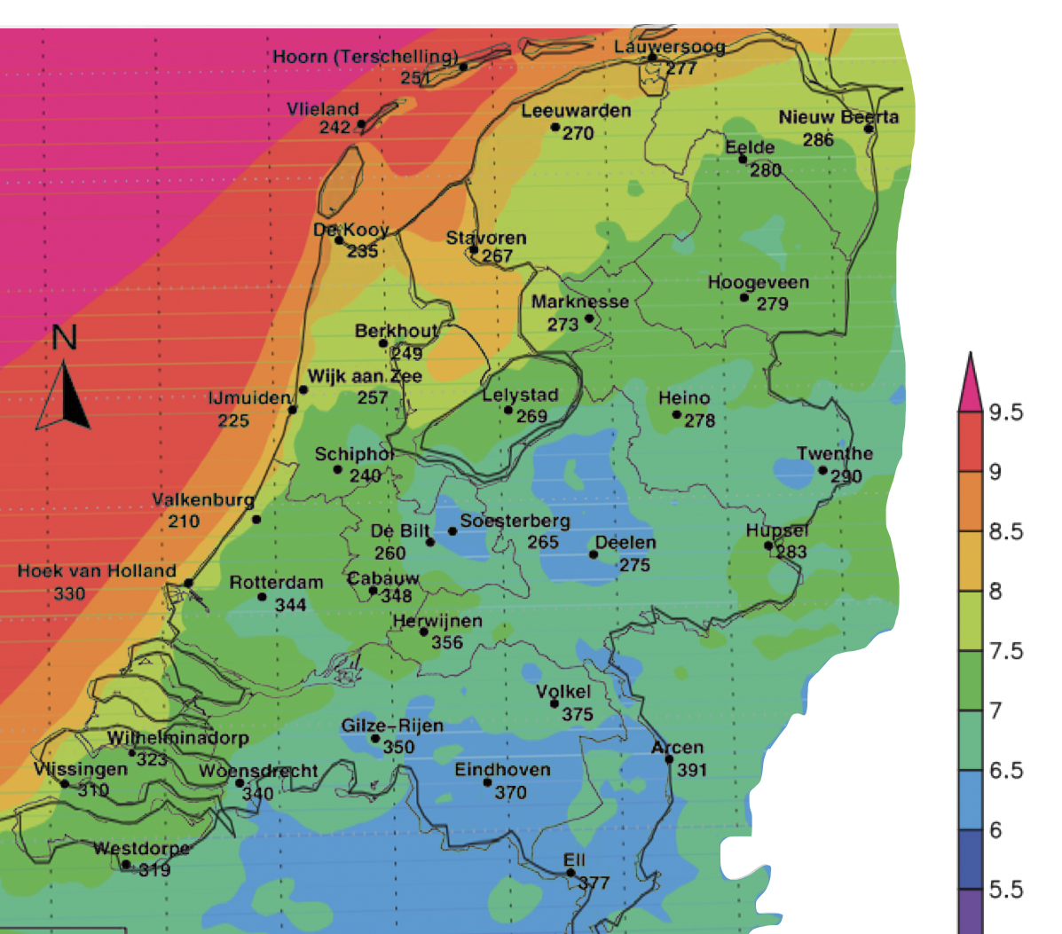
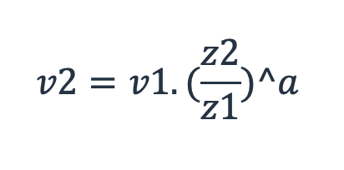
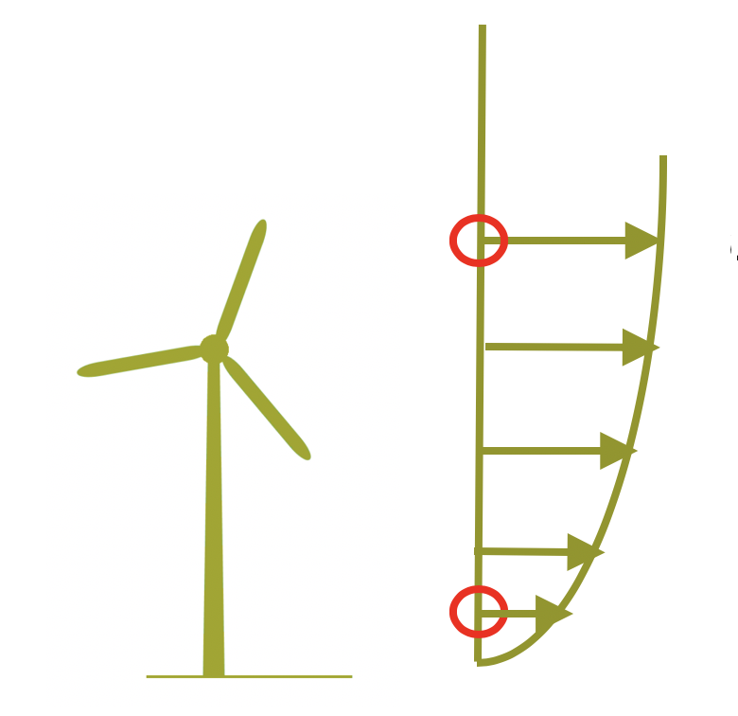
Terrein factor berekenen
Invoer windsnelheid 10m hoogte
Gemiddelde windsnelheid op 100m
Berkenen van "a"
Source: KNMI

Slide 12
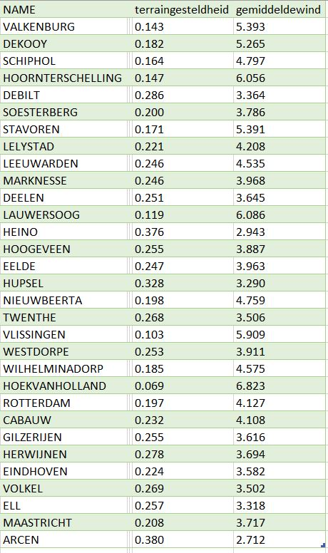
Terrein factor
Notes:
We need to find the find the best configuration for a hybrid solar/wind energy powerplant to power danone factory that has a constant demand of 6MW. This configuration must be the lowest cost or close to the lowest cost configuration for a specific scenario. We also need to use the Simulink simulation that will provide us with the the power output based on the weather data and the configuration that is given.

Slide 13
Demonstratie GUI

Slide 14
Voortgang
Paper
Creëren executable

Slide 15

Questions?

