Slide 1
PID Controller Design using “Genetic Algorithm”
by-Anil Karaka(06EE1023)
guide: Prof Jayanta Pal

Slide 2
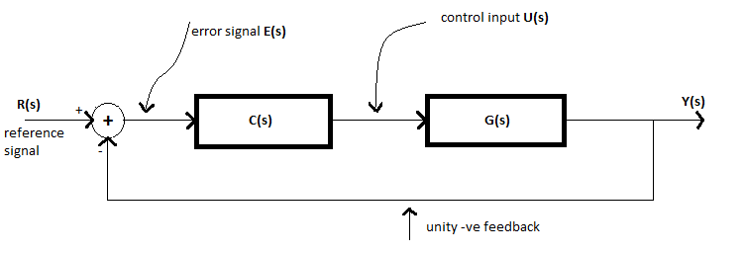
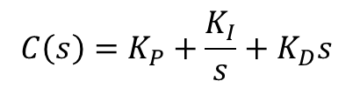
Basic PID controller

Slide 3
Genetic algorithm.
GA is a search technique used in computing to find exact or approximate solutions to optimization problems
Genetic Representation(phenotype-genotype)
Fitness function

Slide 4
Genetic Representation
Representing solutions/individuals
Phenotype-genotype relation
The most standard one is an array of bits
K_{P} |  |  |  |  |  |  |  | K_{I} |  |  |  |  |  |  |  | K_{D}
1 | 0 | 1 | 0 | 0 | 1 | 1 | 1 | 1 | 0 | 1 | 0 | 0 | 0 | 0 | 0 | 0 | 1 | 1 | 1 | 1 | 1 | 1 | 0
genotype
KP=10.27
KI=8.13
KD=2.97
phenotype

Slide 5
Fitness function
Definition
Problem dependent
Integral performance indices(squared error over large time period)

Slide 6
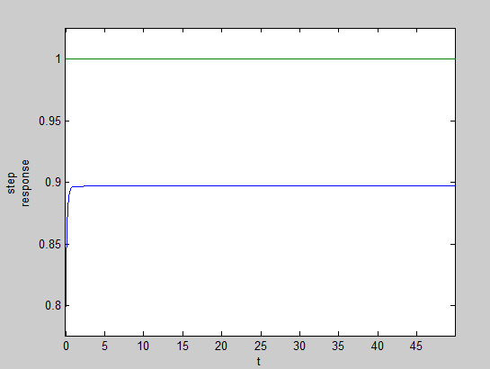
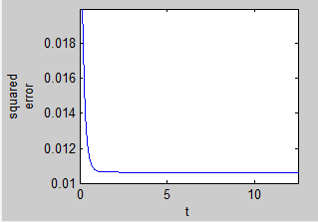
Fitness for a particular solution
Squared error
K_{P}=10;K_{I}=8.7032;K_{D}=1.33
Step response
Fitness=0.5354
Area under squared error curve
Here lower the fitness value higher the quality of the chromosome

Slide 7
Various stages
Initialization
Selection
Crossover
Mutation
Termination

Slide 8
Initialization
Initialization is nothing but random generation of individual solutions to form initial population.
genotypes
K_{P}
K_{I}
K_{D}
1
2
3
4
5
.
.
.
0 | 1 | 1 | 0 | 1 | 0 | 1 | 0
1 | 1 | 0 | 1 | 0 | 0 | 0 | 1
0 | 0 | 1 | 0 | 0 | 1 | 0 | 1
Example of initial population in this case(PID controller)
Here the bit size is taken as 8 for variable
Population is generally based on the problem

Slide 9
selection
During each successive generation, a proportion of the existing population is selected to breed a new generation.
Roulette wheel selection method
Individuals are given a probability of being selected that is directly proportional to their fitness

Slide 10
Roulette wheel selection.
Wheel is rotated
5
1
Weakest individual
2
Selection point
4
3
Strongest individual
This replicates the nature in that fitter individuals will tend to have a better probability of
Survival and will go forward to form the mating pool for the next generation

Slide 11
crossover
Genetic operator used to vary the programming of a chromosomes from one generation to the next
Crossover probability(P_{c})
Single point crossover
Double point crossover

Slide 12
mutation
After selection and crossover, mutation occurs to ensure that individuals are not exactly the same. You allow for a small chance of mutation.
Mutation probability(P_{m})
before
1 | 1 | 0 | 1 | 1 | 0 | 1 | 1 | 0 | 1
after
1 | 1 | 0 | 1 | 1 | 1 | 1 | 1 | 0 | 1
Vital in ensuring population diversity

Slide 13
termination
The generational process is repeated until termination condition is reached.
Solution that satisfied minimum criteria
Fixed number of generations reached
Successive iterations are no longer better
Combination of the above based on the problem.

Slide 14
flow chart
initialization
Fitness function
selection
no
crossover
yes
Final population
mutation
solution
Termination condition
next generation

Slide 15
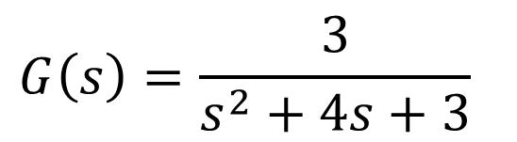
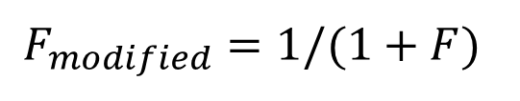
results
K_{P}= (7, 12)
K_{I}= (5, 10)
K_{D}= (1, 5)
P_{m}=0.7
P_{c}=0.012
No of generations=50

Slide 16
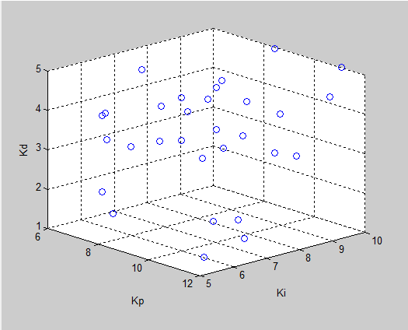
Initial distribution
Initial population distribution

Slide 17
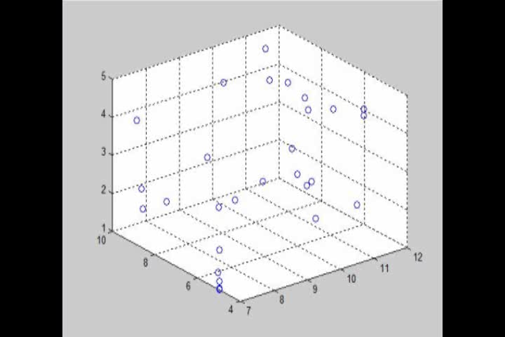
Distribution throughout the GA

Slide 18
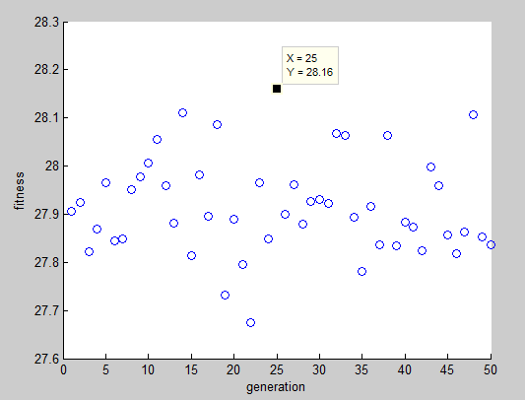
Fitness Vs. Generation
Fitness vs. generation

Slide 19
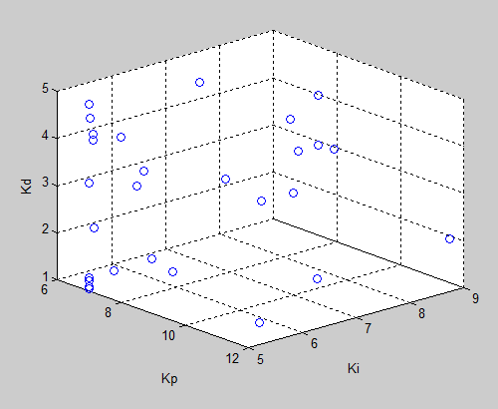
Solution
K_{P}=7.1569
K_{I}=5.0196
K_{D}=1.9569
Fittest individual
25th generation

Slide 20
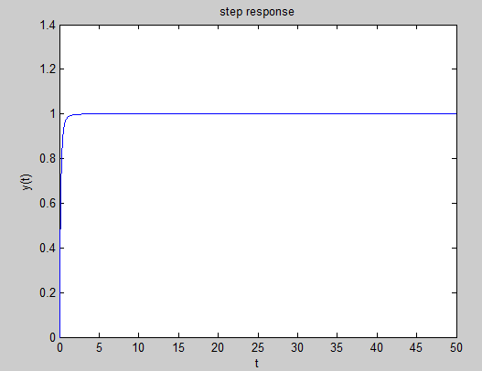
Step response
K_{P}=7.1569
K_{I}=5.0196
K_{D}=1.9569
Step response for the solution

Slide 21
conclusion
Fitness vs. generation graph GA is not converging, this can be improved by using various methods
  F_{modified}
  Crossover Operator
  Prior knowledge of ranges

Slide 22
THE END

