Slide 1
Query Processing 2:
Sorting & Joins
R&G, Chapters 13
Lecture 14
One of the advantages of being
disorderly is that one is
constantly making exciting
discoveries.
A. A. Milne

Slide 2
Administrivia
Homework 2 Due Next Tuesday
I have midterm exams for people who weren’t here on Tuesday

Slide 3
Questions
We learned that the same query can be written many ways.
  How does DBMS decide which is best?
We learned about tree & hash indexes.
  How does DBMS know when to use them?
Sometimes we need to sort data.
  How to sort more data than will fit in memory?

Slide 4
Review: Query Processing
Queries start out as SQL
Database translates SQL to one or more Relational Algebra plans
Plan is a tree of operations, with access path for each
Access path is how each operator gets tuples
  If working directly on table, can use scan, index
  Some operators, like sort-merge join, or group-by, need tuples sorted
  Often, operators pipelined, getting tuples that are output from earlier operators in the tree
Database estimates cost for various plans, chooses least expensive

Slide 5
Review: Operator Costs
Selection – either scan all tuples, or use index
Projection – expensive only if duplicates eliminated, requires sorting or hashing
Join – several algorithms:
  Nested Loops
  Indexed Nested Loops
  Sort-Merge
  Hash Join
(On-the-fly)
sname
bid=100
rating > 5
(On-the-fly)
(Simple Nested Loops)
sid=sid
Reserves
Sailors

Slide 6
Review: Cost Estimation
To compute operator costs, DBMS needs:
  Sizes of relations
  Info on indexes (type, size)
  Info on attribute values (high, low, distr, etc.)
  This info stored in catalogs
Cost often related to input size
  Need to compute reduction factor, how big output will be compared to how big it could be
Query costs can vary hugely between plans

Slide 7
What we’ll cover:
Today – efficient sorting
Today or Tuesday – different join algorithms
Later – developing query plans, computing costs

Slide 8
Why Sort?
A classic problem in computer science!
Database needs it in order
  e.g., find students in increasing gpa order
  first step in bulk loading B+ tree index.
  eliminating duplicates
  aggregating related groups of tuples
  Sort-merge join algorithm involves sorting.
Problem: sort 1Gb of data with 1Mb of RAM.
  why not virtual memory?

Slide 9

Streaming Data Through RAM
An important detail for sorting & other DB operations
Simple case:
  Compute f(x) for each record, write out the result
  Read a page from INPUT to Input Buffer
  Write f(x) for each item to Output Buffer
  When Input Buffer is consumed, read another page
  When Output Buffer fills, write it to OUTPUT
Reads and Writes are not coordinated
  E.g., if f() is Compress(), you read many pages per write.
  E.g., if f() is DeCompress(), you write many pages per read.
Input
Buffer
Output
Buffer
INPUT
f(x)
OUTPUT
RAM

Slide 10
2-Way Sort
Pass 0: Read a page, sort it, write it.
  only one buffer page is used (as in previous slide)
Pass 1, 2, …, etc.:
  requires 3 buffer pages
  merge pairs of runs into runs twice as long
  three buffer pages used.
INPUT 1
OUTPUT
INPUT 2
Main memory buffers
Disk
Disk

Slide 11
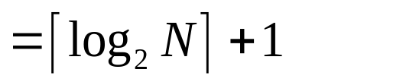
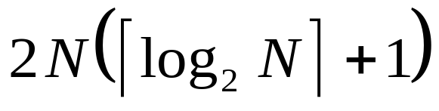
Two-Way External Merge Sort
Each pass we read + write each page in file.
N pages in the file => the number of passes
So total cost is:
Idea: Divide and conquer: sort subfiles and merge
3,4
6,2
9,4
8,7
5,6
3,1
2
Input file
PASS 0
3,4
2,6
4,9
7,8
5,6
1,3
2
1-page runs
PASS 1
2,3
4,7
1,3
2-page runs
4,6
8,9
5,6
2
PASS 2
2,3
4,4
1,2
4-page runs
6,7
3,5
8,9
6
PASS 3
1,2
2,3
3,4
8-page runs
4,5
6,6
7,8
9

Slide 12
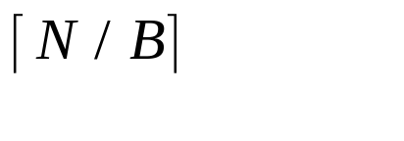
General External Merge Sort
More than 3 buffer pages. How can we utilize them?
To sort a file with N pages using B buffer pages:
  Pass 0: use B buffer pages. Produce sorted runs of B pages each.
  Pass 1, 2, …, etc.: merge B-1 runs.
INPUT 1
. . .
INPUT 2
. . .
. . .
OUTPUT
INPUT B-1
Disk
Disk
B Main memory buffers

Slide 13
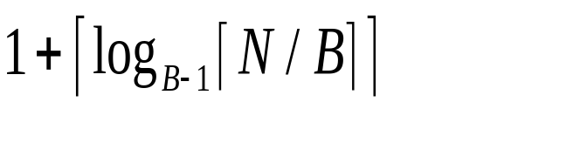
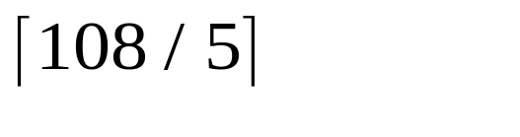
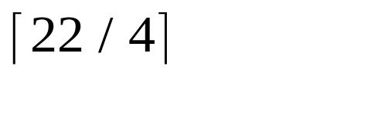
Cost of External Merge Sort
Number of passes:
Cost = 2N * (# of passes)
E.g., with 5 buffer pages, to sort 108 page file:
  Pass 0: = 22 sorted runs of 5 pages each (last run is only 3 pages)
Now, do four-way (B-1) merges
  Pass 1: = 6 sorted runs of 20 pages each (last run is only 8 pages)
  Pass 2: 2 sorted runs, 80 pages and 28 pages
  Pass 3: Sorted file of 108 pages

Slide 14
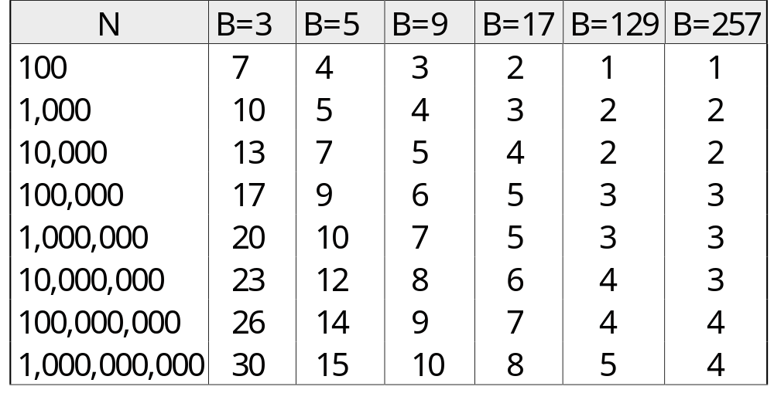
Number of Passes of External Sort
( I/O cost is 2N times number of passes)

Slide 15
Internal Sort Algorithm
Quicksort is a fast way to sort in memory.
Alternative: “tournament sort” (a.k.a. “heapsort”, “replacement selection”)
Keep two heaps in memory, H1 and H2
  read B-2 pages of records, inserting into H1;
  while (records left) {
    m = H1.removemin(); put m in output buffer;
    if (H1 is empty)
      H1 = H2; H2.reset(); start new output run;
    else
      read in a new record r (use 1 buffer for input pages);
      if (r < m) H2.insert(r);
      else H1.insert(r);
  }
  H1.output(); start new run; H2.output();

Slide 16
More on Heapsort
Fact: average length of a run is 2(B-2)
  The “snowplow” analogy
Worst-Case:
  What is min length of a run?
  How does this arise?
Best-Case:
  What is max length of a run?
  How does this arise?
Quicksort is faster, but … longer runs often means fewer passes!
B

Slide 17
I/O for External Merge Sort
Actually, doing I/O a page at a time
  Not an I/O per record
In fact, read a block (chunk) of pages sequentially!
Suggests we should make each buffer (input/output) be a chunk of pages.
  But this will reduce fan-out during merge passes!
  In practice, most files still sorted in 2-3 passes.

Slide 18
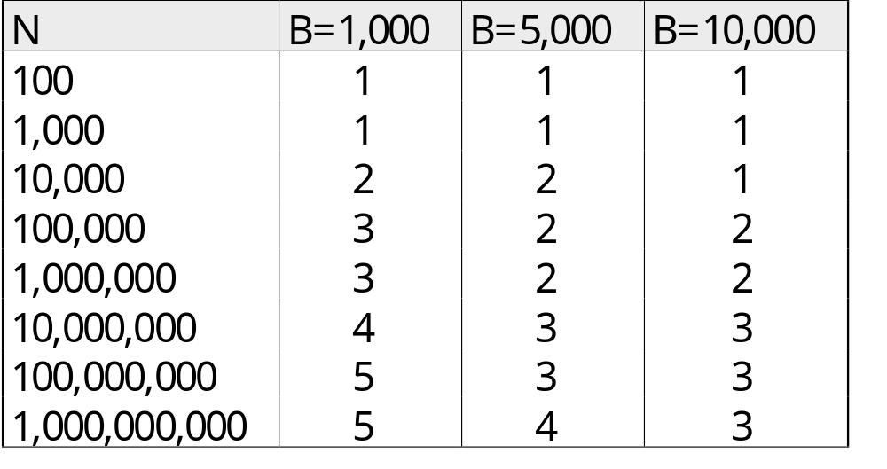
Number of Passes of Optimized Sort
Block size = 32, initial pass produces runs of size 2B.

Slide 19
Sorting Records!
Sorting has become a competition between labs, universities, DBMS vendors
  Parallel sorting is the name of the game ...
Minute Sort: how many 100-byte records can you sort in a minute?
  Typical DBMS: 10MB (~100,000 records)
  Current World record: 116 GB
    80 Itanium2s running Linux
Terabyte Sort: how fast to sort 1TB
  Current record 7.25 minutes (80 Itanium2s)
See http://research.microsoft.com/barc/SortBenchmark/

Slide 20
Using B+ Trees for Sorting
Scenario: Table to be sorted has B+ tree index on sorting column(s).
Idea: Can retrieve records in order by traversing leaf pages.
Is this a good idea?
Cases to consider:
  B+ tree is clustered Good idea!
  B+ tree is not clustered Could be a very bad idea!

Slide 21
Clustered B+ Tree Used for Sorting
Cost: root to the left-most leaf, then retrieve all leaf pages (Alternative 1)
If Alternative 2 is used? Additional cost of retrieving data records: each page fetched just once.
Index
(Directs search)
Data Entries
("Sequence set")
Data Records
Better than external sorting!

Slide 22
Unclustered B+ Tree Used for Sorting
Alternative (2) for data entries; each data entry contains rid of a data record. In general, one I/O per data record!
Index
(Directs search)
Data Entries
("Sequence set")
Data Records

Slide 23
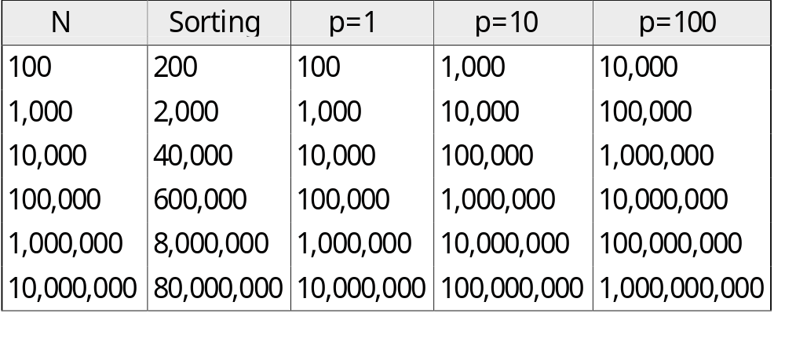
External Sorting vs. Unclustered Index
p: # of records per page
B=1,000 and block size=32 for sorting
p=100 is the more realistic value.

Slide 24
Sorting - Review
External sorting is important; DBMS may dedicate part of buffer pool for sorting!
External merge sort minimizes disk I/O cost:
  Pass 0: Produces sorted runs of size B (# buffer pages). Later passes: merge runs.
  # of runs merged at a time depends on B, and block size.
  Larger block size means less I/O cost per page.
  Larger block size means smaller # runs merged.
  In practice, # of passes rarely more than 2 or 3.

Slide 25
Sorting – Review (cont)
Choice of internal sort algorithm may matter:
  Quicksort: Quick!
  Heap/tournament sort: slower (2x), longer runs
The best sorts are wildly fast:
  Despite 40+ years of research, we’re still improving!
Clustered B+ tree is good for sorting; unclustered tree is usually very bad.

Slide 26
Joins
How does DBMS join two tables?
Sorting is one way...
Database must choose best way for each query

Slide 27
Schema for Examples
Sailors (sid: integer, sname: string, rating: integer, age: real)
Reserves (sid: integer, bid: integer, day: dates, rname: string)
Similar to old schema; rname added for variations.
Reserves:
  Each tuple is 40 bytes long,
  100 tuples per page,
  M = 1000 pages total.
Sailors:
  Each tuple is 50 bytes long,
  80 tuples per page,
  N = 500 pages total.
Notes:
4

Slide 28

Equality Joins With One Join Column
SELECT *
FROM Reserves R1, Sailors S1
WHERE R1.sid=S1.sid
In algebra: R S. Common! Must be carefully optimized. R × S is large; so, R × S followed by a selection is inefficient.
Assume: M tuples in R, p_{R} tuples per page, N tuples in S, p_{S} tuples per page.
  In our examples, R is Reserves and S is Sailors.
We will consider more complex join conditions later.
Cost metric: # of I/Os. We will ignore output costs.
Notes:
5

Slide 29
Simple Nested Loops Join
foreach tuple r in R do
foreach tuple s in S do
if r_{i} == s_{j} then add <r, s> to result
For each tuple in the outer relation R, we scan the entire inner relation S.
  Cost: M + p_{R} * M * N = 1000 + 100*1000*500 I/Os.
Page-oriented Nested Loops join: For each page of R, get each page of S, and write out matching pairs of tuples <r, s>, where r is in R-page and S is in S-page.
  Cost: M + M*N = 1000 + 1000*500
  If smaller relation (S) is outer, cost = 500 + 500*1000
Notes:
6

Slide 30
Block Nested Loops Join
Use one page as an input buffer for scanning the inner S, one page as the output buffer, and use all remaining pages to hold ``block’’ of outer R.
  For each matching tuple r in R-block, s in S-page, add <r, s> to result. Then read next R-block, scan S, etc.
R & S
Join Result
Hash table for block of R
(k < B-1 pages)
. . .
. . .
. . .
Input buffer for S
Output buffer
Notes:
9

Slide 31
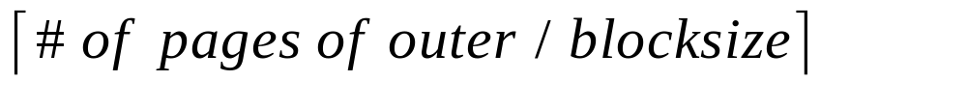
Examples of Block Nested Loops
Cost: Scan of outer + #outer blocks * scan of inner
  #outer blocks =
With Reserves (R) as outer, and 100 pages of R:
  Cost of scanning R is 1000 I/Os; a total of 10 blocks.
  Per block of R, we scan Sailors (S); 10*500 I/Os.
  If space for just 90 pages of R, we would scan S 12 times.
With 100-page block of Sailors as outer:
  Cost of scanning S is 500 I/Os; a total of 5 blocks.
  Per block of S, we scan Reserves; 5*1000 I/Os.
With sequential reads considered, analysis changes: may be best to divide buffers evenly between R and S.

Slide 32
Index Nested Loops Join
foreach tuple r in R do
foreach tuple s in S where r_{i} == s_{j} do
add <r, s> to result
If there is an index on the join column of one relation (say S), can make it the inner and exploit the index.
  Cost: M + ( (M*p_{R}) * cost of finding matching S tuples)
For each R tuple, cost of probing S index is about 1.2 for hash index, 2-4 for B+ tree. Cost of then finding S tuples (assuming Alt. (2) or (3) for data entries) depends on clustering.
  Clustered index: 1 I/O (typical), unclustered: upto 1 I/O per matching S tuple.

Slide 33
Examples of Index Nested Loops
Hash-index (Alt. 2) on sid of Sailors (as inner):
  Scan Reserves: 1000 page I/Os, 100*1000 tuples.
  For each Reserves tuple: 1.2 I/Os to get data entry in index, plus 1 I/O to get (the exactly one) matching Sailors tuple. Total: 220,000 I/Os.
Hash-index (Alt. 2) on sid of Reserves (as inner):
  Scan Sailors: 500 page I/Os, 80*500 tuples.
  For each Sailors tuple: 1.2 I/Os to find index page with data entries, plus cost of retrieving matching Reserves tuples. Assuming uniform distribution, 2.5 reservations per sailor (100,000 / 40,000). Cost of retrieving them is 1 or 2.5 I/Os depending on whether the index is clustered.
Notes:
8

Slide 34

Sort-Merge Join (R S)
i=j
Sort R and S on the join column, then scan them to do a ``merge’’ (on join col.), and output result tuples.
  Advance scan of R until current R-tuple >= current S tuple, then advance scan of S until current S-tuple >= current R tuple; do this until current R tuple = current S tuple.
  At this point, all R tuples with same value in Ri (current R group) and all S tuples with same value in Sj (current S group) match; output <r, s> for all pairs of such tuples.
  Then resume scanning R and S.
R is scanned once; each S group is scanned once per matching R tuple. (Multiple scans of an S group are likely to find needed pages in buffer.)
Notes:
11

Slide 35
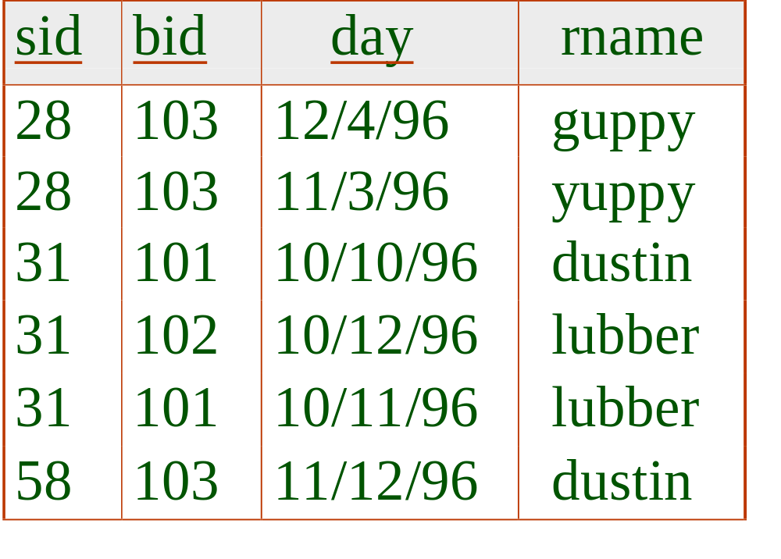
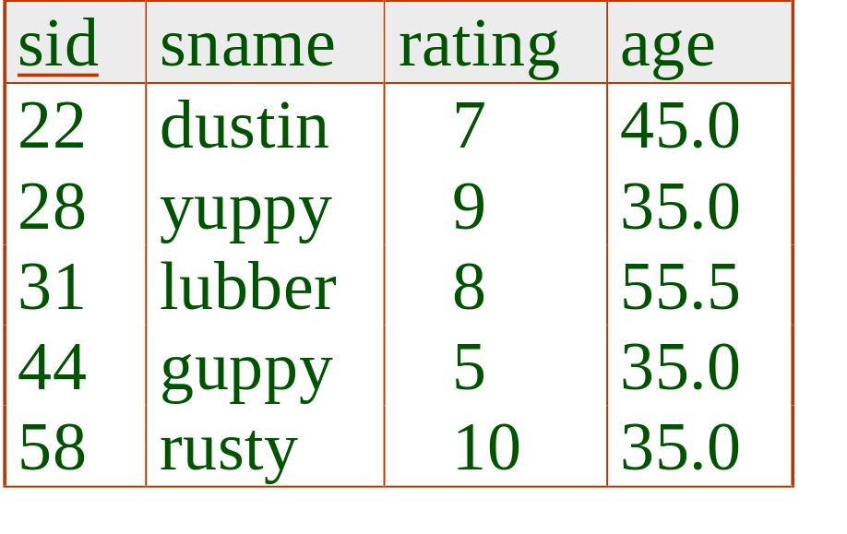
Example of Sort-Merge Join
Cost: M log M + N log N + (M+N)
  The cost of scanning, M+N, could be M*N (very unlikely!)
With 35, 100 or 300 buffer pages, both Reserves and Sailors can be sorted in 2 passes; total join cost: 7500.
(BNL cost: 2500 to 15000 I/Os)
Notes:
12

Slide 36
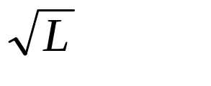
Refinement of Sort-Merge Join
We can combine the merging phases in the sorting of R and S with the merging required for the join.
  With B > , where L is the size of the larger relation, using the sorting refinement that produces runs of length 2B in Pass 0, #runs of each relation is < B/2.
  Allocate 1 page per run of each relation, and `merge’ while checking the join condition.
  Cost: read+write each relation in Pass 0 + read each relation in (only) merging pass (+ writing of result tuples).
  In example, cost goes down from 7500 to 4500 I/Os.
In practice, cost of sort-merge join, like the cost of external sorting, is linear.
Notes:
13

Slide 37
Hash-Join
Original
Relation
OUTPUT
Partitions
1
Partition both relations using hash fn h: R tuples in partition i will only match S tuples in partition i.
1
INPUT
2
hash
function
h
2
. . .
B-1
B-1
Disk
B main memory buffers
Disk
Partitions
of R & S
Join Result
Read in a partition of R, hash it using h2 (<> h!). Scan matching partition of S, search for matches.
Hash table for partition
Ri (k < B-1 pages)
hash
fn
h2
h2
Input buffer
for Si
Output
buffer
Disk
B main memory buffers
Disk
Notes:
14

Slide 38
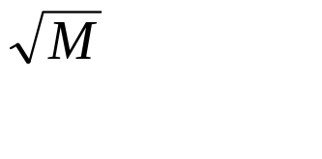
Observations on Hash-Join
#partitions k < B-1 (why?), and B-2 > size of largest partition to be held in memory. Assuming uniformly sized partitions, and maximizing k, we get:
  k= B-1, and M/(B-1) < B-2, i.e., B must be >
If we build an in-memory hash table to speed up the matching of tuples, a little more memory is needed.
If the hash function does not partition uniformly, one or more R partitions may not fit in memory. Can apply hash-join technique recursively to do the join of this R-partition with corresponding S-partition.
Notes:
15

Slide 39
Cost of Hash-Join
In partitioning phase, read+write both relns; 2(M+N). In matching phase, read both relns; M+N I/Os.
In our running example, this is a total of 4500 I/Os.
Sort-Merge Join vs. Hash Join:
  Given a minimum amount of memory (what is this, for each?) both have a cost of 3(M+N) I/Os. Hash Join superior on this count if relation sizes differ greatly. Also, Hash Join shown to be highly parallelizable.
  Sort-Merge less sensitive to data skew; result is sorted.
Notes:
16

Slide 40
General Join Conditions
Equalities over several attributes (e.g., R.sid=S.sid AND R.rname=S.sname):
  For Index NL, build index on <sid, sname> (if S is inner); or use existing indexes on sid or sname.
  For Sort-Merge and Hash Join, sort/partition on combination of the two join columns.
Inequality conditions (e.g., R.rname < S.sname):
  For Index NL, need (clustered!) B+ tree index.
    Range probes on inner; # matches likely to be much higher than for equality joins.
  Hash Join, Sort Merge Join not applicable.
  Block NL quite likely to be the best join method here.

Slide 41
Conclusions
Database needs to run queries fast
Sorting efficiently is one factor
Choosing the right join another factor
Next time: optimizing all parts of a query

