Slide 1
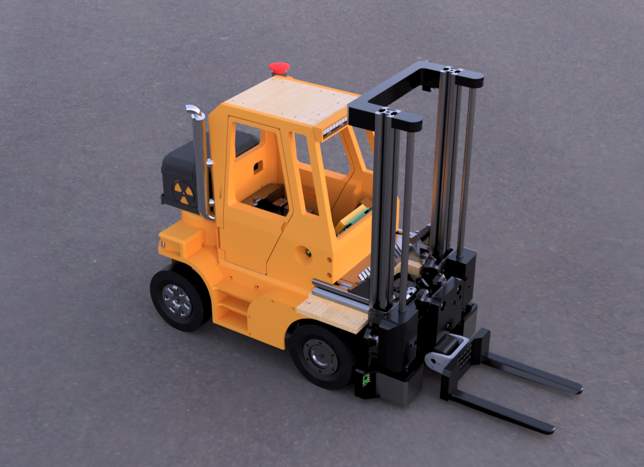
Back
Resistors
129 items found
Show items
◀
Thread type
Diameter
Head type
Length
Material
Screw type
▶
2 mm
≤
≥

