Slide 1
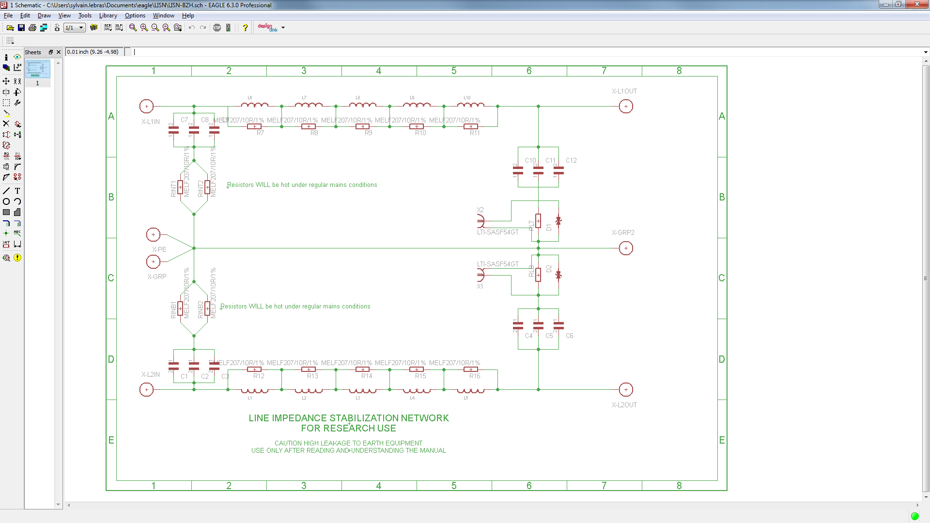
Isolation
Transformer
Line
D. U. T
Neutral
Protective Earth

