Slide 1
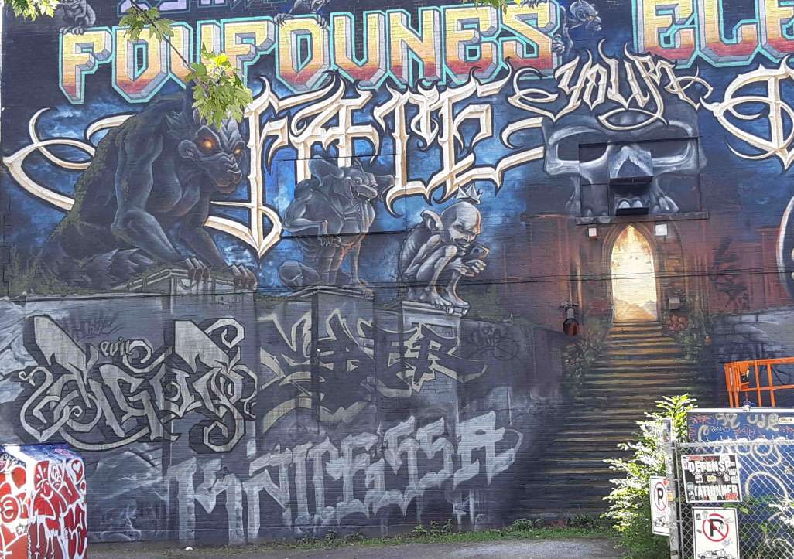
Piece 4
Piece 1
Piece 5 Saer
Piece 2
Piece 3
K6A ???
Boisbriand-DerrièreLesFoufounes-1
K6A

Slide 2
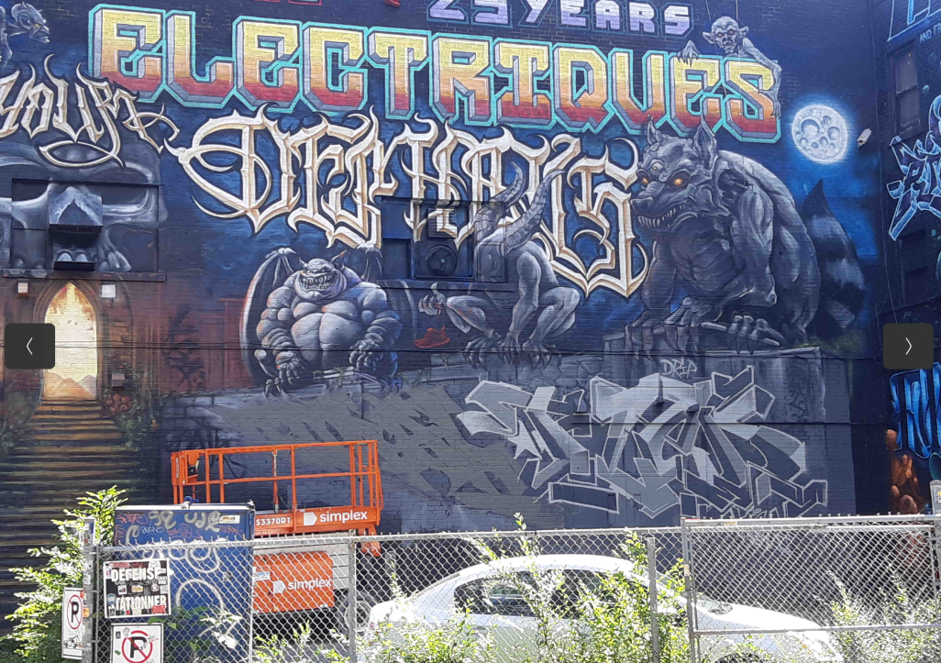
Piece 7: Serak
https://www.instagram.com/serak_k6a_kg/
Piece 8: Fleo
https://www.instagram.com/p/CDC5_Ein6bt/
Boisbriand-DerrièreLesFoufounes-1
K6A

Slide 3
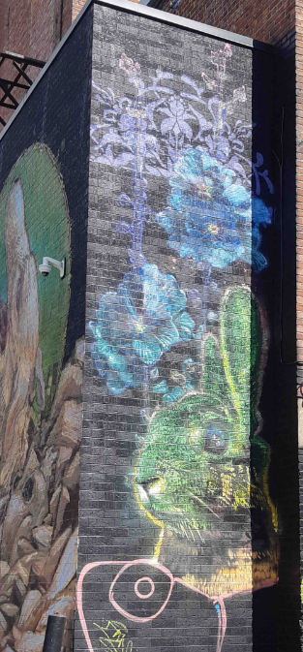
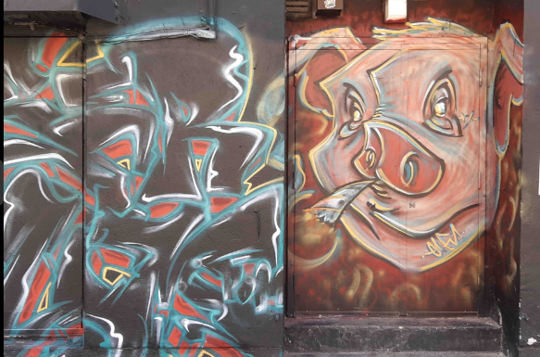
Murale 1: ???
DeBullion-SaintCatherineEst-CôtéDesFoufounes
Murale 2: ???
Rue Saint-Dominique

