Slide 1
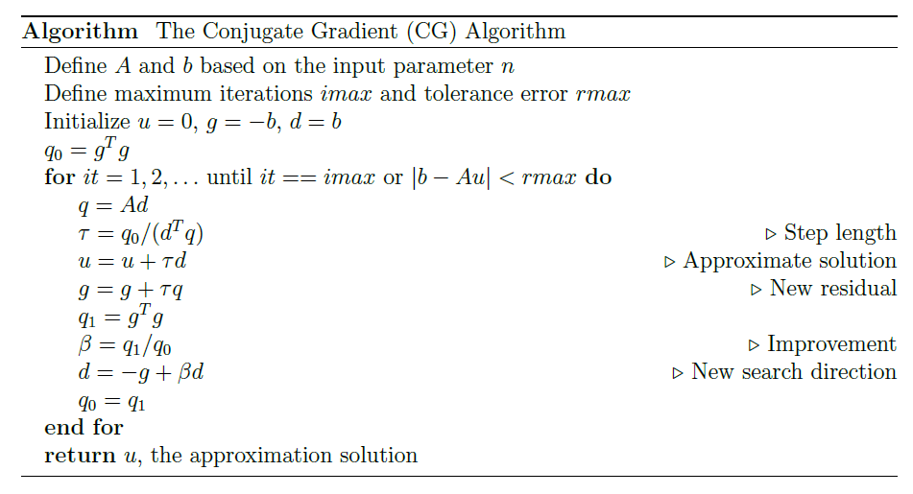
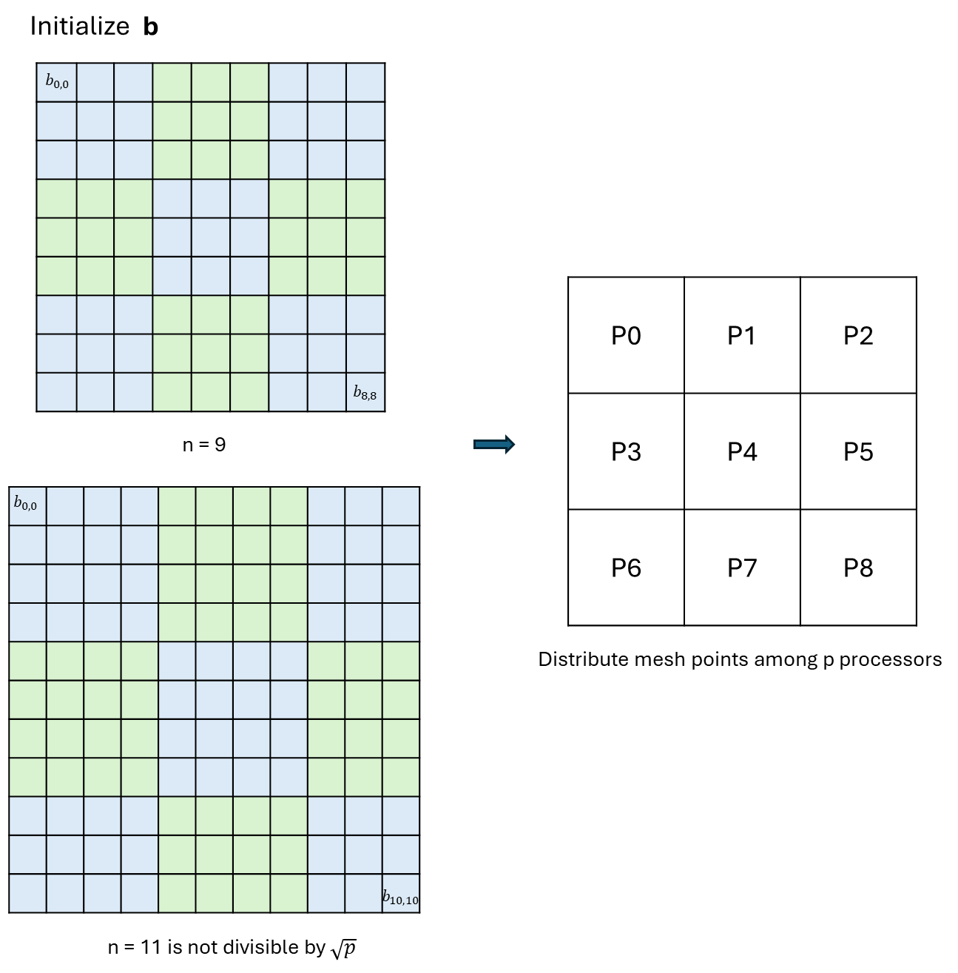







Parallel Conjugate Gradient Method
with Stencil-Based Matrix-Vector Multiplication
Notes:
Hi, Marina, this is Yangmei. The project I choose is the Parallel CG method.
So the CG method is a widely used iteration method to solve large linear system. It is efficient for the matrix that is sparse, symmetric and positive definite. The equation we target solving in this project is derived from the discretization of the Poisson equation, with Dirichlet boundary condition.
Here is a pseudo/'sʊdo/-code for the Sequential Algorithm. And we can see there are three basic operations: matrix-vector multiplication, vector inner product, and the vector updates. And these operations are easily to be paralleled.
The right figures show how the mesh /mɛʃ/ points are distributed among processes. The idea is , assume we have such a logical architecture. The processes are located one a square grid. We use block partitioning to divide mesh points into several blocks according to the number of processes. For better work loading, if the n is not divisible by the square root of p, some processes will get an extra row or column of points.

Slide 2
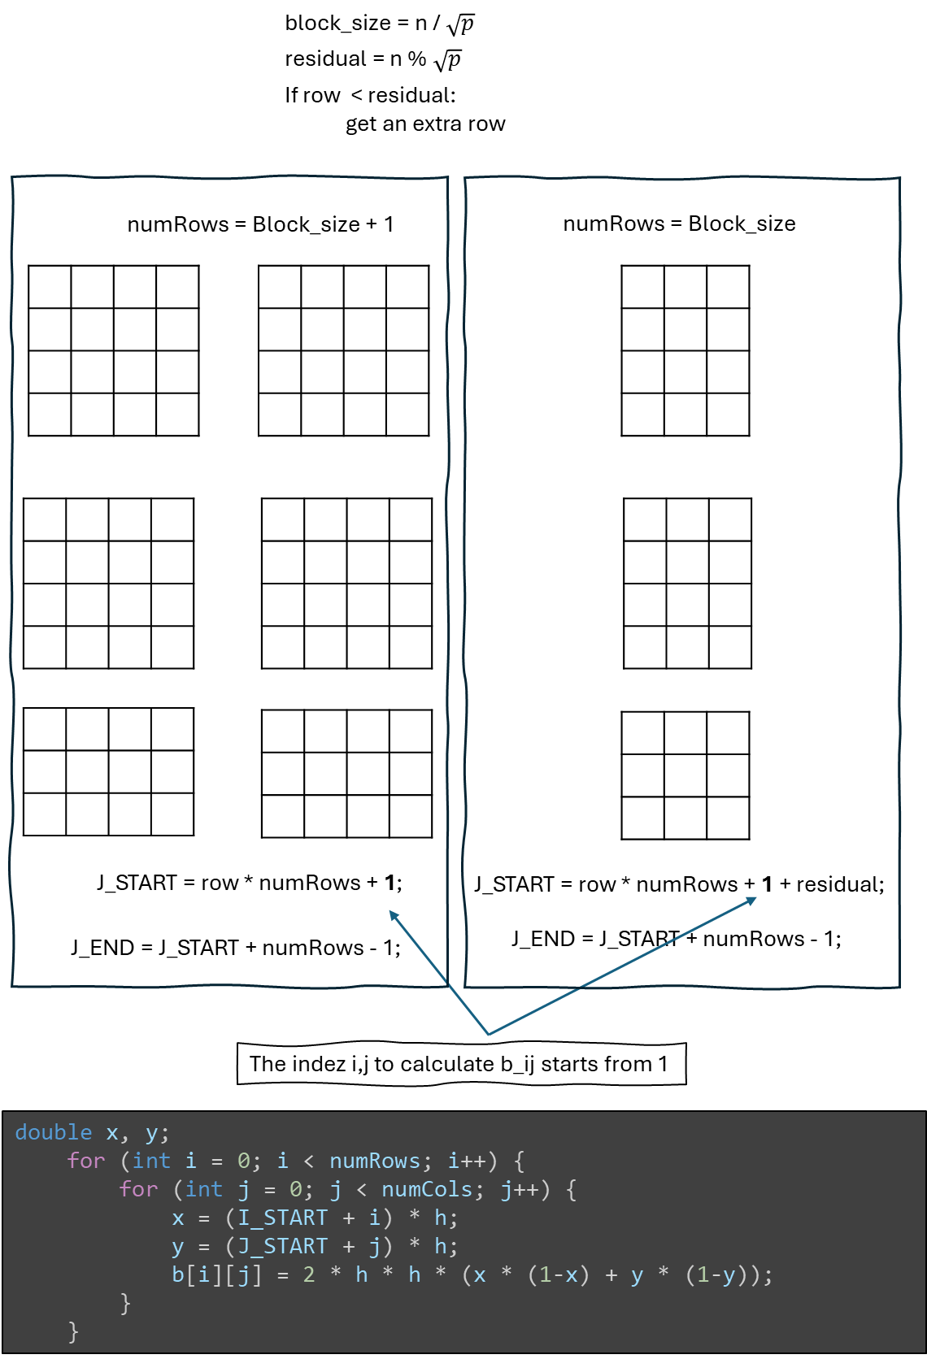
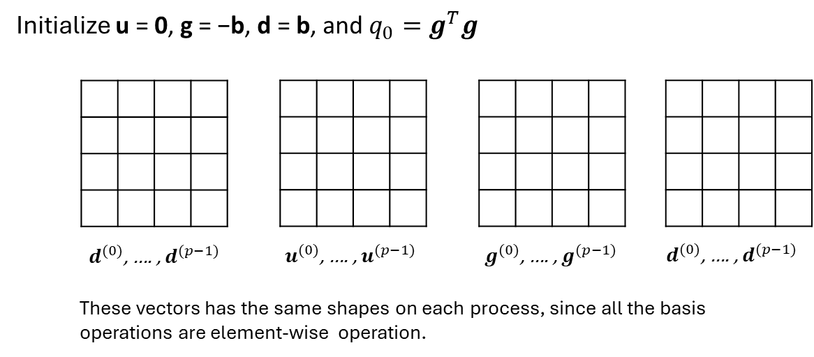
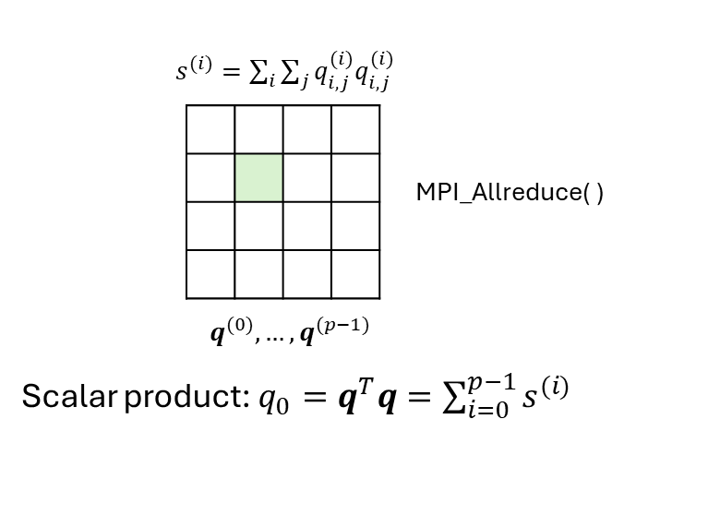
Initialization
Notes:
And since the values of elements in b is associated with the coordinates of the points on the original mesh. We need to record the indexes of its block to initialize b on each process locally.
we initialize u, g, d with the same shape of b.

Slide 3
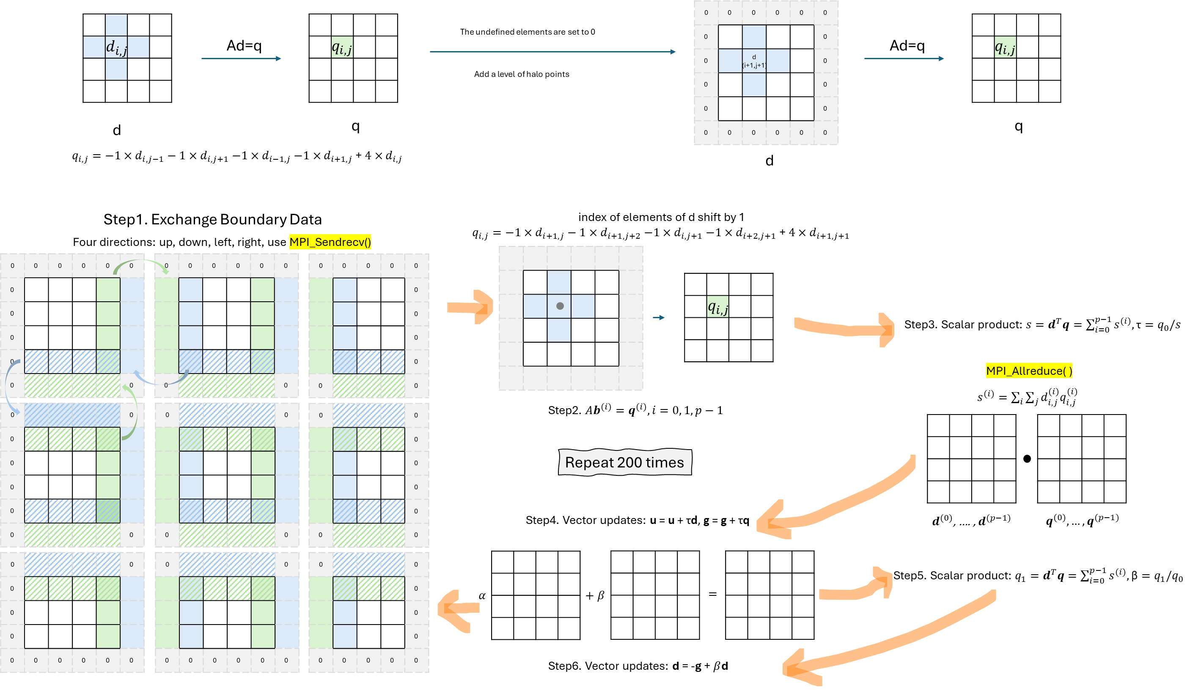
Iteration Process
Notes:
Instead, we can consider using MPI persistent communications. It is suitable for the programs which repeatedly call the same point-to-point message passing routines with the same arguments. Like here, each process change border elements at the beginning of each iteration.
It can reduce communications overhead like redundant message setup.

Slide 4
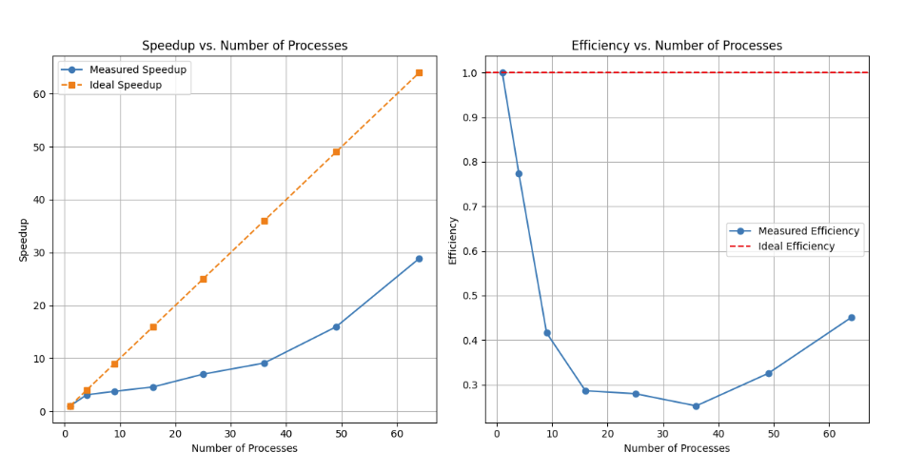
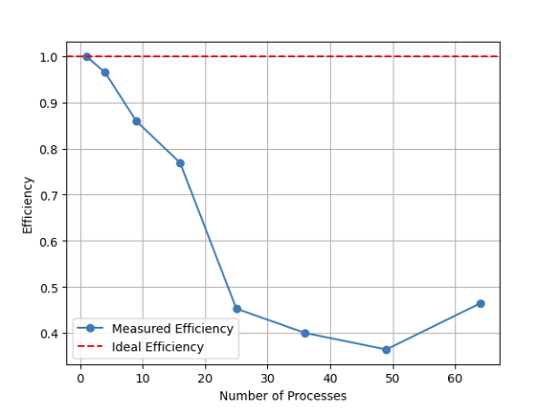

Scalability Experiments
Strong Scalibility, n = 2048
Weak Scalibility, n = 256 per process

Slide 5
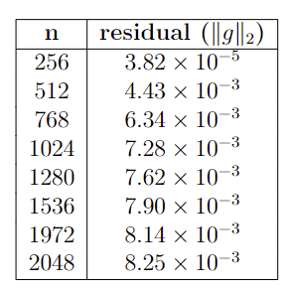
Outputs
O(n^2)
n = 1024, itr = 722, r = 9.75e-6

