Slide 1
COVID-19 Prediction Model and Visualizations
UCI Data Analysis and Visualization Boot Camp
May 23, 2020
Abel Anthony
Atusa
Jonpaul
Sylvia

Slide 2
Project Steps
01
Data Engineering & Preprocessing
02
Machine Learning Model
03
Visualization and Web Development
04
Conclusions

Slide 3
Covid-19 Story
Coronavirus (COVID-19) is a new disease, and our understanding of the virus that causes it continues to evolve
It was first detected in China and has now been detected in over 100 countries, including the United States.
The virus has been named coronavirus (COVID-19)
Can we use existing data to predict if someone has COVID?
https://www.unchealthcare.org/coronavirus/understanding-coronaviruscovid-19

Slide 4
Preprocessing Data
We decided to predict COVID-19 test results based on symptoms (temperature, loss of smell, loss of taste, etc.)
Our data source: https://covidclinicaldata.org/
Total 1900 data of patients with 85 columns of patients' test results, which top 5 columns were selected based on the scores we got for our model.

Slide 5
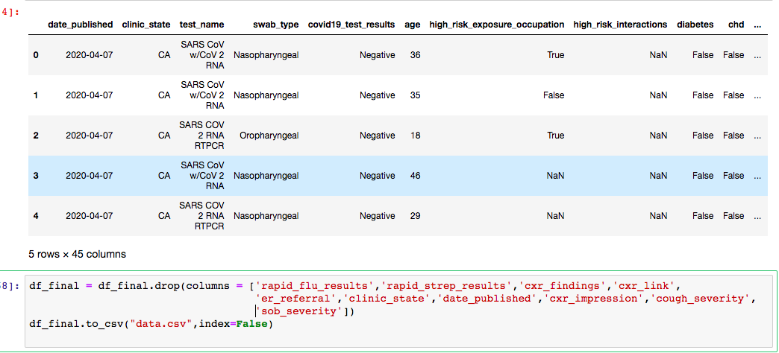
Preprocessing Data
Our Dataset
Notes:
One of our challenges was missing values …. We had to take two steps to solve this problem

Slide 6
Preprocessing Data
Feature selection refers to the process of applying statistical tests to inputs, given a specified output, to determine which columns are more predictive of the output.
Possible prediction of the test result for COVID-19 (positive/negative) based on Feature selection:
loss_of_smell
Temperature
Sats
loss_of_taste
diabetes
Notes:
By choosing the right features, you can potentially improve the accuracy and efficiency of classification.

Slide 7
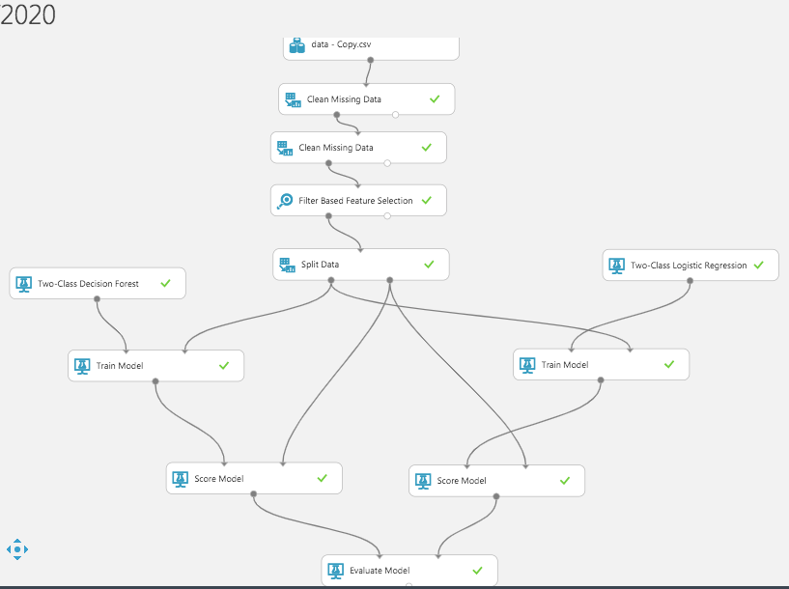
Machine Learning Model Building

Slide 8
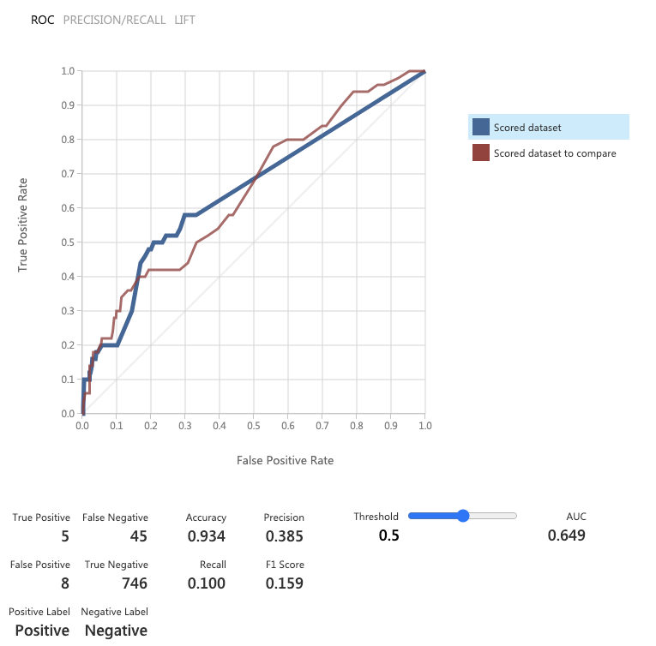
Logistic Regression Model

Slide 9
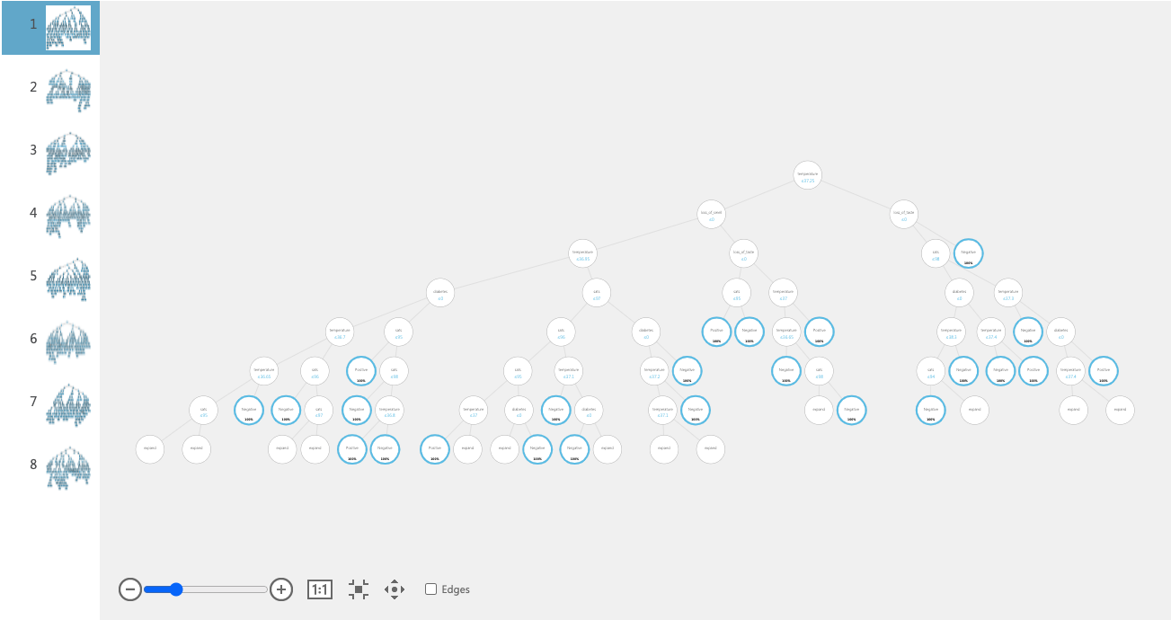
Decision Forests Model

Slide 10
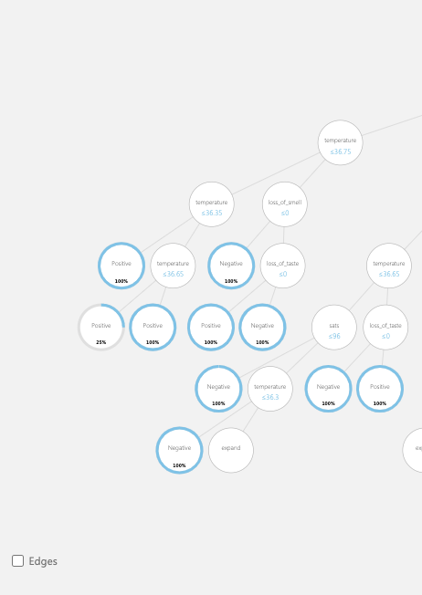
Decision Forests Model

Slide 11
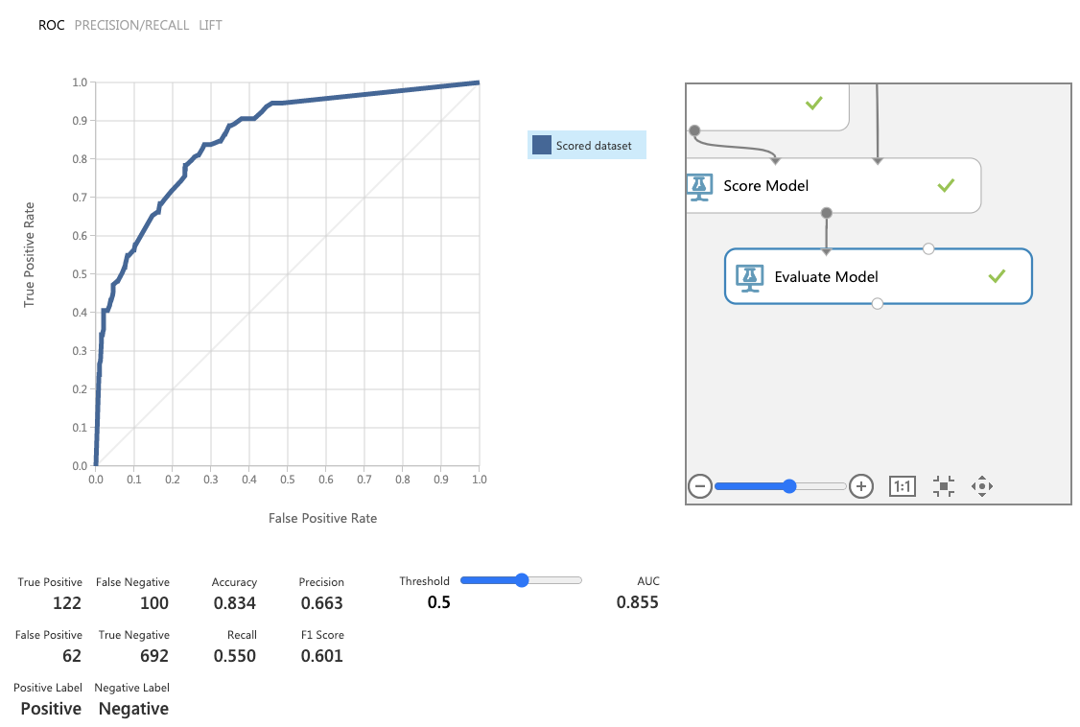
Decision Forests Model

Slide 12
Visualization and Web Development
https://lir1nrzwn1.execute-api.us-east-1.amazonaws.com/dev

Slide 13
Platforms
Machine Learning Analysis: Azureml(Classifiers and Regressors), Pandas, Jupyter Notebooks, Python
Web: Python , Flask , AWS
Visualization: JavaScript , Tableau

Slide 14
Conclusions
For more accurate prediction models:
Require much larger data
Cleaner Data
Robust Data

Slide 15
Thank You
Do you have any questions?

