Slide 1
Capstone Project -Fraud Analysis Using ML Algorithms
Submitted By – Sylvia Chadha

Slide 2
Objective – To Analyse customers purchase dataset to detect fraud purchases. To perform customer segmentation. Descriptive and Predictive Analysis.

Slide 3
Exploratory Data Analysis for Fraud Data

Slide 4
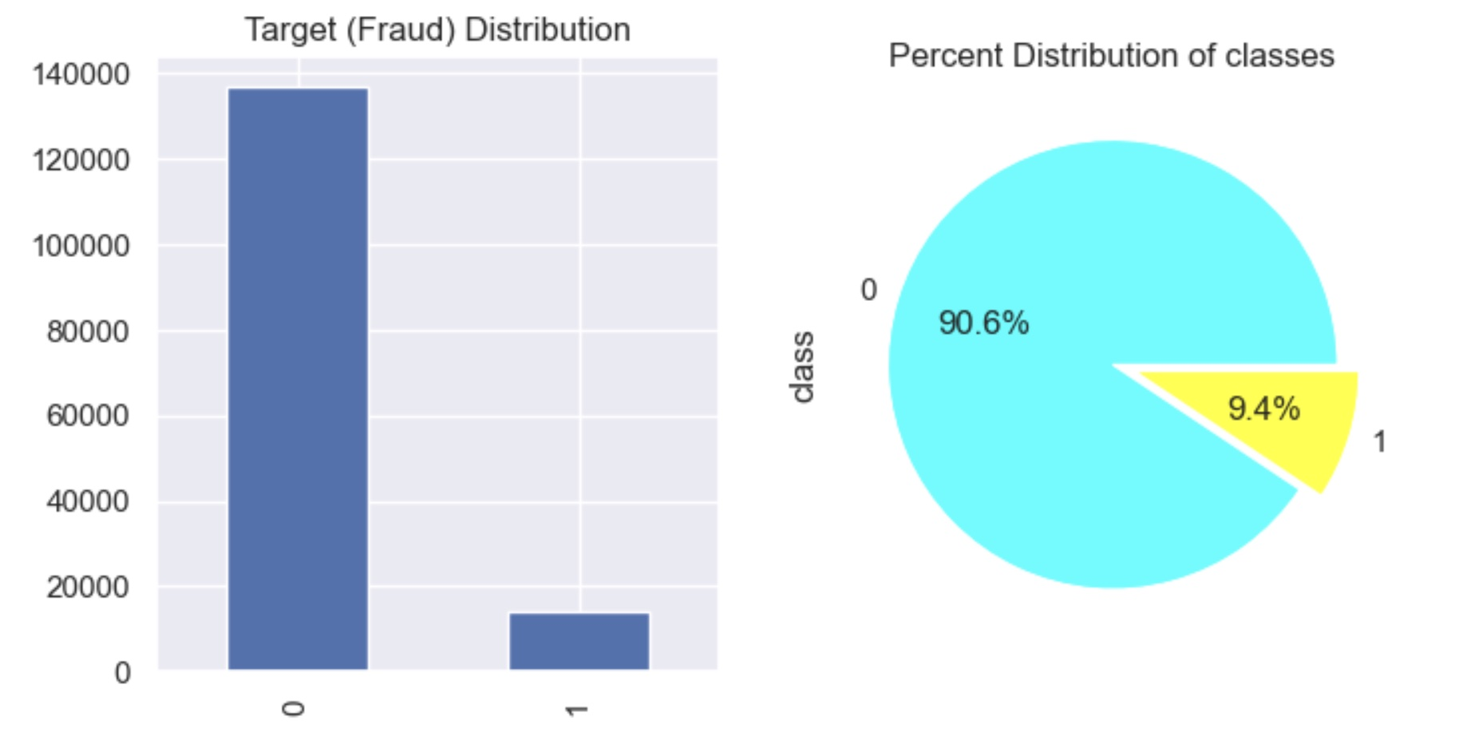
Fraud Distribution Fraud dataset classes are unevenly distributed

Slide 5
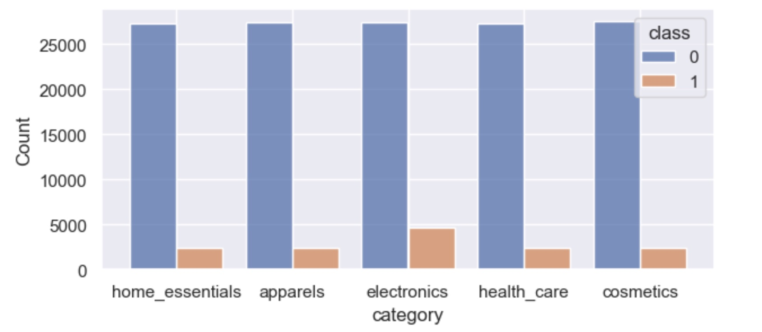
Distribution of Category of Items w.r.t Fraud transactions. Particularly in electronics category fraud higher.

Slide 6
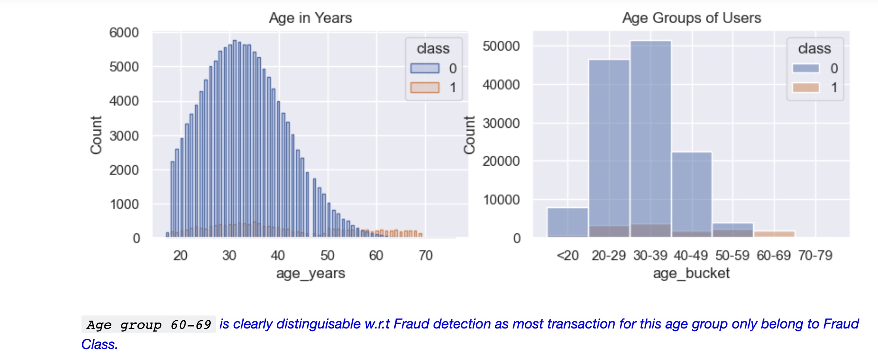
Feature Engineering – Age group 60-69 mostly fraud transactions in comparison to non-fraud.

Slide 7
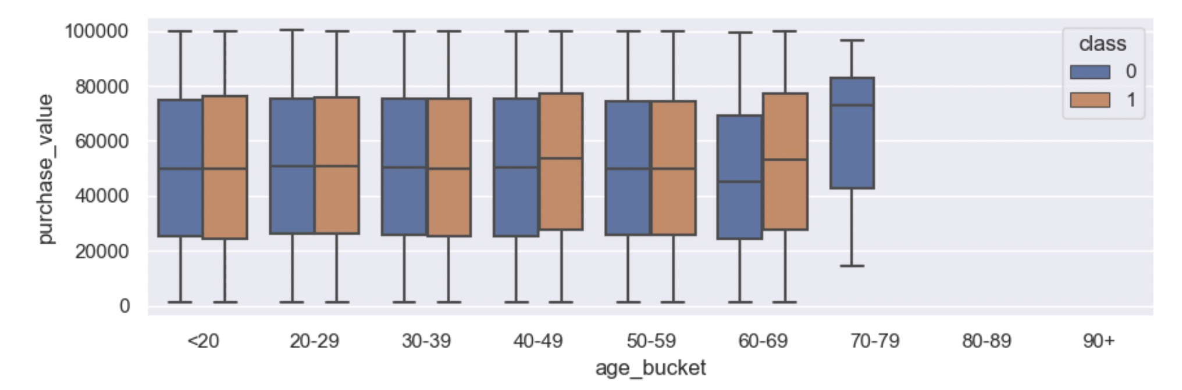
Multivariate Analysis
W.r.t purchase value, age and Fraud we see that for fraud transactions the median purchase value is higher only in age groups 40-49 and 60-69.

Slide 8
Predictive Analysis using ML Algorithms

Slide 9
Tree Based Algorithms
Decision Tree
Parallel Ensemble – Random Forest
Sequential Ensemble – Gradient Boosting

Slide 10
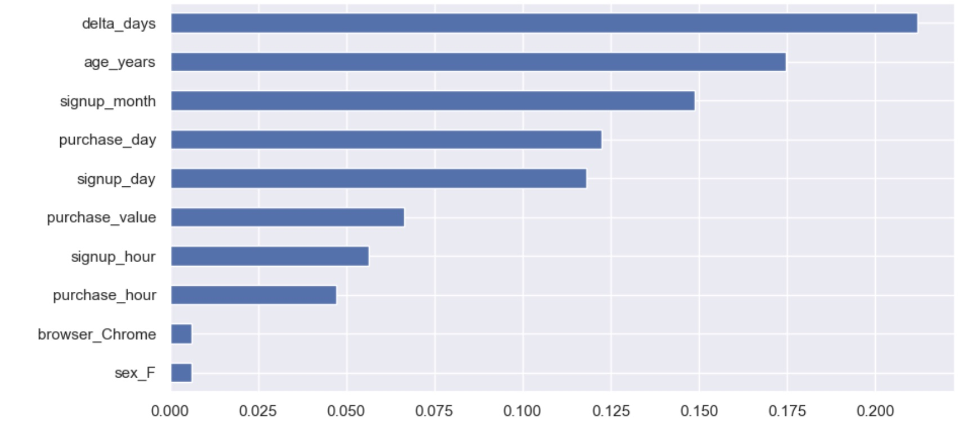
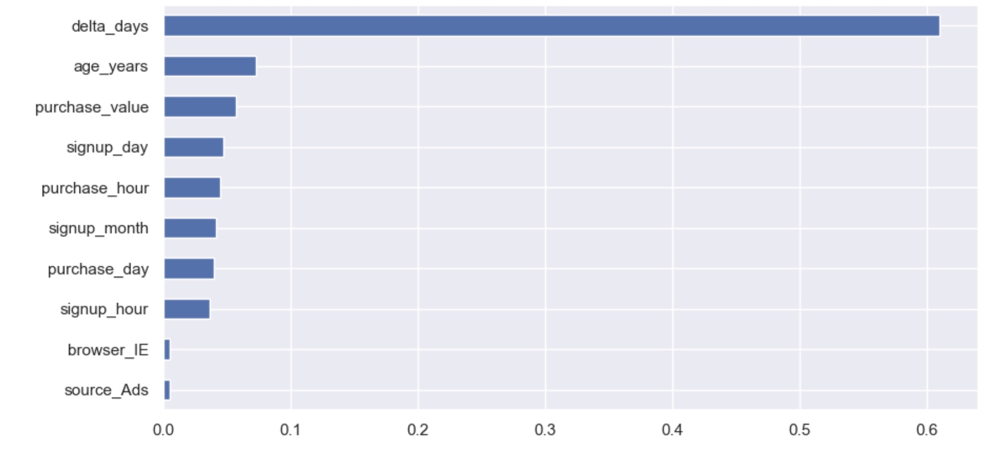
Feature Importance in Random Forest Out of 100 estimators/trees used in Random Forest, feature importance by 2 trees is depicted here. Different features as well as weightage is picked by each tree in the ensemble.

Slide 11
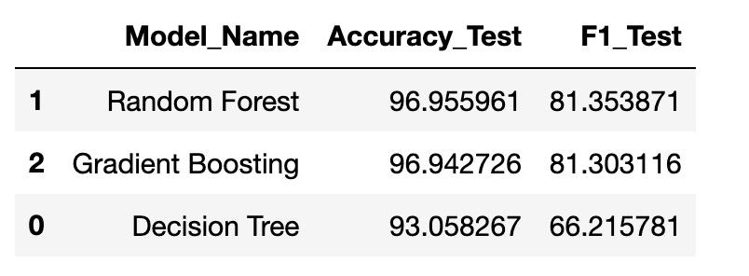
Evaluation Metrics In terms of Accuracy & F1 score

Slide 12
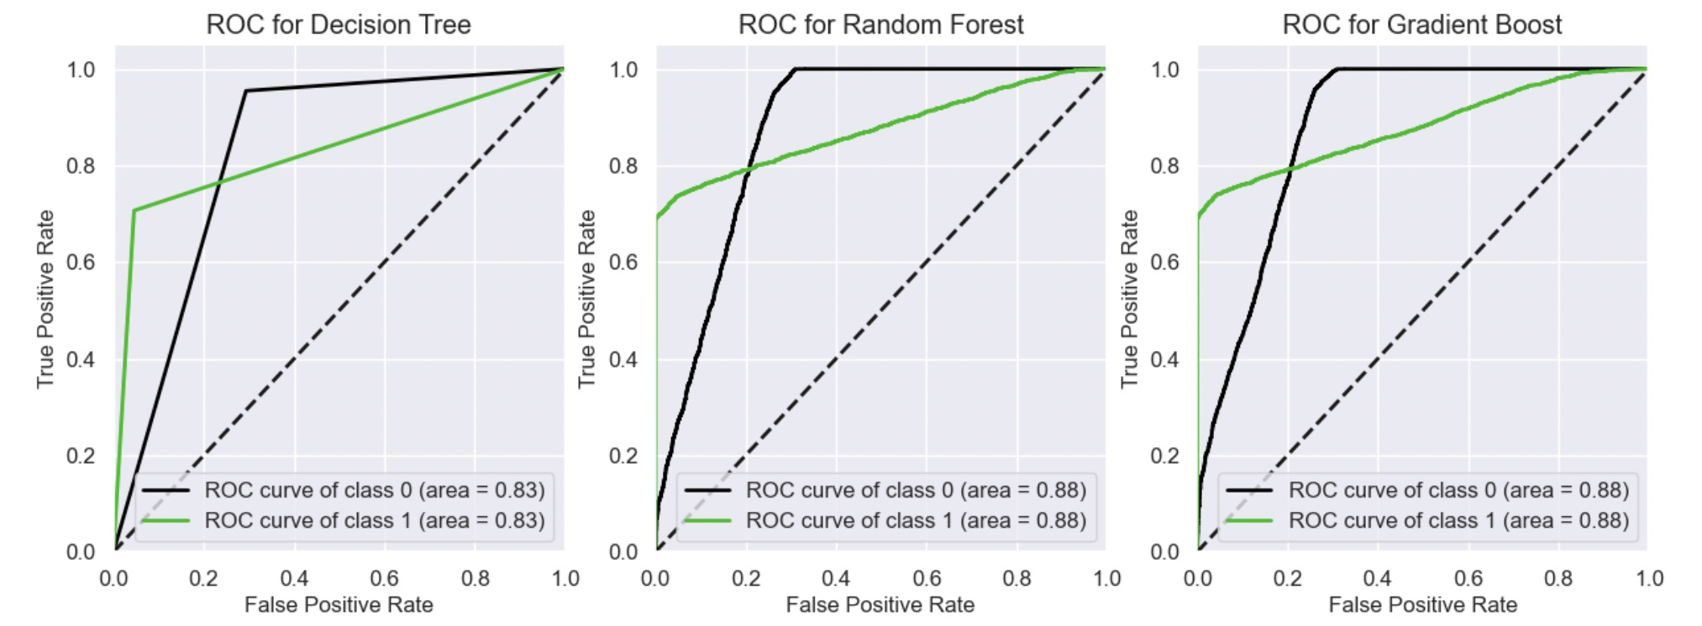
Evaluation Metrics with ROC/AUC Curves

Slide 13
Summary and Conclusions
FRAUD DETECTION & CUSTOMER SEGMENTATION
We perform Exploratory Data Analysis and Predictive Analysis for this problem of fraud detection and customer segmentation.
Especially date-time features and Age features provide insights that help to distinguish b/w fraud and non-fraud data.
The tree-based algorithms perform better after feature engineering.
Evaluation is measured in terms of Accuracy, F1 Score and AUC. Random Forest has better accuracy & F1.
Customer Segmentation is performed on user specific features and evaluated using Silhouette Score.

