Slide 1
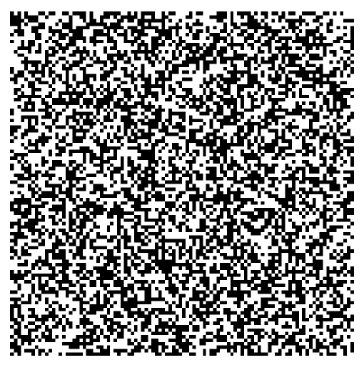
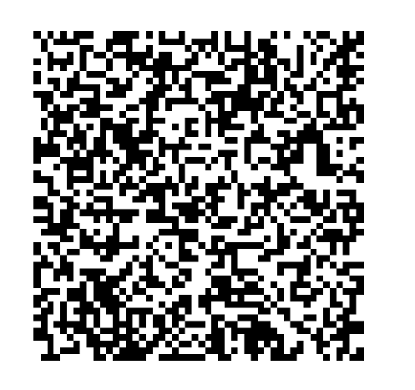
Consider an m x m grid with randomly distributed 0’s and 1’s and a “neighborhood extent” defined as the grid cells +/- included in a probability calculation.
100 x 100 grid
50 x 50 grid
10 x 10 grid
And calculate the information entropy in this matrix.

Slide 2
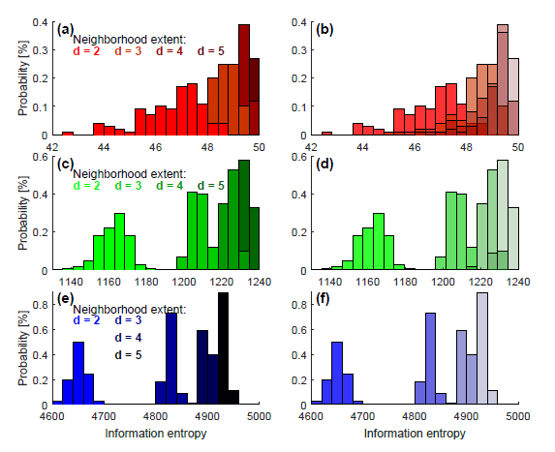
How does the information entropy change with the grid size and neighborhood extent?
For a larger grid size, changing the neighborhood extent has a bigger impact.
For a larger neighborhood extent, there is more information entropy.
For a larger grid, there is more information entropy (roughly a linear relation – 10x bigger grid, 10x more information)
For a larger grid or a larger neighborhood extent, there is less spread in the information entropy values.
10 x 10 grid
50 x 50 grid
100 x 100 grid

Slide 3
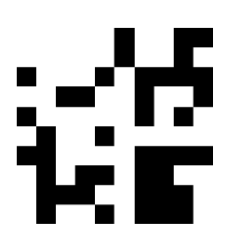
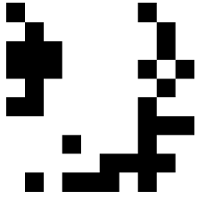
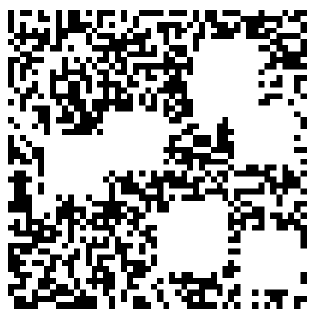
Now consider an m x m grid with clustered 0’s and 1’s. Clustering is done by creating a small matrix of 1’s [=] o1 x o1 and placing it within the larger grid o2 times. The order metric is then the product of o1 and o2.
10 x 10 grid
order = 4
order = 8
order = 10
order = 18
50 x 50 grid
order = 16
order = 30
order = 42
order = 80

Slide 4
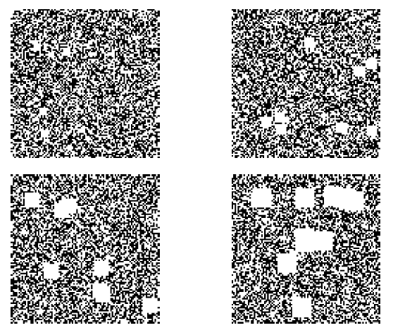
Clustering in the largest grid.
100 x 100 grid
order = 56
order = 20
order = 80
order = 130
And calculate the information entropy in these clustered matrices.

Slide 5
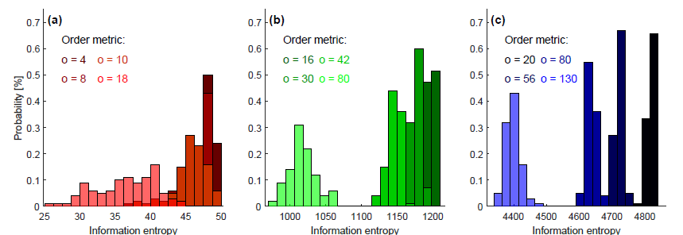
How does the information entropy change in these clustered grids with order metric and grid size?
As expected, the higher the order metric / clustering, the lower the information entropy. But given the random nature of the ordering, there is also more spread in entropy for the higher order metric.
Again ordering shift the distribution the most for the largest grid.
Information entropy magnitudes are all lower than the randomly distributed case.
These are all for a neighborhood extent of 3.

Slide 6
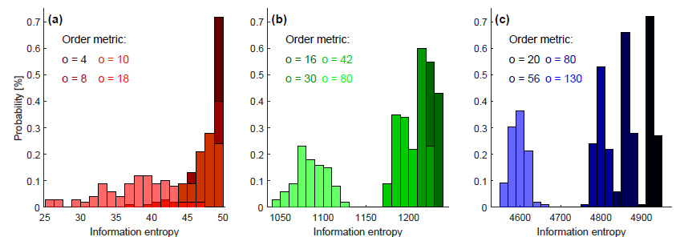
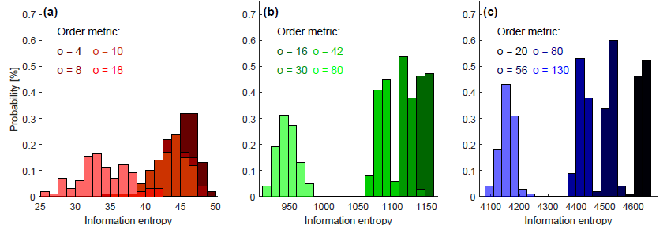
So how does the information entropy change in these clustered grids neighborhood extent?
Trends of lower entropy with higher order remain and trends of greater spread with lower entropy are intensified.
These are for neighborhood extents of 5.
Minimal differences for neighborhood extents of 2 versus 3.

Slide 7
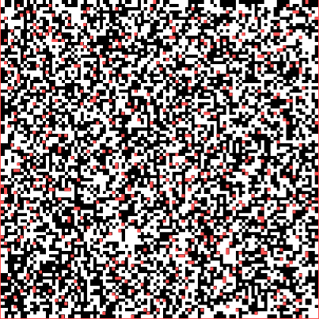
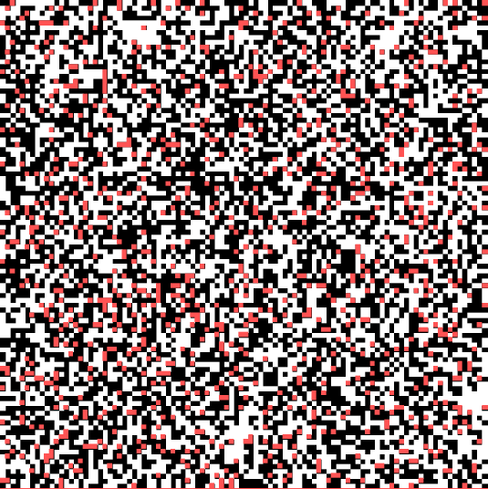
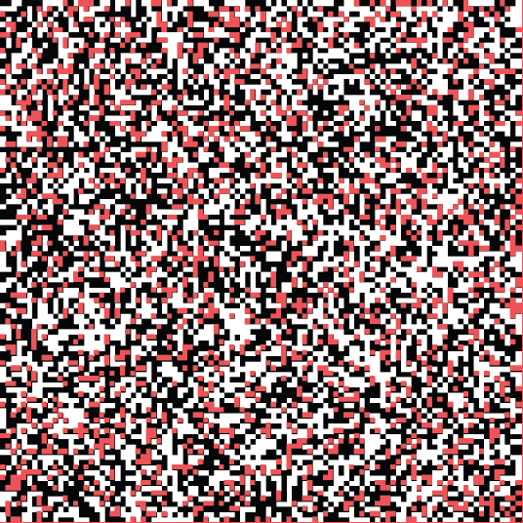
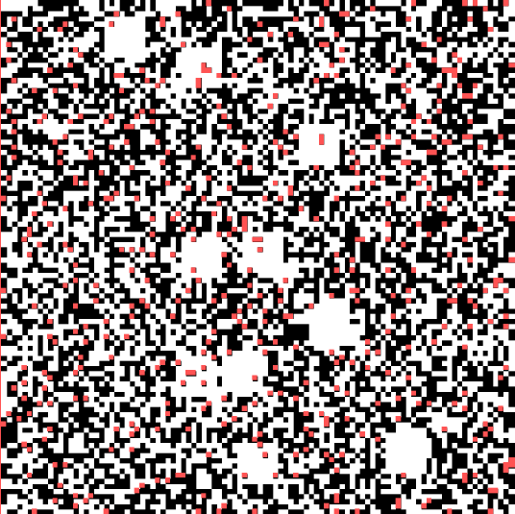
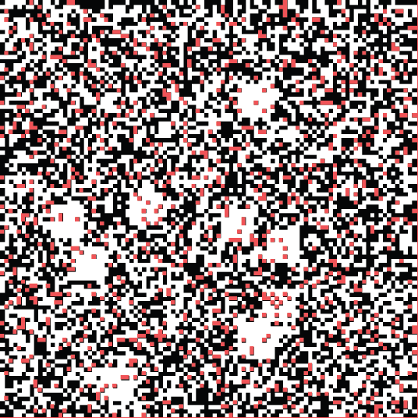
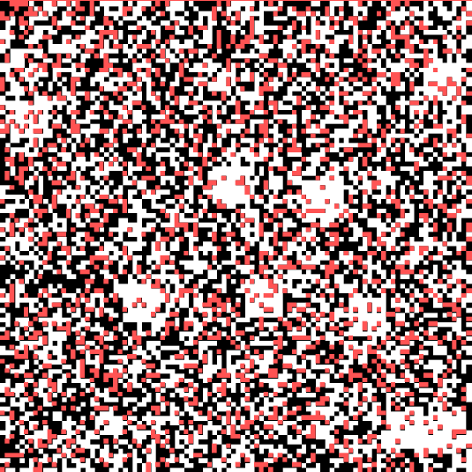
How do gaps in the matrix affect the distribution? Replace 5, 10, and 20% of the values in the clustered matrices with NaNs (shown in red below).
p = 0.05, o = 20
p = 0.10, o = 20
p = 0.20, o = 20
p = 0.05, o = 80
p = 0.10, o = 80
p = 0.20, o = 80

Slide 8
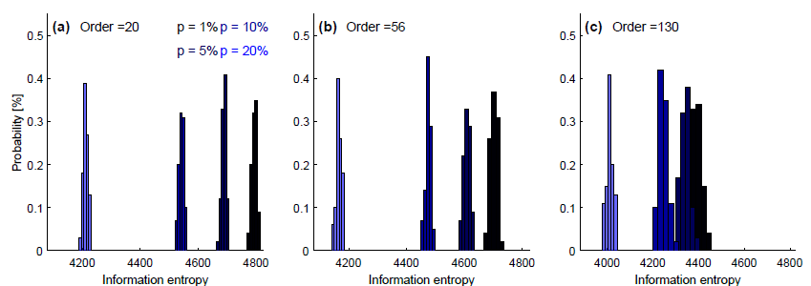
So how does the information entropy change in these clustered grids with gaps?
Missing data reduces the information entropy. But perhaps this is a flaw in the algorithm because “knowing less” should increase entropy..
As the order decreases, gaps alter the information entropy more.
There is not a linear relation between the percentage of missing data and the alteration in information entropy (i.e. ΔH (p=5% to p = 10%) ≠ ΔH (p=10% to p = 20%) ).
There is a bit less spread in the entropy values for more missing values.

Slide 9
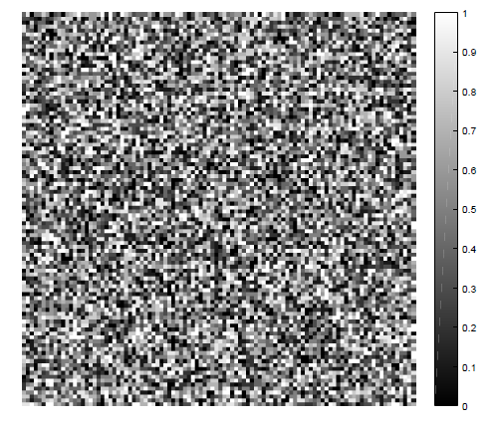
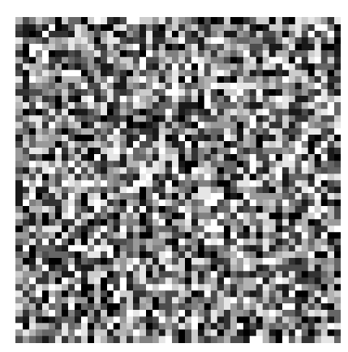
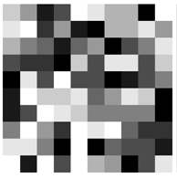
Now translate to the continuous case. Consider an m x m grid with randomly distributed values between 0 and 1 and the same notion of “neighborhood extent”.
100 x 100 grid
50 x 50 grid
10 x 10 grid

Slide 10
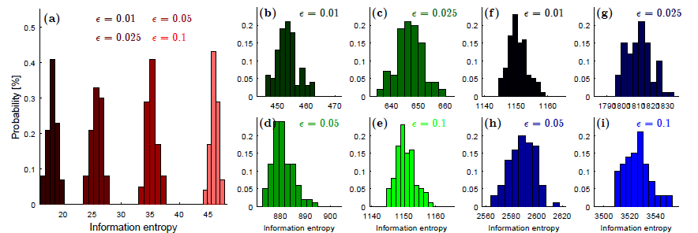
Define an additional threshold parameter ɛ. If neighboring values are within this +/- threshold of one another, they are considered to “contain information”, i.e. p += 1.
10 x 10 grid
50 x 50 grid
100 x 100 grid
The lower the threshold for “information content”, the higher the information entropy in a given grid.
Again the change in median information entropy is non-linear with the change in ɛ (ΔH (ɛ =0.025 to ɛ = 0.05) ≠ ΔH (ɛ =0.05 to ɛ = 0.1))

Slide 11


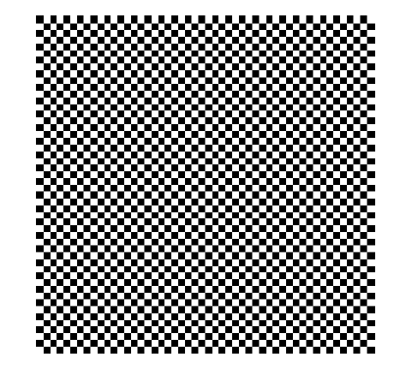
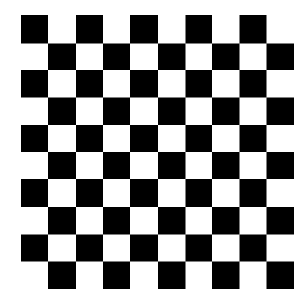
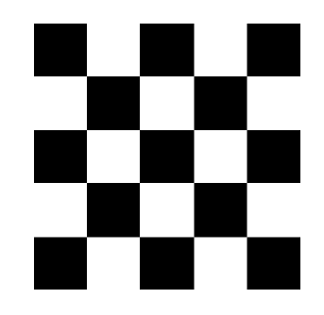
How does the algorithm treat a checkerboard?
If we make the window size less than / equal to / greater than the feature size, what happens?
m is the dimension of the matrix, n is the scale of repetition, d is the neighborhood extent
m = 10, n = 1, d = 5
H = 0.4968
m = 10, n = 1, d = 3
H = 0.4916
m = 10, n = 1, d = 2
H = 0.4791
m = 10, n = 2, d = 5
H = 0.4966
m = 10, n = 2, d = 3
H = 0.4934
m = 10, n = 2, d = 2
H = 0.4878
m = 10, n = 5, d = 5
H = 0.4981
m = 10, n = 5, d = 3
H = 0.4665
m = 10, n = 5, d = 2
H = 0.3786
So for n <= d, entropy is essentially a random value (close to 0.5).
Even for n < 2*d, entropy is still quite high (0.4665).
Only for n > 2*d does entropy drop significantly.
m = 50, n = 1, d = 5
H = 0.4963
m = 50, n = 1, d = 3
H = 0.4905
m = 50, n = 1, d = 2
H = 0.4791
m = 50, n = 5, d = 5
H = 0.4969
m = 50, n = 5, d = 3
H = 0.4665
m = 50, n = 5, d = 2
H = 0.3786
m = 50, n = 10, d = 5
H = 0.3725
m = 50, n = 10, d = 3
H = 0.2502
m = 50, n = 10, d = 2
H = 0.1561
For the same n/d, H is similar independent of grid size….. If n <= 0.1 * m for both grids

Slide 12
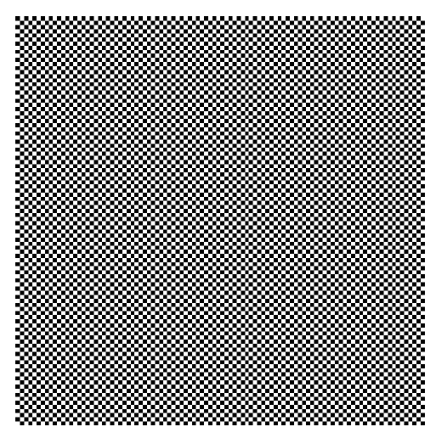
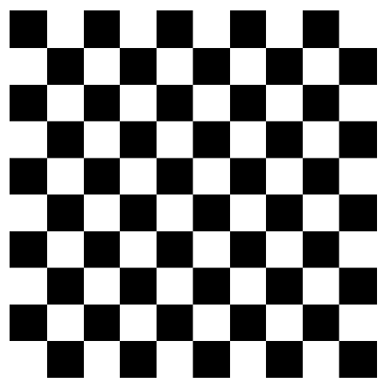
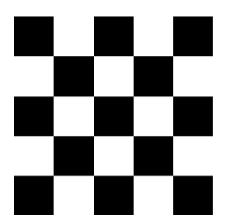
m = 100, n = 10, d = 5
H = 0.427
m = 100, n = 10, d = 3
H = 0.3035
m = 100, n = 10, d = 2
H = 0.2018
m = 100, n = 1, d = 5
H = 0.4963
m = 100, n = 1, d = 3
H = 0.4903
m = 100, n = 1, d = 2
H = 0.4791
m = 100, n = 20, d = 5
H = 0.2135
m = 100, n = 20, d = 3
H = 0.1234
m = 100, n = 20, d = 2
H = 0.0543

Slide 13
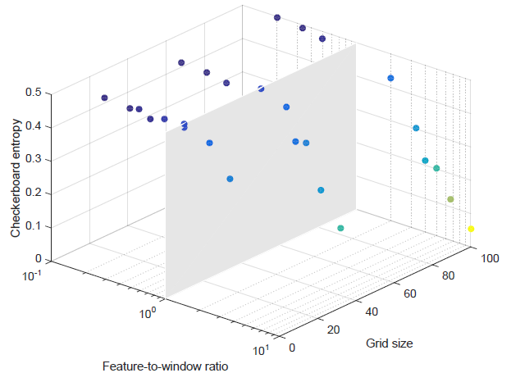
If we make the window size less than / equal to / greater than the feature size, what happens?
m = 10, n = 1, d = 5
H = 0.4968
m = 10, n = 1, d = 3
H = 0.4916
m = 10, n = 1, d = 2
H = 0.4791
m = 10, n = 2, d = 5
H = 0.4966
m = 10, n = 2, d = 3
H = 0.4934
m = 10, n = 2, d = 2
H = 0.4878
m = 10, n = 5, d = 5
H = 0.4981
m = 10, n = 5, d = 3
H = 0.4665
m = 10, n = 5, d = 2
H = 0.3786
m = 50, n = 1, d = 5
H = 0.4963
m = 50, n = 1, d = 3
H = 0.4905
m = 50, n = 1, d = 2
H = 0.4791
m = 50, n = 5, d = 5
H = 0.4969
m = 50, n = 5, d = 3
H = 0.4665
m = 50, n = 5, d = 2
H = 0.3786
m = 50, n = 10, d = 5
H = 0.3725
m = 50, n = 10, d = 3
H = 0.2502
m = 50, n = 10, d = 2
H = 0.1561
Below a “feature-to-window ratio” of 1, the entropy is essentially random (= 0.5); the window is too big to pick up the feature as a coherent structure. Above the ratio of 1, the entropy drops with increasing feature-to-window ratio (log-linearly); as the window gets smaller relative to the feature, it picks up the feature being a more and more coherent structure.
m = 100, n = 1, d = 5
H = 0.4963
m = 100, n = 1, d = 3
H = 0.4903
m = 100, n = 1, d = 2
H = 0.4791
m = 100, n = 10, d = 5
H = 0.427
m = 100, n = 10, d = 3
H = 0.3035
m =100, n = 10, d = 2
H = 0.2018
m = 100, n = 20, d = 5
H = 0.2135
m = 100, n = 20, d = 3
H = 0.1234
m = 100, n = 20, d = 2
H = 0.0543

Slide 14
Can we normalize entropy values so that they are comparable for various feature sizes and neighborhood extents?

Slide 15
Can we include the distance between clusters as well somehow?
Is it necessary to calculate an accurate entropy for a given field?

Slide 16
