Slide 1
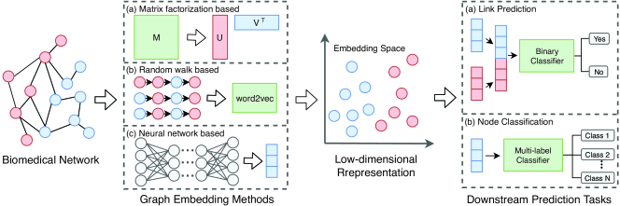
Embedding
Knowledge graph (KG) embedding aims to encode the entities and relations in KG into low dimensional vector space that can be used for subsequent algorithms.
Recommendation
Community detection research
Risk Assessment
Causal Reasoning
……
Information Extraction
Decision Making
Query/Q&A
Document Understanding
KG Completion
KG Construction
Classification
Relation Extraction
Entity Recognition
KG Alignment
……
Reasoning
Linking
KG Validation
Knowledge Graph Embeddings
Knowledge Graphs
An Example of Embedding on Biomedical Networks
[Graph Embedding on Biomedical Networks; Xiang Yue et al.]
KG Embedding is a fundamental problem in mining relational patterns, construction and completion, classification, validation and upper level applications.

Slide 2
Embedding
Challenges | Addressed models (2019-2020)
Combine structural and semantic information in a unified model | NAS (AAAI 2020), ConvKB (ACL 2019), S2E(AAAI 2020), CaRe (NAACL-HIT 2019), InteractE(AAAI2020)
Expression capacity - address on symmetry, inversion, composition, long term dependency etc. | DihEdral (ACL 2019), OTE (ACL 2020), RSN(ICML 2019), CapsE(NAACL-HIT 2019), CrossE(EMNLP-IJCNLP 2019), RotatE(ICLR 2019)
Explainability | RPJE (AAAI 2020, rule enhanced model)
Large scale / Performance | R-MeN (ACL 2020)
Trend 1: distill structural information and combine it with semantic information for different KG tasks.
Trend 2: Better expression capacity, especially representing complex relation features.

Slide 3
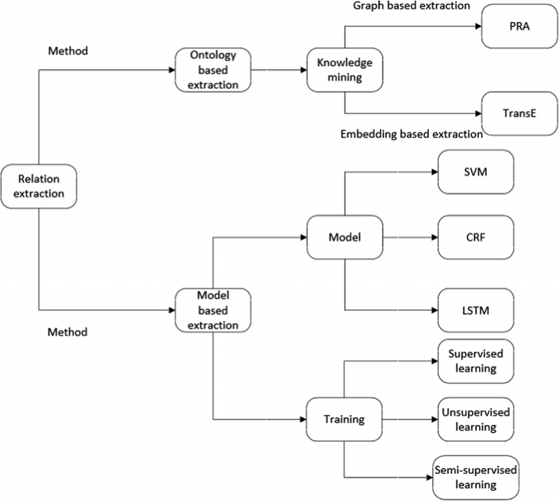
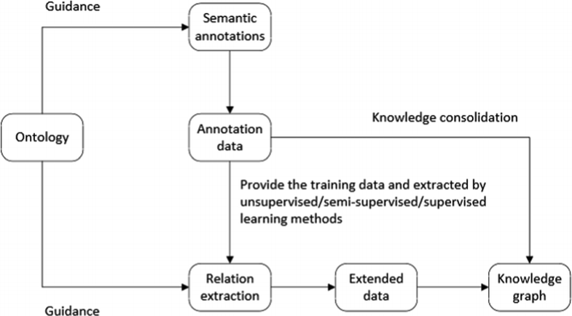
Relation Extraction
Constructing a knowledge graph includes ontology construction, annotated data, relation extraction, and ontology inspection. Relation extraction (RE) aims at extracting the relation between two entities from the text corpora. It is a crucial task for Knowledge Graph (KG) construction.
Relation extraction flow chart
Evolution process diagram of relation extraction
[ A Survey of Relation Extraction of Knowledge Graphs; Aoran Li et al.; 2019 ]

Slide 4
Relation Extraction
Challenge | Works (2019-2010)
Incorporating extra context | Leverage implicit relational knowledge into relation extraction model for long-tailed data (NAACL-HLT 2019) Knowledge-aware attention model Compute entity relation subgraphs and rank relevance (IJCAI 2020)
Unsupervised /unlabeled | Transfer the relational knowledge to identify novel relations in unlabeled data (EMNLP-IJCNLP 2019)
Implicit discourse relation classification | Contextualized representation + bilateral multi-perspective matching + global information fusion (IJCAI 2020)
Few-shot/ Long-tail | Encoding the query instance and class prototype interactively through multi-level matching and aggregation. (ACL 2019) Leverage implicit relational knowledge into relation extraction model for long-tailed data (NAACL-HLT 2019)
Trend : few-shot/long-tailed data which need incorporate extra context and knowledge.

Slide 5
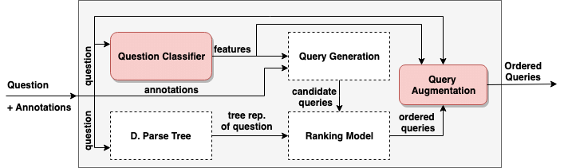
Q&A / Query
Question answering over knowledge graph (QA-KG) aims to use facts in the knowledge graph (KG) to answer natural language questions. Even if the linked entities and relations to an underlying knowledge graph are given, finding the corresponding query that captures the true intention of the input question still remains a challenging task.
An example of QA-KG pipeline
[Complex Query Augmentation for Question Answering over Knowledge Graphs, Hamid Zafar et al; 2019]

Slide 6
Q&A / Query
Challenge | Works
Ability of proactively leading the conversation | Proactive Human-Machine Conversation with Explicit Conversation Goals (ACL 2019) --- Planning dialogue strategy over a knowledge graph Using a KG-Copy Network for Non-Goal Oriented Dialogues (ISWC 2019)
Quantity, Counting and Aggregation | Counting Query Answers over a DL-Lite KB (IJCAI 2020) --- Query rewriting technique into first-order logic with counting Qsearch: Answering Quantity Queries from Text (ISWC 2019) --- Extract quantity facts from text (ISWC 2019)
Complex questions | SPARQA: Skeleton-based Semantic Parsing for Complex Questions over Knowledge Bases (AAAI 2020) Mapping Factoid Adjective Constraints to Existential Restrictions over Knowledge Bases (ISWC 2019) --- Mapping an adjective to several existential restrictions or their negation forms Retrieve, Program, Repeat: Complex Knowledge Base Question Answering via Alternate Meta-learning (IJCAI 2020) Learning to Rank Query Graphs for Complex Question Answering over Knowledge Graphs (ISWC 2019) Formal Query Building with Query Structure Prediction for Complex Question Answering over Knowledge Base (IJCAI 2020)
Large scale / Performance | Absorption-Based Query Answering for Expressive Description Logics (ISWC 2019) --- Rewrites/absorbs a conjunctive query into several simple axioms such that minor extensions of the tableau algorithm appropriately create and propagate bindings for variables through completion graphs. Anytime Large-Scale Analytics of Linked Open Data (ISWC 2019) --- Numerical aggregators/rewrite expensive queries into a set of queries that each satisfy the fair use policy.
Trend 1 : Answering complex questions via KGs is still an important topic
Trend 2: Leading dialogue with and without explicit conversation goal.

