Slide 1
Learning Attention-based Embeddings for Relation Prediction in Knowledge Graphs
Embedding
Limitation of Existing Work:
Translational models learn embeddings using simple operations and limited parameters, they produce low quality embeddings. In contrast, CNN based models learn more expressive embeddings due to their parameter efficiency and consideration of complex relations. However, both translational and CNN based models process each triple independently and hence fail to encapsulate the semantically rich and latent relations that are inherently present in the vicinity of a given entity in a KG.
Key idea of Approach:
This is a novel attention-based feature embedding model that captures both entity and relation features in any given entity’s neighborhood. This architecture is an encoder-decoder model where the generalized graph attention model and ConvKB play the roles of encoder and decoder respectively.
Link: https://arxiv.org/pdf/1906.01195.pdf
Source: ACL 2019

Slide 2
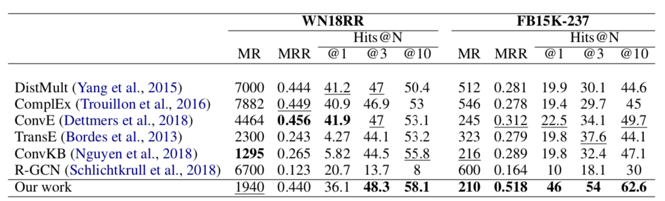
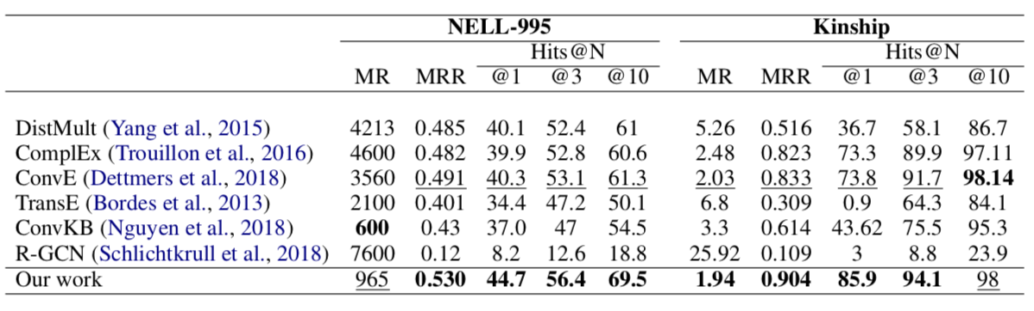
Learning Attention-based Embeddings for Relation Prediction in Knowledge Graphs
Contributions:
Evaluation:
A novel attention-based feature embedding that captures both entity and relation features in any given entity’s neighborhood.
Encapsulate relation clusters and multi-hop relations in this model.
Limitations:
Future work is to extend the method to better perform on hierarchical graphs and capture higher-order relations between entities (like motifs) in this graph attention model.

Slide 3
DihEdral: Relation Embedding with Dihedral Group in Knowledge Graph
Embedding
Limitation of Existing Work:
As a family of effective approaches for link predictions, embedding methods try to learn low-rank representations for both entities and relations such that the bi- linear form defined therein is a well-behaved scoring function. Despite of their successful performances, existing bilinear forms overlook the modeling of relation compositions, resulting in lacks of interpretability for reasoning on KG.
Key idea of Approach:
DihEdral models the relation in knowledge graphs with the representation of dihedral group. It is a bilinear model and supports relation symmetry, skew-symmetry, inversion, abelian composition and non-abelian composition due to the properties of dihedral group.
Link: https://arxiv.org/abs/1906.00687
Source: ACL 2019

Slide 4
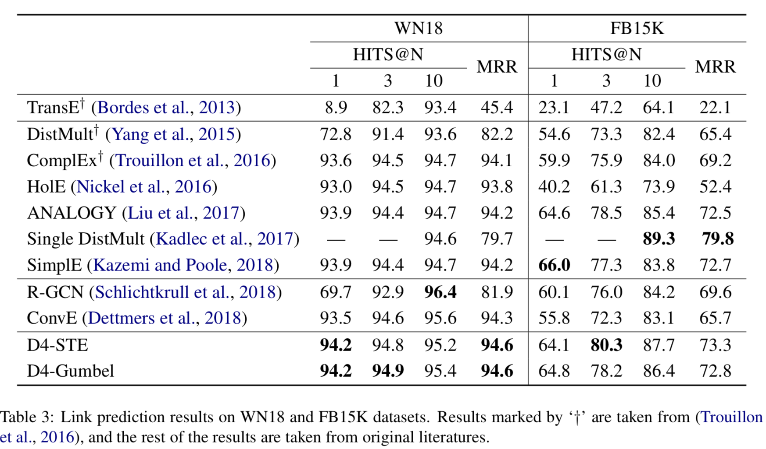
DihEdral: Relation Embedding with Dihedral Group in Knowledge Graph
Evaluation:
Contributions:
This new model learns knowledge graph embeddings that can capture relation compositions by nature.
Furthermore, this approach models the relation embeddings parametrized by discrete values, thereby decrease the solution space drastically.
Capture all desired properties such as (skew-) sym- metry, inversion and (non-) Abelian compo- sition, and outperforms existing bilinear form based approach and is comparable to or better than deep learning models such as ConvE
The first embedding method to incorporate non-Abelian relation compositions in terms of matrix multiplications
Limitations:

Slide 5
A Relational Memory-based Embedding Model for Triple Classification and Search Personalization
Embedding
Limitation of Existing Work:
Existing embedding models are showing promising performances mainly for knowledge graph completion, where the goal is to infer a missing entity given a relation and another entity. But in real applications, less mentioned, such as triple classification that aims to predict whether a given triple is valid, and search personalization that aims to re-rank the relevant documents returned by a user-oriented search system given a query, these models do not effectively capture potential dependencies among entities and relations from existing triples to predict new triples.
Key idea of Approach:
R-MeN explores a relational memory network to encode potential dependencies in relationship triples.
R- MeN considers each triple as a sequence of 3 input vectors that recurrently interact with a memory using a transformer self-attention mechanism. Thus R-MeN encodes new information from interactions between the memory and each input vector to return a corresponding vector.
Consequently, R-MeN feeds these 3 returned vectors to a convolutional neural network-based decoder to produce a scalar score for the triple.
Link: https://arxiv.org/pdf/1907.06080.pdf
Source: ACL 2020

Slide 6
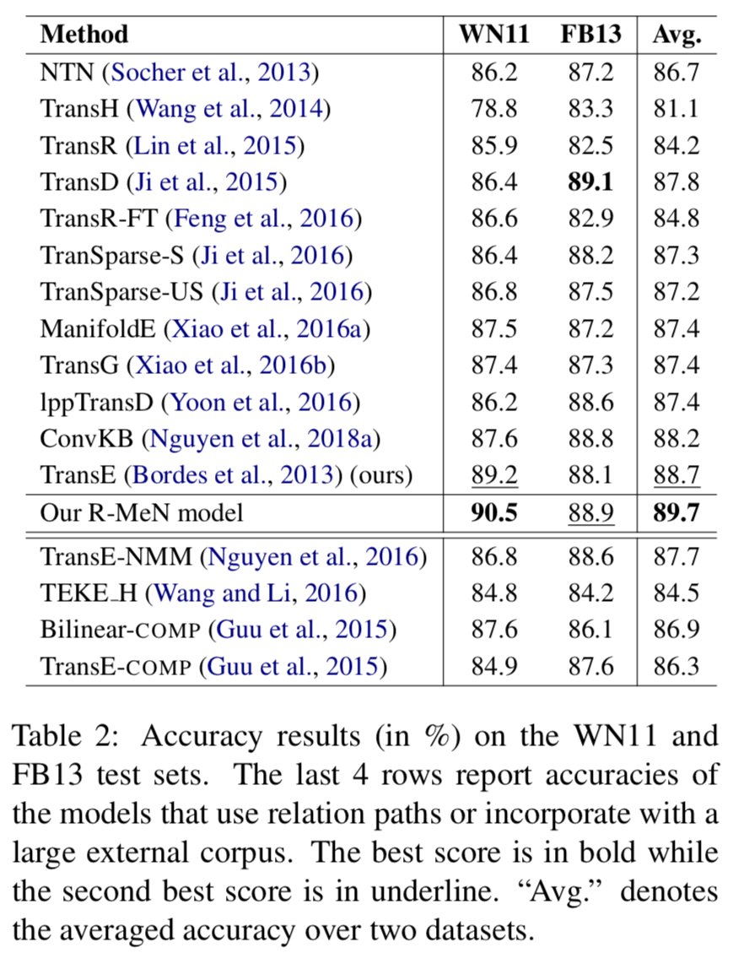
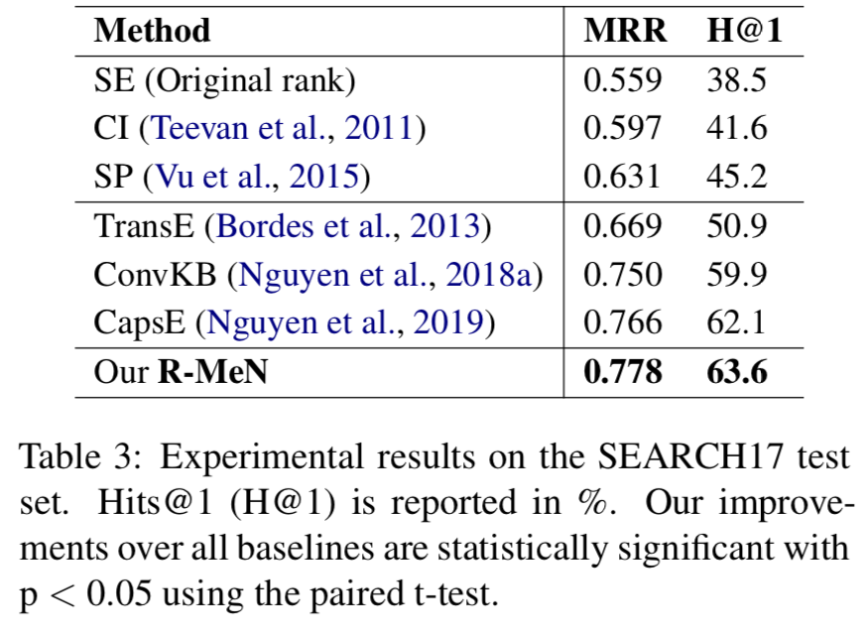
A Relational Memory-based Embedding Model for Triple Classification and Search Personalization
Evaluation:
Contributions:
A novel KG embedding model to memorize and encode the potential dependencies among relations and entities for two real applications of triple classification and search personalization.
Limitations:

Slide 7
Orthogonal Relation Transforms with Graph Context Modeling for Knowledge Graph Embedding
Embedding
Limitation of Existing Work:
Distance-based knowledge graph embeddings have shown substantial improvement on the knowledge graph link prediction task, from TransE to the latest state-of-the-art RotatE. However, complex relations such as N-to-1, 1- to-N and N-to-N still remain challenging to predict.
Key idea of Approach:
First extend the RotatE from 2D complex domain to high dimensional space with orthogonal transforms to model relations. The orthogonal transform embedding for relations keeps the capability for modeling symmetric/anti-symmetric, inverse and compositional relations while achieves better modeling capacity.
Second, the graph context is integrated into distance scoring functions directly.
Graph context is explicitly modeled via two directed context representations. Each node embedding in knowledge graph is augmented with two context representations, which are computed from the neigh- boring outgoing and incoming nodes/edges respectively.
Link: https://arxiv.org/pdf/1911.04910.pdf
Source: ACL 2020

Slide 8
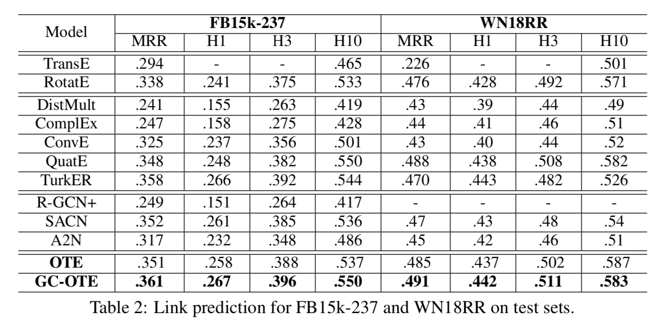
Orthogonal Relation Transforms with Graph Context Modeling for Knowledge Graph Embedding
Evaluation:
Contributions:
• A new orthogonal transform embedding OTE, is proposed to extend RotatE from 2D space to high dimensional space, which also models sym- metry/antisymmery, inversion and compositional relation patterns;
• A directed graph context modeling method is proposed to integrate knowledge graph context (including both neighboring entity nodes and re- lation edges) into the distance scoring function;
• Experimental results of OTE on standard bench- mark FB15k-237 and WN18RR datasets show consistent improvements over RotatE, the state of art distance-based embedding model, espe- cially on FB15k-237 with many high in-degree nodes. On WN18RR our results achieve the new state-of-the-art performance.
Limitations:

Slide 9
Neural Variational Inference For Estimating Uncertainty in Knowledge Graph Embeddings
Embedding/Completion
Limitation of Existing Work:
A significant shortcoming of current neural link prediction models – and for the vast majority of neural representation learning approaches – is their inability to express a notion of uncertainty. Neural link prediction models typically return only point estimates of parameters and predictions, and are trained discriminatively rather than generatively: they aim at predicting one variable of interest conditioned on all the others, rather than accurately representing the relationships between different variables
Key idea of Approach:
Construct an inference network conditioned on the symbolic representation of entities and relation types in the Knowledge Graph, to provide the variational distributions.
Under a Bernoulli sampling framework, it provided an alternative justification for commonly used techniques in large-scale stochastic variational inference, which drastically reduce training time at a cost of an additional approximation to the variational lower bound. It introduced two models from this highly scalable probabilistic framework, namely the Latent Information and Latent Fact models, for reasoning over knowledge graph-based representations.
Link: https://arxiv.org/pdf/1906.04985.pdf
Source: IJCAI 2020

Slide 10
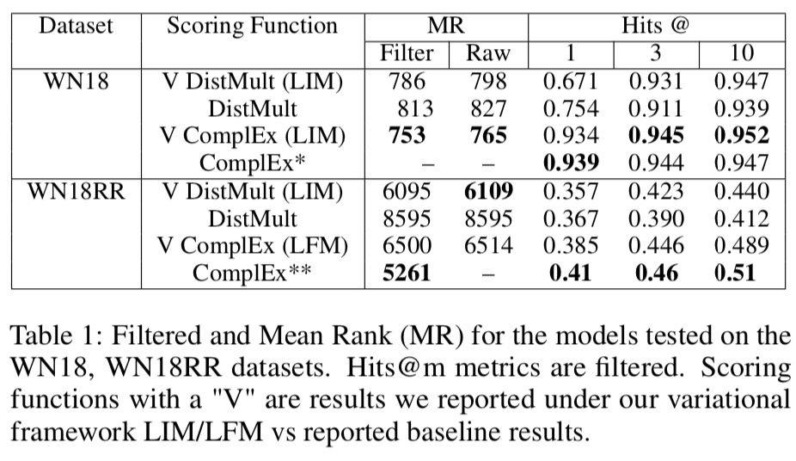
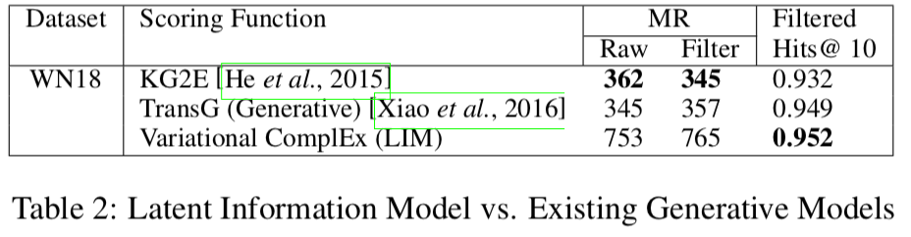
Neural Variational Inference For Estimating Uncertainty in Knowledge Graph Embeddings
Evaluation:
Contributions:
We argue there is a lack of methods for quantifying predictive uncertainty in a knowledge graph embedding representation, which can only be utilised using probabilistic modelling, as well as a lack of expressiveness under fixed-point representations. We introduce a framework for creating a family of highly scalable probabilistic models for knowledge graph representation The framework improves model performance under certain conditions, while reducing the parameter search by one hyper-parameter, as the unit Gaussian prior is self- regularising.
Limitations:
Utilising the uncertainty on the latent embeddings through sampling does not result in improved uncertainty estimates over using the magnitude of likelihood estimate as the confidence, which leaves further room for research into how best to utilise these learnt uncertainty estimates.

Slide 11
Neural Recurrent Structure Search for Knowledge Graph Embedding
Embedding
Limitation of Existing Work:
TransE… , ConvE, ComplEx, PTransE… fail to explore the structural information, but mainly focus on the semantic information. GCN-Align leaves semantic information alone prevents this model from fully capturing properties in KG. RSN focuses more on structural information, along paths and does not adapts well to tasks where semantic information is more important.
Key idea of Approach:
Propose S2E to distill structural information and combine it with semantic information for different KGs as a neural architecture search (NAS) problem.
First, analyze the difficulty of using a unified model to solve the distillation problem.
Based on it, define the path distiller to recurrently combine structural and semantic information along relational paths, which are sampled to preserve both local topologies and semantics.
Then, inspired by the recent success of NAS, design a recurrent network based search space for specific KG tasks, and propose a natural gradient (NG) based search algorithm to update architectures.
Link: https://arxiv.org/pdf/1911.07132.pdf
Source: AAAI 2020

Slide 12
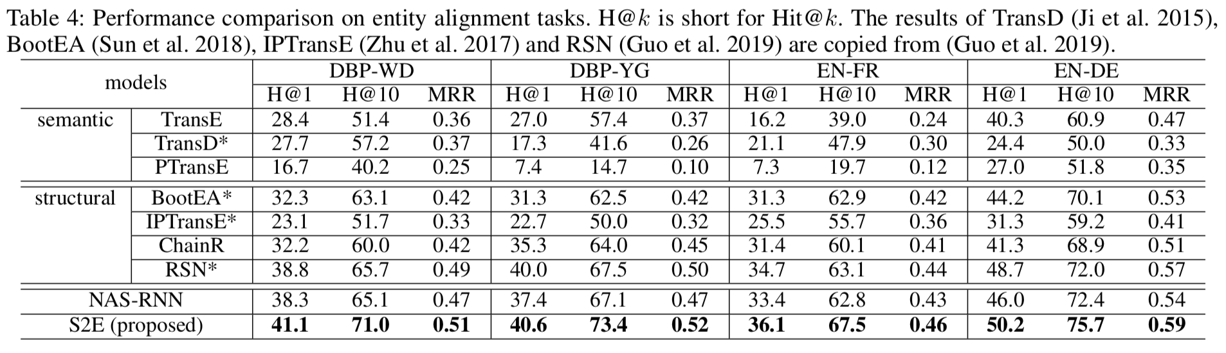
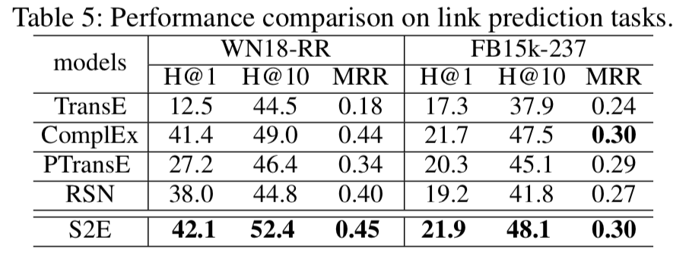
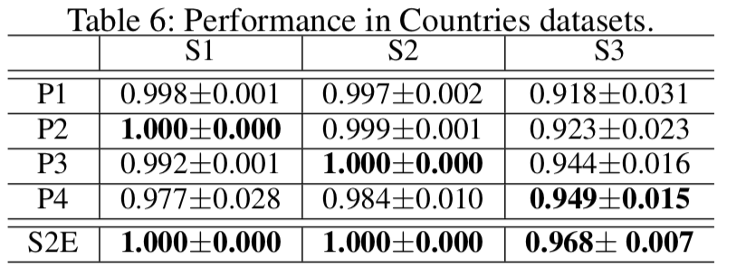
Neural Recurrent Structure Search for Knowledge Graph Embedding
Evaluation:
Contributions:
Proposed an NAS method S2E to search RNN for learning from relational paths, which contains structural and semantic information, in KGs. By designing a specific search space based on human-designed KG embedding models, S2E can adaptively distill structural information and combine with semantic information for different KG tasks.
Limitations:

Slide 13
RSN: Learning to Exploit Long-term Relational Dependencies in Knowledge Graphs
Embedding
Limitation of Existing Work:
For KG embedding, existing methods start with the assumption that similar entities are likely to have similar relational roles. Their primary focus, therefore, lies in learning from relational triples of entities.
Triple-level learning has two major limitations: (i) low expressiveness. (ii) inefficient information propagation
Key idea of Approach:
RSNs integrate recurrent neural networks with residual learning to efficiently capture the long-term relational dependencies of entities within and between KGs. It also design an end-to-end framework to support RSNs on two tasks link prediction and entity alignment.
Link: http://proceedings.mlr.press/v97/guo19c/guo19c.pdf
Source: ICML 2019

Slide 14
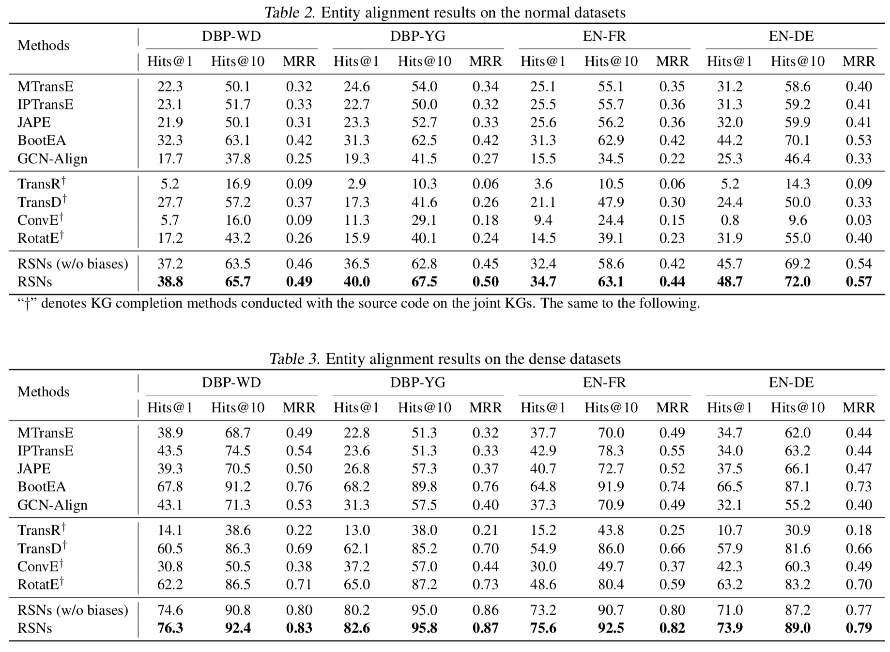
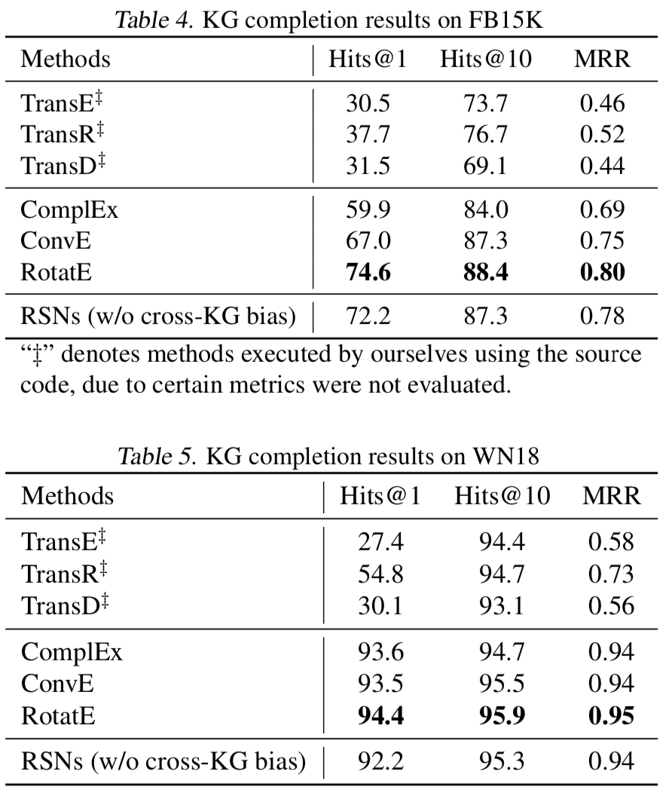
RSN: Learning to Exploit Long-term Relational Dependencies in Knowledge Graphs
Evaluation:
Contributions:
Studied the path-level KG embedding learning and proposed RSNs to remedy the problems of using sequence models to learn relational paths. Presented an end-to-end framework, which uses the biased random walks to sample desired paths and models them with RSNs.
Limitations:
Focus more on the graph structural information; future work includes studying a unified sequence model to learn KG embeddings using both relational paths and textual information.

Slide 15
CapsE: A Capsule Network-based Embedding Model for Knowledge Graph Completion and Search Personalization.
Embedding
Limitation of Existing Work:
Conventional embedding models, such as TransE (Bordes et al., 2013), DISTMULT (Yang et al., 2015) and ComplEx (Trouillon et al., 2016), use addition, subtraction or simple multiplication operators, thus only capture the linear relationships between entities.
Most of KG embedding models are constructed to modeling entries at the same dimension of the given triple, where presumably each dimension captures some relation-specific attribute of entities. None of the existing models has a “deep” architecture for modeling the entries in a triple at the same dimension.
Key idea of Approach:
CapsE represents each triple as a 3-column matrix where each column vector represents the embedding of an element in the triple. This 3-column matrix is then fed to a convolution layer where multiple filters are operated to generate different feature maps. These feature maps are reconstructed into corresponding capsules which are then routed to another capsule to produce a continuous vector. The length of this vector is used to measure the plausibility score of the triple.
The high-level hypothesis is that each capsule accounts for capture variants of a relation-specific attribute of the entities.
Link: https://www.aclweb.org/anthology/N19-1226
Source: NAACL-HIT 2019

Slide 16
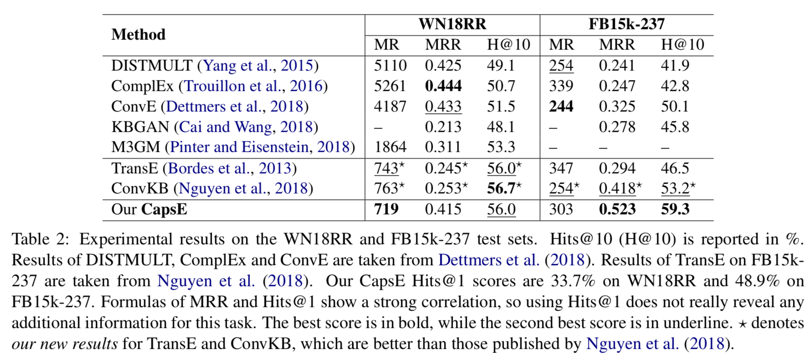
CapsE: A Capsule Network-based Embedding Model for Knowledge Graph Completion and Search Personalization.
Evaluation:
Contributions:
Limitations:

Slide 17
CaRe: Open Knowledge Graph Embeddings
Embedding
Limitation of Existing Work:
Key idea of Approach:
CaRe focuses on canonicalization of OpenKGs. The model infuses canonicalization in-formation combined with the neighborhood graph structure to learn rich representations of NPs. And it captures the semantic similarity of RPs.
Link: http://talukdar.net/papers/CaRe_EMNLP2019.pdf
Source: EMNLP-IJCNLP 2019

Slide 18
CrossE: Interaction Embeddings for Prediction and Explanation in Knowledge Graphs
Embedding
Limitation of Existing Work:
Key idea of Approach:
CrossE, a novel knowledge graph embedding which explicitly simulates crossover interactions. It not only learns one general embedding for each entity and relation as most previous methods do, but also generates multiple triple specific embeddings for both of them, named interaction embeddings.
Link: https://arxiv.org/pdf/1903.04750.pdf
Source: EMNLP-IJCNLP 2019

Slide 19
TuckER: Tensor Factorization for Knowledge Graph Completion
Embedding
Limitation of Existing Work:
Key idea of Approach:
TuckER is a relatively simple but powerful linear model based on Tucker decomposition of the binary tensor representation of knowledge graph triples. TuckER is a fully expressive model, deriving the bound on its entity and relation embedding dimensionality for full expressiveness which is several orders of magnitude smaller than the bound of previous models ComplEx and SimplE. Besides, TuckER achieves the state-of-the-art performance.
Link: https://arxiv.org/pdf/1901.09590.pdf
Source: 2019

Slide 20
RotatE: Knowledge Graph Embedding by Relational Rotation in Complex Space.
Embedding
RotatE is limited to 2-D rotations and thus has limited modeling capacity. In addition, RotatE does not consider graph context, which is helpful in handling 1-to-N, N-to-1, and N-to-N relation prediction.
Limitation of Existing Work:
Key idea of Approach:
RotatE infers various relation patterns including: symmetry/antisymmetry, inversion, and composition. Specifically, the RotatE model defines each relation as a rotation from the source entity to the target entity in the complex vector space.
Link: https://openreview.net/pdf?id=HkgEQnRqYQ
Source: ICLR 2019

Slide 21
Evaluation:
Contributions:
Limitations:

Slide 22
InteractE: Improving Convolution-based Knowledge Graph Embeddings by Increasing Feature Interactions
Embedding
Limitation of Existing Work:
Key idea of Approach:
We propose InteractE, a method that augments the ex- pressive power of ConvE through three key ideas – fea- ture permutation, "checkered" feature reshaping, and circular convolution.
We provide a precise definition of an interaction, and theoretically analyze InteractE to show that it increases interactions compared to ConvE. Further, we establish a correlation between the number of heterogeneous interactions (refer to Def. 3.2) and link prediction performance.
Feature Permutation: Instead of using one fixed order of the input, we utilize multiple permutations to capture more possible interactions.
• Checkered Reshaping: We substitute simple feature re- shaping of ConvE with checked reshaping and prove its superiority over other possibilities.
• Circular Convolution: Compared to the standard convo- lution, circular convolution allows to capture more feature interactions as depicted in Figure 3. The convolution is performed in a depth-wise manner (Chollet 2017) on different input permutations.
Link: https://arxiv.org/pdf/1911.00219.pdf
Source: AAAI2020

Slide 23
Rule-Guided Compositional Representation Learning on Knowledge Graphs
Embedding/Explainability
Limitation of Existing Work:
Early KG embedding methods only pay attention to structured information encoded in triples, which would cause limited performance due to the structure sparseness of KGs. Some recent attempts consider paths in- formation to expand the structure of KGs but lack explain- ability in the process of obtaining the path representations.
Key idea of Approach:
we propose a novel Rule and Path-based Joint Em- bedding (RPJE) scheme, which takes full advantage of the ex- plainability and accuracy of logic rules, the generalization of KG embedding as well as the supplementary semantic struc- ture of paths. Specifically, logic rules of different lengths (the number of relations in rule body) in the form of Horn clauses are first mined from the KG and elaborately encoded for rep- resentation learning. Then, the rules of length 2 are applied to compose paths accurately while the rules of length 1 are explicitly employed to create semantic associations among relations and constrain relation embeddings. Moreover, the confidence level of each rule is also considered in optimiza- tion to guarantee the availability of applying the rule to rep- resentation learning.
Link:
Source: 2019

Slide 24
TransEdge: Translating Relation-contextualized Embeddings for Knowledge Graphs
Embedding
Limitation of Existing Work:
Most embedding models in literature
interpret relations as linear or bilinear mapping functions to operate
on entity embeddings. However, we find that such relation-level modeling
cannot capture the diverse relational structures of KGs well.
Key idea of Approach:
We propose a novel KG embedding model TransEdge. Different from existing
models that learn one simple embedding per relation, TransEdge learns
KG embeddings by contextualizing relation representations in terms of the
specific head-tail entity pairs. We refer to such contextualized representations
of a relation as edge embeddings and build edge translations between
entity embeddings to capture the relational structures of KGs. TransEdge
provides a novel perspective for KG embedding
Link:
Source: 2019

Slide 25
DIAG-NRE: A neural pattern diagnosis framework for distantly supervised neural relation extraction
Relation Extraction
Limitation of Existing Work:
Pattern-based labeling methods require significant expert labor to write relation-specific patterns, which makes them too sophisticated to generalize quickly.
Distant supervision models inevitably introduce intolerable labeling noises.
Pattern-based labeling, where the key idea was to regard both DS and pattern-based heuristics as the weak supervision sources and develop a weak-label-fusion (WLF) model to produce denoised labels. However, the major limitation of the WLF paradigm lies in the requirement of human experts to write relation-specific patterns.
Key idea of Approach:
Proposed a neural pattern diagnosis framework, DIAG-NRE, that can automatically summarize and refine high-quality relational patterns from noise data with human experts in the loop:
1) pattern extraction, extracting potential patterns from NRE models by employing reinforcement learning (RL), and 2) pattern refinement, asking human experts to annotate a small set of actively selected examples.
Link: https://www.aclweb.org/anthology/P19-1137.pdf
Source: ACL 2019

Slide 26
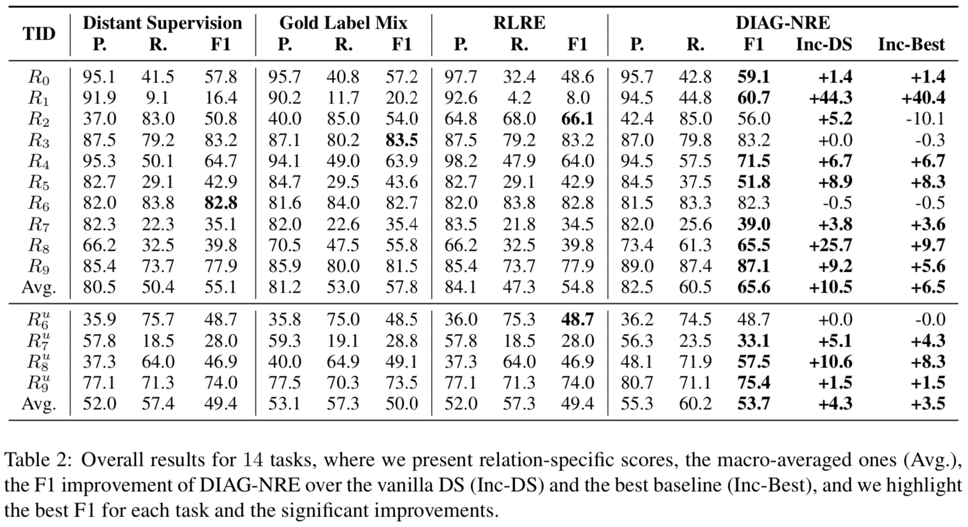
DIAG-NRE: A neural pattern diagnosis framework for distantly supervised neural relation extraction
Contributions:
Evaluation:
Proposed a neural pattern diagnosis framework, DIAG-NRE, to diagnose and improve NRE models trained on DS-generated data.
DIAG-NRE not only eases the hard pattern-writing work of human experts by generating patterns automatically, but also enables the quick generalization to new relation types by only requiring a small number of human annotations.
Coupled with the WLF model, DIAG-NRE can produce denoised labels to retrain a better NRE model.
Limitations:
Tasks (three from NYT and two from UW) suffering large labeling noises, most tasks experience a rapid improvement phase with the help of high-quality patterns automatically generated by DIAG-NRE and then enter a saturate phase where adding annotations does not contribute much. This saturation accords with the intuition that high-quality relational patterns are often limited.

Slide 27
ZeroShotCeres: Zero-Shot Relation Extraction from Semi-Structured Webpages
Relation Extraction
Limitation of Existing Work:
Key idea of Approach:
Link:
Source: 2019

Slide 28
C
Relation Extraction
Limitation of Existing Work:
Key idea of Approach:
Link:
Source: 2019

Slide 29
C
Relation Extraction
Limitation of Existing Work:
Key idea of Approach:
Link:
Source: 2019

Slide 30
Evaluation:
Contributions:
Limitations:

