Slide 1
DATA-DRIVEN CLIMATE AWARENESS
Global Emissions & Energy Mix
An interactive analytics dashboard exploring CO₂, GHG emissions,
and energy transitions across 190+ countries (1990–2023).
Plotly Dash
Python
Plotly
Responsive Design
Dashboard by Quynh Huong (Sylvie) Nguyen • Macquarie University

Slide 2
01 / DASHBOARD INTRODUCTION
Built with Plotly Dash
A fully interactive, responsive web application — accessible anywhere.
🌐 Responsive Web App
📱 Mobile-Ready via QR Code
Built on Plotly Dash with a fluid CSS grid layout. The app automatically adapts to desktop, tablet, and mobile screen sizes with no extra configuration.
Scan a QR code to open the dashboard instantly on your phone. No installation needed — just a browser. Perfect for presentations or on-the-go exploration.
⚡ Real-Time Interactivity
🔍 Linked Cross-Filtering
Dash callbacks power live filters: change year range, continent, country, or power source and every chart updates simultaneously without page reload.
Select a region on the map and all six charts update in sync. The animated bar chart timeline plays automatically to walk audiences through emissions trends.

Slide 3
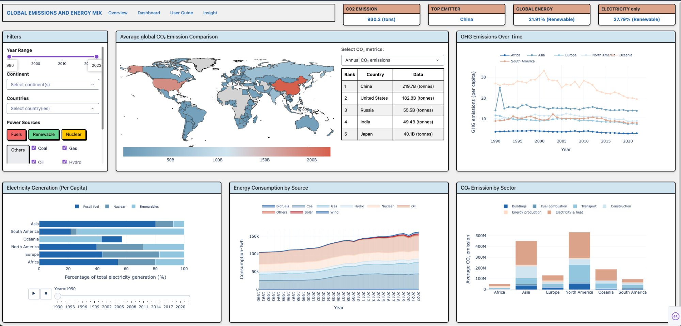
02 / DASHBOARD OVERVIEW
6 Charts. 1 Story. Fully Interactive.
World Map • GHG Trend Lines • Electricity Per Capita • Energy by Source • CO₂ by Sector • KPI Cards

Slide 4
03 / WHY THIS MATTERS
The Burning Question
41.6B
37.4B
+60%
6 yrs
tonnes CO₂
fossil only
since 1990
to 1.5 °C
Total emissions in 2024 — an all-time record
From burning coal, oil and gas alone (2024)
Global CO₂ has grown more than 60% in 35 years
Estimated time left before breaching Paris target
Carbon is a global, not local, problem. While some regions make real progress — Europe's emissions are falling — global totals keep rising, driven by industrialisation in Asia. China and the United States together account for over 40% of all emissions. 2024 was the hottest year on record, temporarily breaching 1.5 °C above pre-industrial levels. The gap between where we are and where we need to be has never been more urgent.

Slide 5
04 / KEY INSIGHTS
Who's Responsible?
The Emitter Landscape
China
219.7B t
🔑 Key Take
China & USA together: >40% of global emissions.
Despite similar development levels, European G7 nations emit far less per-capita thanks to decarbonisation policies.
Australia emits 15× less in total than the US — yet per-capita it still ranks high due to fossil-fuel-intensive industry.
USA
182.8B t
Russia
55.5B t
India
49.4B t
Japan
40.1B t
Australia
12.1B t
Source: Dashboard data 1990–2023 (cumulative totals, billion tonnes CO₂)

Slide 6
04 / KEY INSIGHTS
The Clean Energy Gap:
Electricity vs Total Energy
Global Electricity
Total Global Energy
31.97%
21.91%
~10%
gap
Nuclear + Renewables
share of electricity
(2015–2023)
Same sources in
total energy mix
(incl. transport & heat)
The gap exists because electricity is just one-third of total energy. Transport (petrol/diesel) and heating (gas/oil) remain stubbornly fossil-fuel-dependent. Decarbonising only the power grid is NOT enough — transport and heating must also transition.

Slide 7
04 / KEY INSIGHTS
Diverging Paths:
Who's Going Down, Who's Going Up?
📉 Emissions Declining
📈 Emissions Rising / Stable High
🇪🇺 Europe: Strong downward trend — coal phase-outs, efficiency policy, renewables expansion.
🇨🇳 China: Industrialisation surge — now ~30% of global emissions, though renewables are growing fast.
🇺🇸 USA: Gradual decline post-2007 thanks to gas replacing coal and renewable growth.
🇮🇳 India: Fastest growing major economy; fossil fuels still dominate energy mix.
🇫🇷 France: Exceptionally low CO₂ due to dominant nuclear share (~70% of electricity).
🇦🇺 Australia: ~80% fossil-fuel electricity; renewables expanding but starting from high base.
🇩🇪 Germany: Steady decline despite post-nuclear transition challenges.
🇯🇵 Japan: Post-Fukushima nuclear gap filled by fossil fuels — slow recovery since.

Slide 8
04 / KEY INSIGHTS
Where Does the CO₂ Actually Come From?
The Hard Truth
~75% of global GHG emissions come from energy production and combustion.
Electricity & Heat is just one piece. Transport and industrial heating — the "hidden" sectors — are still almost entirely fossil-fuel powered.
This means clean electricity alone cannot get us to net zero. We need electrification of transport and heat, plus green hydrogen for heavy industry.
Energy Production — 34%
Fuel Combustion — 14%
Electricity & Heat — 25%
Industry / Buildings — 11%
Transport — 16%

Slide 9
05 / CHALLENGES
The Challenges We Face
01
Electricity ≠ All Energy
02
Unequal Global Burden
Progress on clean electricity is real but insufficient. Transport and heating still rely almost entirely on fossil fuels, making the 31.97% renewable electricity share misleading when total energy is only 21.91% clean.
China and the US account for >40% of emissions while lower-income nations bear the brunt of climate impacts. The trade-off between industrialisation and decarbonisation creates a profound justice gap.
03
6 Years to 1.5 °C
04
Fossil Path Dependency
At current rates, there is a 50% chance we permanently breach 1.5 °C within 6 years. Fossil CO₂ hit a record 37.4B tonnes in 2024 — with no sign of a global peak yet.
Australia's grid is ~80% fossil-fuelled. Japan reversed nuclear gains after Fukushima. Policy reversals and economic pressures mean progress is fragile and uneven across regions.

Slide 10
06 / RECOMMENDATIONS
From Data to Action
⚡ Electrify Beyond the Grid
🏗️ Tackle Heavy Industry & Heating
Accelerate EV adoption and heat pumps to bring transport and heating into the clean energy system. This closes the 10% electricity-vs-energy gap that our dashboard highlights.
Buildings, steel, cement, and chemicals are CO₂-intensive and hard to electrify. Green hydrogen, carbon capture, and deep efficiency standards are essential for these sectors.
🌱 Global Accountability Mechanisms
📊 Data Transparency & Awareness
The data proves carbon is borderless. Reinforce Paris Agreement commitments with binding national targets, especially for China, USA, and India — the three largest current emitters.
Dashboards like this one are tools for empathy. Making emissions data accessible — filterable by country, sector, and year — helps citizens, policymakers, and businesses make informed decisions.
🔋 Scale Renewables in Emerging Economies
Solar costs have fallen 90% since 2010. Fund renewable infrastructure in India, Southeast Asia, and Africa where emissions are rising fastest — without repeating fossil industrialisation.

Slide 11
The data tells us the story.
What we do with it matters.
Global emissions hit a record high in 2024. Yet the signs of a turning point are visible: renewables met nearly three-quarters of electricity demand growth, EV sales grew 26%, and Europe's power sector is near fossil-free. The transition is happening — it just needs to accelerate.
40.9%
−2.2%
Net Zero
Low-carbon electricity share (2024)
EU CO₂ change in 2024
Global target by 2050
Sources: IEA Global Energy Review 2025 · Global Carbon Budget 2024 · Ember 2025 · Dashboard by Quynh Huong (Sylvie) Nguyen

