Slide 1
Paintings and streets
A deck made from public-domain samples
Notes:
Every picture and number in this deck comes from the other samples of the demo.

Slide 2
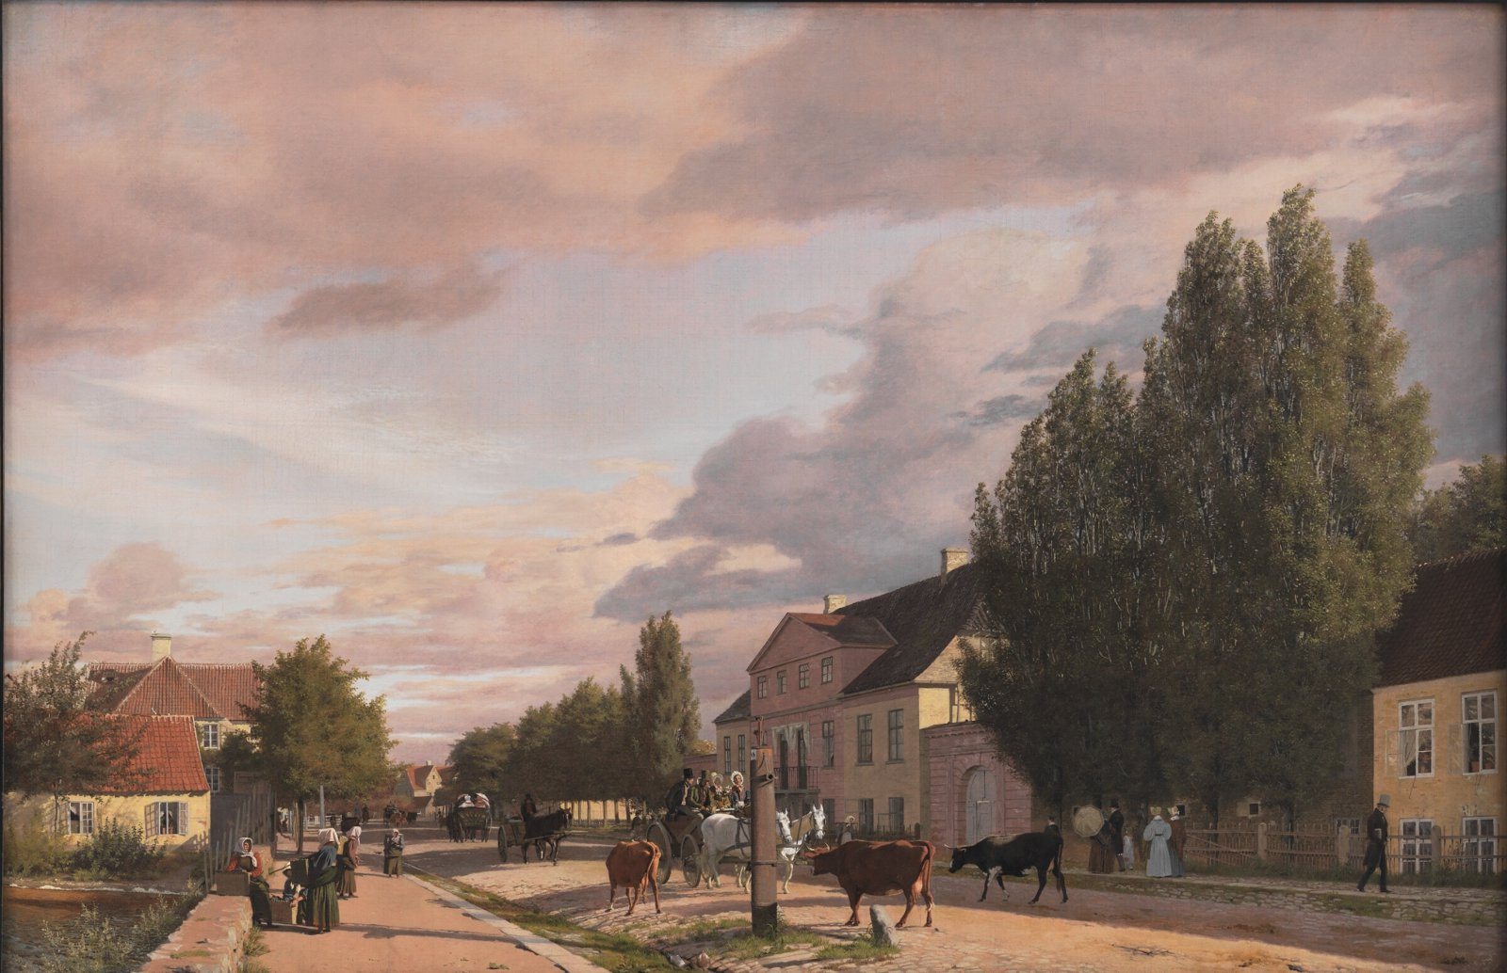
Christen Købke, 1836
View of a Street in Østerbro outside Copenhagen. Morning Light
Notes:
Statens Museum for Kunst, Copenhagen, marks this painting as in the public domain.

Slide 3
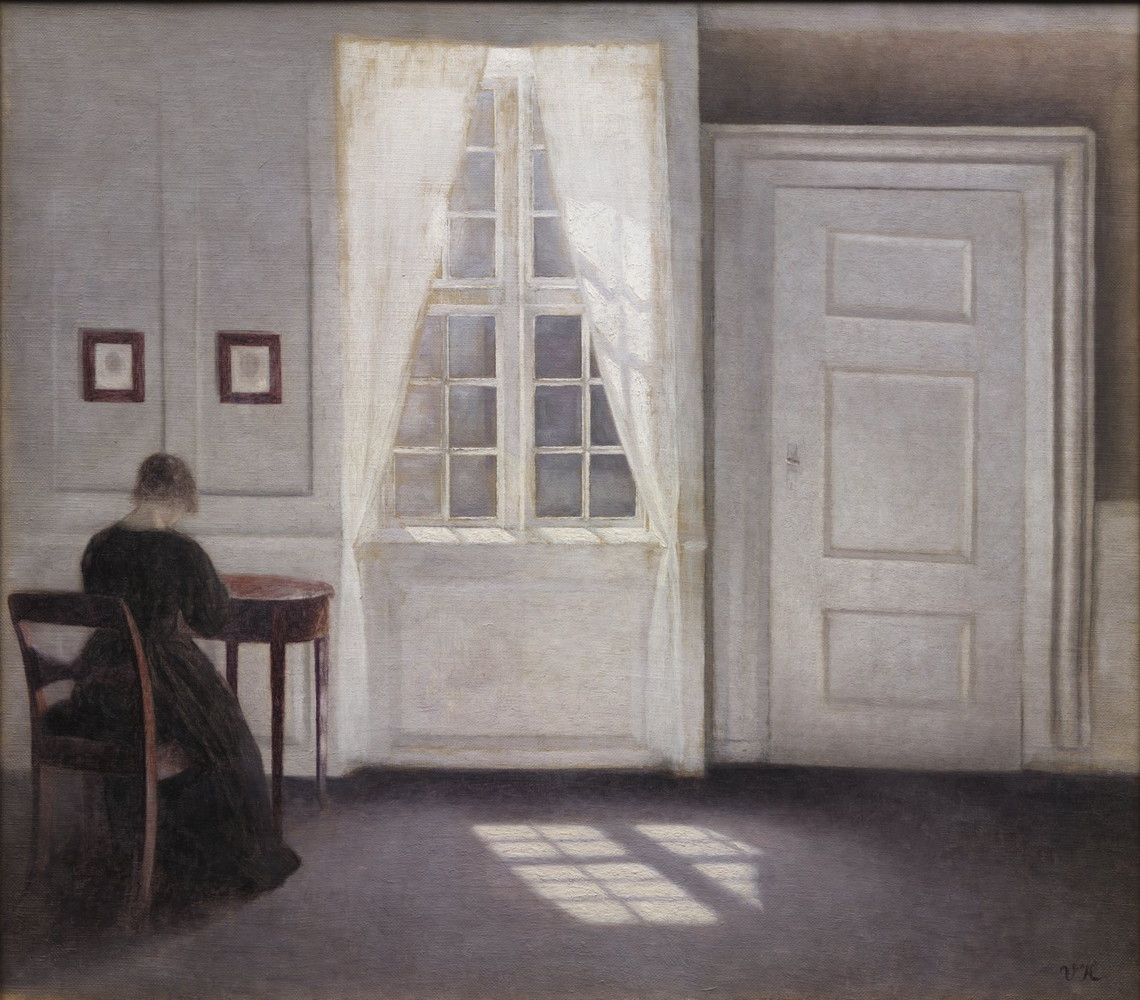
Vilhelm Hammershøi, 1901
Interior in Strandgade, Sunlight on the Floor
Notes:
Statens Museum for Kunst, Copenhagen, marks this painting as in the public domain.

Slide 4
Streets of Potsdam by district
Notes:
From Potsdam's street register, the eight districts with the most streets.

Slide 5
How the streets are classified
Classification | Streets
Ortsstraße | 899
Privatstraße | 174
Sonstige Öfftl. Straße | 25
Bundesstraße + Ortsstraße | 13
Bundesstraße | 7
Notes:
The register's classification of each street (Einstufung).

Slide 6
Sources
Statens Museum for Kunst, Copenhagen
  Paintings marked Public Domain
Landeshauptstadt Potsdam
  Street register, Datenlizenz Deutschland Zero 2.0
Notes:
This deck is dedicated to the public domain under CC0 1.0.

