Slide 1
Almost Persuaded
Acts 26:24-29

Slide 2
Acts 26:27-29
²⁷King Agrippa, believest thou the prophets? I know that thou believest. ²⁸Then Agrippa said unto Paul, Almost thou persuadest me to be a Christian. ²⁹And Paul said, I would to God, that not only thou, but also all that hear me this day, were both almost, and altogether such as I am, except these bonds. (KJV)

Slide 3
King Agrippa: Almost, But Lost
He knew & believed the facts about Jesus
But faith which does not obey is not enough
The demons believe that much (Jms. 2:19f)
Rulers would not confess Jesus (Jno. 12:42f)
Principle: If know truth & continue in sin, no hope remains (Heb. 10:26-31)
Must have faith & obedience (Rom. 6:17f)

Slide 4
Other Bible Characters Who Were Almost Saved

Slide 5
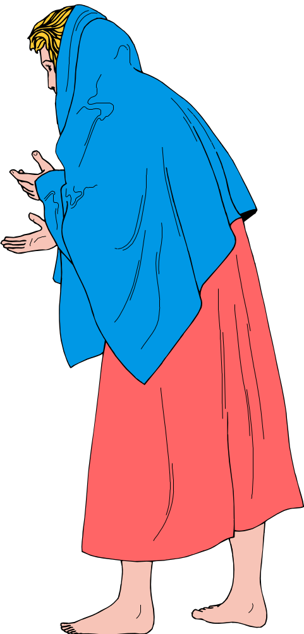
LOT’S WIFE
(Genesis 19:15-26)

Slide 6


Remember Lot’s Wife!
Lk. 17:32
Escape for your life!
Do not look back!
Escape to mountains!
Disregarded God’s Commands
Lacked Faith and Courage
Failed To Fully Obey God
Failed To Keep Eyes on the Goal
Suffered Results of Disobedience
Failed To Flee To Safety
Genesis 19:17, 26

Slide 7
LOT’S WIFE:
Evil Influence Overcomes Good
“Looked back” refers to longing look - desire
Despite all of the evil seen in Sodom, it had become home and she wanted to return
Evil relationship corrupt us (1 Cor. 15:33)
Familiarity with sin breeds acceptance of its practice (Psa. 1:1-2; Gal. 6:7)
Sure way to avoid evil (Prov. 4:14-15)

Slide 8
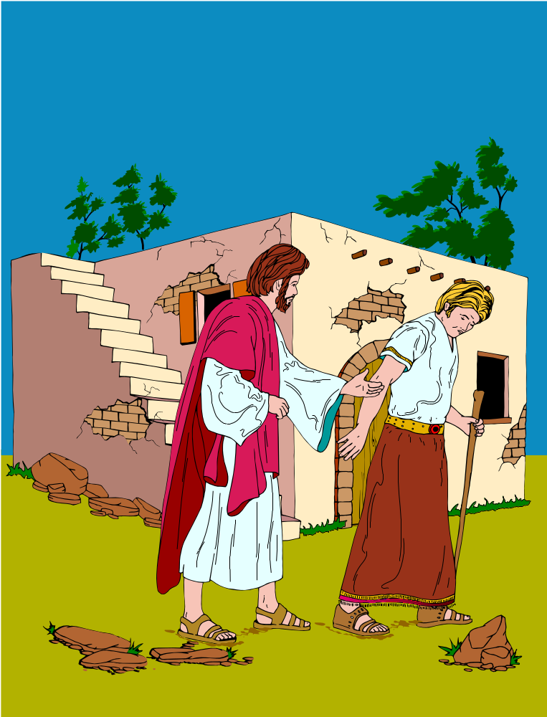
RICH RULER
(Lk. 18:18-23)

Slide 9
RICH RULER
(Lk. 18:18-23)
Many things to his credit physically:
Rich
Young
Power, Authority
Many things to his credit spiritually:
  Asked the right question.
  Recognized the authority of Jesus.
  Reverent
  Kept the Law from his youth.

Slide 10
RICH RULER:
Materialism Over Salvation
Rich ruler wanted salvation, but not enough
Not willing to put Lord above material things
Jesus requires the priority of spiritual service over all material concerns (Mt. 6:19-33;16:24)
Must follow example of Moses (Heb. 11:24f)
Reminder concerning wealth (1 Tim. 6:7-10)
Materialism: Bag without bottom (Hag. 1:4f)

Slide 11
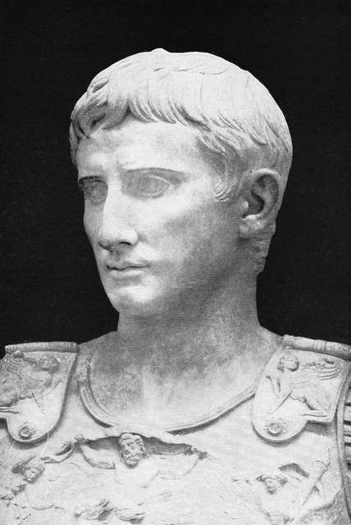
FELIX (Acts 24:24-27)

Slide 12
FELIX: Fearful, But Delaying
Felix was moved by first hearing of gospel.
But delay made his heart grow cold to truth.
We do not have any assurance of tomorrow. (Jms. 4:13-17)
Procrastination before obeying shows other things have priority with us. (Lk. 9:57-62)
If truth rejected as people close minds, not due to Bible’s lack of clarity. (Acts 28:23f)

Slide 13
Am I “Almost” or “Altogether” Persuaded To Obey Christ Now?
Has a knowledge of truth moved me to obey or do I remain unchanged as I reject gospel?
Has my love for the sinful world caused me to come close to salvation, but look back?
Has my pursuit of earthly things & concerns taken the priority over spiritual things?
Has delaying obedience until a convenient time caused my heart to be hardened?
Have relationships hindered me obeying?
Must count cost to see if I am ready for it...

Slide 14
Luke 14:25-33
“If any man cometh unto me, and hateth not his own father, and mother, and wife, and children, and brethren, and sisters, yea, and his own life also, he cannot be my disciple. Whosoever doth not bear his own cross, and come after me, cannot be my disciple. For which of you, desiring to build a tower, doth not first sit down and count the cost, whether he have (wherewith) to complete it? Lest haply, when he hath laid a foundation, and is not able to finish, all that behold begin to mock him, saying, This man began to build, and was not able to finish. Or what king, as he goeth to encounter another king in war, will not sit down first and take counsel whether he is able with ten thousand to meet him that cometh against him with twenty thousand? Or else, while the other is yet a great way off, he sendeth an ambassage, and asketh conditions of peace. So therefore whosoever he be of you that renounceth not all that he hath, he cannot be my disciple.”
ASV
“…first sit down and count the cost…”

Slide 15
Luke 14:25-33
“If any man cometh unto me, and hateth not his own father, and mother, and wife, and children, and brethren, and sisters, yea, and his own life also, he cannot be my disciple. Whosoever doth not bear his own cross, and come after me, cannot be my disciple. For which of you, desiring to build a tower, doth not first sit down and count the cost, whether he have wherewith to complete it? Lest haply, when he hath laid a foundation, and is not able to finish, all that behold begin to mock him, saying, This man began to build, and was not able to finish. Or what king, as he goeth to encounter another king in war, will not sit down first and take counsel whether he is able with ten thousand to meet him that cometh against him with twenty thousand? Or else, while the other is yet a great way off, he sendeth an ambassage, and asketh conditions of peace. So therefore whosoever he be of you that renounceth not all that he hath, he cannot be my disciple.”
Family
Hardship
Material Things
Everything

Slide 16
Costs To Be Counted
Following Christ may cost relationship with family
  Lk. 14:26 Compared to love of Christ, hate family
  Mt. 10:34-37 Serving Lord may bring family trouble
Following Christ will cost with hardships in life
  Mt. 16:24 Deny self, take up cross & follow Christ
  2 Tim. 3:12 All living godly will suffer persecution
Following Christ will cost our material things
  Mt. 19:16-22 Rich young ruler told to sell all & follow
  1 Tim. 6:17-19 Giving in service lays up eternal riches
Following Christ will cost time (Eph. 5:15-16)
Following Christ will cost whole self (Rom. 12:1f)
Must Serve God
With The Whole Heart!
Ps. 119

Slide 17
What Might It Cost Me?
Following Christ may cost you family relationships
  “My mother & father may be hurt or mad if I obey”
  “My family may reject me for putting Christ first”
Following Christ will cost you hardships in life
  “Living as a Christian will mean overcoming my lusts”
  “I will never be popular if I am strict in serving Christ”
Following Christ will cost you in material things
  “Giving to the Lord as I should will cost too much”
  “Does God really expect me to give for all these things”
Following Christ will cost you in time
  “Sunday morning, Sunday night & Wed. is too much”
  “You mean I must study, meditate & pray every day”
Yes, serving Christ will
affect your whole life!

Slide 18
Is Following Christ Worth The Cost To You?
Have You Considered
The Cost Of Not
Following Christ?

Slide 19


HEAVEN
A Real Place!
Unimaginable Joy!
Only The Faithful Few!
A Place of Eternal Bliss!
Obedient There!
No Desire To Escape!
Can Forfeit or Gain!
HELL
A Real Place!
A Place of Horror!
Many Will Go There!
Place Unending Torment!
Devil, evil, disobedient!
No Way of Escape!
A Place To Avoid!
Where Will You Spend Eternity?

