Slide 2

THE
CHURCH OF
THE BIBLE

Slide 3
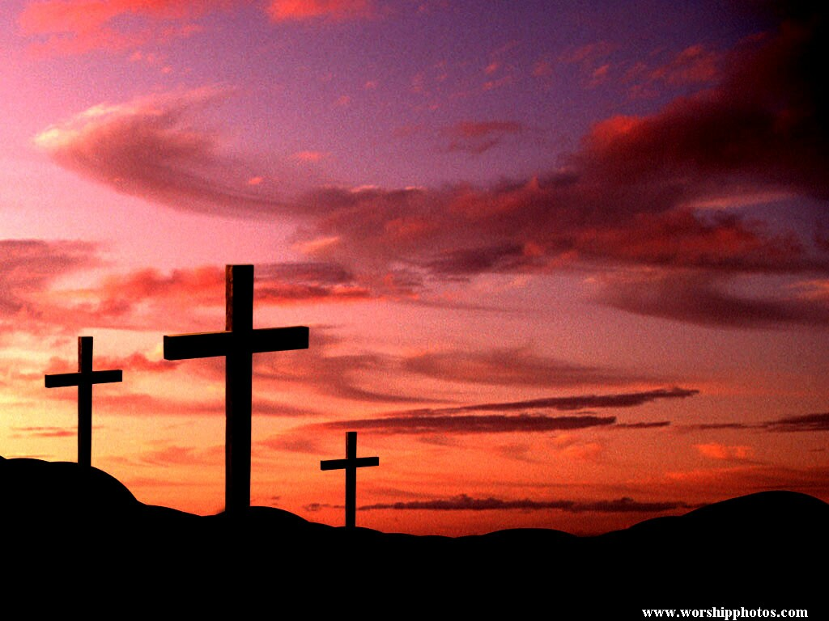
CHRIST MADE A PROMISE
BEFORE HE WAS CRUCIFIED
HE WOULD BUILD HIS CHURCH

Slide 4
THE CHURCH OF THE BIBLE
The Lord Questioned His Apostles
Matt. 16:15-16
“He said unto them, But whom say ye that I am? And Simon Peter answered and said, Thou art the Christ, the Son of the living God.”

Slide 5
THE CHURCH OF THE BIBLE
After Peter’s confession, Jesus stated His promise
Matt.16:18
“And I say also unto thee, That thou art Peter, and upon this rock I will build my church; and the gates of Hades shall not prevail against it.”
What is the church?

Slide 6
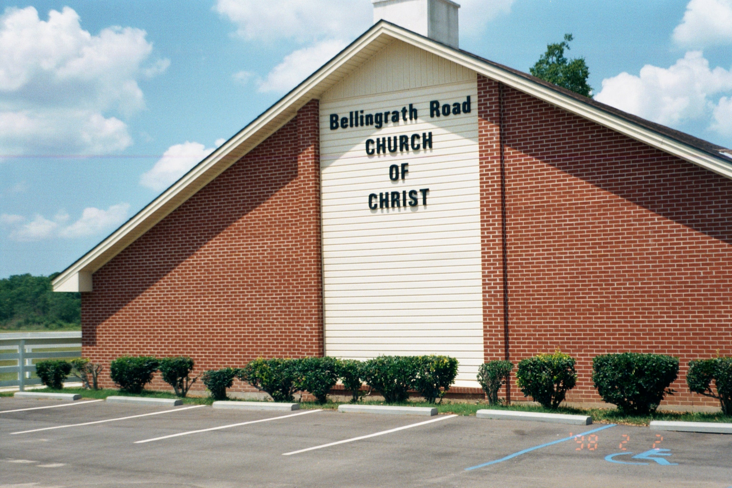
THE CHURCH OF THE BIBLE
IS THIS THE CHURCH?

Slide 7
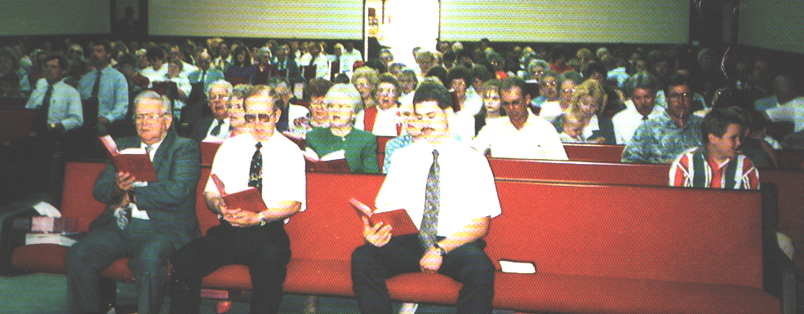
THE CHURCH OF THE BIBLE
What is the church?
Is this the church? Yes, the people!

Slide 8
THE CHURCH OF THE BIBLE
What did Jesus promise?
Matt.16:18
“And I say also unto thee, That thou art Peter, and upon this rock I will build my church; and the gates of Hades shall not prevail against it.”
HOW MANY DID HE PROMISE TO BUILD?

Slide 9
THE CHURCH OF THE BIBLE
HOW MANY DID HE PROMISE TO BUILD?
Jesus said, “My Church.”
How many is this?
ONE!

Slide 10
THE CHURCH OF THE BIBLE
HOW MANY DID HE PROMISE TO BUILD?
Jesus said, “My Church.”
How many is this?
Col. 1:18 “And He is the head of
the body, the church...”
Eph. 4:4 “There is one body...”

Slide 11
THE CHURCH OF THE BIBLE
Eph. 1:22-23
“And hath put all things under His feet, and gave Him to be the head over all things to the church, which is His body, the fullness of Him that fills all in all.”
If Jesus Had more than 1 body,
would He be normal?

Slide 12
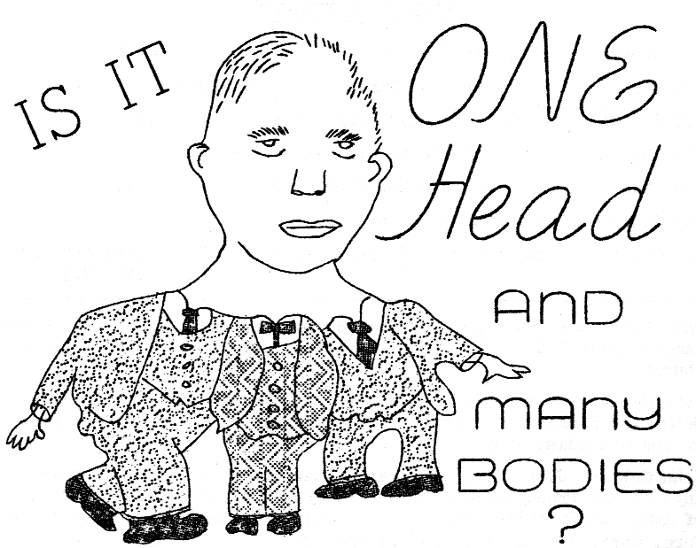
Man’s concept of Christ & His church

Slide 13
THE CHURCH OF THE BIBLE
God Gave the identifying marks of His church.
Isaiah 2:2
“And it shall come to pass in the last days, that the mountain of the Lord's house shall be established in the top of the mountains...”

Slide 14
THE CHURCH OF THE BIBLE
Identifying Marks
WHAT? The “Lord’s House - Isa. 2:2
I Tim. 3:15
“But if I tarry long, that thou may know how thou ought to behave thyself in the house of God, which is the church of the living God, the pillar and ground of the truth.”

Slide 15
THE CHURCH OF THE BIBLE
Identifying Marks
WHEN? “Last days” – Isa. 2:2
Dan. 2:44
“And in the days of these kings shall the God of heaven set up a kingdom, which shall never be destroyed...”
Acts 2:1ff Church was established

Slide 16
THE CHURCH OF THE BIBLE
Identifying Marks
WHERE? – Zion - Jerusalem
Isa. 2:3
“And many people shall go and say, Come ye, and let us go up to the mountain of the LORD to the house of the God of Jacob; and he will teach us of his ways, and we will walk in his paths: for out of Zion shall go forth the law, and the word of the LORD from Jerusalem.”

Slide 17
THE CHURCH OF THE BIBLE
Identifying Marks
WHO? Christ Said, “I will build”
Matt.16:18
“And I say also unto thee, That thou art Peter, and upon this rock I will build my church; and the gates of Hades shall not prevail against it.”

Slide 18
THE CHURCH OF THE BIBLE
Identifying Marks
HOW? Purchase with blood
Acts 20:28
“Take heed unto yourselves, and to all the flock, in which the Holy Spirit hath made you bishops, to feed the church of the Lord which He purchased with his own blood.”

Slide 19
THE CHURCH OF THE BIBLE
Identifying Marks
HOW? Purchase with blood
Acts 20:28
“Take heed unto yourselves, and to all the flock, in which the Holy Spirit hath made you bishops, to feed the church of the Lord which He purchased with his own blood.”

Slide 20
THE CHURCH OF THE BIBLE
What have we found?
1. Church is the house of God
2. It was est. in 33 AD – Acts 2
3. It was est. in Jerusalem (Zion)
4. Christ was the builder – not man
5. Christ purchased it with His blood
6. The Lord built ONLY ONE!

Slide 21
THE CHURCH OF THE BIBLE
Establishment of the church is:
Supported by God’s word, the Bible
Supported by historical records
If people were as concerned with their souls as they are everything else,
they would be willing to search for the right church!

Slide 22
THE CHURCH OF THE BIBLE
What does one do to become a member?
Hear-----Romans 10:17
Believe--Hebrews 11:6
Repent--------Luke 13:3
Confess---Acts 8:36-37
Be baptized--Acts 2:47
Acts 2:47 “Praising God and having favor with all the people. And the Lord added to the church daily those who were being saved.”

Slide 23
THE CHURCH OF THE BIBLE
The Lord established only one.
Man has established thousands.
Which one do you want to be a member of, on judgment day?

Slide 24
THE CHURCH OF THE BIBLE
You have to make the decision!
The decision you make will determine the eternal destiny of your soul.
God wants all to be saved!

Slide 25
THE CHURCH OF THE BIBLE
You have to make the decision!
I Corinthians 15:24
“Then cometh the end, when he shall have delivered up the kingdom to God, even the Father; when he shall have put down all rule and all authority and power.”
One MUST be in the church or kingdom
To be delivered up to the Father.

