Slide 2
WHAT ARE WE AUTHORIZED TO CELEBRATE OR COMMENORATE?

Slide 3

What are we authorized to do?
Many have celebrated Easter today.
Sunrise service
Is this what God
Instituted

Slide 4
What are we authorized to do?
Where did Easter come from?
Acts 12:4
“And when he had apprehended him, he put him in prison, and delivered him to four quaternions of soldiers to keep him; intending after Easter to bring him forth to the people.” (KJV)

Slide 5
What are we authorized to do?
Where did Easter come from?
Acts 12:4
“And when he had taken him, he put him prison, and delivered him to four quarternions of soldiers to guard him; intending after the Passover to bring him forth to the people.” (ASV)
(NKJV), (NIV), (RSV), (NASV), (NRSV)

Slide 6
What are we authorized to do?
What do we find from this?
The same Greek word is translated PASSOVER 28 times in the New Testament (KJV)
It is translated EASTER one time with no justification for so doing
“Easter” came from man – not God!

Slide 7
What are we authorized to do?
Albert Barnes – A great Bible scholar, wrote on Acts 12:4.
“There never was a more absurd or unhappy translation than this. The original is simply after the Passover.”
“The word “Easter” now denotes the festival observed by many Christian churches in honor of the resurrection of the Saviour.”

Slide 8
What are we authorized to do?
Albert Barnes – A great Bible scholar, wrote in Acts 12:4.
“But the original has no reference to that, nor is there the slightest evidence that any such festival was observed at the time when this book was written.”
“The translation is not only unhappy, as it does not convey at all the meaning of the original, but because it may contribute to foster an opinion that such a festival was observed in the time of the apostles.”

Slide 9
What are we authorized to do?
Jesus did established a memorial
Matthew 26:26-27
“And as they were eating, Jesus took bread, and blessed it, and brake it, and gave it to the disciples, and said, Take, eat; this is my body. And he took the cup, and gave thanks, and gave it to them, saying, Drink ye all of it;”

Slide 10
What are we authorized to do?
I. Jesus did established a memorial
Matthew 26:28-29
“For this is my blood of the new testament, which is shed for many for the remission of sins. But I say unto you, I will not drink henceforth of this fruit of the vine, until that day when I drink it new with you in my Father's kingdom.”

Slide 11
What are we authorized to do?
Jesus did established a memorial
I Corinthians 11:24
“And when he had given thanks, he brake it, and said, Take, eat: this is my body, which is broken for you: this do in remembrance of me.”

Slide 12
What are we authorized to do?
Jesus did established a memorial
I Corinthians 11:25
After the same manner also he took the cup, when he had supped, saying, This cup is the new testament in my blood: this do ye, as oft as ye drink it, in remembrance of me.

Slide 13
What are we authorized to do?
II. What is the Lord’s Supper?
It is a memorial that Christ instituted
A great monument among others
Brazen serpent - Num. 21:8-9
Rainbow - Gen. 7:13
A memorial is to enable one to remember.

Slide 14
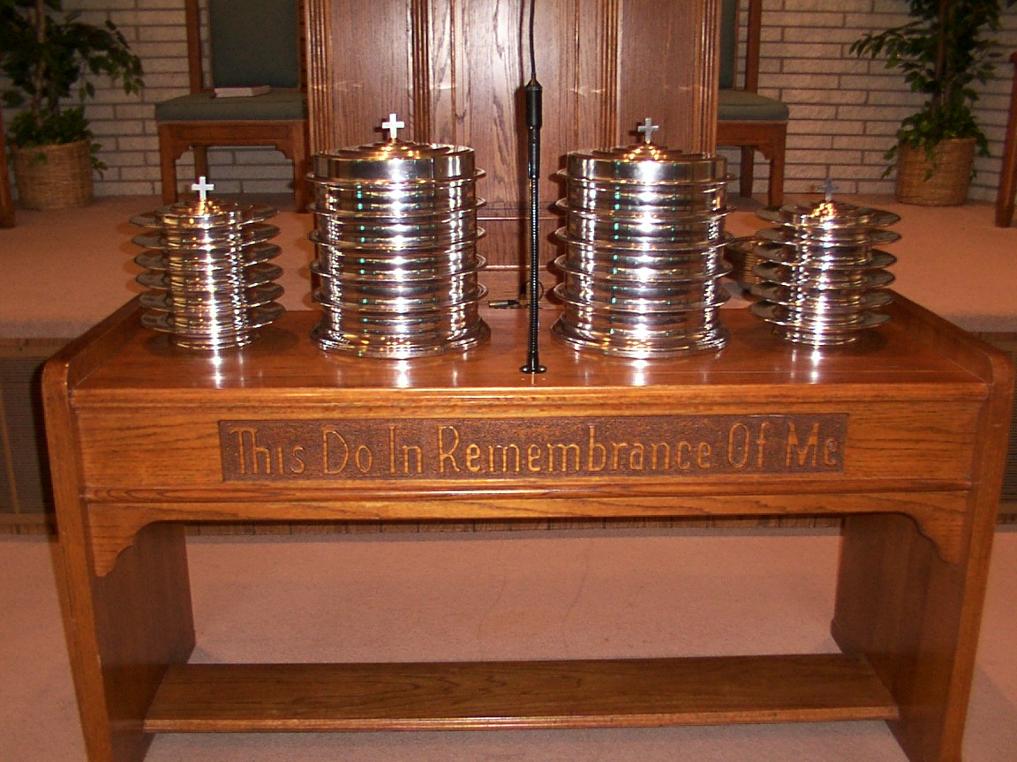
The Lord’s Supper is a . . .
1. MEMORIAL
2. COMMUNION
3. PROCLAMATION

Slide 15
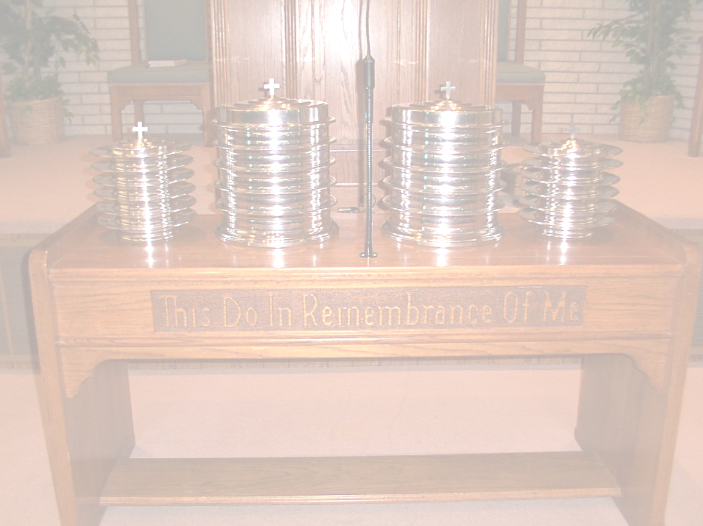
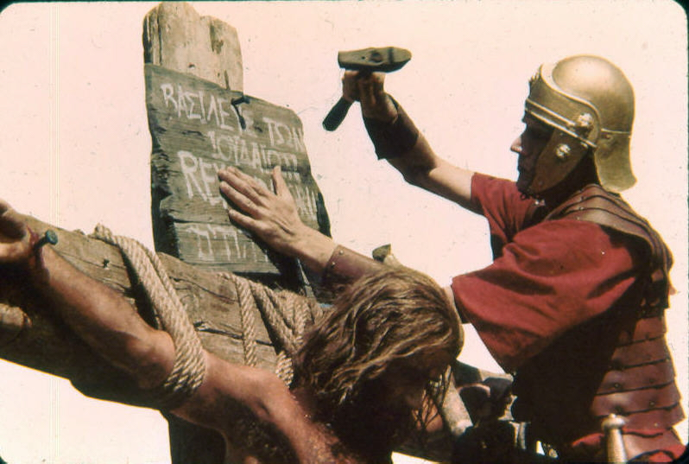
The Lord’s Supper is …
An announcement,
a publication,
a declaration
^{1 Corinthians 11:26}
²⁶ For as often as ye eat this bread, and drink this cup, ye do shew the Lord’s death till he come.
“proclaim” = NKJV, NASV

Slide 16
What are we authorized to do?
II. What is the Lord’s Supper?
The Passover was a memorial
Exodus 12:14
“And this day shall be unto you for a memorial; and ye shall keep it a feast to the LORD throughout your generations; ye shall keep it a feast by an ordinance for ever.”

Slide 17
What are we authorized to do?
II. What is the Lord’s Supper?
The Passover was a memorial
God spared the first born Israelite
By the lamb’s blood on the door.
Passover lamb was a type of Christ
Christ is our Passover Lamb
By His blood we escape eternal death

Slide 18
What are we authorized to do?
III. What is used in Lord’s Supper?
Unleavened bread -Symbolic of body
Exodus 12:19
“Seven days shall there be no leaven found in your houses: for whosoever eateth that which is leavened, even that soul shall be cut off from the congregation of Israel, whether he be a stranger, or born in the land.”

Slide 19
What are we authorized to do?
III. What is used in Lord’s Supper?
Fruit of the vine - Symbolic of blood
Matthew 26:29
Jesus called it: “…fruit of the vine…”
This refers to Grape Juice
Acts 15:29 commanded to abstain from blood - therefore we know it was juice.

Slide 20
What are we authorized to do?
IV. Manner of observance of Lord’s Supper
I Corinthians 11:27
“Wherefore whosoever shall eat this bread, and drink this cup of the Lord, unworthily, shall be guilty of the body and blood of the Lord.”

Slide 21
What are we authorized to do?
IV. Manner of observance of Lord’s Supper
To eat the break or drink the fruit of the vine UNWORTHILY is in general to come to the Lord’s table in a CARELESS IRREVERENT SPIRIT without the intention or desire to commemorate the death of Christ.

Slide 22
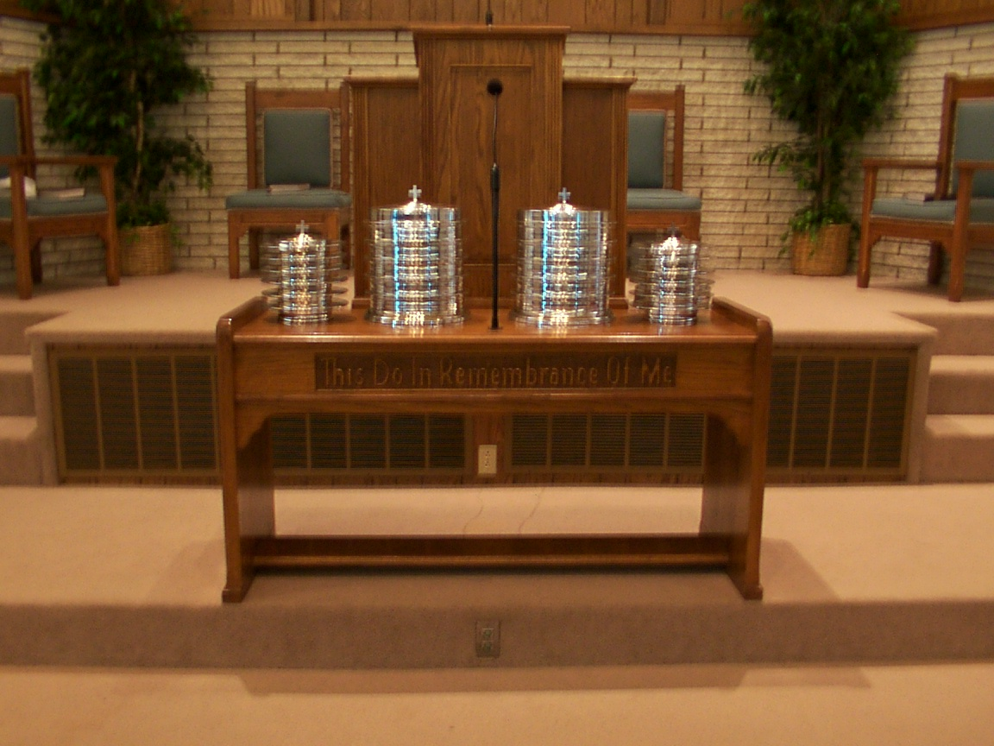
When a Christian deliberately forsakes the Lord’s Supper he is saying, ‘My faith and hope is in the world, not in Christ.’

Slide 23
What are we authorized to do?
IV. Manner of observance of Lord’s Supper
To neglect is to show disrespect for Christ & His sacrifice of Himself.
It is one of the avenues by which we worship God.
When properly partaken by the faithful Christian, it is a great source of spiritual nourishment.

Slide 24
What are we authorized to do?
What about Easter?
Man has no authorization from God to celebrate Christ’s Resurrection or Easter in the worship unto God!
What one does in worship unto God, must be authorized by God.
The Lord’s Supper is to enable Christians to remember Christ’s death

Slide 25
What are we authorized to do?
God Gave some warnings for mankind
Deuteronomy 4:2
“Ye shall not add unto the word which I command you, neither shall ye diminish ought from it, that ye may keep the commandments of the LORD your God which I command you.”

Slide 26
What are we authorized to do?
God Gave some warnings for mankind
Revelation 22:18
“For I testify unto every man that heareth the words of the prophecy of this book, If any man shall add unto these things, God shall add unto him the plagues that are written in this book:

Slide 27
What are we authorized to do?
God Gave some warnings for mankind
Revelation 22:19
“And if any man shall take away from the words of the book of this prophecy, God shall take away his part out of the book of life, and out of the holy city, and from the things which are written in this book.”

Slide 28


The Lord’s Supper … a Proclamation
A sermon on God’s love, grace, and salvation, that every Christian can preach every week!

Slide 29
What are we authorized to do?
God has commanded all to obey gospel
Hear – Rom. 10:17
Believe – Heb. 11:6
Repent – Luke 13:3
Confess – Acts 8:36-37
Be Baptized – Acts 2:38, 47
Remain Faithful – Rev. 2:10

