Slide 1


Slide 2
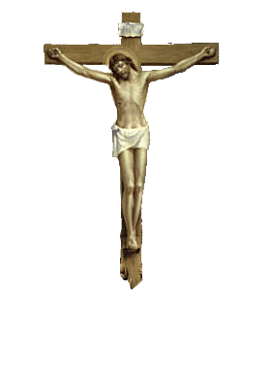
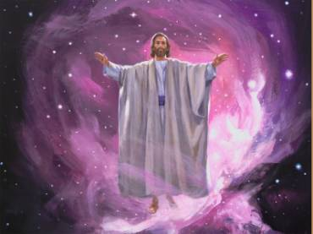
Should we not have something to sing about, In a joyful way?

Slide 3
The Joy Of Singing
Psalm 142:1-2 “Praise ye the LORD. Praise the LORD, O my soul. While I live will I praise the LORD: I will sing praises unto my God while I have any being.”

Slide 4
The Joy Of Singing
Singing is one avenue of our worship
It also has a place in our private devotions to God.
No one can sing for you!
Many Christians sing with virtually no emotions.
Some do not sing at all!

Slide 5
The Joy Of Singing
Why do such conditions exist?
I suspect it may be a failure to appreciate:
The true purpose of singing
How we can get more out of singing
Our singing should be a JOY!

Slide 6
The Joy Of Singing
The Purpose Of Singing
First, to praise God
Acts 16:25
“And at midnight Paul and Silas prayed, and sang praises unto God: and the prisoners heard them.”

Slide 7
The Joy Of Singing
The Purpose Of Singing
The most popular concept of the purpose of singing is praising God.
Word “Hymn” = “a song in praise of”
Praising God should be “a natural” for Christians!

Slide 8
The Joy Of Singing
The Purpose Of Singing
Psalm 28:6-7
“Blessed be the LORD, because he hath heard the voice of my supplications. The LORD is my strength and my shield; my heart trusted in him, and I am helped: therefore my heart greatly rejoiceth; and with my song will I praise him.”

Slide 9
The Joy Of Singing
The Purpose Of Singing
Singing is one of the “spiritual sacrifices” that we offer to God.
Heb. 13:15
“By him therefore let us offer the sacrifice of praise to God continually, that is, the fruit of our lips giving thanks to his name.”

Slide 10
The Joy Of Singing
The Purpose Of Singing
If not careful, we might be guilty of offering “defiled” service to God.
Mal. 1:7 “Ye offer polluted bread upon mine altar; and ye say, Wherein have we polluted thee? In that ye say, The table of the LORD is contemptible. (13) “Ye said also, Behold, what a weariness is it! and ye have snuffed at it…”

Slide 11
The Joy Of Singing
The Purpose Of Singing
Second, to teach & admonish
Col.3:16
“Let the word of Christ dwell in you richly in all wisdom; teaching and admonishing one another in psalms and hymns and spiritual songs, singing with grace in your hearts to the Lord.”

Slide 12
The Joy Of Singing
The Purpose Of Singing
Second, to teach & admonish
Many songs are directed to God.
Some are directed to each other
Teaching & admonishing us to live properly & be encouraged.

Slide 13
The Joy Of Singing
II. Getting More Out Of Our singing
We must engage the “mind” in singing
Remember: to teach & admonish
Therefore, we must understand what we sing.
Be careful not to just like the music without caring about the words.

Slide 14
The Joy Of Singing
II. Getting More Out Of Our singing
We must engage the “heart” in singing
Col. 3:16 “…singing with grace in your hearts to the Lord.”
Eph. 5:19 “…singing and making melody in your heart to the Lord;”
We must involve emotions when singing

Slide 15
The Joy Of Singing
III. Questions To Evaluate Our Singing
Is our singing limited to the assemblies?
Paul & Silas felt need to Pray & Sing
Acts 16:25
“And at midnight Paul and Silas prayed, and sang praises unto God: and the prisoners heard them.”

Slide 16
The Joy Of Singing
III. Questions To Evaluate Our Singing
Is our singing limited to the assemblies?
Paul & Silas felt need to Pray & Sing
Acts 16:25
“And at midnight Paul and Silas prayed, and sang praises unto God: and the prisoners heard them.”

Slide 17
The Joy Of Singing
III. Questions To Evaluate Our Singing
Do we understand what we sing?
Again, singing must involve the mind.
One cannot teach what he does not understand.

Slide 18
The Joy Of Singing
III. Questions To Evaluate Our singing
Do we stress musical harmony to the detriment of N. T. singing?
God stresses making melody in our hearts over making harmony with our voices.
Certainly it should be the desire of all to do both, if possible.

Slide 19
The Joy Of Singing
III. Questions To Evaluate Our singing
Do we hinder our singing by where we sit?
Sitting alone or spread out naturally discourages us from singing as we could.
A first step to better singing is to sit with those who love to sing.

Slide 20
The Joy Of Singing
Have we lost the joy of singing?
If we could see ourselves as the song leaders do, we might have to say, YES.
Remember we must seek to improve in every avenue of our worship!

Slide 21
The Joy Of Singing
May David’s attitude, a man after God’s own heart, describe our own.
Psalm 104:33
“I will sing unto the LORD as long as I live: I will sing praise to my God while I have my being.”

Slide 22
The Joy Of Singing
May David’s attitude, a man after God’s own heart, describe our own.
Psalm 147:1
“Praise ye the LORD: for it is good to sing praises unto our God; for it is pleasant; and praise is beautiful”

Slide 23
The Joy Of Singing
The heart that has been redeemed by the blood of the Lamb, has something to sing about!
Obedience is a must in order to be redeemed!
ALL HAVE A CHOICE!

Slide 24
The Joy Of Singing

