Slide 1
Looking at Data - Distributions
Displaying Distributions with Graphs
IPS Chapter 1.1
© 2009 W.H. Freeman and Company

Slide 2
Objectives (IPS Chapter 1.1)
Displaying distributions with graphs
Variables
Types of variables
Graphs for categorical variables
  Bar graphs
  Pie charts
Graphs for quantitative variables
  Histograms
  Stemplots
  Stemplots versus histograms
Interpreting histograms
Time plots

Slide 3
Variables
In a study, we collect information—data—from individuals. Individuals can be people, animals, plants, or any object of interest.
A variable is any characteristic of an individual. A variable varies among individuals.
  Example: age, height, blood pressure, ethnicity, leaf length, first language
The distribution of a variable tells us what values the variable takes and how often it takes these values.

Slide 4
Two types of variables
Variables can be either quantitative…
  Something that takes numerical values for which arithmetic operations, such as adding and averaging, make sense.
  Example: How tall you are, your age, your blood cholesterol level, the number of credit cards you own.
… or categorical.
  Something that falls into one of several categories. What can be counted is the count or proportion of individuals in each category.
  Example: Your blood type (A, B, AB, O), your hair color, your ethnicity, whether you paid income tax last tax year or not.

Slide 5
How do you know if a variable is categorical or quantitative?
Ask:
What are the n individuals/units in the sample (of size “n”)?
What is being recorded about those n individuals/units?
Is that a number (→ quantitative) or a statement (→ categorical)?
Categorical
Each individual is assigned to one of several categories.
Quantitative
Each individual is attributed a numerical value.
Individuals in sample | DIAGNOSIS | AGE AT DEATH
Patient A | Heart disease | 56
Patient B | Stroke | 70
Patient C | Stroke | 75
Patient D | Lung cancer | 60
Patient E | Heart disease | 80
Patient F | Accident | 73
Patient G | Diabetes | 69

Slide 6
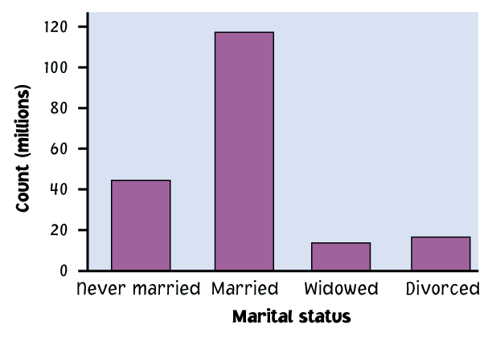
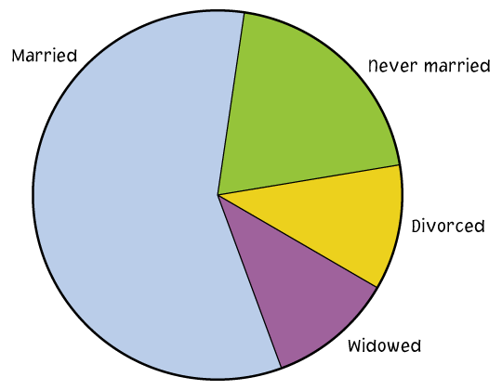
Ways to chart categorical data
Because the variable is categorical, the data in the graph can be ordered any way we want (alphabetical, by increasing value, by year, by personal preference, etc.)
  Bar graphs
  Each category is
  represented by
  a bar.
  Pie charts
  The slices must
  represent the parts of one whole.

Slide 7
Example: Top 10 causes of death in the United States 2001
Rank | Causes of death | Counts | % of top 10s | % of total deaths
1 | Heart disease | 700,142 | 37% | 29%
2 | Cancer | 553,768 | 29% | 23%
3 | Cerebrovascular | 163,538 | 9% | 7%
4 | Chronic respiratory | 123,013 | 6% | 5%
5 | Accidents | 101,537 | 5% | 4%
6 | Diabetes mellitus | 71,372 | 4% | 3%
7 | Flu and pneumonia | 62,034 | 3% | 3%
8 | Alzheimer’s disease | 53,852 | 3% | 2%
9 | Kidney disorders | 39,480 | 2% | 2%
10 | Septicemia | 32,238 | 2% | 1%
 | All other causes | 629,967 |  | 26%
For each individual who died in the United States in 2001, we record what was the cause of death. The table above is a summary of that information.

Slide 8
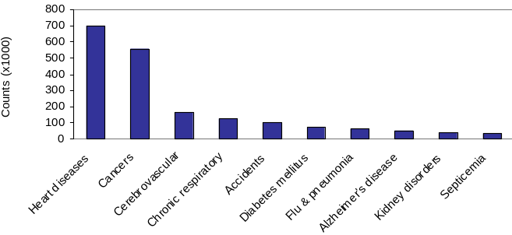
Bar graphs
Each category is represented by one bar. The bar’s height shows the count (or sometimes the percentage) for that particular category.
Top 10 causes of deaths in the United States 2001
The number of individuals who died of an accident in 2001 is approximately 100,000.

Slide 9
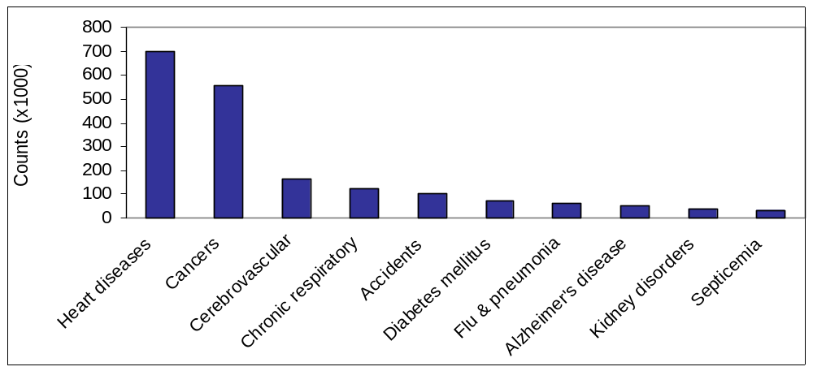
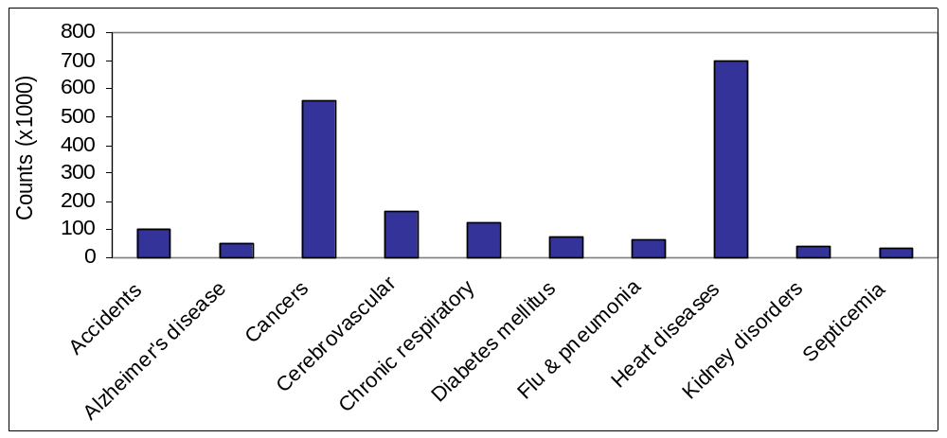
Top 10 causes of deaths in the United States 2001
Bar graph sorted by rank
→ Easy to analyze
Sorted alphabetically
→ Much less useful

Slide 10
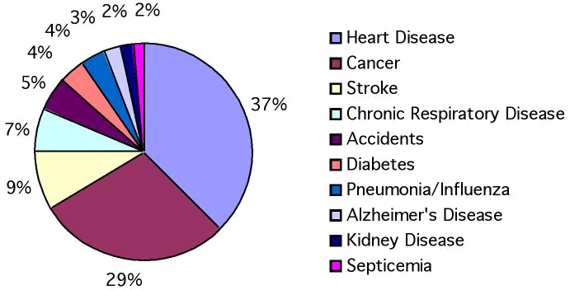
Pie charts
Each slice represents a piece of one whole. The size of a slice depends on what
percent of the whole this category represents.
Percent of people dying from
top 10 causes of death in the United States in 2000
Notes:
Another way to graphically illustrate the same categorical data is using a Pie Chart.
Here is listed in order, and can see relative proportions as pieces of pie.
Notice here that we have changed from the numbers of people dying to the percent of people dying
To make a pie chart, typically use percentages, and they have to add up to one, or you won’t have the whole pie.
?

Slide 11
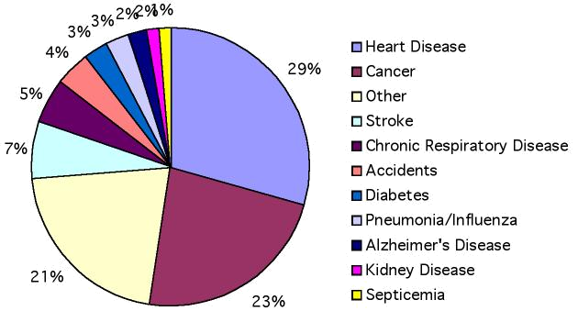
Make sure your
labels match
the data.
Make sure
all percents
add up to 100.
Percent of deaths from top 10 causes
Percent of
deaths from
all causes
Notes:
The top pie chart is the one we have just been looking at.
In the bottom one I have added deaths from all other causes - 21% in addition to the top 10.
Adding this additional category changes the percentages on the original 10, so, for instance
Heart disease was 37% of total before, now is a smaller percent, 29%, because we are looking at
All deaths.

Slide 12
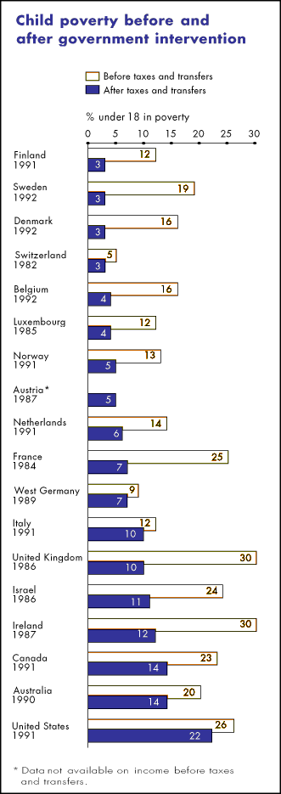
Child poverty before and after government intervention—UNICEF, 1996
What does this chart tell you?
  The United States has the highest rate of child poverty among developed nations (22% of under 18).
  Its government does the least—through taxes and subsidies—to remedy the problem (size of orange bars and percent difference between orange/blue bars).
Could you transform this bar graph to fit in 1 pie chart? In two pie charts? Why?
The poverty line is defined as 50% of national median income.

Slide 13
Ways to chart quantitative data
Histograms and stemplots
  These are summary graphs for a single variable. They are very useful to understand the pattern of variability in the data.
Line graphs: time plots
  Use when there is a meaningful sequence, like time. The line connecting the points helps emphasize any change over time.

Slide 14
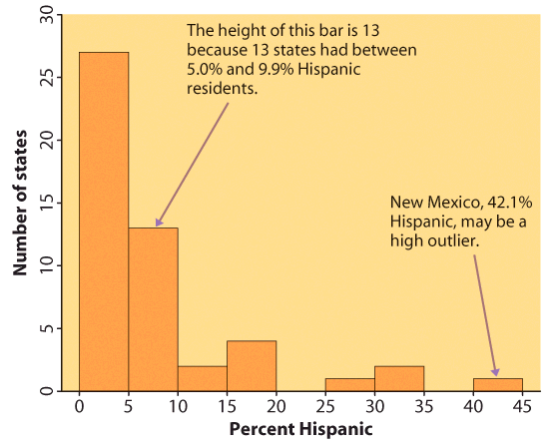
Histograms
The range of values that a variable can take is divided into equal size intervals.
The histogram shows the number of individual data points that fall in each interval.
The first column represents all states with a Hispanic percent in their population between 0% and 4.99%. The height of the column shows how many states (27) have a percent in this range.
The last column represents all states with a Hispanic percent in their population between 40% and 44.99%. There is only one such state: New Mexico, at 42.1% Hispanics.

Slide 15
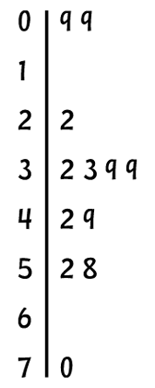
Stem plots
How to make a stemplot:
Separate each observation into a stem, consisting of all but the final (rightmost) digit, and a leaf, which is that remaining final digit. Stems may have as many digits as needed, but each leaf contains only a single digit.
Write the stems in a vertical column with the smallest value at the top, and draw a vertical line at the right of this column.
Write each leaf in the row to the right of its stem, in increasing order out from the stem.
STEM
LEAVES

Slide 16
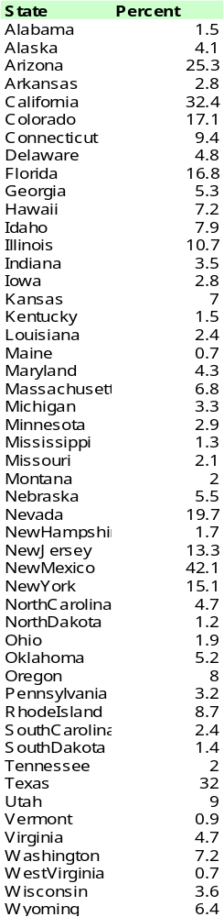
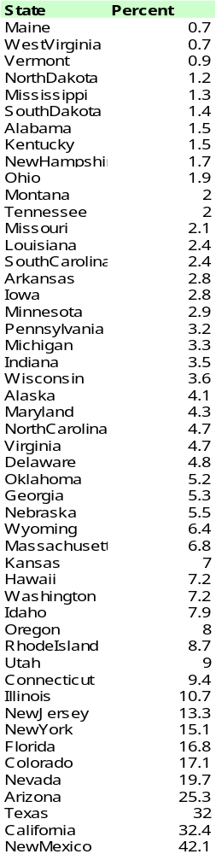
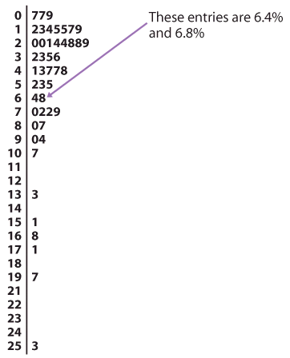
Percent of Hispanic residents in each of the 50 states
Step 1:
Sort the data
Step 2:
Assign the values to stems and leaves

Slide 17
Stem Plot
To compare two related distributions, a back-to-back stem plot with common stems is useful.
Stem plots do not work well for large datasets.
When the observed values have too many digits, trim the numbers before making a stem plot.
When plotting a moderate number of observations, you can split each stem.

Slide 18
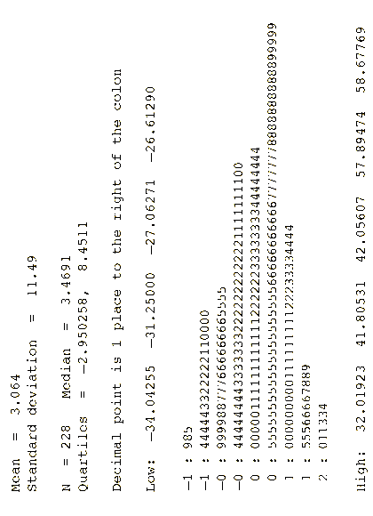
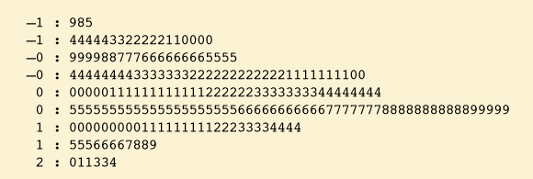
Stemplots versus histograms
Stemplots are quick and dirty histograms that can easily be done by hand, and therefore are very convenient for back of the envelope calculations. However, they are rarely found in scientific or laymen publications.

Slide 19
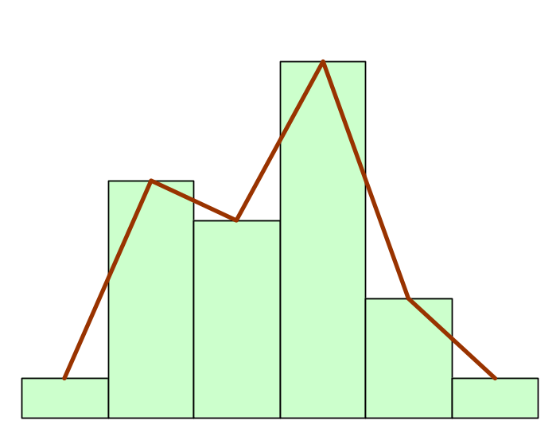
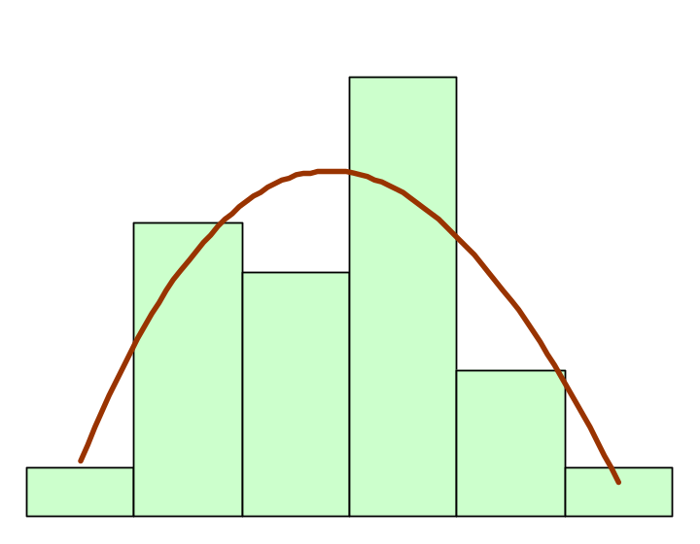
Interpreting histograms
When describing the distribution of a quantitative variable, we look for the overall pattern and for striking deviations from that pattern. We can describe the overall pattern of a histogram by its shape, center, and spread.
Histogram with a line connecting each column → too detailed
Histogram with a smoothed curve highlighting the overall pattern of the distribution

Slide 20
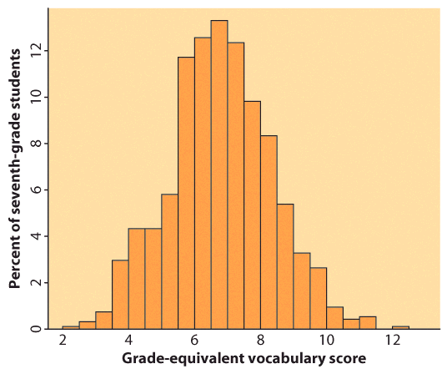
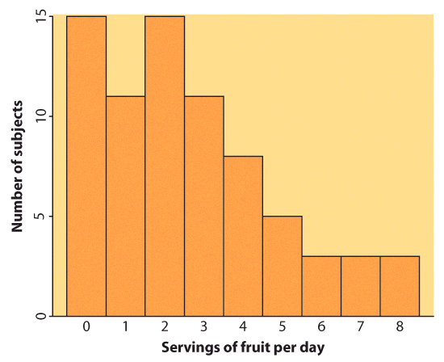
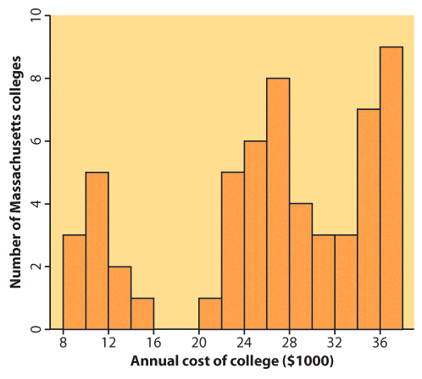
Most common distribution shapes
Symmetric distribution
A distribution is symmetric if the right and left sides of the histogram are approximately mirror images of each other.
A distribution is skewed to the right if the right side of the histogram (side with larger values) extends much farther out than the left side. It is skewed to the left if the left side of the histogram extends much farther out than the right side.
Skewed distribution
Complex, multimodal distribution
Not all distributions have a simple overall shape, especially when there are few observations.

Slide 21
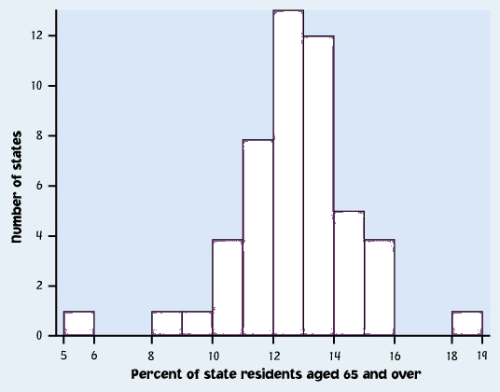
Outliers
An important kind of deviation is an outlier. Outliers are observations that lie outside the overall pattern of a distribution. Always look for outliers and try to explain them.
The overall pattern is fairly symmetrical except for 2 states that clearly do not belong to the main trend. Alaska and Florida have unusual representation of the elderly in their population.
A large gap in the distribution is typically a sign of an outlier.
Alaska
Florida
Notes:
This is from the book. Imagine you are doing a study of health care in the 50 US states, and need to know how they differ in terms of their elderly population.
This is a histogram of the number of states grouped by the percentage of their residents that are 65 or over.
You can see there is one very small number and one very large number, with a gap between them and the rest of the distribution.
Values that fall outside of the overall pattern are called outliers. They might be interesting, they might be mistakes - I get those in my data from typos in entering RNA sequence data into the computer.
They might only indicate that you need more samples. Will be paying a lot of attention to them throughout class both for what we can learn about biology and also because they can cause trouble with your statistics.
Guess which states they are (florida and alaska).

Slide 22
How to create a histogram
It is an iterative process – try and try again.
What bin size should you use?
Not too many bins with either 0 or 1 counts
Not overly summarized that you loose all the information
Not so detailed that it is no longer summary
➔ rule of thumb: start with 5 to 10 bins
Look at the distribution and refine your bins
(There isn’t a unique or “perfect” solution)

Slide 23
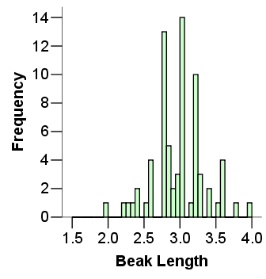
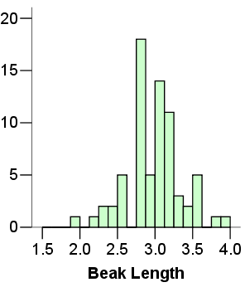

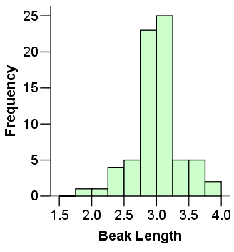
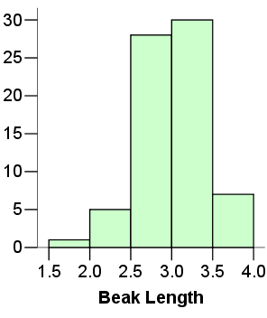
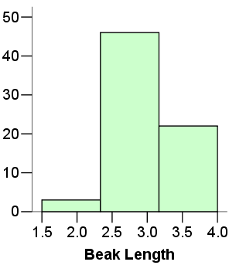
Same data set
Not summarized enough
Too summarized

Slide 24
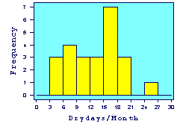
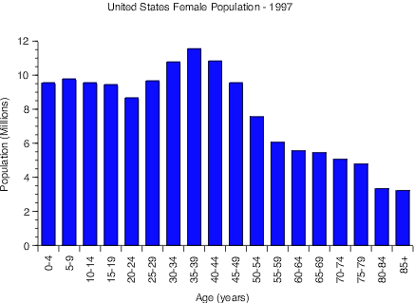
IMPORTANT NOTE:
Your data are the way they are. Do not try to force them into a particular shape.
Histogram of Drydays in 1995
It is a common misconception that if you have a large enough data set, the data will eventually turn out nice and symmetrical.

Slide 25
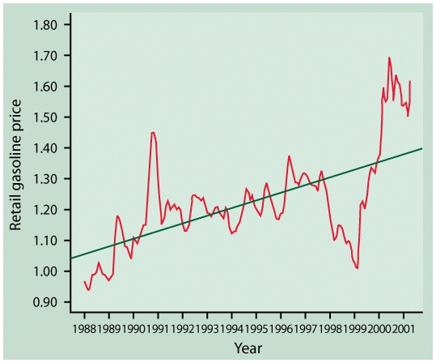
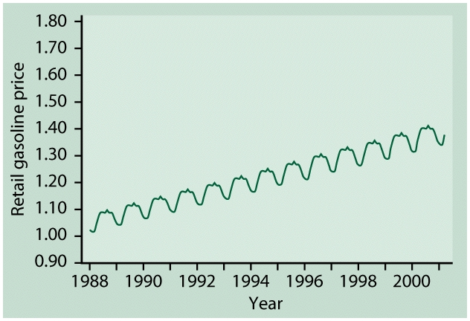
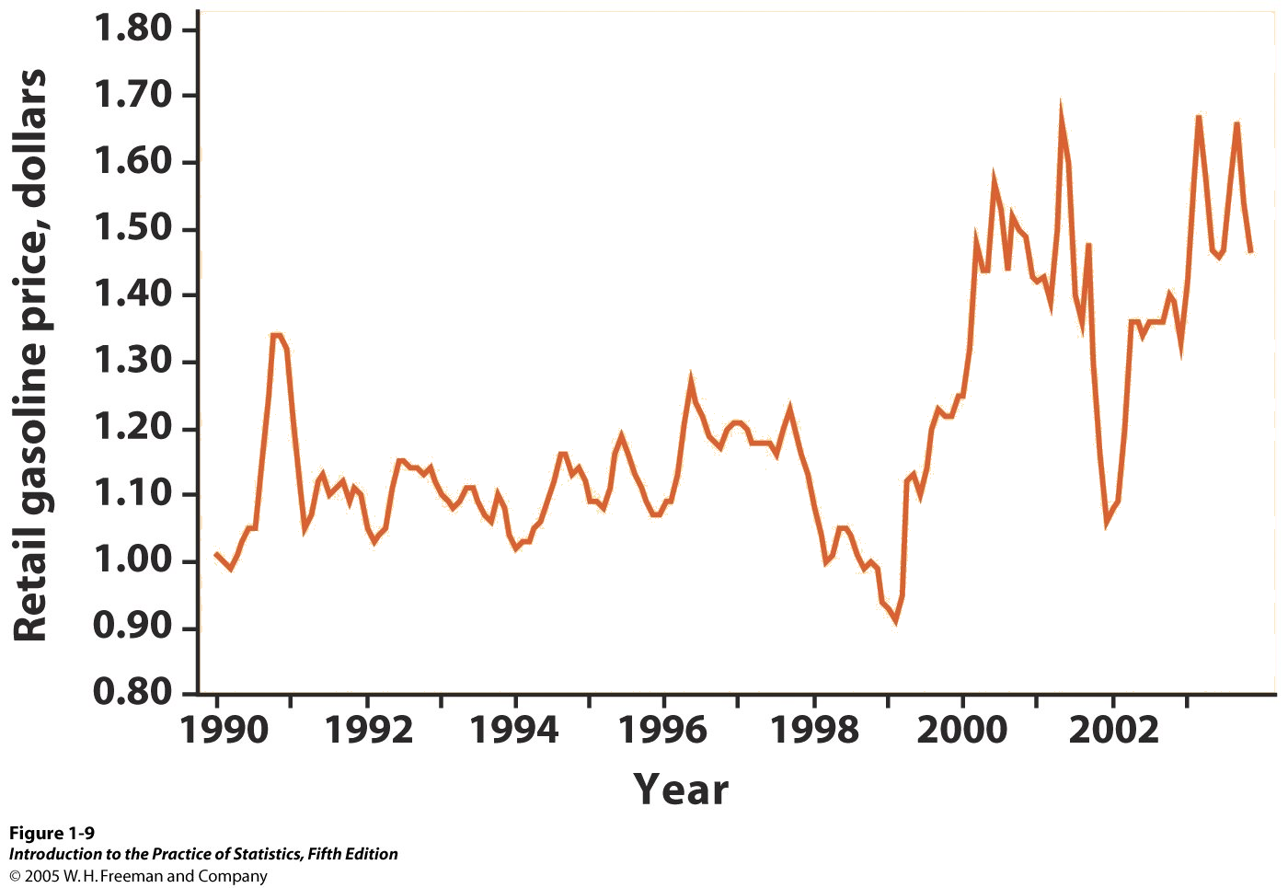
Line graphs: time plots
In a time plot, time always goes on the horizontal, x axis.
We describe time series by looking for an overall pattern and for striking deviations from that pattern. In a time series:
A trend is a rise or fall that persists over time, despite small irregularities.
A pattern that repeats itself at regular intervals of time is called seasonal variation.

Slide 26
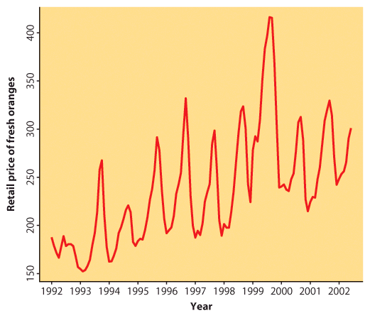

Retail price of fresh oranges over time
Time is on the horizontal, x axis.
The variable of interest—here “retail price of fresh oranges”— goes on the vertical, y axis.
This time plot shows a regular pattern of yearly variations. These are seasonal variations in fresh orange pricing most likely due to similar seasonal variations in the production of fresh oranges.
There is also an overall upward trend in pricing over time. It could simply be reflecting inflation trends or a more fundamental change in this industry.

Slide 27
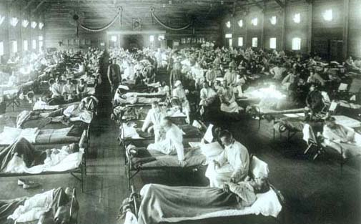
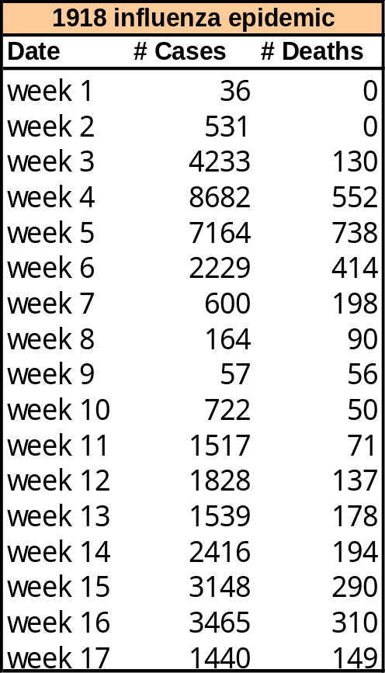
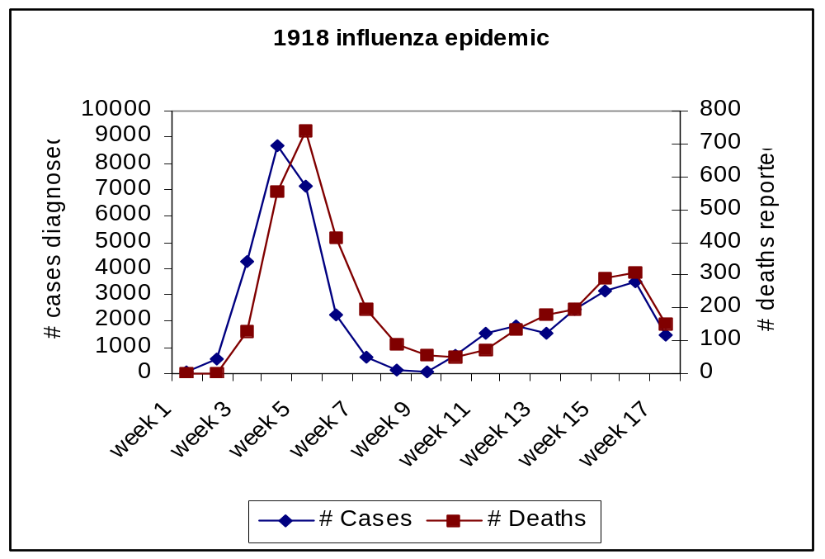
A time plot can be used to compare two or more data sets covering the same time period.
The pattern over time for the number of flu diagnoses closely resembles that for the number of deaths from the flu, indicating that about 8% to 10% of the people diagnosed that year died shortly afterward, from complications of the flu.

Slide 28
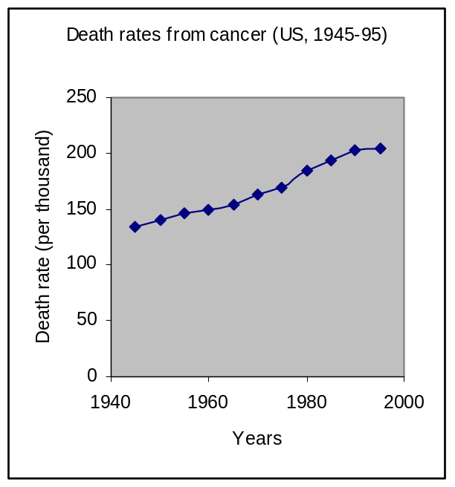
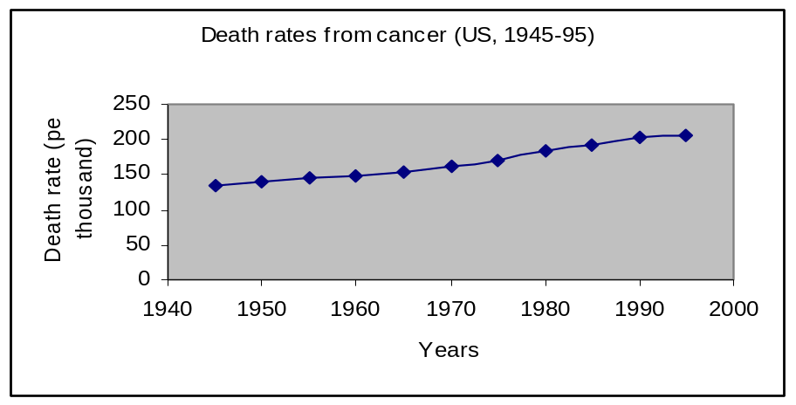
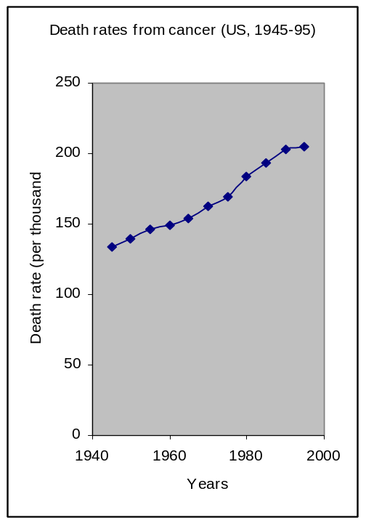
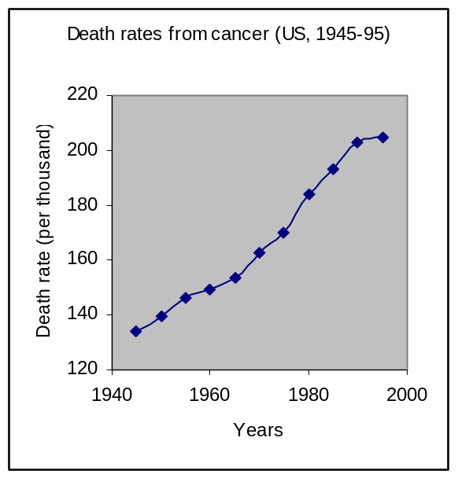
Scales matter
How you stretch the axes and choose your scales can give a different impression.
A picture is worth a thousand words,
BUT
There is nothing like hard numbers.
→ Look at the scales.

Slide 29
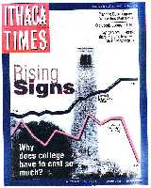
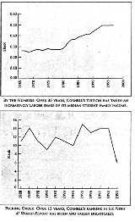
Why does it matter?
What's wrong with
these graphs?
Careful reading
reveals that:
1. The ranking graph covers an 11-year period, the tuition graph 35 years, yet they are shown comparatively on the cover and without a horizontal time scale.
2. Ranking and tuition have very different units, yet both graphs are placed on the same page without a vertical axis to show the units.
3. The impression of a recent sharp “drop” in the ranking graph actually shows that Cornell’s rank has IMPROVED from 15th to 6th ...
Cornell’s tuition over time
Cornell’s ranking over time

Slide 30
Looking at Data - Distributions
Describing distributions with numbers
IPS Chapter 1.2
© 2009 W.H. Freeman and Company

Slide 31
Objectives (IPS Chapter 1.2)
Describing distributions with numbers
Measures of center: mean, median
Mean versus median
Measures of spread: quartiles, standard deviation
Five-number summary and boxplot
Choosing among summary statistics
Changing the unit of measurement

Slide 32
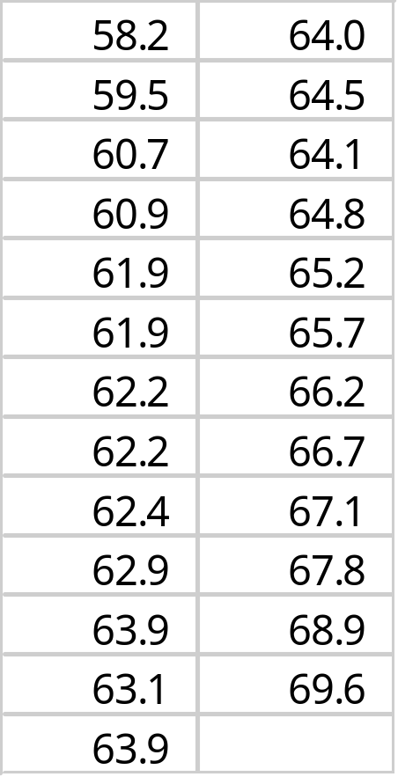
Measure of center: the mean
The mean or arithmetic average
To calculate the average, or mean, add all values, then divide by the number of individuals. It is the “center of mass.”
Sum of heights is 1598.3
divided by 25 women = 63.9 inches
Notes:
Most of you know what a mean, or common arithmetic average is.
You should know how to calculate the mean both by hand and using your calculator. See Dr. Baldi.

Slide 33
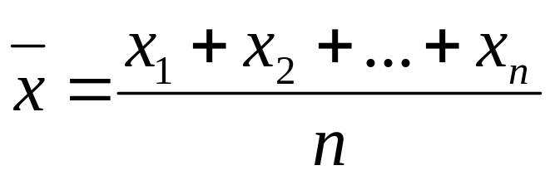
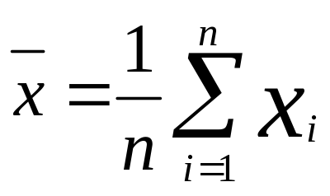
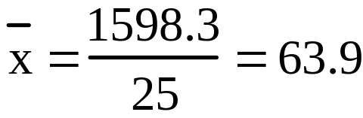
Mathematical notation:
w
o
ma
n
h
ei
gh
t
w
o
ma
n
h
ei
gh
t
(
i
)
(
x
)
(
i
)
(
x
)
i
=
1
x
1
=
5
8
.
2
i
=
14
x
14
=
6
4
.
0
i
=
2
x
2
=
5
9
.
5
i
=
15
x
15
=
6
4
.
5
i
=
3
x
3
=
6
0
.
7
i
=
16
x
16
=
6
4
.
1
i
=
4
x
4
=
6
0
.
9
i
=
17
x
17
=
6
4
.
8
i
=
5
x
5
=
6
1
.
9
i
=
18
x
18
=
6
5
.
2
i
=
6
x
6
=
6
1
.
9
i
=
19
x
19
=
6
5
.
7
i
=
7
x
7
=
6
2
.
2
i
=
20
x
20
=
6
6
.
2
i
=
8
x
8
=
6
2
.
2
i
=
21
x
21
=
6
6
.
7
i
=
9
x
9
=
6
2
.
4
i
=
22
x
22
=
6
7
.
1
i
=
10
x
10
=
6
2
.
9
i
=
23
x
23
=
6
7
.
8
i
=
11
x
11
=
6
3
.
9
i
=
24
x
24
=
6
8
.
9
i
=
12
x
12
=
6
3
.
1
i
=
25
x
25
=
6
9
.
6
n
=
Σ
=
1
5
9
8
.
3
i
=
13
x
13
=
6
3
.
9
2
5
Learn right away how to get the mean using your calculators.
Notes:
There is some standard math notation for referring to the mean and the numbers used to calculate it.
We number the individuals using the letter I, here I goes from 1 to 25.
The total number is n, or 25
We refer to the variable height, associated with each individual, using x. Doesn’t have to be I or x, but usually is. I will always make it clear to you what is what, as in column headings here.
The x’s get numbered to match the individual.
The mean, x BAR, is the sum of the individual heights, or the x sub I’s, divided by the total
Number of individuals n.
A shorthand way to write the same equation is below, where the summation symbol means to sum the x values, or heights, as I goes from 1 to n.
Mean height is about 5’4”

Slide 34
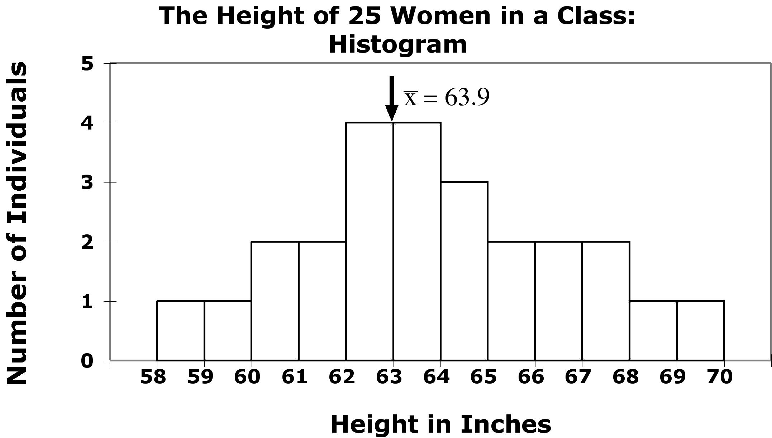

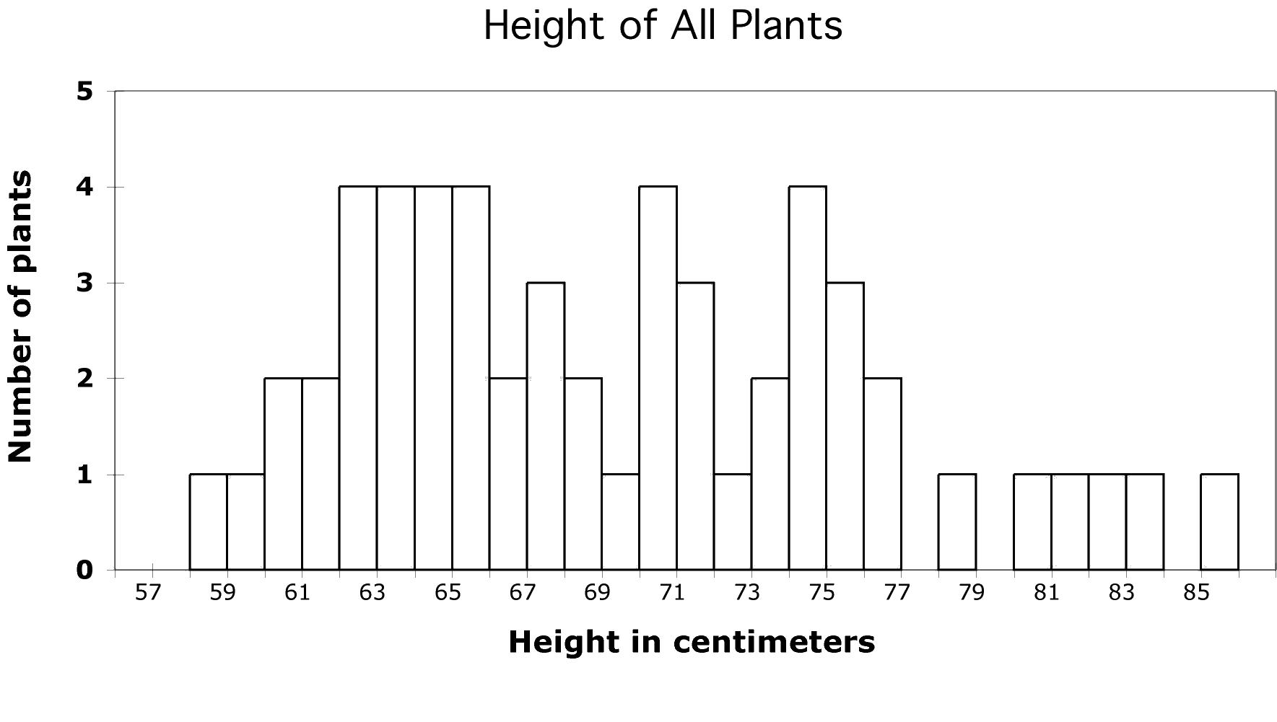

Your numerical summary must be meaningful.
Height of 25 women in a class
  The distribution of women’s heights appears coherent and symmetrical. The mean is a good numerical summary.
  Here the shape of the distribution is wildly irregular. Why?
  Could we have more than one plant species or phenotype?
Notes:
While we are looking at a number of histograms at once, and talking about means, here is another example of how you might use histograms and descriptive statistics like means to find out something of biological interest.
You are interested in studying what pollinators visit a particular species of plant. Let’s say that there has been an increase in agriculture in the area with all the pesticide spraying that comes along with that. If insects are needed to pollinate the plant, and the pesticides kill the insects, the plant species may go extinct.
Here is the mean of this distribution., but is it a good description of th center? Why would we care? Maybe plant height is a measure of plant age, and we wonder how well the population is holding up. - here you see there are not very many little plants, which might make you worry that there has been insufficient pollination.
One of the things you have noticed about the plants is that the flower color varies. Pollinators are attracted to flower color, so you happen to have the plants divided up into three groups - red pink and white flowers. Typically hummingbirds pollinate red flowers and moths pollinate white flowers. Which makes you start to wonder about your sample. So group them by flower color and get means for each group.

Slide 35

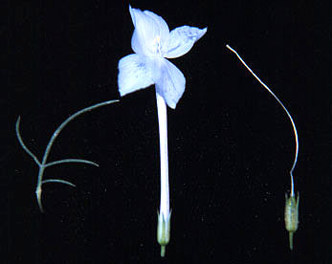

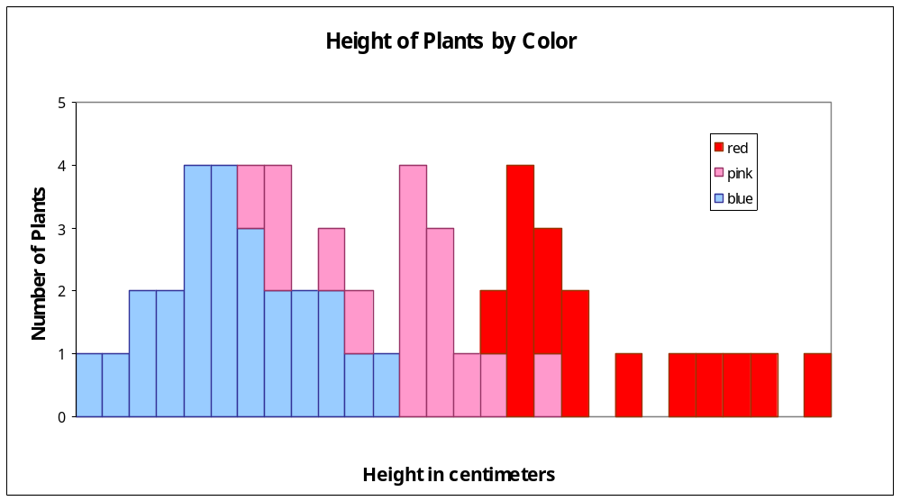



58 60 62 64 66 68 70 72 74 76 78 80 82 84
A single numerical summary here would not make sense.
Notes:
Here you see part of the reason for that broad lumpy distribution. The plants with different flower colors also have different
Size distributions. What you may be looking at here are two species - big ones with red and little one with white flowers, and their hybrids, which are
Intermediate in both size and color.
By adding extra information, here, grouping based on another categorical variable, histograms you might get insights you would never have gotten otherwise.
So that is the mean - a simple statistic used to describe the center of a distribution. Didn’t look like we had a center before, once we realize we have separate samples here they do in fact appear more as centers.

Slide 36
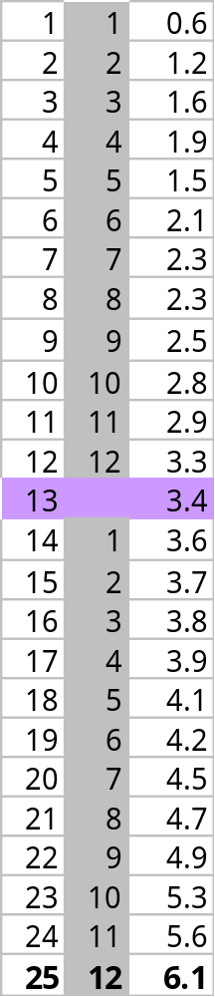

Measure of center: the median
The median is the midpoint of a distribution—the number such that half of the observations are smaller and half are larger.
1. Sort observations by size.
n = number of observations
______________________________
2.a. If n is odd, the median is observation (n+1)/2 down the list
⬅ n = 25
(n+1)/2 = 26/2 = 13
Median = 3.4
2.b. If n is even, the median is the
mean of the two middle observations.
n = 24 ➔
n/2 = 12
Median = (3.3+3.4) /2 = 3.35

Slide 37


Comparing the mean and the median
The mean and the median are the same only if the distribution is symmetrical. The median is a measure of center that is resistant to skew and outliers. The mean is not.
Mean and median for a symmetric distribution
Mean
Median
Mean and median for skewed distributions
Left skew
Mean
Median
Right skew
Mean
Median

Slide 38



Mean and median of a distribution with outliers
Without the outliers
Percent of people dying
With the outliers
The mean is pulled to the right a lot by the outliers
(from 3.4 to 4.2).
The median, on the other hand, is only slightly pulled to the right by the outliers (from 3.4 to 3.6).
Notes:
Here is the same data set with some outliers - some lucky people who managed to live longer than the others.
The few large values moved the mean up from 3.5 to 4.0
However, the median , the number of years it takes for half the people to die only went from 3.4 to 3.6
This is typical behavior for the mean and median. The mean is sensitive to outliers, because when you add all the values up to get the mean the outliers are weighted disproportionately by their large size.
However, when you get the median, they are just another two points to count - the fact that their size is so large does not matter much.

Slide 39




Impact of skewed data
Symmetric distribution…
Disease X:
Mean and median are the same.
… and a right-skewed distribution
Multiple myeloma:
The mean is pulled toward the skew.
Notes:
It is maybe easier to see that by comparing the two distributions we just looked at that show time to death after diagnosis.
For both disease X and MM you have on average 3 years to live. Does that mean you don’t care which one you get?
Well, of the 25 people getting disease X, only 1 died in the first year after diagnosis. Of the ones getting MM, 7 did.
So if you get X, according to what we see here only 1/25 or about 4 percent of people don’t make it through year one.
But if you get MM, well, if 1 in 7 die in year one, it means you have an almost 30% chance of not making it even a year.
Now, you might be one of these very few who live a long time, but it is much more likely that it is time to get your will together
and hurry around to say goodbye to your loved ones.
Means are the same, medians are different, because of the shape of the distribution.
This is one of the major take-home messages from this class - you all thought you knew what an average meant, and you did,
But you should also realized that what the average is telling you is different depending on the distribution.
When the doctor diagnoses you with some disease, and people with that disease live on average for 3 years,
You say Doctor! Show me the distribution!
And as you go on in biology and you see charts like this in journal articles or even in the paper, you now know why they are showing them to you.
Statistical descriptors, like using the mean to describe the center, are only telling you so much.
To really understand what is going on you have to plot the data and look at the distribution for things like overall shape, symmetry, and the presence of outliers, and you have to understand the effect they have on things like the mean.
Now, the next obvious question for a biologist of course is why you see these different types of patterns.
The top is a normal distribution, represents lots of things in the natural world as we have seen in our women’s height and toucan bill examples.
The distribution on the bottom is very different, and when you see something like this it challenges researchers to understand it - why do such a large percentage of people die so quickly - is there one single thing that if we could figure it out would save a huge chunk of the people dying down here? Could they figure out what it is about either these people or their treatment that allowed them to live so long? Lots still not known but a big part of it is that this diagnosis, MM, does not have the word multiple in its name for no reason. When you get down to the level of the cells involved, lots of different ones - so is really a suite of diseases. So this diagnosis is like “cancer” in general - a term that covers a broad range of biological phenomena that you can study and pick apart and understand on the cell biology to epidemiological level using not your intuition, but statistics.
Now let’s move on from describing the center to describing the spread and symmetry, which are, again, really different for these two distributions.

Slide 40

Measure of spread: the quartiles
The first quartile, Q₁, is the value in the sample that has 25% of the data at or below it (⬄ it is the median of the lower half of the sorted data, excluding M).
The third quartile, Q₃, is the value in the sample that has 75% of the data at or below it (⬄ it is the median of the upper half of the sorted data, excluding M).
Q₁= first quartile = 2.2
M = median = 3.4
Q₃= third quartile = 4.35
Notes:
We are going to start out with a very general way to describe the spread that doesn’t matter whether it is symmetric or not - quartiles.
Just as the word suggests - quartiles is like quarters or quartets, it involves dividing up the distribution into 4 parts.
Now, to get the median, we divided it up into two parts. To get the quartiles we do the exact same thing to the two halves.
Use same rules as for median if you have even or odd number of observations.
Now, what an we do with these that helps us understand the biology of these diseases?

Slide 41


Five-number summary and boxplot
Largest = max = 6.1
BOXPLOT
Q₃= third quartile
= 4.35
M = median = 3.4
Q₁= first quartile
= 2.2
Five-number summary:
min Q₁ M Q₃ max
Smallest = min = 0.6
Notes:
Add in a one other thing we know - the spread - the largest and smallest values, and make a box plot.
Now, why would you want to make one of these?

Slide 42



Boxplots for skewed data
Comparing box plots for a normal
and a right-skewed distribution
Boxplots remain true to the data and depict clearly symmetry or skew.
Notes:
They are most useful for comparing two things.
Here we see immediately that they are different beasts.
Start at the bottom - you can die of either in the first year,
The first quarter of individuals die of disease X in 2 years, only takes 1 for MM
Medians, or point at which half are dead, are not too different - 3 1/2 vs 2 1/2
For both diseases 3/4 of people are dead by about 4.5 years.
Disease X kills everyone by year 6 while some people with MM hang on a long time.
Quite obvious that the distribution of variation around midpoint is symmetric for X and highly skewed towards larger values for MM.
That is actually quite a bit of information -

Slide 43
Suspected outliers
Outliers are troublesome data points, and it is important to be able to identify them.
One way to raise the flag for a suspected outlier is to compare the distance from the suspicious data point to the nearest quartile (Q₁ or Q₃). We then compare this distance to the interquartile range (distance between Q₁ and Q₃).
We call an observation a suspected outlier if it falls more than 1.5 times the size of the interquartile range (IQR) above the first quartile or below the third quartile. This is called the “1.5 * IQR rule for outliers.”
Notes:
Add in a one other thing we know - the spread - the largest and smallest values, and make a box plot.
Now, why would you want to make one of these?

Slide 44

8
Distance to Q₃
7.9 − 4.35 = 3.55
Q₃ = 4.35
Interquartile range
Q₃ – Q₁
4.35 − 2.2 = 2.15
Q₁ = 2.2
Individual #25 has a value of 7.9 years, which is 3.55 years above the third quartile. This is more than 3.225 years, 1.5 * IQR. Thus, individual #25 is a suspected outlier.
Notes:
Add in a one other thing we know - the spread - the largest and smallest values, and make a box plot.
Now, why would you want to make one of these?

Slide 45




Measure of spread: the standard deviation
The standard deviation “s” is used to describe the variation around the mean. Like the mean, it is not resistant to skew or outliers.
1. First calculate the variance s².
2. Then take the square root to get the standard deviation s.
Mean
± 1 s.d.
Notes:
Boxplots are used to show the spread around a median - can use no matter what the distribution, and is a good way to contrast variables having different distributions.
But if your distribution is symmetrical, you can use the mean as the center of your distribution, you can use a different (and more common) measure of spread around the mean - standard deviation.
The Standard Deviation measures spread by looking at how far the observations are from their mean.
Go through calc. This is women’s height data again, First, N is again the number of observations. From this we calculate the degrees of freedom, which is just n-1.
Come back to this in a second.
Take difference from mean, square it so all are positive, add them up. Then divide not by number of observations by by n-1 = df
Although variance is a useful measure of spread, it’s units are units squared.
So we like to take the square root and use that number, the SD, which has the same units as the mean.
Height squared is not intuitive.
Now, as to why dividing by n-1 instead of n. When we got the mean it was easy to imagine why we divided by N intuitively.
But actually, what we are doing even there is dividing by the number of independent pieces of information that go into the estimate of a parameter.
This number is called the degrees of freedom (df, and it is equal to the number of independent scores that go into the estimate minus the number of parameters estimated as intermediate steps in the estimation of the parameter itself. For example, if the variance, s2 , is to be estimated from a random sample of N independent scores, then the degrees of freedom is equal to the number of independent scores (N) minus the number of parameters estimated as intermediate steps (here, we have estimated the mean) and is therefore equal to N-1.
But why the term “degrees of freedom”?
When we calculate the s-square of a random sample, we must first calculate the mean of that sample and then compute the sum of the several squared deviations from that mean. While there will be n such squared deviations only (n - 1) of them are, in fact, free to assume any value whatsoever. This is because the final squared deviation from the mean must include the one value of X such that the sum of all the Xs divided by n will equal the obtained mean of the sample. All of the other (n - 1) squared deviations from the mean can, theoretically, have any values whatsoever. For these reasons, the statistic s-square is said to have only (n - 1) degrees of freedom.
I know this is hard to understand. I don’t expect you to understand it completely. But in a second I will come back to it to show you the effect of dividing by n-1 rather than n, and perhaps that will make is easier to accept.

Slide 46


Calculations …
Women height (inches)
Mean = 63.4
Sum of squared deviations from mean = 85.2
Degrees freedom (df) = (n − 1) = 13
s² = variance = 85.2/13 = 6.55 inches squared
s = standard deviation = √6.55 = 2.56 inches
We’ll never calculate these by hand, so make sure to know how to get the standard deviation using your calculator or software.

Slide 47
Properties of Standard Deviation
s measures spread about the mean and should be used only when the mean is the measure of center.
s = 0 only when all observations have the same value and there is no spread. Otherwise, s > 0.
s is not resistant to outliers.
s has the same units of measurement as the original observations.

Slide 48


Software output for summary statistics:
Excel - From Menu:
Tools/Data Analysis/
Descriptive Statistics
Give common statistics of your sample data.
Minitab

Slide 49

Choosing among summary statistics
Because the mean is not resistant to outliers or skew, use it to describe distributions that are fairly symmetrical and don’t have outliers.
→ Plot the mean and use the standard deviation for error bars.
Otherwise use the median in the five number summary which can be plotted as a boxplot.
Boxplot Mean ± SD

Slide 50
What should you use, when, and why?
$$$
Arithmetic mean or median?
Middletown is considering imposing an income tax on citizens. City hall wants a numerical summary of its citizens’ income to estimate the total tax base.
In a study of standard of living of typical families in Middletown, a sociologist makes a numerical summary of family income in that city.
  Mean: Although income is likely to be right-skewed, the city government wants to know about the total tax base.
  Median: The sociologist is interested in a “typical” family and wants to lessen the impact of extreme incomes.

Slide 51
Changing the unit of measurement
Variables can be recorded in different units of measurement. Most often, one measurement unit is a linear transformation of another measurement unit: x_{new} = a + bx.
  Temperatures can be expressed in degrees Fahrenheit or degrees Celsius.
  Temperature^{Fahrenheit} = 32 + (9/5)* Temperature^{Celsius} ➔ a + bx.
Linear transformations do not change the basic shape of a distribution (skew, symmetry, multimodal). But they do change the measures of center and spread:
  Multiplying each observation by a positive number b multiplies both measures of center (mean, median) and spread (IQR, s) by b.
  Adding the same number a (positive or negative) to each observation adds a to measures of center and to quartiles but it does not change measures of spread (IQR, s).

Slide 52
Looking at Data - Distributions
Density Curves and Normal Distributions
IPS Chapter 1.3
© 2009 W.H. Freeman and Company

Slide 53
Objectives (IPS Chapter 1.3)
Density curves and Normal distributions
Density curves
Measuring center and spread for density curves
Normal distributions
The 68-95-99.7 rule
Standardizing observations
Using the standard Normal Table
Inverse Normal calculations
Normal quantile plots

Slide 54


Density curves
A density curve is a mathematical model of a distribution.
The total area under the curve, by definition, is equal to 1, or 100%.
The area under the curve for a range of values is the proportion of all observations for that range.
Histogram of a sample with the smoothed, density curve describing theoretically the population.
Notes:
Here is our histogram. One woman in the first group, 2 in the second, etc.
This is a normal distribution - it has a single peak, is symmetric, does not have outliers, and when a curve is drawn to describe it, the curve takes on a particular shape.

Slide 55

Density curves come in any imaginable shape.
Some are well known mathematically and others aren’t.

Slide 56


Median and mean of a density curve
The median of a density curve is the equal-areas point: the point that divides the area under the curve in half.
The mean of a density curve is the balance point, at which the curve would balance if it were made of solid material.
The median and mean are the same for a symmetric density curve.
The mean of a skewed curve is pulled in the direction of the long tail.
Notes:
Here is our histogram. One woman in the first group, 2 in the second, etc.
This is a normal distribution - it has a single peak, is symmetric, does not have outliers, and when a curve is drawn to describe it, the curve takes on a particular shape.

Slide 57


Normal distributions
Normal – or Gaussian – distributions are a family of symmetrical, bell-shaped density curves defined by a mean μ (mu) and a standard deviation σ (sigma) : N(μ,σ).
x
x
e = 2.71828… The base of the natural logarithm
π = pi = 3.14159…
Notes:
Commonly called the bell curve - if were skiing down it you are going steeper and steeper, then starts to flatten out.
This is the equation - don’t have to know it - basically for every value x, gestation time, you can plug it in and get f(x), the value on the y axis.
What we have done here is to go from a histogram, which is just your few data points, to this curve, which is a representation of what values you would get for any possible value of x whether you have it in your data set or not.

Slide 58


A family of density curves
Here, means are the same (μ = 15) while standard deviations are different (σ = 2, 4, and 6).
Here, means are different
(μ = 10, 15, and 20) while standard deviations are the same (σ = 3)

Slide 59

The 68-95-99.7% Rule for Normal Distributions
About 68% of all observations are within 1 standard deviation
(σ) of the mean (μ).
About 95% of all observations are within 2 σ of the mean μ.
Almost all (99.7%) observations are within 3 σ of the mean.
Inflection point
mean µ = 64.5 standard deviation σ = 2.5
N(µ, σ) = N(64.5, 2.5)
Reminder: µ (mu) is the mean of the idealized curve, while x¯ is the mean of a sample.
s (sigma) is the standard deviation of the idealized curve, while s is the s.d. of a sample.
Notes:
Going to an example from the book on women’s heights, the mean here was 64.5, standard deviation 2.5 inches.
When we talk about the mean and standard deviation with respect to the curve instead of the actual sample, we use different notation.
Mu for mean, sigma for sd. If you consider the area under the curve to represent all of the individuals, then you can divide it into chunks to represent parts of the whole. Like if you divided it down the middle, half of the people are in each half. Here it is divided up into parts not through the middle but by lines that are 1, 2 or 3 standard deviations away from the mean. If you look at the center, pink part, it is the area 1 sd on either side of the mean. By definition for normal curves, this area is 68% of the total. So if you know the mean and sd, you also know that 68% of women are between 62 and 67 inches tall. Similarly for the areas defined by lines drawn 2 or 3 sd from the mean. We might want to know what percent of women are over 72 inches tall. That is 3 sd. We can see that 99.7 percent of women are less than 72 or greater than 57. Or that .3 percent of women are really tall or really short. Since the distribution is symmetric, we can divide by two to find the percent of women that are really tall: .15%
You need to be able to work problems like I just did - bunch in book. But what if you want to know something not defined by the sd? Like, what percentage of women are taller than 68 inches? Know that half are smaller than 64.5. And that half of this middle area, 34%, are smaller than 67 inches, so 50+34 = 84% are smaller than 67, or 16% are larger than 67 inches. But you want to know the proportion larger than 68 inches. You can look this up on a table, but first you have to do something called standardizing. The reason is that although all normal curves share the properties shown above, they differ by their mean and standard deviation. You would have to have a different table for every curve. When you standardize a normal distribution, you change it so the mean is 0 and the sd is 1. Any normal distribution can be standardized.

Slide 60




The standard Normal distribution
Because all Normal distributions share the same properties, we can standardize our data to transform any Normal curve N(μ,σ) into the standard Normal curve N(0,1).
N(64.5, 2.5)
N(0,1)
=>
Standardized height (no units)
For each x we calculate a new value, z (called a z-score).

Slide 61



Standardizing: calculating z-scores
A z-score measures the number of standard deviations that a data value x is from the mean μ.
When x is 1 standard deviation larger than the mean, then z = 1.
When x is 2 standard deviations larger than the mean, then z = 2.
When x is larger than the mean, z is positive.
When x is smaller than the mean, z is negative.
Notes:
We do this by standardizing the distributions - really all this is redefining them not changing the shape but the bottom axis so that instead of being N(mu, sigma) they are N(mean =0,sd=1), and the bottom axis is in terms of the SD rather than the Height.
You get this by calculating a value z for every point in x your data set. If you were to then draw the density curve for the z values you get a curve with a mean of 0 and a sd of 1. Once you have standardized, you can look up any value you want using a table. So, for instance, we knew that 68% of women were between 62 and 67 inches tall from knowing simple rules about 1,2,3 sd from mean. But if wanted to know the percentage of women that were less than 63 inches tall. Can’t just use those rules. need to standardize and go to table A - standard normal probabilities - on green card in book or in back. First standardize x to get z, the number of sd from the mean. It is 0.6 to the left (is negative). Look for -0.6 in left column (z), and then going across row, under .00 column (no more decimals on (-0.6) you find .2743. Twenty seven percent of women are shorter than 62 inches tall.

Slide 62

Ex. Women heights
N(µ, σ) = N(64.5, 2.5)
Women’s heights follow the N(64.5”,2.5”) distribution. What percent of women are shorter than 67 inches tall (that’s 5’6”)?
Area= ???
Area = ???
mean µ = 64.5"
standard deviation σ = 2.5"
x (height) = 67"
μ = 64.5” x = 67”
z = 0 z = 1
We calculate z, the standardized value of x:
Because of the 68-95-99.7 rule, we can conclude that the percent of women shorter than 67” should be, approximately, .68 + half of (1 - .68) = .84 or 84%.
Notes:
We do this by standardizing the distributions - really all this is redefining them not changing the shape but the bottom axis so that instead of being N(mu, sigma) they are N(0,1). we had a bunch of observations we called x - height of women, and they come from this distribution N(mu, sigma).
Percentage of women shorter than 67 is 50+half of 68=34, or 84%

Slide 63

Using the standard Normal table
Table A gives the area under the standard Normal curve to the left of any z value.
.0082 is the area under N(0,1) left of z = -2.40
0.0069 is the area under N(0,1) left of z = -2.46
.0080 is the area under N(0,1) left of z = -2.41
(…)
Notes:
We do this by standardizing the distributions - really all this is redefining them not changing the shape but the bottom axis so that instead of being N(mu, sigma) they are N(mean =0,sd=1), and the bottom axis is in terms of the SD rather than the Height.
You get this by calculating a value z for every point in x your data set. If you were to then draw the density curve for the z values you get a curve with a mean of 0 and a sd of 1. Once you have standardized, you can look up any value you want using a table. So, for instance, we knew that 68% of women were between 62 and 67 inches tall from knowing simple rules about 1,2,3 sd from mean. But if wanted to know the percentage of women that were less than 63 inches tall. Can’t just use those rules. need to standardize and go to table A - standard normal probabilities - on green card in book or in back. First standardize x to get z, the number of sd from the mean. It is 0.6 to the left (is negative). Look for -0.6 in left column (z), and then going across row, under .00 column (no more decimals on (-0.6) you find .2743. Twenty seven percent of women are shorter than 62 inches tall.

Slide 64

Percent of women shorter than 67”
For z = 1.00, the area under the standard Normal curve to the left of z is 0.8413.
N(µ, σ) = N(64.5”, 2.5”)
Area ≈ 0.84
Conclusion:
84.13% of women are shorter than 67”.
By subtraction, 1 - 0.8413, or 15.87% of women are taller than 67".
Area ≈ 0.16
μ = 64.5” x = 67”
z = 1

Slide 65



Tips on using Table A
Because the Normal distribution is symmetrical, there are 2 ways that you can calculate the area under the standard Normal curve to the right of a z value.
Area = 0.9901
Area = 0.0099
z = -2.33
area right of z = area left of -z
area right of z = 1 - area left of z

Slide 66

Tips on using Table A
To calculate the area between 2 z- values, first get the area under N(0,1) to the left for each z-value from Table A.
Then subtract the smaller area from the larger area.
A common mistake made by students is to subtract both z values. But the Normal curve is not uniform.
area between z₁ and z₂ =
area left of z₁ – area left of z₂
➔ The area under N(0,1) for a single value of z is zero.
(Try calculating the area to the left of z minus that same area!)

Slide 67

The National Collegiate Athletic Association (NCAA) requires Division I athletes to score at least 820 on the combined math and verbal SAT exam to compete in their first college year. The SAT scores of 2003 were approximately normal with mean 1026 and standard deviation 209.
What proportion of all students would be NCAA qualifiers (SAT ≥ 820)?
area right of 820 = total area - area left of 820
= 1 - 0.1611
≈ 84%
Note: The actual data may contain students who scored exactly 820 on the SAT. However, the proportion of scores exactly equal to 820 is 0 for a normal distribution is a consequence of the idealized smoothing of density curves.

Slide 68


The NCAA defines a “partial qualifier” eligible to practice and receive an athletic scholarship, but not to compete, with a combined SAT score of at least 720.
What proportion of all students who take the SAT would be partial qualifiers? That is, what proportion have scores between 720 and 820?
area between = area left of 820 - area left of 720
720 and 820 = 0.1611 - 0.0721
≈ 9%
About 9% of all students who take the SAT have scores between 720 and 820.

Slide 69


The cool thing about working with normally distributed data is that we can manipulate it, and then find answers to questions that involve comparing seemingly non-comparable distributions.
We do this by “standardizing” the data. All this involves is changing the scale so that the mean now = 0 and the standard deviation =1. If you do this to different distributions it makes them comparable.
N(0,1)
Notes:
We do this by standardizing the distributions - really all this is redefining them not changing the shape but the bottom axis so that instead of being N(mu, sigma) they are N(mean =0,sd=1), and the bottom axis is in terms of the SD rather than the Height.
You get this by calculating a value z for every point in x your data set. If you were to then draw the density curve for the z values you get a curve with a mean of 0 and a sd of 1. Once you have standardized, you can look up any value you want using a table. So, for instance, we knew that 68% of women were between 62 and 67 inches tall from knowing simple rules about 1,2,3 sd from mean. But if wanted to know the percentage of women that were less than 63 inches tall. Can’t just use those rules. need to standardize and go to table A - standard normal probabilities - on green card in book or in back. First standardize x to get z, the number of sd from the mean. It is 0.6 to the left (is negative). Look for -0.6 in left column (z), and then going across row, under .00 column (no more decimals on (-0.6) you find .2743. Twenty seven percent of women are shorter than 62 inches tall.

Slide 70

Ex. Gestation time in malnourished mothers
What is the effect of better maternal care on gestation time and preemies?
The goal is to obtain pregnancies 240 days (8 months) or longer.
What improvement did we get by adding better food?
266
σ 15
250
σ 20
Notes:
Now, this will become more apparent later on in the class, but the cool thing about standardizing is that it allows you to compare across different scales.
Remember we started out the day using gestation time as an example. Women who are malnourished risk have premature babies, and studies are being done to see whether different diet and vitamin supplements work better. Let’s say the goal is to get them to carry the baby at least 240 days (8 months). For treatment 1, say vitamins only, get normal distribution with mean 250, sd is 20.
Treatment 2 is vitamins plus a meals on wheels program. Mean is 266, sd 15 . The mean is increased, but the spread has changed too. You can eyeball this and see that more of the women in treatment two are above our goal of 240 days, but how much of an improvement is it?

Slide 71


Under each treatment, what percent of mothers failed to carry their babies at least 240 days?
Vitamins Only
μ=250, σ=20,
x=240
Vitamins only: 30.85% of women would be expected to have gestation times shorter than 240 days.
Notes:
Remember we started out the day using gestation time as an example. Women who are malnourished risk have premature babies, and studies are being done to see whether different diet and vitamin supplements work better. Let’s say the goal is to get them to carry the baby at least 240 days (8 months). For treatment 1, say vitamins only, get normal distribution with mean 250, sd is 20.
Treatment 2 is vitamins plus a meals on wheels program. Mean is 266, sd 15 . You can eyeball this and see that more of the women in treatment two are above our goal of 240 days, but how much of an improvement is it? The mean is increased, but the spread has changed too. Let’s standardize to get the proportion of women below 240 in each distribution.
Go through - bottom line is that adding food to vitamins resulted in the proportion of women with gestation times of less than 240 days going from 30.85% to only 4.18%. You see figures like this in news stories all the time - if you went to the primary (medical literature) you would see that they had to go through this rigamarole to get you that tidy summary.

Slide 72


Vitamins and better food
μ=266, σ=15,
x=240
Vitamins and better food: 4.18% of women would be expected to have gestation times shorter than 240 days.
Compared to vitamin supplements alone, vitamins and better food resulted in a much smaller percentage of women with pregnancy terms below 8 months (4% vs. 31%).
Notes:
Remember we started out the day using gestation time as an example. Women who are malnourished risk have premature babies, and studies are being done to see whether different diet and vitamin supplements work better. Let’s say the goal is to get them to carry the baby at least 240 days (8 months). For treatment 1, say vitamins only, get normal distribution with mean 250, sd is 20.
Treatment 2 is vitamins plus a meals on wheels program. Mean is 266, sd 15 . You can eyeball this and see that more of the women in treatment two are above our goal of 240 days, but how much of an improvement is it? The mean is increased, but the spread has changed too. Let’s standardize to get the proportion of women below 240 in each distribution.
Go through - bottom line is that adding food to vitamins resulted in the proportion of women with gestation times of less than 240 days going from 30.85% to only 4.18%. You see figures like this in news stories all the time - if you went to the primary (medical literature) you would see that they had to go through this rigamarole to get you that tidy summary.

Slide 73
Inverse normal calculations
We may also want to find the observed range of values that correspond to a given proportion/ area under the curve.
For that, we use Table A backward:
we first find the desired area/ proportion in the body of the table,
we then read the corresponding z-value from the left column and top row.
For an area to the left of 1.25 % (0.0125),
the z-value is -2.24
Notes:
Commonly called the bell curve - if were skiing down it you are going steeper and steeper, then starts to flatten out.
This is the equation - don’t have to know it - basically for every value x, gestation time, you can plug it in and get f(x), the value on the y axis.
What we have done here is to go from a histogram, which is just your few data points, to this curve, which is a representation of what values you would get for any possible value of x whether you have it in your data set or not.

Slide 74

Vitamins and better food
How long are the longest 75% of pregnancies when mothers with malnutrition are given vitamins and better food?
μ=266, σ=15,
upper area 75%
upper 75%
?
Remember that Table A gives the area to the left of z. Thus, we need to search for the lower 25% in Table A in order to get z.
➔ The 75% longest pregnancies in this group are about 256 days or longer.
Notes:
Remember we started out the day using gestation time as an example. Women who are malnourished risk have premature babies, and studies are being done to see whether different diet and vitamin supplements work better. Let’s say the goal is to get them to carry the baby at least 240 days (8 months). For treatment 1, say vitamins only, get normal distribution with mean 250, sd is 20.
Treatment 2 is vitamins plus a meals on wheels program. Mean is 266, sd 15 . You can eyeball this and see that more of the women in treatment two are above our goal of 240 days, but how much of an improvement is it? The mean is increased, but the spread has changed too. Let’s standardize to get the proportion of women below 240 in each distribution.
Go through - bottom line is that adding food to vitamins resulted in the proportion of women with gestation times of less than 240 days going from 30.85% to only 4.18%. You see figures like this in news stories all the time - if you went to the primary (medical literature) you would see that they had to go through this rigamarole to get you that tidy summary.

Slide 75
Normal quantile plots
One way to assess if a distribution is indeed approximately normal is to plot the data on a normal quantile plot.
The data points are ranked and the percentile ranks are converted to z-scores with Table A. The z-scores are then used for the x axis against which the data are plotted on the y axis of the normal quantile plot.
  If the distribution is indeed normal the plot will show a straight line, indicating a good match between the data and a normal distribution.
  Systematic deviations from a straight line indicate a non-normal distribution. Outliers appear as points that are far away from the overall pattern of the plot.

Slide 76


Good fit to a straight line: the distribution of rainwater pH values is close to normal.
Curved pattern: the data are not normally distributed. Instead, it shows a right skew: a few individuals have particularly long survival times.
Normal quantile plots are complex to do by hand, but they are standard features in most statistical software.

