Slide 1
Inference for Regression
Simple Linear Regression
IPS Chapter 10.1
© 2009 W.H. Freeman and Company

Slide 2
Objectives (IPS Chapter 10.1)
Simple linear regression
Statistical model for linear regression
Estimating the regression parameters
Confidence interval for regression parameters
Significance test for the slope
Confidence interval for µ_{y}
Prediction intervals

Slide 3
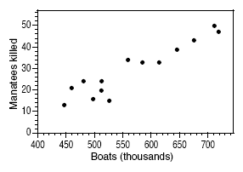


The data in a scatterplot are a random sample from a population that may exhibit a linear relationship between x and y. Different sample ➔ different plot.
Now we want to describe the population mean response μ_{y} as a function of the explanatory variable x: μ_{y} = β₀ + β₁x.
And to assess whether the observed relationship is statistically significant (not entirely explained by chance events due to random sampling).

Slide 4
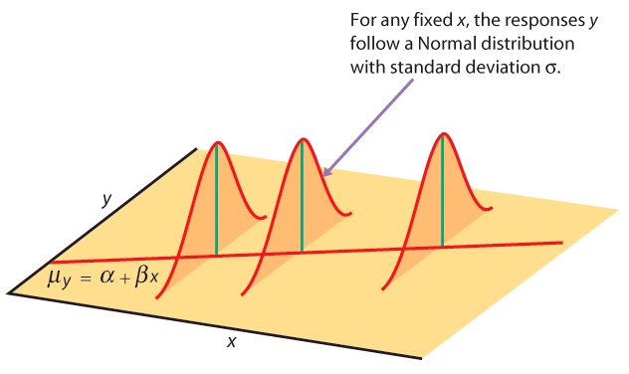
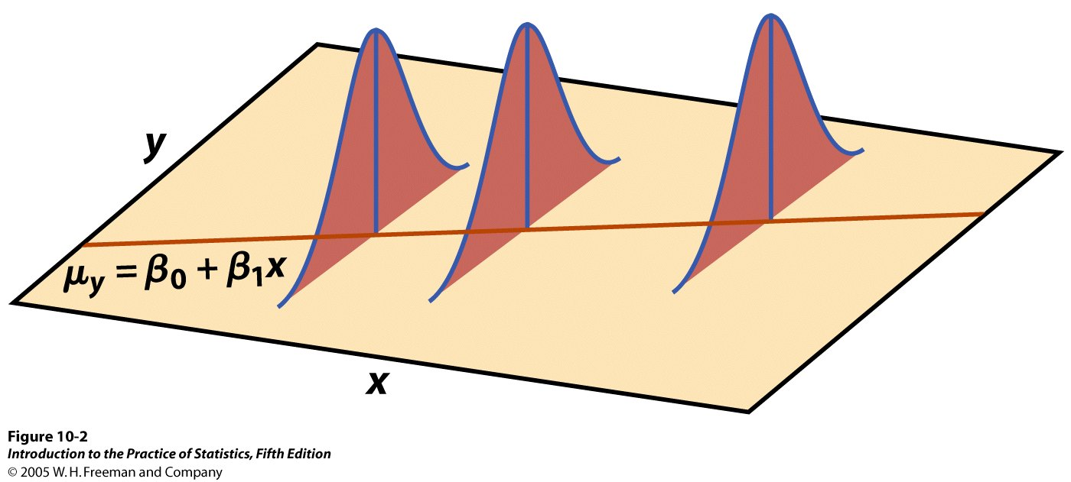
Statistical model for linear regression
In the population, the linear regression equation is μ_{y} = β₀ + β₁x.
Sample data then fits the model:
Data = fit + residual
y_{i} = (β₀ + β₁x_{i}) + (ε_{i})
where the ε_{i} are
independent and
Normally distributed N(0,σ).
Linear regression assumes equal variance of y
(σ is the same for all values of x).

Slide 5
Estimating the parameters
μ_{y} = β₀ + β₁x
The intercept β₀, the slope β₁, and the standard deviation σ of y are the unknown parameters of the regression model. We rely on the random sample data to provide unbiased estimates of these parameters.
  The value of ŷ from the least-squares regression line is really a prediction of the mean value of y (μ_{y}) for a given value of x.
  The least-squares regression line (ŷ = b₀ + b₁x) obtained from sample data is the best estimate of the true population regression line (μ_{y} = β₀ + β₁x).
ŷ unbiased estimate for mean response μ_{y}
b₀ unbiased estimate for intercept β₀
b₁ unbiased estimate for slope β₁

Slide 6
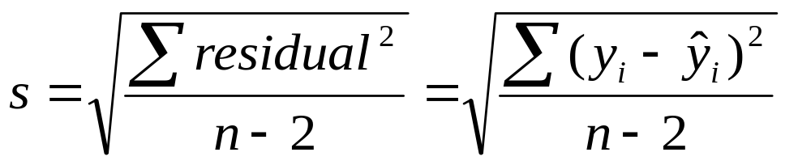
The population standard deviation σ for y at any given value of x represents the spread of the normal distribution of the ε_{i} around the mean μ_{y} .
The regression standard error, s, for n sample data points is calculated from the residuals (y_{i} – ŷ_{i}):
  s is an unbiased estimate of the regression standard deviation σ.

Slide 7
Conditions for inference
The observations are independent.
The relationship is indeed linear.
The standard deviation of y, σ, is the same for all values of x.
The response y varies normally
around its mean.

Slide 8
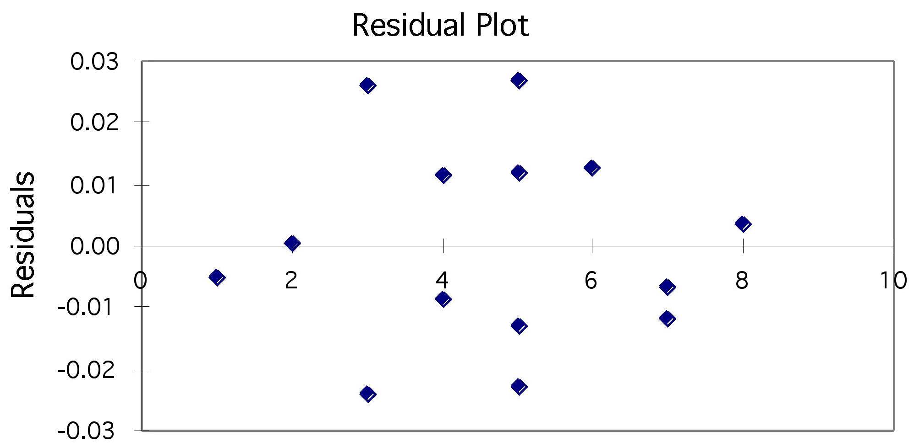
Using residual plots to check for regression validity
The residuals (y − ŷ) give useful information about the contribution of individual data points to the overall pattern of scatter.
We view the residuals in
a residual plot:
If residuals are scattered randomly around 0 with uniform variation, it indicates that the data fit a linear model, have normally distributed residuals for each value of x, and constant standard deviation σ.

Slide 9
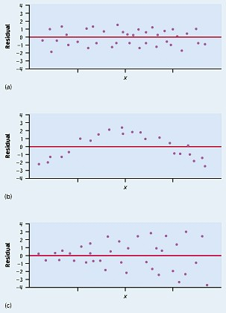
Residuals are randomly scattered
→ good!
Curved pattern
→ the relationship is not linear.
Change in variability across plot
→ σ not equal for all values of x.

Slide 10
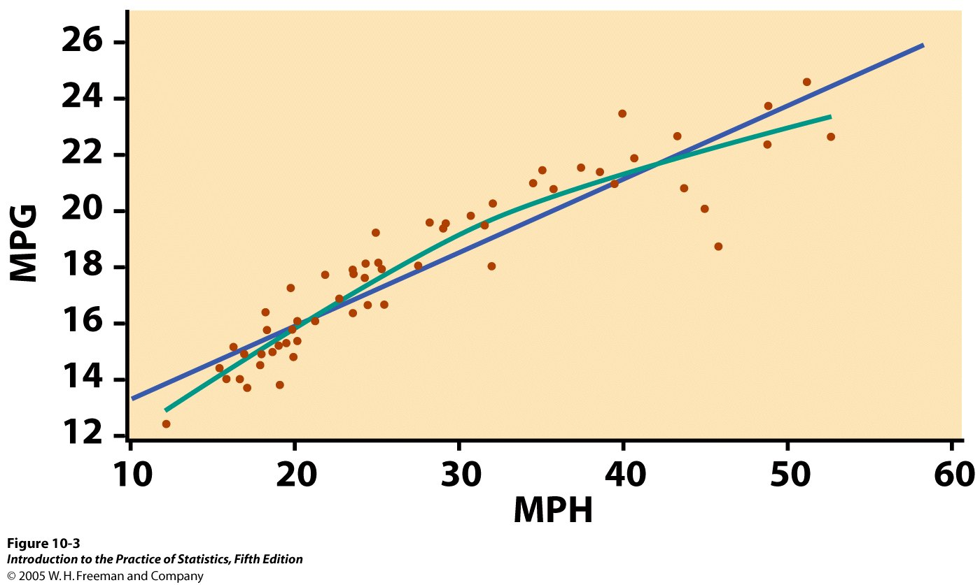
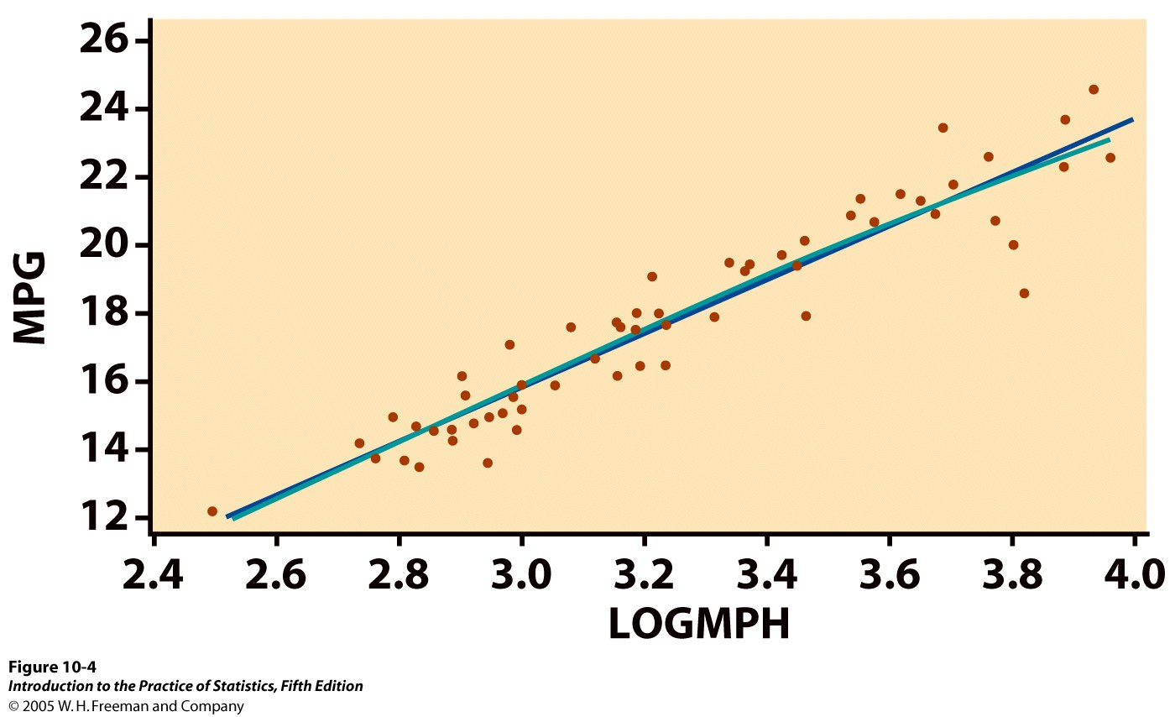

What is the relationship between the average speed a car is driven and its fuel efficiency?
We plot fuel efficiency (in miles
per gallon, MPG) against average speed (in miles per hour, MPH)
for a random sample of 60 cars. The relationship is curved.
When speed is log transformed (log of miles per hour, LOGMPH) the new scatterplot shows a positive, linear relationship.

Slide 11
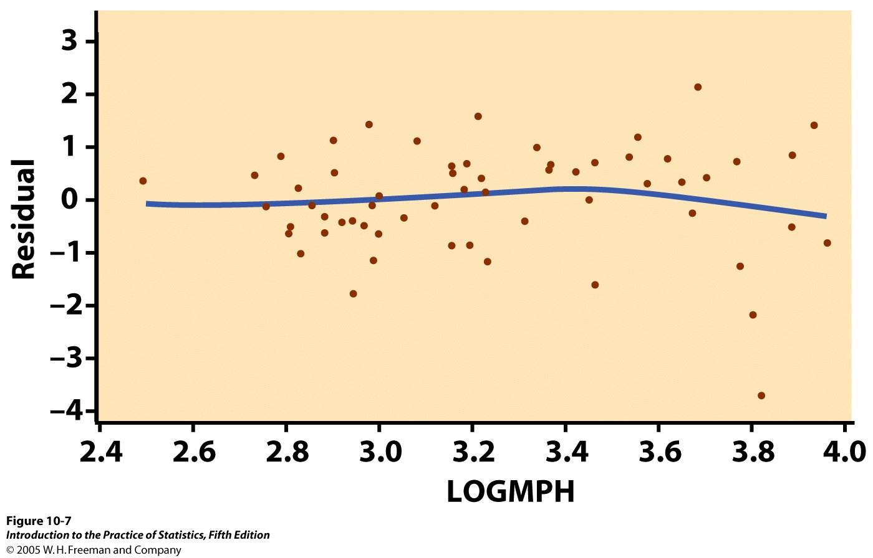
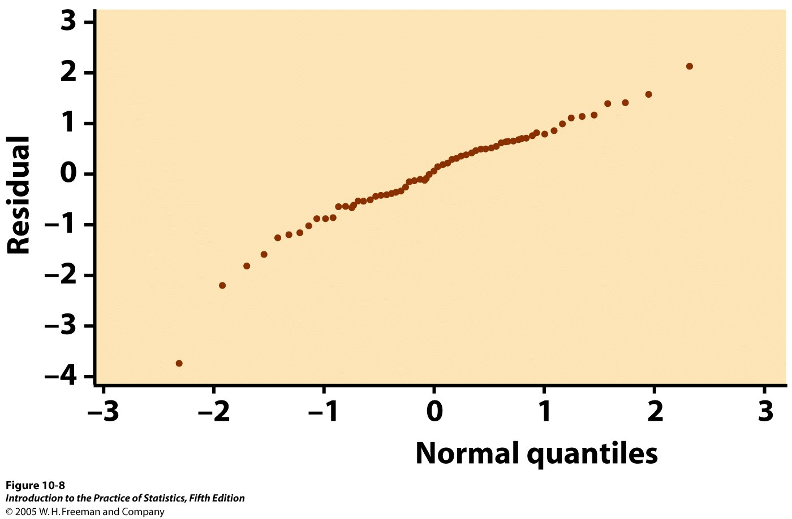
Residual plot:
The spread of the residuals is reasonably random—no clear pattern. The relationship is indeed linear.
But we see one low residual (3.8, −4) and one potentially influential point (2.5, 0.5).
Normal quantile plot for residuals:
The plot is fairly straight, supporting the assumption of normally distributed residuals.
➔ Data okay for inference.

Slide 12
Confidence interval for regression parameters
Estimating the regression parameters β₀, β₁ is a case of one-sample inference with unknown population variance.
➔ We rely on the t distribution, with n – 2 degrees of freedom.
A level C confidence interval for the slope, β₁, is proportional to the standard error of the least-squares slope:
b₁ ± t* SE_{b1}
A level C confidence interval for the intercept, β₀ , is proportional to the standard error of the least-squares intercept:
b₀ ± t* SE_{b0}
t* is the t critical for the t (n – 2) distribution with area C between –t* and +t*.

Slide 13
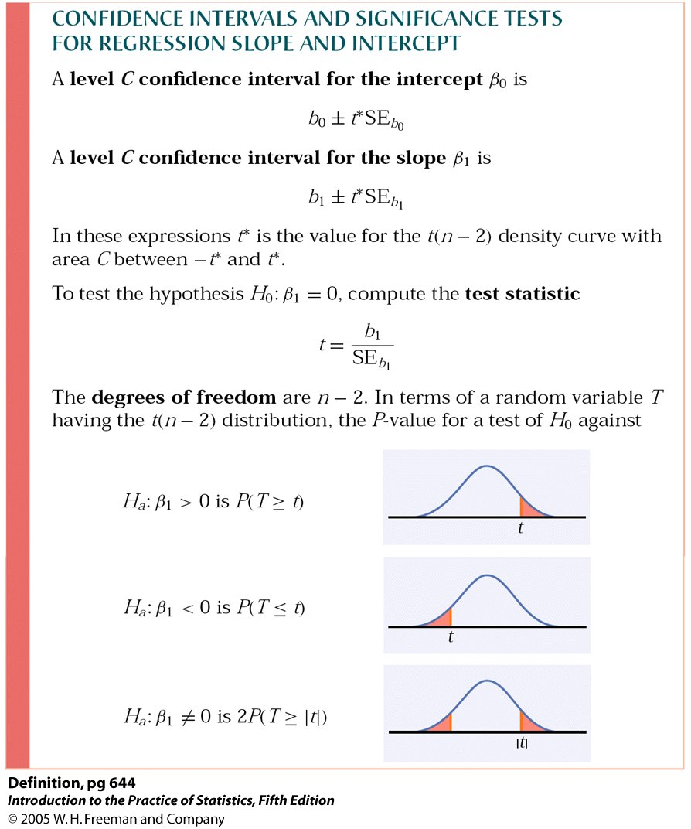
Significance test for the slope
We can test the hypothesis H₀: β₁ = 0 versus a 1 or 2 sided alternative.
We calculate t = b₁ / SE_{b1}
which has the t (n – 2)
distribution to find the
p-value of the test.
Note: Software typically provides
two-sided p-values.

Slide 14
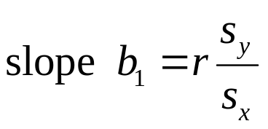
Testing the hypothesis of no relationship
We may look for evidence of a significant relationship between variables x and y in the population from which our data were drawn.
For that, we can test the hypothesis that the regression slope parameter β is equal to zero.
H₀: β₁ = 0 vs. H₀: β₁ ≠ 0
  Testing H₀: β₁ = 0 also allows to test the hypothesis of no correlation between x and y in the population.
Note: A test of hypothesis for β₀ is irrelevant (β₀ is often not even achievable).

Slide 15
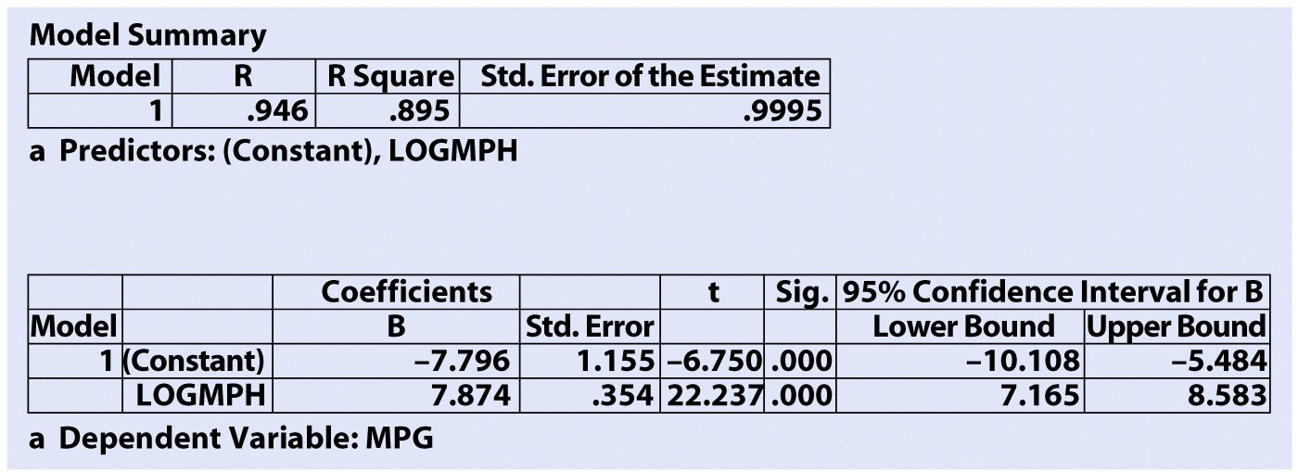
Using technology
Computer software runs all the computations for regression analysis.
Here is some software output for the car speed/gas efficiency example.
SPSS
Slope
Intercept
Confidence intervals
p-value for tests of significance
The t-test for regression slope is highly significant (p < 0.001). There is a significant relationship between average car speed and gas efficiency.

Slide 16
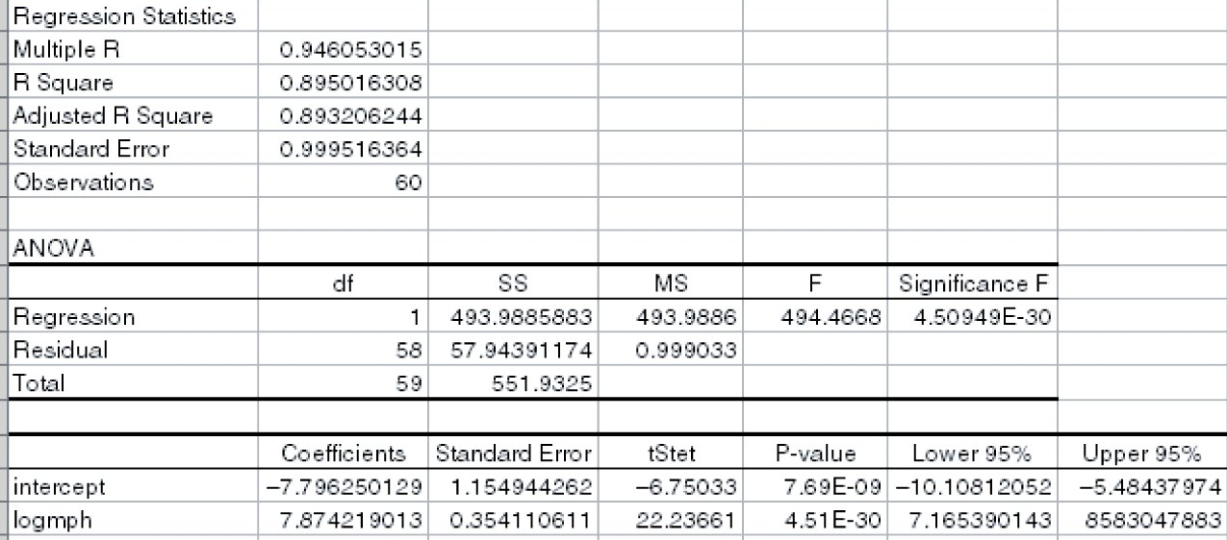
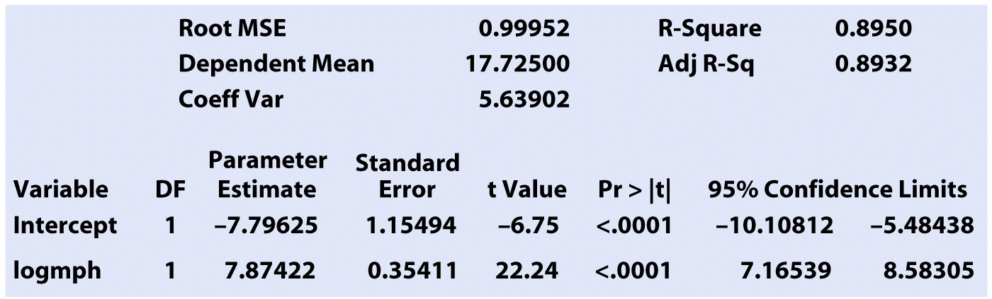
Excel
“intercept”: intercept
“logmph”: slope
P-value for tests of significance
confidence intervals
SAS

Slide 17
Confidence interval for µ_{y}
Using inference, we can also calculate a confidence interval for the population mean μ_{y} of all responses y when x takes the value x* (within the range of data tested):
  This interval is centered on ŷ, the unbiased estimate of μ_{y}.
  The true value of the population mean μ_{y} at a given
  value of x, will indeed be within our confidence
  interval in C% of all intervals calculated
  from many different random samples.

Slide 18

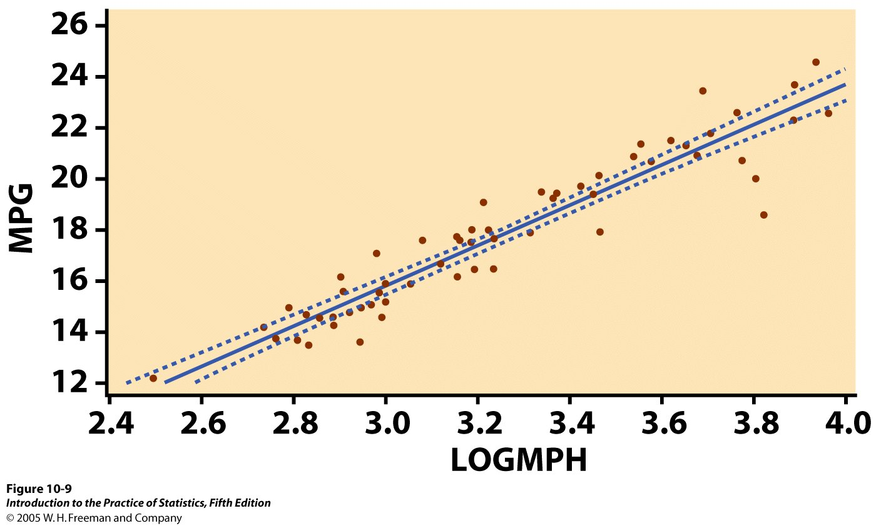
The level C confidence interval for the mean response μ_{y} at a given value x* of x is:
μ_{y} ± t_{n − 2} * SE_{μ}
t* is the t critical for the t (n – 2) distribution with area C between –t* and +t*.
A separate confidence interval is calculated for μ_{y} along all the values that x takes.
Graphically, the series of confidence intervals is shown as a continuous interval on either side of ŷ.
95% confidence interval for μ_{y}

Slide 19
Inference for prediction
One use of regression is for predicting the value of y, ŷ, for any value of x within the range of data tested: ŷ = b₀ + b₁x.
But the regression equation depends on the particular sample drawn. More reliable predictions require statistical inference:
To estimate an individual response y for a given value of x, we use a prediction interval.
  If we randomly sampled many times, there
  would be many different values of y
  obtained for a particular x following
  N(0, σ) around the mean response µ_{y}.

Slide 20
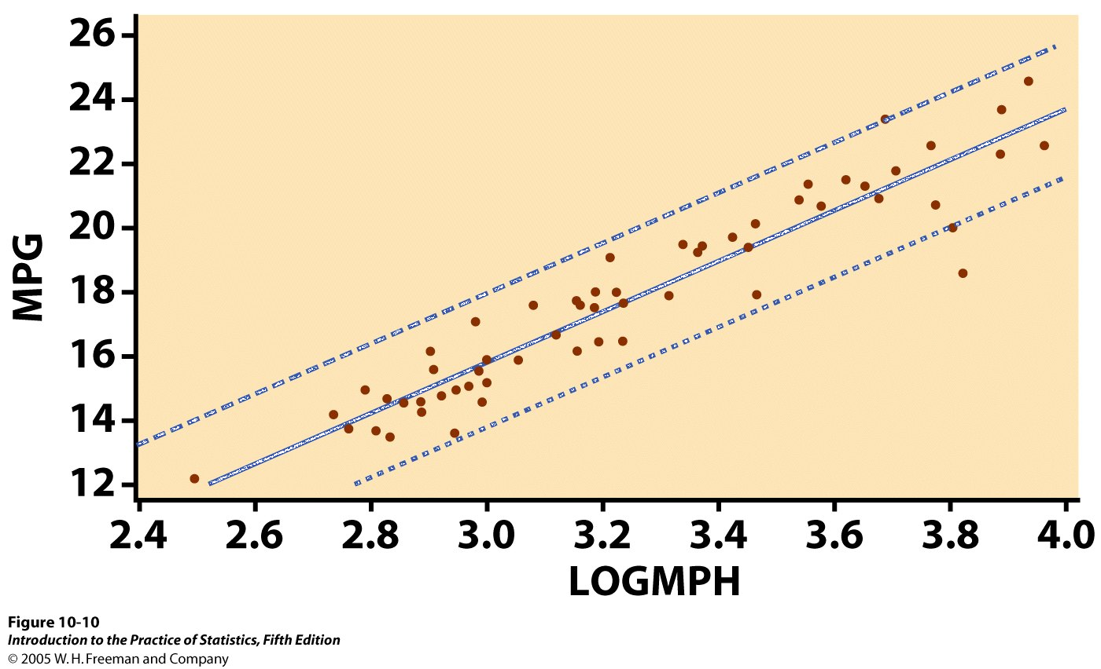
The level C prediction interval for a single observation on y when x takes the value x* is:
ŷ ± t*_{n − 2} SE_{ŷ}
t* is the t critical for the t (n – 2) distribution with area C between –t* and +t*.
The prediction interval represents mainly the error from the normal distribution of the residuals ε_{i}.
Graphically, the series confidence intervals are shown as a continuous interval on either side of ŷ.
95% prediction interval for ŷ

Slide 21

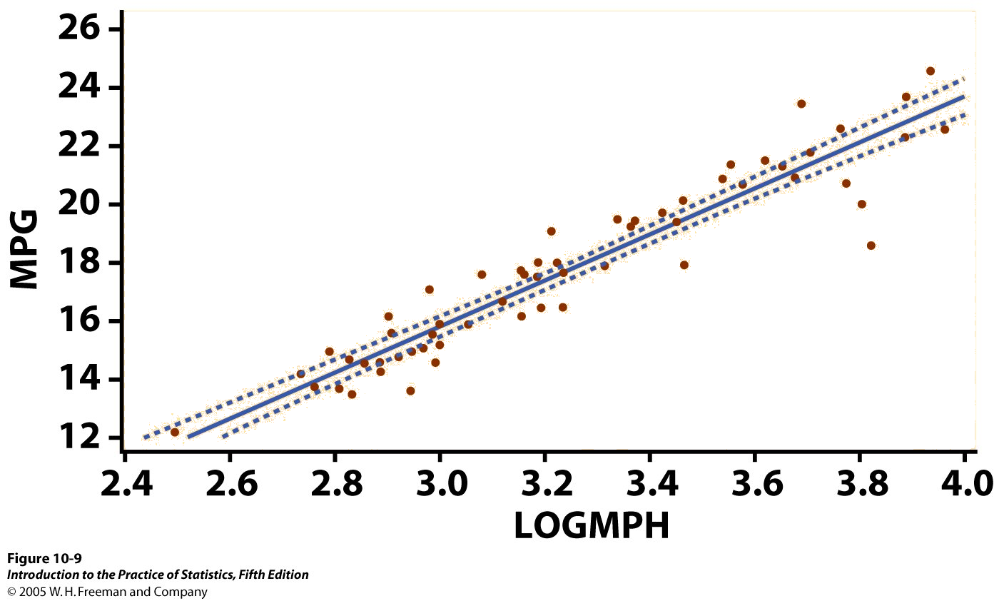
The confidence interval for μ_{y} contains with C% confidence the population mean μ_{y} of all responses at a particular value of x.
The prediction interval contains C% of all the individual values taken by y at a particular value of x.
95% prediction interval for ŷ
95% confidence interval for μ_{y}
Estimating μ_{y} uses a smaller confidence interval than estimating an individual in the population (sampling distribution narrower than population
distribution).

Slide 22
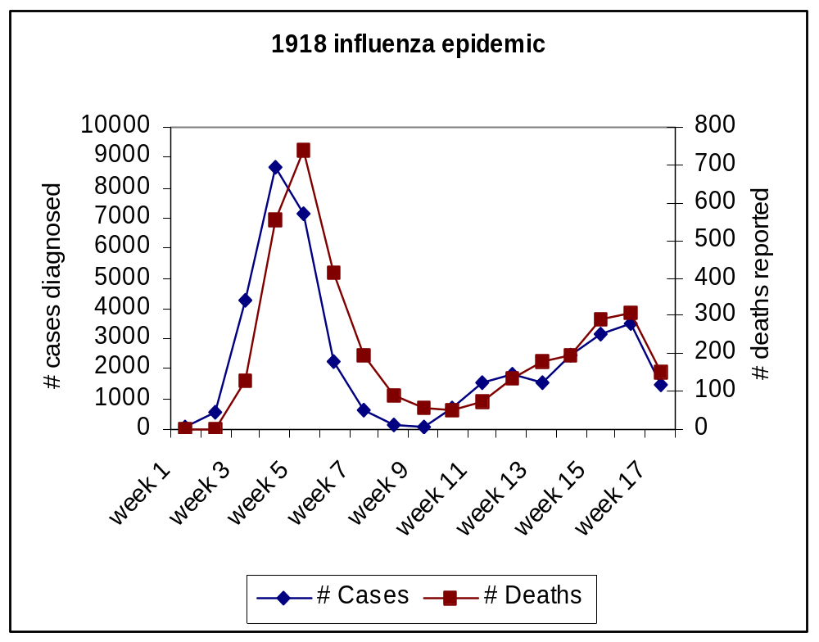

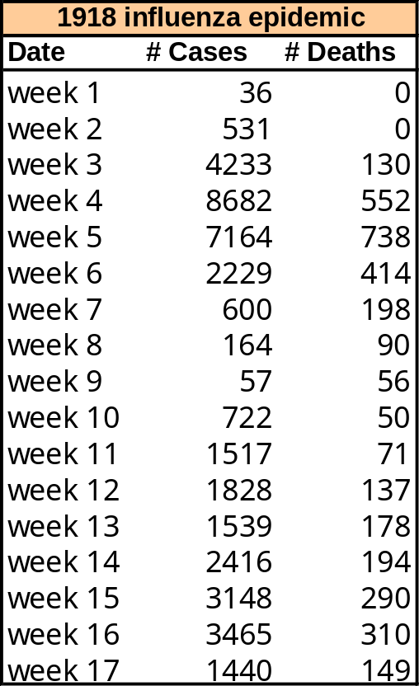
1918 flu epidemics
The line graph suggests that 7 to 9% of those diagnosed with the flu died within about a week of diagnosis.
We look at the relationship between the number of deaths in a given week and the number of new diagnosed cases one week earlier.

Slide 23
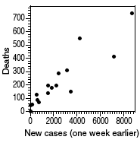

1918 flu epidemic: Relationship between the number of deaths in a given week and the number of new diagnosed cases one week earlier.
r = 0.91
EXCEL
Regression Statistics
Multiple R 0.911
R Square 0.830
Adjusted R Square 0.82
Standard Error 85.07
Observations 16.00
Coefficients St. Error t Stat P-value Lower 95% Upper 95%
Intercept 49.292 29.845 1.652 0.1209 (14.720) 113.304
FluCases0 0.072 0.009 8.263 0.0000 0.053 0.091
s
b₁
P-value for H₀: β₁ = 0
P-value very small ➔ reject H₀ ➔ β₁ significantly different from 0
There is a significant relationship between the number of flu cases and the number of deaths from flu a week later.

Slide 24
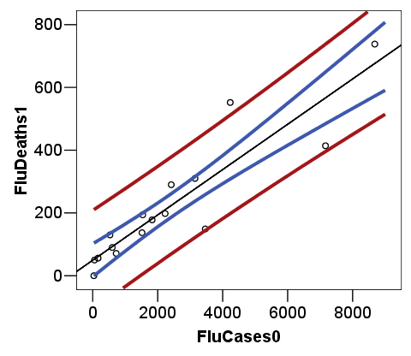
SPSS
CI for mean weekly death count one week after 4000 flu cases are diagnosed: µ_{y} within about 300–380.
Prediction interval for a weekly death count one week after 4000 flu cases are diagnosed: ŷ within about 180–500 deaths.
Least squares regression line
95% prediction interval for ŷ
95% confidence interval for μ_{y}

Slide 25
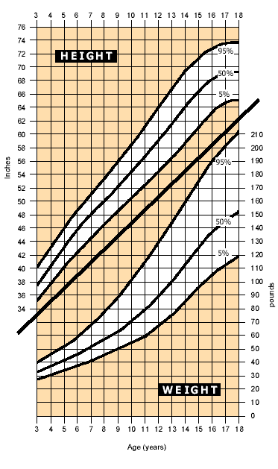
What is this?
A 90% prediction interval
for the height (above) and
a 90% prediction interval for the weight (below) of male children, ages 3 to 18.
Notes:
So, any individual
boy may be well within the range of height for his age, but
also be within the distributions for boys year or two older
or younger as well. Two possible size distributions are shown.

Slide 26
Inference for Regression
More Detail about Simple Linear Regression
IPS Chapter 10.2
© 2009 W.H. Freeman and Company

Slide 27
Objectives (IPS Chapter 10.2)
Inference for regression—more details
Analysis of variance for regression
The ANOVA F test
Calculations for regression inference
Inference for correlation

Slide 28
Analysis of variance for regression
The regression model is:
Data = fit + residual
y_{i} = (β₀ + β₁x_{i}) + (ε_{i})
where the ε_{i} are independent and
normally distributed N(0,σ), and
σ is the same for all values of x.
It resembles an ANOVA, which also assumes equal variance, where
SST = SS model + SS error and
DFT = DF model + DF error

Slide 29
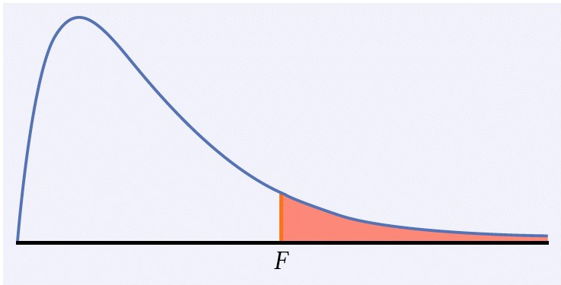
The ANOVA F test
For a simple linear relationship, the ANOVA tests the hypotheses
H₀: β₁ = 0 versus H_{a}: β₁ ≠ 0
by comparing MSM (model) to MSE (error): F = MSM/MSE
When H₀ is true, F follows
the F(1, n − 2) distribution.
The p-value is P(F > f ).
The ANOVA test and the two-sided t-test for H₀: β₁ = 0 yield the same p-value.
Software output for regression may provide t, F, or both, along with the p-value.

Slide 30



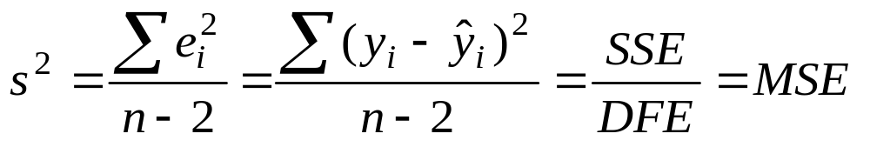
ANOVA table
Source | Sum of squares SS | DF | Mean square MS | F | P-value
Model |  | 1 | SSM/DFM | MSM/MSE | Tail area above F
Error |  | n − 2 | SSE/DFE
Total |  | n − 1
SST = SSM + SSE
DFT = DFM + DFE
The standard deviation of the sampling distribution, s, for n sample data points is calculated from the residuals e_{i} = y_{i} – ŷ_{i}
s is an unbiased estimate of the regression standard deviation σ.

Slide 31
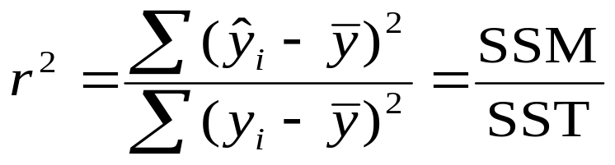
Coefficient of determination, r²
The coefficient of determination, r², square of the correlation coefficient, is the percentage of the variance in y (vertical scatter from the regression line) that can be explained by changes in x.
r ² ₌ variation in y caused by x (i.e., the regression line)
total variation in observed y values around the mean
Notes:
Go over point that missing zero is OK - this is messy data, a prediction based on messy data.
Residuals should be scattered randomly around the line, or there is something wrong with your data - not linear, outliers, etc.

Slide 32
What is the relationship between the average speed a car is driven and its fuel efficiency?
We plot fuel efficiency (in miles
per gallon, MPG) against average speed (in miles per hour, MPH)
for a random sample of 60 cars. The relationship is curved.
When speed is log transformed (log of miles per hour, LOGMPH) the new scatterplot shows a positive, linear relationship.

Slide 33
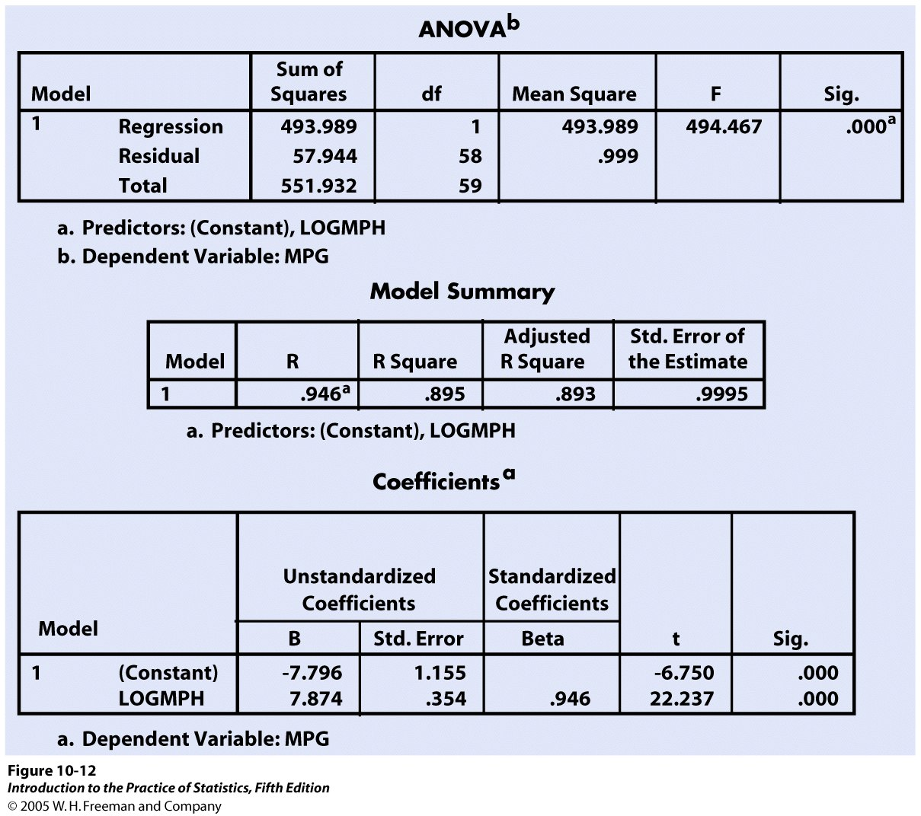
Using software: SPSS
r² =SSM/SST = 494/552
ANOVA and t-test give same p-value.

Slide 34
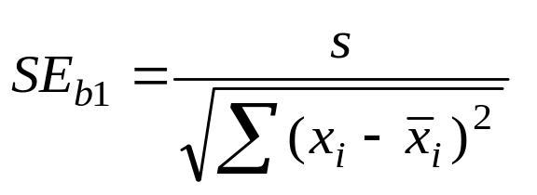
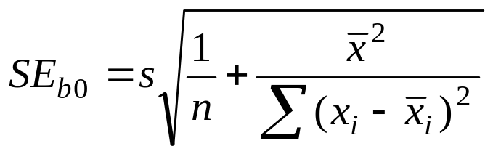
Calculations for regression inference
To estimate the parameters of the regression, we calculate the standard errors for the estimated regression coefficients.
The standard error of the least-squares slope β₁ is:
The standard error of the intercept β₀ is:

Slide 35
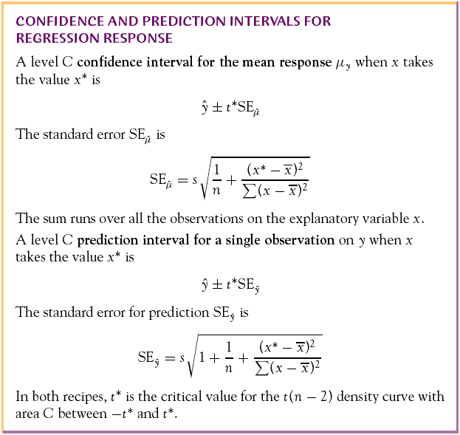
To estimate or predict future responses, we calculate the following standard errors
The standard error of the mean response µ_{y} is:
The standard error for predicting an individual response ŷ is:

Slide 36
1918 flu epidemics
The line graph suggests that about 7 to 8% of those diagnosed with the flu died within about a week of diagnosis. We look at the relationship between the number of deaths in a given week and the number of new diagnosed cases one week earlier.

Slide 37




1918 flu epidemic: Relationship between the number of deaths in a given week and the number of new diagnosed cases one week earlier.
r = 0.91
MINITAB - Regression Analysis:
FluDeaths1 versus FluCases0
The regression equation is
FluDeaths1 = 49.3 + 0.0722 FluCases0
Predictor Coef SE Coef T P
Constant 49.29 29.85 1.65 0.121
FluCases 0.072222 0.008741 8.26 0.000
S = 85.07 R-Sq = 83.0% R-Sq(adj) = 81.8%
Analysis of Variance
Source DF SS MS F P
Regression 1 494041 494041 68.27 0.000
Residual Error 14 101308 7236
Total 15 595349
P-value for
H₀: β₁ = 0; H_{a}: β₁ ≠ 0
r² = SSM / SST
SSM
SST

Slide 38
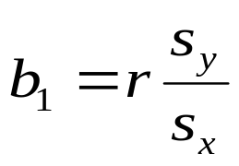
Inference for correlation
To test for the null hypothesis of no linear association, we have the choice of also using the correlation parameter ρ.
  When x is clearly the explanatory variable, this test
  is equivalent to testing the hypothesis H₀: β = 0.
  When there is no clear explanatory variable (e.g., arm length vs. leg length), a regression of x on y is not any more legitimate than one of y on x. In that case, the correlation test of significance should be used.
  When both x and y are normally distributed H₀: ρ = 0 tests for no association of any kind between x and y—not just linear associations.

Slide 39
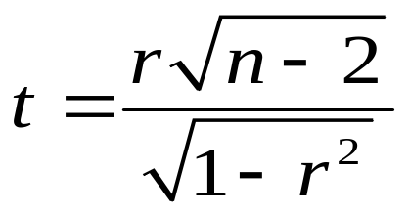
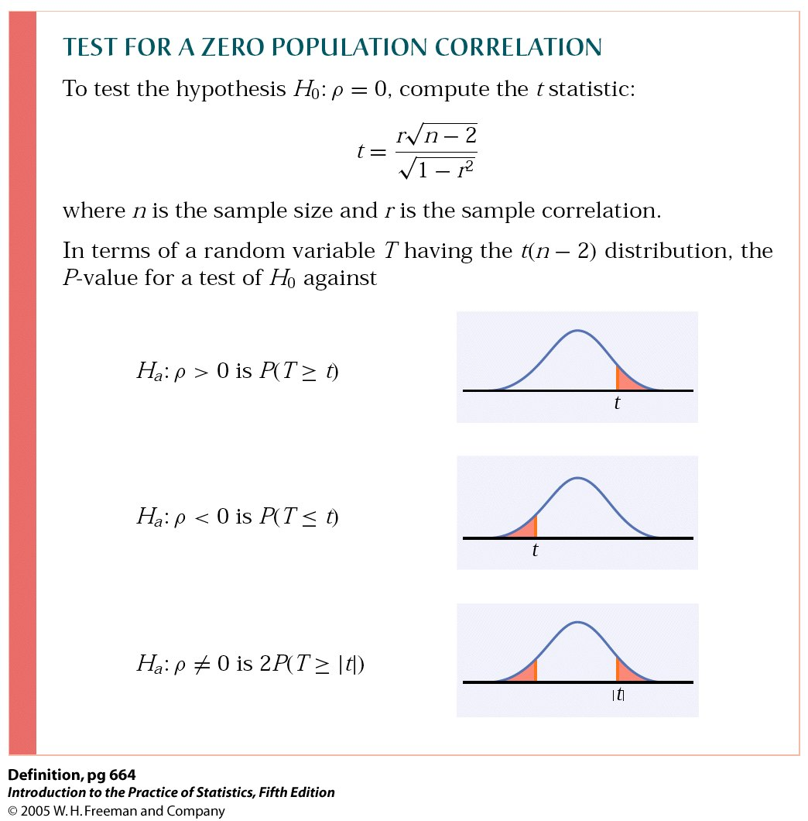
The test of significance for ρ uses the one-sample t-test for: H₀: ρ = 0.
We compute the t statistics
for sample size n and
correlation coefficient r.
The p-value is the area
under t (n – 2) for values of
T as extreme as t or more
in the direction of H_{a}:

Slide 40
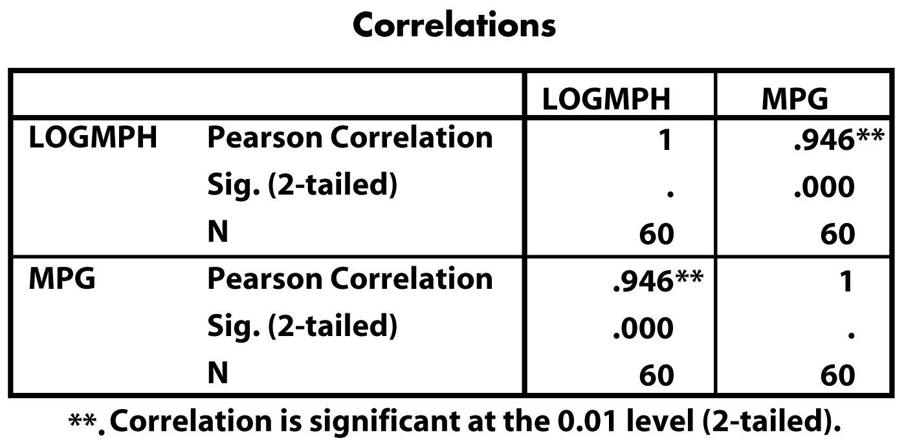
Relationship between average car speed and fuel efficiency
r
p-value
n
There is a significant correlation (r is not 0) between fuel efficiency (MPG) and the logarithm of average speed (LOGMPH).

