Slide 1
One-Way Analysis of Variance
IPS Chapter 12
Inference for On-Way Analysis of Variance
Comparing the Means
© 2010 W.H. Freeman and Company
Notes:
Alternate to slide 1 – needed only because I can not delete the lines.

Slide 2
One-way ANOVA
Inference for one-way ANOVA
IPS Chapter 12.1
© 2009 W.H. Freeman and Company

Slide 3
Objectives (IPS Chapter 12.1)
Inference for one-way ANOVA
Comparing means
The two-sample t statistic
An overview of ANOVA
The ANOVA model
Testing hypotheses in one-way ANOVA
The F-test
The ANOVA table

Slide 4
The idea of ANOVA
Reminders: A factor is a variable that can take one of several levels used to differentiate one group from another.
An experiment has a one-way, or completely randomized, design if several levels of one factor are being studied and the individuals are randomly assigned to its levels. (There is only one way to group the data.)
  Example: Four levels of nematode quantity in seedling growth experiment.
  But two seed species and four levels of nematodes would be a two-way design.
Analysis of variance (ANOVA) is the technique used to determine whether more than two population means are equal.
One-way ANOVA is used for completely randomized, one-way designs.

Slide 5
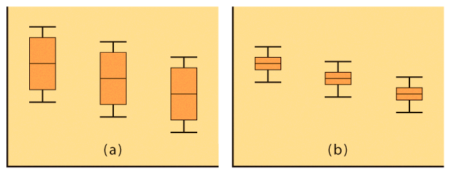
Comparing means
We want to know if the observed differences in sample means are likely to have occurred by chance just because of random sampling.
This will likely depend on both the difference between the sample means and how much variability there is within each sample.

Slide 6
Two-sample t statistic
A two sample t-test assuming equal variance and an ANOVA comparing only two groups will give you the exact same p-value (for a two-sided hypothesis).
H₀: μ₁ = μ₂
H_{a}: μ₁ ≠ μ₂
One-way ANOVA
F-statistic
H₀: μ₁ = μ₂
H_{a}: μ₁ ≠ μ₂
t-test assuming equal variance
t-statistic
F = t² and both p-values are the same.
But the t-test is more flexible: You may choose a one-sided alternative instead, or you may want to run a t-test assuming unequal variance if you are not sure that your two populations have the same standard deviation σ.

Slide 7
An Overview of ANOVA
We first examine the multiple populations or multiple treatments to test for overall statistical significance as evidence of any difference among the parameters we want to compare. ➔ANOVA F-test
If that overall test showed statistical significance, then a detailed follow-up analysis is legitimate.
  If we planned our experiment with specific alternative hypotheses in mind (before gathering the data), we can test them using contrasts.
  If we do not have specific alternatives, we can examine all pair-wise parameter comparisons to define which parameters differ from which, using multiple comparisons procedures.

Slide 8
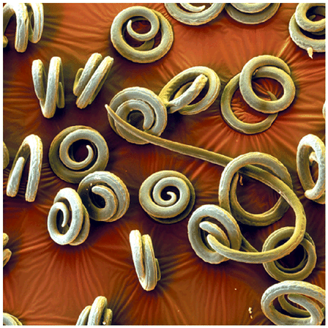
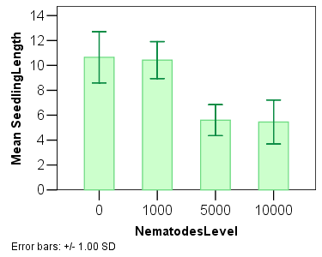
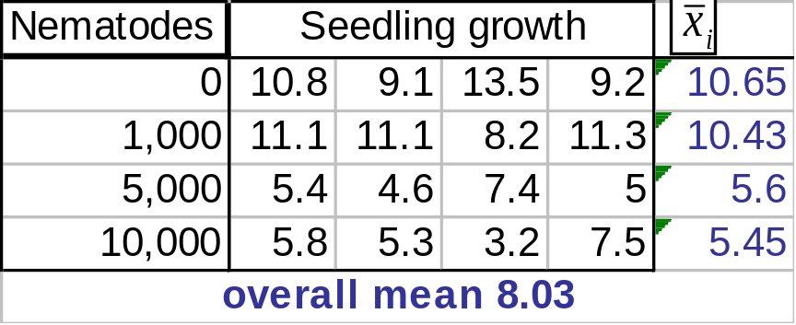
Nematodes and plant growth
Do nematodes affect plant growth? A botanist prepares 16 identical planting pots and adds different numbers of nematodes into the pots. Seedling growth (in mm) is recorded two weeks later.
Hypotheses: All μ_{i} are the same (H₀)
versus not All μ_{i} are the same (H_{a})
Notes:
Any attempt to modify the 3.2, the third seedling for 10,000 nematodes whitens the background.

Slide 9
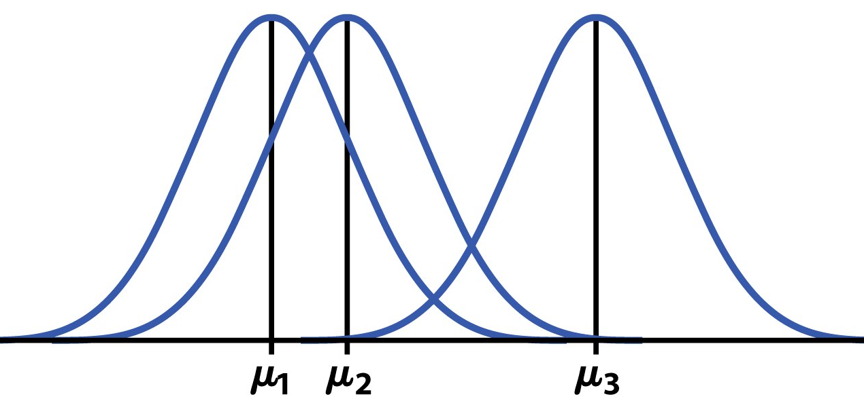
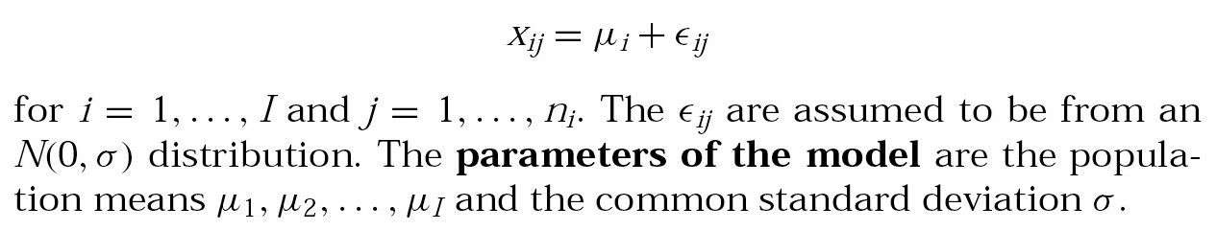
The ANOVA model
Random sampling always produces chance variations. Any “factor effect” would thus show up in our data as the factor-driven differences plus chance variations (“error”):
Data = fit (“factor/groups”) + residual (“error”)
The one-way ANOVA model analyses
situations where chance variations are
normally distributed N(0,σ) so that:

Slide 10
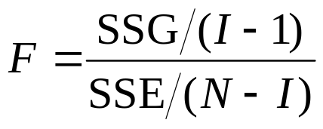
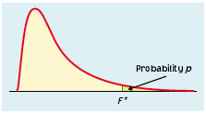
Testing hypotheses in one-way ANOVA
We have I independent SRSs, from I populations or treatments.
The i^{th} population has a normal distribution with unknown mean µ_{i}.
All I populations have the same standard deviation σ, unknown.
The ANOVA F statistic tests:
H₀: μ₁ = μ₂ = … = μ_{I}
H_{a}: not all the μ_{i} are equal.
When H₀ is true, F has the F distribution with I − 1 (numerator) and N − I (denominator) degrees of freedom.

Slide 11
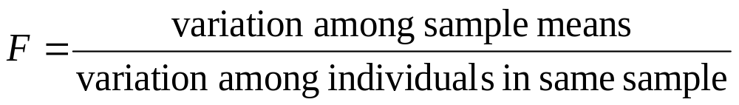
The ANOVA F-test
The ANOVA F-statistic compares variation due to specific sources (levels of the factor) with variation among individuals who should be similar (individuals in the same sample).
Difference in means large relative to overall variability
Difference in means small relative to overall variability
➔ F tends to be small
➔ F tends to be large
Larger F-values typically yield more significant results. How large depends on the degrees of freedom (I − 1 and N − I).

Slide 12
Checking our assumptions
Each of the #I populations must be normally distributed (histograms or normal quantile plots). But the test is robust to normality deviations for large enough sample sizes, thanks to the central limit theorem.
The ANOVA F-test requires that all populations have the same standard deviation σ. Since σ is unknown, this can be hard to check.
Practically: The results of the ANOVA F-test are approximately correct when the largest sample standard deviation is no more than twice as large as the smallest sample standard deviation.
(Equal sample sizes also make ANOVA more robust to deviations from the equal σ rule)

Slide 13

Do nematodes affect plant growth?
Seedling growth s_{i}
0 nematode 10.8 9.1 13.5 9.2 10.65 2.053
1000 nematodes 11.1 11.1 8.2 11.3 10.425 1.486
5000 nematodes 5.4 4.6 7.4 5.0 5.6 1.244
10000 nematodes 5.8 5.3 3.2 7.5 5.45 1.771
Conditions required:
equal variances: checking that largest s_{i} no more than twice smallest s_{i}
  Largest s_{i} = 2.053; smallest s_{i} = 1.244
Independent SRSs
  Four groups obviously independent
Distributions “roughly” normal
  It is hard to assess normality with only
  four points per condition. But the pots in
  each group are identical, and there is no
  reason to suspect skewed distributions.

Slide 14
Smoking influence on sleep
A study of the effect of smoking classifies subjects as nonsmokers, moderate smokers, and heavy smokers. The investigators interview a random sample of 200 people in each group and ask “How many hours do you sleep on a typical night?”
1. Study design?
2. Hypotheses?
3. ANOVA assumptions?
4. Degrees of freedom?
1. This is an observational study.
Explanatory variable: smoking -- 3 levels: nonsmokers, moderate smokers, heavy smokers
Response variable: # hours of sleep per night
2. H₀: all 3 μ_{i} equal (versus not all equal)
3. Three obviously independent SRS. Sample size of 200 should accommodate any departure from normality. Would still be good to check for s_{min}/s_{max}.
4. I = 3, n1 = n2 = n3 = 200, and N = 600,
so there are I - 1 = 2 (numerator) and N - I = 597 (denominator) degrees of freedom.

Slide 15



The ANOVA table
Source of variation | Sum of squares SS | DF | Mean square MS | F | P value | F crit
Among or between “groups” |  | I -1 | SSG/DFG | MSG/MSE | Tail area above F | Value of F for α
Within groups or “error” |  | N - I | SSE/DFE
Total | SST=SSG+SSE | N – 1
R² = SSG/SST √MSE = s_{p}
Coefficient of determination Pooled standard deviation
The sum of squares represents variation in the data: SST = SSG + SSE.
The degrees of freedom likewise reflect the ANOVA model: DFT = DFG + DFE.
Data (“Total”) = fit (“Groups”) + residual (“Error”)

Slide 16
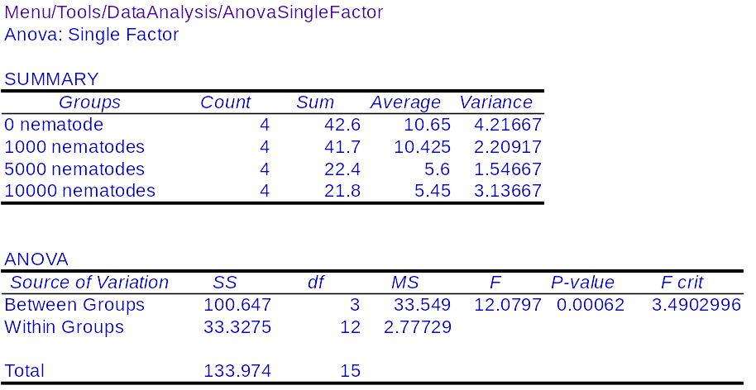
Excel output for the one-way ANOVA
numerator
denominator
Here, the calculated F-value (12.08) is larger than F_{critical} (3.49) for α 0.05.
Thus, the test is significant at α 5% ➔ Not all mean seedling lengths are the same; the number of nematode’s is an influential factor.

Slide 17
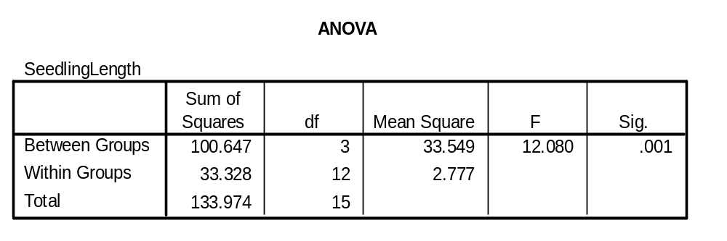
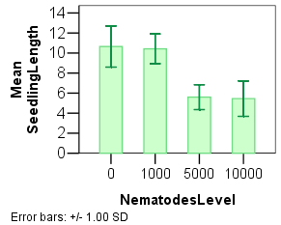
SPSS output for the one-way ANOVA
The ANOVA found that the amount of nematodes in pots significantly impacts seedling growth.
The graph suggests that nematode amounts above 1,000 per pot are detrimental to seedling growth.

Slide 18
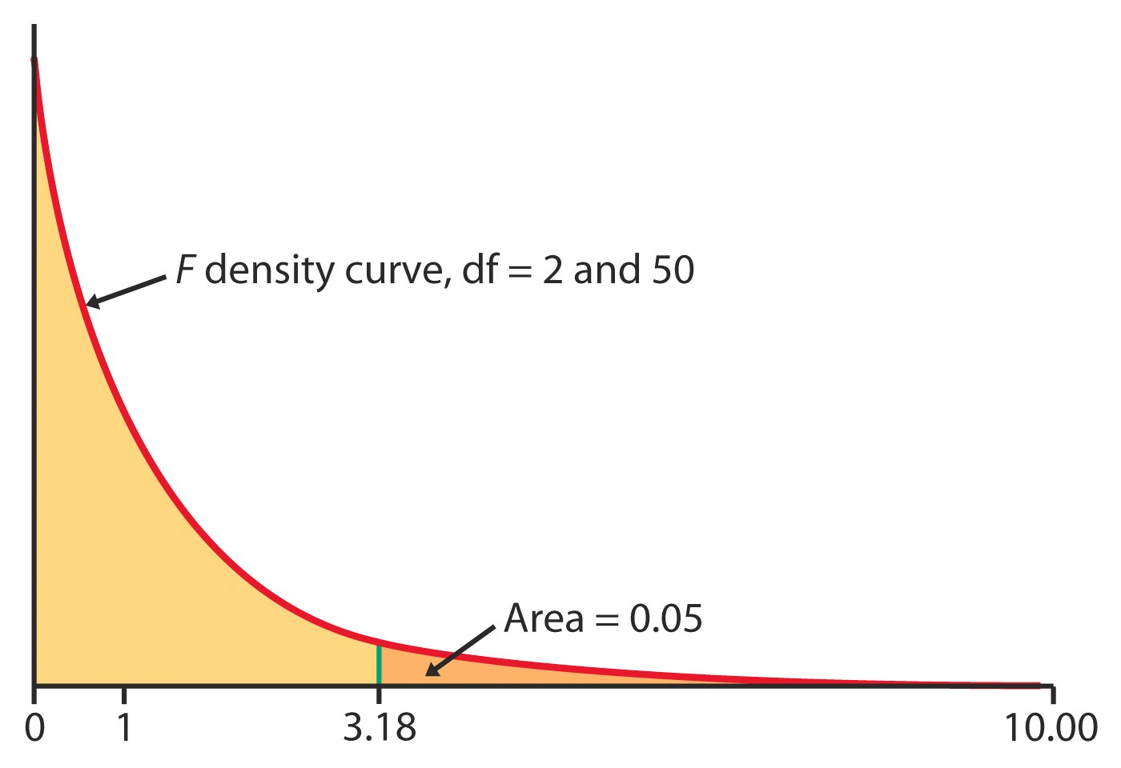
Using Table E
The F distribution is asymmetrical and has two distinct degrees of freedom. This was discovered by Fisher, hence the label “F.”
Once again, what we do is calculate the value of F for our sample data and then look up the corresponding area under the curve in Table E.

Slide 19
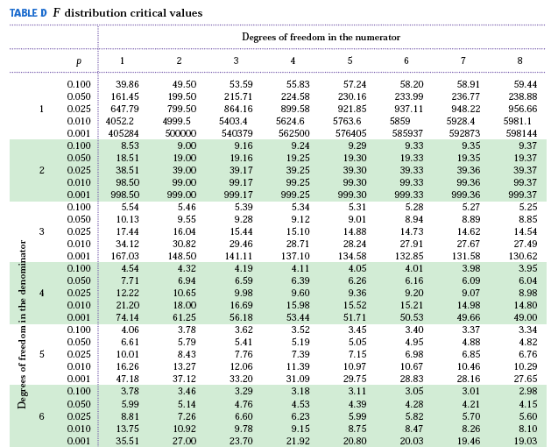
Table E
df_{num} = I − 1
For df: 5,4
p
F
df_{den}
=
N − I

Slide 20
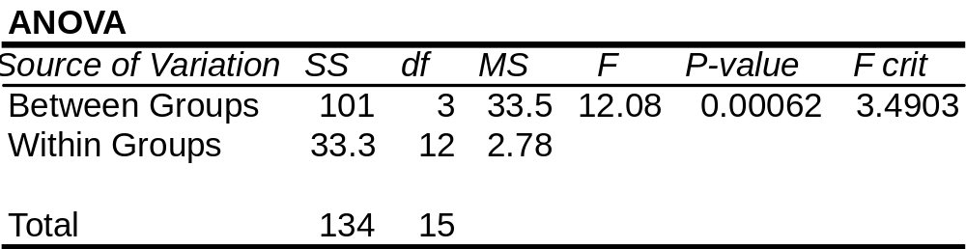
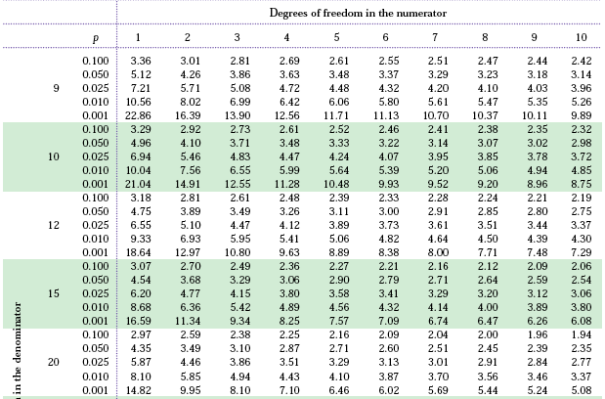
F_{critical} for α 5% is 3.49
F = 12.08 > 10.80
Thus p < 0.001

Slide 21
Yogurt preparation and taste
Yogurt can be made using three distinct commercial preparation methods: traditional, ultra filtration, and reverse osmosis.
To study the effect of these methods on taste, an experiment was designed where three batches of yogurt were prepared for each of the three methods. A trained expert tasted each of the nine samples, presented in random order, and judged them on a scale of 1 to 10.
Variables, hypotheses, assumptions, calculations?
ANOVA table
Source of variation | SS | df | MS | F | P-value | F crit
Between groups | 17.3 | I-1=2 | 8.65 | 11.283
Within groups | 4.6 | N-I=6 | 0.767
Total | 17.769

Slide 22
df_{num} = I − 1
df_{den}
=
N − I
F

Slide 23
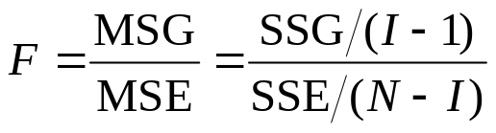
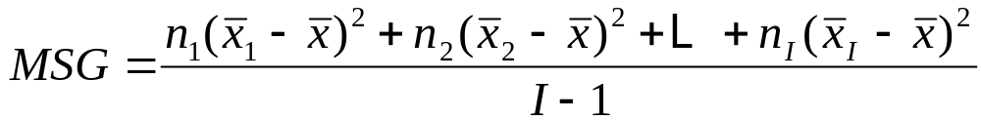
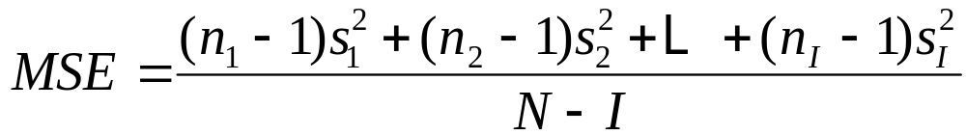
Computation details
MSG, the mean square for groups, measures how different the individual means are from the overall mean (~ weighted average of square distances of sample averages to the overall mean). SSG is the sum of squares for groups.
MSE, the mean square for error is the pooled sample variance s_{p}² and estimates the common variance σ² of the I populations (~ weighted average of the variances from each of the I samples). SSE is the sum of squares for error.

Slide 24
One-way ANOVA
Comparing the means
IPS Chapter 12.2
© 2009 W.H. Freeman and Company

Slide 25
Objectives (IPS Chapter 12.2)
Comparing the means
Contrasts
Multiple comparisons
Power of the one-way ANOVA test

Slide 26
You have calculated a p-value for your ANOVA test. Now what?
If you found a significant result, you still need to determine which treatments were different from which.
  You can gain insight by looking back at your plots (boxplot, mean ± s).
  There are several tests of statistical significance designed specifically for multiple tests. You can choose apriori contrasts, or aposteriori multiple comparisons.
  You can find the confidence interval for each mean μ_{i} shown to be significantly different from the others.

Slide 27
Contrasts can be used only when there are clear expectations BEFORE starting an experiment, and these are reflected in the experimental design. Contrasts are planned comparisons.
  Patients are given either drug A, drug B, or a placebo. The three treatments are not symmetrical. The placebo is meant to provide a baseline against which the other drugs can be compared.
Multiple comparisons should be used when there are no justified expectations. Those are aposteriori, pair-wise tests of significance.
  We compare gas mileage for eight brands of SUVs. We have no prior knowledge to expect any brand to perform differently from the rest. Pair-wise comparisons should be performed here, but only if an ANOVA test on all eight brands reached statistical significance first.
It is NOT appropriate to use a contrast test when suggested comparisons appear only after the data is collected.

Slide 28
Contrasts: planned comparisons
When an experiment is designed to test a specific hypothesis that some treatments are different from other treatments, we can use contrasts to test for significant differences between these specific treatments.
  Contrasts are more powerful than multiple comparisons because they are more specific. They are more able to pick up a significant difference.
  You can use a t-test on the contrasts or calculate a t-confidence interval.
  The results are valid regardless of the results of your multiple sample ANOVA test (you are still testing a valid hypothesis).

Slide 29
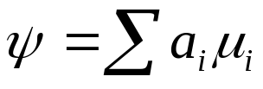
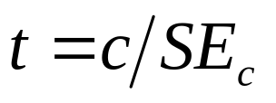
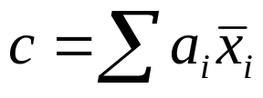
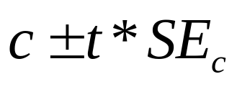
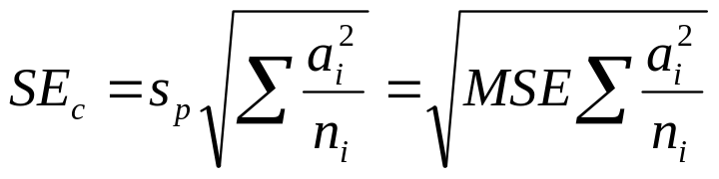
A contrast is a combination of population means of the form :
Where the coefficients a_{i} have sum 0.
The corresponding sample contrast is :
The standard error of c is :
To test the null hypothesis
H₀: ψ = 0 use the t-statistic:
With degrees of freedom DFE that is associated with sp. The alternative hypothesis can be one- or two-sided.
A level C confidence interval for the difference ψ is :
Where t* is the critical value defining the middle C% of the t distribution with DFE degrees of freedom.

Slide 30
Contrasts are not always readily available in statistical software packages (when they are, you need to assign the coefficients “a_{i}”), or may be limited to comparing each sample to a control.
If your software doesn’t provide an option for contrasts, you can test your contrast hypothesis with a regular t-test using the formulas we just highlighted. Remember to use the pooled variance and degrees of freedom as they reflect your better estimate of the population variance. Then you can look up your p-value in a table of t-distribution.

Slide 31
Nematodes and plant growth
Do nematodes affect plant growth? A botanist prepares 16 identical planting pots and adds different numbers of nematodes into the pots. Seedling growth
(in mm) is recorded two weeks later.
One group contains no nematode at all. If the botanist planned this group as a baseline/control, then a contrast of all the nematode groups against the control would be valid.

Slide 32
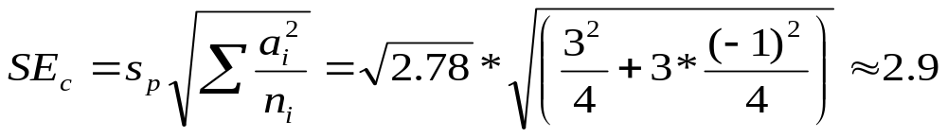
Nematodes: planned comparison
Contrast of all the nematode groups against the control:
Combined contrast hypotheses:
H₀: µ₁ = 1/3 (µ₂+ µ₃ + µ₄) vs.
H_{a}: µ₁ > 1/3 (µ₂+ µ₃ + µ₄) → one tailed
Contrast coefficients: (+1 −1/3 −1/3 −1/3) or (+3 −1 −1 −1)
x¯_{i} s_{i}
G1: 0 nematode 10.65 2.053
G2: 1,000 nematodes 10.425 1.486
G3: 5,000 nematodes 5.6 1.244
G4: 1,0000 nematodes 5.45 1.771
In Excel: TDIST(3.6,12,1) = tdist(t, df, tails) ≈ 0.002 (p-value).
Nematodes result in significantly shorter seedlings (alpha 1%).

Slide 33

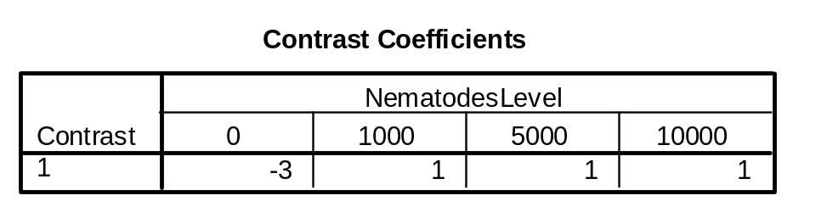
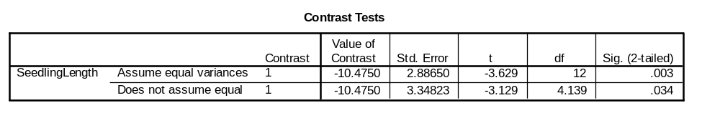
ANOVA vs. contrasts in SPSS
ANOVA: H₀: all µ_{i} are equal vs. H_{a}: not all µ_{i} are equal
➔ not all µ_{i} are equal
Planned comparison:
H₀: µ₁ = 1/3 (µ₂+ µ₃ + µ₄) vs.
H_{a}: µ₁ > 1/3 (µ₂+ µ₃ + µ₄) → one tailed
Contrast coefficients: (+3 −1 −1 −1)
Nematodes result in significantly shorter seedlings (alpha 1%).

Slide 34
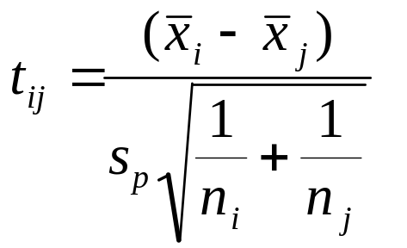
Multiple comparisons
Multiple comparison tests are variants on the two-sample t-test.
  They use the pooled standard deviation s_{p} = √MSE.
  The pooled degrees of freedom DFE.
  And they compensate for the multiple comparisons.
We compute the t-statistic
for all pairs of means:
A given test is significant (µ_{i} and µ_{j} significantly different), when
|t_{ij}| ≥ t** (df = DFE).
The value of t** depends on which procedure you choose to use.

Slide 35
The Bonferroni procedure
The Bonferroni procedure performs a number of pair-wise comparisons with t-tests and then multiplies each p-value by the number of comparisons made. This ensures that the probability of making any false rejection among all comparisons made is no greater than the chosen significance level α.
  As a consequence, the higher the number of pair-wise comparisons you make, the more difficult it will be to show statistical significance for each test. But the chance of committing a type I error also increases with the number of tests made. The Bonferroni procedure lowers the working significance level of each test to compensate for the increased chance of type I errors among all tests performed.

Slide 36
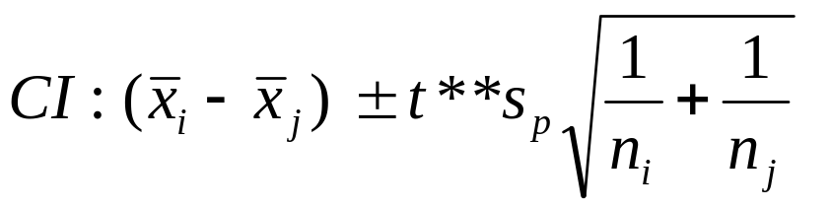
Simultaneous confidence intervals
We can also calculate simultaneous level C confidence intervals for all pair-wise differences (µ_{i} − µ_{j}) between population means:
s_{p} is the pooled variance, MSE.
t** is the t critical with degrees of freedom DFE = N – I, adjusted for multiple, simultaneous comparisons (e.g., Bonferroni procedure).

Slide 37
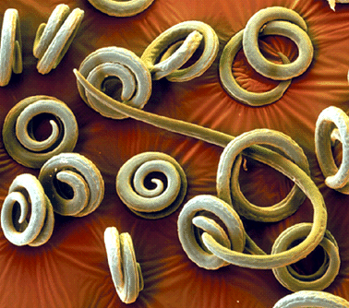
SYSTAT
File contains variables: GROWTH NEMATODES$
Categorical values encountered during processing are:
NEMATODES$ (four levels): 10K, 1K, 5K, none
Dep Var: GROWTH N: 16 Multiple R: 0.867 Squared multiple R: 0.751
Analysis of Variance
Source Sum-of-Squares df Mean-Square F-ratio P
NEMATODES$ 100.647 3 33.549 12.080 0.001
Error 33.328 12 2.777
Post Hoc test of GROWTH Using model MSE of 2.777 with 12 df.
Matrix of pairwise mean differences:
1 2 3 4
1 0.000
2 4.975 0.000
3 0.150 −4.825 0.000
4 5.200 0.225 5.050 0.000
Bonferroni Adjustment
Matrix of pairwise comparison probabilities:
1 2 3 4
1 1.000
2 0.007 1.000
3 1.000 0.009 1.000
4 0.005 1.000 0.006 1.000

Slide 38
SigmaStat—One-Way Analysis of Variance
Normality Test: Passed (P > 0.050)
Equal Variance Test: Passed (P = 0.807)
Group Name N Missing Mean Std dev SEM
None 4 0 10.650 2.053 1.027
1K 4 0 10.425 1.486 0.743
5K 4 0 5.600 1.244 0.622
10K 4 0 5.450 1.771 0.886
Source of variation DF SS MS F P
Between groups 3 100.647 33.549 12.080 <0.001
Residual 12 33.328 2.777
Total 15 133.974
Power of performed test with alpha = 0.050: 0.992
All Pairwise Multiple Comparison Procedures (Bonferroni t-test):
Comparisons for factor: Nematodes
Comparison Diff of means t P P<0.050
None vs. 10K 5.200 4.413 0.005 Yes
None vs. 5K 5.050 4.285 0.006 Yes
None vs. 1K 0.225 0.191 1.000 No
1K vs. 10K 4.975 4.222 0.007 Yes
1K vs. 5K 4.825 4.095 0.009 Yes
5K vs. 10K 0.150 0.127 1.000 No

Slide 39
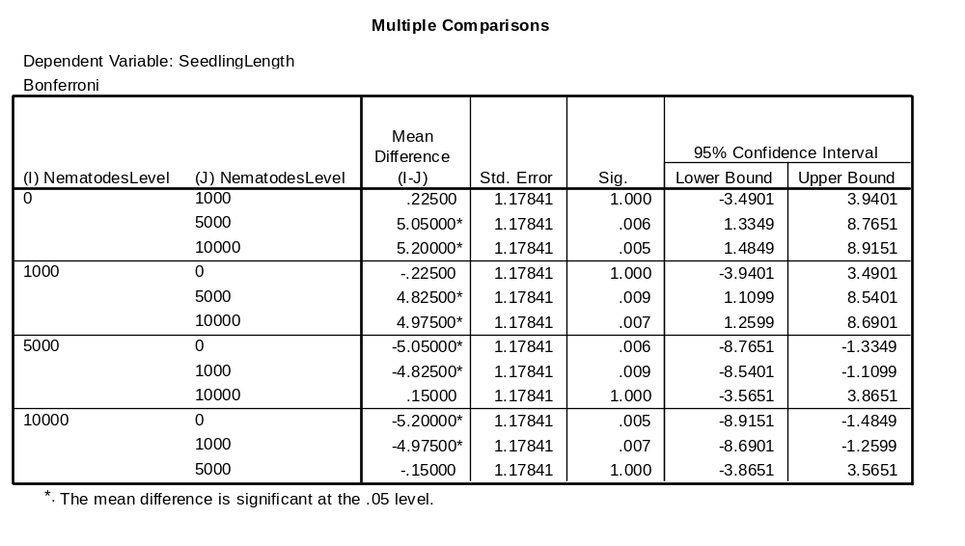
SPSS

Slide 40
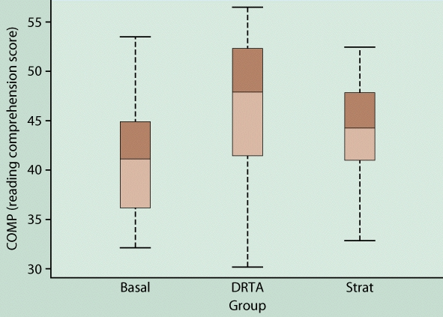
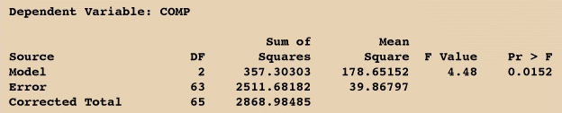
Teaching methods
A study compares the reading comprehension (“COMP,” a test score) of children randomly assigned to one of three teaching methods: basal, DRTA, and strategies.
We test: H₀: µ_{Basal} = µ_{DRTA} = µ_{Strat} vs. H_{a}: H₀ not true
The ANOVA test is significant (α 5%): we have found evidence that the three methods do not all yield the same population mean reading comprehension score.

Slide 41
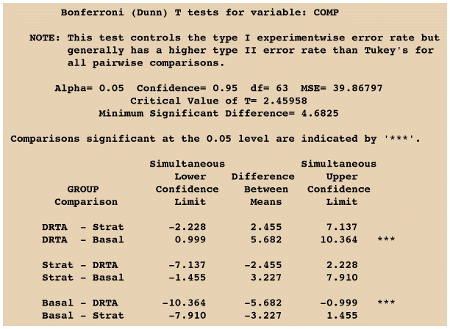
What do you conclude?
The three methods do not yield the same results: We found evidence of a significant difference between DRTA and basal methods (DRTA gave better results on average), but the data gathered does not support the claim of a difference between the other methods (DRTA vs. strategies or basal vs. strategies).

Slide 42
Power
The power, or sensitivity, of a one-way ANOVA is the probability that the test will be able to detect a difference among the groups (i.e. reach statistical significance) when there really is a difference.
Estimate the power of your test while designing your experiment to select sample sizes appropriate to detect an amount of difference between means that you deem important.
  Too small a sample is a waste of experiment, but too large a sample is also a waste of resources.
  A power of at least 80% is often suggested.

Slide 43
Power computations
ANOVA power is affected by
  The significance level α
  The sample sizes and number of groups being compared
  The differences between group means µ_{i}
  The guessed population standard deviation
You need to decide what alternative H_{a} you would consider important, detect statistically for the means µ_{i,} and to guess the common standard deviation σ (from similar studies or preliminary work).
The power computations then require calculating a non-centrality paramenter λ, which follows the F distribution with DFG and DFE degrees of freedom to arrive at the power of the test.

Slide 44
Systat: Power analysis
Alpha = 0.05
Model = Oneway
Number of groups = 4
Within cell S.D. = 1.5
Mean(01) = 7.0
Mean(02) = 8.0
Mean(03) = 9.0
Mean(04) = 10.0
Effect Size = 0.745
Noncentrality parameter = 2.222 * sample size
SAMPLE SIZE POWER
(per cell)
3 0.373
4 0.551
5 0.695
6 0.802
7 0.876
8 0.925
If we anticipated a gradual decrease of seedling length for increasing amounts of nematodes in the pots and would consider gradual changes of 1 mm on average to be important enough to be reported in a scientific journal…
guessed
…then we would reach a power of 80% or more when using six pots or more for each condition.
(Four pots per condition would only bring a power of 55%.)

Slide 45
Systat: Power analysis
Alpha = 0.05
Power = 0.80
Model = One-way
Number of groups = 4
Within cell S.D. = 1.7
Mean(01) = 6.0
Mean(02) = 6.0
Mean(03) = 10.0
Mean(04) = 10.0
Effect size = 1.176
Noncentrality parameter = 5.536 * sample size
SAMPLE SIZE POWER
(per cell)
2 0.394
3 0.766
4 0.931
Total sample size = 16
If we anticipated that only large amounts of nematodes in the pots would lead to substantially shorter seedling lengths and would consider step changes of 4 mm on average an important effect…
guessed
…then we would reach a power of 80% or more when using four pots or more in each group (three pots per condition might be close enough though).

