Slide 1
Looking at Data–Relationships
IPS Chapter 2
2.1: Scatterplots
2.2: Correlation
2.3: Least-Squares Regression
2.4: Cautions About Correlation and Regression
2.5: Data Analysis for Two-Way Tables
2.6: The Question of Causation
© 2012 W.H. Freeman and Company

Slide 2
Looking at Data–Relationships
2.1 Scatterplots
© 2012 W. H. Freeman and Company

Slide 3
Objectives
2.1 Scatterplots
Scatterplots
Explanatory and response variables
Interpreting scatterplots
Outliers
Categorical variables in scatterplots
Scatterplot smoothers

Slide 4
Examining Relationships
Most statistical studies involve more than one variable.
Questions:
What cases does the data describe?
What variables are present and how are they measured?
Are all of the variables quantitative?
Do some of the variables explain or even cause changes in other variables?

Slide 5
Here, we have two quantitative variables for each of 16 students.
  1) How many beers they drank, and
  2) Their blood alcohol level (BAC)
We are interested in the relationship between the two variables: How is one affected by changes in the other one?
Student | Beers | Blood Alcohol
1 | 5 | 0.1
2 | 2 | 0.03
3 | 9 | 0.19
6 | 7 | 0.095
7 | 3 | 0.07
9 | 3 | 0.02
11 | 4 | 0.07
13 | 5 | 0.085
4 | 8 | 0.12
5 | 3 | 0.04
8 | 5 | 0.06
10 | 5 | 0.05
12 | 6 | 0.1
14 | 7 | 0.09
15 | 1 | 0.01
16 | 4 | 0.05

Slide 6
Looking at relationships
Start with a graph
Look for an overall pattern and deviations from the pattern
Use numerical descriptions of the data and overall pattern (if appropriate)

Slide 7
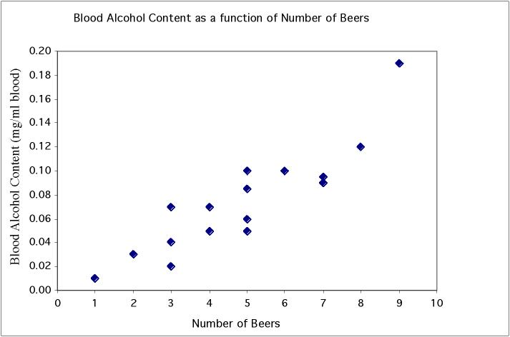
Scatterplots
In a scatterplot, one axis is used to represent each of the variables, and the data are plotted as points on the graph.
Student | Beers | BAC
1 | 5 | 0.1
2 | 2 | 0.03
3 | 9 | 0.19
6 | 7 | 0.095
7 | 3 | 0.07
9 | 3 | 0.02
11 | 4 | 0.07
13 | 5 | 0.085
4 | 8 | 0.12
5 | 3 | 0.04
8 | 5 | 0.06
10 | 5 | 0.05
12 | 6 | 0.1
14 | 7 | 0.09
15 | 1 | 0.01
16 | 4 | 0.05
Notes:
Quantitative data - have two pieces of data per individual and wonder if there is an association between them. Very important in biology, as we not only want to describe individuals but also understand various things about them. Here for example we plot BAC vs number of beers. Can clearly see that there is a pattern to the data. When you drink more beers you generally have a higher BAC. Dots are arranged in pretty straight line - a linear relationship. And since when one goes up, the other does too, it is a positive linear relationship. Also see that

Slide 8
Interpreting scatterplots
After plotting two variables on a scatterplot, we describe the relationship by examining the form, direction, and strength of the association. We look for an overall pattern …
  Form: linear, curved, clusters, no pattern
  Direction: positive, negative, no direction
  Strength: how closely the points fit the “form”
… and deviations from that pattern.
  Outliers
Notes:
An example of a study in which you are looking at the effects of number of beers on blood alcohol content. If you think about it, the response is obviously an increase in blood alcohol, and we want see if we can explain it by the number of beers drunk. Always put the explanatory variable on the x axis and response variable on the y axis.

Slide 9
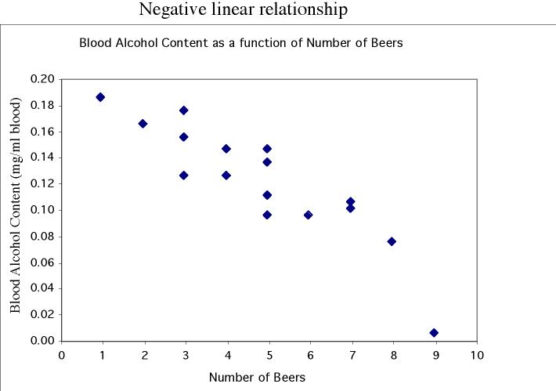
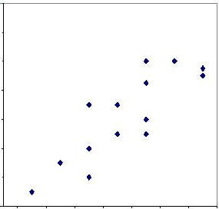
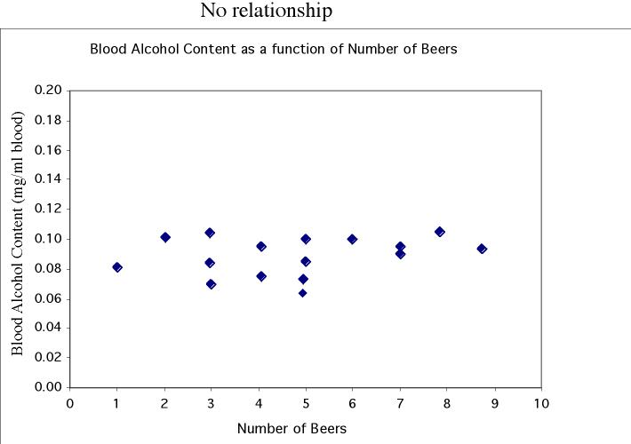
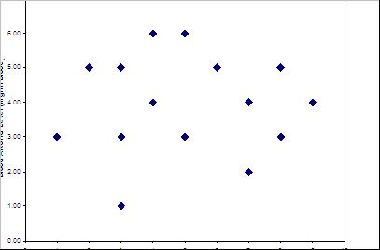
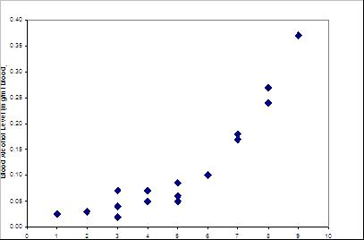
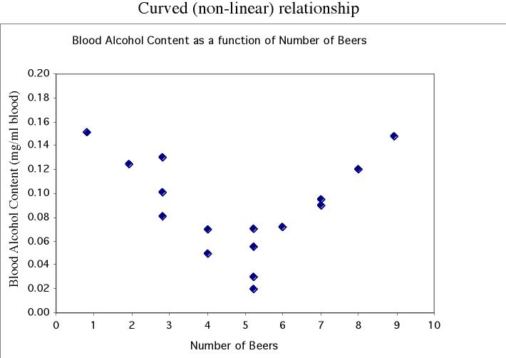
Form and direction of an association
Linear
No relationship
Nonlinear

Slide 10
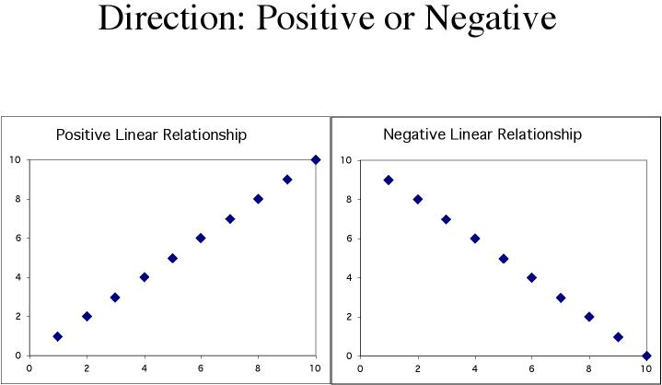
Positive association: High values of one variable tend to occur together with high values of the other variable.
Negative association: High values of one variable tend to occur together with low values of the other variable.
Notes:
An example of a study in which you are looking at the effects of number of beers on blood alcohol content. If you think about it, the response is obviously an increase in blood alcohol, and we want see if we can explain it by the number of beers drunk. Always put the explanatory variable on the x axis and response variable on the y axis.

Slide 11
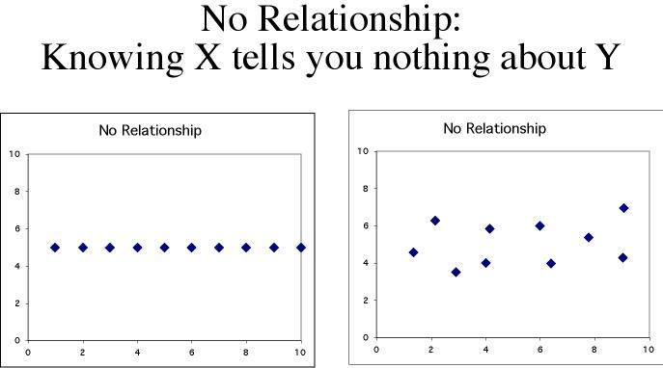
No relationship: X and Y vary independently. Knowing X tells you nothing about Y.

Slide 12
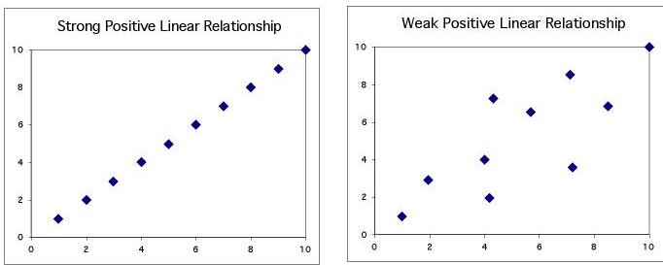
Strength of the association
The strength of the relationship between the two variables can be seen by how much variation, or scatter, there is around the main form.
With a strong relationship, you can get a pretty good estimate of y if you know x.
With a weak relationship, for any x you might get a wide range of y values.

Slide 13
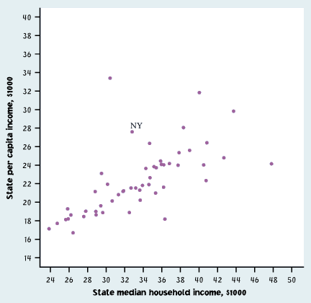
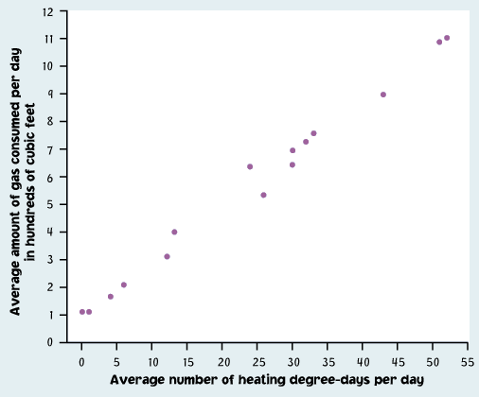
This is a weak relationship. For a particular state median household income, you can’t predict the state per capita income very well.
This is a very strong relationship. The daily amount of gas consumed can be predicted quite accurately for a given temperature value.

Slide 14
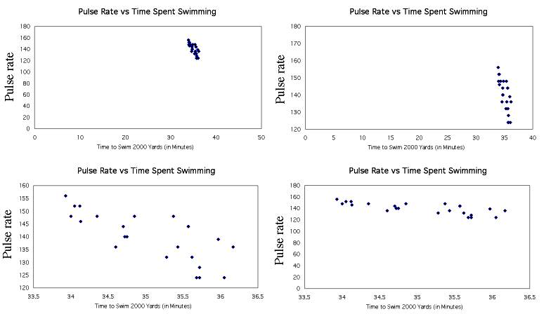
How to scale a scatterplot
Same data in all four plots
Using an inappropriate scale for a scatterplot can give an incorrect impression.
Both variables should be given a similar amount of space:
Plot roughly square
Points should occupy all the plot space (no blank space)

Slide 15
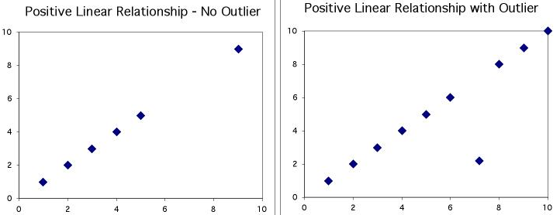
Outliers
An outlier is a data value that has a very low probability of occurrence (i.e., it is unusual or unexpected).
In a scatterplot, outliers are points that fall outside of the overall pattern of the relationship.

Slide 16
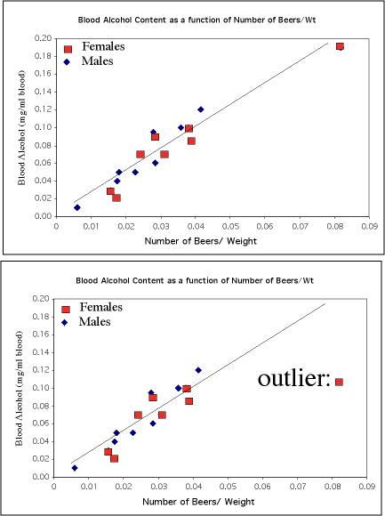
Outliers
Not an outlier:
The upper right-hand point here is not an outlier of the relationship—It is what you would expect for this many beers given the linear relationship between beers/weight and blood alcohol.
This point is not in line with the
others, so it is an outlier of the relationship.

Slide 17
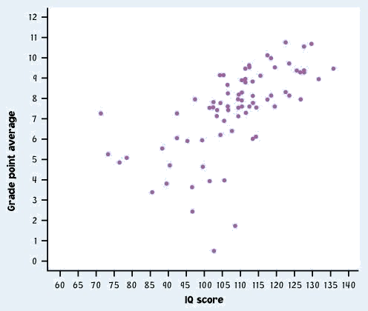
IQ score and
Grade point average
Describe in words what this plot shows.
Describe the direction, shape, and strength. Are there outliers?
What is the deal with these people?

Slide 18
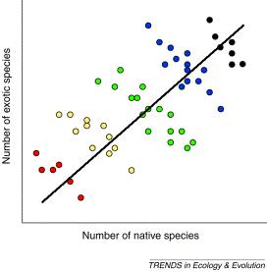
Categorical variables in scatterplots
Often, things are not simple and one-dimensional. We need to group the data into categories to reveal trends.
What may look like a positive linear relationship is in fact a series of negative linear associations.
Plotting different habitats in different colors allows us to make that important distinction.

Slide 19
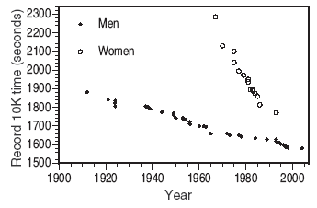
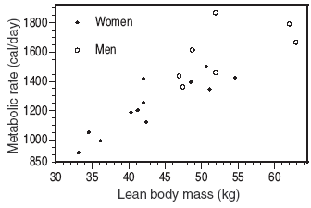
Comparison of men and women racing records over time.
Each group shows a very strong negative linear relationship that would not be apparent without the gender categorization.
Relationship between lean body mass and metabolic rate in men and women. Both men and women follow the same positive linear trend, but women show a stronger association. As a group, males typically have larger values for both variables.

Slide 20
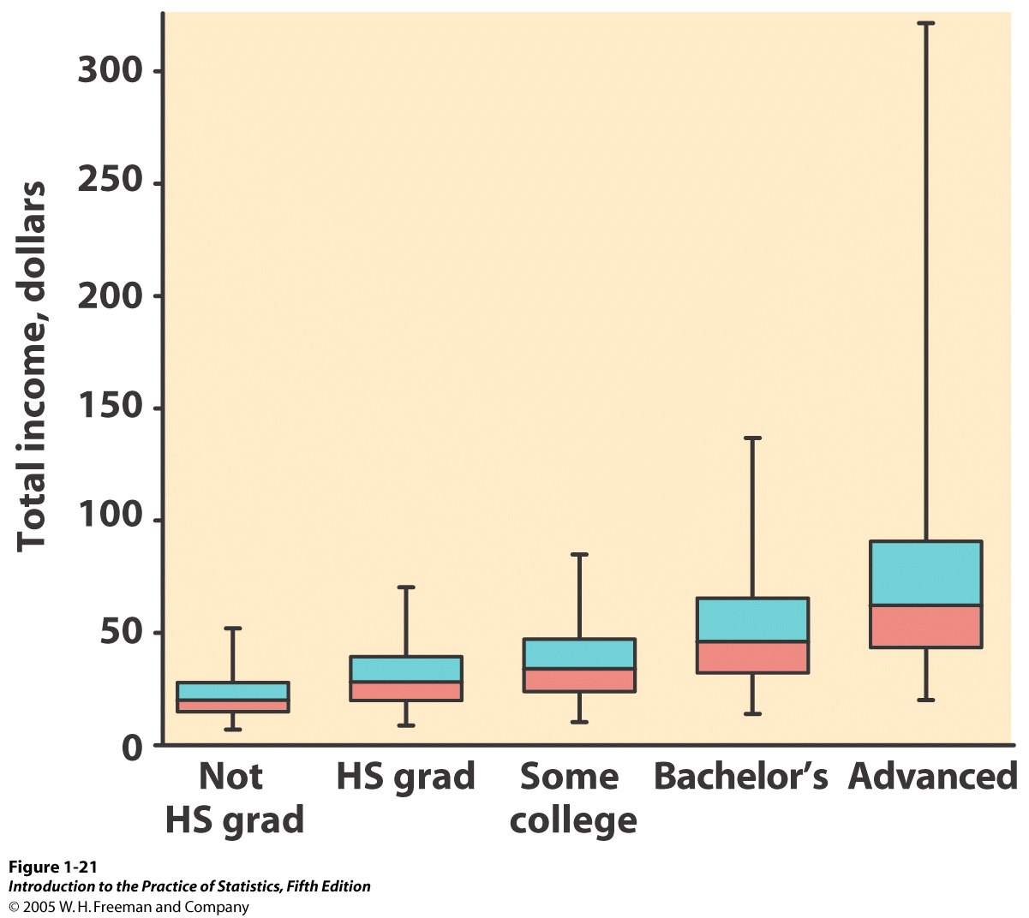
Categorical explanatory variables
When the explanatory variable is categorical, you cannot make a scatterplot, but you can compare the different categories side by side on the same graph (boxplots, or mean +/− standard deviation).
Comparison of income (quantitative response variable) for different education levels (five categories).
But be careful in your interpretation: This is NOT a positive association, because education is not quantitative.

Slide 21
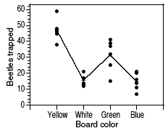
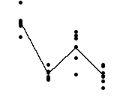
Example: Beetles trapped on boards of different colors
Beetles were trapped on sticky boards scattered throughout a field. The sticky boards were of four different colors (categorical explanatory variable). The number of beetles trapped (response variable) is shown on the graph below.
?
What association? What relationship?
Blue White Green Yellow
Board color
Blue Green White Yellow
Board color
➔ Describe one category at a time.
When both variables are quantitative, the order of the data points is defined entirely by their value. This is not true for categorical data.

Slide 22
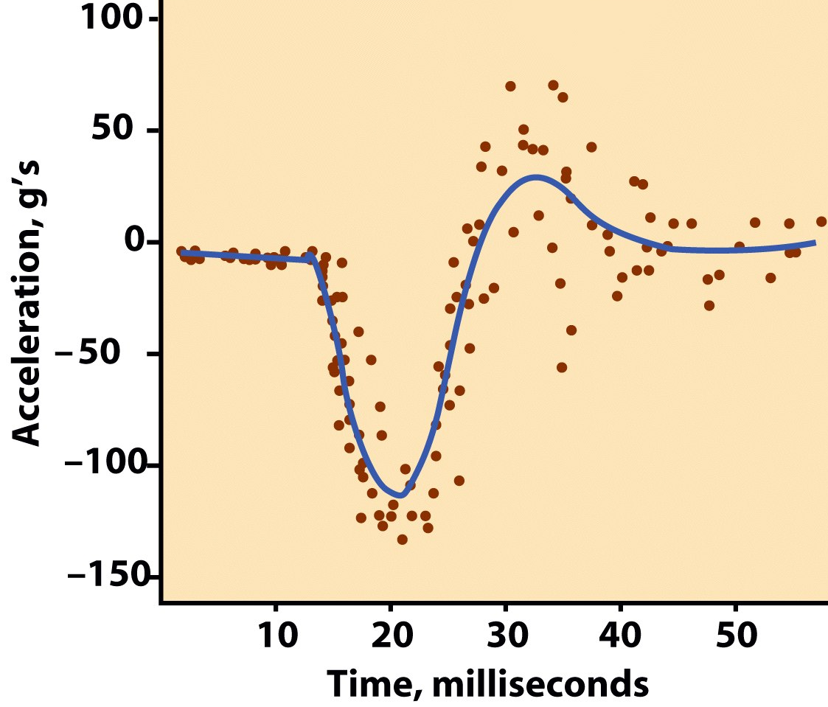
Scatterplot smoothers
When an association is more complex than linear, we can still describe the overall pattern by smoothing the scatterplot.
  You can simply average the y values separately for each x value.
  When a data set does not have many y values for a given x, software smoothers form an overall pattern by looking at the y values for points in the neighborhood of each x value. Smoothers are resistant to outliers.
Time plot of the acceleration of the head of a crash test dummy as a motorcycle hits a wall.
The overall pattern was calculated by a software scatterplot smoother.

Slide 23
Looking at Data—Relationships
2.2 Correlation
© 2012 W. H. Freeman and Company

Slide 24
Objectives
2.2 Correlation
The correlation coefficient “r”
r does not distinguish between x and y
r has no units of measurement
r ranges from -1 to +1
Influential points

Slide 25
The correlation coefficient "r"
The correlation coefficient is a measure of the direction and strength of a linear relationship.
It is calculated using the mean and the standard deviation of both the x and y variables.
Correlation can only be used to describe quantitative variables. Categorical variables don’t have means and standard deviations.

Slide 26
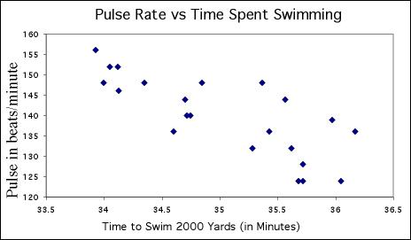
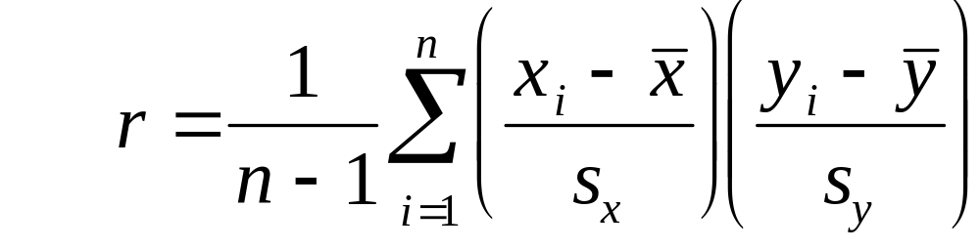


The correlation coefficient "r"
Time to swim: = 35, s_{x} = 0.7
Pulse rate: = 140 s_{y} = 9.5

Slide 27

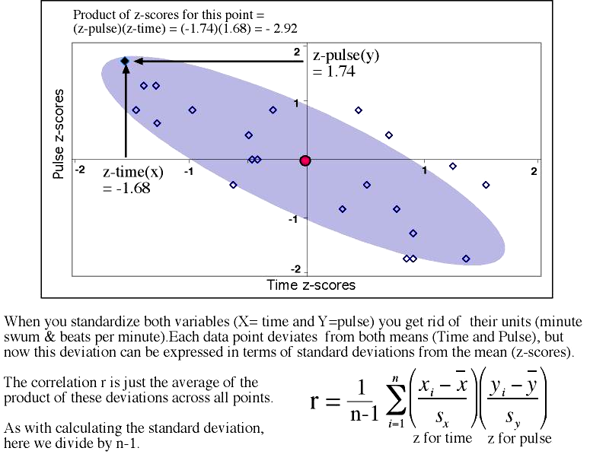
z for time z for pulse
Part of the calculation involves finding z, the standardized score we used when working with the normal distribution.
You DON'T want to do this by hand. Make sure you learn how to use your calculator or software.

Slide 28
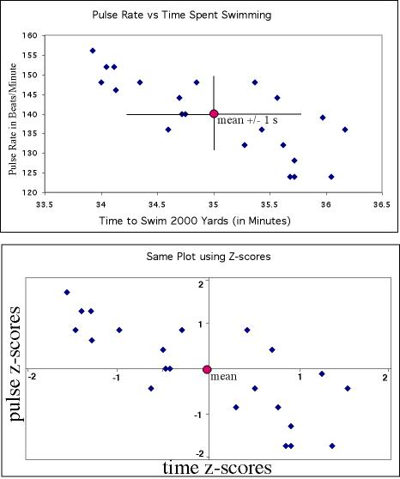

Standardization:
Allows us to compare correlations between data sets where variables are measured in different units or when variables are different.
For instance, we might
want to compare the correlation between [swim time and pulse], with the correlation between [swim time and breathing rate].

Slide 29
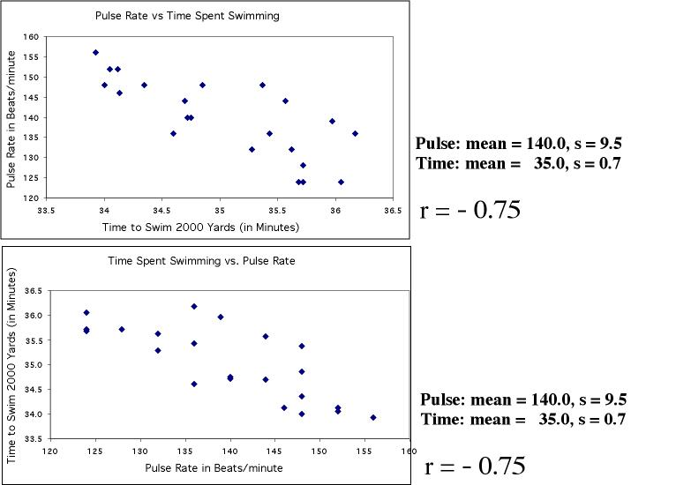
“r” does not distinguish x & y
The correlation coefficient, r, treats x and y symmetrically.
r = -0.75
r = -0.75
"Time to swim" is the explanatory variable here, and belongs on the x axis. However, in either plot r is the same (r=-0.75).

Slide 30
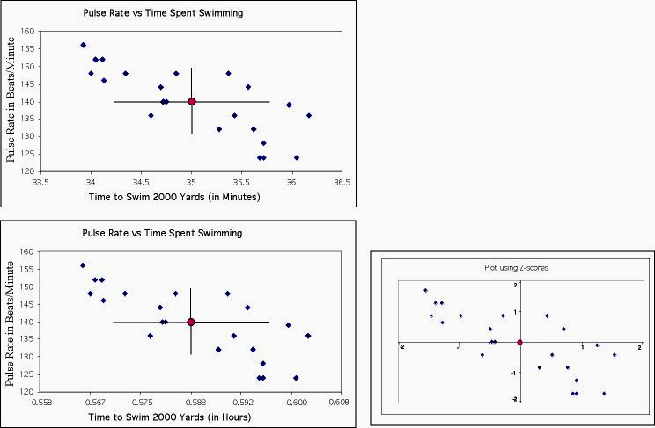
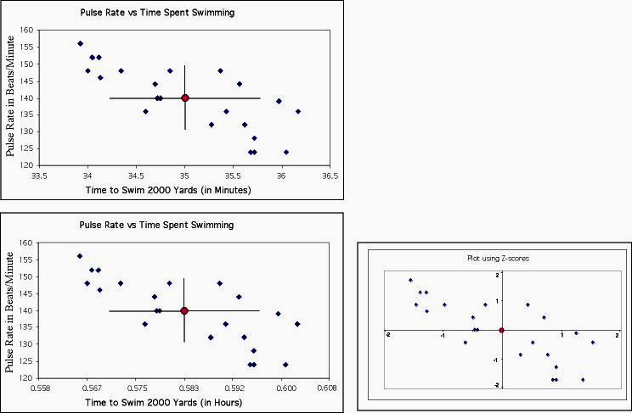
"r" has no unit
r = -0.75
Changing the units of variables does not change the correlation coefficient "r", because we get rid of all our units
when we standardize (get z-scores).
z for time z for pulse
z-score plot is the same
for both plots
r = -0.75

Slide 31
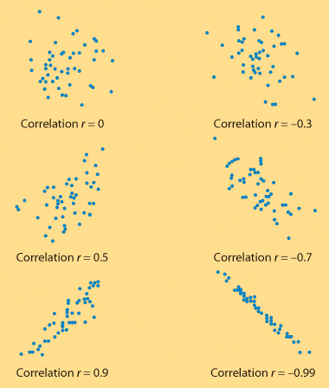
"r" ranges from -1 to +1
"r" quantifies the strength and direction of a linear relationship between 2 quantitative variables.
Strength: how closely the points follow a straight line.
Direction: is positive when individuals with higher X values tend to have higher values of Y.

Slide 32
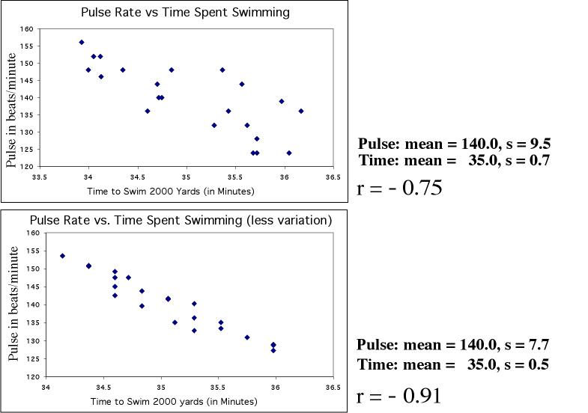
When variability in one or both variables decreases, the correlation coefficient gets stronger
(→ closer to +1 or -1).

Slide 33
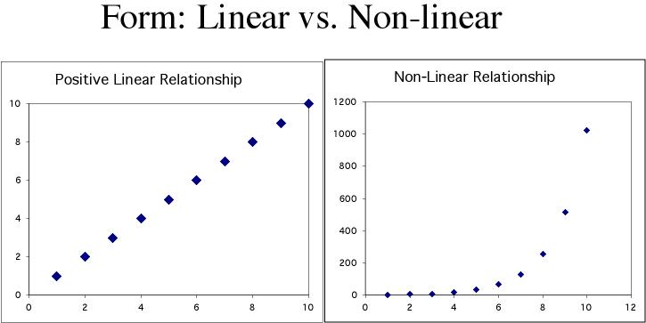
Correlation only describes linear relationships
No matter how strong the association,
r does not describe curved relationships.
Note: You can sometimes transform a non-linear association to a linear form, for instance by taking the logarithm. You can then calculate a correlation using the transformed data.

Slide 34
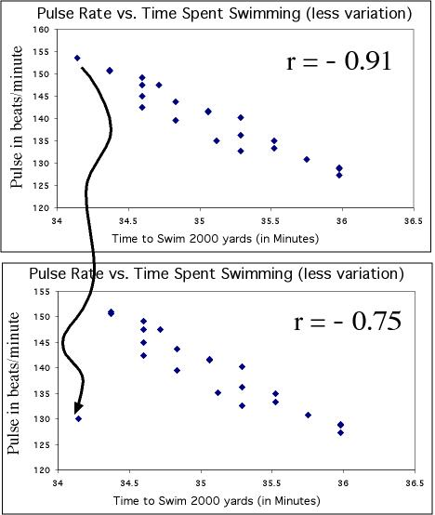
Influential points
Correlations are calculated using means and standard deviations, and thus are NOT resistant to outliers.
Just moving one point away from the general trend here decreases the correlation from -0.91 to -0.75

Slide 35
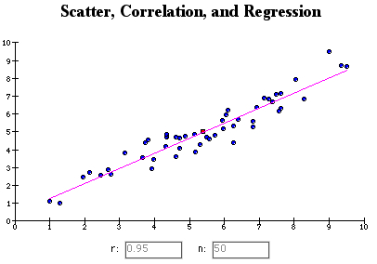
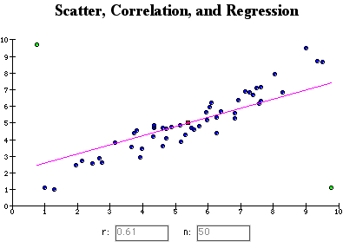
Try it out for yourself—companion book website:
http://www.whfreeman.com/ips7e
Adding two outliers decreases r from 0.95 to 0.61.

Slide 36
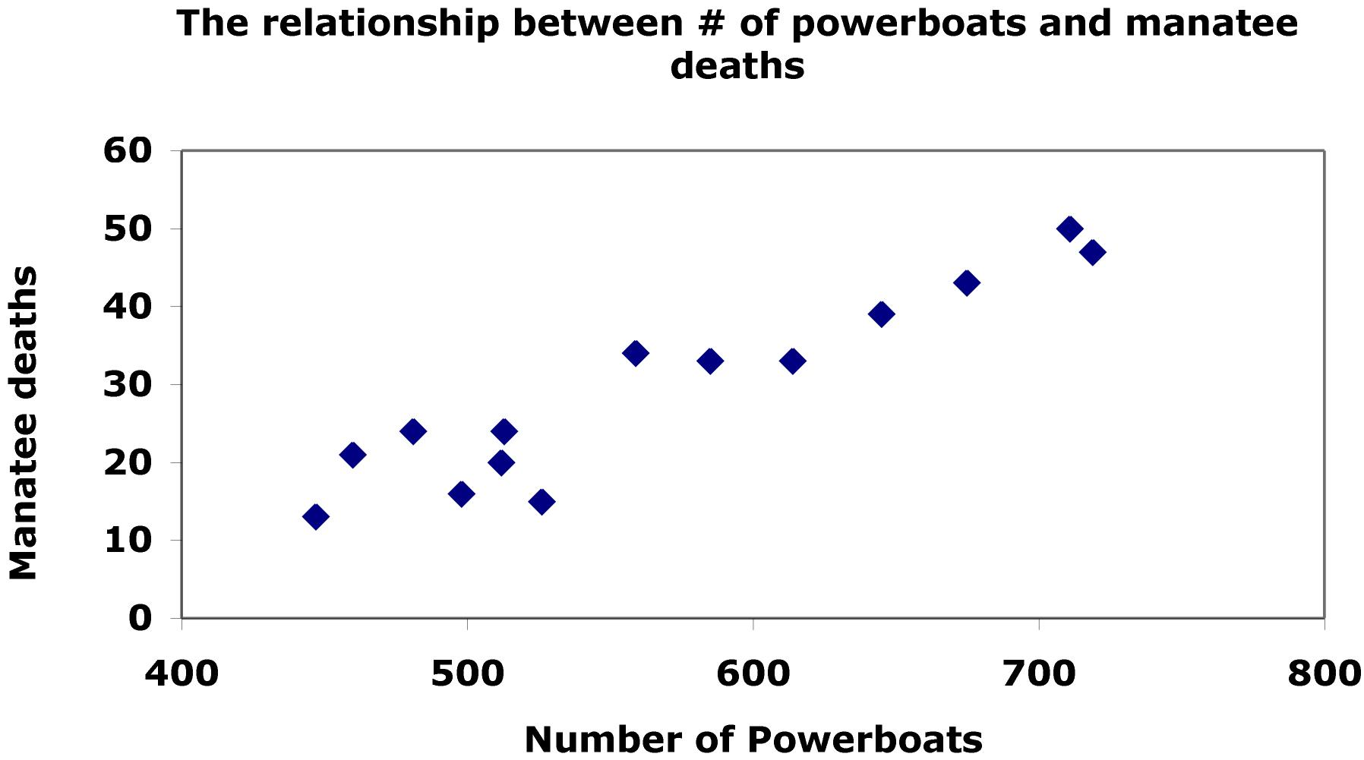

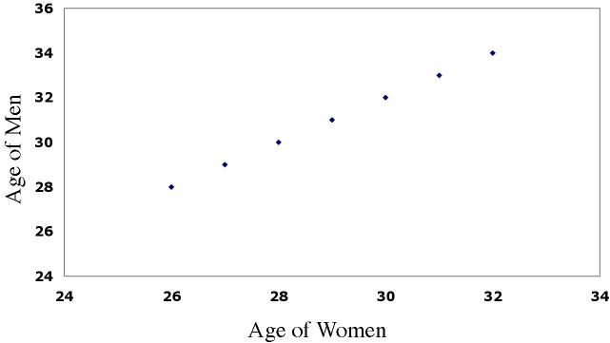
Review examples
1) What is the explanatory variable?
Describe the form, direction, and strength of the relationship.
Estimate r.
(in 1000’s)
2) If women always marry men 2 years older than themselves, what is the correlation of the ages between husband and wife?
age_{man} = age_{woman} + 2
equation for a straight line

Slide 37
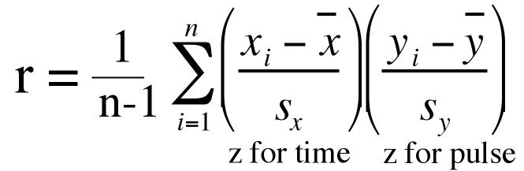
Thought quiz on correlation
Why is there no distinction between explanatory and response variables in correlation?
Why do both variables have to be quantitative?
How does changing the units of measurement affect correlation?
What is the effect of outliers on correlations?
Why doesn’t a tight fit to a horizontal line imply a strong correlation?

Slide 38
Looking at Data–Relationships
2.3 Least-Squares Regression
© 2012 W. H. Freeman and Company

Slide 39
Objectives
2.3 Least-squares regression
Regression lines
Prediction and Extrapolation
Correlation and r²
Transforming relationships

Slide 40
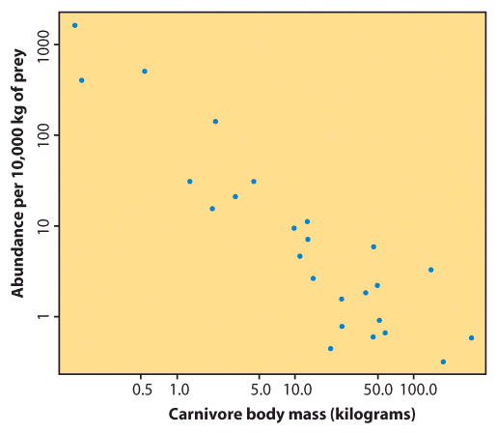
Correlation tells us about strength (scatter) and direction of the linear relationship between two quantitative variables.
In addition, we would like to have a numerical description of how both variables vary together. For instance, is one variable increasing faster than the other one? And we would like to make predictions based on that numerical description.
But which line best describes our data?

Slide 41
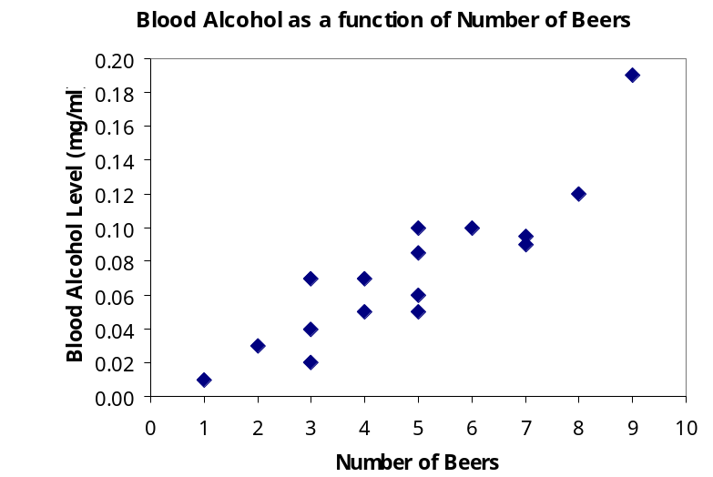
Explanatory and response variables
A response variable measures or records an outcome of a study. An explanatory variable explains changes in the response variable.
Typically, the explanatory or independent variable is plotted on the x axis, and the response or dependent variable is plotted on the y axis.
Response
(dependent)
variable:
blood alcohol
content
y
x
Explanatory (independent) variable:
number of beers
Notes:
An example of a study in which you are looking at the effects of number of beers on blood alcohol content. If you think about it, the response is obviously an increase in blood alcohol, and we want see if we can explain it by the number of beers drunk. Always put the explanatory variable on the x axis and response variable on the y axis.

Slide 42
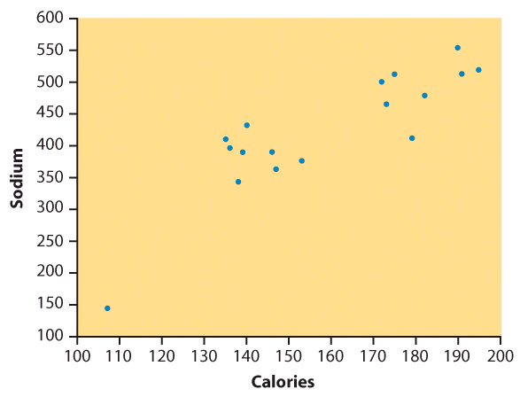
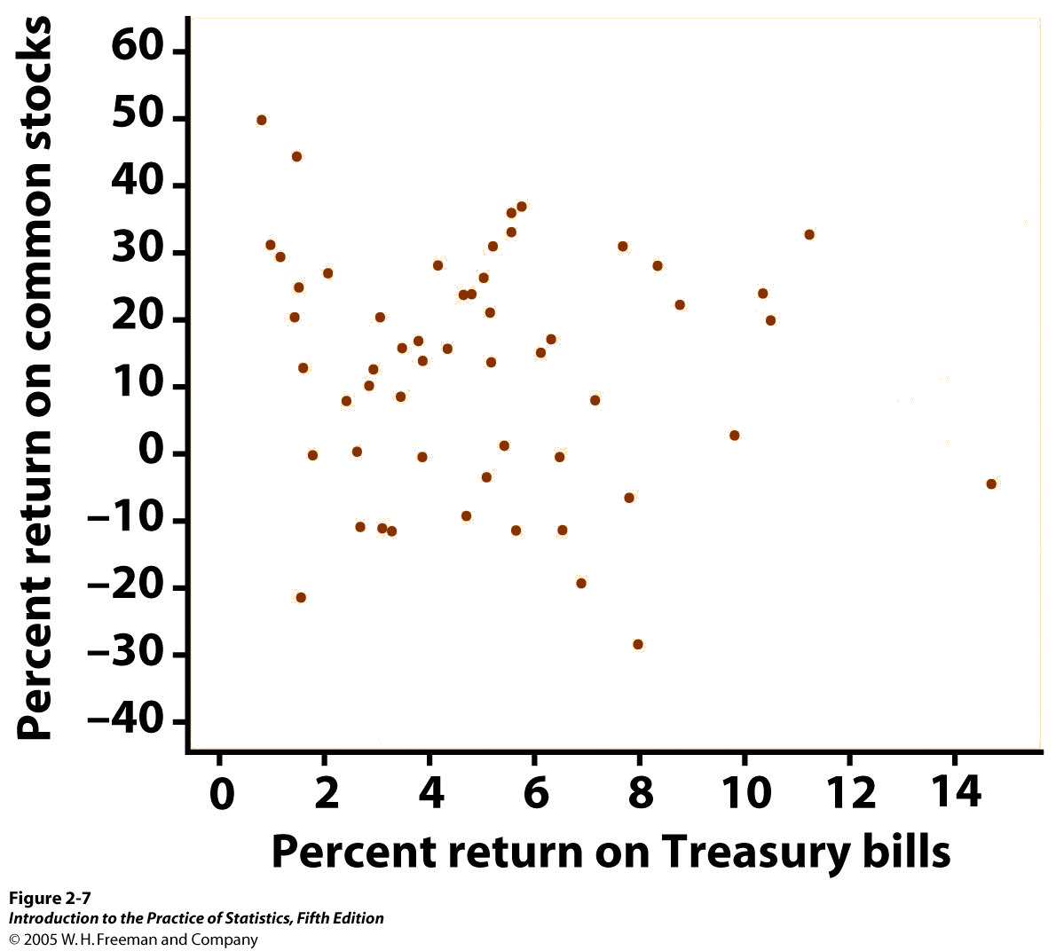
Some plots don’t have clear explanatory and response variables.
Do calories explain sodium amounts?
Does percent return on Treasury
bills explain percent return
on common stocks?
Notes:
However, we can also make scatterplots in which one variable does not cause the other variable to change. For instance, here is UCI men’s basketball ht and weight. Now, as get taller usually have to weigh more, but don’t think of cause and effect here as we did with the effect of beer on BAC.
Just as in chapter 1, we will plot data, examine our scatterplots for overall shape, outliers, etc, then summarize them numerically. Last, just as with using density curves as mathematical descriptions of our histograms, we will use math to model the relationships between variables seen in our scatterplots.

Slide 43
The regression line
A regression line is a straight line that describes how a response variable y changes as an explanatory variable x changes.
We often use a regression line to predict the value of y for a given value of x.
In regression, the distinction between explanatory and response variables is important.

Slide 44
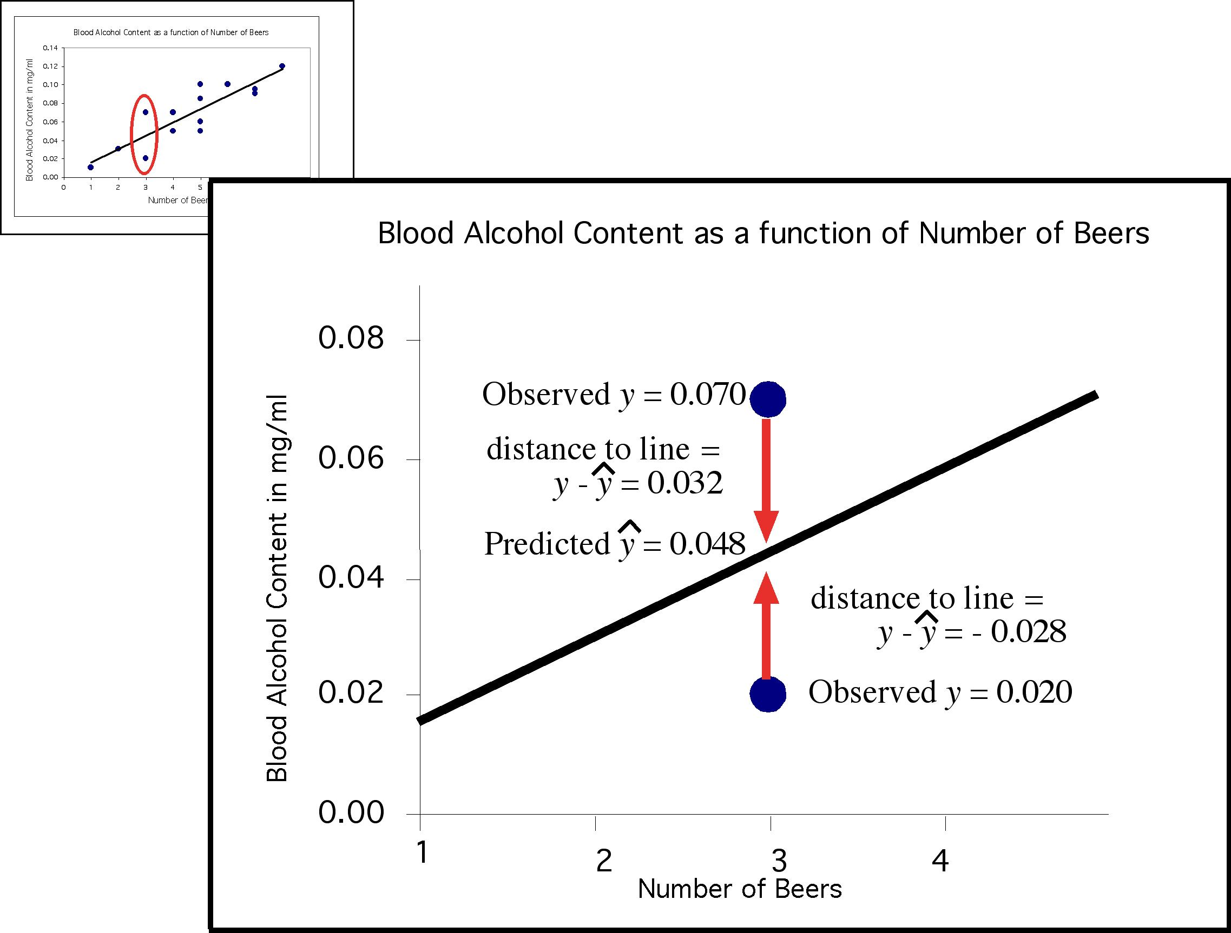
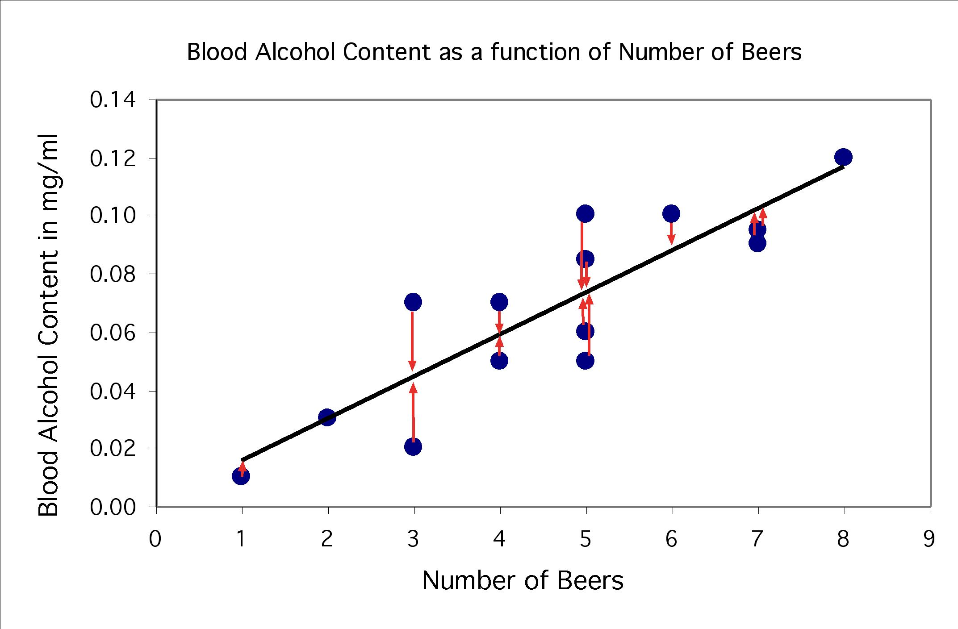
The regression line
The least-squares regression line is the unique line such that the sum of the squared vertical (y) distances between the data points and the line is as small as possible.
Distances between the points and line are squared so all are positive values. This is done so that distances can be properly added (Pythagoras).

Slide 45
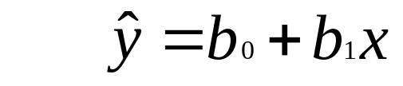
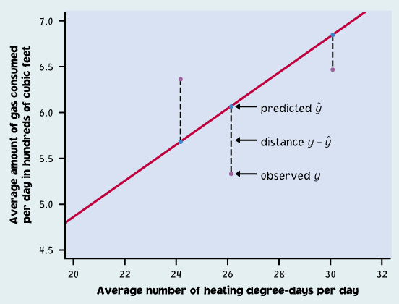

Properties
The least-squares regression line can be shown to have this equation:
is the predicted y value (y hat)
  b₁ is the slope
  b₀ is the y-intercept

Slide 46
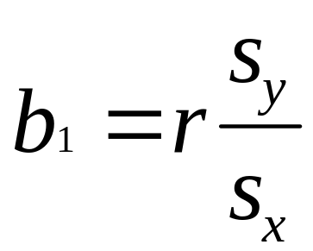
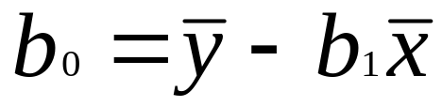


How to:
First we calculate the slope of the line, b₁; from statistics we already know:
r is the correlation.
s_{y} is the standard deviation of the response variable y.
s_{x} is the the standard deviation of the explanatory variable x.
Once we know b₁, the slope, we can calculate b₀, the y-intercept:
Where and are the sample means of the x and y variables
Typically, we use a 2-var stats calculator or stats software.

Slide 47
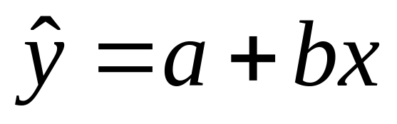


BEWARE!!!
Not all calculators and software use the same convention. Some use:
And some use:
Make sure you know what YOUR calculator gives you for a and b before you answer homework or exam questions.

Slide 48


Software output
intercept
slope
R²
r
R²
intercept
slope

Slide 49


The equation completely describes the regression line.
To plot the regression line you only need to plug two x values into the equation, get y, and draw the line that goes through those points.
Hint: The regression line always passes through the mean of x and y.
The points you use for drawing the regression line are derived from the equation.
They are NOT points from your sample data (except by pure coincidence).

Slide 50

The distinction between explanatory and response variables is crucial in regression. If you exchange y for x in calculating the regression line, you will get the wrong line.
Regression examines the distance of all points from the line in the y direction only.
Hubble telescope data about galaxies moving away from earth:
These two lines are the two regression lines calculated either correctly (x = distance, y = velocity, solid line) or incorrectly (x = velocity, y = distance, dotted line).

Slide 51


Correlation versus regression
The correlation is a measure of spread (scatter) in both the x and y directions in the linear relationship.
In regression we examine the variation in the response variable (y) given change in the explanatory variable (x).

Slide 52




Making predictions
The equation of the least-squares regression allows you to predict y for any x within the range studied.
Nobody in the study drank 6.5 beers, but by finding the value of from the regression line for x = 6.5 we would expect a blood alcohol content of 0.094 mg/ml.

Slide 53


(in 1000s)
ˆ
=
−
y
0
.
125
x
41
.
4
€
There is a positive linear relationship between the number of powerboats registered and the number of manatee deaths.
ˆ
=
−
y
0
.
125
x
41
.
4
The least squares regression line has the equation:
Thus if we were to limit the number of powerboat registrations to 500,000, what could we expect for the number of manatee deaths?
Roughly 21 manatees.

Slide 54

Extrapolation
!!!
!!!
Extrapolation is the use of a regression line for predictions outside the range of x values used to obtain the line.
This can be a very stupid thing to do, as seen here.
Height in Inches
Height in Inches

Slide 55

The y intercept
Sometimes the y-intercept is not biologically possible. Here we have negative blood alcohol content, which makes no sense…
y-intercept shows negative blood alcohol
But the negative value is appropriate for the equation of the regression line.
There is a lot of scatter in the data, and the line is just an estimate.

Slide 56

Coefficient of determination, r²
r², the coefficient of determination, is the square of the correlation coefficient.
r² represents the percentage of the variance in y (vertical scatter from the regression line) that can be explained by changes in x.
Notes:
Go over point that missing zero is OK - this is messy data, a prediction based on messy data.
Residuals should be scattered randomly around the line, or there is something wrong with your data - not linear, outliers, etc.

Slide 57
r = -1
r² = 1
Changes in x explain 100% of the variations in y.
Y can be entirely predicted for any given value of x.
r = 0.87
r² = 0.76
r = 0
r² = 0
Changes in x explain 0% of the variations in y.
The value(s) y takes is (are) entirely independent of what value x takes.
Here the change in x only explains 76% of the change in y. The rest of the change in y (the vertical scatter, shown as red arrows) must be explained by something other than x.

Slide 58


There is quite some variation in BAC for the same number of beers drank. A person’s blood volume is a factor in the equation that was overlooked here.
r =0.7
r² =0.49
We changed number of beers to number of beers/weight of person in lb.
r =0.9
r² =0.81
In the first plot, number of beers only explains 49% of the variation in blood alcohol content.
But number of beers / weight explains 81% of the variation in blood alcohol content.
Additional factors contribute to variations in BAC among individuals (like maybe some genetic ability to process alcohol).
Notes:
So let’s look at this scatterplot. Overall pattern: in general, the BAC increases with the number of beers you drink.

Slide 59

Grade performance
If class attendance explains 16% of the variation in grades, what is the correlation between percent of classes attended and grade?
1. We need to make an assumption: attendance and grades are positively correlated. So r will be positive too.
2. r² = 0.16, so r = +√0.16 = + 0.4
A weak correlation.

Slide 60
Transforming relationships
A scatterplot might show a clear relationship between two quantitative variables, but issues of influential points or nonlinearity prevent us from using correlation and regression tools.
Transforming the data—changing the scale in which one or both of the variables are expressed—can make the shape of the relationship linear in some cases.
  Example: Patterns of growth are often exponential, at least in their initial phase. Changing the response variable y into log(y) or ln(y) will transform the pattern from an upward-curved exponential to a straight line.

Slide 61




Exponential bacterial growth
In ideal environments, bacteria multiply through binary fission. The number of bacteria can double every 20 minutes in that way.
1 - 2 - 4 - 8 - 16 - 32 - 64 - …
Exponential growth 2^{n},
not suitable for regression.
log(2^{n}) = n*log(2) ≈ 0.3n
Taking the log changes the growth pattern into a straight line.

Slide 62


Body weight and brain weight in 96 mammal species
r = 0.86, but this is misleading.
The elephant is an influential point. Most mammals are very small in comparison. Without this point, r = 0.50 only.
Now we plot the log of brain weight against the log of body weight.
The pattern is linear, with r = 0.96.
The vertical scatter is homogenous
→ good for predictions of brain weight from body weight (in the log scale).

Slide 63
Looking at Data–Relationships
2.4 Cautions about Correlation and Regression
© 2012 W. H. Freeman and Company

Slide 64
Objectives
2.4 Cautions about correlation and regression
Residuals
Outliers and influential points
Lurking variables
Correlation/regression using averages
The restricted range problem

Slide 65
Correlation/regression using averages
Many regression or correlation studies use average data.
While this is appropriate, you should know that correlations based on averages are usually quite higher than those made on the raw data.
The correlation is a measure of spread (scatter) in a linear relationship. Using averages greatly reduces the scatter.
Therefore, r and r² are typically greatly increased when averages are used.

Slide 66


Boys
Boys
Each dot represents an average. The variation among boys per age class is not shown.
These histograms illustrate that each mean represents a distribution of boys of a particular age.
Should parents be worried if their son does not match the point for his age?
If the raw values were used in the correlation instead of the mean, there would be a lot of spread in the y-direction, and thus the correlation would be smaller.

Slide 67

That's why typically growth charts show a range of values (here from 5th to 95th percentiles).
This is a more comprehensive way of displaying the same information.
Notes:
So, any individual
boy may be well within the range of height for his age, but
also be within the distributions for boys year or two older
or younger as well. Two possible size distributions are shown.

Slide 68

Residuals
The distances from each point to the least-squares regression line give us potentially useful information about the contribution of individual data points to the overall pattern of scatter.
These distances are
called “residuals.”
The sum of these
residuals is always 0.
Points above the line have a positive residual.
Points below the line have a negative residual.
Predicted ŷ
Observed y
Notes:
So where does this line come from?

Slide 69

Residual plots
Residuals are the distances between y-observed and y-predicted. We plot them in a residual plot.
If residuals are scattered randomly around 0, chances are your data
fit a linear model, was normally distributed, and you didn’t have outliers.

Slide 70


The x-axis in a residual plot is the same as on the scatterplot.
Only the y-axis is different.

Slide 71

Residuals are randomly scattered—good!
Curved pattern—means the relationship
you are looking at is not linear.
A change in variability across a plot is a warning sign. You need to find out why it is, and remember that predictions made in areas of larger variability will not be as good.

Slide 72
Outliers and influential points
Outlier: observation that lies outside the overall pattern of observations.
“Influential individual”: observation that markedly changes the regression if removed. This is often an outlier on the x-axis.
Child 19 = outlier in y direction
Child 19 is an outlier of the relationship.
Child 18 is only an outlier in the x direction and thus might be an influential point.
Child 18 = outlier in x direction

Slide 73

All data
Without child 18
Without child 19
outlier in y-direction
Are these points influential?
influential

Slide 74
Always plot your data
A correlation coefficient and a regression line can be calculated for any relationship between two quantitative variables. However, outliers greatly influence the results, and running a linear regression on a nonlinear association is not only meaningless but misleading.
So make sure to always plot your data before you run a correlation or regression analysis.

Slide 75

Always plot your data!
The correlations all give r ≈ 0.816, and the regression lines are all approximately ŷ = 3 + 0.5x. For all four sets, we would predict ŷ = 8 when x = 10.

Slide 76

However, making the scatterplots shows us that the correlation/ regression analysis is not appropriate for all data sets.
Moderate linear association; regression OK.
Obvious nonlinear relationship; regression not OK.
One point deviates from the highly linear pattern; this outlier must be examined closely before proceeding.
Just one very influential point; all other points have the same x value; a redesign is due here.

Slide 77


Lurking variables
A lurking variable is a variable not included in the study design that does have an effect on the variables studied.
Lurking variables can falsely suggest a relationship.
  What is the lurking variable in these examples?
  How could you answer if you didn’t know anything about the topic?
Strong positive association between
number of firefighters at a fire site and the
amount of damage a fire does.
  Negative association between moderate
  amounts of wine drinking and death rates
  from heart disease in developed nations.

Slide 78
There is quite some variation in BAC for the same number of beers drank. A person’s blood volume is a factor in the equation that we have overlooked.
Now we change number of beers to number of beers/weight of person in lb.
The scatter is much smaller now. One’s weight was indeed influencing the response variable “blood alcohol content.”
Notes:
So let’s look at this scatterplot. Overall pattern: in general, the BAC increases with the number of beers you drink.

Slide 79
Vocabulary: lurking vs. confounding
A lurking variable is a variable that is not among the explanatory or response variables in a study and yet may influence the interpretation of relationships among those variables.
Two variables are confounded when their effects on a response variable cannot be distinguished from each other. The confounded variables may be either explanatory variables or lurking variables.
Association is not causation. Even if an association is very strong, this is not by itself good evidence that a change in x will cause a change in y.

Slide 80
Caution before rushing into a correlation or a regression analysis
Do not use a regression on inappropriate data.
  Pattern in the residuals
  Presence of large outliers Use residual plots for help.
  Clumped data falsely appearing linear
Beware of lurking variables.
Avoid extrapolating (going beyond interpolation).
Recognize when the correlation/regression is performed on averages.
A relationship, however strong it is, does not itself imply causation.

Slide 81
Looking at Data–Relationships
2.5 Data analysis for two-way tables
© 2012 W.H. Freeman and Company

Slide 82
Objectives
2.5 Data analysis for two-way tables
Two-way tables
Joint distributions
Marginal distributions
Relationships between categorical variables
Conditional distributions
Simpson’s paradox

Slide 83

Two-way tables
An experiment has a two-way, or block, design if two categorical factors are studied with several levels of each factor.
Two-way tables organize data about two categorical variables obtained from a two-way, or block, design. (There are now two ways to group the data).
Group by age
Record education
First factor: age
Second factor: education

Slide 84
Two-way tables
We call education the row variable and age group the column variable.
Each combination of values for these two variables is called a cell.
For each cell, we can compute a proportion by dividing the cell entry by the total sample size. The collection of these proportions would be the joint distribution of the two variables.

Slide 85
Marginal distributions
We can look at each categorical variable separately in a two-way table by studying the row totals and the column totals. They represent the marginal distributions, expressed in counts or percentages. (They are written as if in a margin.)
2000 U.S. census

Slide 86


The marginal distributions can then be displayed on separate bar graphs, typically expressed as percents instead of raw counts. Each graph represents only one of the two variables, completely ignoring the second one.

Slide 87


Parental smoking
Does parental smoking influence the smoking habits of their high school children?
Summary two-way table: High school students were asked whether they smoke and whether their parents smoke.
Marginal distribution for the categorical variable “parental smoking”:
The row totals are used and re-expressed as percent of the grand total.
 | Both parents smoke | One parent smokes | Neither parent smokes
Percent of Students | 33.1% | 41.7% | 25.2%
The percents are then displayed in a bar graph.

Slide 88
Relationships between categorical variables
The marginal distributions summarize each categorical variable independently. But the two-way table actually describes the relationship between both categorical variables.
The cells of a two-way table represent the intersection of a given level of one categorical factor and a given level of the other categorical factor.

Slide 89
Conditional Distribution
In the table below, the 25 to 34 age group occupies the first column. To find the complete distribution of education in this age group, look only at that column. Compute each count as a percent of the column total.
These percents should add up to 100% because all persons in this age group fall into one of the education categories. These four percents together are the conditional distribution of education, given the 25 to 34 age group.
2000 U.S. census

Slide 90

Conditional distributions
The percents within the table represent the conditional distributions. Comparing the conditional distributions allows you to describe the “relationship” between both categorical variables.
Here the percents are calculated by age range (columns).
29.30% = 11071
37785
= cell total .
column total

Slide 91

The conditional distributions can be graphically compared using side by side bar graphs of one variable for each value of the other variable.
Here, the percents are calculated by age range (columns).

Slide 92



Music and wine purchase decision
What is the relationship between type of music played in supermarkets and type of wine purchased?
We want to compare the conditional distributions of the response variable (wine purchased) for each value of the explanatory variable (music played). Therefore, we calculate column percents.
Calculations: When no music was played, there were 84 bottles of wine sold. Of these, 30 were French wine.
30/84 = 0.357 ➔ 35.7% of the wine sold was French when no music was played.
30 = 35.7%
84
₌ cell total .
column total
We calculate the column conditional percents similarly for each of the nine cells in the table:

Slide 93



For every two-way table, there are two sets of possible conditional distributions.
Does background music in supermarkets influence customer purchasing decisions?
Wine purchased for each kind of music played (column percents)
Music played for each kind of wine purchased (row percents)

Slide 94


Simpson’s paradox
An association or comparison that holds for all of several groups can reverse direction when the data are combined (aggregated) to form a single group. This reversal is called Simpson’s paradox.
Example: Hospital death rates
On the surface, Hospital B would seem to have a better record.
But once patient
condition is taken
into account, we
see that hospital A
has in fact a better
record for both patient conditions (good and poor).
Here, patient condition was the lurking variable.

Slide 95
Looking at Data–Relationships
2.6 The Question of Causation
© 2012 W. H. Freeman and Company

Slide 96
Objectives
2.6 The question of causation
Causation
Common response
Confounding
Establishing causation

Slide 97
Explaining association: causation
Association, however strong, does NOT imply causation.
Example 1: Daughter’s body mass index depends on mother’s body mass index. This is an example of direct causation.
Example 2: Married men earn more than single men. Can a man raise his income by getting married?
Only careful experimentation can show causation.

Slide 98


Association and causation
Not all examples are so obvious…

Slide 99
Explaining association: common response
Students who have high SAT scores in high school have high GPAs in their first year of college.
This positive correlation can be explained as a common response to students’ ability and knowledge.
The observed association between two variables x and y could be explained by a third lurking variable z.
Both x and y change in response to changes in z. This creates an association even though there is no direct causal link.

Slide 100
Explaining association: confounding
Two variables are confounded when their effects on a response variable cannot be distinguished from each other. The confounded variables may be either explanatory variables or lurking variables.
Example: Studies have found that religious people live longer than nonreligious people.
Religious people also take better care of themselves and are less likely to smoke or be overweight.

Slide 101

Some possible explanations for an observed association. The dashed lines show an association. The solid arrows show a cause-and-effect link. x is explanatory, y is response, and z is a lurking variable.
Figure 2.28
Introduction to the Practice of Statistics, Sixth Edition
© 2009 W.H. Freeman and Company

Slide 102

Establishing causation
It appears that lung cancer is associated with smoking.
How do we know that both of these variables are not being affected by an unobserved third (lurking) variable?
For instance, what if there is a genetic predisposition that causes people to both get lung cancer and become addicted to smoking, but the smoking itself doesn’t CAUSE lung cancer?
We can evaluate the association using the following criteria:
The association is strong.
The association is consistent.
Higher doses are associated with stronger responses.
Alleged cause precedes the effect.
The alleged cause is plausible.

Slide 103
Alternate Slides
The following slides offer alternate software output data and examples for this presentation.

Slide 104


Software output
CrunchIt!
JMP
Notes:
JMP and CrunchIt! slide for slide 48. Source file in alternate Word and Excel files.

Slide 105

Software output
CrunchIt!
JMP
Notes:
JMP and CrunchIt! slide for slide 48. Source file in alternate Word and Excel files.

