Slide 1
Inference for Distributions
IPS Chapter 7
7.1: Inference for the Mean of a Population
7.2: Comparing Two Means
7.3: Optional Topics in Comparing Distributions
© 2012 W.H. Freeman and Company
Notes:
Alternate to slide 1

Slide 2
Inference for Distributions
7.1 Inference for the Mean of a Population
© 2012 W.H Freeman and Company

Slide 3
Objectives
7.1 Inference for the mean of a population
  The t distributions
  The one-sample t confidence interval
  The one-sample t test
  Matched pairs t procedures
  Robustness
  Power of the t-test
  Inference for non-normal distributions

Slide 4

Sweetening colas
Cola manufacturers want to test how much the sweetness of a new cola drink is affected by storage. The sweetness loss due to storage was evaluated by 10 professional tasters (by comparing the sweetness before and after storage):
Taster Sweetness loss
1 2.0
2 0.4
3 0.7
4 2.0
5 −0.4
6 2.2
7 −1.3
8 1.2
9 1.1
10 2.3
Obviously, we want to test if storage results in a loss of sweetness, thus:
H₀: μ = 0 versus H_{a}: μ > 0
This looks familiar. However, here we do not know the population parameter σ.
  The population of all cola drinkers is too large.
  Since this is a new cola recipe, we have no population data.
This situation is very common with real data.

Slide 5
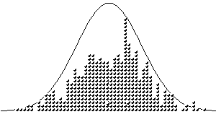
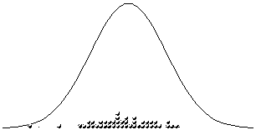
When σ is unknown
The sample standard deviation s provides an estimate of the population standard deviation σ.
When the sample size is large, the sample is likely to contain elements representative of the whole population. Then s is a good estimate of σ.
But when the sample size is small, the sample contains only a few individuals. Then s is a mediocre estimate of σ.
Population
distribution
Large sample
Small sample

Slide 6
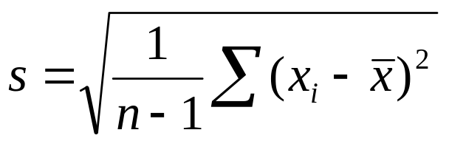
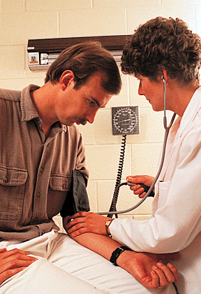
Standard deviation s – standard error s/√n
For a sample of size n,
the sample standard deviation s is:
n − 1 is the “degrees of freedom.”
The value s/√n is called the standard error of the mean SEM.
Scientists often present sample results as mean ± SEM.
A study examined the effect of a new medication on the seated systolic blood pressure. The results, presented as mean ± SEM for 25 patients, are 113.5 ± 8.9.
What is the standard deviation s of the sample data?
SEM = s/√n <=> s = SEM*√n
s = 8.9*√25 = 44.5

Slide 7
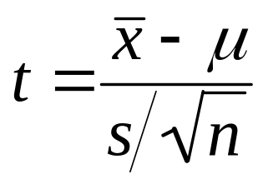
The t distributions
Suppose that an SRS of size n is drawn from an N(µ, σ) population.
When σ is known, the sampling distribution is N(μ, σ/√n).
When σ is estimated from the sample standard deviation s, the sampling distribution follows a t distribution t(μ, s/√n) with degrees of freedom n − 1.
is the one-sample t statistic.

Slide 8
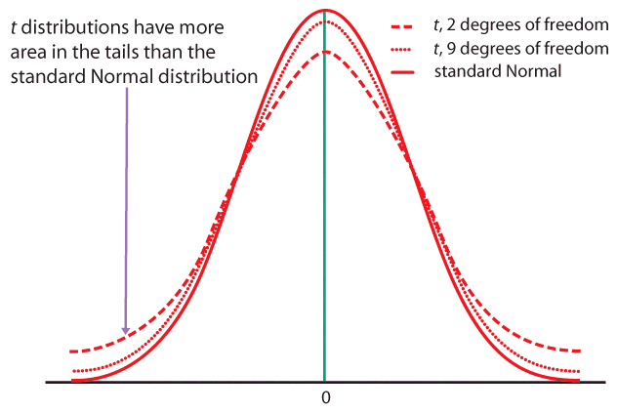
When n is very large, s is a very good estimate of σ, and the corresponding t distributions are very close to the normal distribution.
The t distributions become wider for smaller sample sizes, reflecting the lack of precision in estimating σ from s.

Slide 9
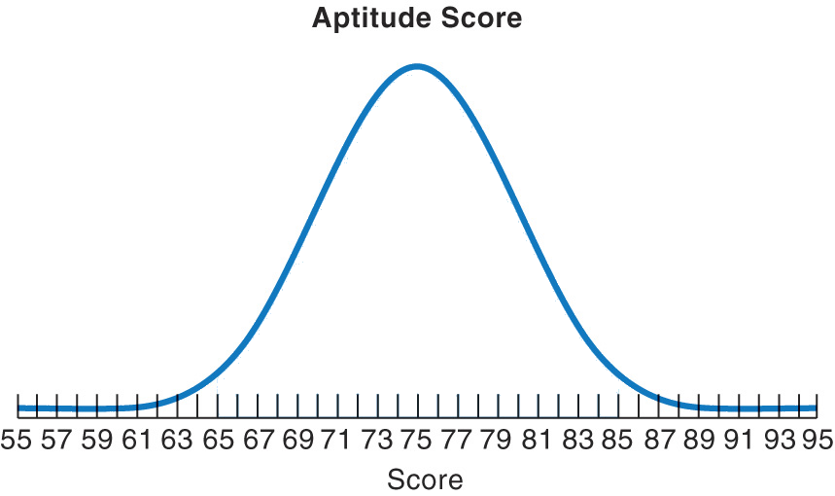
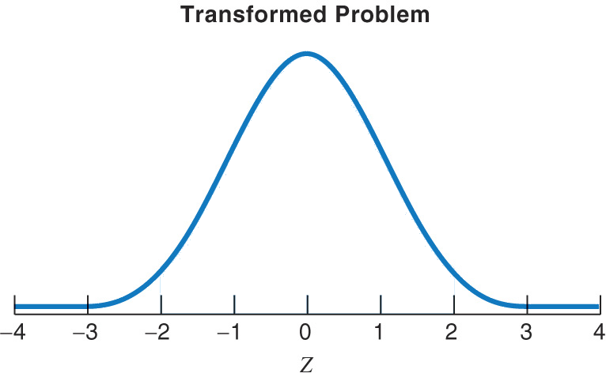

Standardizing the data before using Table D
As with the normal distribution, the first step is to standardize the data. Then we can use Table D to obtain the area under the curve.
t(μ,s/√n)
df = n − 1
t(0,1)
df = n − 1
s/√n
1
μ
0
t
Here, μ is the mean (center) of the sampling distribution,
and the standard error of the mean s/√n is its standard deviation (width).
You obtain s, the standard deviation of the sample, with your calculator.

Slide 10
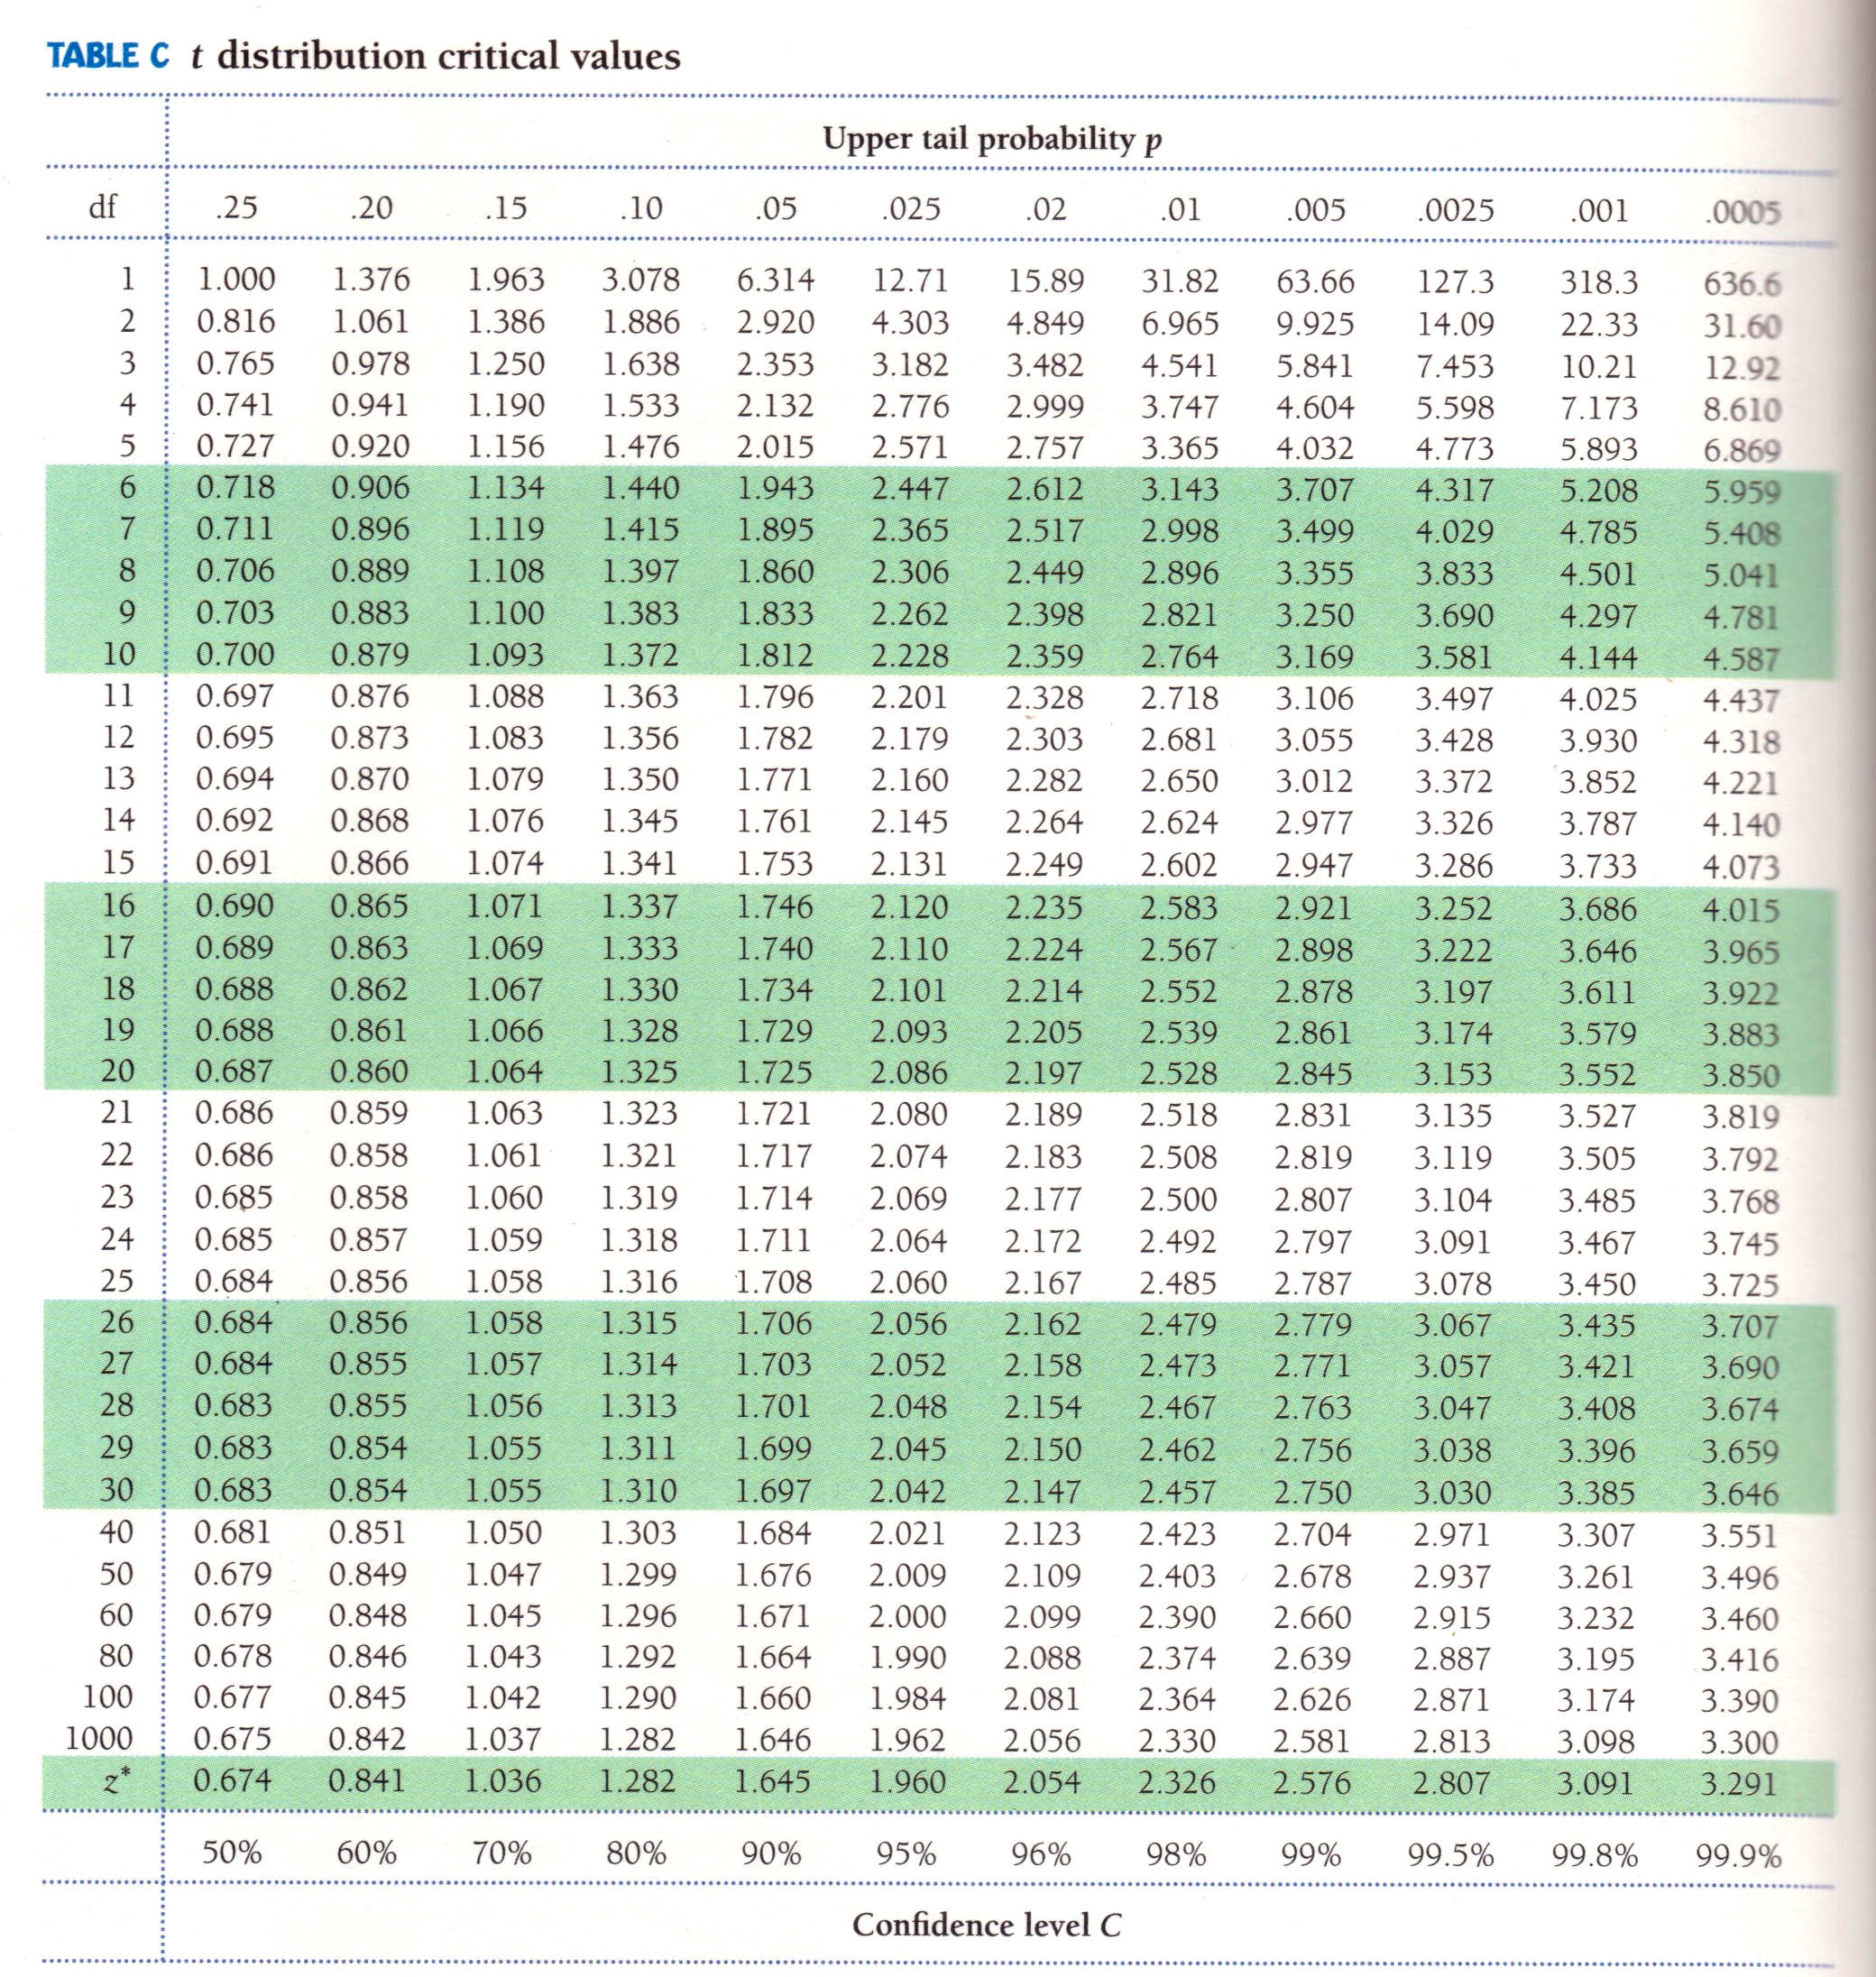
Table D
When σ is unknown, we use a t distribution with “n−1” degrees of freedom (df).
Table D shows the
z-values and t-values corresponding to landmark P-values/ confidence levels.
When σ is known, we use the normal distribution and the standardized z-value.

Slide 11
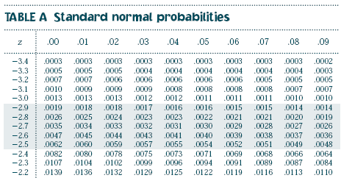
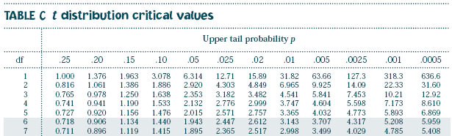

Table A vs. Table D
Table A gives the area to the LEFT of hundreds of z-values.
It should only be used for Normal distributions.
(…)
Table D
Table D gives the area to the RIGHT of a dozen t or z-values.
It can be used for
t distributions of a given df and for the Normal distribution.
(…)
Table D also gives the middle area under a t or normal distribution comprised between the negative and positive value of t or z.

Slide 12

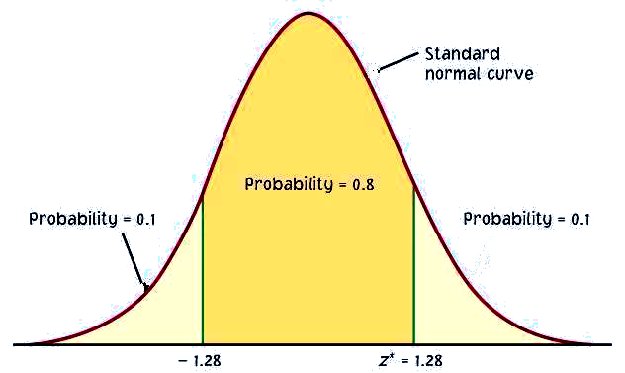
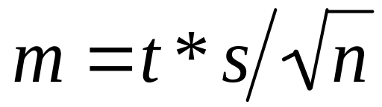
The one-sample t-confidence interval
The level C confidence interval is an interval with probability C of containing the true population parameter.
We have a data set from a population with both μ and σ unknown. We use to estimate μ and s to estimate σ, using a t distribution (df n−1).
Practical use of t : t*
C is the area between −t* and t*.
We find t* in the line of Table D for df = n−1 and confidence level C.
The margin of error m is:
C
m m
−t*
t*

Slide 13

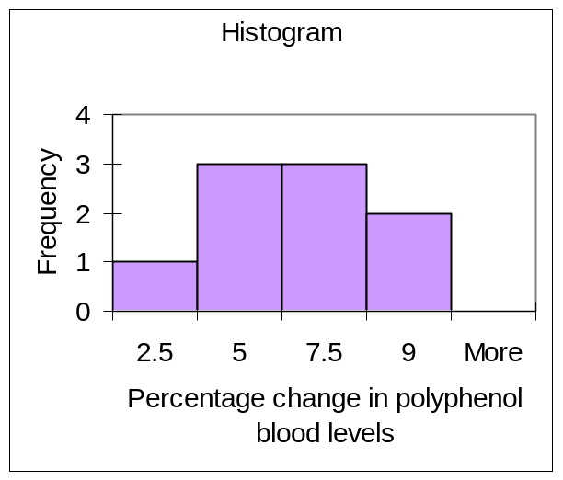
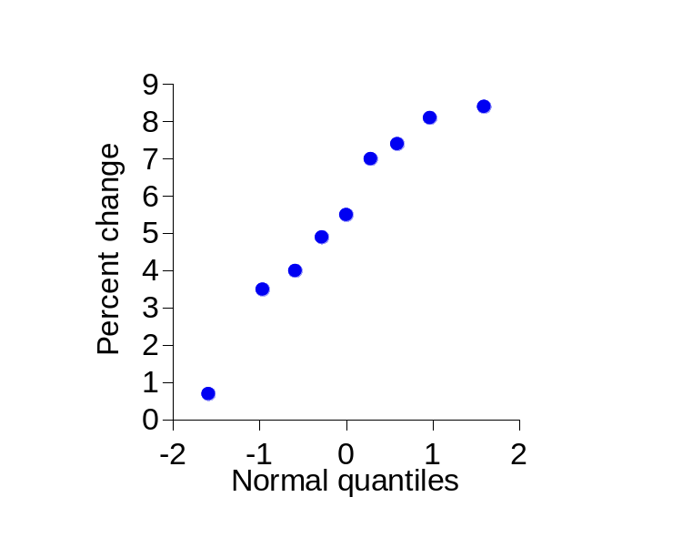

Red wine, in moderation
Drinking red wine in moderation may protect against heart attacks. The polyphenols it contains act on blood cholesterol, likely helping to prevent heart attacks.
To see if moderate red wine consumption increases the average blood level of polyphenols, a group of nine randomly selected healthy men were assigned to drink half a bottle of red wine daily for two weeks. Their blood polyphenol levels were assessed before and after the study, and the percent change is presented here:
Firstly: Are the data approximately normal?
0.7 | 3.5 | 4 | 4.9 | 5.5 | 7 | 7.4 | 8.1 | 8.4
There is a low value, but overall the data can be considered reasonably normal.

Slide 14
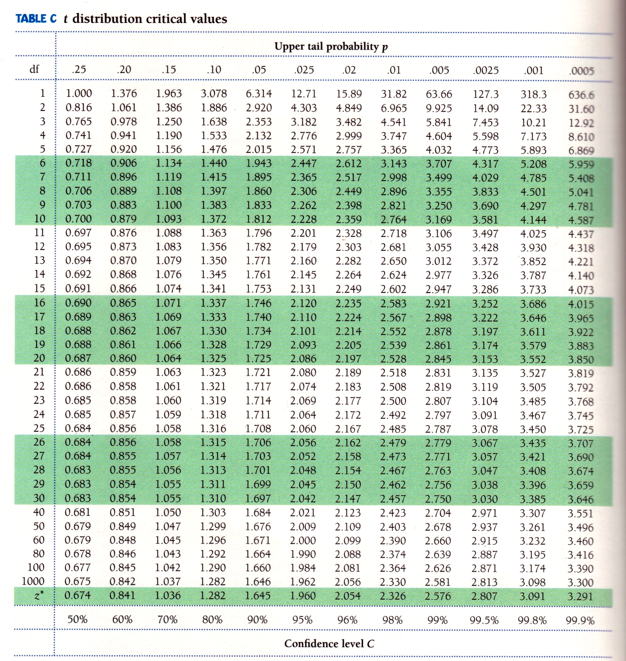
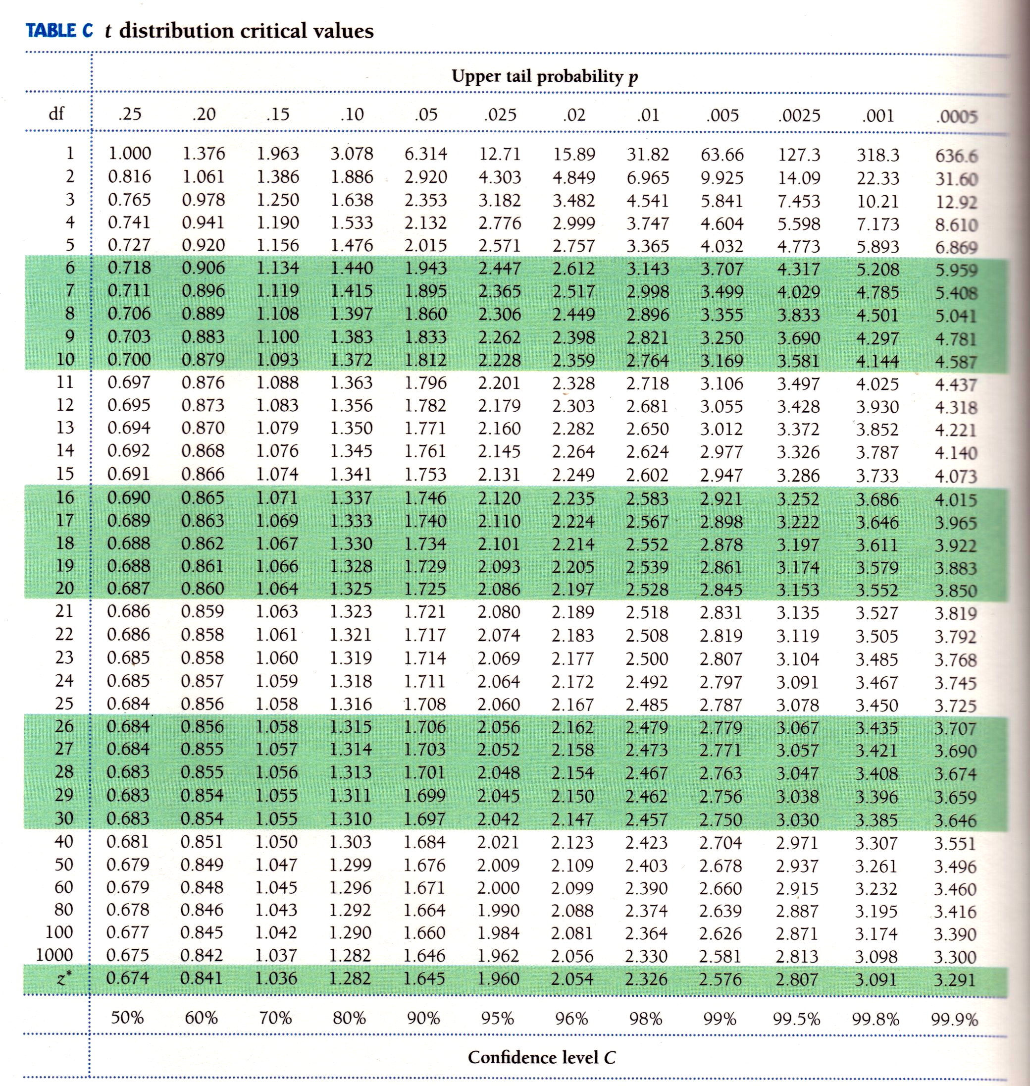
What is the 95% confidence interval for the average percent change?
Sample average = 5.5; s = 2.517; df = n − 1 = 8
(…)
The sampling distribution is a t distribution with n − 1 degrees of freedom.
For df = 8 and C = 95%, t* = 2.306.
The margin of error m is: m = t*s/√n = 2.306*2.517/√9 ≈ 1.93.
With 95% confidence, the population average percent increase in polyphenol blood levels of healthy men drinking half a bottle of red wine daily is between 3.6% and 7.4%. Important: The confidence interval shows how large the increase is, but not if it can have an impact on men’s health.

Slide 15
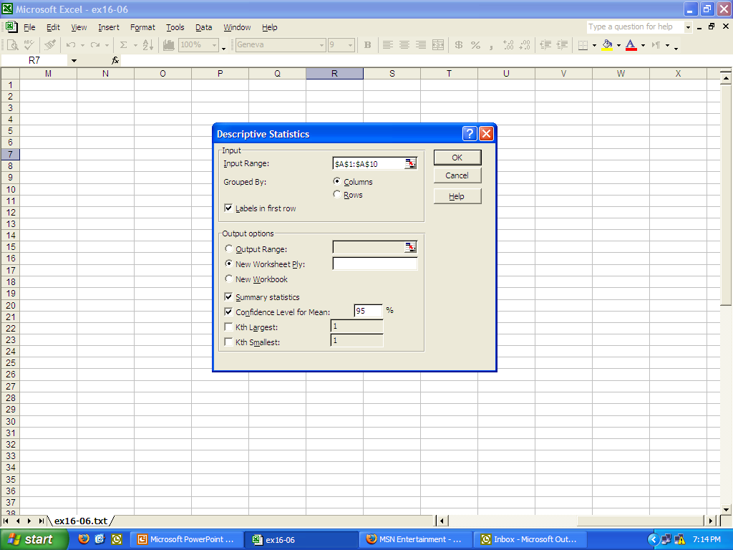
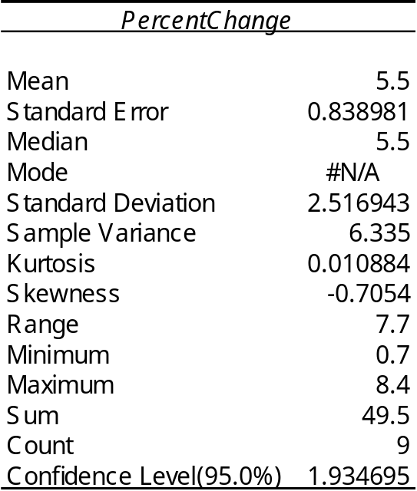
Excel
Menu: Tools/DataAnalysis: select “Descriptive statistics”
s/√n
m
!!! Warning: do not use the function =CONFIDENCE(alpha, stdev, size)
This assumes a normal sampling distribution (stdev here refers to σ)
and uses z* instead of t* !!!

Slide 16
The one-sample t-test
As in the previous chapter, a test of hypotheses requires a few steps:
  Stating the null and alternative hypotheses (H₀ versus H_{a})
  Deciding on a one-sided or two-sided test
  Choosing a significance level α
  Calculating t and its degrees of freedom
  Finding the area under the curve with Table D
  Stating the P-value and interpreting the result

Slide 17
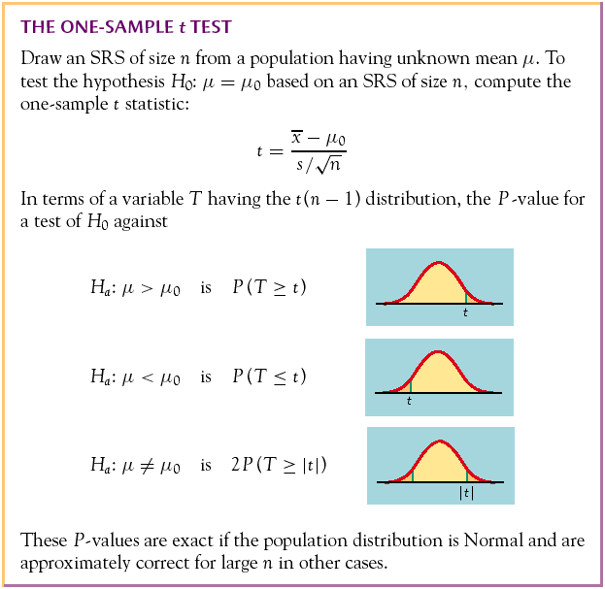
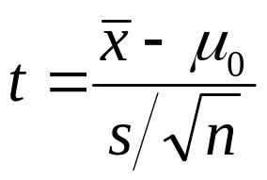
The P-value is the probability, if H₀ is true, of randomly drawing a sample like the one obtained or more extreme, in the direction of H_{a}.
The P-value is calculated as the corresponding area under the curve, one-tailed or two-tailed depending on H_{a}:
One-sided
(one-tailed)
Two-sided
(two-tailed)

Slide 18
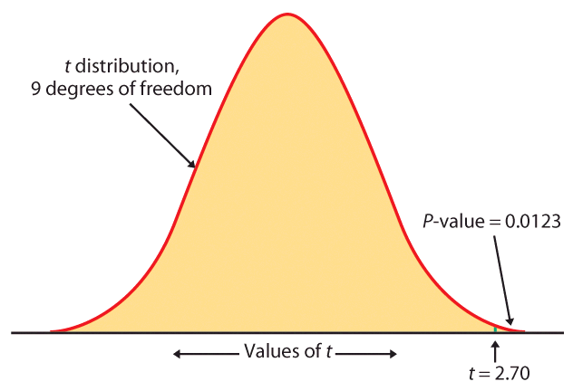
Table D
For df = 9 we only look into the corresponding row.
The calculated value of t is 2.7. We find the 2 closest t values.
2.398 < t = 2.7 < 2.821
thus
0.02 > upper tail p > 0.01
For a one-sided H_{a}, this is the P-value (between 0.01 and 0.02);
for a two-sided H_{a}, the P-value is doubled (between 0.02 and 0.04).

Slide 19
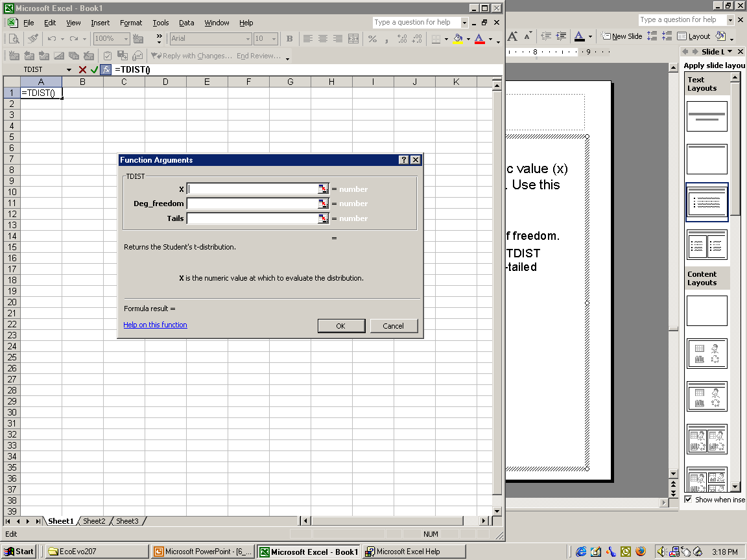
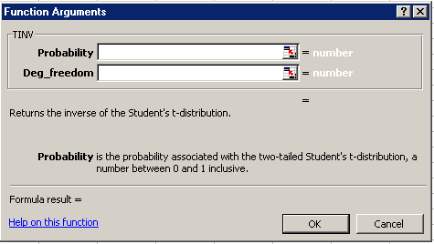
Excel
TDIST(x, degrees_freedom, tails)
TDIST = P(X > x) for a random variable X following the t distribution (x positive). Use it in place of Table C or to obtain the p-value for a positive t-value.
  X is the standardized value at which to evaluate the distribution (i.e., “t”).
  Degrees_freedom is an integer indicating the number of degrees of freedom.
  Tails specifies the number of distribution tails to return. If tails = 1, TDIST returns the one-tailed p-value. If tails = 2, TDIST returns the two-tailed p-value.
TINV(probability,degrees_freedom)
Gives the t-value (e.g., t*) for a given probability and degrees of freedom.
  Probability is the probability associated with the two-tailed t distribution.
  Degrees_freedom is the number of degrees of freedom of the t distribution.

Slide 20
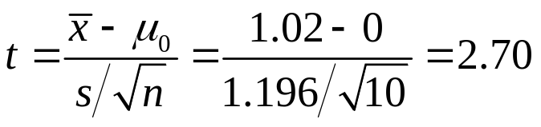

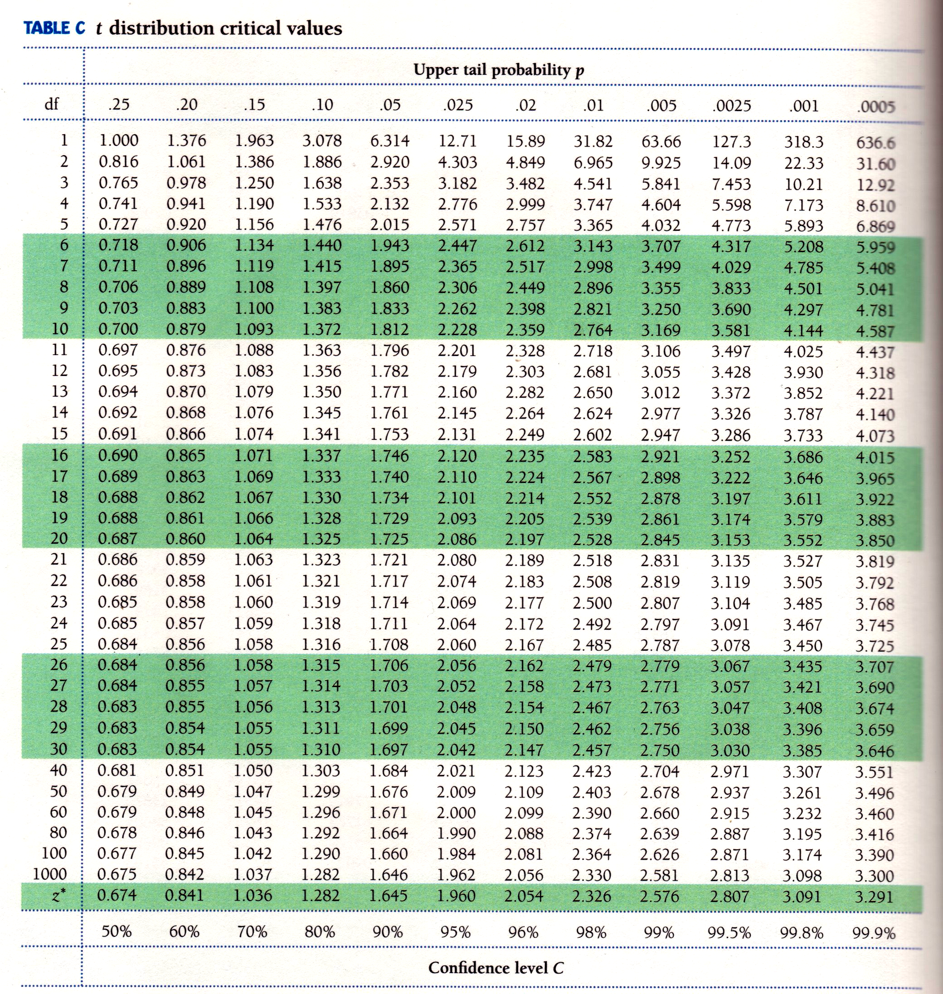
Sweetening colas (continued)
Is there evidence that storage results in sweetness loss for the new cola
recipe at the 0.05 level of significance (α = 5%)?
H₀: μ = 0 versus H_{a}: μ > 0 (one-sided test)
  The critical value t_{α} = 1.833.
  t > t_{α} thus the result is significant.
  2.398 < t = 2.70 < 2.821 thus 0.02 > p > 0.01.
  p < α thus the result is significant.
The t-test has a significant p-value. We reject H₀.
There is a significant loss of sweetness, on average, following storage.
Taster Sweetness loss
1 2.0
2 0.4
3 0.7
4 2.0
5 -0.4
6 2.2
7 -1.3
8 1.2
9 1.1
10 2.3
___________________________
Average 1.02
Standard deviation 1.196
Degrees of freedom n − 1 = 9

Slide 21
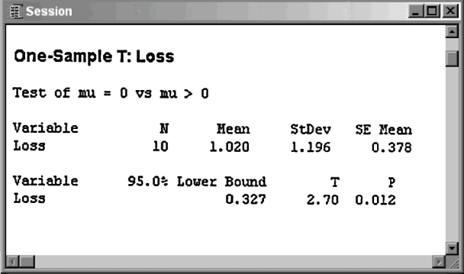
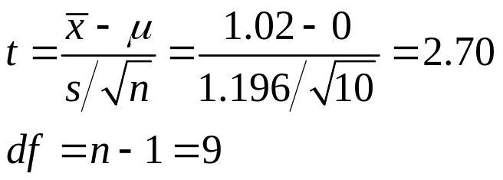
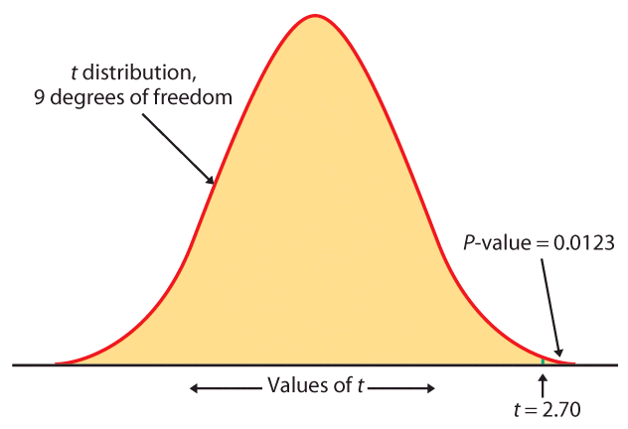
Sweetening colas (continued)
Minitab
In Excel, you can obtain the precise
p-value once you have calculated t:
Use the function dist(t, df, tails)
“=tdist(2.7, 9, 1),” which gives 0.01226

Slide 22
Matched pairs t procedures
Sometimes we want to compare treatments or conditions at the individual level. These situations produce two samples that are not independent — they are related to each other. The members of one sample are identical to, or matched (paired) with, the members of the other sample.
  Example: Pre-test and post-test studies look at data collected on the same sample elements before and after some experiment is performed.
  Example: Twin studies often try to sort out the influence of genetic factors by comparing a variable between sets of twins.
  Example: Using people matched for age, sex, and education in social studies allows canceling out the effect of these potential lurking variables.

Slide 23
In these cases, we use the paired data to test the difference in the two population means. The variable studied becomes X_{difference} = (X₁ − X₂), and
H₀: µ_{difference}= 0 ; H_{a}: µ_{difference}>0 (or <0, or ≠0)
Conceptually, this is not different from tests on one population.

Slide 24
Sweetening colas (revisited)
The sweetness loss due to storage was evaluated by 10 professional tasters (comparing the sweetness before and after storage):
Taster Sweetness loss
1 2.0
2 0.4
3 0.7
4 2.0
5 −0.4
6 2.2
7 −1.3
8 1.2
9 1.1
10 2.3
We want to test if storage results in a loss of sweetness, thus:
H₀: μ = 0 versus H_{a}: μ > 0
Although the text didn’t mention it explicitly, this is a pre-/post-test design and the variable is the difference in cola sweetness before minus after storage.
A matched pairs test of significance is indeed just like a one-sample test.

Slide 25
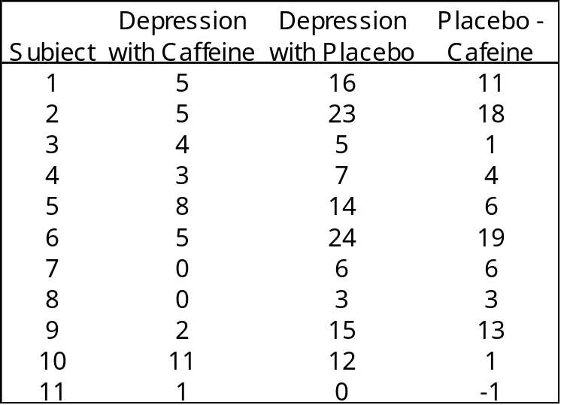
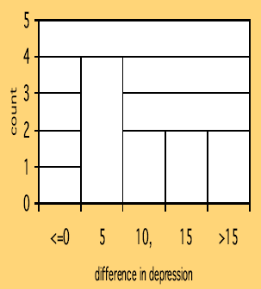
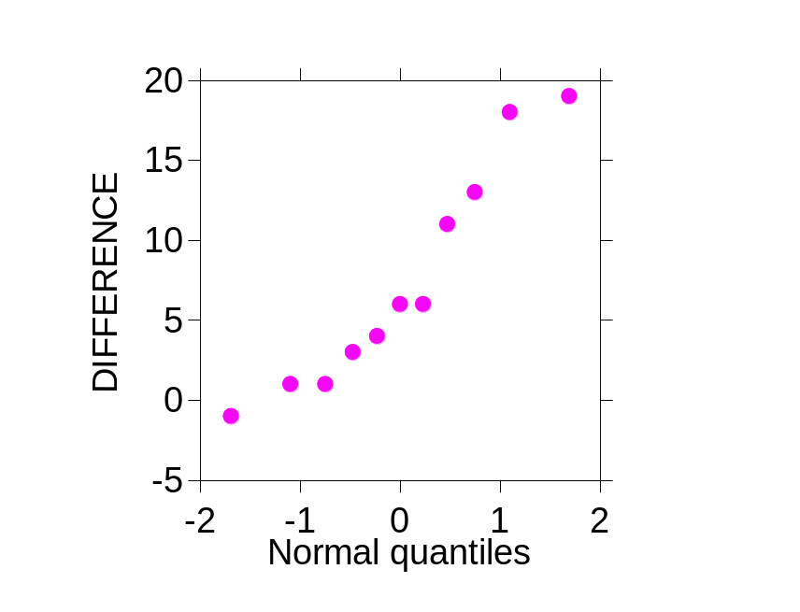
Does lack of caffeine increase depression?
Individuals diagnosed as caffeine-dependent are
deprived of caffeine-rich foods and assigned
to receive daily pills. Sometimes, the pills
contain caffeine and other times they contain
a placebo. Depression was assessed.
  There are 2 data points for each subject, but we’ll only look at the difference.
  The sample distribution appears appropriate for a t-test.
11 “difference”
data points.

Slide 26
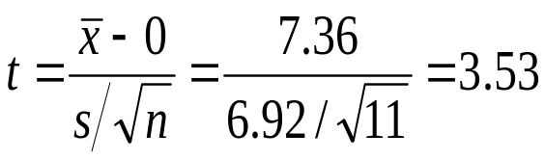
Does lack of caffeine increase depression?
For each individual in the sample, we have calculated a difference in depression score (placebo minus caffeine).
There were 11 “difference” points, thus df = n − 1 = 10.
We calculate that = 7.36; s = 6.92
H₀: μ_{difference} = 0 ; H₀: μ_{difference} > 0
For df = 10, 3.169 < t = 3.53 < 3.581 ➔ 0.005 > p > 0.0025
Caffeine deprivation causes a significant increase in depression.

Slide 27
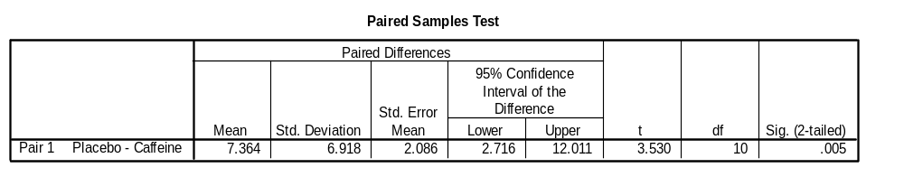
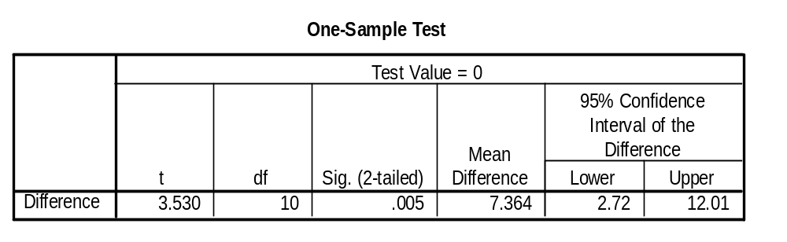
SPSS statistical output for the caffeine study:
Conducting a paired sample t-test on the raw data (caffeine and placebo)
Conducting a one-sample t-test on difference (caffeine – placebo)
Our alternative hypothesis was one-sided, thus our p-value is half of the two-tailed p-value provided in the software output (half of 0.005 = 0.0025).

Slide 28
Robustness
The t procedures are exactly correct when the population is distributed exactly normally. However, most real data are not exactly normal.
The t procedures are robust to small deviations from normality – the results will not be affected too much. Factors that strongly matter:
  Random sampling. The sample must be an SRS from the population.
  Outliers and skewness. They strongly influence the mean and therefore the t procedures. However, their impact diminishes as the sample size gets larger because of the Central Limit Theorem.
Specifically:
  When n < 15, the data must be close to normal and without outliers.
  When 15 > n > 40, mild skewness is acceptable but not outliers.
  When n > 40, the t-statistic will be valid even with strong skewness.

Slide 29
Power of the t-test
The power of the one sample t-test for a specific alternative value of the population mean µ, assuming a fixed significance level α, is the probability that the test will reject the null hypothesis when the alternative value of the mean is true.
Calculation of the exact power of the t-test is a bit complex. But an approximate calculation that acts as if σ were known is almost always adequate for planning a study. This calculation is very much like that for the z-test.
  When guessing σ, it is always better to err on the side of a standard deviation that is a little larger rather than smaller. We want to avoid failing to find an effect because we did not have enough data.

Slide 30
Does lack of caffeine increase depression?
Suppose that we wanted to perform a similar study but using subjects who regularly drink caffeinated tea instead of coffee. For each individual in the sample, we will calculate a difference in depression score (placebo minus caffeine). How many patients should we include in our new study?
In the previous study, we found that the average difference in depression level was 7.36 and the standard deviation 6.92.
  We will use µ = 3.0 as the alternative of interest. We are confident that the effect was larger than this in our previous study, and this increase in depression would still be considered important.
  We will use s = 7.0 for our guessed standard deviation.
We can choose a one-sided alternative because, like in the previous study, we would expect caffeine deprivation to have negative psychological effects.

Slide 31
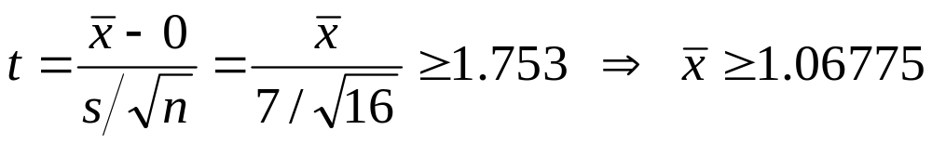
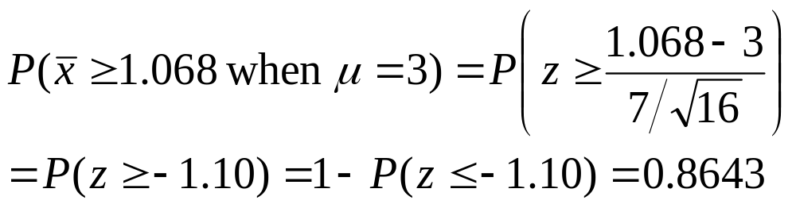
Does lack of caffeine increase depression?
How many subjects should we include in our new study? Would 16 subjects be enough? Let’s compute the power of the t-test for
against the alternative µ = 3. For a significance level α 5%, the t-test with n observations rejects H₀ if t exceeds the upper 5% significance point of
t(df:15) = 1.729. For n = 16 and s = 7:
H₀: μ_{difference} = 0 ; H_{a}: μ_{difference} > 0
The power for n = 16 would be the probability that ≥ 1.068 when µ = 3, using σ = 7. Since we have σ, we can use the normal distribution here:
The power would be about 86%.

Slide 32
Inference for non-normal distributions
What if the population is clearly non-normal and your sample is small?
If the data are skewed, you can attempt to transform the variable to bring it closer to normality (e.g., logarithm transformation). The t- procedures applied to transformed data are quite accurate for even moderate sample sizes.
A distribution other than a normal distribution might describe your data well. Many non-normal models have been developed to provide inference procedures too.
You can always use a distribution-free (“nonparametric”) inference procedure (see chapter 15) that does not assume any specific distribution for the population. But it is usually less powerful than distribution-driven tests (e.g., t test).

Slide 33
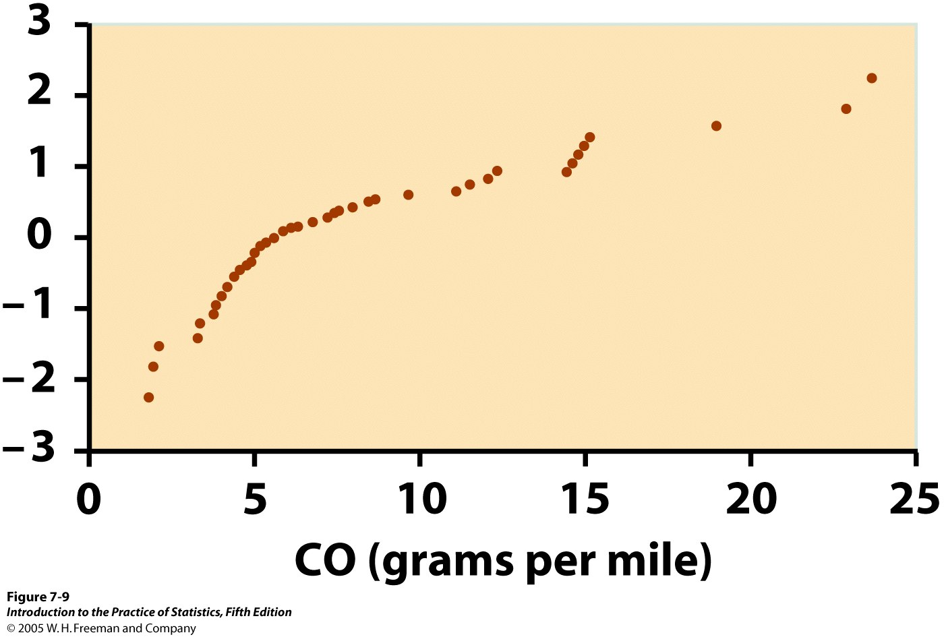
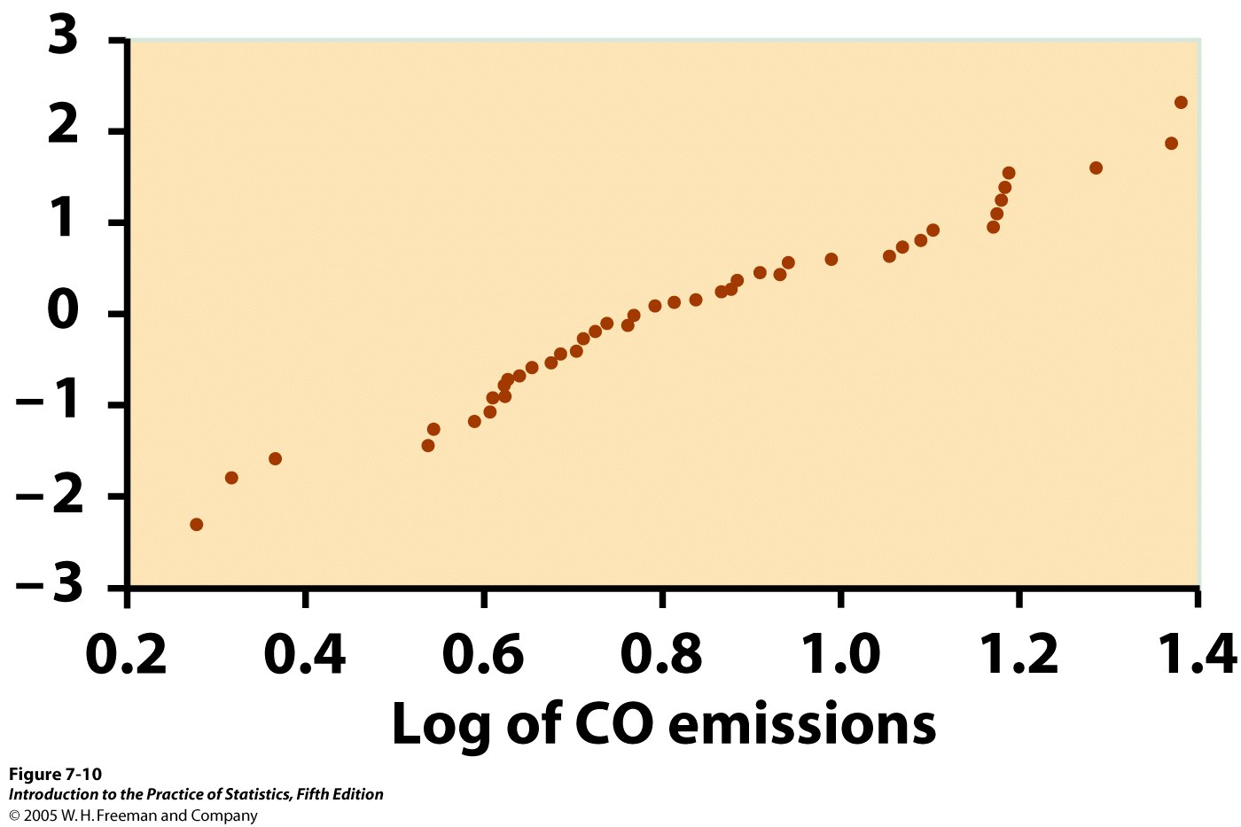
Transforming data
The most common transformation is the logarithm (log), which tends to pull in the right tail of a distribution.
Instead of analyzing the original variable X, we first compute the logarithms and analyze the values of log X.
However, we cannot simply use the confidence interval for the mean of the logs to deduce a confidence interval for the mean µ in the original scale.
Normal quantile plots for 46 car CO emissions

Slide 34
Nonparametric method: the sign test
A distribution-free test usually makes a statement of hypotheses about the median rather than the mean (e.g., “are the medians different”). This makes sense when the distribution may be skewed.
A simple distribution-free test is the sign test for matched pairs.
Calculate the matched difference for each individual in the sample.
Ignore pairs with difference 0.
The number of trials n is the count of the remaining pairs.
The test statistic is the count X of pairs with a positive difference.
P-values for X are based on the binomial B(n, 1/2) distribution.
H₀: population median = 0 vs. H_{a}: population median > 0
H₀: p = 1/2 vs. H_{a}: p > 1/2

Slide 35
Inference for Distributions
7.2 Comparing Two Means
© 2012 W.H. Freeman and Company

Slide 36
Objectives
7.2 Comparing two means
  Two-sample z statistic
  Two-samples t procedures
  Two-sample t significance test
  Two-sample t confidence interval
  Robustness
  Details of the two-sample t procedures

Slide 37
Comparing two samples
(A)
Population 1
Population 2
Sample 2
Sample 1
Which
is it?
We often compare two treatments used on independent samples.
Is the difference between both treatments due only to variations from the random sampling (B), or does it reflect a true difference in population means (A)?
(B)
Population
Sample 2
Sample 1
Independent samples: Subjects in one samples are completely unrelated to subjects in the other sample.

Slide 38
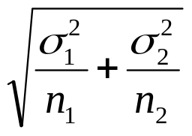
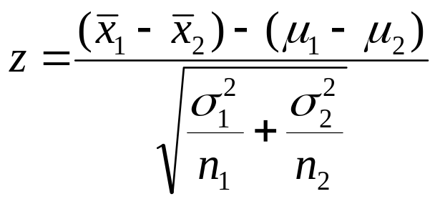
Two-sample z statistic
We have two independent SRSs (simple random samples) possibly coming from two distinct populations with (μ₁,σ₁) and (μ₂,σ₂). We use ₁ and ₂ to estimate the unknown μ₁ and μ₂.
When both populations are normal, the sampling distribution of ( ₁− ₂) is also normal, with standard deviation :
Then the two-sample z statistic
has the standard normal N(0, 1)
sampling distribution.

Slide 39
Two independent samples t distribution
We have two independent SRSs (simple random samples) possibly coming from two distinct populations with (μ₁,σ₁) and (μ₂,σ₂) unknown. We use ( ₁,s₁) and ( ₂,s₂) to estimate (μ₁,σ₁) and (μ₂,σ₂), respectively.
To compare the means, both populations should be normally distributed. However, in practice, it is enough that the two distributions have similar shapes and that the sample data contain no strong outliers.

Slide 40
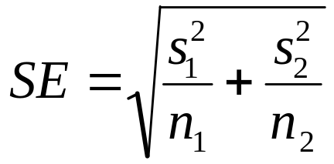
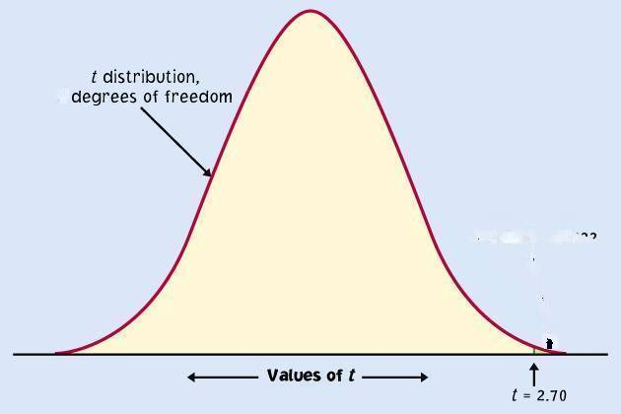
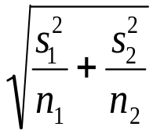

The two-sample t statistic follows approximately the t distribution with a standard error SE (spread) reflecting
variation from both samples:
Conservatively, the degrees of freedom is equal to the smallest of (n₁ − 1, n₂ − 1).
df
μ₁-μ₂

Slide 41
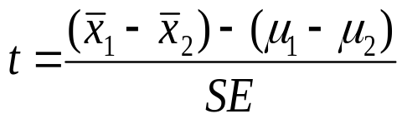
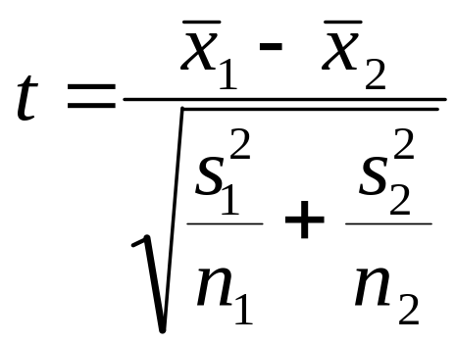
Two-sample t significance test
The null hypothesis is that both population means μ₁ and μ₂ are equal, thus their difference is equal to zero.
H₀: μ₁ = μ₂ <=> μ₁ − μ₂ = 0
with either a one-sided or a two-sided alternative hypothesis.
We find how many standard errors (SE) away
from (μ₁ − μ₂) is ( ₁− ₂) by standardizing with t:
Because in a two-sample test H₀
poses (μ₁ − μ₂) = 0, we simply use
With df = smallest(n₁ − 1, n₂ − 1)

Slide 42
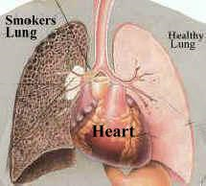
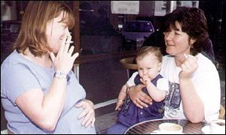
Does smoking damage the lungs of children exposed to parental smoking?
Forced vital capacity (FVC) is the volume (in milliliters) of air that an individual can exhale in 6 seconds.
FVC was obtained for a sample of children not exposed to parental smoking and a group of children exposed to parental smoking.
Parental smoking | FVC | s | n
Yes | 75.5 | 9.3 | 30
No | 88.2 | 15.1 | 30
We want to know whether parental smoking decreases children’s lung capacity as measured by the FVC test.
Is the mean FVC lower in the population of children exposed to parental smoking?

Slide 43
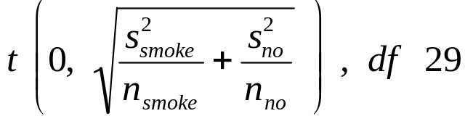
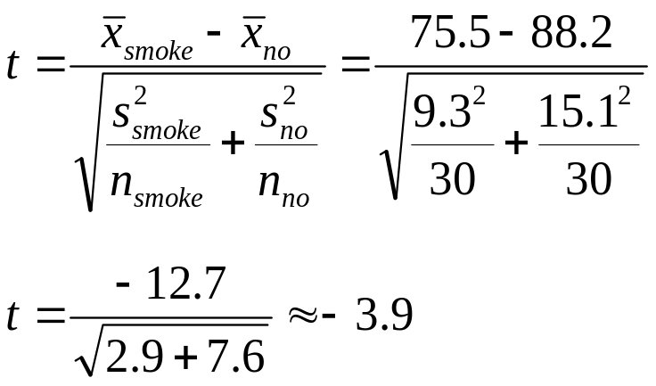
H₀: μ_{smoke} = μ_{no} <=> (μ_{smoke} − μ_{no}) = 0
H_{a}: μ_{smoke} < μ_{no} <=> (μ_{smoke} − μ_{no}) < 0 (one sided)
The difference in sample averages follows approximately the t distribution:
We calculate the t statistic:
Parental smoking | FVC | s | n
Yes | 75.5 | 9.3 | 30
No | 88.2 | 15.1 | 30
In table D, for df 29 we find:
|t| > 3.659 => p < 0.0005 (one sided)
It’s a very significant difference, we reject H₀.
Lung capacity is significantly impaired in children of smoking parents.

Slide 44

Two-sample t confidence interval
Because we have two independent samples we use the difference between both sample averages ( ₁ − ₂) to estimate (μ₁ − μ₂).
Practical use of t: t*
C is the area between −t* and t*.
We find t* in the line of Table D for df = smallest (n₁−1; n₂−1) and the column for confidence level C.
The margin of error m is:
C
m m
−t*
t*

Slide 45

Common mistake !!!
A common mistake is to calculate a one-sample confidence interval for μ₁ and then check whether μ₂ falls within that confidence interval, or vice-versa.
This is WRONG because the variability in the sampling distribution for two independent samples is more complex and must take into account variability coming from both samples. Hence the more complex formula for the standard error.

Slide 46



Can directed reading activities in the classroom help improve reading ability? A class of 21 third-graders participates in these activities for 8 weeks while a control classroom of 23 third-graders follows the same curriculum without the activities. After 8 weeks, all children take a reading test (scores in table).
95% confidence interval for (µ₁ − µ₂), with df = 20 conservatively → t* = 2.086:
With 95% confidence, (µ₁ − µ₂), falls within 9.96 ± 8.99 or 1.0 to 18.9.

Slide 47
Robustness
The two-sample t procedures are more robust than the one-sample t procedures. They are the most robust when both sample sizes are equal and both sample distributions are similar. But even when we deviate from this, two-sample tests tend to remain quite robust.
  ➔ When planning a two-sample study, choose equal sample sizes if you can.
As a guideline, a combined sample size (n₁ + n₂) of 40 or more will allow you to work with even the most skewed distributions.

Slide 48

Details of the two sample t procedures
The true value of the degrees of freedom for a two-sample t-distribution is quite lengthy to calculate. That’s why we use an approximate value, df = smallest(n₁ − 1, n₂ − 1), which errs on the conservative side (often smaller than the exact).
Computer software, though, gives the exact degrees of freedom—or the rounded value—for your sample data.

Slide 49



95% confidence interval for the reading ability study using the more precise degrees of freedom:
Excel
t*
Independent Samples Test
SPSS
Levene's Test for
Equality of Variances
t-test for Equality of Means
95% Confidence
Interval of the
Mean
Std. Error
Difference
F
Sig.
t
df
Sig. (2-tailed)
Difference
Difference
Lower
Upper
Reading Score
Equal variances
2.362
.132
2.267
42
.029
9.95445
4.39189
1.09125
18.81765
assumed
Equal variances
2.311
37.855
.026
9.95445
4.30763
1.23302
18.67588
not assumed

Slide 50

Excel
menu/tools/data_analysis →
or
=TTEST(array1,array2,tails,type)
Array1 is the first data set.
Array2 is the second data set.
Tails specifies the nature of the alternative hypothesis
(1: one-tailed; 2: two-tailed).
Type is the kind of t-test to perform
(1: paired; 2: two-sample equal variance; 3: two-sample unequal variance).

Slide 51

Pooled two-sample procedures
There are two versions of the two-sample t-test: one assuming equal variance (“pooled 2-sample test”) and one not assuming equal variance (“unequal” variance, as we have studied) for the two populations. They have slightly different formulas and degrees of freedom.
The pooled (equal variance) two-sample t-test was often used before computers because it has exactly the t distribution for degrees of freedom n₁ + n₂ − 2.
However, the assumption of equal variance is hard to check, and thus the unequal variance test is safer.
Two normally distributed populations with unequal variances

Slide 52



When both population have the
same standard deviation, the
pooled estimator of σ² is:
The sampling distribution for (x₁ − x₂) has exactly the t distribution with (n₁ + n₂ − 2) degrees of freedom.
A level C confidence interval for µ₁ − µ₂ is
(with area C between −t* and t*)
  To test the hypothesis H₀: µ₁ = µ₂ against a
  one-sided or a two-sided alternative, compute
  the pooled two-sample t statistic for the
  t(n₁ + n₂ − 2) distribution.

Slide 53
Which type of test? One sample, paired samples, two samples?
Comparing vitamin content of bread immediately after baking vs. 3 days later (the same loaves are used on day one and 3 days later).
Comparing vitamin content of bread immediately after baking vs. 3 days later (tests made on independent loaves).
Average fuel efficiency for 2005 vehicles is 21 miles per gallon. Is average fuel efficiency higher in the new generation “green vehicles”?
Is blood pressure altered by use of an oral contraceptive? Comparing a group of women not using an oral contraceptive with a group taking it.
Review insurance records for dollar amount paid after fire damage in houses equipped with a fire extinguisher vs. houses without one. Was there a difference in the average dollar amount paid?

Slide 54
Inference for Distributions
7.3 Optional Topics in Comparing Distributions
© 2012 W.H. Freeman and Company

Slide 55
Objectives
7.3 Optional topics in comparing distributions
  Inference for population spread
  The F test
  Power of the two-sample t-test

Slide 56
Inference for population spread
It is also possible to compare two population standard deviations σ₁ and σ₂ by comparing the standard deviations of two SRSs. However, these procedures are not robust at all against deviations from normality.
When s₁² and s₂² are sample variances from independent SRSs of sizes n₁ and n₂ drawn from normal populations, the F statistic
F = s₁² / s₂²
has the F distribution with n₁ − 1 and n₂ − 1 degrees of freedom when H₀: σ₁ = σ₂ is true.

Slide 57


The F distributions are right-skewed and cannot take negative values.
  The peak of the F density curve is near 1 when both population standard deviations are equal.
  Values of F far from 1 in either direction provide evidence against the hypothesis of equal standard deviations.
Table E in the back of the book gives critical F-values for upper p of 0.10, 0.05, 0.025, 0.01, and 0.001. We compare the F statistic calculated from our data set with these critical values for a one-side alternative; the p-value is doubled for a two-sided alternative.

Slide 58

Table E
df_{num} = n₁ − 1
p
F
df_{den}
=
n₂ − 1

Slide 59


Does parental smoking damage the lungs of children?
Forced vital capacity (FVC) was obtained for a sample of children not exposed to parental smoking and a group of children exposed to parental smoking.
Parental smoking | FVC | s | n
Yes | 75.5 | 9.3 | 30
No | 88.2 | 15.1 | 30
H₀: σ²_{smoke} = σ²_{no}
H_{a}: σ²_{smoke} ≠ σ²_{no} (two sided)
The degrees of freedom are 29 and 29, which can be rounded to the closest values in Table E: 30 for the numerator and 25 for the denominator.
2.54 < F(30,25) = 2.64 < 3.52 ➔ 0.01 > 1-sided p > 0.001
➔0.02 > 2-sided p > 0.002

Slide 60
Cautions about Inference for population spread
Unlike t procedures, the F test and other inference procedures about variances are not robust at all against deviations from normality.
The F test for comparing standard deviations or variances performs poorly if populations are not close to normal. Consequently, statisticians recommend that these procedures are not used.

Slide 61
Power of the two-sample t-test
The power of the two-sample t-test for a specific alternative value of the difference in population means (µ₁ − µ₂), assuming a fixed significance level α, is the probability that the test will reject the null hypothesis when the alternative is true.
The basic concept is similar to that for the one-sample t-test. The exact method involves the noncentral t distribution. Calculations are carried out with software.
You need information from a pilot study or previous research to calculate an expected power for your t-test and this allows you to plan your study smartly.

Slide 62

Power calculations using a noncentral t distribution
For the pooled two-sample t-test, with parameters µ₁, µ₂, and the common standard deviation σ we need to specify:
  An alternative that would be important to detect (i.e., a value for µ₁ − µ₂)
  The sample sizes, n₁ and n₂
  The Type I error for a fixed significance level, α
  A guess for the standard deviation σ
We find the degrees of freedom df = n₁ + n₂ − 2 and the value of t* that will lead to rejection of H₀: µ₁ − µ₂ = 0
Then we calculate the non-centrality parameter δ

Slide 63

Lastly, we find the power as the probability that a noncentral t random variable with degrees of freedom df and noncentrality parameter δ will be less than t*:
  In SAS this is 1-PROBT(tstar, df, delta). There are also several free online tools that calculate power.
  Without access to software, we can approximate the power as the probability that a standard normal random variable is greater than t* − δ, that is, P(z > t* − δ), and use Table A.
For a test with unequal variances we can simply use the conservative degrees of freedom, but we need to guess both standard deviations and combine them for the guessed standard error:

Slide 64

Online tools:

Slide 65



Slide 66
Alternate Slides
The following slides offer alternate software output data and examples for this presentation.

Slide 67


JMP
Menu: Analyze/Distribution: select “Percent Change” as your “Y, Columns” OK
A 95% confidence interval for the mean is included in “Moments”.
For a different confidence level, click the red triangle next to Percent Change
Confidence Interval:
Choose desired confidence level
OK
s/√n
Notes:
Alternate for slide 15 using JMP.

Slide 68

Sweetening colas (continued)
JMP
JMP provides the precise P-value
0.0123

Slide 69


JMP statistical output for the caffeine study:
Conducting a paired sample t-test on the raw data (caffeine and placebo), using Analyze: Matched Pairs
Conducting a one-sample t-test on difference (caffeine – placebo), using Analyze: Distribution for paired differences.
Our alternative hypothesis was one-sided, thus our P-value is 0.0027, provided in the software output.

Slide 70

95% confidence interval for the reading ability study using the more precise degrees of freedom:
JMP
Analyze: Fit Y by X
Enter Group as “X, Factor”, Test Score as “Y, Response”
Click , select t Test
Notes:
Alternate for slide 49, using JMP.

