Slide 1
Analysis of Two-Way Tables
IPS Chapter 9
9.1: Inference for Two-Way Tables
9.2: Formulas and Models for Two-Way Tables
9.3: Goodness of Fit
© 2012 W.H. Freeman and Company
Notes:
Alternate to slide 1

Slide 2
Analysis of Two-Way Tables
9.1 Inference for Two-Way Tables
© 2012 W.H. Freeman and Company

Slide 3
Objectives
9.1 Inference for two-way tables
The hypothesis: no association
Expected cell counts
The chi-square test
The chi-square test and the z test
Using software

Slide 4
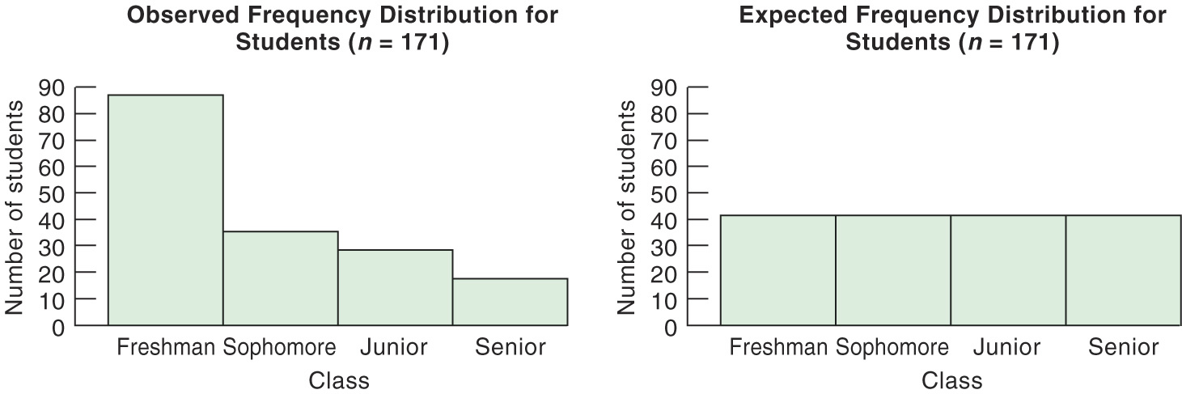
Hypothesis: no association
Again, we want to know if the differences in sample proportions are likely to have occurred just by chance due to random sampling.
We use the chi-square (χ²) test to assess the null hypothesis of no relationship between the two categorical variables of a two-way table.

Slide 5
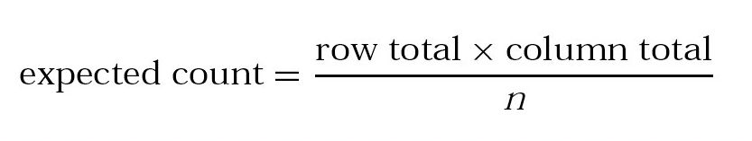
Expected cell counts
Two-way tables sort the data according to two categorical variables. We want to test the hypothesis that there is no relationship between these two categorical variables (H₀).
To test this hypothesis, we compare actual counts from the sample data with expected counts, given the null hypothesis of no relationship.
The expected count in any cell of a two-way table when H₀ is true is:

Slide 6
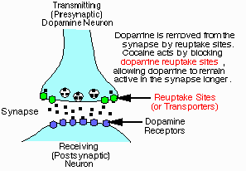
Cocaine addiction
Cocaine produces short-term feelings of physical and mental well being. To maintain the effect, the drug may have to be taken more frequently and at higher doses. After stopping use, users will feel tired, sleepy and depressed.
The pleasurable high followed by unpleasant after-effects encourage repeated compulsive use, which can easily lead to dependency.
Desipramine is an antidepressant affecting the brain chemicals that may become unbalanced and cause depression. It was thus tested for recovery from cocaine addiction.
Treatment with desipramine was compared to a standard treatment (lithium, with strong anti-manic effects) and a placebo.

Slide 7
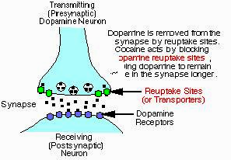
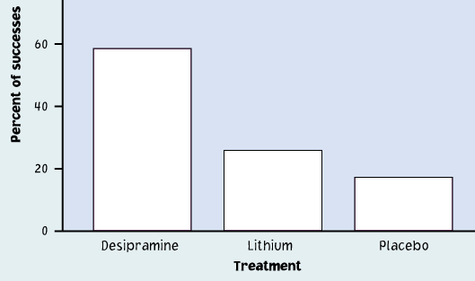
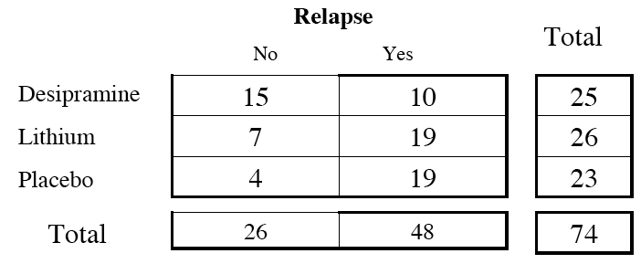
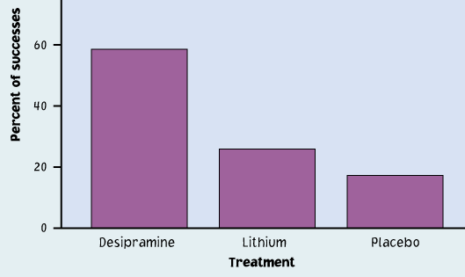
Cocaine addiction
Observed
Expected
Expected relapse counts
No Yes
35%
35%
35%
Desipramine
Lithium
Placebo
(25)(26)/74 ≈ 8.78 25 x 0.35 | 16.22 25 x 0.65
9.14 26 x 0.35 | 16.86 25 x 0.65
8.08 23 x 0.35 | 14.92 25 x 0.65

Slide 8
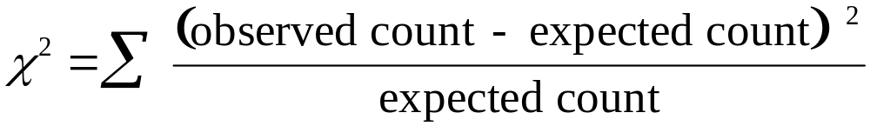
The chi-square test
The chi-square statistic (χ²) is a measure of how much the observed cell counts in a two-way table diverge from the expected cell counts.
The formula for the χ² statistic is:
(summed over all r X c cells in the table)
Large values for χ² represent strong deviations from the expected distribution under the H₀ and provide evidence against H₀.
However, since χ² is a sum, how large a χ² is required for statistical significance will depend on the number of comparisons made.

Slide 9
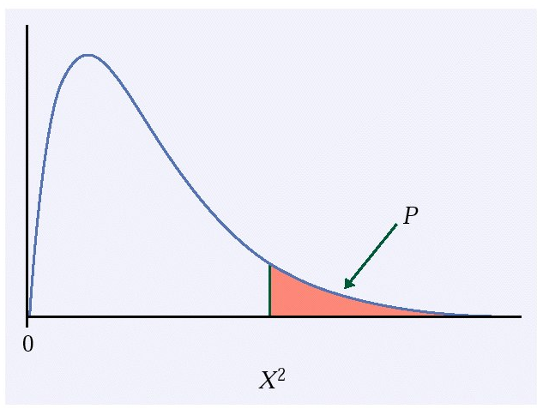
For the chi-square test, H₀ states that there is no association between the row and column variables in a two-way table. The alternative is that these variables are related.
If H₀ is true, the chi-square test has approximately a χ² distribution with (r − 1)(c − 1) degrees of freedom.
The P-value for the chi-square test is the area to the right of χ² under the χ² distribution with df (r−1)(c−1):
P(χ² ≥ X²).

Slide 10
When is it safe to use a χ² test?
We can safely use the chi-square test when:
  The samples are simple random samples (SRS)
  All individual expected counts are 1 or more (≥1)
  Average of expected counts are 5 or more
  ➔ For a 2 x 2 table, all four expected counts should be 5
  or more.

Slide 11
Chi-square test vs. z-test for two proportions
When comparing only two proportions, such as in a 2x2 table where the columns represent counts of “success” and “failure,” we can test
H₀: p₁ = p₂ vs. H_{a}: p₁ ≠ p₂
equally with a two-sided z test or with a chi-square test with 1 degree of freedom and get the same p-value. In fact, the two test statistics are related: χ² = (z)².

Slide 12
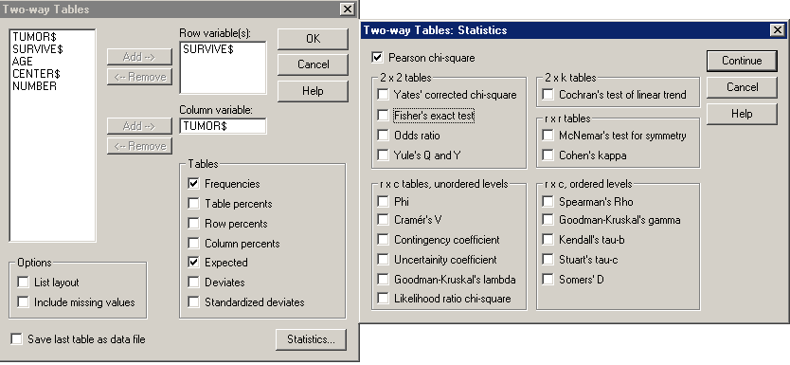
Using software
In Excel you have to do almost all the calculations for the chi-square test yourself, and it only gives you the p-value (not the component).
This is Systat: Menu/Statistics/Crosstabs

Slide 13
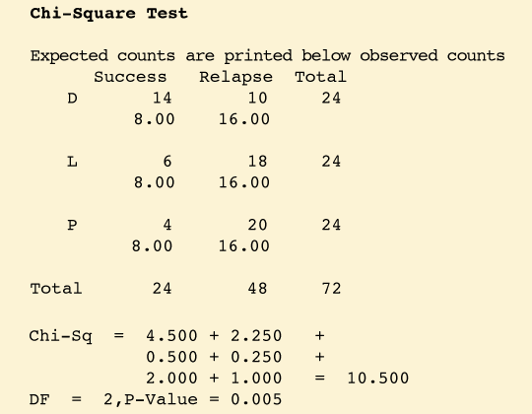
Cocaine addiction
Observed
Minitab statistical software output for the cocaine study
The p-value is 0.005 or half a percent. This is very significant.
We reject the null hypothesis of no association and conclude that there is a significant relationship between treatment (desipramine, lithium, placebo) and outcome (relapse or not).

Slide 14
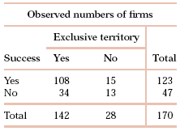
Successful firms
Franchise businesses are sometimes given an exclusive territory by contract. This means that the new outlet will not have to compete with other outlets of the same chain within its own territory. How does the presence of an exclusive-territory clause in the contract relate to the survival of the business?
A simple random sample of 170 new franchises recorded two categorical variables for each firm: (1) whether the firm was successful or not (based on economic criteria) and (2) whether or not the firm had an exclusive-territory contract.
This is a 2x2 table (two levels for success, yes/no; two levels for exclusive territory, yes/no).
df = (2 − 1)(2 − 1) = 1

Slide 15
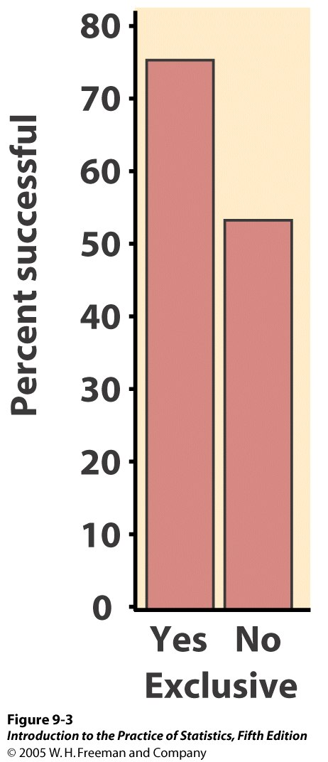
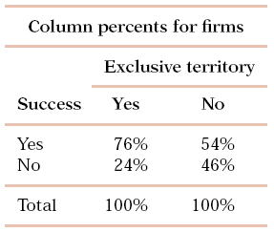
Successful firms
How does the presence of an exclusive-territory clause in the contract relate to the survival of the business?
To compare firms that have
an exclusive territory with
those that do not, we start by
examining column percents
(conditional distribution):
The difference between the percent of successes among the two types of firms is quite large. The chi-square test can tell us whether or not these differences can be plausibly attributed to chance (random sampling). Specifically, we will test:
H₀: No relationship between exclusive clause and success
H_{a}: There is some relationship between the two variables

Slide 16
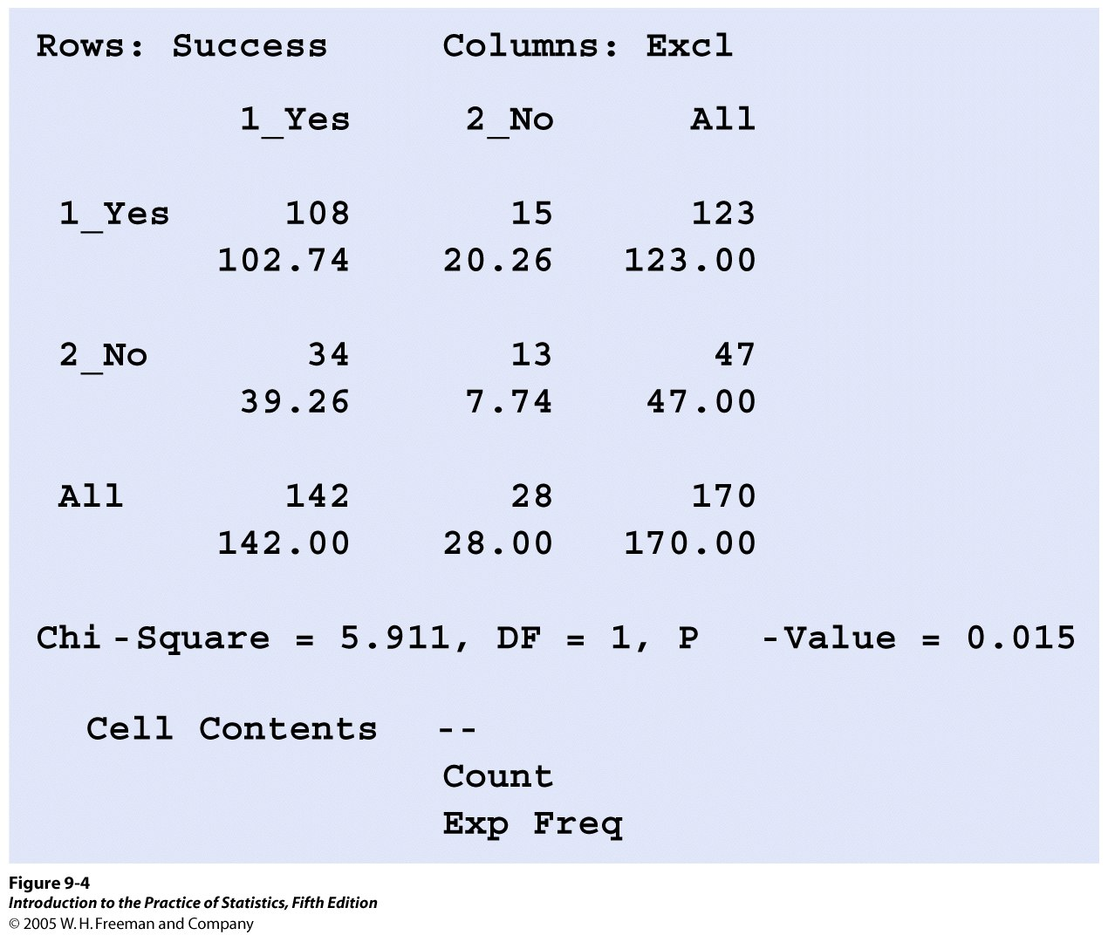
Successful firms
Here is the chi-square output from Minitab:
The p-value is significant at α = 5% (p = 1.5%) thus we reject H₀: we have found a significant relationship between an exclusive territory and the success of a franchised firm.

Slide 17
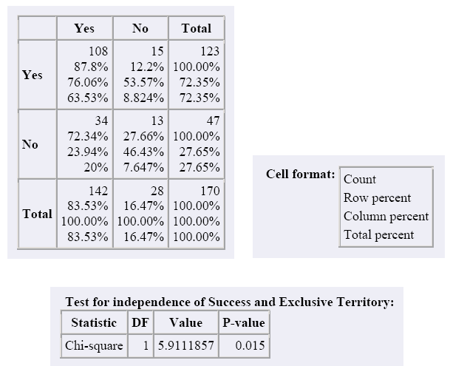
Successful firms
Computer output using Crunch It!

Slide 18
Analysis of Two-Way Tables
9.2 Formulas and Models for Two-Way Tables
9.3 Goodness of Fit
© 2012 W.H. Freeman and Company

Slide 19
Objectives
9.2 Formulas and models for two-way tables
9.3 Goodness of fit
Computations for two-way tables
  Computing conditional distributions
  Computing expected cell counts
  Computing the chi-square statistic
  Finding the p-value with Table F
Models for two-way tables
  Comparing several populations
  Testing for independence
Goodness of fit

Slide 20
Computations for two-way tables
When analyzing relationships between two categorical variables, follow this procedure:
1. Calculate descriptive statistics that convey the important information
in the table—usually column or row percents.
2. Find the expected counts and use them to compute the X² statistic.
3. Compare your X² statistic to the chi-square critical values from Table F to find the approximate P-value for your test.
4. Draw a conclusion about the association between the row and column variables.

Slide 21
Computing conditional distributions
The calculated percents within a two-way table represent the conditional distributions describing the “relationship” between both variables.
For every two-way table, there are two sets of possible conditional distributions (column percents or row percents).
  For column percents, divide each cell count by the column total. The sum of the percents in each column should be 100, except for possible small roundoff errors.
When one variable is clearly explanatory, it makes sense to describe the relationship by comparing the conditional distributions of the response variable for each value (level) of the explanatory variable.

Slide 22
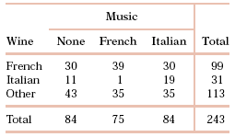
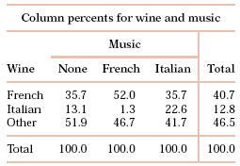

Music and wine purchase decision
What is the relationship between type of music played in supermarkets and type of wine purchased?
We want to compare the conditional distributions of the response variable (wine purchased) for each value of the explanatory variable (music played). Therefore, we calculate column percents.
Calculations: When no music was played, there were 84 bottles of wine sold. Of these, 30 were French wine.
30/84 = 0.357 ➔ 35.7% of the wine sold was French when no music was played.
30 = 35.7%
84
₌ cell total .
column total
We calculate the column conditional percents similarly for each of the nine cells in the table:

Slide 23
Computing expected counts
When testing the null hypothesis that there is no relationship between both categorical variables of a two-way table, we compare actual counts from the sample data with expected counts given H₀.
The expected count in any cell of a two-way table when H₀ is true is:
Although in real life counts must be whole numbers, an expected count need not be. The expected count is the mean over many repetitions of the study, assuming no relationship.

Slide 24
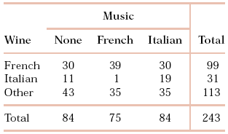
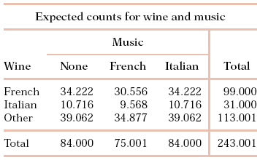
Music and wine purchase decision
The null hypothesis is that there is no relationship between music and wine
sales. The alternative is that these two variables are related.
What is the expected count in the upper-left cell of the two-way table, under H₀?
Column total 84: Number of bottles sold without music
Row total 99: Number of bottles of French wine sold
Table total 243: all bottles sold during the study
This expected cell count is thus
(84)(99) / 243 = 34.222
Nine similar calculations produce the table of expected counts:

Slide 25
Computing the chi-square statistic
The chi-square statistic (χ²) is a measure of how much the observed cell counts in a two-way table diverge from the expected cell counts.
The formula for the χ² statistic is:
(summed over all r x c cells in the table)
Tip: First, calculate the χ² components, (observed-expected)²/expected, for each cell of the table, and then sum them up to arrive at the χ² statistic.

Slide 26
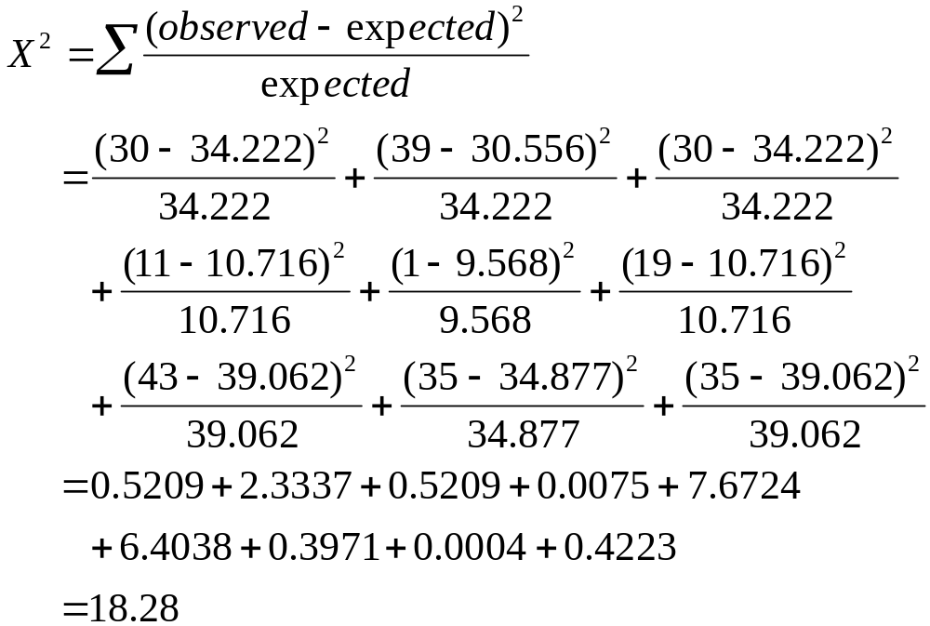
Music and wine purchase decision
H₀: No relationship between music and wine H_{a}: Music and wine are related
Observed counts Expected counts
We calculate nine X² components and sum them to produce the X² statistic:

Slide 27
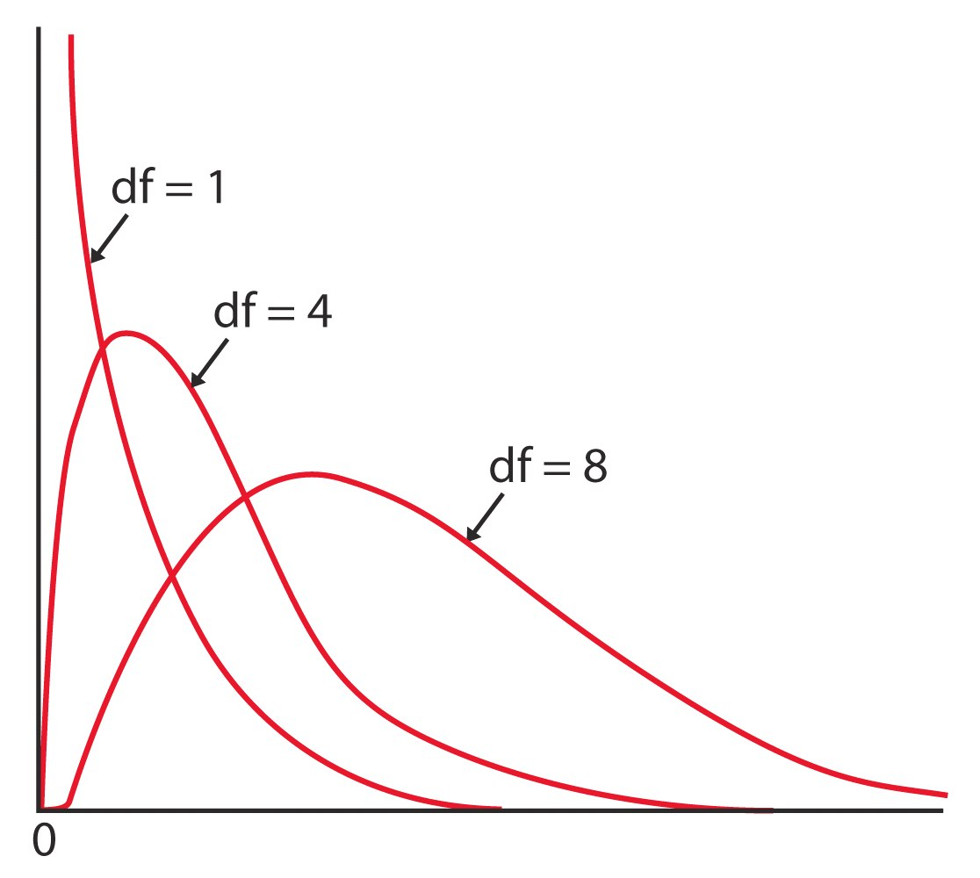
Finding the p-value with Table F
The χ² distributions are a family of distributions that can take only positive values, are skewed to the right, and are described by a specific degrees of freedom.
Table F gives upper critical values for many χ² distributions.

Slide 28

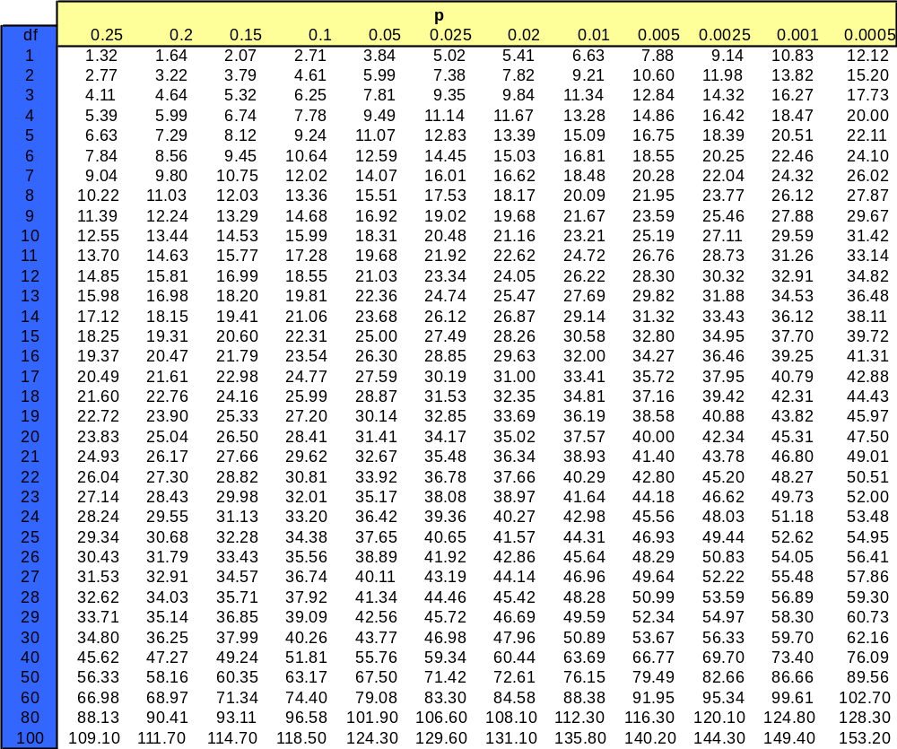
Table F
df = (r−1)(c−1)
Ex: In a 4x3 table, df = 3*2 = 6
If X² = 16.1, the p-value is between 0.01−0.02.

Slide 29
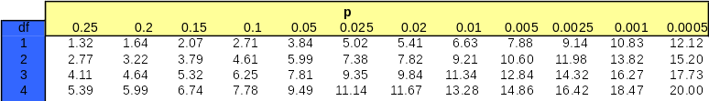
Music and wine purchase decision
H₀: No relationship between music and wine H_{a}: Music and wine are related
We found that the χ² statistic under H₀ is 18.28.
The two-way table has a 3x3 design (3 levels of music and 3 levels of wine). Thus, the degrees of freedom for the χ² distribution for this test is:
(r – 1)(c – 1) = (3 – 1)(3 – 1) = 4
16.42 < X² = 18.28 < 18.47
0.0025 > p-value > 0.001 ➔ very significant
There is a significant relationship between the type of music played and wine purchases in supermarkets.

Slide 30
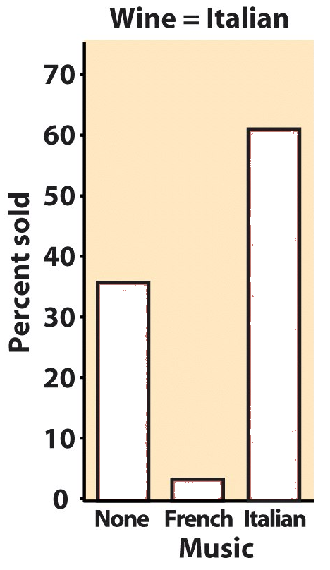
Interpreting the χ² output
The values summed to make up χ² are called the χ² components. When the test is statistically significant, the largest components point to the conditions most different from the expectations based on H₀.
Music and wine purchase decision
Two chi-square components contribute most to the χ² total ➔ the largest effect is for sales of Italian wine, which are strongly affected
by Italian and French
music.
χ² components
0.5209 2.3337 0.5209
0.0075 7.6724 6.4038
0.3971 0.0004 0.4223
Actual proportions show that Italian music helps sales of Italian wine, but French music hinders it.

Slide 31
Models for two-way tables
The chi-square test is an overall technique for comparing any number of population proportions, testing for evidence of a relationship between two categorical variables. We can either:
  Compare several populations: Randomly select several SRSs each from a different population (or from a population subjected to different treatments) → experimental study.
  Test for independence: Take one SRS and classify the individuals in the sample according to two categorical variables (attribute or condition) → observational study, historical design.
Both models use the χ² test to test the hypothesis of no relationship.

Slide 32
Comparing several populations: the first model
Select independent SRSs from each of c populations, of sizes
n₁, n₂, . . . , n_{c}. Classify each individual in a sample according to a categorical response variable with r possible values. There are c different probability distributions, one for each population.
The null hypothesis is that the distributions of the response variable are the same in all c populations. The alternative hypothesis says that these c distributions are not all the same.

Slide 33
Cocaine addiction
Cocaine produces short-term feelings of physical and mental well being. To maintain the effect, the drug may have to be taken more frequently and at higher doses. After stopping use, users will feel tired, sleepy, and depressed.
The pleasurable high followed by unpleasant after-effects encourage repeated compulsive use, which can easily lead to dependency.
We compare treatment with an anti-depressant (desipramine), a standard treatment (lithium), and a placebo.
Population 1: Antidepressant treatment (desipramine)
Population 2: Standard treatment (lithium)
Population 3: Placebo (“sugar pill”)

Slide 34
Cocaine addiction
H₀: The proportions of success (no relapse) are the same in all three populations.
Observed
Expected
Expected relapse counts
No Yes
35%
35%
35%
Desipramine
Lithium
Placebo
(25)(26)/74 ≈ 8.78 25 x 0.35 | 16.22 25 x 0.65
9.14 26 x 0.35 | 16.86 25 x 0.65
8.08 23 x 0.35 | 14.92 25 x 0.65

Slide 35
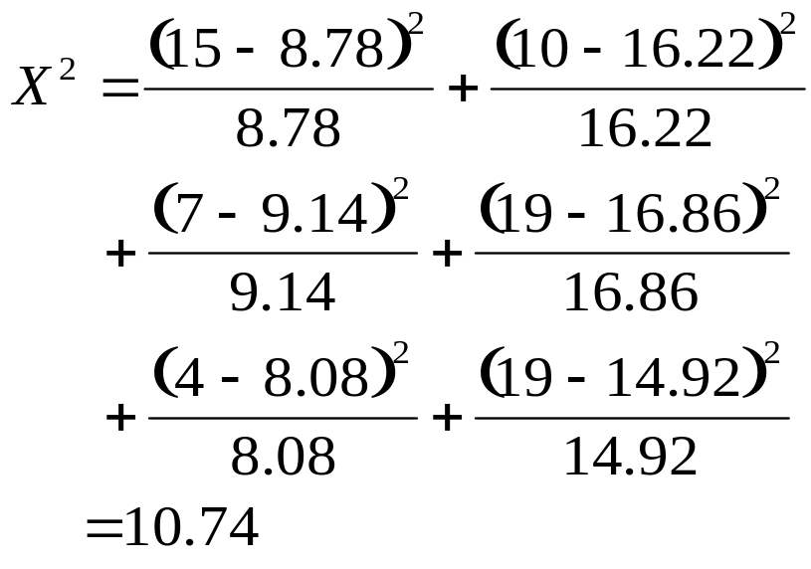
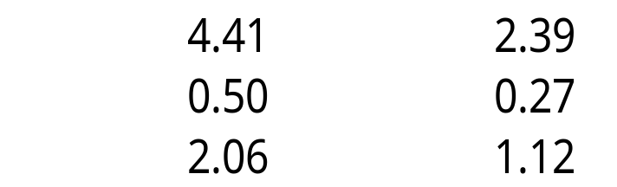
Cocaine addiction
No relapse Relapse
Table of counts:
“actual / expected,” with three rows and two columns:
df = (3−1)*(2−1) = 2
15 8.78 | 10 16.22
7 9.14 | 19 16.86
4 8.08 | 19 14.92
Desipramine
Lithium
Placebo
χ² components:

Slide 36
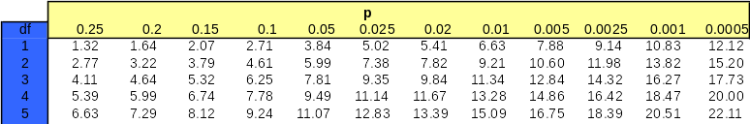
Cocaine addiction: Table F
H₀: The proportions of success (no relapse) are the same in all three populations.
X² = 10.71 and df = 2
10.60 < X² < 11.98 ➔ 0.005 < p < 0.0025 ➔ reject the H₀
➔The proportions of success are not the same in
all three populations (Desipramine, Lithium, Placebo).
Desipramine is a more successful treatment →→→
Observed

Slide 37
Testing for independence: the second model
We now have a single sample from a single population. For each individual in this SRS of size n we measure two categorical variables. The results are then summarized in a two-way table.
The null hypothesis is that the row and column variables are independent. The alternative hypothesis is that the row and column variables are dependent.

Slide 38
Successful firms
How does the presence of an exclusive-territory clause in the contract for a franchise business relate to the survival of that business?
A random sample of 170 new franchises recorded two categorical variables for each firm: (1) whether the firm was successful or not (based on economic criteria) and (2) whether or not the firm had an exclusive-territory contract.
This is a 2x2, two-way table
(2 levels for business success, yes/no, 2 levels for exclusive territory, yes/no).
We will test H₀: The variables exclusive clause and success are independent.

Slide 39
Successful firms
Computer output for the chi-square test using Minitab:
The p-value is significant at α 5% thus we reject H₀:
The existence of an exclusive territory clause in a franchise’s contract and the success of that franchise are not independent variables.

Slide 40
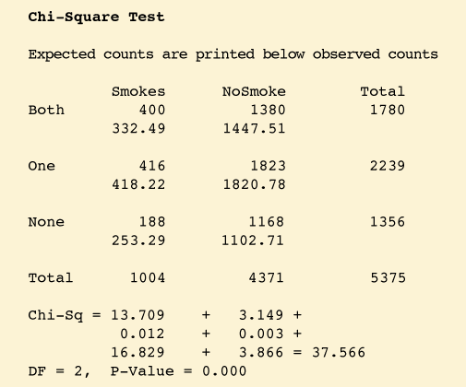
Parental smoking
Does parental smoking influence the incidence of smoking in children when they reach high school? Randomly chosen high school students were asked whether they smoked (columns) and whether their parents smoked (rows).
Examine the computer output for the chi-square test performed on these data. What does it tell you?
Sample size?
Hypotheses?
Are data ok for χ² test?
Interpretation?

Slide 41
Testing for goodness of fit
We have used the chi-square test as the tool to compare two or more distributions all based on sample data.
We now consider a slight variation on this scenario where only one of the distributions is known (our sample data observations) and we want to compare it with a hypothesized distribution.
  Data for n observations on a categorical variable with k possible outcomes are summarized as observed counts, n₁, n₂, . . . , n_{k}.
  The null hypothesis specifies probabilities p₁, p₂, . . . , p_{k} for the possible outcomes.

Slide 42
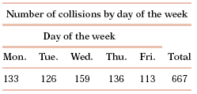
Car accidents and day of the week
A study of 667 drivers who were using a cell phone when they were involved in a collision on a weekday examined the relationship between these accidents and the day of the week.
Are the accidents equally likely to occur on any day of the working week?
H₀ specifies that all 5 days are equally likely for car accidents ➔ each p_{i} = 1/5.

Slide 43
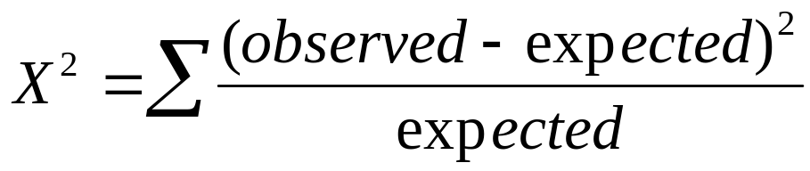
The chi-square goodness of fit test
Data for n observations on a categorical variable with k possible outcomes are summarized as observed counts, n₁, n₂, . . . , n_{k} in k cells.
H₀ specifies probabilities p₁, p₂, . . . , p_{k} for the possible outcomes.
For each cell, multiply the total number of observations n by the specified probability p_{i}:
expected count = np_{i}
The chi-square statistic follows the chi-square distribution with k − 1 degrees of freedom:

Slide 44
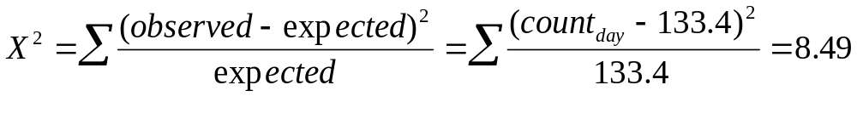
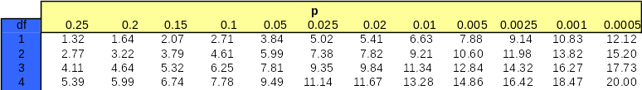
Car accidents and day of the week
H₀ specifies that all days are equally likely for car accidents ➔ each p_{i} = 1/5.
The expected count for each of the five days is np_{i} = 667(1/5) = 133.4.
Following the chi-square distribution with 5 − 1 = 4 degrees of freedom.
The p-value is thus between 0.1 and 0.05, which is not significant at α 5%.
➔ There is no significant evidence of different car accident rates for different weekdays when the driver was using a cell phone.

Slide 45
Using software
The chi-square function in Excel does not compute expected counts automatically but instead lets you provide them. This makes it easy to test for goodness of fit. You then get the test’s p-value—but no details of the χ² calculations.
=CHI TEST (array of actual values, array of expected values)
with values arranged in two similar r * c tables
--> returns the p value of the Chi Square test
Note: Many software packages do not provide a direct way to compute the chi-square goodness of fit test. But you can find a way around:
  Make a two-way table where the first column contains k cells with the observed counts. Make a second column with counts that correspond exactly to the probabilities specified by H₀, using a very large number of observations. Then analyze the two-way table with the chi-square function.

Slide 46
Alternate Slides
The following slides offer alternate software output data and examples for this presentation.

Slide 47
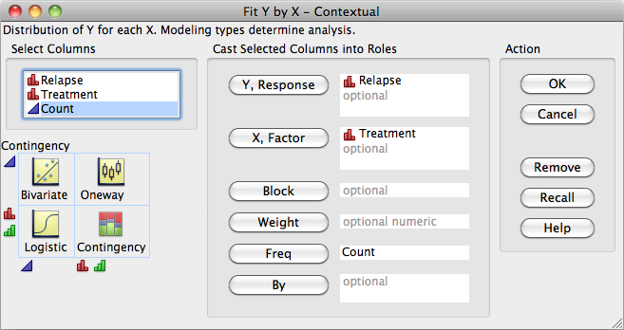
Using software
In Excel you have to do almost all the calculations for the chi-square test yourself, and it only gives you the p-value (not the component).
This is JMP: Analyze/Fit Y by X
Notes:
Alternate to slide 12 using JMP.

Slide 48
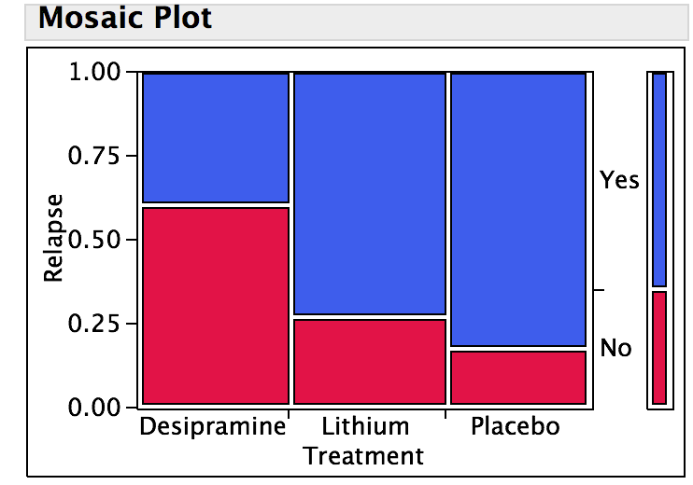
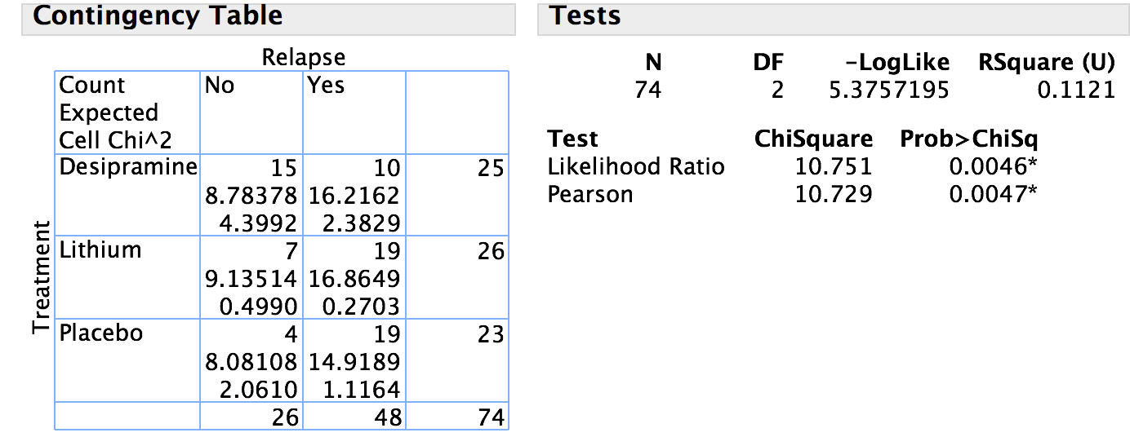
Cocaine addiction
JMP statistical software output for the cocaine study
- after de-selecting Total, Column and Row percentages and selecting Expected and Cell Chi Square
The p-value is 0.0047 or half a percent (use Pearson χ²). This is very significant.
We reject the null hypothesis of no association and conclude that there is a significant relationship between treatment (desipramine, lithium, placebo) and outcome (relapse or not).
Notes:
Alternate to slide 13 using JMP.

Slide 49
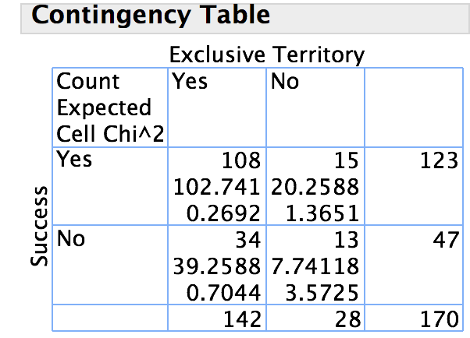
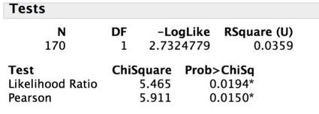
Successful firms
Here is the chi-square output from JMP:
The p-value is significant at α = 5% (p = 1.5%) thus we reject H₀: we have found a significant relationship between an exclusive territory and the success of a franchised firm.
Notes:
Alternate to slide 16 using JMP.

Slide 50
Successful firms
Here is the chi-square output from JMP:
The p-value is significant at α 5% thus we reject H₀:
The existence of an exclusive territory clause in a franchise’s contract and the success of that franchise are not independent variables.
Notes:
Alternate to slide 36 using JMP.

