Slide 1
Polynomial Approximation of Machine Learning Models
Prepared by Symbat Bekzhigit
Supervisors: Eduardo Chielle, Manaar Alam
Engineering Ethics | Spring 2023 | Self-driving cars

Slide 2

The problem addressed
The available research on the privacy-preserving inference on DNNs has managed to make only small models work due to the challenges posed by homomorphic encryption on larger models.
Therefore, our primary objective in this internship was to contribute to the current research on the privacy-preserving inference on DNNs by exploring various methodologies for approximating the ReLU (Rectified Linear Unit) function with low-degree polynomials, progressively shifting from small models to a larger, more complex models.
Symbat Bekzhigit
NYU Abu Dhabi
2
Notes:
So far, the available research on the privacy-preserving inference on DNNs has managed to make only small models work due to the challenges posed by homomorphic encryption on larger models. Therefore, our primary objective in this internship was to contribute to the current research on the privacy-preserving inference on DNNs by exploring various methodologies for approximating the ReLU (Rectified Linear Unit) function with low-degree polynomials, progressively shifting from small models to a larger, more complex models.

Slide 3
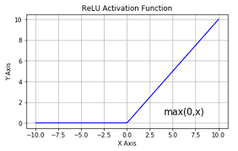
Reasoning
Homomorphic encryption allows for secure computation on encrypted data, making it a valuable tool for privacy-preserving applications. However, it has its limitations, particularly in performing computations with complex functions like ReLU.
By approximating the ReLU function with low-order polynomials, it becomes possible to efficiently compute the ReLU operation using homomorphic encryption, expanding its utility and enabl secure processing of ReLU-based neural networks or algorithms
Symbat Bekzhigit
NYU Abu Dhabi
3
Notes:
Our reasoning for exploring low-order polynomial approximations of the ReLU function was to overcome the limitations posed by complex functions in homomorphic encryption. Homomorphic encryption allows for secure computation on encrypted data, making it a valuable tool for privacy-preserving applications. However, it has its limitations, particularly in performing computations with complex functions like ReLU.
When dealing with small models, the computational overhead introduced by homomorphic encryption can be more manageable. Smaller models have fewer parameters and are generally less complex, leading to less computation being required during inference. This makes it feasible to use homomorphic encryption and still achieve reasonable inference times and resource utilization.
However, as models become larger and more complex, the computational demands increase exponentially. The sheer size and depth of larger DNNs lead to substantially higher computations during inference, which can result in significantly increased overhead when applying homomorphic encryption. As a consequence, the practicality and efficiency of using homomorphic encryption on larger models would largely depend on the efficiency of the approximations chosen for non-linear functions such as ReLU.
By approximating the ReLU function with low-order polynomials, it becomes possible to efficiently compute the ReLU operation using homomorphic encryption, expanding its utility and enabling secure processing of ReLU-based neural networks or algorithms.

Slide 4
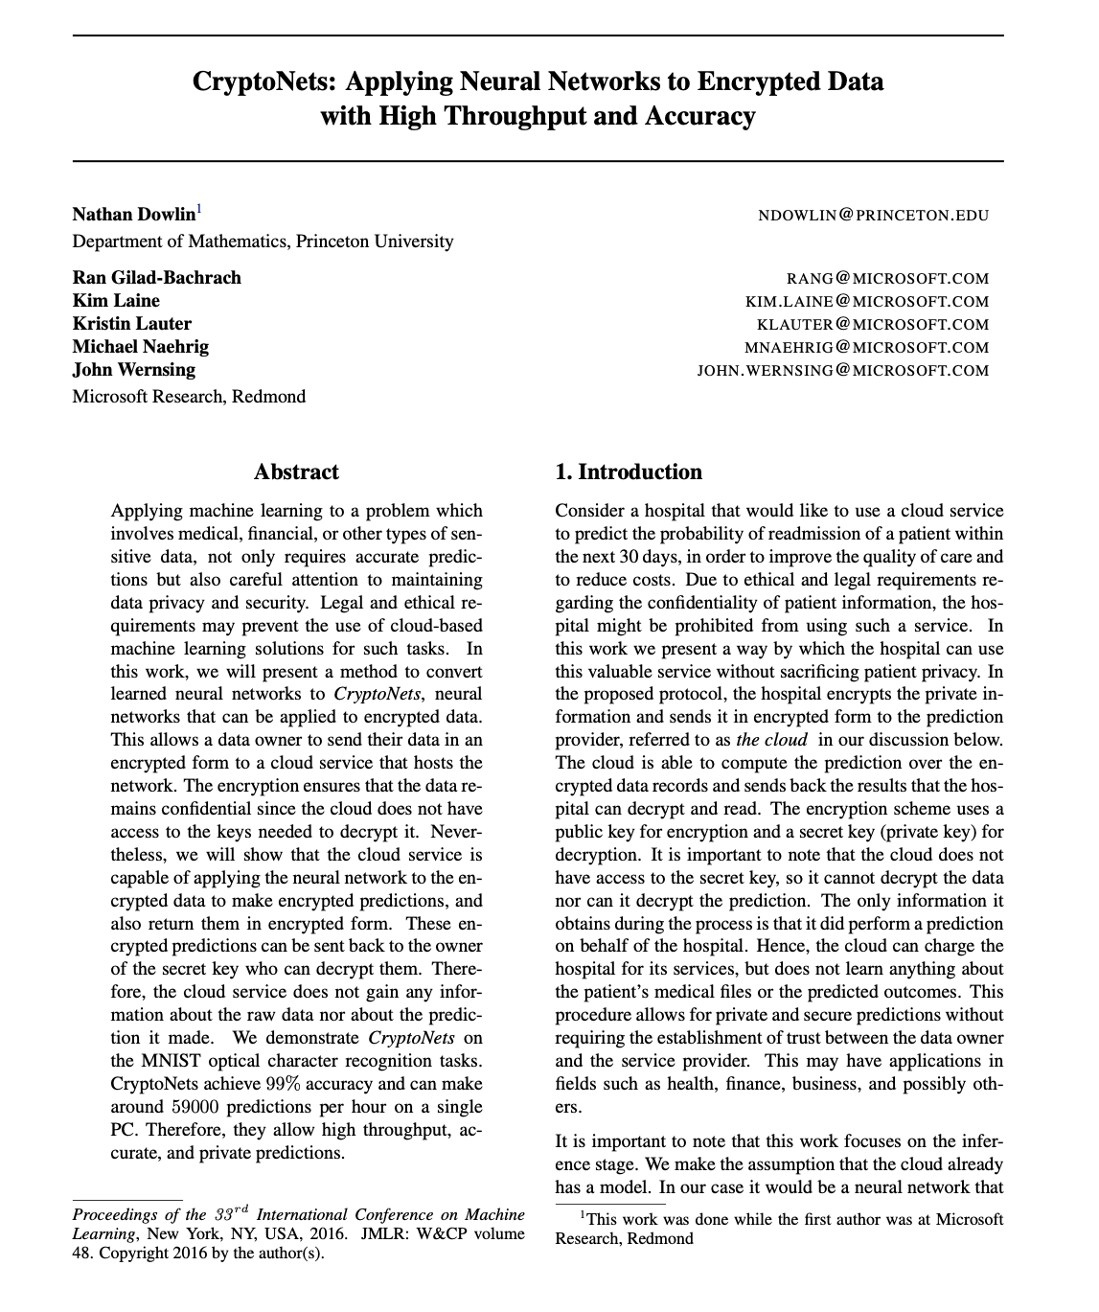
What I have done to address it
Literature review
CryptoNets: Applying Neural Networks to Encrypted Data with High Throughput and Accuracy
Fast and Private Inference of Deep Neural Networks by Co-designing Activation Functions
Sisyphus: A Cautionary Tale of Using Low-Degree Polynomial Activations in Privacy-Preserving Deep Learning
Symbat Bekzhigit
NYU Abu Dhabi
5
Notes:
We looked at the existing research and approaches related to polynomial approximations for nonlinear functions, specifically focusing on ReLU in the context of homomorphic encryption. This helped us identify the state-of-the-art techniques and any limitations or challenges faced in this area.

Slide 5
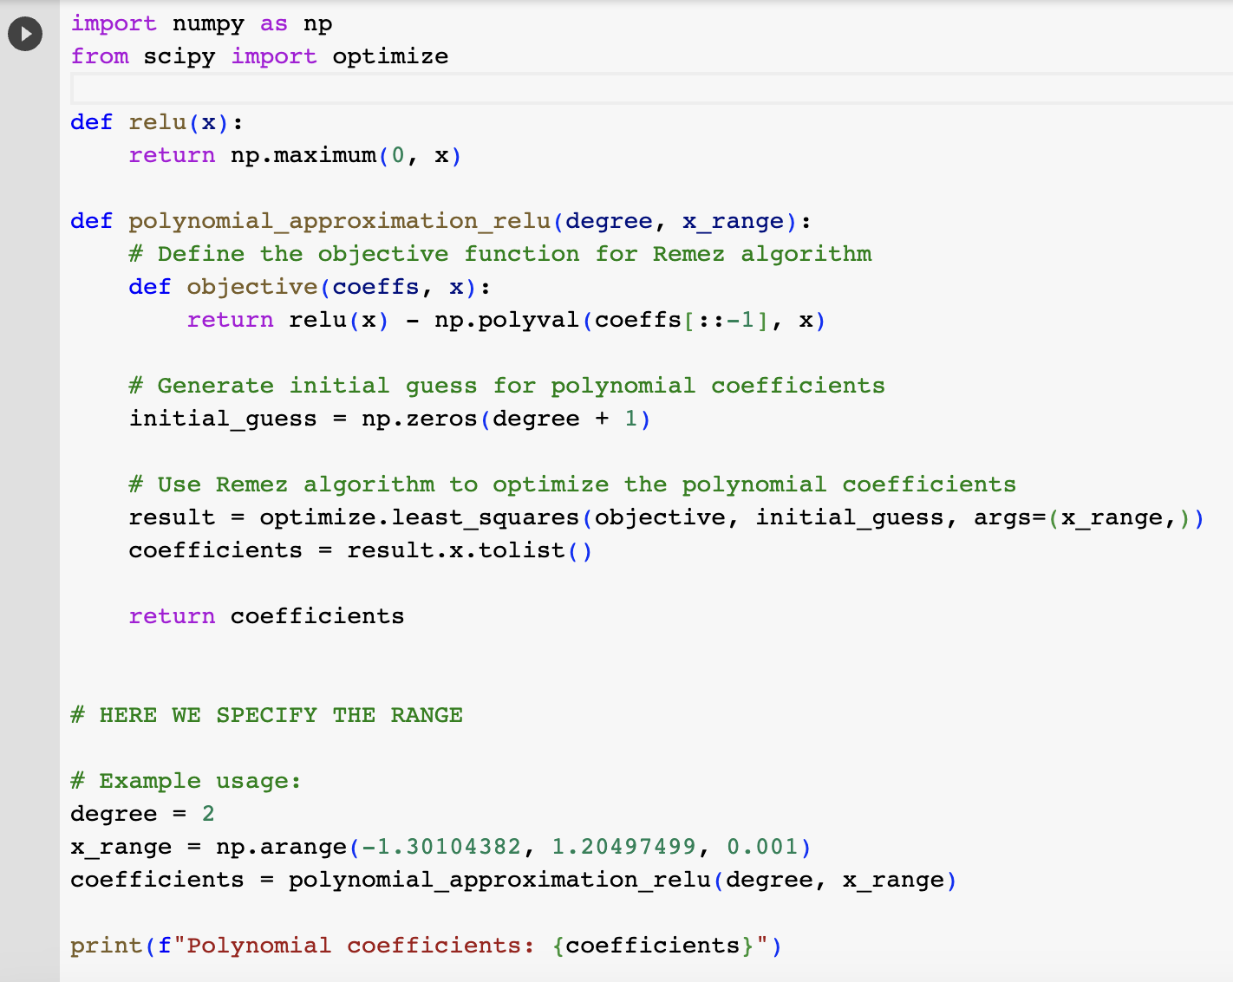
What I have done to address it
Polynomial Approximation Algorithm
The Remez Algorithm is an iterative method used to find
the best polynomial approximation of a given function over
a specified interval. It aims to minimize the maximum error
between the function and the polynomial approximation,
also known as the maximum deviation.
Models
Custom CNN #1: 1 ReLU layer, 1 Convolutionional layer,
Flatten, and Dense layers
Custom CNN #2: 2 ReLU layers, 2 Convolutionional layers,
Flatten, and Dense layers
LeNet-5: implemented from scratch
ResNet-18: implemented from scratch
Symbat Bekzhigit
NYU Abu Dhabi
5
Notes:
The Remez Algorithm is an iterative method used to find
the best polynomial approximation of a given function over
a specified interval. It aims to minimize the maximum error
between the function and the polynomial approximation,
also known as the maximum deviation.
The Remez algorithm iteratively improves the polynomial coefficients by focusing on reducing the maximum deviation. By adjusting the coefficients based on the largest error, it gradually refines the polynomial approximation to better match the original function within the specified interval. In my case, the objective function measures the error between the ReLU function and the polynomial approximation, and the algorithm optimizes the polynomial coefficients to minimize this error. The resulting coefficients represent the most optimal polynomial approximation of the ReLU function within the specified range.

Slide 6
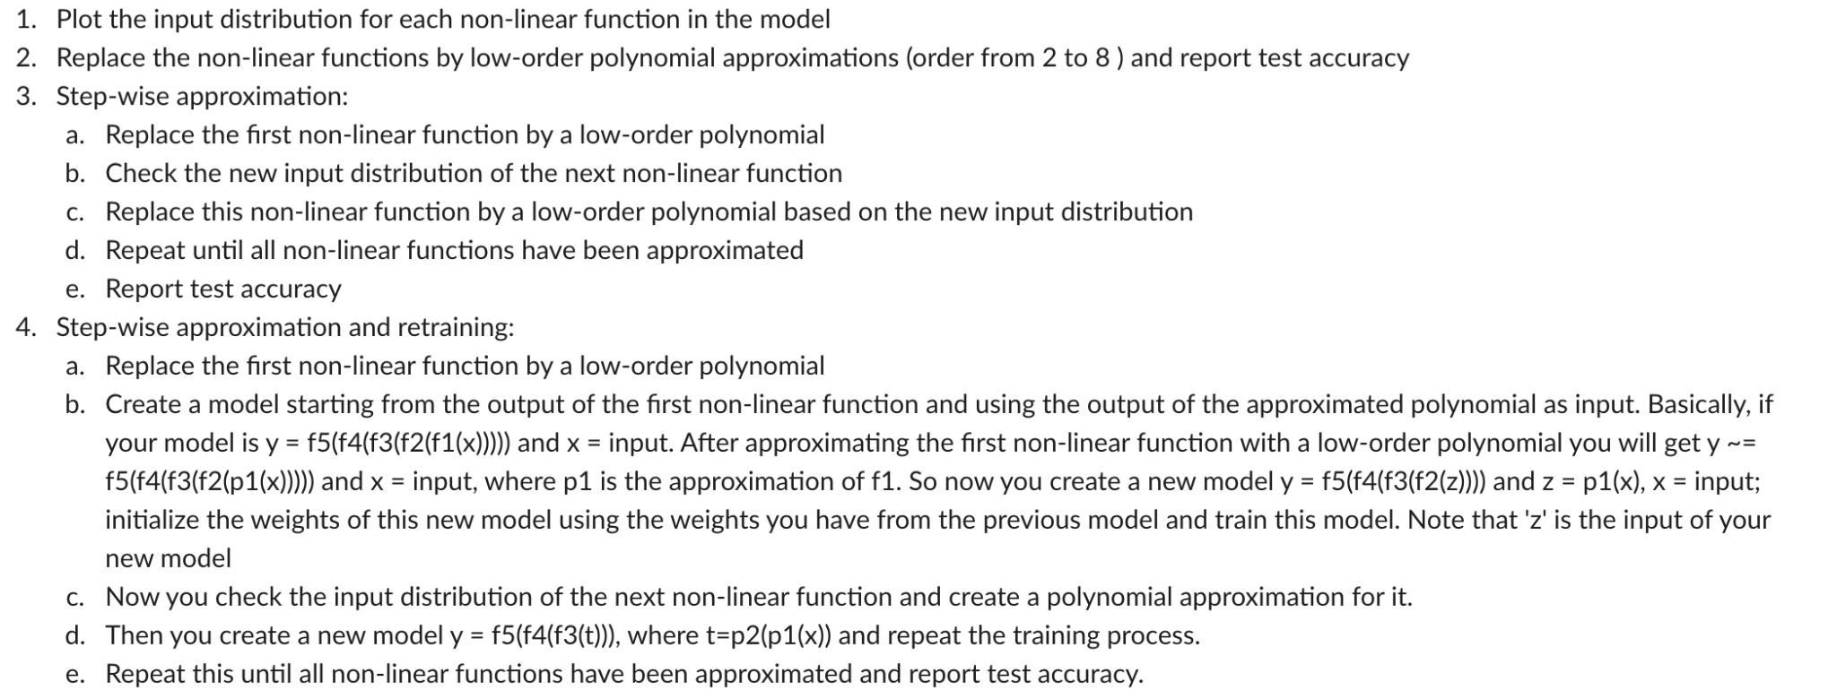
3 Types of Polynomial Approximations
Symbat Bekzhigit
NYU Abu Dhabi
5

Slide 7
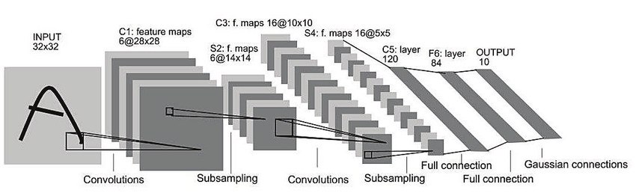
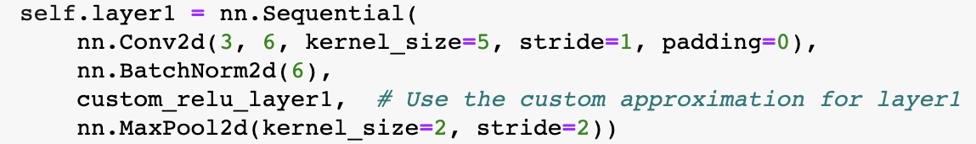
2 Different Approaches To Approximations
Approximation of the ReLU layer as a whole
Channel-specific approximation
Figure 1: LeNet-5 architecture
Symbat Bekzhigit
NYU Abu Dhabi
5

Slide 8
Results
 | MNIST | CIFAR-10 | Caltech-101
Custom CNN #1 | Original: 97.290 M1: 96.840 M2: - M3: - | x | x
Custom CNN #2 | Original: 98.620 M1: 94.040 M2: 92.150 M3: 95.200 | x | x
LeNet-5 | x | Original: 74.410 M1: 23.600 -> 31.810 M2: 9.320 -> 28.430 M3: 59.150 | Original: 59.447 M1: 37.558 M2: 37.788 M3: 56.336
Symbat Bekzhigit
NYU Abu Dhabi
5

Slide 9
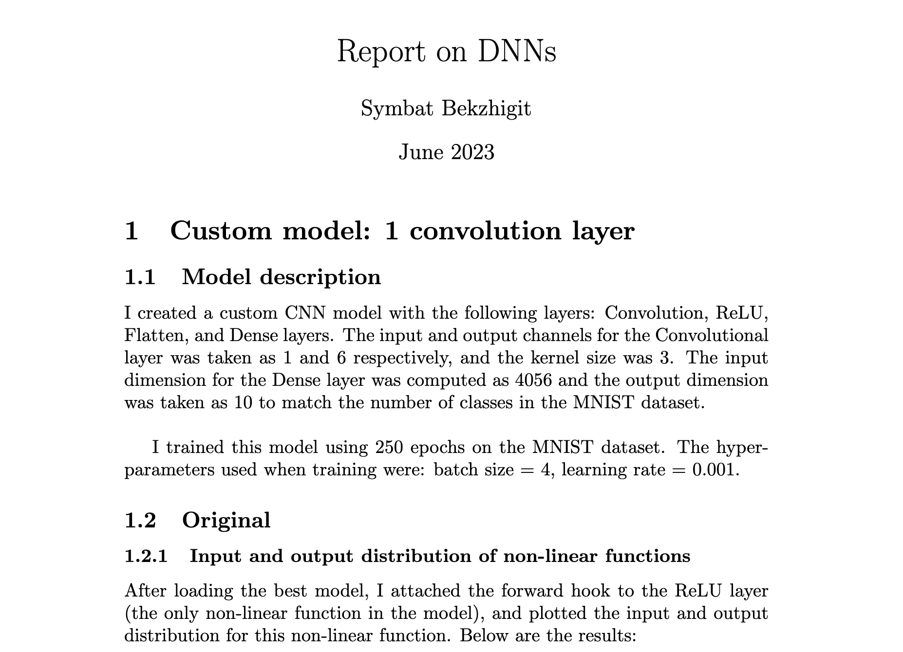
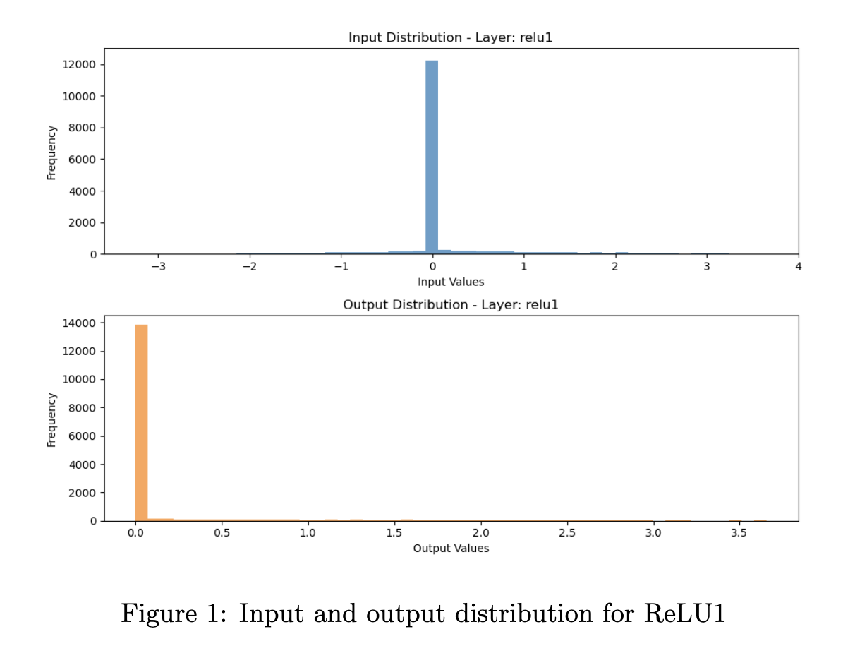
Deliverable
Report
I’ve compiled everything I did throughout the internship, including figures, tables, results, etc. in this comprehensive report.
Symbat Bekzhigit
NYU Abu Dhabi
6
Notes:
New technologies should solve problems, rather than create new ones.
Putting a computer in control of something as potentially dangerous as a car may lead to more risks than it removes. For example, it opens up the door to potential hacking incidents that could be fatal.
With autonomous vehicles, this danger is heightened, since the vehicle would have to be connected to the internet for things like software updates and GPS. A hacker could use this to carjack someone while they were driving, anonymously steal their car in the middle of the night, or remotely unlock their doors.
From an ethical standpoint, is this situation safer than the risks of human error on the road? Considering the rising rates of cybercrime, some may argue self-driving cars pose too great a security risk to go mainstream.

Slide 10
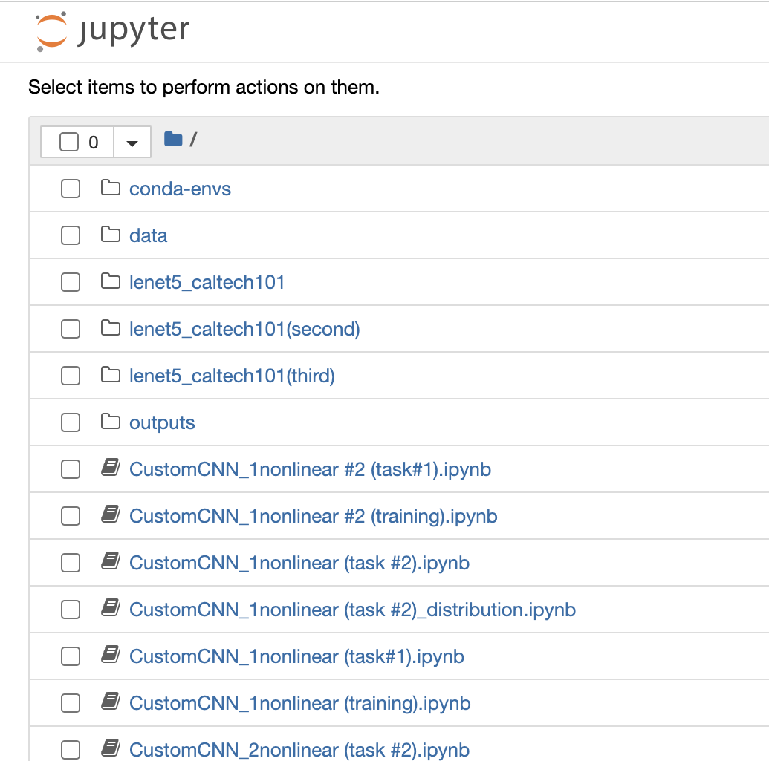
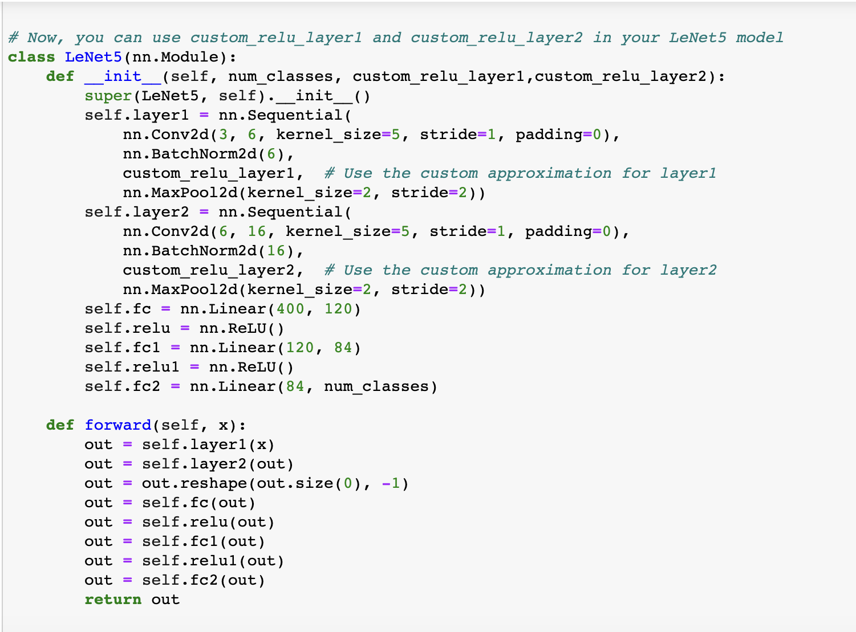
Deliverable
2. Source Code
GitHub repository with the code of the algorithms used, training code, etc.
Symbat Bekzhigit
NYU Abu Dhabi
6
Notes:
New technologies should solve problems, rather than create new ones.
Putting a computer in control of something as potentially dangerous as a car may lead to more risks than it removes. For example, it opens up the door to potential hacking incidents that could be fatal.
With autonomous vehicles, this danger is heightened, since the vehicle would have to be connected to the internet for things like software updates and GPS. A hacker could use this to carjack someone while they were driving, anonymously steal their car in the middle of the night, or remotely unlock their doors.
From an ethical standpoint, is this situation safer than the risks of human error on the road? Considering the rising rates of cybercrime, some may argue self-driving cars pose too great a security risk to go mainstream.

Slide 11
Feedback
&
Thank you!
Tomiris Doskhozhina, Shajee’ah Ramjaun, Samira Aldybergenova, Symbat Bekzhigit
Engineering ethics | Spring 2023 | Self-driving cars
8
Notes:
Meetings are a bit long. It’d be good to have it shortened
More workshops in the beginning: Workshop on Pytorch, How to access supporting software/hardware i.e. setup help
Clearer expectations and frequent feedback on the correctness of the code/approach

Slide 12
Q&A
Tomiris Doskhozhina, Shajee’ah Ramjaun, Samira Aldybergenova, Symbat Bekzhigit
Engineering ethics | Spring 2023 | Self-driving cars
8
Notes:
The discussion around self-driving cars has been connected to the trolley problem, an idealized and unsolvable decision-making conundrum. If we go to the definition… but we need to understand that the reasoning that we apply to the trolley problem cannot be used for sdc.further arguments for the inadequacy of the trolley problem for the analysis of ethical and social aspects of self-driving cars.
The trolley problem assumes that self-driving car would have a system that will make a precise and reliable distinction, not only between humans and other kinds of obstacles on the road (which is already a problem), but even distinctions among people. However, there are already principles and laws that forbid to differentiate among humans based on attributes such as age, nation, wealth, social status, gender, etc., in regard to the right to life. Therefore, choosing which human one will kill is not an option.

