Slide 1
Paradigm of Condensed Matter Theory
Theory of Quantum Magnetism
Tao Xiang
http://www.itp.ac.cn/~txiang/
11 September 2006

Slide 2
Acknowledgement
In this lecture, I have used many pictures downloaded from Internet. I am very grateful to the authors of these pictures, although I do not even known their names in many cases.
Notes:
Ferromagnetism is known since the time of the ancient greeks. Magnetic materials find numerous applications
Starting from magnetic needle in a compass and including hard drives which can carry terabytes of information.
Record holder for commercial products: Hitachi hard drives with density of 230 billion bits per sq. inch. This allows
Computer drives capable of storing a trillion bytes (terabyte)

Slide 3
Magnetism Is an Evergreen Tree of Science
The study of magnetism as a cooperative phenomena has been responsible for the most significant advances in the theory of thermodynamic phase transitions. This has transformed statistical mechanics into one of the sharpest and most significant tools for the study of condensed matter.
Notes:
Ferromagnetism is known since the time of the ancient greeks. Magnetic materials find numerous applications
Starting from magnetic needle in a compass and including hard drives which can carry terabytes of information.
Record holder for commercial products: Hitachi hard drives with density of 230 billion bits per sq. inch. This allows
Computer drives capable of storing a trillion bytes (terabyte)

Slide 4

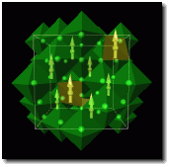



Magnets: Ancient Gift
China
4000 BC magnetite 磁铁矿
3000-2500 BC meteoric iron
Greek
800 BC lodestone 磁石
Han Dynasty Chinese Compass
Fe₃O₄
Magnetic memory
Notes:
Ferromagnetism is known since the time of the ancient greeks. Magnetic materials find numerous applications
Starting from magnetic needle in a compass and including hard drives which can carry terabytes of information.
Record holder for commercial products: Hitachi hard drives with density of 230 billion bits per sq. inch. This allows
Computer drives capable of storing a trillion bytes (terabyte)

Slide 5
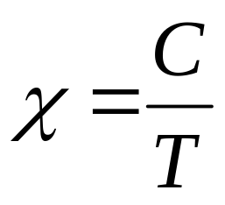
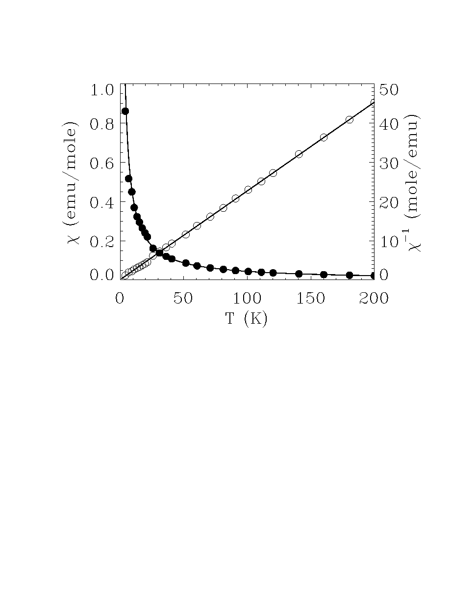
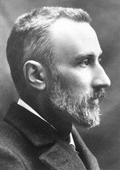
Outset of Modern Theory of Magnetism
Pierre Curie discovered the Curie law of paramagnetic materials and Curie transition temperature
FeBr(C₄₄H₂₈N₄)
Pierre Curie
1903 Nobel Prize
1859-1906
Notes:
Ferromagnetism is known since the time of the ancient greeks. Magnetic materials find numerous applications
Starting from magnetic needle in a compass and including hard drives which can carry terabytes of information.
Record holder for commercial products: Hitachi hard drives with density of 230 billion bits per sq. inch. This allows
Computer drives capable of storing a trillion bytes (terabyte)

Slide 6
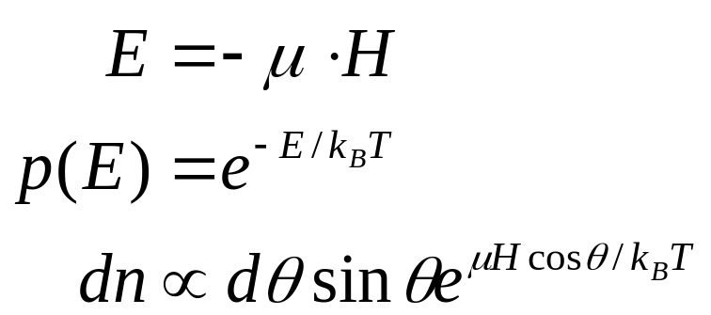
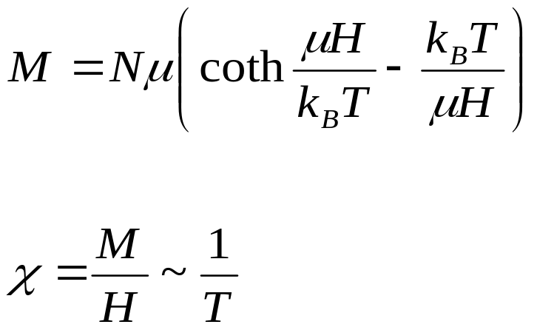
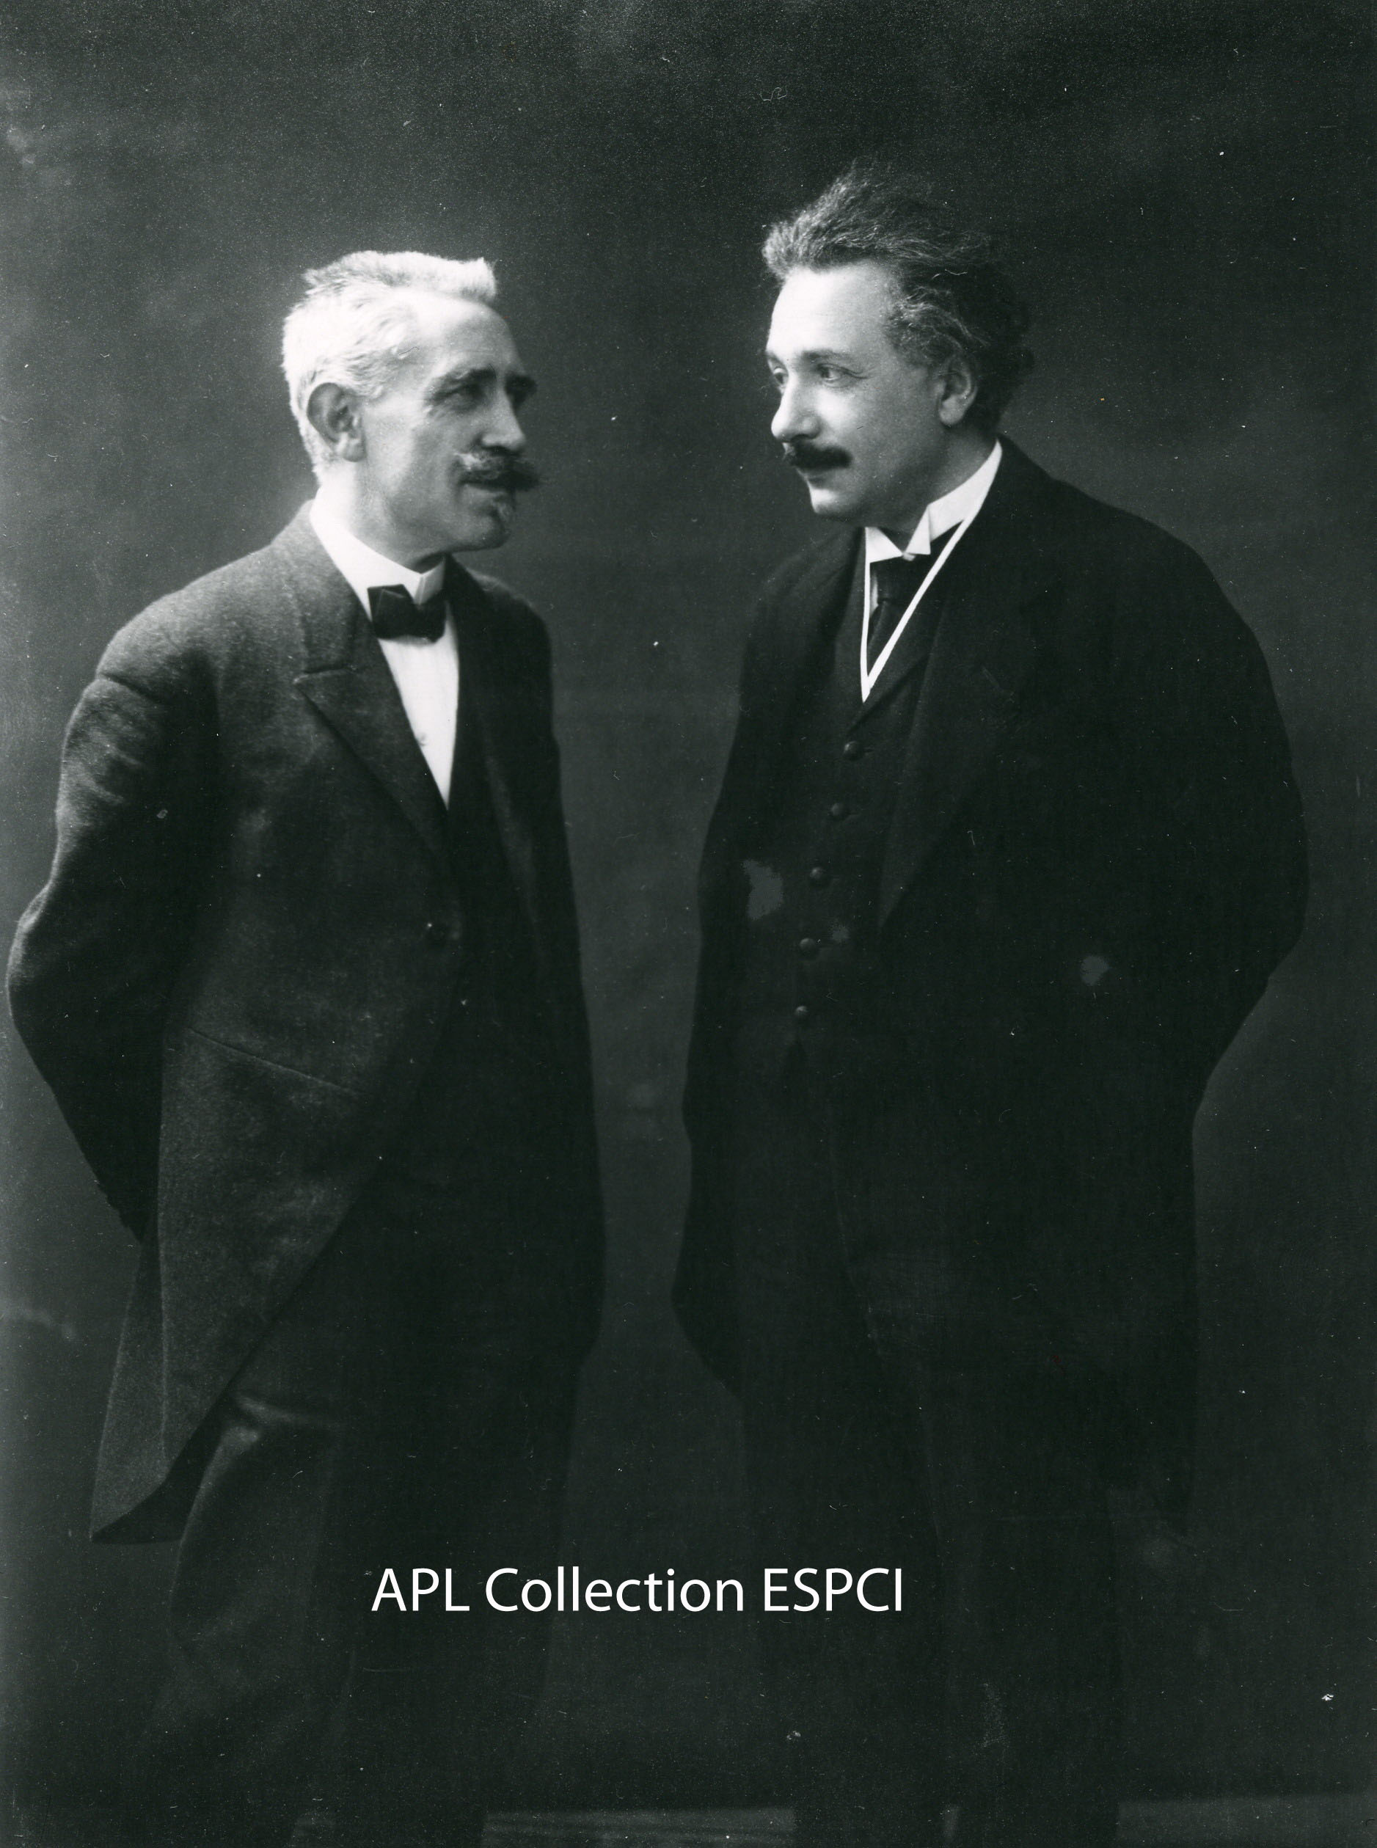
Classical Theory of Paramagnetism
Energy of a dipole
Probability of a dipole in energy E
Average of dipole orientation
Magnetization:
Susceptibility
Paul Langevin
1872-1946

Slide 7
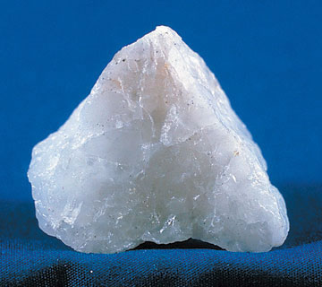
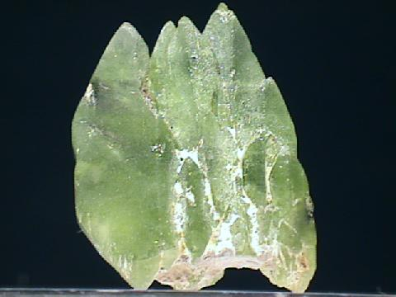
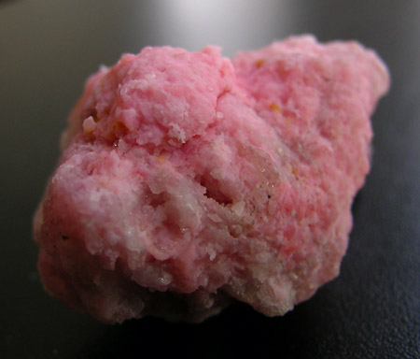
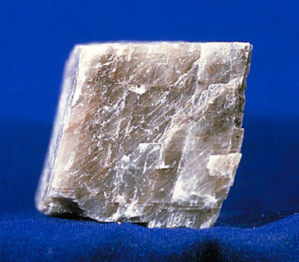
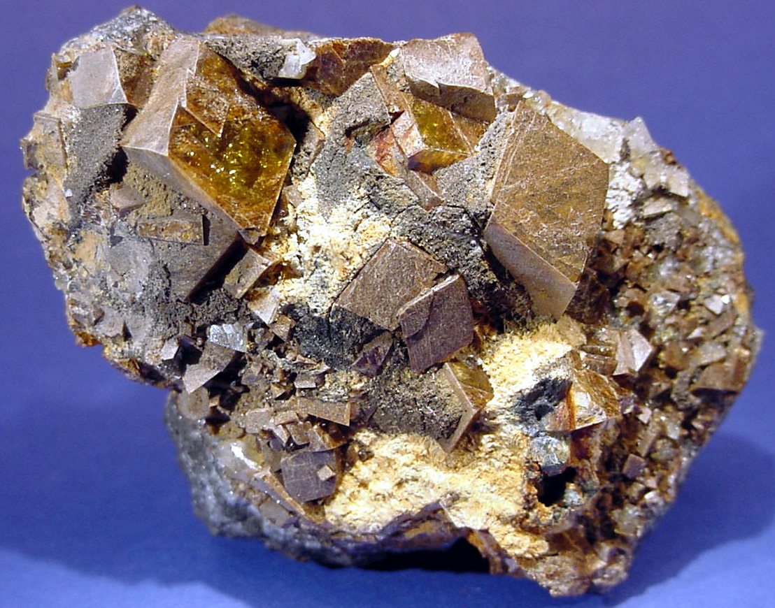
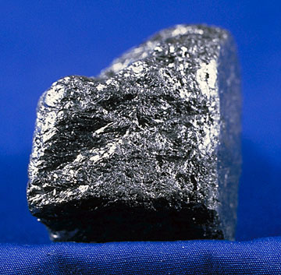
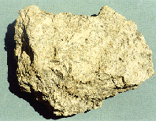
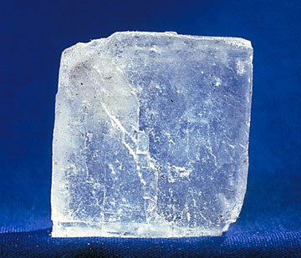
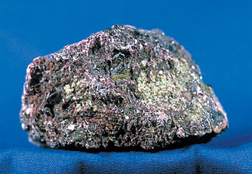
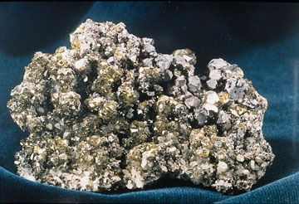
paramagnetic minerals
diamagnetic minerals
Olivine (Fe,Mg)₂SiO₄橄榄石
Quartz (SiO₂)石英
Montmorillonite (clay)蒙脱石（粘土）
Calcite (CaCO₃)方解石
Siderite (FeCO₃)菱铁矿, 陨铁
Graphite (C)石墨
Serpentinite Mg₃Si₂O₅(OH)₄蛇纹岩
Halite (NaCl)岩盐
Chromite (FeCr₂O₄)铬铁矿
Sphalerite (ZnS)闪锌矿

Slide 8
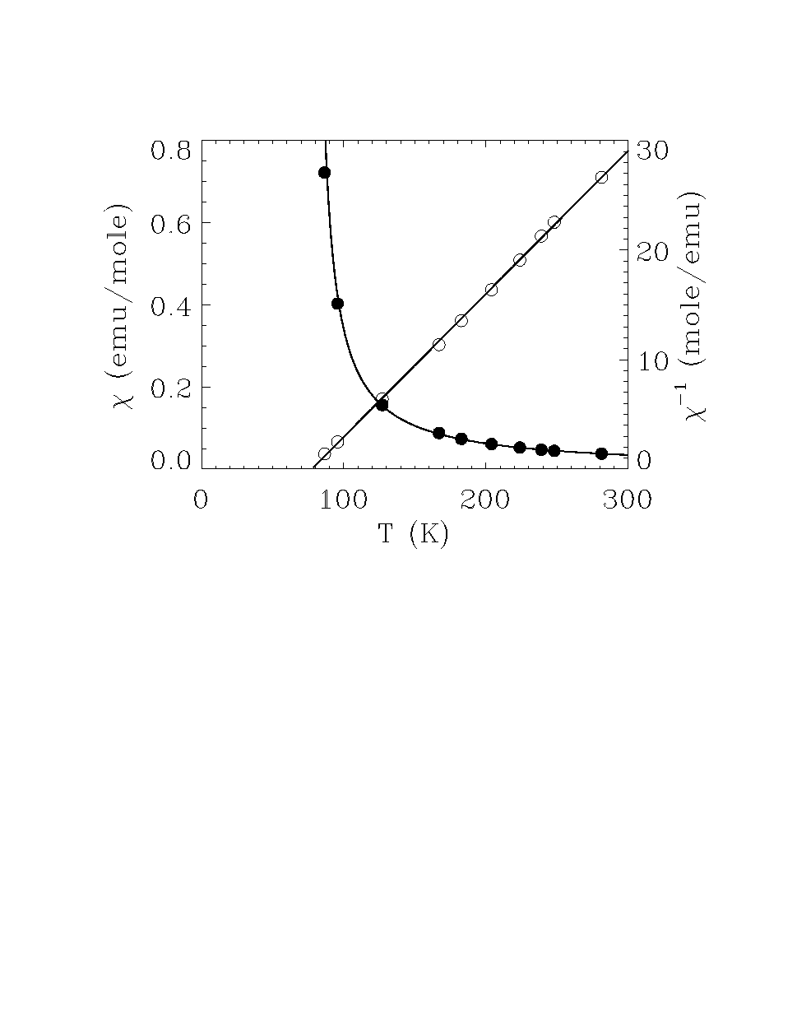
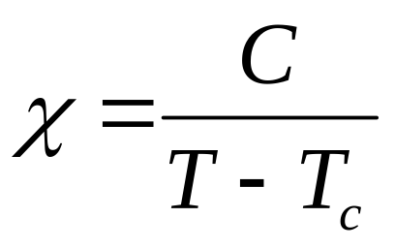
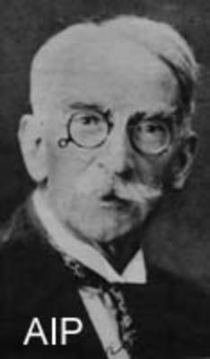
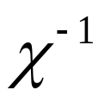

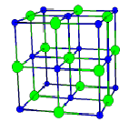
Theory of Molecular Field
1907 Pierre Weiss formulated the first modern theory of magnetism: molecular field
--- first self-consistent mean-field theory
EuO
Pierre Weiss
1864-1940
Notes:
Ferromagnetism is known since the time of the ancient greeks. Magnetic materials find numerous applications
Starting from magnetic needle in a compass and including hard drives which can carry terabytes of information.
Record holder for commercial products: Hitachi hard drives with density of 230 billion bits per sq. inch. This allows
Computer drives capable of storing a trillion bytes (terabyte)

Slide 9

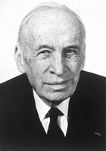
Bohr-van Leeuwen Theorem
At any finite temperature, and in all finite applied electrical or magnetic fields, the net magnetization of a collection of electrons (orbital currents) in thermal equilibrium vanishes identically.
Niels Bohr
1885-1962
Classic Theory of magnetism is irrelevant and Quantum Theory is needed!
Van Vleck
1977 Nobel
Notes:
Ferromagnetism is known since the time of the ancient greeks. Magnetic materials find numerous applications
Starting from magnetic needle in a compass and including hard drives which can carry terabytes of information.
Record holder for commercial products: Hitachi hard drives with density of 230 billion bits per sq. inch. This allows
Computer drives capable of storing a trillion bytes (terabyte)

Slide 10


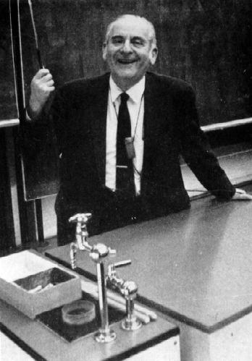
Spin: Origin of Magnetic Moment
Electron spin
Ion spins: Hund’s Rule
Paul Dirac
George Uhlenbeck
S.A. Goudsmit
↑ | ↑ | ↑
Cr3+: 3d³
1st rule: S=3/2
2nd rule: L=3
S-O coupling: J = 3/2
↑↓ | ↑ | ↑ | ↑ | ↑
Fe: 3d6
S = 2, L = 2, J = L+S = 4

Slide 11
79 elements are magnetic in atomic state
H |  |  |  |  |  |  |  |  |  |  |  |  |  |  |  |  | He
Li | Be |  |  |  |  |  |  |  |  |  |  | B | C | N | O | F | Ne
Na | Mg |  |  |  |  |  |  |  |  |  |  | Al | Si | P | S | Cl | Ar
K | Ca | Sc | Ti | V | Cr | Mn | Fe | Co | Ni | Cu | Zn | Ga | Ge | As | Se | Br | Kr
Rb | Sr | Y | Zr | Nb | Mo | Tc | Ru | Rh | Pd | Ag | Cd | In | Sn | Sb | Te | I | Xe
Cs | Ba | La | Hf | Ta | W | Re | Os | Ir | Pt | Au | Hg | Tl | Pb | Bi | Po | At | Rn
Fr | Ra | Ac
 |  |  |  | Ce | Pr | Nd | Pm | Sm | Eu | Gd | Tb | Dy | Ho | Er | Tm | Yb | Lu
 |  |  |  | Th | Pa | U | Np | Pu | Am | Cm | Bk | Cf | Es | Fm | Md | No | Lw

Slide 12
15 elements are magnetically ordered in the solid state
H |  |  |  |  |  |  |  |  |  |  |  |  |  |  |  |  | He
Li | Be |  |  |  |  |  |  |  |  |  |  | B | C | N | O | F | Ne
Na | Mg |  |  |  |  |  |  |  |  |  |  | Al | Si | P | S | Cl | Ar
K | Ca | Sc | Ti | V | Cr | Mn | Fe | Co | Ni | Cu | Zn | Ga | Ge | As | Se | Br | Kr
Rb | Sr | Y | Zr | Nb | Mo | Tc | Ru | Rh | Pd | Ag | Cd | In | Sn | Sb | Te | I | Xe
Cs | Ba | La | Hf | Ta | W | Re | Os | Ir | Pt | Au | Hg | Tl | Pb | Bi | Po | At | Rn
Fr | Ra | Ac
 |  |  |  | Ce | Pr | Nd | Pm | Sm | Eu | Gd | Tb | Dy | Ho | Er | Tm | Yb | Lu
 |  |  |  | Th | Pa | U | Np | Pu | Am | Cm | Bk | Cf | Es | Fm | Md | No | Lw

Slide 13
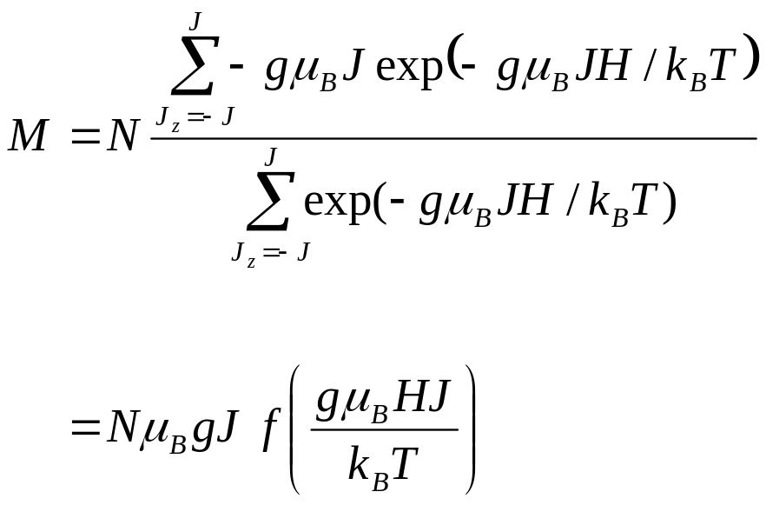
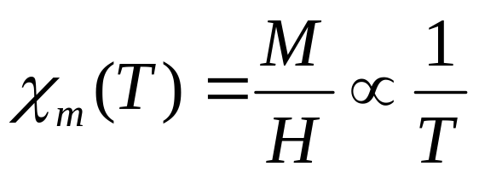
Quantized Langevin Theory
J_{z}
2
1
0
-1
-2
J
Curie Law:

Slide 14
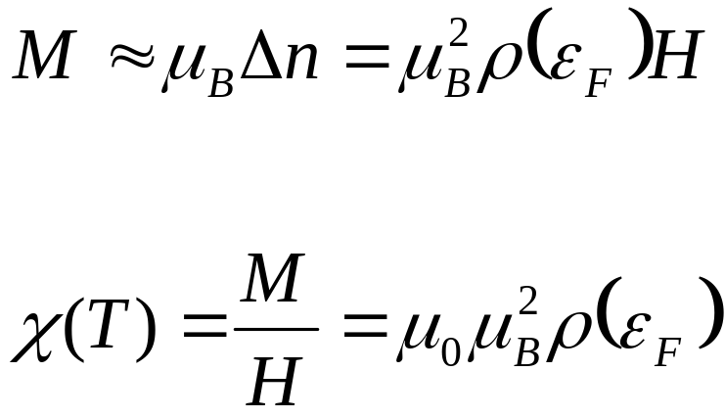
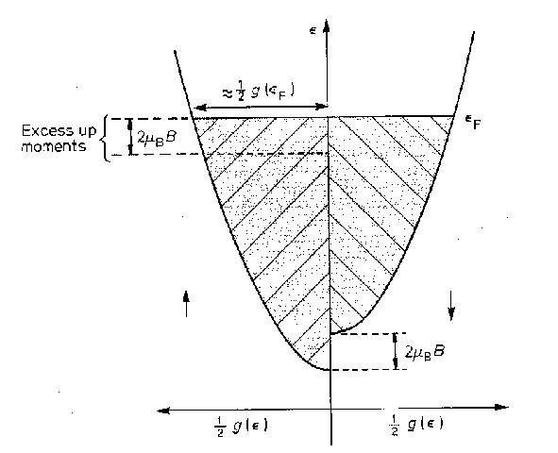
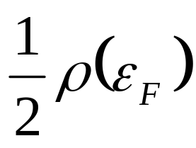
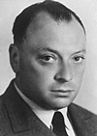
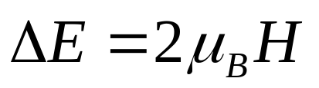
Pauli Paramagnetism of Metal
Density of states
Wolfgang Pauli

Slide 15
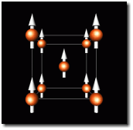
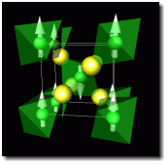
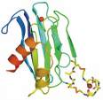
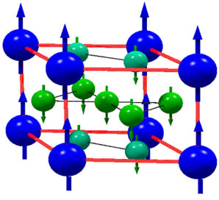
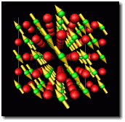
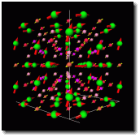
Different types of collective magnetism
BCC Iron
Ferromagnet
MnF₂
Antiferromagnet
Paramagnet
GdCo₅
Ferrimagnet
MnO
Antiferromagnet
Er₆Mn₂₃

Slide 16
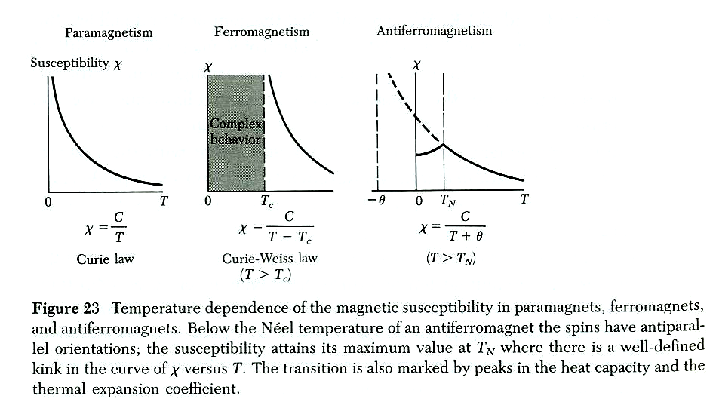
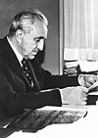
Different types of collective magnetism

Slide 17
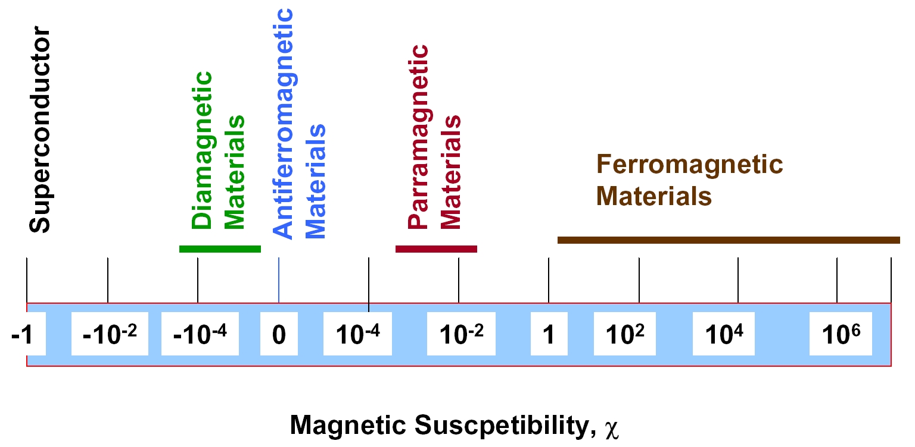
Susceptibility

Slide 18
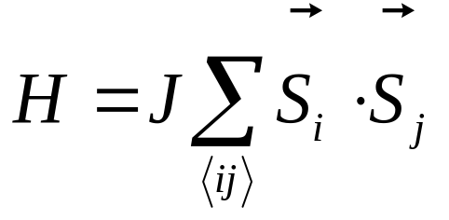
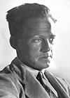
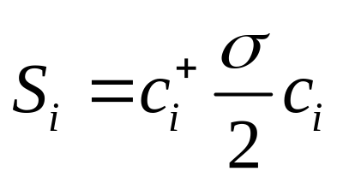
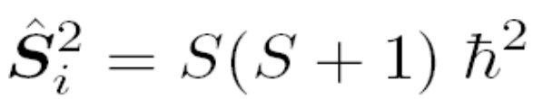
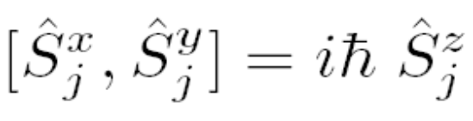
Heisenberg Model
J < 0 Ferromagnetic coupling (metal or insulator)
J > 0 Antiferromagnetic coupling (insulator, freeze charge degrees of freedom)
Heisenberg Nobel 1932

Slide 19
Hint from Hydrogen molecule
Direct Coulomb prevents two electrons to form a chemical bond
H₂ or chemical bond is formed by the exchange interaction of electrons
energy
H₂分子
triplet
singlet
J

Slide 20
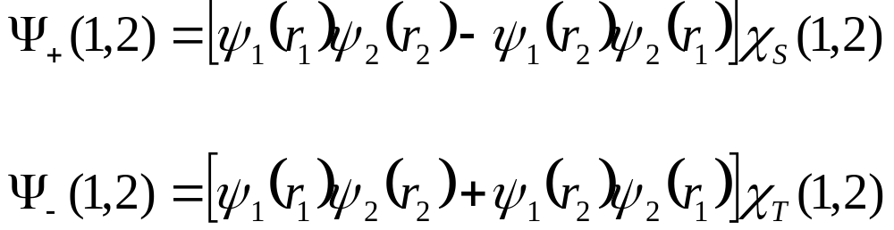
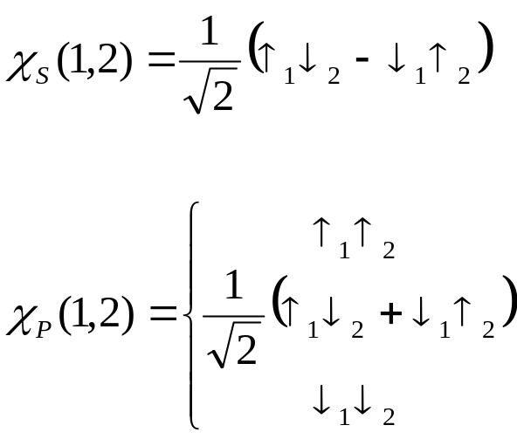
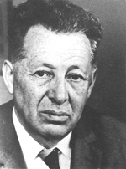
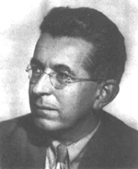
Exchange Interaction of Electrons
E₀ ground state, spin singlet
E₁ 1st excitation, spin triplet
W Heitler F London Z. Physik, 44， 455 (1927)

Slide 21
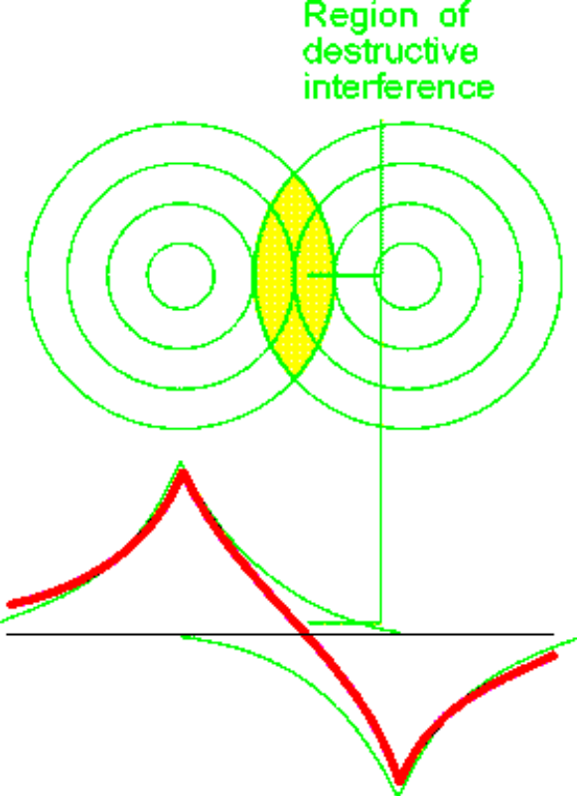

Exchange interactions
S=1 wave function antisymmetric
S=0 wave function symmetric

Slide 22

Effective description of low energy states of H₂
Heisenberg exchange interaction
energy
H₂分子
triplet
singlet
J

Slide 23

Exchange interactions
In solids: direct exchange is present but small because d and f orbitals are localized:
Indirect mecanisms are usually larger:
Superexchange (short range, ferro or AF)
RKKY (long range, oscillating sign)
Double exchange (ferro)
Itinerant magnetic systems

Slide 24

Superexchange

Slide 25




More Examples of Superexchange interactions
Antiferromagnetic
Strong:
weak:
Ferromagnetic
2 different orbitals
90° coupling

Slide 26



Double exchange
La1-xCaxMnO3
Colossal Magnetoresistance
Mn⁴⁺ (S=3/2) and Mn³⁺ (S=2)
Ferro: possible hopping
AF: no hopping
Mn³⁺ Mn⁴⁺
Mn³⁺ Mn⁴⁺
Notes:
Figure double echange

Slide 27


Mermin-Wagner Theorem
No long range magnetic ordering for Heisenberg spins with short range interactions at finite temperature in 1-D and 2-D

Slide 28
Ferromagnetism
magnetic moments are spontaneously aligned
M
T^{3/2}
Paramagnetic
Ferromagnetic
T
T_{c}
Curie temperature

Slide 29

Holstein-Primakoff Transformation

Slide 30


Spin Wave Expansion
Low temperature excitations are dominated by spin waves
Spin wave:
Harmonic motion of Holstein-Primakoff bosons

Slide 31


Ferromagnetic Spin Wave

Slide 32

Ferromagnetic Spin Wave
dimension

Slide 33

Comparison with Experimental Result

Slide 34


Bloch Law of Magnetization

Slide 35

Experiment vs Self-Consistent Spin Wave

Slide 36



Antiferromagnetism
Neel Nobel 1970
U
t
cuprate high temperature superconductors

Slide 37


Typical Antiferromagnetic Susceptibility
KNiF₃

Slide 38






Low Dimensional Magnetic Materials
Li₂VO(Si,Ge)O₄
NaV₂O₅

Slide 39


Two Sublattices HP Transformation
A B
A sublattice
B sublattice

Slide 40

Antiferromagnetic Spin Wave
Bogoliubov transformation

Slide 41

Spin Wave in La₂CuO₄

Slide 42


S=1/2 Heisenberg antiferromagnet on square lattice
Magnon excitations
spin-wave theory
Linear
Data points for Cu(DCOO)₂ 4D₂0
Notes:
Quantum fluctuations reduce moment to 60% of classical value

Slide 43

Schwinger Boson Representation
SU(2) symmetric
Commonly used in the mean-field treatment
Magnetic long range order corresponding to the condensation of bosons

Slide 44



Jordan-Wigner Transformation
S=1/2 spin operators in 1D can be represented using purely Fermion operators
1D X-Y model can be readily diagonalized with this transformation
ε/J
q (π)

Slide 45

Two Spinon contribution to S(Q,w)
J
ε/J
ω

q (π)
Q (π)
Notes:
Because things get harder in a field do H=0 in some detail
Graphically this is how to go from band structure to boundaries of continuum
Point out the characteristic points in the continuum

Slide 46

Two spinon continuum in uniform spin ½ chain
Two Spinon Excitation in S=1/2 Spin Chain
I (meV⁻¹)
Notes:
The two spinon continuum has been observed in several materials. Here are data for copper benzoate. This material is difficult to grown in single crystalline form and that explains the modest data quality. However it is one of the only systems where H/J can be appreciable.
Resolution
Significantly broadened in region close to pi
Not spin wave mode but continuum
Data is consis

Slide 47
Paradigm of Quantum Magnetism
Phenomena
Theory
Crisis
New Theory

