Slide 1

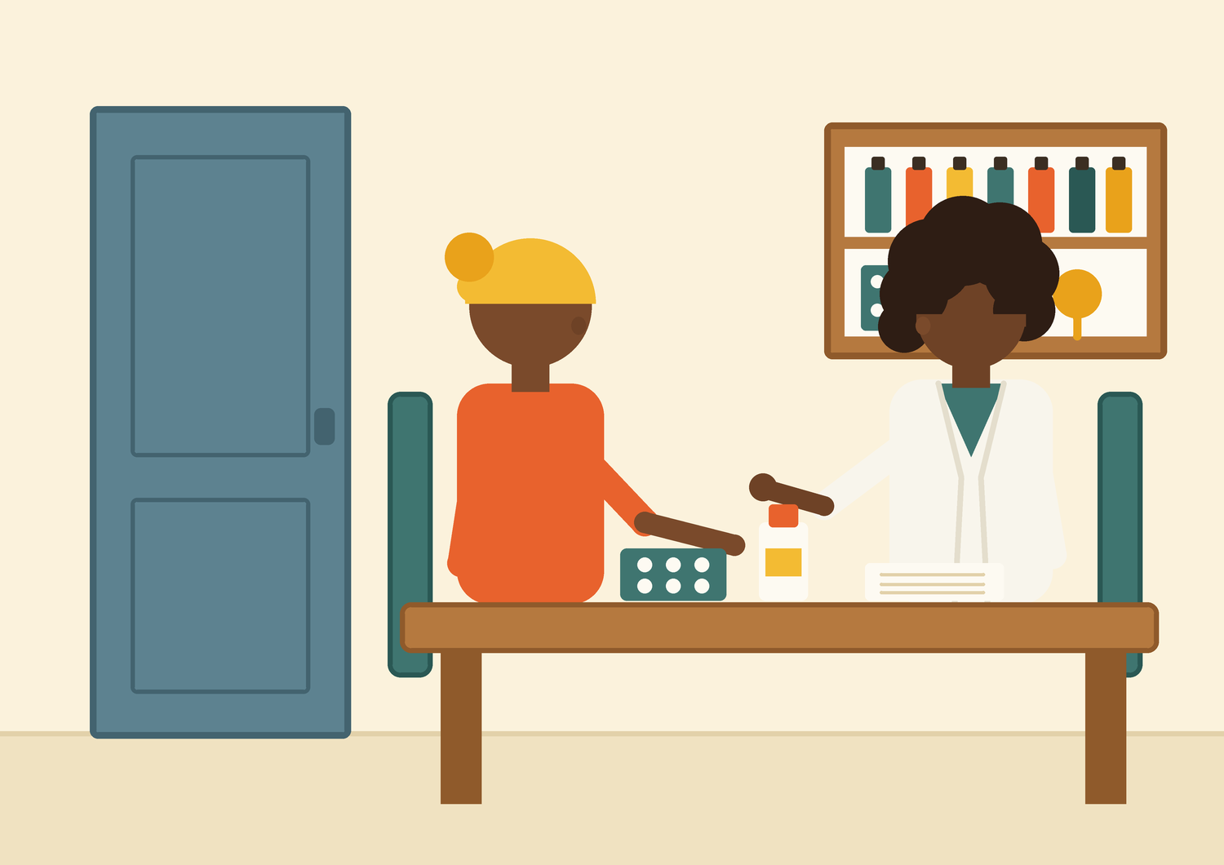
THE INSIGHT ARCHITECTS
Predicting
Contraceptive
Use in Kenya
What 32,156 women in the 2022 Kenya Demographic & Health Survey tell us about who uses family planning — and who is being left behind.
Claire Simiyu
Antony Sila
David Theuri
Shadrack Symekah
Joy Nyuguto
Martin Kitema
Live tool: kdhs-contraceptive-api.onrender.com

Slide 2

WHY THIS PROJECT EXISTS
One country. Two realities.
57%
1.2%
vs
EMBU COUNTY
MANDERA COUNTY
of women aged 15–49 use modern contraception
of women aged 15–49 use modern contraception
WHY IT MATTERS
Behind every data point is a real woman navigating her choices within the realities of her county and household. A 56-point gap between two counties in one country means help is not reaching the women who need it most. This project predicts who is being left behind, explains why, and puts that knowledge into planners' hands.
THE INSIGHT ARCHITECTS · KDHS 2022 CAPSTONE
02 / 27

Slide 3
OUR OBJECTIVES
Five questions we promised to answer
Our mission, in plain words: help Kenya's health planners find the women family planning is not reaching — and give them a working tool to act on it.
Q1
Q2
Q3
Q4
Q5
THE PICTURE
PLACES & PEOPLE
MONEY vs SCHOOL
TOWN vs COUNTRY
THE PREDICTOR
How many women use a modern method, a traditional one, a folkloric one — or none at all?
Which counties have the most non-use, and what do the women at highest risk have in common?
How do wealth and education work together to shape whether a woman uses contraception?
Does living in a city or the countryside still matter once wealth and education are taken into account?
Which prediction model works best — and what actually drives its decisions?
Answered in Part 2
Answered in Parts 2 & 5
Answered in Part 2
Answered in Part 2
Answered in Parts 3 & 4
Watch for the pink tags on the slides ahead — each one marks a question being answered.
THE INSIGHT ARCHITECTS · KDHS 2022 CAPSTONE
03 / 27

Slide 4





THE JOURNEY
How we'll walk you through it
→
→
→
→
PART 1
PART 2
PART 3
PART 4
PART 5
THE DATA
WHAT IT SHOWS
THE MODEL
WHY IT DECIDES
ACTION
One national survey, 32,156 voices
The patterns that answer Q1–Q4
Five approaches compete on fair ground
Every prediction, explained
Answers become fundable programmes
Method: CRISP-DM · Tools: Python · scikit-learn · LightGBM · SHAP · Flask
THE INSIGHT ARCHITECTS · KDHS 2022 CAPSTONE
04 / 27

Slide 5
PART 1 OF 5
The Data
One survey knocked on doors in all 47 counties and asked women about their lives. Everything in this project starts with their answers.
THE INSIGHT ARCHITECTS · KDHS 2022 CAPSTONE
05 / 27

Slide 6
PART 1 · THE DATA
32,156 women, in their own words
32,156
47
15–49
5,925
women interviewed face-to-face
counties — every one in Kenya
age range of respondents
raw survey variables, distilled to the ones that matter
WHAT'S HERE
WHY IT MATTERS
The 2022 Kenya Demographic & Health Survey (KDHS) — women's questionnaire. For each woman: age, county, education, household wealth, religion, work status, marriage, children born and living — and which contraceptive method, if any, she currently uses.
62% of respondents live in rural areas, 38% in urban ones, and every wealth group holds roughly a fifth of the sample — so every kind of woman is fairly represented.
It is the most detailed, nationally representative snapshot of Kenyan women's reproductive health available — the same lens the Ministry of Health uses to plan. A pattern found here describes the real Kenya of 2022.
Honesty notes: answers are self-reported, only women were interviewed, and one snapshot in time shows associations, not proof of cause.
THE INSIGHT ARCHITECTS · KDHS 2022 CAPSTONE
06 / 27

Slide 7
PART 2 OF 5
What the Data Shows
Before any model, we let the data speak — and it answers four of our five questions directly.
THE INSIGHT ARCHITECTS · KDHS 2022 CAPSTONE
07 / 27

Slide 8
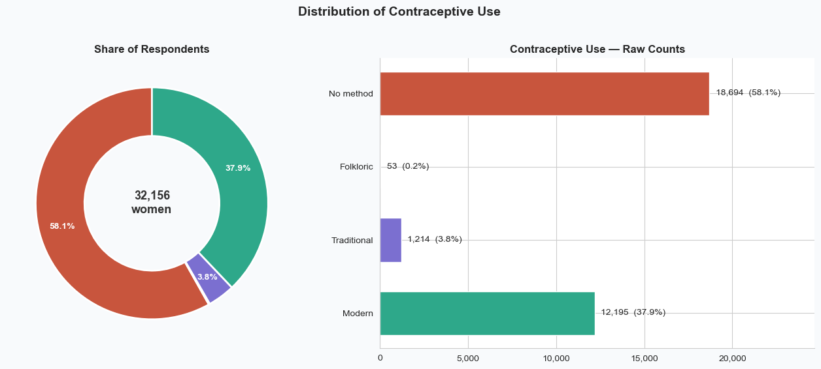
PART 2 · WHAT THE DATA SHOWS
ANSWERS QUESTION 1 — THE PICTURE
Who uses what, today
WHAT YOU'RE SEEING
58.1% of women use no method at all. 37.9% use a modern method. Traditional methods cover 3.8%, and folkloric methods just 53 women — 0.2% of the whole survey.
WHY IT MATTERS
This answers Q1 — and it sets the rules for everything after. Two groups dominate; two are vanishingly rare. A model can learn a lot about the big groups, but no method on earth can learn reliably from 53 examples. We balance the training data and judge models with metrics that respect the small groups.
THE INSIGHT ARCHITECTS · KDHS 2022 CAPSTONE
08 / 27

Slide 9
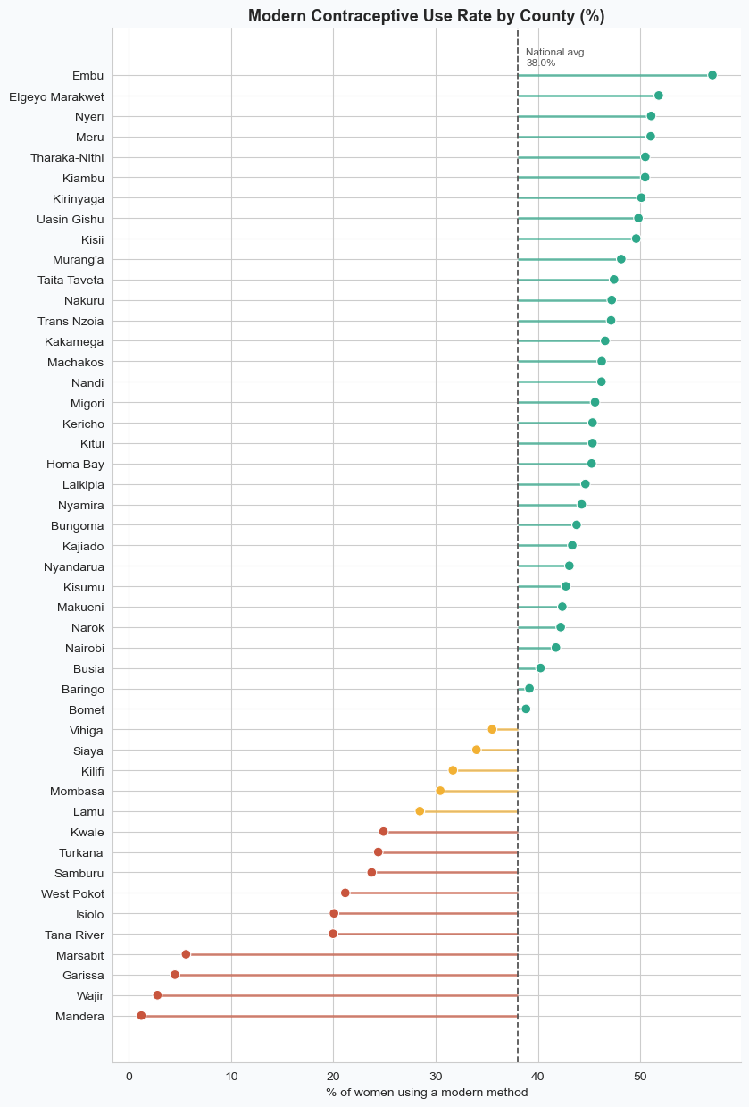
PART 2 · WHAT THE DATA SHOWS
ANSWERS QUESTION 2 — PLACES & PEOPLE
Geography is the biggest divide
WHAT YOU'RE SEEING
All 47 counties, ranked by modern-method use. Embu leads at 57%; Mandera sits at about 1%, with Wajir, Garissa and Marsabit all under 6% — the whole arid north clusters at the bottom, far from the 38% national average.
WHY IT MATTERS
This is the heart of Q2. The counties with the greatest need are knowable in advance — so family planning can be targeted by place. A uniform national programme treats Embu and Mandera the same; this chart shows those two situations have nothing in common.
THE INSIGHT ARCHITECTS · KDHS 2022 CAPSTONE
09 / 27

Slide 10
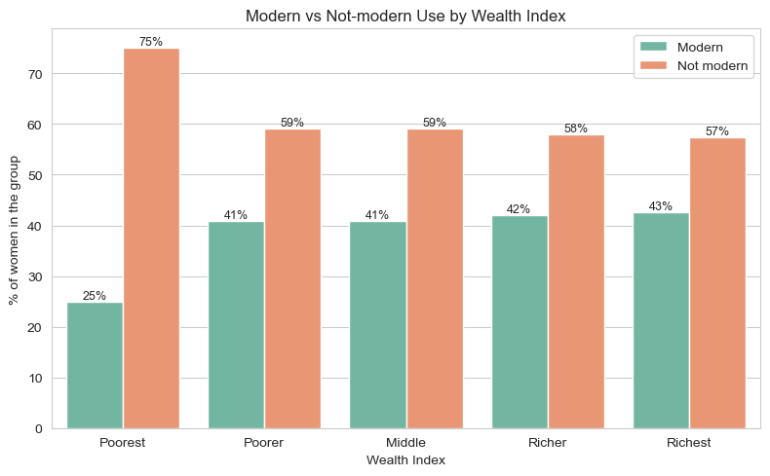
PART 2 · WHAT THE DATA SHOWS
ANSWERS QUESTION 3 — MONEY vs SCHOOL
Wealth is a cliff, not a ladder
WHAT YOU'RE SEEING
The poorest women stand alone at 25% modern use. Every group above them is nearly flat — 41%, 41%, 42%, 43%. The big gap is between the poorest and everyone else, not a steady climb from poor to rich.
WHY IT MATTERS
If money mattered evenly, the bars would climb like a staircase. They don't. Almost the entire wealth effect happens at the very bottom — so subsidies and free supplies aimed at the poorest fifth of households buy far more impact per shilling than spreading the same money across everyone.
THE INSIGHT ARCHITECTS · KDHS 2022 CAPSTONE
10 / 27

Slide 11
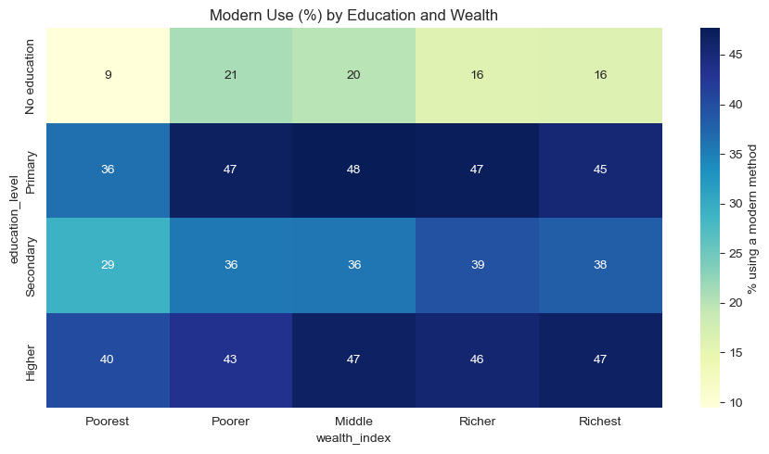
PART 2 · WHAT THE DATA SHOWS
ANSWERS QUESTION 3 — MONEY vs SCHOOL
Education outweighs wealth
WHAT YOU'RE SEEING
Each cell is the modern-use rate for one wealth × education group. With no education, use stays at 9–21% no matter how wealthy the household. With any schooling, it jumps into the 29–48% range across every wealth group.
WHY IT MATTERS
The full answer to Q3: education is the stronger lever. Raising incomes alone would probably not be enough — the no-education row stays pale all the way across. Programmes that keep girls in school, and adult literacy for women, are also family planning programmes.
THE INSIGHT ARCHITECTS · KDHS 2022 CAPSTONE
11 / 27

Slide 12
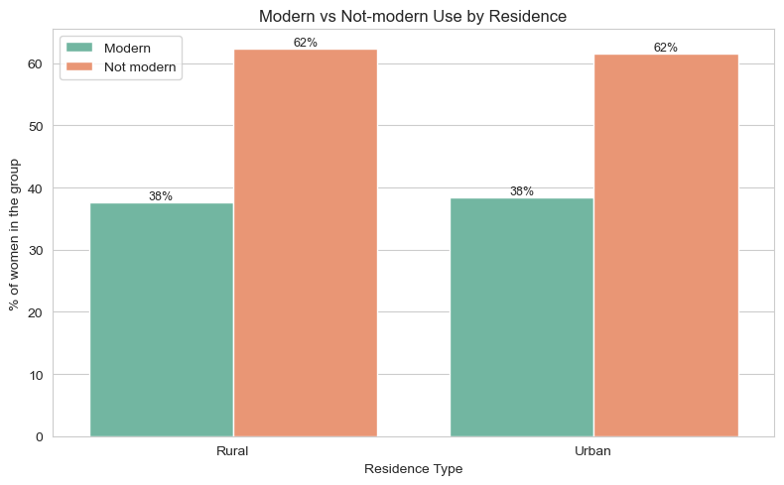
PART 2 · WHAT THE DATA SHOWS
ANSWERS QUESTION 4 — TOWN vs COUNTRY
Town vs country: a myth, tested
WHAT YOU'RE SEEING
Urban and rural women use modern methods at almost exactly the same rate — about 38% each.
WHY IT MATTERS
Q4 answered: on its own, where a woman lives barely matters. Any urban–rural gap people expect is explained by education and wealth, not by residence itself. That is genuinely useful for planners: don't budget by town-versus-country — budget by county, poverty, and education, where the real differences live.
THE INSIGHT ARCHITECTS · KDHS 2022 CAPSTONE
12 / 27

Slide 13
PART 2 · WHAT THE DATA SHOWS
Four findings that shaped what we built
Two rare groups
County is the biggest signal
Found: Traditional (3.8%) and Folkloric (0.2%, 53 women) are tiny.
Found: A 56-point spread, with every arid county at the bottom.
So we: Balanced the training data and used metrics that respect small groups — raw accuracy alone would hide failure.
So we: Gave the model an explicit arid-county flag so geography is seen directly, not guessed.
Education beats wealth
Twin variables
Found: No-education women stay at 9–21% use at every wealth level.
Found: Children ever born ≈ living children (r = 0.98).
So we: Kept education and wealth as ordered scales so the cliff and the jump are learnable.
So we: Kept one and derived new features from the difference — no double counting.
THE INSIGHT ARCHITECTS · KDHS 2022 CAPSTONE
13 / 27

Slide 14
PART 3 OF 5
Building the Model
Five different approaches — from a simple statistical baseline to two deep-learning designs — compete on the same held-out test of 6,432 women.
THE INSIGHT ARCHITECTS · KDHS 2022 CAPSTONE
14 / 27

Slide 15
PART 3 · BUILDING THE MODEL
Playing fair with the data
Decode everything
Respect the blanks
Raw survey codes became words (county 47 → “Nairobi”), so every chart and explanation downstream is readable by the health planners who will use it.
Missing ages-at-first-birth belong to women who never gave birth — that's information, not noise. It became a has_given_birth flag; partner details for single women became “No partner”, not a guess.
Balance only the practice data
Engineer what the EDA taught
The rare groups were boosted (SMOTE) in training data only — the test set stays exactly as real life looks, so scores are honest.
New features came straight from the findings: an arid-county flag, ordered wealth and education scales, and family-stage measures like child density — each one traceable to a chart in Part 2.
THE INSIGHT ARCHITECTS · KDHS 2022 CAPSTONE
15 / 27

Slide 16
PART 3 · BUILDING THE MODEL
ANSWERS QUESTION 5 — THE PREDICTOR
Five models, one held-out test
MODEL
ACCURACY
MACRO F1
MACRO AUC
WHY LIGHTGBM WON
Best accuracy (72.4%) and the best ability to tell the four groups apart (macro AUC 0.798) — plus practical wins that matter for a Ministry of Health deployment:
· Explains itself — native SHAP support
· Tiny (6 MB) and fast — predictions in under a millisecond
· No special hardware or deep-learning software needed
Logistic Regression (baseline)
54.8%
0.354
0.764
Random Forest
70.6%
0.390
0.775
LightGBM (tuned) — selected
72.4%
0.367
0.798
Deep MLP (neural network)
70.3%
0.385
0.751
TabTransformer
64.8%
0.384
0.754
Runner-up strengths: Random Forest has the best macro F1 (0.390); TabTransformer alone finds 34% of Traditional users.
THE HONEST TRADE-OFF
On the two big groups — 96% of all women — the models are strong. On the two rare groups (Traditional, Folkloric) every one of the five architectures hits the same wall. That wall is the data, not the models — and it shaped our recommendations.
THE INSIGHT ARCHITECTS · KDHS 2022 CAPSTONE
16 / 27

Slide 17
PART 3 · BUILDING THE MODEL
Tuning the winner: searching smarter, not harder
How the search worked
The winning recipe
Instead of trying every combination (nearly two million), Optuna uses Bayesian search — like asking locals for restaurant tips after each meal instead of wandering the city at random.
30 trials · quick 2-fold checks · a fast 15,000-row subsample — then the winning recipe is retrained on all 59,820 training rows.
Trees
Learning rate
700
0.011
Max depth
Leaves per tree
10
70
The payoff — before vs after tuning (held-out test set)
ACCURACY
MACRO F1
MACRO AUC
+23.5 pp
+0.143
+0.153
72.4% → 95.9%
0.367 → 0.510
0.798 → 0.951
THE INSIGHT ARCHITECTS · KDHS 2022 CAPSTONE
17 / 27

Slide 18
PART 3 · BUILDING THE MODEL
The final tuned model, up close
How often it finds each group (recall, test set)
THE HEADLINE SCORES
95.9% accuracy · 0.951 macro AUC · 0.510 macro F1 on 6,432 women the model never saw during training — the tuned configuration (700 trees, learning rate 0.011) carried into the deployed pipeline.
Modern
100%
No method
99%
Traditional
4%
USE IT AS A RISK FLAG
Stakeholders should read its output as a two-way flag — “likely non-user” vs “likely modern user”. Pretending four-class precision would create false confidence exactly where the data is weakest.
Folkloric
0%
Strong on the 96% of women in the two main groups; honest about the rest.
THE INSIGHT ARCHITECTS · KDHS 2022 CAPSTONE
18 / 27

Slide 19
PART 4 OF 5
Why the Model Decides
A prediction nobody can question is a prediction nobody should trust. SHAP opens the box — no statistics degree needed.
THE INSIGHT ARCHITECTS · KDHS 2022 CAPSTONE
19 / 27

Slide 20
PART 4 · WHY THE MODEL DECIDES
Think of it as a tug-of-war
For every single woman, each fact about her life pulls the prediction one way or the other. SHAP measures exactly how hard each fact pulls.
PULLS AWAY FROM MODERN USE
PULLS TOWARD MODERN USE
ONE WOMAN
younger · no children yet · never married · not working · large household · arid county
older · has children · in a union · employed · educated · non-arid county
Read it like a before-and-after comparison — no statistics background required.
THE INSIGHT ARCHITECTS · KDHS 2022 CAPSTONE
20 / 27

Slide 21
PART 4 · WHY THE MODEL DECIDES
ANSWERS QUESTION 5 — THE PREDICTOR
What actually drives the prediction
1
Age — the strongest driver
2
Living children — a close second
3
Employment — the actionable lever
A life-stage effect: older women are pushed strongly toward modern use; younger women away. Not something policy can change — but essential for timing outreach.
Women adopt contraception after having children, not before — exactly what the EDA showed. Postpartum contact is the moment advice lands.
Employed women are pushed toward modern use. Unlike age or children, employment can be changed by programmes — the most policy-tractable finding in the project.
4
Arid county — a genuine barrier
5
Being in a union — the top enabler
6
Household size — the surprise
Living in an ASAL county pushes away from modern use even after wealth, education and religion are accounted for. Real access and infrastructure gaps, not a proxy for poverty.
The single strongest enabler of modern use in the per-class analysis — and, paired with the other factors, the key to the doorstep checklist in Part 5.
Larger households push away from modern use — suggesting stretched resources rather than greater demand.
THE INSIGHT ARCHITECTS · KDHS 2022 CAPSTONE
21 / 27

Slide 22
PART 4 · WHY THE MODEL DECIDES
Two real women — how the model decided
RESPONDENT C
RESPONDENT D
Predicted: “No method” — 99.9% sure
Predicted: “Modern” — 92.5% sure
Young · never married · no children · not employed
Older · married · employed · several children · non-arid county
Every strong pull comes from her life stage: she is not yet exposed to pregnancy risk at all.
The model is not flagging an access problem — it is recognising a woman who does not need an intervention visit. Sending outreach to her doorstep would waste everyone's time.
Every lever points the same way — union, employment, family stage, geography.
She is the prototype of the woman today's programmes already reach. The women our recommendations target are the ones missing these enablers — exposed to risk, but without the supports Respondent D has.
THE POINT
Telling these two apart from a high-risk non-user is exactly what the model is for — target the women who are exposed to risk but missing the enablers.
THE INSIGHT ARCHITECTS · KDHS 2022 CAPSTONE
22 / 27

Slide 23
PART 5 OF 5
From Insight to Action
Analysis that stays in a notebook helps no one. Here is what we now know, what we recommend, and the tool that is already live.
THE INSIGHT ARCHITECTS · KDHS 2022 CAPSTONE
23 / 27

Slide 24
PART 5 · FROM INSIGHT TO ACTION
Six things we now know
1
County is the biggest signal in the data
2
No education means being left behind
3
Wealth acts like a cliff
Modern use runs from ~1% in Mandera to 57% in Embu — the arid north needs its own approach.
Roughly 12% modern use without schooling vs 37–46% with any — and wealth can't close that gap alone.
25% for the poorest fifth, then flat at 41–43% for everyone else.
4
Where you live barely matters — who you are does
5
The best model improved with tuning — and stays honest
6
The drivers are knowable and usable
Urban and rural women both sit at ~38%; county, poverty and schooling drive the real differences.
LightGBM won the five-model contest and Optuna tuning lifted it to 95.9% accuracy / 0.951 macro AUC — used as a two-way risk flag, not a four-class oracle.
Age and children lead; union status enables; arid geography blocks; employment is the lever programmes can pull.
THE INSIGHT ARCHITECTS · KDHS 2022 CAPSTONE
24 / 27

Slide 25
PART 5 · FROM INSIGHT TO ACTION
ANSWERS QUESTION 2 — PLACES & PEOPLE
What we recommend — and to whom
Give the arid north its own programme tier
Use the four-question doorstep checklist
Fund women's employment as family planning
MOH · UNFPA
COMMUNITY HEALTH PROMOTERS
COUNTIES · NGOS
Mandera, Wajir, Garissa, Marsabit and Tana River face real infrastructure barriers — dedicated budget and staffing, not a share of a uniform plan.
In a union + not employed + poorest wealth group + arid county = priority visit. No model, smartphone or training required.
Employment is the strongest driver a programme can actually change — co-locate family planning with microfinance and vocational training.
Aim subsidies at the poorest fifth
Don't chase the rare classes
Put the live tool in the workflow
MOH · USAID
ALL PARTNERS
CHMTS · FP2030
The wealth cliff means targeted free supplies beat universal subsidies on impact per shilling.
Treat the model as a two-way risk flag. Promising four-class precision would fail exactly where the data is weakest — and cost trust.
The API returns a prediction and risk flag for any profile — usable from a browser today, or integrated into county dashboards (DHIS2).
THE INSIGHT ARCHITECTS · KDHS 2022 CAPSTONE
25 / 27

Slide 26
PART 5 · FROM INSIGHT TO ACTION
It's not a slide — it's already live, and it works
A woman's profile
The sealed pipeline
LightGBM predicts
Action guidance
→
→
→
age · county · education · wealth · family
same cleaning & features as the notebook
class probabilities for her profile
risk flag: non-use risk / using a method
VERIFIED END-TO-END — A REAL TEST CASE
We sent a real profile through the live system: a 28-year-old married woman from Turkana — an arid county — primary-educated, in the poorest wealth group, unemployed, with three children.
The model flagged her as a non-use risk (52% “No method” vs 41% “Modern”) — exactly the profile the analysis says outreach should prioritise. The prediction, the reasoning and the recommendation all point the same way.
kdhs-contraceptive-api.onrender.com
THE INSIGHT ARCHITECTS · KDHS 2022 CAPSTONE
26 / 27

Slide 27
THE INSIGHT ARCHITECTS
Thank you
Questions & discussion welcome.
Claire Simiyu
Antony Sila
David Theuri
Shadrack Symekah
Joy Nyuguto
Martin Kitema
Live tool: kdhs-contraceptive-api.onrender.com
Code & data: github.com/symekah1999 — KDHS 2022 Capstone

