Slide 1
New York City Shooting Incidents
Seth Porter

Slide 2
What are we looking at, and why should I care?
We will examine “shooting incident” data from the New York City Police Department.
Shooting incidents are extreme events which can end or radically change the lives of both the victim and the shooter in a single action.
Understanding their patterns is crucial to policy and intervention decisions from law enforcement, other city agencies, and non-governmental actors.

Slide 3
Where is the data from?
Dataset sourced from https://catalog.data.gov/dataset/nypd-shooting-incident-data-historic, described in Footnotes (https://bit.ly/3KSLRjA)
“List of every shooting incident that occurred in NYC going back to 2006 through the end of the previous calendar year.”
“Only valid shooting incidents resulting in an injured victim are included in this release.”

Slide 4
Secondary data sources
In addition to the primary data, some secondary sources are used to contextualize or suggest possible causal variables:
Temperature data from https://www.weather.gov/media/okx/Climate/CentralPark/DailyAvgTNormals.pdf
Population data from https://www.census.gov/quickfacts/newyorkcitynewyork

Slide 5
Preliminary Cautions
Be cautious; this data is from a law enforcement agency reporting on its own jurisdiction, and may have obvious as well as unexpected biases or gaps in the collection and reporting process.

Slide 6
Self Links
Github repo: https://github.com/symmatree/data-science/tree/main/r
These slides: Source (https://github.com/symmatree/data-science/raw/main/r/NYPDShootingDataSlides.Rmd) / pdf / pptx
The full analysis document has more discussion of data tidying and methods: https://github.com/symmatree/data-science/raw/main/r/NYPDShootingData.Rmd (source) / pdf

Slide 7
Two Major Approaches
We will consider
patterns-over-time and seasonality
demographics of victims and perpetrators
in hopes of understanding the patterns and impacts of these incidents.

Slide 8
Data Analysis - Temporal trends
Our first layer of analysis will focus on when shootings occur, considering both the overall trend and various scales of periodic behavior.

Slide 9
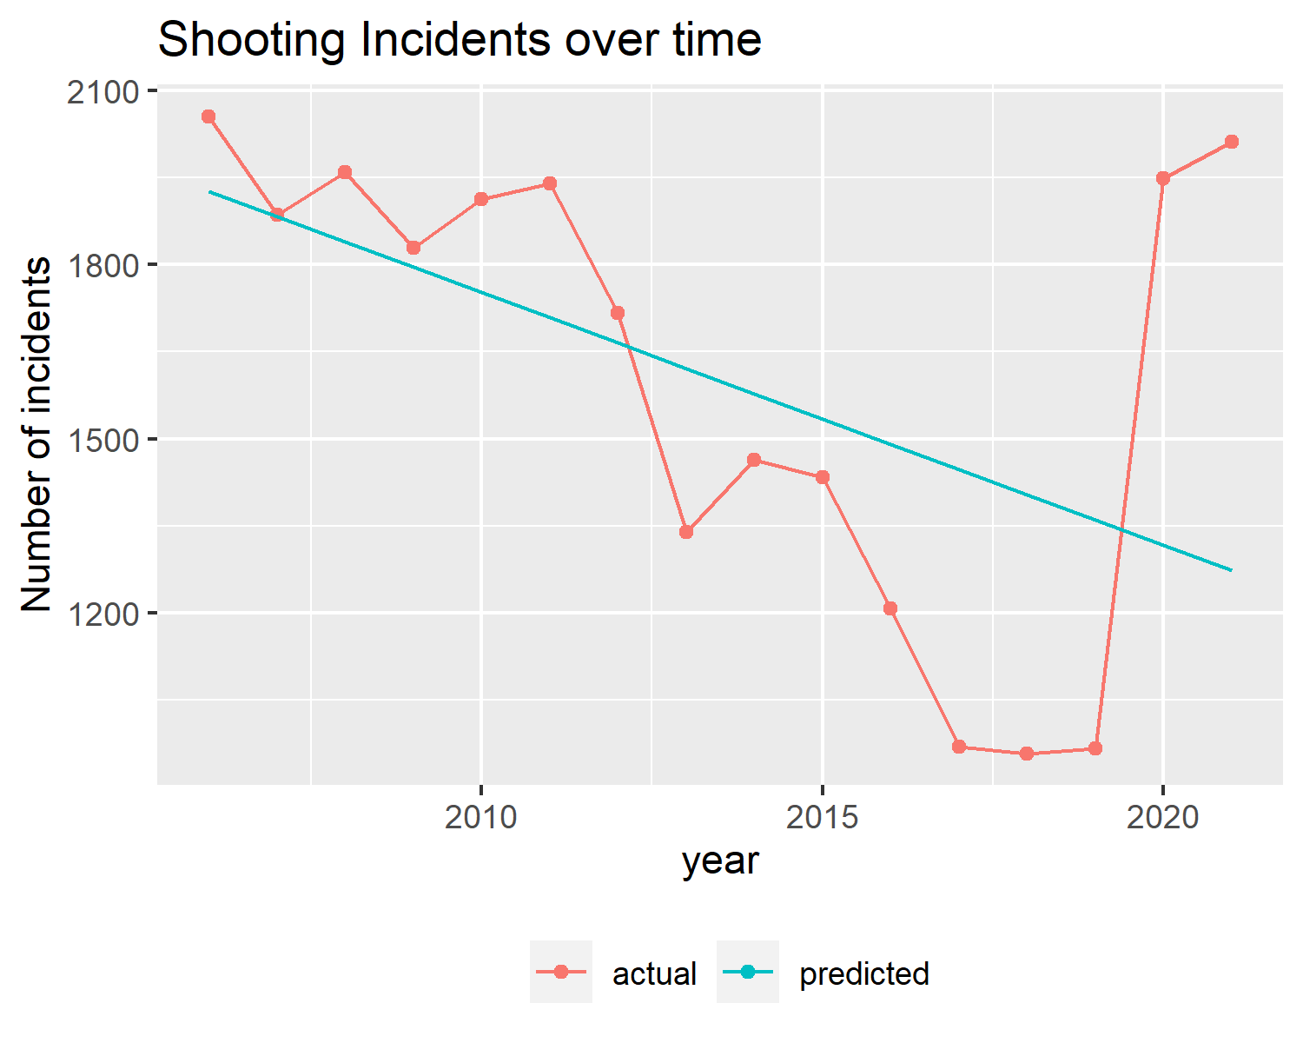
Long-term trends
Reported shooting incidents dropped steadily, then rose sharply in 2020 (presumably pandemic-related, though possibly a reporting change).
This is such a sharp reversal that it dominates other trends.
The rest of this analysis will normalize by annual incident count to reveal patterns masked by this macro-trend.

Slide 10
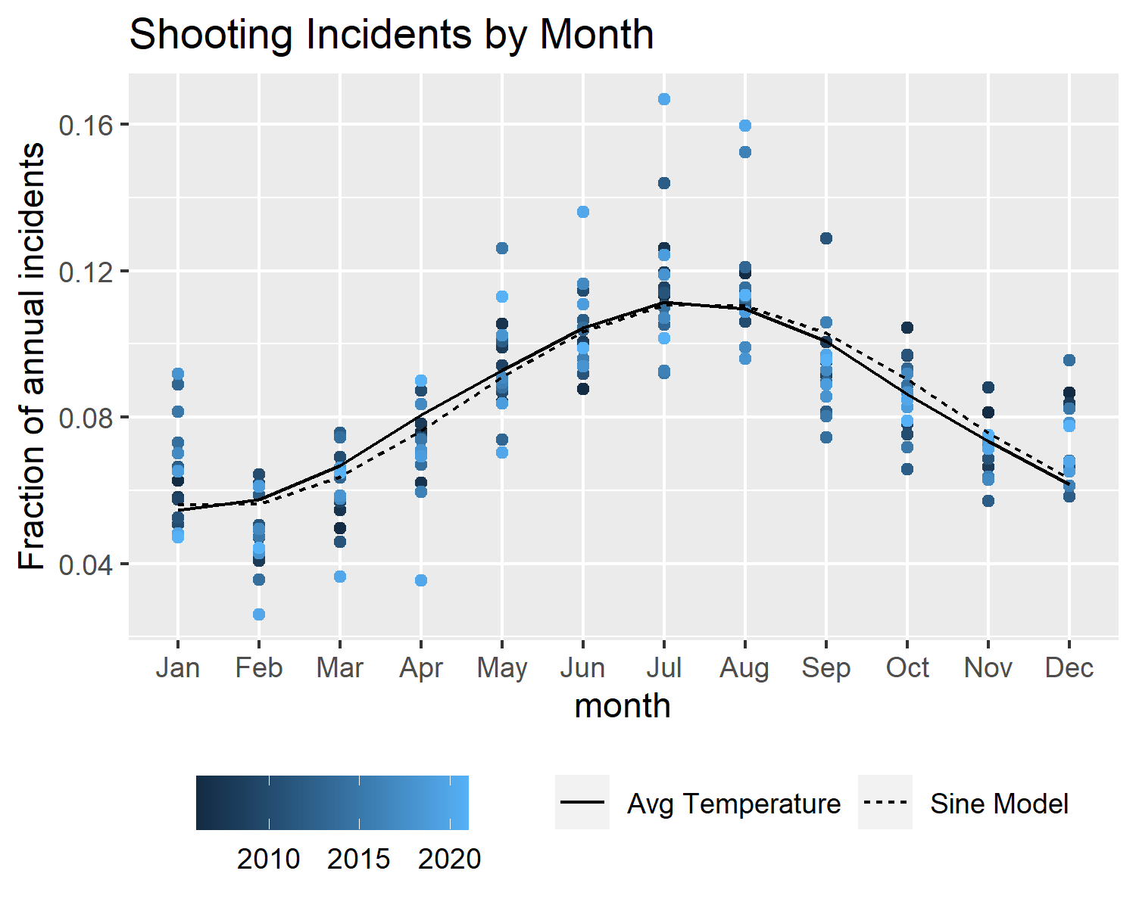
Seasonality: Month of year
A shifted and vertically-scaled sine wave fits the monthly data quite nicely.
Average NYC temperatures correlate strongly with both this model and the observed incident counts.
This suggests (though does not prove!) that temperature-driven behavior patterns are a major driver of the overall level of shootings.

Slide 11
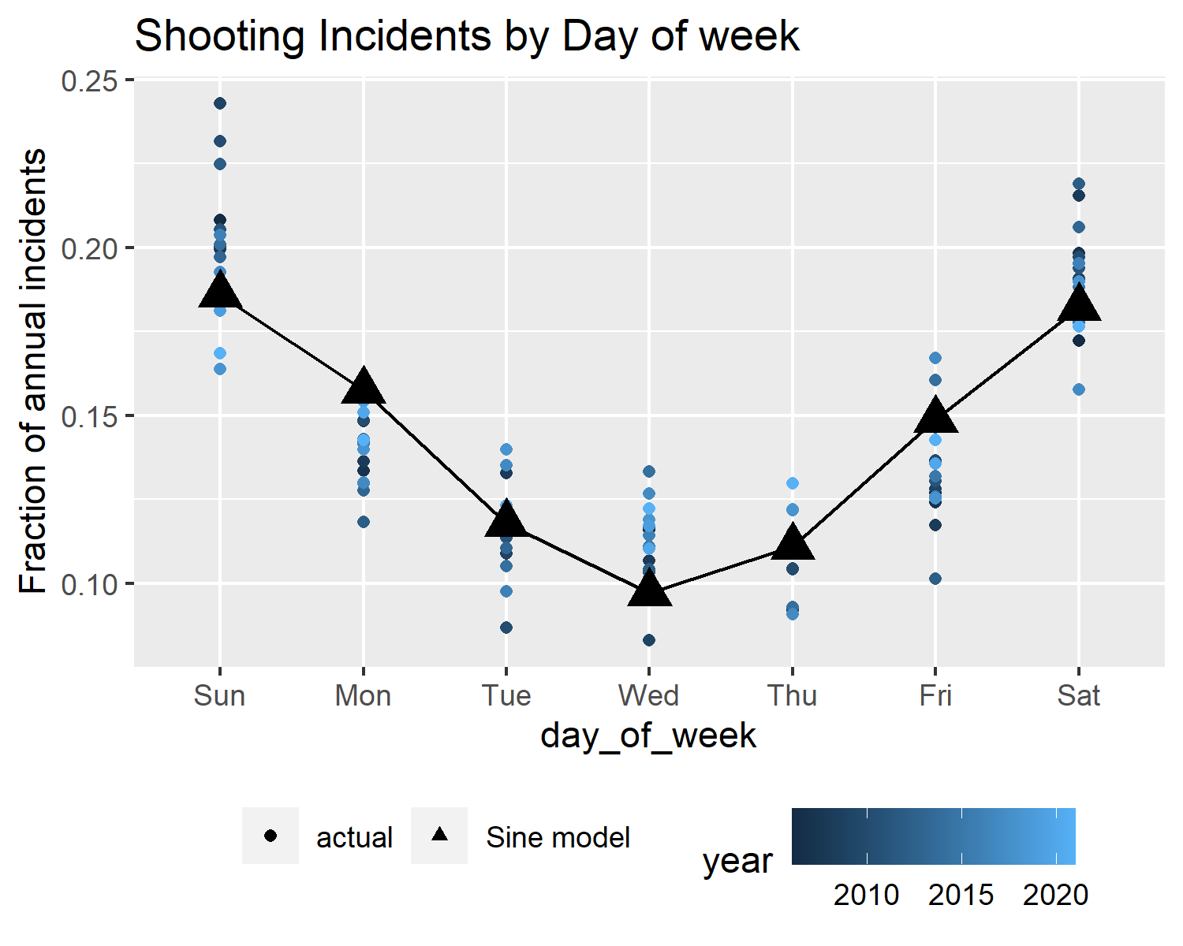
Seasonality: Day of week
Weekly rhythms have a strong influence on shooting incidents; a scaled and phase-shifted sine wave fits quite nicely (RMSE ~2 percentage points of annual incidents).
There is no immediately-obvious explanation of this pattern, other than the incident rates being higher on Fridays and weekends when more social interaction is likely to occur.

Slide 12
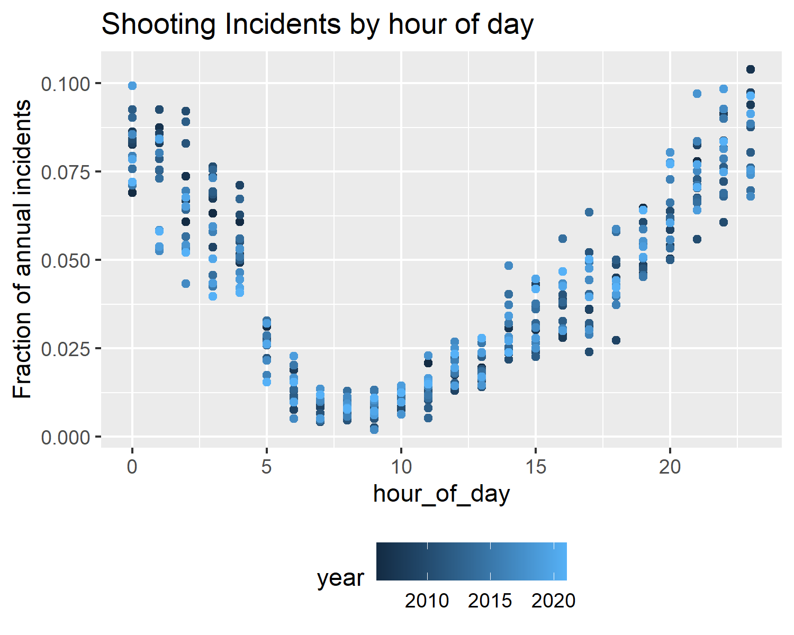
Seasonality: Hour of day
While not a simple sinusoidal, there is a repeated cycle throughout the day, with incidents rarest in the morning hours and most common at night until 4am (which is when bars close in NYC).
This aligns with the weekly pattern: shootings happen less during typical working hours and days.

Slide 13
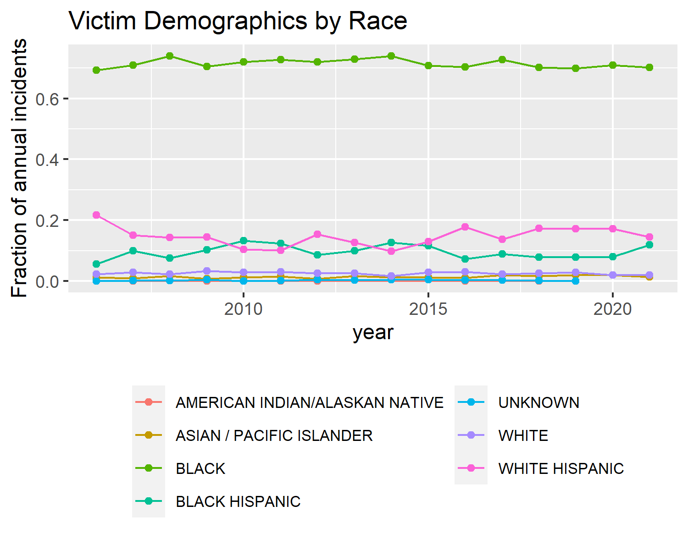
Demographics: Victim, By Race
The victim’s race is overwhelmingly coded as Black.

Slide 14
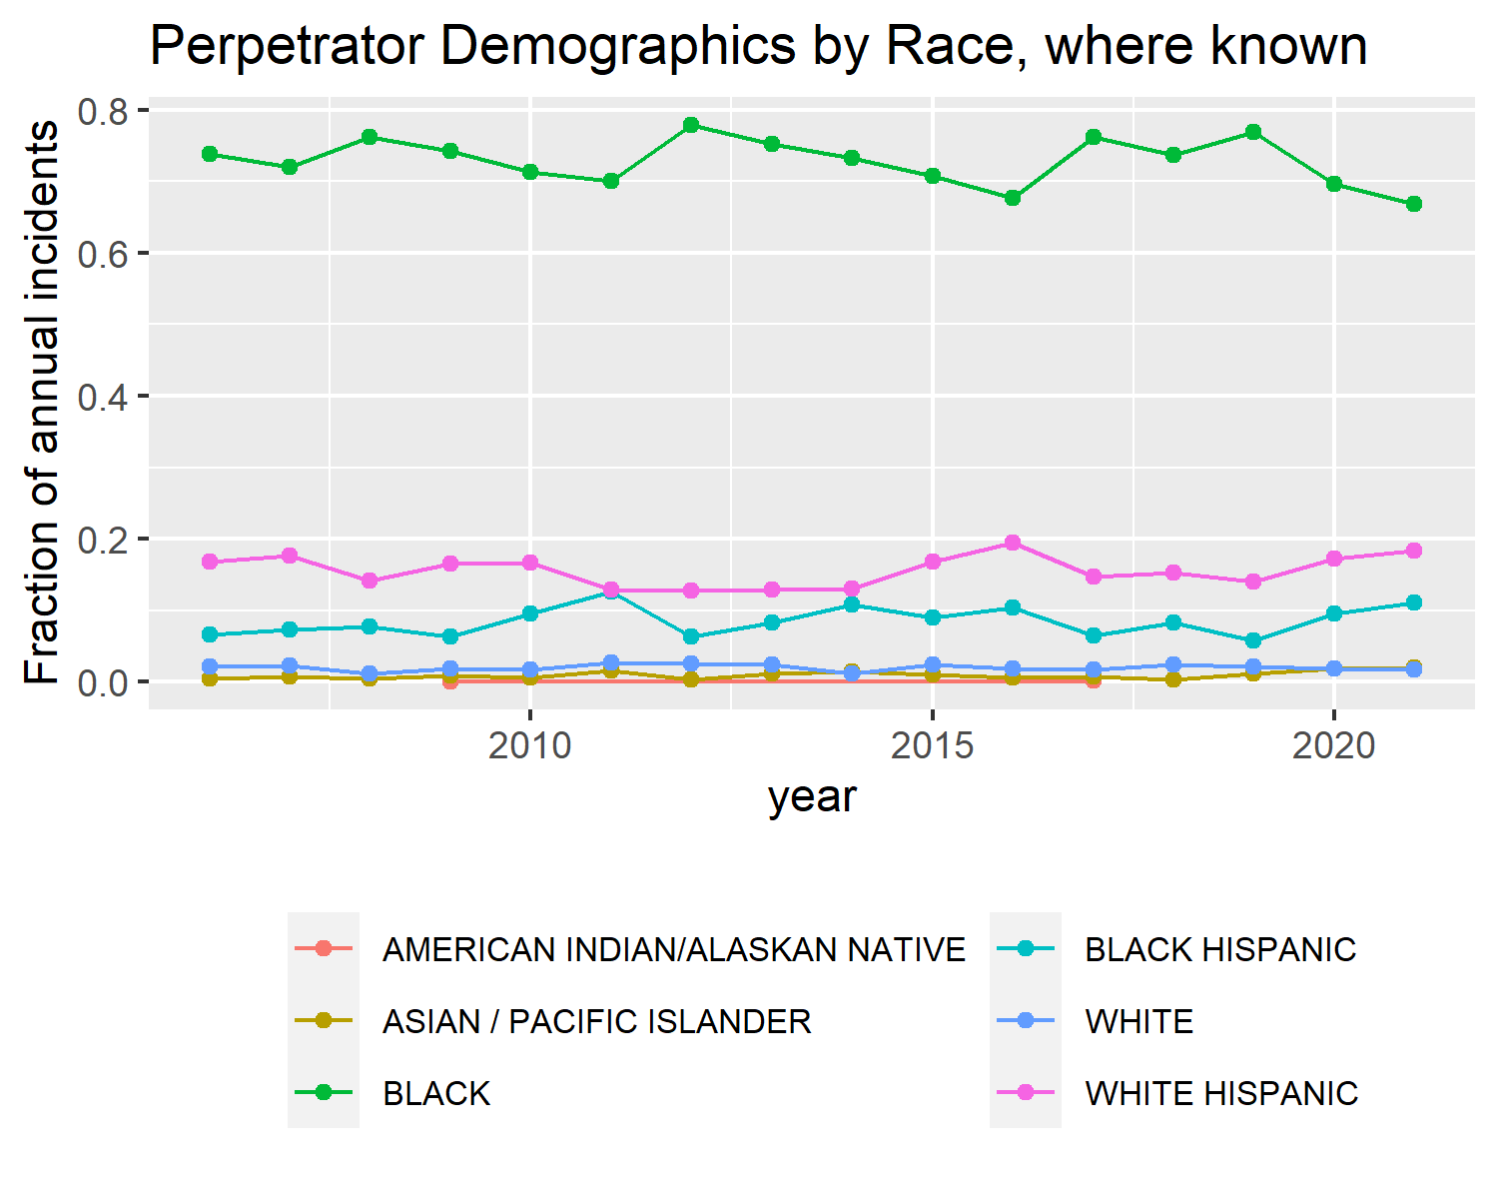
Demographics: Perpetrator, by Race
The same holds true, in almost the same proportions, for the perpetrator’s race (where known).

Slide 15
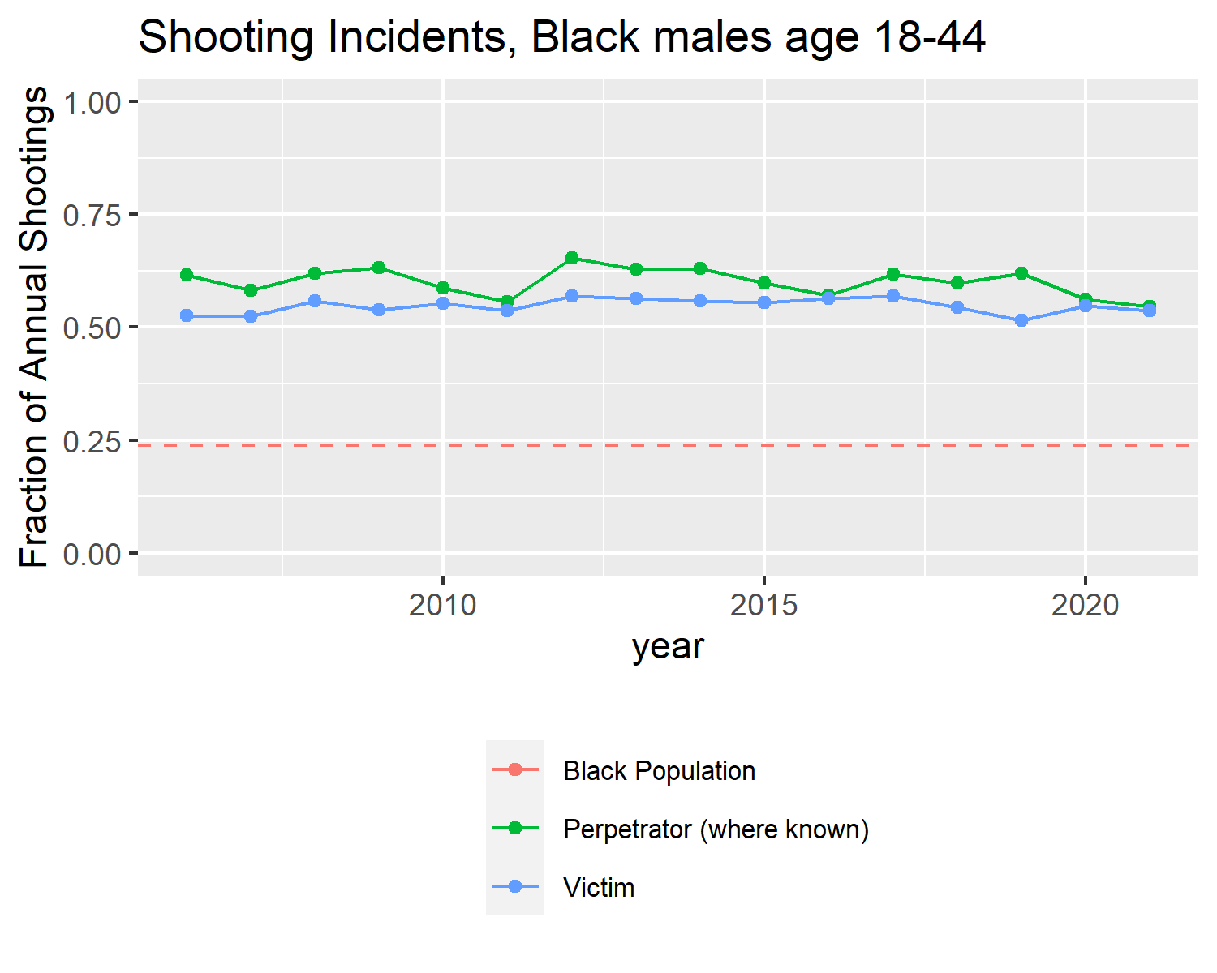
Younger Black males
We can narrow the data to consider only the combined fractions for victims and perpetrators coded as Black males in the 18-24 or 25-44 age groups.
More than half of all shooting incidents involve someone in this demographic as victim, and roughly the same proportion as perpetrator (where known).
The entire Black population of NYC is just under a quarter of the city; males in this age group would be a still smaller fraction.

Slide 16
Conclusions - Temporal Conclusions
Despite sharp changes in overall incident counts, there are strong seasonal patterns at multiple scales: over the course of a day, a week, and a year

Slide 17
Conclusions - Demographic Conclusions
The impact of shootings (both as victim and perpetrator) falls wildly disproportionately on individuals reported as Black males aged 18-44.
Any strategy or intervention must consider both these temporal and demographic factors or it will be mis-targeted or inefficient.

Slide 18
A Caution
The demographic concentration of shootings should not be read as causal but rather as descriptive and correlated. Demographics are correlated with many other factors including socio-economic status, education, job opportunities, geographic location, historical deprivation etc., which are more likely to be actual causation.

Slide 19
Error and Bias
Finally, we consider the many ways this analysis might be wrong or misleading.

Slide 20
Error and Bias: Data Source Motivations
The underlying data comes from the NYPD. They are not a neutral party: this data may be used to demonstrate their effectiveness, to argue for more resources in certain areas, or to support theories of crime and victimhood.

Slide 21
Error and Bias: Data Source Avenues of Bias
Any of these would be a reason to bias the data collection and reporting:
Skewing demographic data toward desirable patterns
More subtly, controlling what is reported as a shooting incident and what is absent altogether

Slide 22
Error and Bias: Analysis
Beyond the data, the analysis may be flawed, biased or misleading.
The focus on proportional analysis masks the changing absolute numbers of incidents, which may be a better measure of “cost” in many dimensions
There may be important subtleties in who reports data and how, unknown to the analyst. Demographic fields are subjective and vulnerable to misinterpretation.
That said, the patterns reported seem to be so strong as to resist most small-scale biases or misinterpretations!

