Slide 1
New York City Shooting Incidents
Seth Porter

Slide 2
What are we looking at, and why should I care?
We will examine “shooting incident” data from the New York City Police Department.
Shooting incidents are extreme events which can end or radically change the lives of both the victim and the shooter in a single action.
Understanding their patterns is crucial to policy and intervention decisions from law enforcement, other city agencies, and non-governmental actors.
Notes:
What are we looking at? Why should you care?
Shootings end or radically change the lives of both the victim and the shooter.
Understanding the patterns to shootings is vital when trying to reduce them or mitigate their effects.
So this is data about a subject that’s important to people at both a personal and a systemic level.

Slide 3
Where is the data from?
Dataset sourced from https://catalog.data.gov/dataset/nypd-shooting-incident-data-historic, described in Footnotes (https://bit.ly/3KSLRjA)
“List of every shooting incident that occurred in NYC going back to 2006 through the end of the previous calendar year.”
“Only valid shooting incidents resulting in an injured victim are included in this release.”
Notes:
This is a dataset from the NYPD, with links here to the data and a PDF describing it.
This is a list of every shooting incident that occurred in New York since 2006, where someone was shot and injured. (And, it should be pointed out, where that was reported to or discovered by police.)

Slide 4
Secondary data sources
In addition to the primary data, some secondary sources are used to contextualize or suggest possible causal variables:
Temperature data from https://www.weather.gov/media/okx/Climate/CentralPark/DailyAvgTNormals.pdf
Population data from https://www.census.gov/quickfacts/newyorkcitynewyork
Notes:
I used some additional data from public sources for temperature and population.

Slide 5
Preliminary Cautions
Be cautious; this data is from a agency reporting on its own jurisdiction, and may have resulting biases or gaps in the collection, characterization, and reporting process.
Notes:
Before presenting the data, I just want to remind everyone that this is from an organization reporting on its own area of responsibility, which is an inherent conflict of interest (or rather a family of related conflicts, at different levels and in different parts of the organization).

Slide 6
Self Links
Github repo: https://github.com/symmatree/data-science/tree/main/r
These slides: Source (https://github.com/symmatree/data-science/raw/main/r/NYPDShootingDataSlides.Rmd) / pdf / pptx
The full analysis document has more discussion of data tidying and methods: https://github.com/symmatree/data-science/raw/main/r/NYPDShootingData.Rmd (source) / pdf
Notes:
These slides are available on Github, as well as the full analysis which gets further into many of these topics including data cleaning.

Slide 7
Two Major Approaches
We will consider
patterns-over-time and seasonality
demographics of victims and perpetrators
in hopes of understanding the patterns and impacts of these incidents.
Notes:
In this analysis I consider the patterns of these incidents in terms of 1) time and 2) the demographics of the victims and perpetrators.

Slide 8
Data Analysis - Temporal trends
Our first layer of analysis will focus on when shootings occur, considering both the overall trend and various scales of periodic behavior.
Notes:
We look first at the time axis, on several different scales.

Slide 9
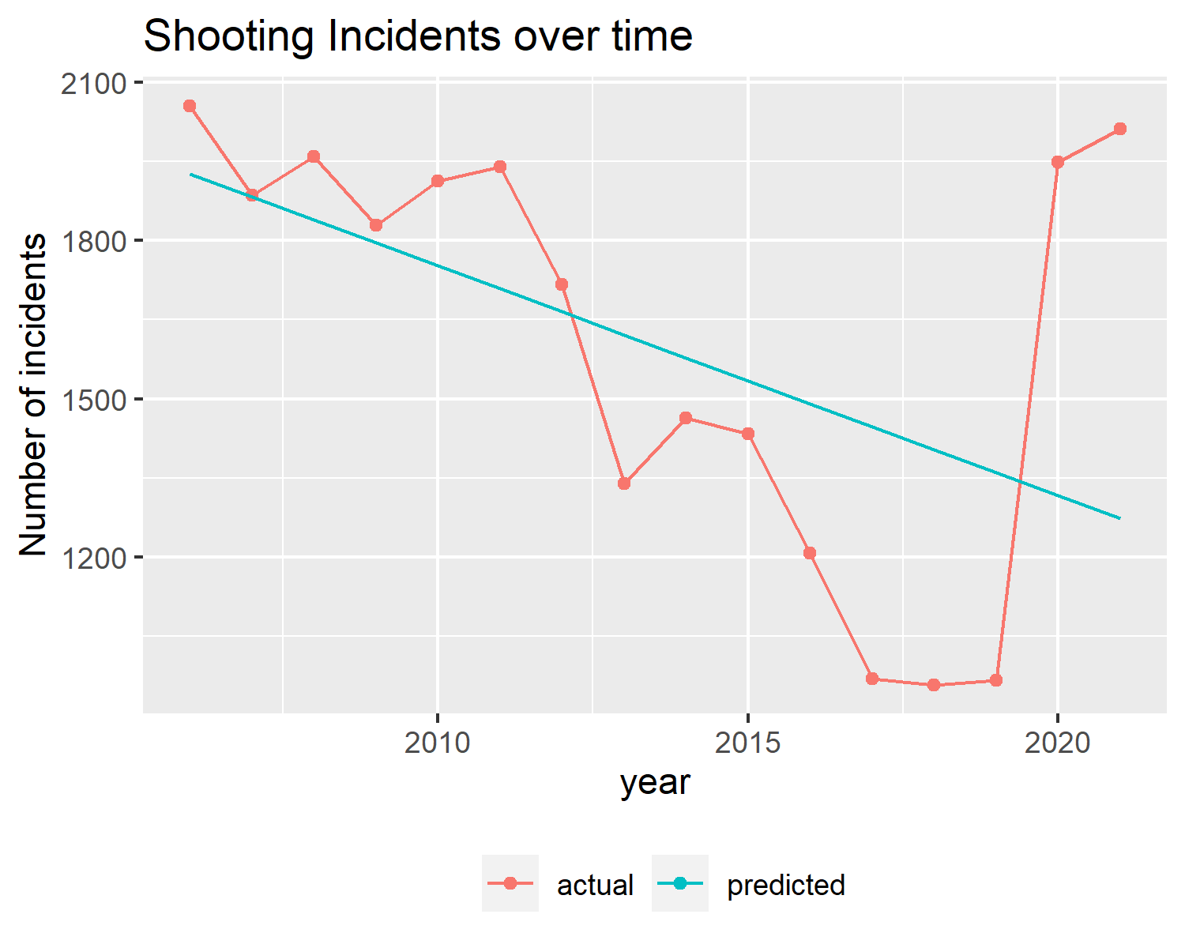
Long-term trends
Reported shooting incidents dropped steadily, then rose sharply in 2020 (presumably pandemic-related, though possibly a reporting change).
This is such a sharp reversal that it dominates other trends.
The rest of this analysis will normalize by annual incident count to reveal patterns masked by this macro-trend.
Notes:
As you see in the chart, an initial roughly-linear trend through 2019 turned into a steep rise in 2020, sustained in 2021. This two-stage macro behavior dominates everything else. Therefore, for the rest of this presentation, all graphs will be normalized to “fraction of the incidents that year” to reveal patterns otherwise masked.

Slide 10
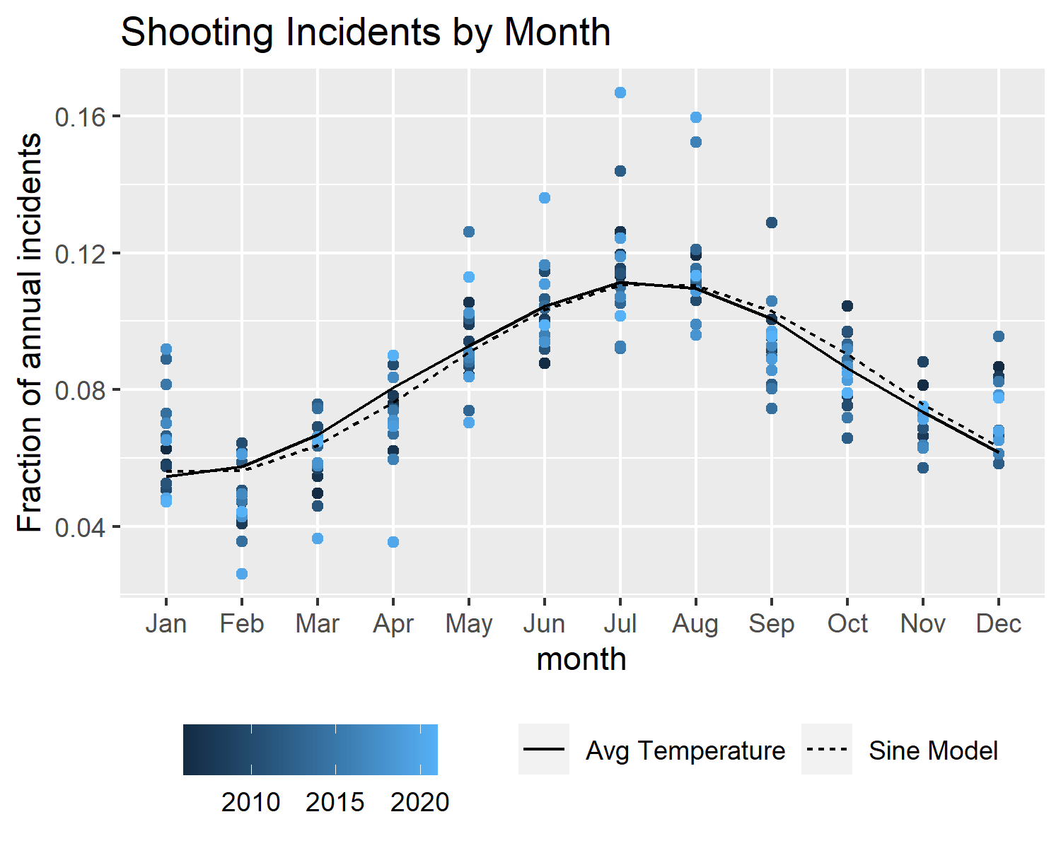
Seasonality: Month of year
A shifted and vertically-scaled sine wave fits the monthly data quite nicely.
Average NYC temperatures correlate strongly with both this model and the observed incident counts.
This suggests (though does not prove!) that temperature-driven behavior patterns are a major driver of the overall level of shootings.
Notes:
Turning to variation within a year, we see a strong monthly pattern. This can be approximated quite well by a scaled-and-shifted sine wave, and more suggestively, by average temperature data for the city.
This suggests, though in no way proves, a connection between temperature, behavior, and propensity for shootings.
Note that the fit is in no way perfect; that overshoot in February and undershoot in December are notable.

Slide 11
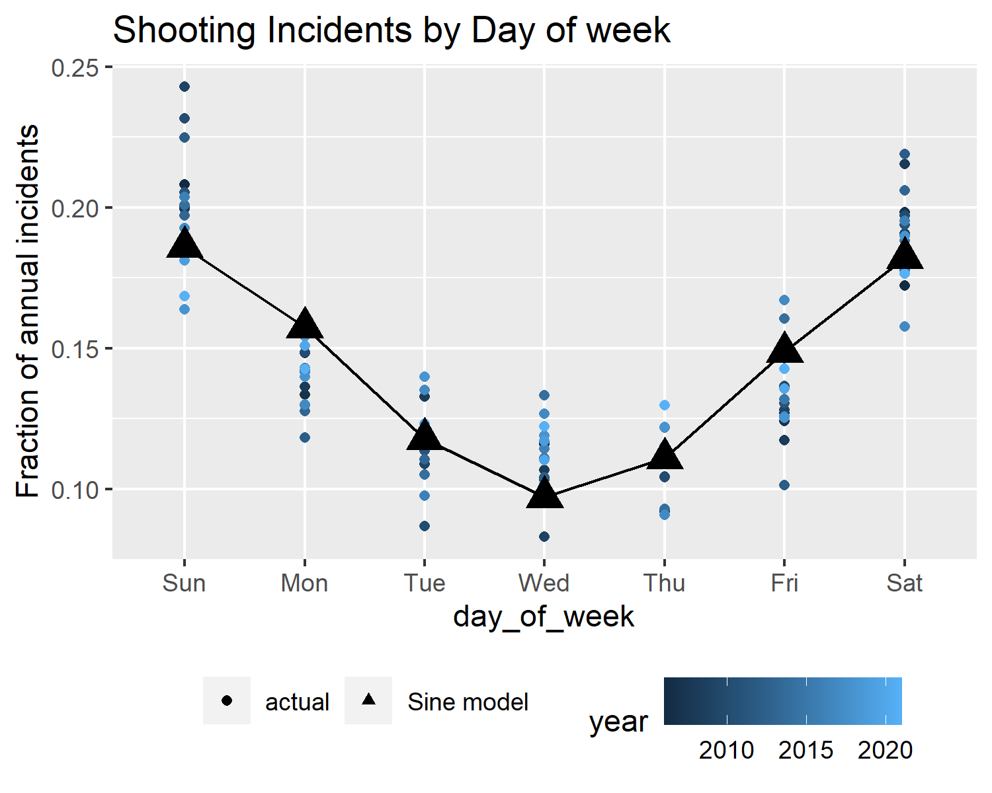
Seasonality: Day of week
Weekly rhythms have a strong influence on shooting incidents; a scaled and phase-shifted sine wave fits quite nicely (RMSE ~2 percentage points of annual incidents).
There is no immediately-obvious explanation of this pattern, other than the incident rates being higher on Fridays and weekends when more social interaction is likely to occur.
Notes:
We see a strong weekly cycle as well, again fit nicely by a scaled-and-shifted sine wave.
Weeks are a purely human phenomena, so the temperature explanation isn’t relevant here. This pattern is sustained across many years, so there must be some underlying mechanism.

Slide 12
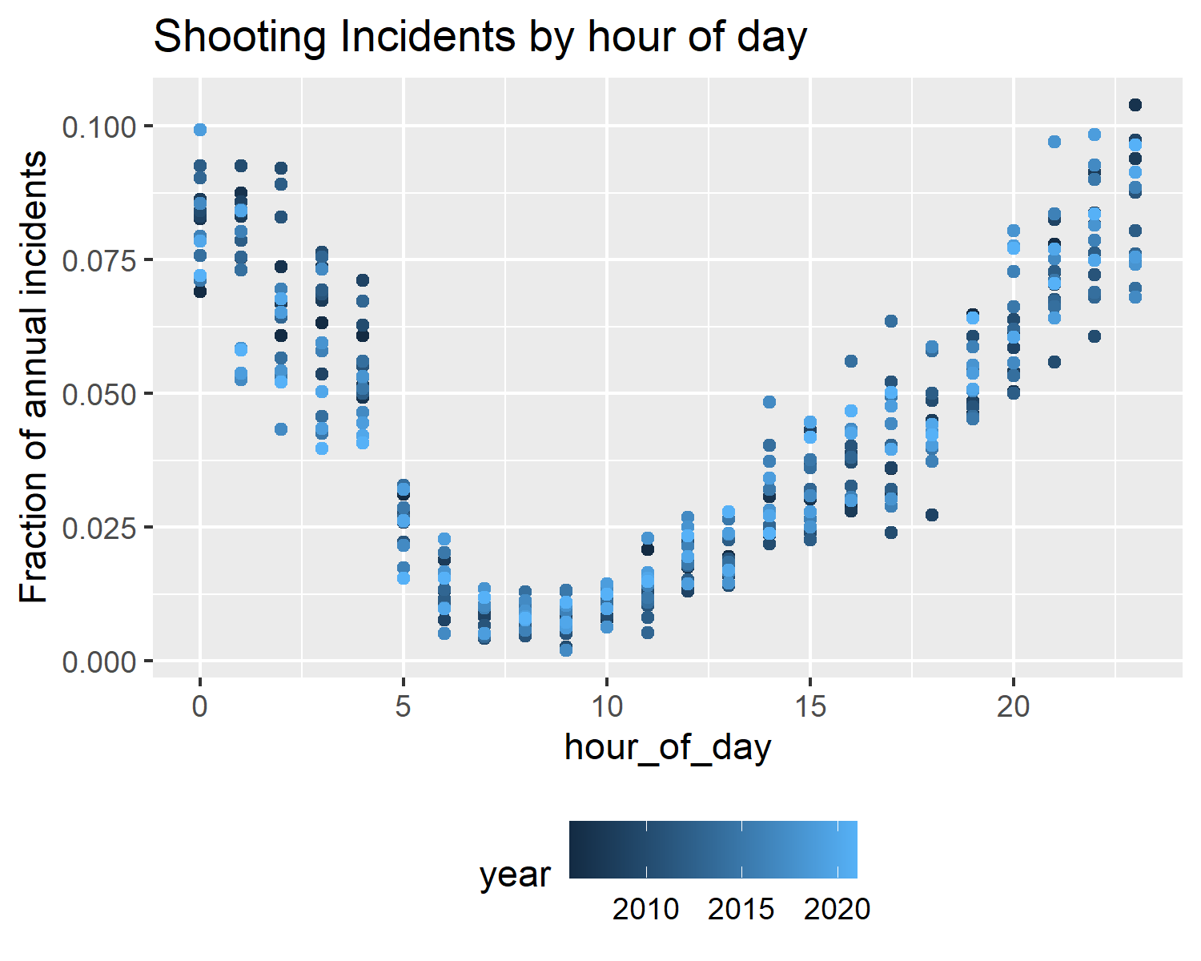
Seasonality: Hour of day
While not a simple sinusoidal, there is a repeated cycle throughout the day, with incidents rarest in the morning hours and most common at night until 4am (which is when bars close in NYC).
This aligns with the weekly pattern: shootings happen less during typical working hours and days.
Notes:
The times of day when shootings occur are also highly structured. Not a sine wave, but a tightly repeating pattern across the years.
One feature of this chart can likely be explained by the fact that bars close at 4am in New York.

Slide 13
Conclusions - Temporal Conclusions
Despite sharp changes in overall incident counts, there are strong seasonal patterns at multiple scales: over the course of a day, a week, and a year

Slide 14
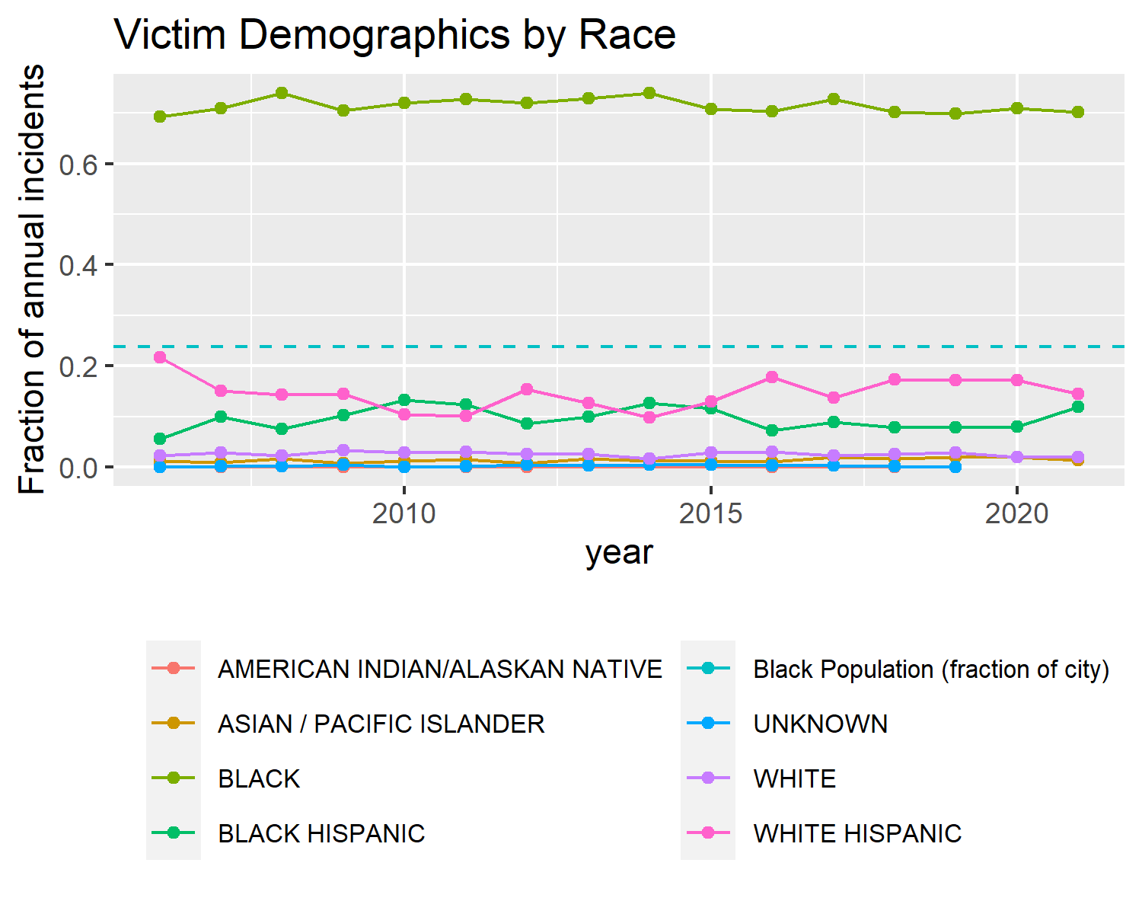
Demographics: Victim, By Race
The victim’s race is overwhelmingly coded as Black, disproportionate to the Black share of the overall city population.
Notes:
Turning to the demographics of the people involved, we start with the race of the victim.

Slide 15
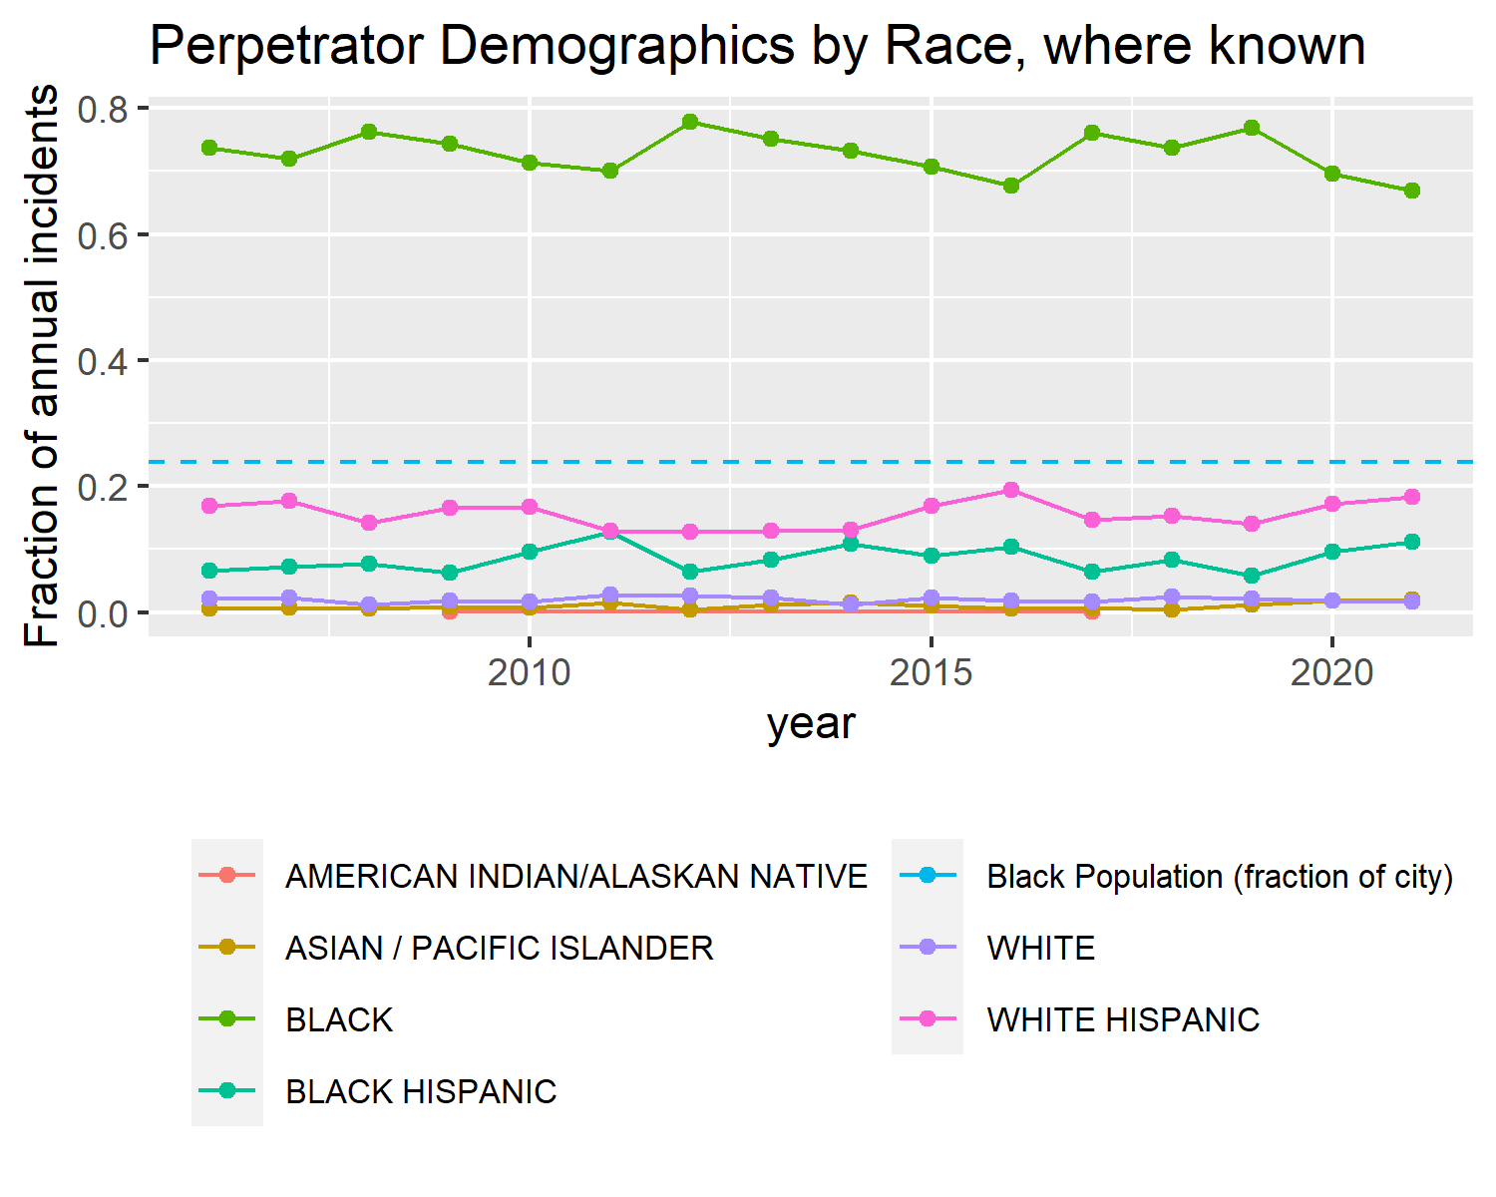
Demographics: Perpetrator, by Race
The same holds true, in almost the same proportions, for the perpetrator’s race (where known), again disproportionately so.

Slide 16
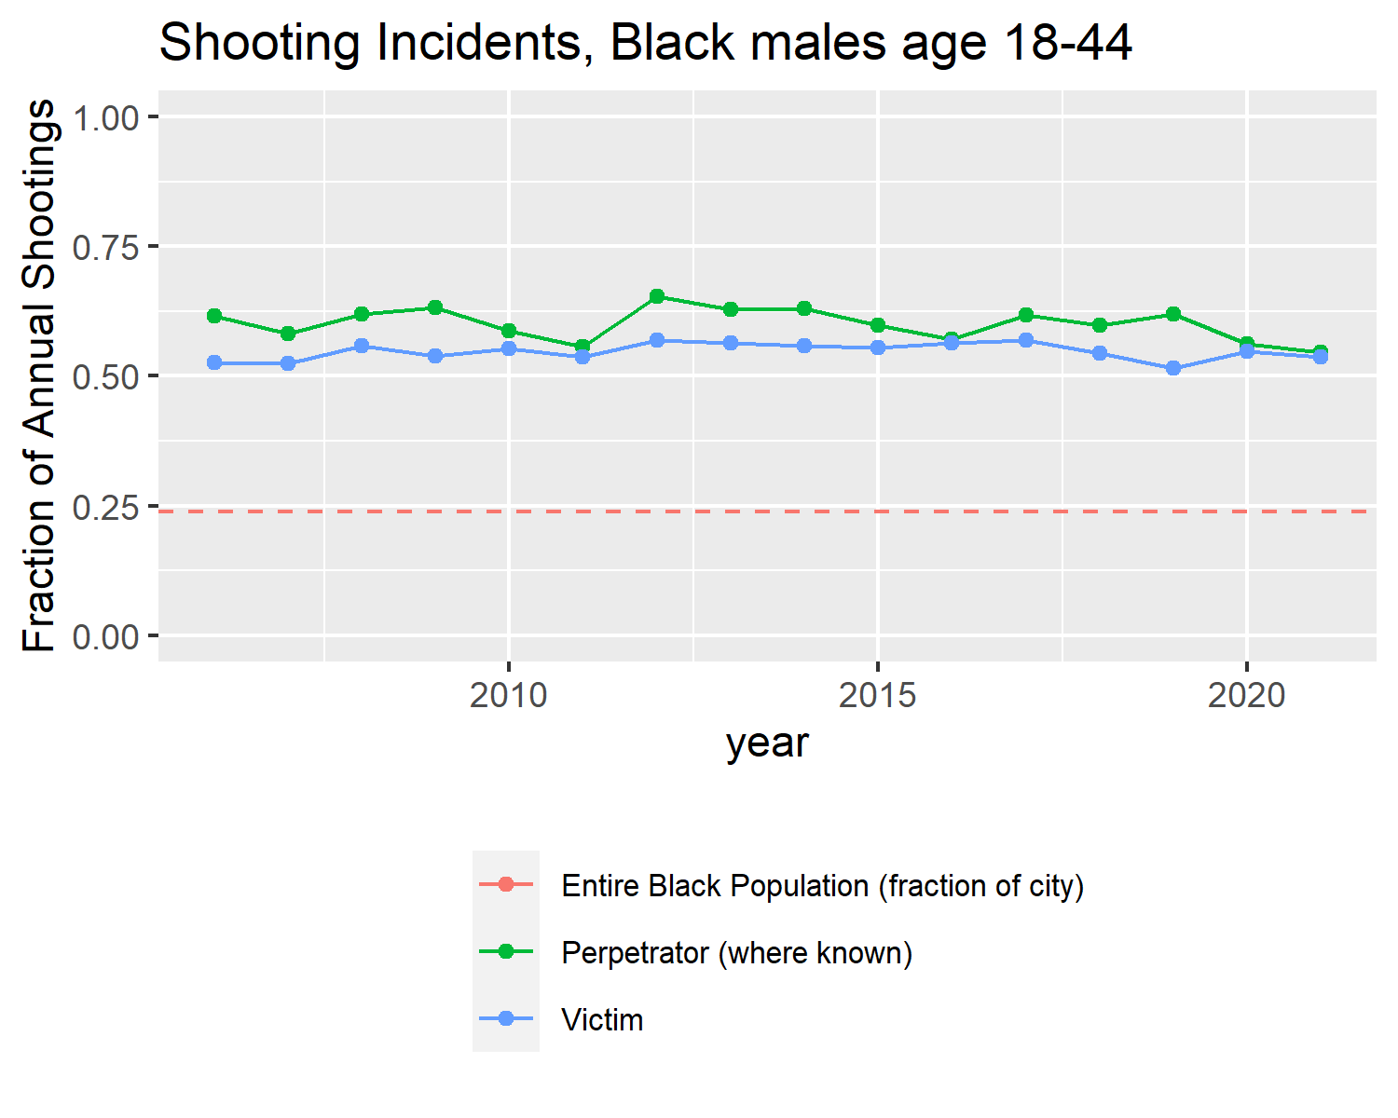
Younger Black males
We can narrow the data to consider only the combined fractions for victims and perpetrators coded as Black males in the 18-24 or 25-44 age groups.
More than half of all shooting incidents involve someone in this demographic as victim, and roughly the same proportion as perpetrator (where known).
The entire Black population of NYC is just under a quarter of the city, so the corresponding line is an overestimate of the fraction of Black males in this age group.

Slide 17
Conclusions - Demographic Conclusions
The impact of shootings (both as victim and perpetrator) falls wildly disproportionately on individuals reported as Black males aged 18-44.
Any strategy or intervention must consider both these temporal and demographic factors or it will be mis-targeted or inefficient.

Slide 18
A Caution
The demographic concentration of shootings should not be read as causal but rather as descriptive and correlated. Demographics are correlated with many other factors including socio-economic status, education, job opportunities, geographic location, historical deprivation etc., which are more likely to be actual causation.

Slide 19
Error and Bias
Finally, we consider the many ways this analysis might be wrong or misleading.

Slide 20
Error and Bias: Data Source Motivations
The underlying data comes from the NYPD. They are not a neutral party: this data may be used to demonstrate their effectiveness, to argue for more resources in certain areas, or to support theories of crime and victimhood.

Slide 21
Error and Bias: Data Source Avenues of Bias
Any of these would be a reason to bias the data collection and reporting:
Skewing demographic data toward desirable patterns
More subtly, controlling what is reported as a shooting incident and what is absent altogether

Slide 22
Error and Bias: Analysis
Beyond the data, the analysis may be flawed, biased or misleading.
The focus on proportional analysis masks the changing absolute numbers of incidents, which may be a better measure of “cost” in many dimensions
There may be important subtleties in who reports data and how, unknown to the analyst. Demographic fields are subjective and vulnerable to misinterpretation.
That said, the patterns reported seem to be so strong as to resist most small-scale biases or misinterpretations!

