Slide 2
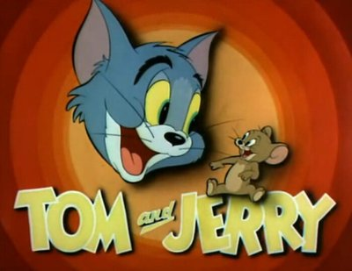

by Zhu Zhiwen

Slide 3
TOM and JERRY
Introduction
01
Example
02
Summary
03

Slide 4
Introduction
01
Part One

Slide 5
Tom and Jerry is a cartoon produced by MGM in 1939. The cartoon was written by William Hannah and Joseph Barbera and produced by Fred quinby. The first drama Sweet home was presented in the United States on February 10, 1940.

Slide 6
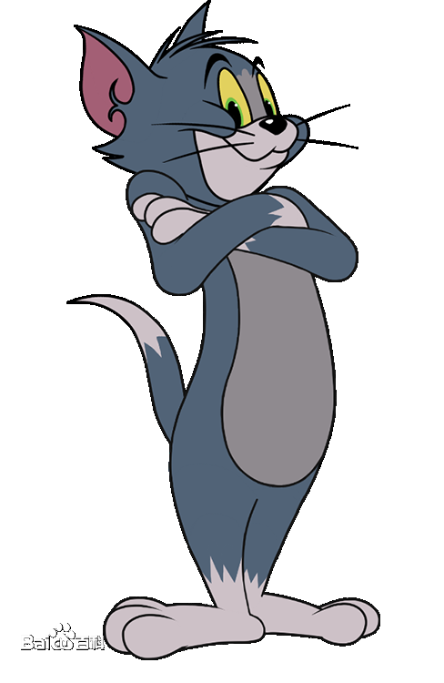
Tom
Tom is one main character of this cartoon. He always tries his best to catch Jerry, however, he hardly succeeds. when he catches Jerry, he can't deal with the mouse, then Jerry will run away. Tom is interested in love very much. As soon as he sees a beautiful female cat, he will be out of control.

Slide 7
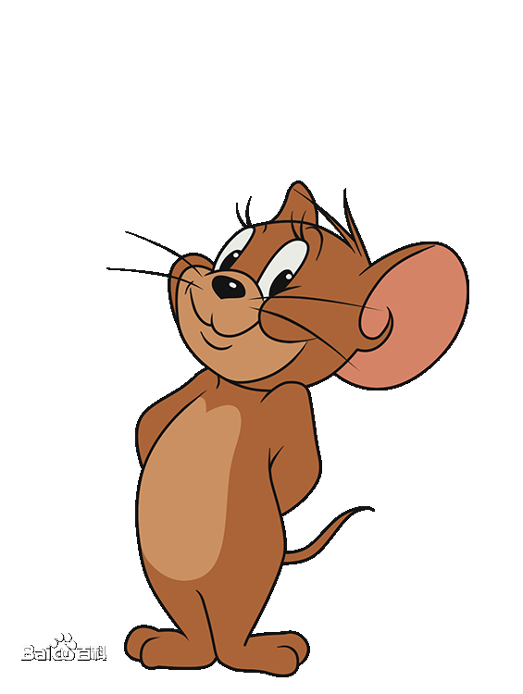
Jerry
The other main character is Jerry. He is a wise mouse, and he likes playing tricks on Tom. However, he may be tricked by Tom from time to time because of his greed. He is a kind mouse as well. He has saved a little duck and a canary from Tom.

Slide 8
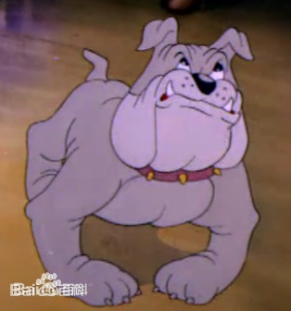
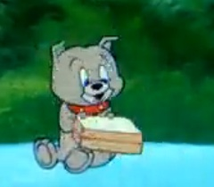
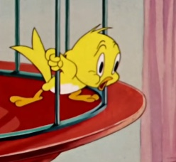
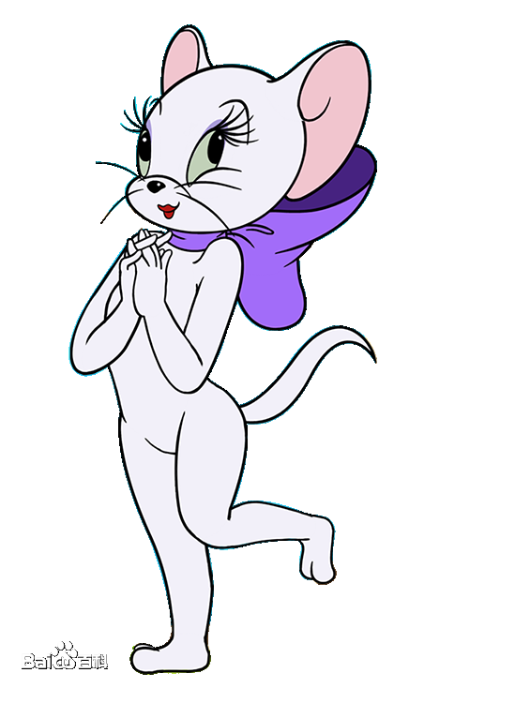
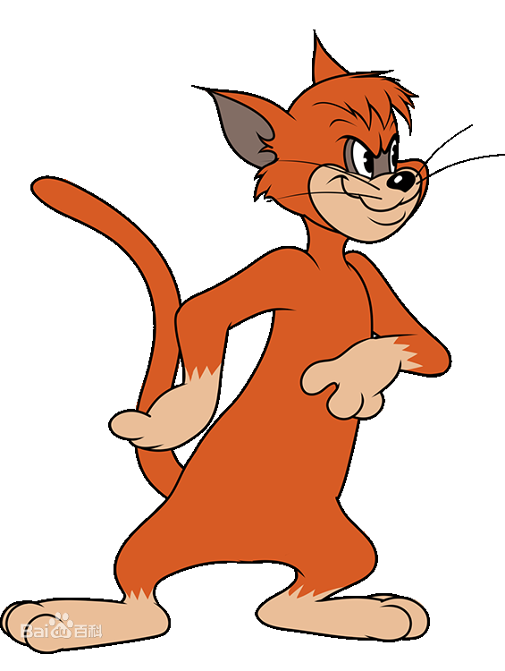
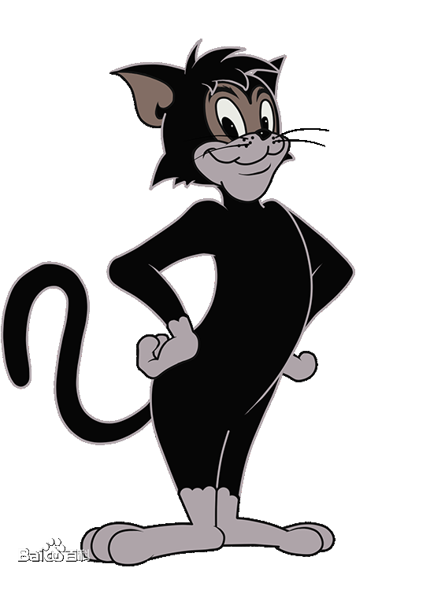
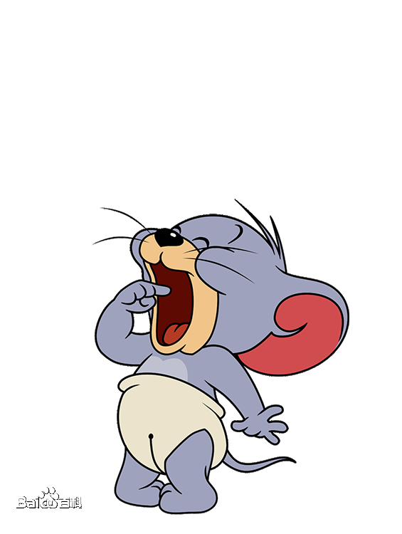

Slide 9
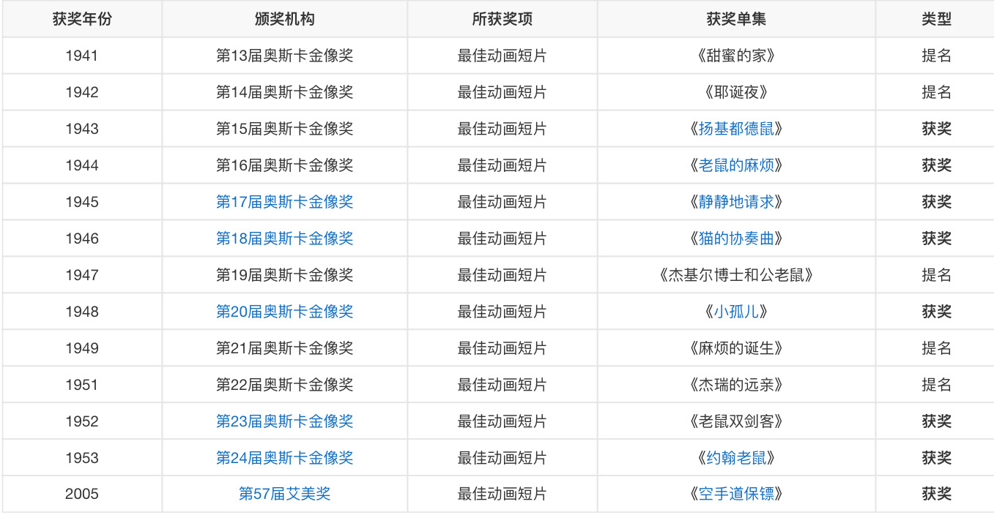

Slide 10
Example
02
Part Two

Slide 11
Tom and Jerry——the World War Two

Slide 12
Summary
03
Part Three

Slide 13
Tom and Jerry is one of the greatest memories of my childhood. Although it is always short, it brings much fun and knowledge to me. It is a meaningful cartoon, almost all the content was produced based on the great events at that time. I think that is why Tom and Jerry could win so many awards.

Slide 14



Although there are many editions of Tom and Jerry, they may be fun enough to draw children‘s attention, they can't be as meaningful as the oldest one.

Slide 15
Thanks for listening.

Slide 16
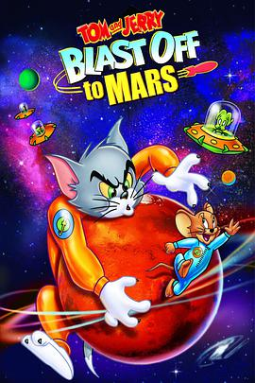
Tom and Jerry's story happened in Mars too. Do you want to learn more about Mars？So......

