Slide 1

Murang’a University of Technology Innovation for Prosperity
Title : EMPLOYEE ATTENDANCE MANAGEMENT BY FACE RECOGNITION
Presenter : VIRGINIA PAUL NGAMI
Supervisors :

Slide 2
Outline :
1. Introduction
2. Algorithm ( flow chart )
3. Functional Block Diagram
4. Results
5. Conclusion
6. Future Work

Slide 3
Introduction :
Traditionally, attendance is marked manually by Officers in charge and they must make sure correct attendance is marked for respective employee.
This whole process wastes some of work time and part of correct information is missed due to fraudulent and proxy cases.

Slide 4
Introduction :
In order to determine the attendance, face detection and face recognition are performed. Face detection is used to determine the location of the faces in an office image and extract sub images for each face. Then, in face recognition, the face images detected will be compared with the data base consisting of images of employees in the office, and attendance will be recorded accordingly.
This could also be implemented at entrance areas.

Slide 5
Significance:
1-Automated
2- Economically
3-Effective
4- Keep extra time

Slide 6
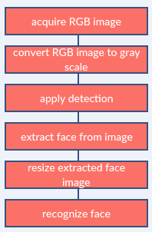
Image processing:

Slide 7
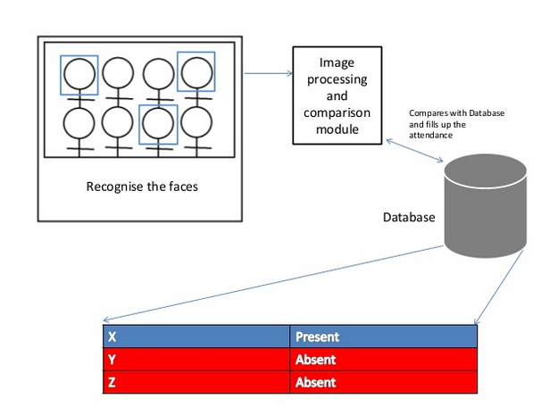
Basic structure

Slide 8
Face Detection:
Face detection is a computer technology used to identify human faces in digital images by determining the location of the faces in the image and extract sub images for each face.
Viola Jones algorithm will be implemented to recognize face and non-face patterns and enable us to identify locations of the faces in the image.

Slide 9
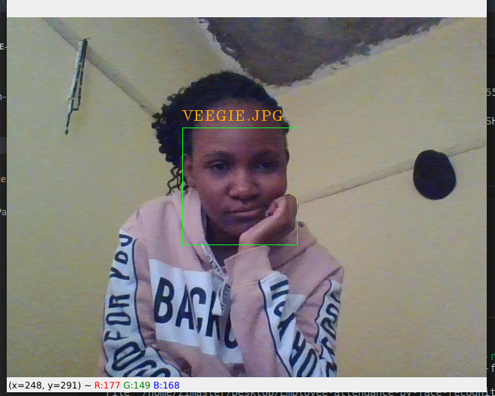
Example of a detected face :

Slide 10
How To Create a Database
A Database here is a collection of face images and extracted features. The database includes names of employees & their corresponding images.
I created a database of two people representing employees, added images per person as captured from a smartphone camera. These images were taken at different times and with variations in illumination, facial expressions, and facial details.

Slide 11
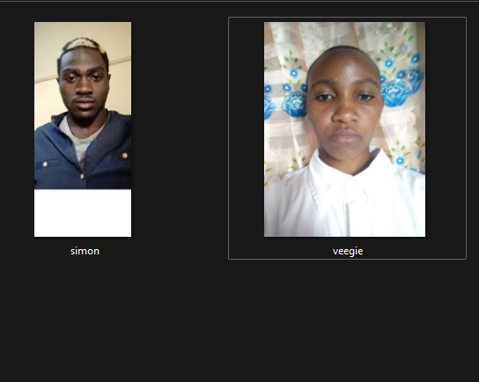
Example for data base images:

Slide 12
The Process of Recognition face
1. Create a training set and concatenate columned images into one matrix (in case of many images)
2. Normalize the images and calculate the covariance matrix (for many images)
3. Calculate the weight of the image (images).
4. Input an unknown face image.
5. Normalize and calculate weight of input image.
6. Calculate the distance.

Slide 13

Reconstructed Image from existing Images:
I input a new image of an employee and got this result:
Test Image Reconstructed image

Slide 14
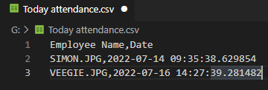
Text file for employee attendance information:

Slide 15
The problem that I faced
In my project I faced a number of problems and managed to overcome them:
1- Downloading Python and its libraries was quite a problem
2- Version incompatibility which either needed an upgrade or downgrade of other libraries.

Slide 16
Conclusion:
From my project, I noticed the face recognition was sensitive to face background, light, and head orientations. This technique described the accurate and efficient method of automatic attendance in a work area which could replace the traditional method. An automatic attendance has many advantages. Most of the existing systems are time consuming and require semi manual interference from administrators. My system seeks to solve these issues by using face recognition in the process to save the time and labor. And No need for installing complex hardware for taking the attendance in an office. All you need is a camera and laptop or desktop computer. I used algorithms that can detect and recognize faces in the image.

Slide 17
Future work
Automatic attendance system can be improved by increasing the number of features which can be extracted to increase accuracy of face recognition. Once the software is developed and tested properly, it could be improved to cover other institutions such as schools, military training camps and may more.

Slide 18
THE END
THANK YOU ALL.

