Slide 1
SYNADIA WORKSHOP
Multi-Cloud and Disasters
Disaster recovery with NATS JetStream
Jean-Noël Moyne · Synadia
October 2026
Notes:
Hold while people join. 90 minutes: 75 of content, 15 of Q&A. Five sections: basics, 3 clouds, 2 clouds, 1 machine, backups, then moves and things to know.

Slide 2
THE DEAL
What you'll leave with
01
A decision matrix for two and three clouds
Stretch, mirrors, sourcing, arbitrator, leaf nodes, backups: RPO, RTO, consistency, latency, what survives.
02
Four demo environments and runbooks that run on a laptop
arbitrator, sourcing-replication, mirror-dr, backup-restore: scripts, kill switches, a network-partition proxy.
03
The gotchas
Ghost peers in the meta quorum, mirror lag that lies during a partition, what sync_interval protects, promotion of a mirror is one-way.
Notes:
State the three takeaways; everything else is in service of them.

Slide 3

THE DEAL · HANDS-ON
Clone the repo, run every demo on your laptop
Four demo folders: arbitrator, sourcing-replication, mirror-dr, backup-restore. Each has its scripts, a kill switch per region and a runbook with the expected output of every step.
Needs nats-server, the nats CLI and Go (for the proxy that cuts gateway links). Everything listens on 127.0.0.1.
The diagrams of this deck are in there too. Clone it now and run along, or replay it after the session.
https://github.com/synadia-labs/workshop-disaster-recovery-2026

Slide 4
00
Some basics about disasters

Slide 5
BASICS · VOCABULARY
Three words to agree on
Cloud, site, DC, AZ: interchangeable here
Active/active vs active/passive
Write consistency
Read consistency
The distinction happens at two levels.
The NATS service: does each site serve traffic?
The client applications: are they deployed on all sites? Do they write on all sites, at the same time, on the same key?
One single order of the messages in a stream. Atomic batching and compare-and-set are available.
This is what RAFT replication gives you, at the price of a quorum round trip.
Coherency, really: e.g. read your own writes. Technically it means no caching of any kind; practically it is a latency.
Which application needs what? What are your latency requirements?
Notes:
Ask the room which applications truly need immediate consistency. Most need less than they think; the ones that do, really do.

Slide 6
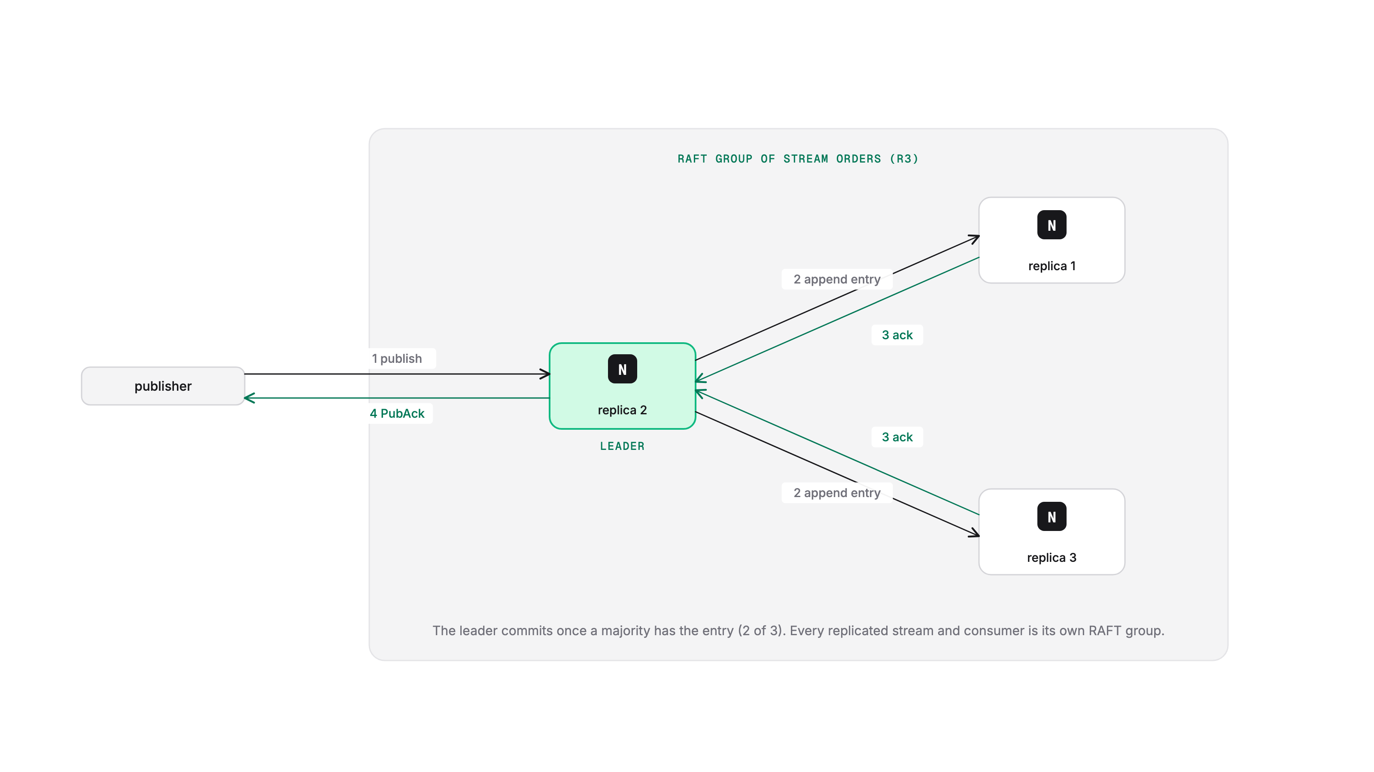
BASICS · RAFT
RAFT: active/active with immediate consistency
Every replicated Stream and Consumer has its own RAFT group. One peer is elected leader and handles publications and requests.
Each message published to a Stream is a RAFT vote between the leader and the replicas (with some optimistic batching).
Each state change of a Consumer, such as a client ack, is a vote too.
At least half the nodes plus one must vote: 2 of 3, 3 of 5.
Notes:
The PubAck means 'stored on a quorum'. Consumer acks cost a vote as well, which is why consumer-heavy workloads care about replica latency.

Slide 7
BASICS · THE META LAYER
One meta leader for the whole (super-)cluster
STOPS WITHOUT A META LEADER
KEEPS WORKING
Stream, KV and Consumer lifecycle (CRUD)
Stream purging
Stream moving
Adding new peers to the cluster
nats stream ls and account-level JetStream info (individual stream infos still work)
Core NATS, obviously
Publishing to existing streams
Consuming from existing consumers
KV reads and writes
Direct gets
Notes:
Verified on the demo cluster: without a meta leader, publish/consume/KV/direct get work; ls, create, edit, purge, delete and the non-direct MSG.GET fail with 10008.

Slide 8
BASICS · GOTCHA
Nodes join automatically, leave administratively
WHAT YOU EXPECT
WHAT ACTUALLY HAPPENS
A server you stopped is no longer part of the cluster.
Start a 4th node once to try something, stop it, forget about it.
Meta leader election counts every peer that has ever joined, running or not. Your 3-node cluster now needs 3 of 4 up.
Remove dead peers explicitly.
3 running servers = a 3-node cluster
nats server cluster peer-remove <name>
Feels obvious. It is wrong.
2.15: nats server cluster rescue temporarily lowers the quorum so dead peers can be removed. Only if you understand it; it can recover a two-site meta layer after a split.
Notes:
Rescue (2.15): $JS.API.META.RESCUE lowers quorum_needed for 5 minutes. Set it to the number of live servers, never lower. Removed peers are ignored for 5 minutes, then rejoin on their own.

Slide 9
01
3 (or more) clouds
Notes:
Roughly 20 minutes. Stretch cluster, super-cluster with a stretch cluster, mirrors, then sourcing and the virtual stream, with the demo.

Slide 10
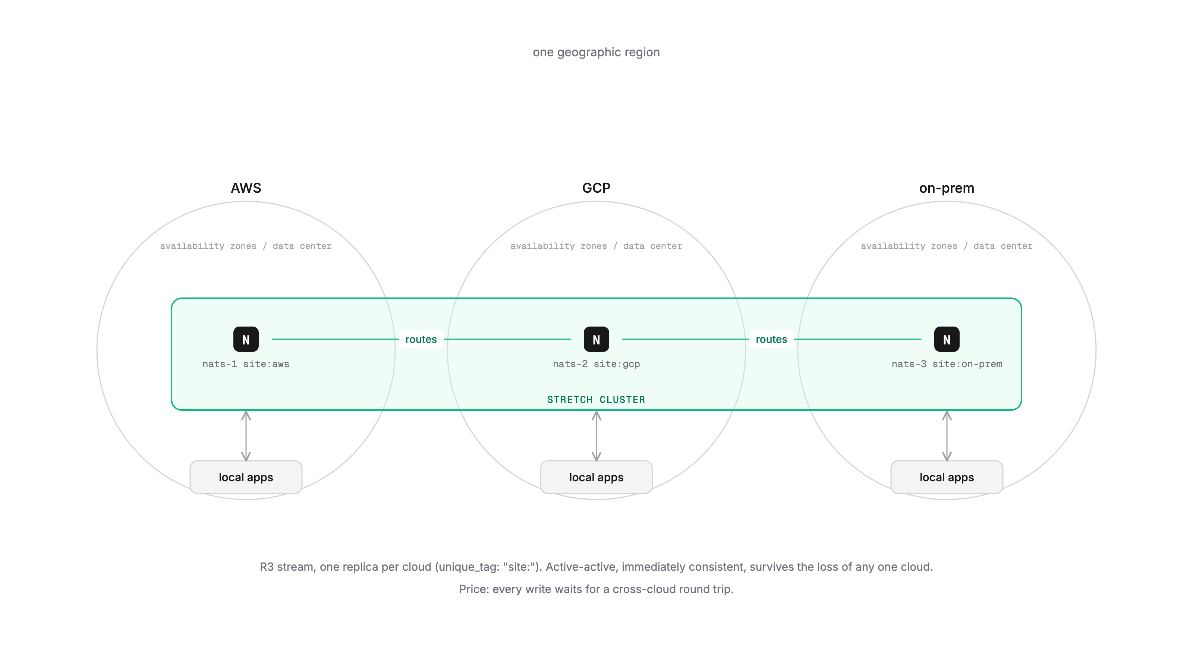
3 CLOUDS · STRETCH CLUSTER
Stretch cluster: one cluster across three clouds
Automatically active-active and immediately consistent. It simply works as long as 2 of the 3 sites are up.
More than 3 nodes? Use tags for placement: jetstream { unique_tag: "site:" } plus server_tags: ["site:aws"], so each replica lands in a different site.
The impact is on operation latency: every write waits for the cross-cloud round trip.
Example: Form3, UK payments, driven by regulation. One node in AWS, one in GCP, one on prem.
Notes:
Zero RPO, RTO in seconds. The price is paid on every write. Without unique_tag, R3 can put two replicas in one site and that site's loss kills the stream.

Slide 11
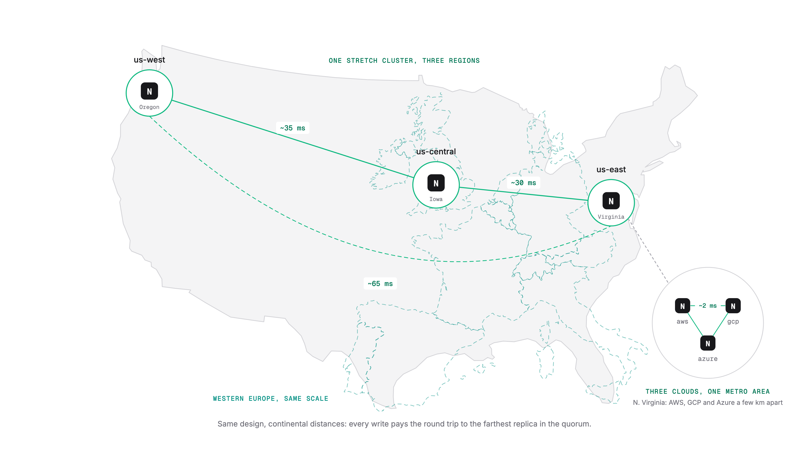
3 CLOUDS · STRETCH CLUSTER
The same thing across the USA
Notes:
Write latency = leader to the farthest replica in the quorum and back, on every message. Reads stay local. Continental distances make the latency cost visible: 30 to 65 ms per write. Fine for many workloads, not for all.

Slide 12
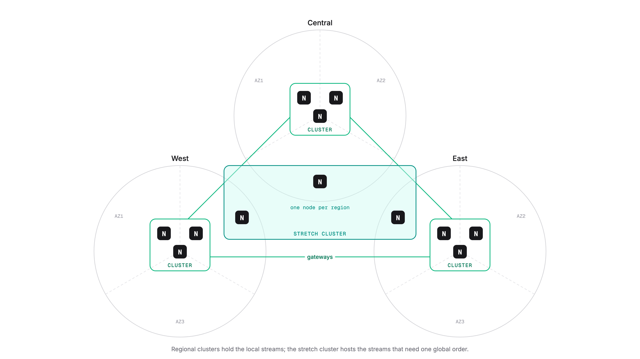
3 CLOUDS · SUPER-CLUSTER
A super-cluster with a stretch cluster
Notes:
Regional clusters for local streams, one stretch cluster for the streams that need a single global order. From the Synadia blog on multi-cluster consistency models. The stretch cluster is also the 'ordering stream' in front of regional write streams if you need global order with the virtual stream design.

Slide 13
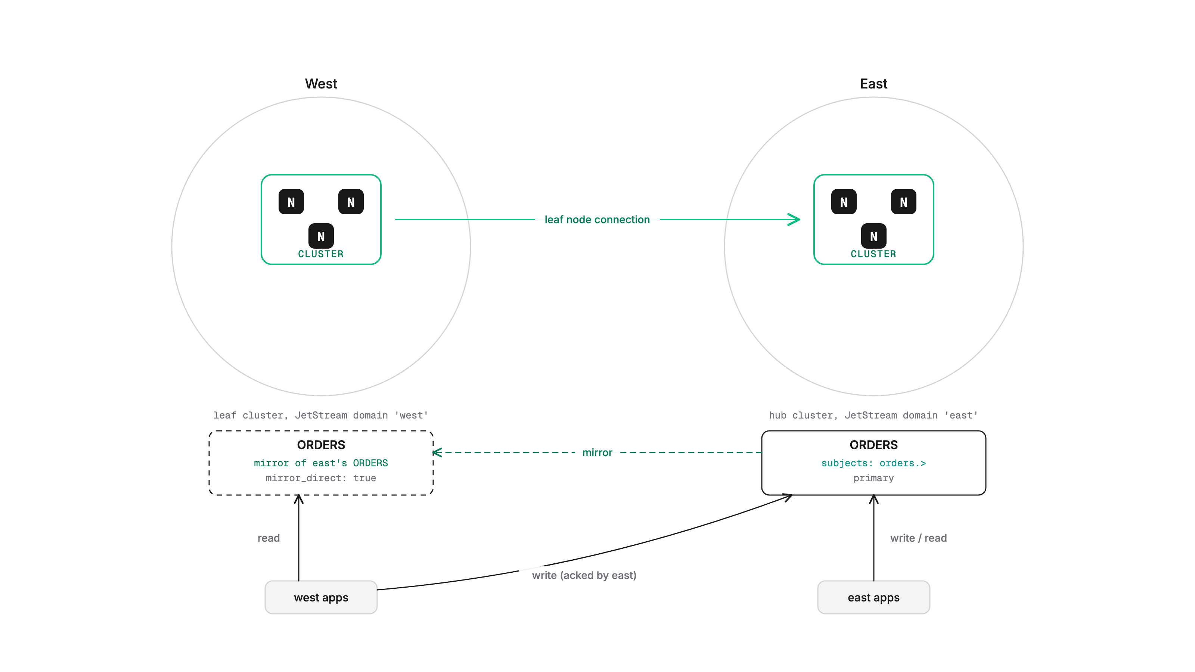
3 CLOUDS · MIRRORS
Mirrors
Built-in mirroring: define a stream in one cluster that is a mirror of a stream in another cluster.
Mirrors can serve direct get requests for their cluster: set mirror_direct: true in the stream's config.
Mirrors can be promoted to regular streams, starting with NATS 2.12.
Reminder: deletes and purges are not mirrored (nor sourced).
Notes:
A mirror keeps the origin's sequence numbers. Promotion is one-way: a promoted stream cannot become a mirror again without being re-created.

Slide 14
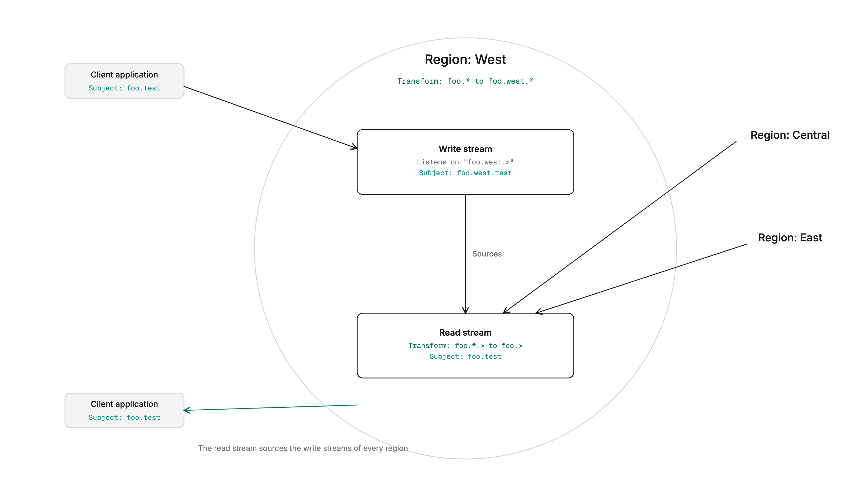
3 CLOUDS · SOURCING
Eventual consistency with sourcing: the virtual stream
'Replicate' through built-in stream sourcing.
Each cluster has a write stream that takes the local clients' writes.
Each cluster has a read stream that local clients consume from, and that sources from every write stream.
When both sides are running, latency is not much more than the network latency.
Notes:
Subject transforms on the sources strip the region token: foo.west.test becomes foo.test in every read stream. Demo folder: sourcing-replication.

Slide 15
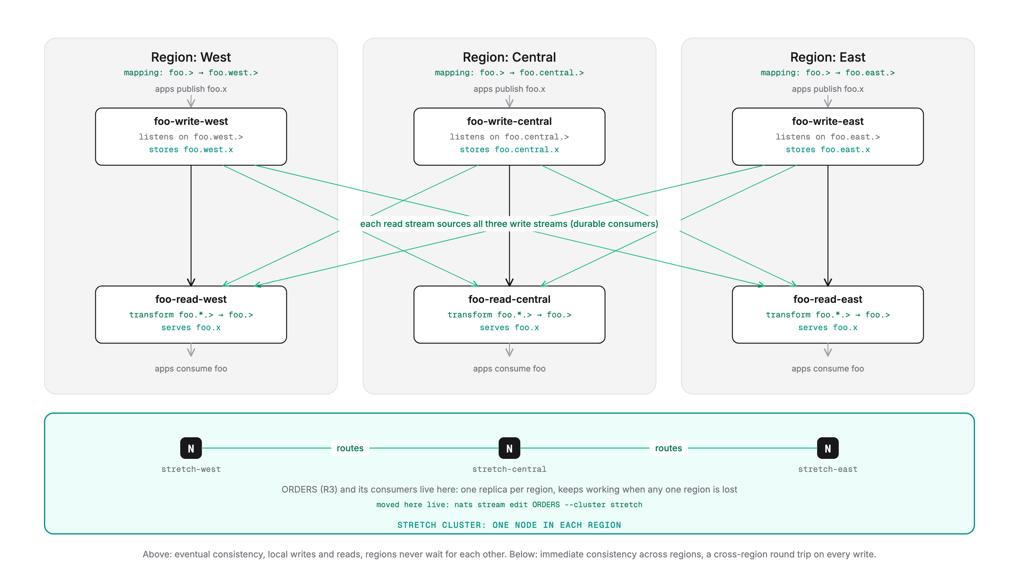
3 CLOUDS · SOURCING
Stretch cluster plus virtual stream
Notes:
Subject transforms on the sources strip the region token: foo.west.test becomes foo.test in every read stream. Demo folder: sourcing-replication.

Slide 16
3 CLOUDS · SOURCING
Transparent to the applications: subject mappings
CORE NATS MAPPINGS, SCOPED BY CLUSTER
OTHERWISE
Clients use one virtual stream name, the same in every cluster; mappings send them to the real streams of the cluster they are connected to.
In west, a publish to foo.> is mapped to foo.west.>, which is what west's write stream listens on.
$JS API subjects for stream foo are mapped to the local read stream.
Caveat: Consumer create can contain a stream name field in it.
The application has to know the name of the cluster it is connected to, and use it as a prefix on subject and stream names.
Notes:
Mappings live in the account config (or the account JWT in operator mode); each entry has one destination per region with cluster: <region>.

Slide 17
3 CLOUDS · SOURCING
What you gain, what you give up
ADVANTAGES
DISADVANTAGES
All operations always have local-cluster latency.
Writes are acked by the local write stream: stored in at least one place when the PubAck arrives.
Sourcing is guaranteed store-and-forward.
Sourcing latency is low as long as both streams are working.
Each side keeps writing through outages and partitions, and converges afterwards.
Eventual consistency: no global order. A problem for KV if the same key is written from more than one place at a time.
Sequence numbers are not global: no real compare-and-set.
Consumers are local to the read stream: no global named durable consumers.
Messages cannot be deleted explicitly.
With durable sourcing (2.14+) any retention policy works; see the sourcing-replication folder.
Notes:
Observed in the demo: after a partition both read streams show the same count with different contents, then converge within a minute of healing.

Slide 18
HANDS-ON
Demo: stretch cluster and sourcing replication
Three regions with a write and a read stream each; every read stream sources all three. A stretch cluster, one node per region.
Publish anywhere: the PubAck names the local write stream; all read streams converge.
Kill east: west and central carry on; ORDERS, placed in east, is gone with it.
Move ORDERS to the stretch cluster live; kill east again: it keeps working.
Partition east: both sides keep writing; heal: converged in seconds.
cd sourcing-replication
./demo-stretch-and-sourcing.sh
runs: start-supercluster.sh, define-streams.sh,
kill-east.sh, partition-east.sh, heal-partition.sh
nats stream edit ORDERS --cluster stretch
RUNBOOK.md has the expected output of every step
Notes:
State what the demo proves before running it: local latency on both sides, convergence after failures, and the limits (order, sequence numbers, consumers).

Slide 19
02
2 sites
Notes:
About 20 minutes: the arbitrator, the leaf-node alternative, primary/backup with mirrors, active/active with sourcing, then the matrix.

Slide 20
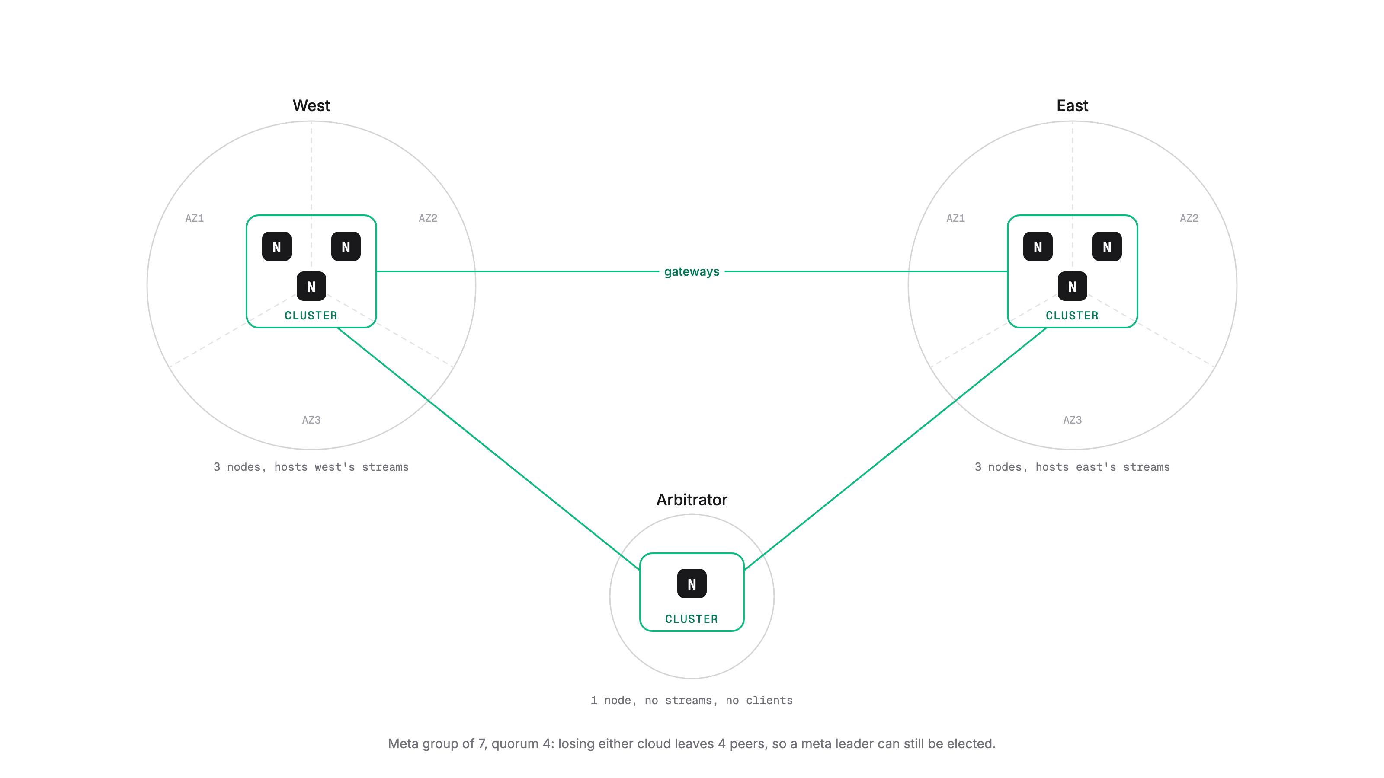
2 CLOUDS · ARBITRATOR
The arbitrator: a single-node third cluster
West 3 nodes, east 3 nodes, arbitrator 1 node: a meta group of 7 with quorum 4. Losing either cloud leaves 4 peers.
The arbitrator can be elected meta leader, but holds no streams or consumers and no client connects to it.
No replicated assets get assigned to it, and no R1 assets happen naturally since no client connects there (set max_ha_assets: 1 to be sure about R>1).
It only saves the meta layer: when a whole cluster goes down, that cluster's streams still become unavailable.
Notes:
Demo folder: arbitrator. gwproxy carries the gateway links so partition-east.sh can cut them without root.

Slide 21
2 CLOUDS · ARBITRATOR
A cloud goes down vs a cloud is cut off
EAST GOES DOWN
EAST IS PARTITIONED
West + arbitrator: 4 of 7, a meta leader in seconds.
West keeps data plane and control plane: publish, consume, KV, create streams.
East's streams: no replicas, unavailable. Publish gets no ack, stream info times out.
A mirror living in east is gone too.
Recovery: start east. Peers rejoin, streams elect leaders, consumers resume, mirrors catch up. Nothing to do by hand.
Same meta picture: leader on the majority side; east has none.
East still serves its own clients from its own R3 streams: publish, consume, direct get.
East's control plane fails with 10008: create consumer, create stream.
A mirror's 'lag' stays 0 during the cut; it cannot know. Watch 'active' or compare counts.
Heal: gateways reconnect in seconds, a brief meta re-election, mirrors catch up.
Notes:
If the meta leader was in east it keeps leading 10 to 25 seconds before stepping down; harmless, it cannot commit. Rejoining peers carry a higher Raft term, hence the re-election after healing.

Slide 22
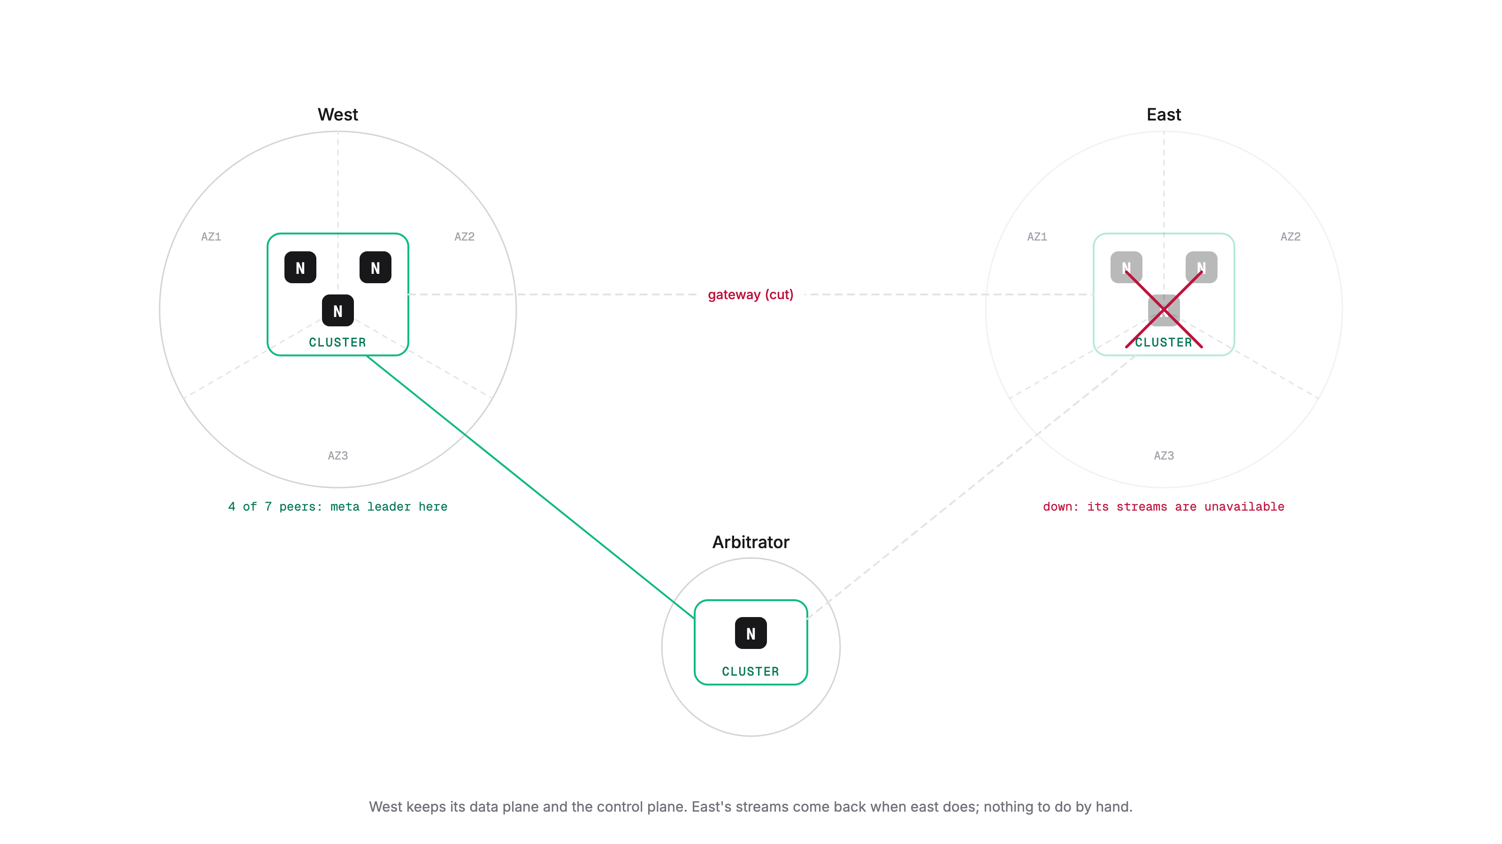
2 CLOUDS · ARBITRATOR
East goes down
Notes:
4 of 7 peers remain: the control plane survives on west. East's streams come back when east does.

Slide 23
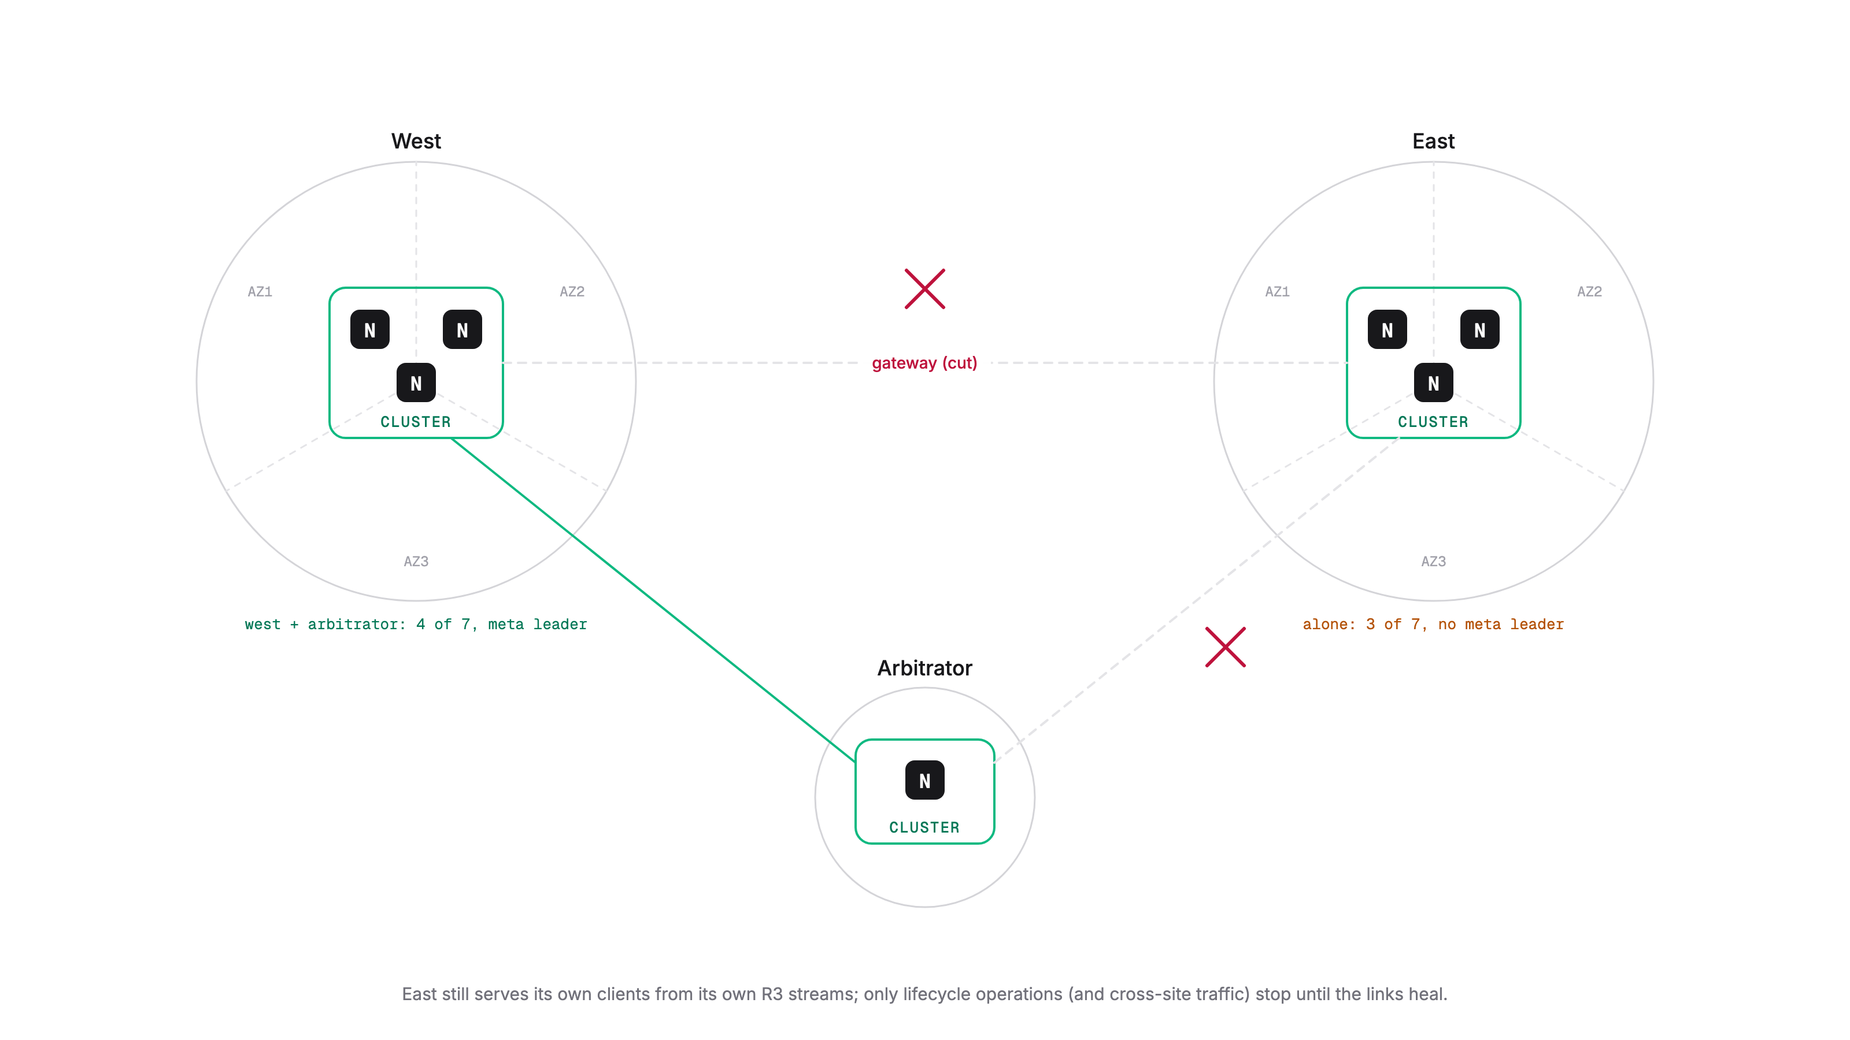
2 CLOUDS · ARBITRATOR
East is cut off
Notes:
Both sides keep their data plane; only the majority side keeps the control plane.

Slide 24
HANDS-ON
Demo: losing a cloud, twice
demo-region-down.sh: kill east; west keeps working; east's streams unavailable; the mirror in east is down; start east and watch everything heal.
demo-partition.sh: cut the gateways; east's data plane lives on, its control plane does not; heal and converge.
Watch 'server report jetstream': Current false and Lag growing before Online changes.
cd arbitrator
./demo-region-down.sh
./demo-partition.sh
kill-east.sh · kill-west.sh · kill-arbitrator.sh
partition-east.sh · heal-partition.sh
RUNBOOK.md
Notes:
Both demos end with a prompt to clean up or keep playing.

Slide 25
2 CLOUDS · LEAF NODE
Rather than a super-cluster: one cluster as a leaf node of the other
Do not connect the system account over the leaf link.
Each cluster has its own independent meta group: losing one never touches the other's control plane.
You lose the ability to move streams between the clusters.
Separate JetStream domains; the other domain is reachable as $JS.<domain>.API for mirrors and sources.
Notes:
This is the topology of the mirror-dr demo: west is a leaf of east, domains 'west' and 'east'.

Slide 26
2 CLOUDS · PRIMARY / BACKUP
Primary/backup clusters with mirrors
01
02
03
04
Mirror
→
Failover
→
East is back
→
Cutover
ORDERS lives in east; west holds a mirror of it, with mirror_direct for local reads. Writes from anywhere go to east.
East is lost. Promote the mirror in west: it becomes a regular stream and takes writes. Sequence numbers continue.
Re-create ORDERS in east as a mirror of west's; let it catch up with everything written meanwhile.
Pause writers. Promote east, delete west's stream, re-create it as a mirror of east. Back to the start.
Once promoted, a stream cannot become a mirror again unless re-created. Delete a resurrected old stream before failback: it would take writes too.
Notes:
Verified: a revived east stream with its old data starts taking writes again within seconds of electing a leader, and the two copies diverge.

Slide 27
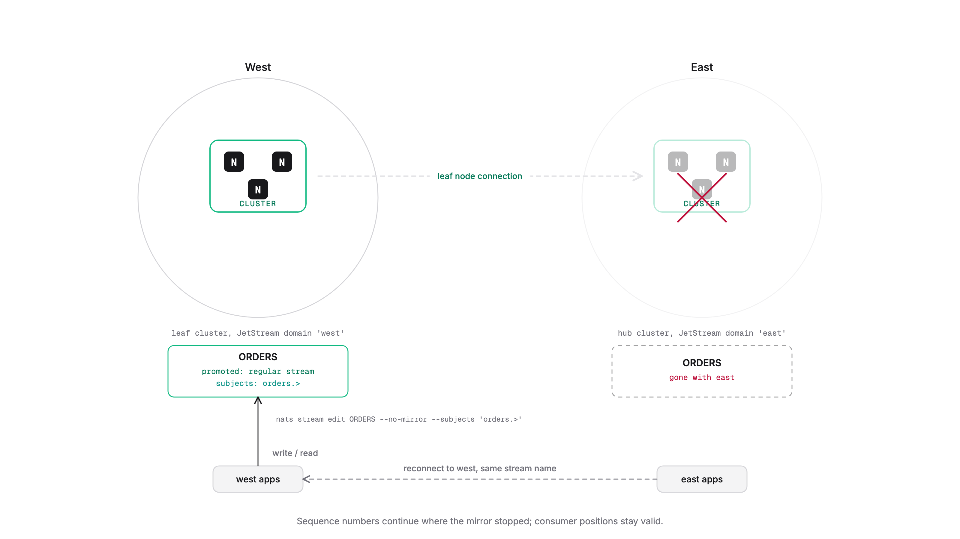
2 CLOUDS · PRIMARY / BACKUP
Failover: promote the mirror
Notes:
nats stream edit ORDERS --no-mirror --subjects 'orders.>' : one command, plus client reconnection.

Slide 28
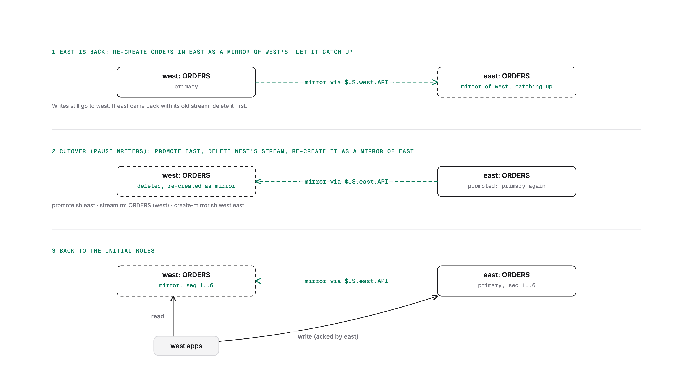
2 CLOUDS · PRIMARY / BACKUP
Failback in two moves
Notes:
Mirror the other way, catch up, then swap roles during a writer pause.

Slide 29
HANDS-ON
Demo: failover and failback with a durable mirror
Durable mirror: a flow-control consumer on the origin first, then the mirror that reads through it.
Writes from west are acked by east over the leaf link; the mirror keeps the origin's sequence numbers.
Delete ORDERS in east, promote west: the next write is seq 4 in domain west.
Re-create east as a mirror of west (fresh consumer), cut over, re-mirror west.
cd mirror-dr
./demo-mirror-dr.sh
create-mirror.sh <ctx> <origin-domain>
consumer add ORDERS mirror-<ctx> (flow control)
promote.sh <ctx>
kill-east.sh for the realistic outage
RUNBOOK.md

Slide 30
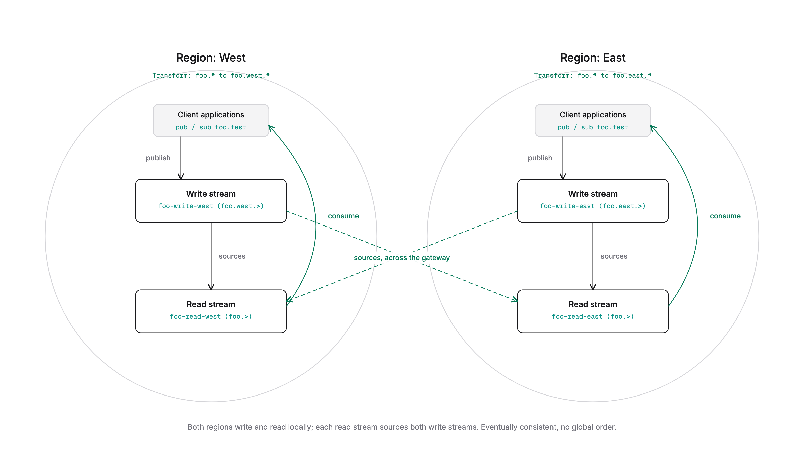
2 CLOUDS · ACTIVE / ACTIVE
Active/active clusters
You must forego immediate consistency across the two clouds.
Use stream sourcing: the virtual stream from section 1, with two regions.
Both clouds write and read locally; each read stream sources both write streams.
Cloud down: the other keeps going, the read stream catches up when it is back. Partition: both keep going and converge after the heal.
Notes:
Same limits as before: no global order, local sequence numbers, consumers per cloud, KV last-writer-wins.

Slide 31
DECISION MATRIX
Pick your trade-off
Arbitrator and backups aren't alternatives to the first four; they're what you add to them.
 | RPO | RTO | CONSISTENCY | WRITE LATENCY | SURVIVES A SITE LOSS | COMPLEXITY
Stretch cluster R3, one node per site | 0 | Seconds: leader election | Immediate: single order, CAS, atomic batch | Cross-site RTT on every write | Everything, while 2 of 3 sites are up | Low, but needs 3 sites
Super-cluster + mirrors primary / backup | Replication lag | Minutes: promote mirror, repoint clients | Immediate on primary; mirror lags, read-only | Local cluster | Data up to the lag. Not consumers | Medium; failback = recreate mirror
Sourcing active / active | Replication lag, per direction | ~0: each site is self-sufficient | Eventual: no global order, no cross-site CAS, LWW on keys | Local cluster | Local reads and writes; remote data catches up; consumers are local | High: 2 streams per site, mappings
Arbitrator 2 sites + 1-node cluster | n/a: control plane only | Seconds: meta leader re-elected | Unchanged | Local cluster | Lifecycle ops, promotes, moves. Lost site's data waits for its return | Low; tiny third location
Leaf node separate JS domains | Cross-domain mirror lag | ~0 for the surviving domain, incl. lifecycle | Immediate in a domain, eventual across | Local cluster | Everything local; no shared quorum to lose | Medium: domains, cross-domain config
Backups nats backup, 2.15 | Time since last backup | Restore time: delete, recreate stream | Point in time; consumers included | None | Everything up to the backup, incl. logical errors replication copies | Low; off-site storage, scheduling
Notes:
The slide people photograph. Walk it column by column. Arbitrator and backups are additions to the other four, not alternatives.

Slide 32
03
1 machine
A single-machine disaster is losing power, or losing a disk.

Slide 33
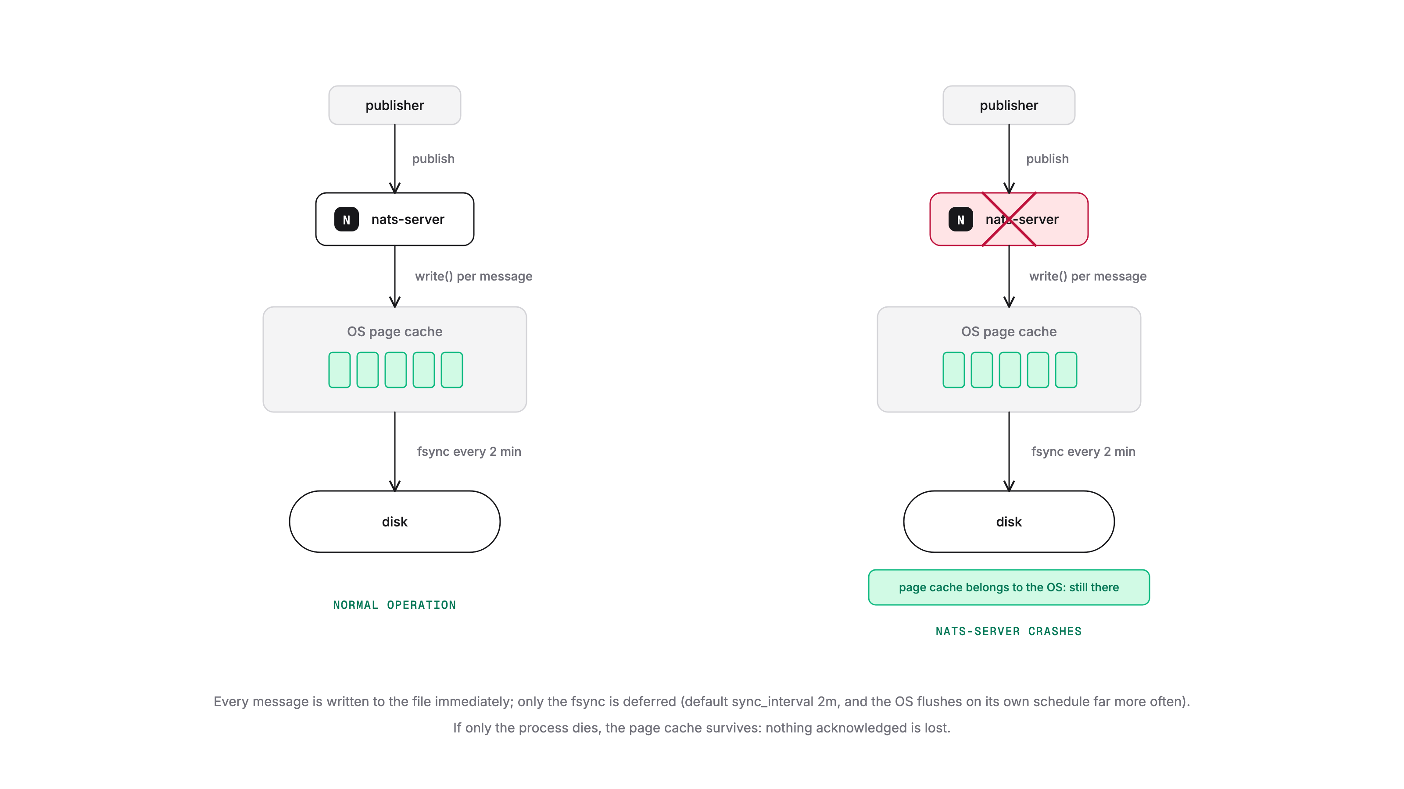
1 MACHINE · FILE SYNC
sync_interval: what the default protects
Default: fsync every 2 minutes. Every message is written to the file immediately; only the flush to the physical disk is deferred.
If the nats-server process dies, nothing is lost: the data is in the OS page cache and the OS writes it out.
If the whole machine dies, messages not yet fsynced can be lost, unless sync_interval: always is set in the server config.
The OS decides to flush much more often than every 2 minutes. fsync is much more expensive on macOS than on Linux.
Notes:
Diagram 14 shows the machine-crash case next to sync: always.

Slide 34
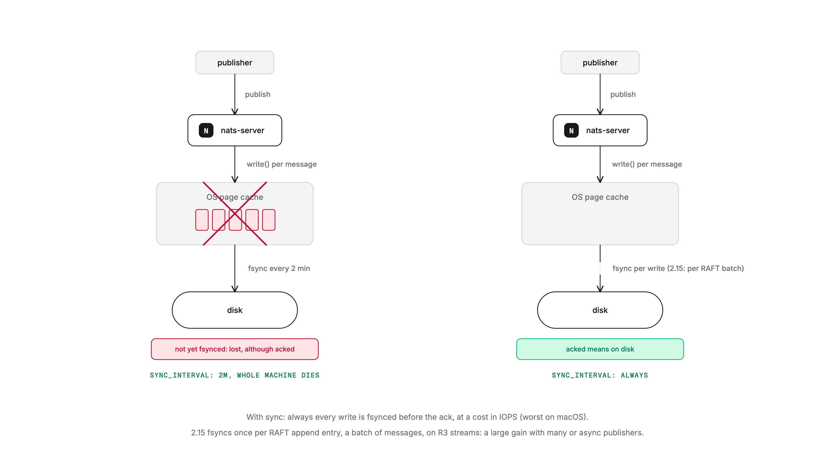
1 MACHINE · FILE SYNC
2.15: sync always, without the old price
Opportunistic batching of messages at the RAFT level, up to a maximum size: one disk sync per batch instead of one per message.
Applies to R3 streams (and to atomic batches on R1 streams).
Async publishing, or many clients publishing at the same time, benefit greatly.
A single client doing synchronous publications does not benefit as much, but is still much faster than before 2.15.
Notes:
Server change: one fsync per RAFT append entry plus one per dirty block before a snapshot, instead of one per entry plus one per message.

Slide 35
1 MACHINE · GOTCHA
A node loses its disk
SAME SERVER NAME
NEW SERVER NAME
R3 / R5 streams and consumers recover automatically from the other replicas.
R1 streams come back empty.
R1 consumers are reset, as if they had just been re-created.
The old name is still a member of the meta group: it counts against quorum forever.
You must clean it up from the meta layer.
nats server cluster peer-remove <old-name>
peer-remove also removes the R1 assets that were assigned to that server.

Slide 36
04
Backups

Slide 37
BACKUPS · 2.15
New nats backup: a giant archive where each message is a file
The tool
What it fixes
Restore and inspect
Use nats backup stream not nats stream backup.
One-way backwards compatible: older backups restore, the new commands (info, validate, edit, lookup) need backups taken from 2.15.
Backs up the consumers as well as the stream, even R1 consumers on an R3 stream living on a node other than the stream leader.
Can back up memory streams.
Restoring means deleting the stream and re-creating it from the backup.
Show backup information, like nats stream info. Validate a backup is complete and restorable.
Notes:
Verified: restore brings consumer C back at its ack floor. Restore stream takes --cluster, --tag, --replicas to re-place.

Slide 38
HANDS-ON
Demo: back up, break, restore, edit
Back up ORDERS with its consumer; info, subjects, validate.
Delete the stream, restore it: 12 messages and consumer C back at ack floor 4.
Edit: by subject, header and payload, last-per-subject with renumber, by time; restore an edited copy next to the original.
Obfuscate and look up; compact a KV bucket; back up a memory stream and a whole account.
cd backup-restore
./demo-backup-restore.sh
nats backup stream | account | restore
nats backup info | validate | edit | lookup
RUNBOOK.md

Slide 39
BACKUPS · EDIT
Edit a backup into a new one
nats backup edit <source> <target> … The source is never touched; --dry-run shows the effect.
Stream config: everything, even the name (edit backup.json)
keep the last N messages per subject
before / after: by time or by sequence number
KV compact: latest revision per key, deleted keys dropped
keep / exclude messages on matching subjects
renumber sequence numbers from 1 (drops consumers)
keep / exclude messages with a header, or a header value
obfuscate: names, subjects, headers hashed with a key file
keep / exclude messages whose payload matches a RegEx
nats backup lookup KEYFILE VALUE shows the original
Planned: incremental backups, and storing backups in S3-type buckets.
Notes:
restore --config cannot rename (it checks the backup's own name first); edit name and subjects in the copy's backup.json instead, then validate.

Slide 40
05
Planned moves vs failover

Slide 41
PLANNED MOVES
Three commands to know
nats stream cluster move
nats server cluster peer-remove
nats server cluster evacuate
Move a stream to another cluster, or re-place it with tags, while it keeps serving.
2.15: highly recommended; the desired-state migration got faster and more robust.
Remove a server from the JetStream meta group.
It also removes the R1 assets that were assigned to it. Use it after a server is gone for good, or before retiring one.
2.15: move every JetStream asset off a peer to other peers, so that then it can be removed safely.
nats stream cluster move <stream> --cluster east
nats server cluster peer-remove <name>
nats server cluster evacuate <name>

Slide 42
THINGS TO KNOW
Durable mirroring and sourcing
Client-side DR
Replication is not backup
Prefer the durable form of mirroring and sourcing, available since 2.14.
nats stream info shows you the mirror or source lag. In 2.15 the highest sourced sequence is exposed too: that number is your RPO.
Deduplication with Nats-Msg-Id: a publish retried across a failover is stored once. It works with sourcing too.
Re-create consumers as part of moving an application to the DR site: consumers are local.
Mirrors and sources copy a bad publisher's data faithfully, and an accidental purge on the origin leaves the mirror frozen.
Pair them with deny_delete / deny_purge where it matters, and with backups.

Slide 43
Questions

