Slide 1


Machine Learning Hackathon
Team Name- Code Fighters
Team Leader Name- ARKAJYOTI KARMAKAR
Team Leader Email Address- 2030063@kiit.ac.in

Slide 2
Brief Description of the Problem at hand:
The primary goal of this project was to develop a robust model capable of accurately classifying individuals as Healthcare Professionals (HCP) and determining their specific area of specialization based on available data from the log files.
The objective was to create a predictive model that can effectively discern whether a person falls into the category of HCP and assign them the corresponding specialization ID or taxonomy code. By achieving this, we aimed to enhance the identification and categorization process for individuals working in the healthcare field, thereby facilitating more precise analysis and targeted decision-making in healthcare-related domains.

Slide 3
Solution proposed and description:
Utilizing the XGBoost model, we predicted the "IS_HCP" variable and achieved an accuracy of 97.39% for our model.
Employing the trained model, we made predictions on our test dataset to determine the "IS_HCP" values.
Next, we focused on predicting the taxonomy of healthcare professionals and utilized a random forest classification model for this task.
To enhance the precision and accuracy of the model, we performed hyperparameter tuning on the random forest classifier.
The resulting dataset, containing the ID and predictions for the "Is_HCP" values, was exported in a .csv file.
Within the exported file, we provided suitable taxonomy predictions for cases where the "IS_HCP" value was 1, facilitating a comprehensive understanding of the healthcare professional's specialization.

Slide 4
Approach:
To develop this prediction model, we followed a systematic approach that involved several key steps. These steps encompassed data preprocessing, feature engineering, model training, predicting taxonomy, and hyperparameter tuning:
Data Preprocessing and Filtering:
Handling missing values and ensuring data consistency by adjusting data types.
Removing unnecessary columns, such as IDs, that are not relevant to the analysis.
Feature Engineering:
Identifying meaningful relationships between different columns in the dataset.
Applying one-hot encoding and label encoding techniques to transform categorical variables into numerical representations.
Specifically, we created separate binary columns for each disease in the "KEYWORDS" column, indicating whether a user had searched for a particular disease.
Model Training using XGBoost:
Training the model on the target variable, "IS_HCP," using the powerful XGBoost algorithm.
Splitting the dataset into a training set (70%) and a test set (30%) to assess the model's performance accurately.

Slide 5
Approach:
Predicting Taxonomy using Random Forest Classification:
Selecting columns that have an "IS_HCP" value of one for taxonomy prediction.
Leveraging the Random Forest Classification algorithm to predict the taxonomy of healthcare professionals.
Hyperparameter Tuning:
Fine-tuning the model's performance by optimizing hyperparameters.
By meticulously following these sequential steps, we successfully developed a prediction model that incorporates data preprocessing, feature engineering, model training with XGBoost, taxonomy prediction using Random Forest Classification, and hyperparameter tuning. This comprehensive approach ensures accurate predictions and enhances the overall performance of the model.

Slide 6
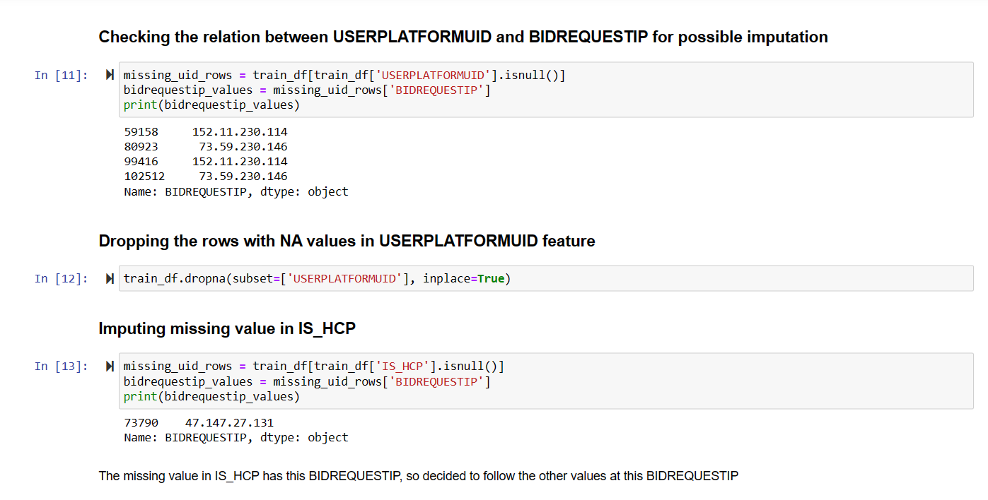
Execution Demo (Video/ Screenshots) of the solution:

Slide 7
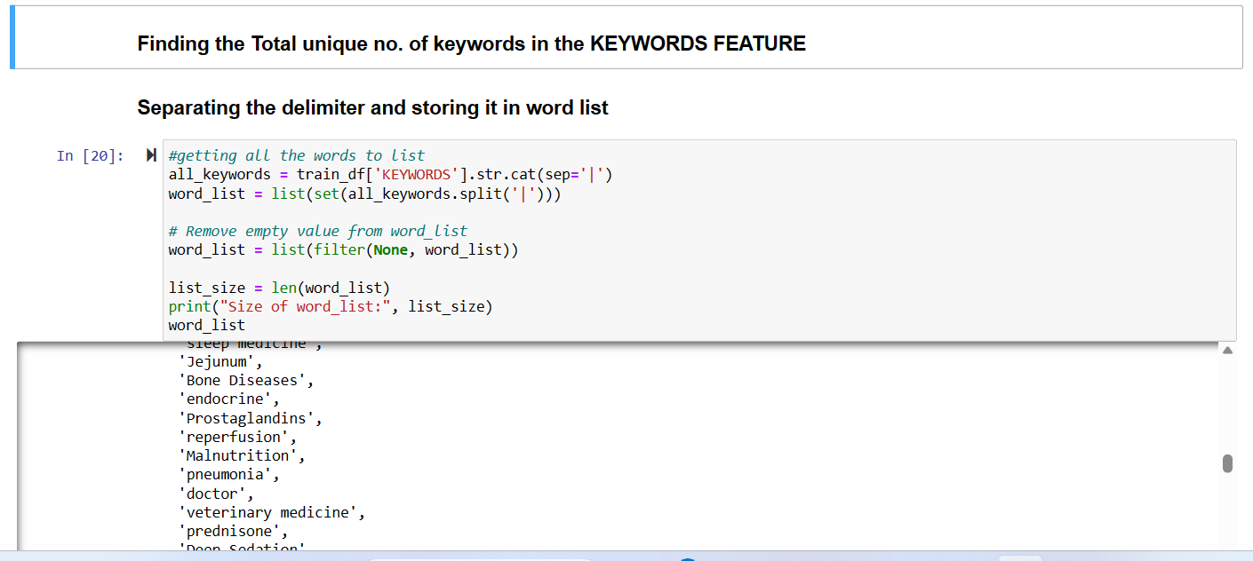

Slide 8
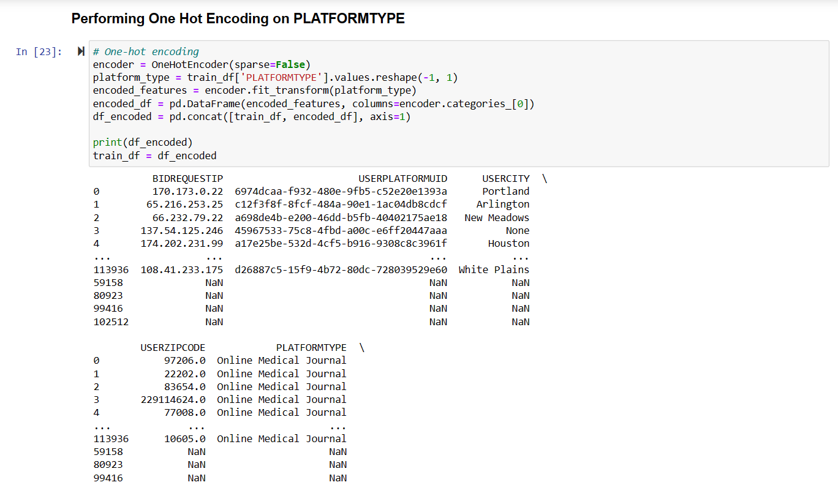

Slide 9
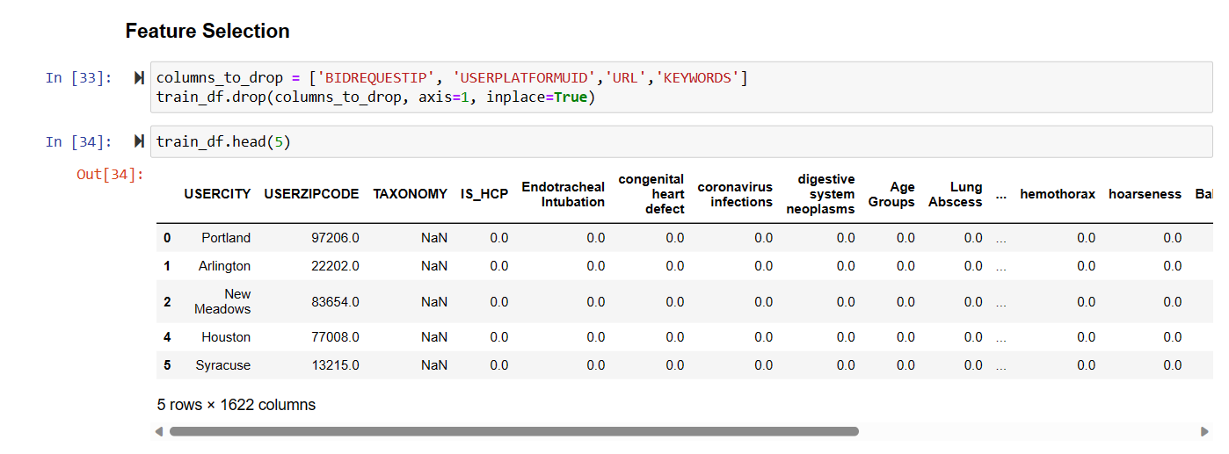

Slide 10
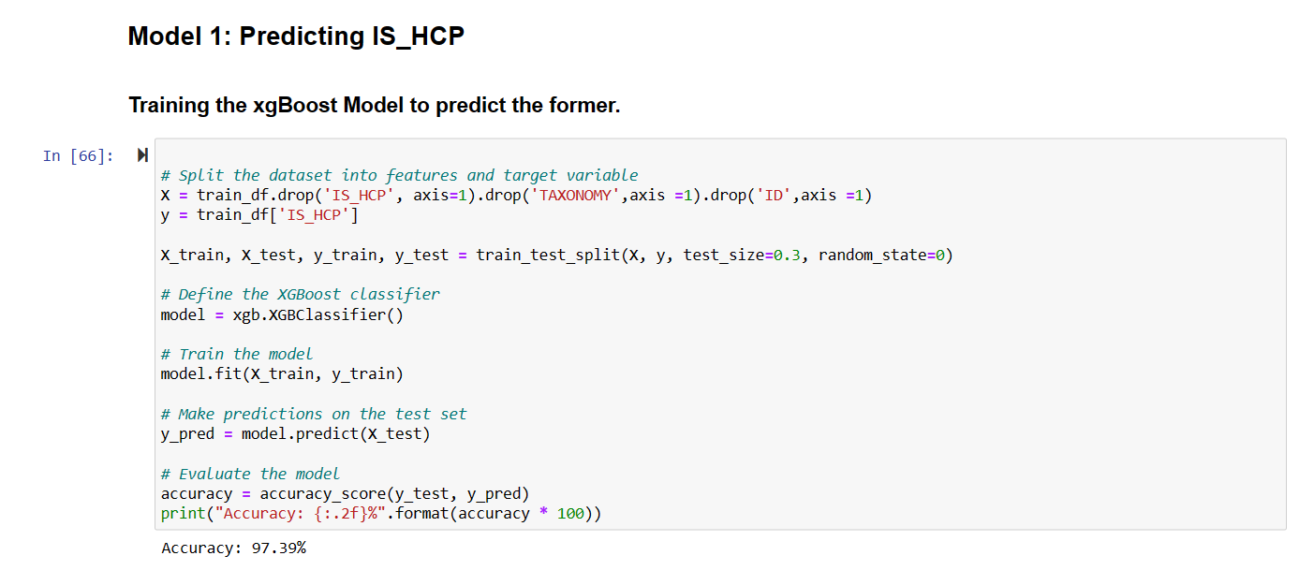

Slide 11
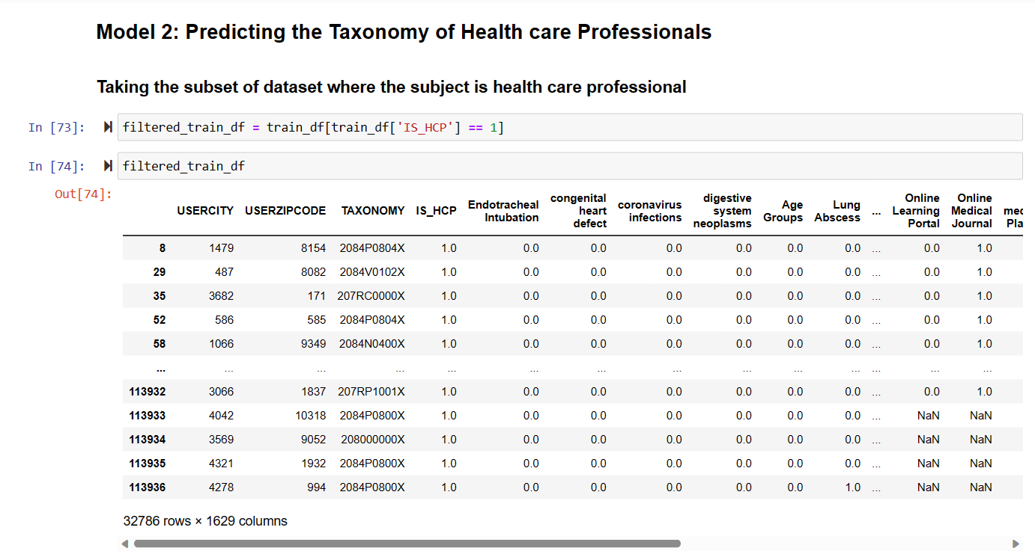

Slide 12
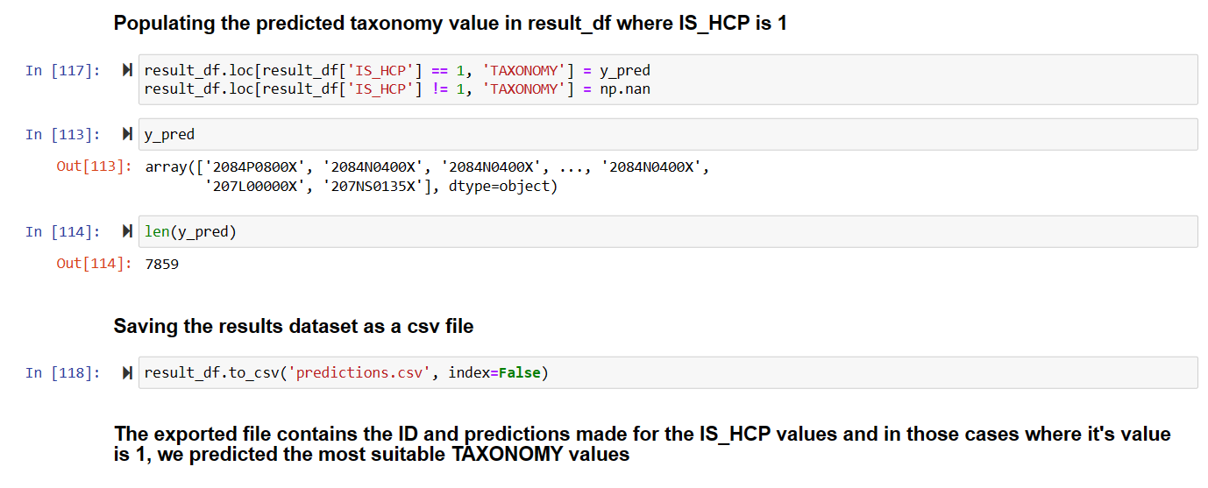

Slide 13
Video Link:-
We have added a video demonstration of our work, click here.

Slide 14
Source code in /Github URL:
To access the GitHub URL of our repository, click here.

Slide 15
Additional comments:
We have performed certain ﻿imputations, feature engineering and selection on our dataset.
We found out the total number of keywords in the Keywords Feature and stored them in a list by separating the delimiters.
Then we performed one hot encoding on certain columns to check the availability of those keywords in those columns.
We also handled certain dimension mismatch problems between train_df and test_df.
Then in model 1 we trained the xgBoost model to predict the Is_HCP.
In model 2 we predicted the Taxonomy of Healthcare Professionals.
We have used the Random Forest Classification for prediction of the taxonomy.

Slide 16
THANK YOU!

