Slide 1

What if hacking were a sport?
By Maja Reißner
2nd september, Tirana/Albania
Notes:
Sports first, soccer as an example
You don't just wake up being a professional soccer player.
How do you become a professional? Do your best, Play harder!
How would you train?

Slide 2
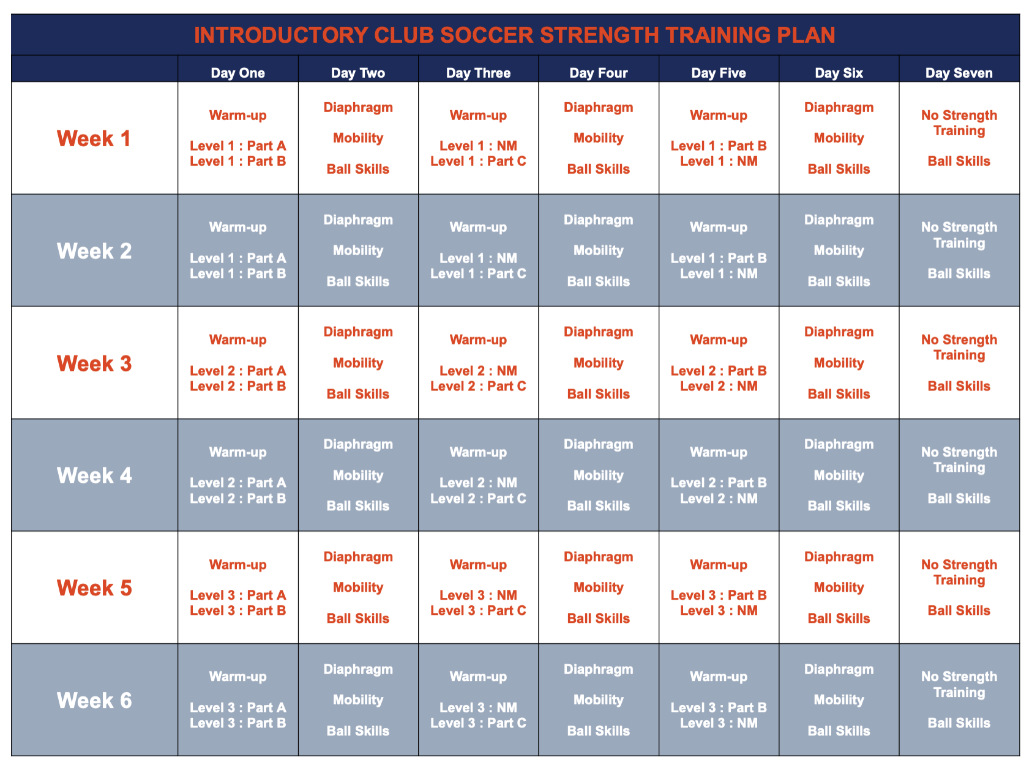
Training when sporting
https://www.gobeyondexercise.com/club-soccer-program
Notes:
Note diversity in schedule
Every other day warmup or strength practice.
Increasing level per week.

Slide 3
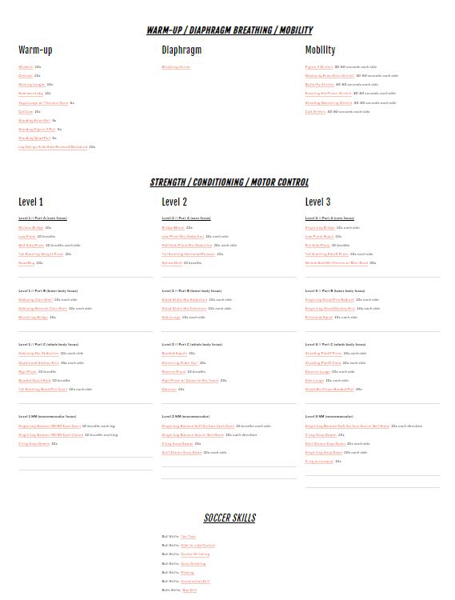
Training when sporting
https://www.gobeyondexercise.com/club-soccer-program
Notes:
Topics split out, detailed description with repetitions
click
Some warmup,
lots of strength/conditioning/motor skills with increasing levels
Some ball skills practice
Ball involved every other day.
We call this
Deliberate practice is structured to improve specific elements of a skill through defined techniques
What's the equivalent approach for hacking?

Slide 4
Training when sporting
https://www.gobeyondexercise.com/club-soccer-program
Notes:
Ball involved every other day.
Deliberate practice is structured to improve specific elements of a skill through defined techniques

Slide 5

And in IT security?
https://www.offsec.com/wp-content/uploads/2010/03/TryHarderFlamesWebPageBannerSmaller.png
Notes:
Try harder is slogan of offensive security which is known for the OSCP certification (offensive security certified professional) with practical exam where you have to hack 5 machines in 24h.
Now, think again, in soccer “try harder” may somewhat work but imagine learning how to play the violin. Trying harder just won't do.
Trying to say: don't give up. Just one piece of advice. If you play soccer, you need to do warmups and strengths practice next to ball skill practice.
Although try harder may not be incorrect in itself, I believe it's awefully bad advice and a pity the slogan stuck.
I believe especially evil since scaring off women.
Oh finally, there's the gender remark. But i'll let you know why.

Slide 6

Gender difference in trying harder?
Evidence from speedcubers:
Whereas boys are slightly discouraged by failing to qualify for the second round, girls are affected more and are more likely to give up forever. Furthermore, we find that this gender difference is most significant in countries with larger gender gaps in labor market outcomes.
https://www.sciencedirect.com/science/article/abs/pii/S0165176521002202
https://commons.wikimedia.org/wiki/File:Rubik%27s_cube.svg by Booyabazooka
Notes:
Try harder implies to me a competitiveness. That i cannot ask for help.
Gender difference in competing.
2021, speedcuber competition with several rounds: Whereas boys are slightly discouraged by failing to qualify for the second round, girls are affected more and are more likely to give up forever. Furthermore, we find that this gender difference is most significant in countries with larger gender gaps in labor market outcomes.
Last remark important as this might be different here in Albania compared to the Netherlands.
(2019, Dutch Math Olympiad to show that women are more likely than men to stop competing if they lose)
Back to OSCP. I got certified, but not by trying harder.

Slide 7
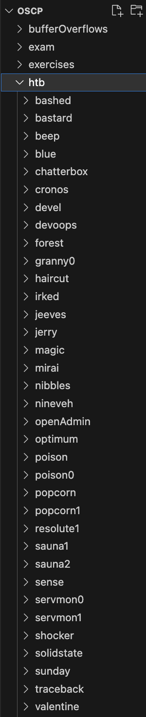
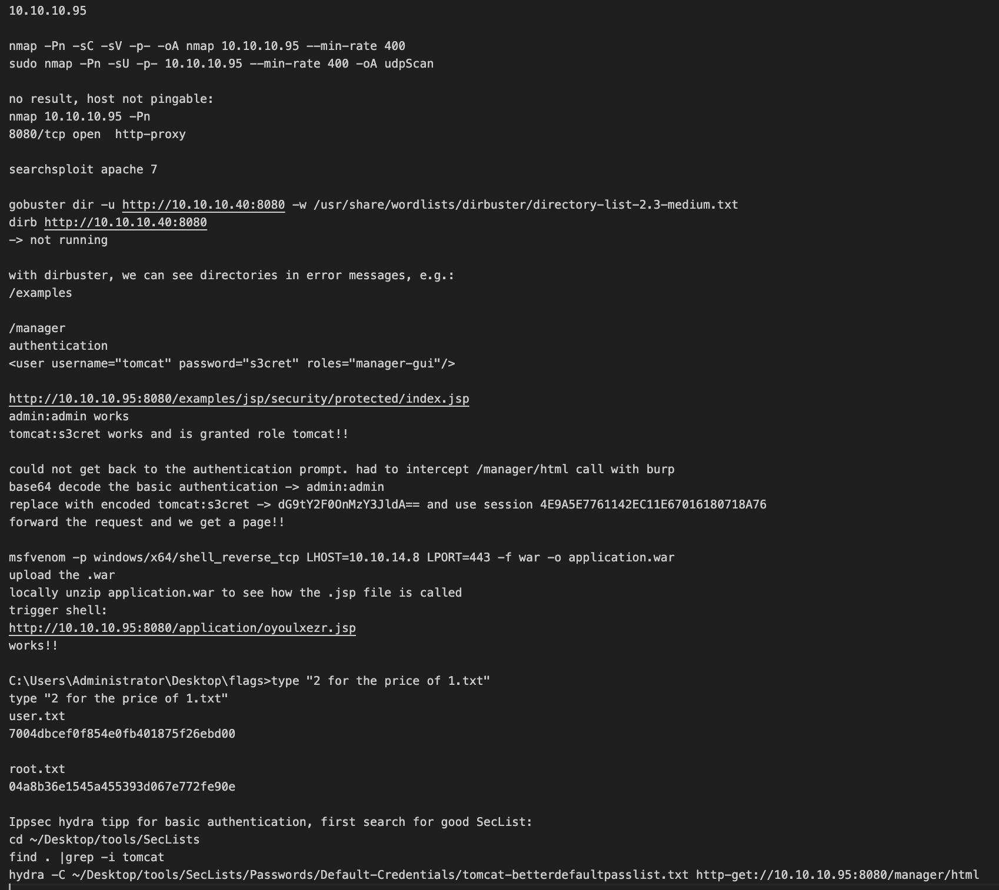

How I got OSCP
TRY
DOCUMENT
WATCH
Notes:
Worked through material and did labs but advice just try harder did not work for me.
Found youtuber ippsec who publishes walkthroughs of retired htb machines. The machines are very similar to OSCP exam.
Got Htb premium account to get access to those machines.
try, do, read, when stuck for longer watch a bit ippsec. So i would cheat.
Documented it all
(After finishing, i'd still watch the video
A flag a day)
From my experience, this is NOT what people recommend in the field.
Andecdotal, so is there evidence this is any good?

Slide 8
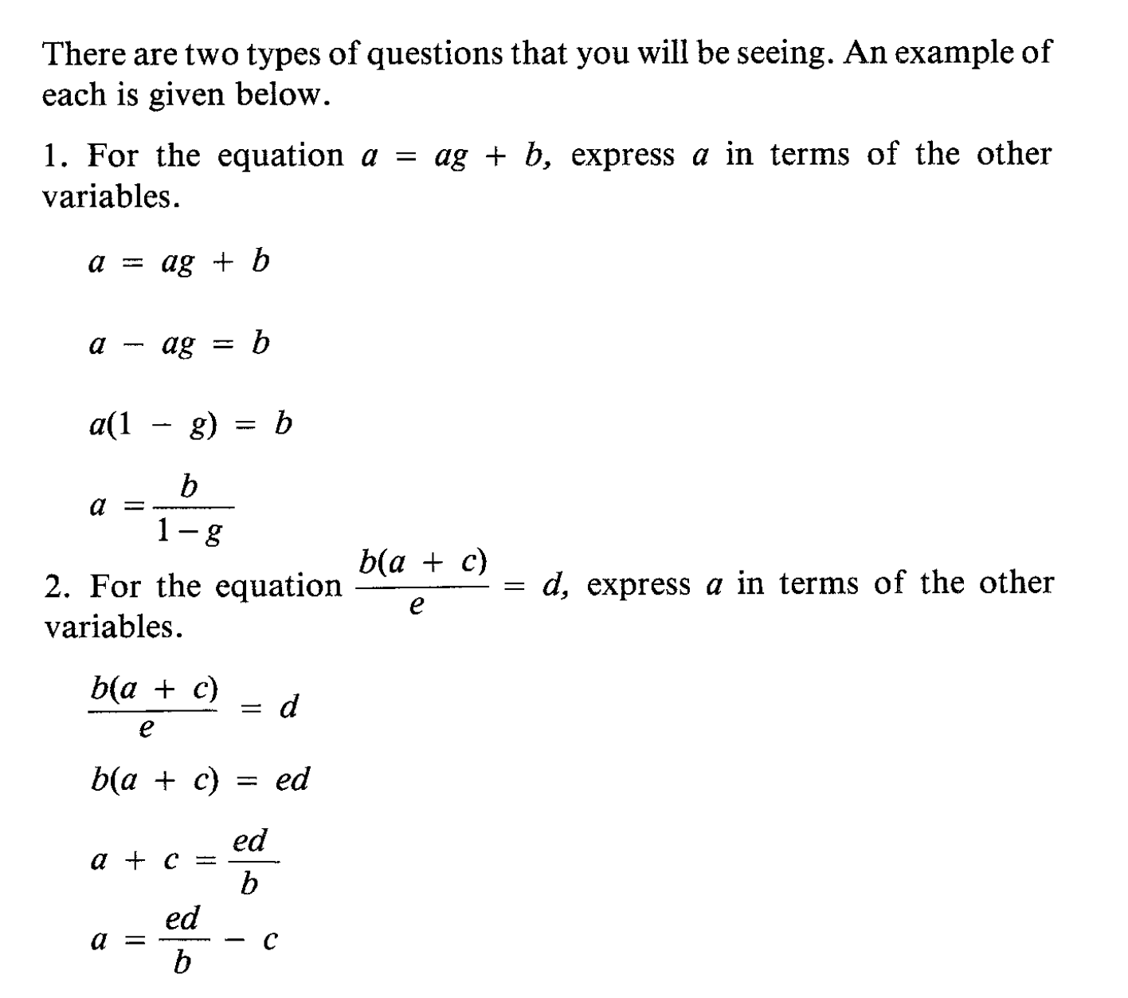
Study: Math with worked examples
John Sweller & Graham A. Cooper (1985): The Use of Worked Examples as a
Substitute for Problem Solving in Learning Algebra, Cognition and Instruction, 2:1, 59-8
Notes:
9-year olds from Sydney
First worked example, then practicing phase with/without worked example
Normal group 2 minutes, Worked example 20 s faster
You can argue if watching ippsec is equivalent to a worked example but i think this still holds because you practice with help
Btw, i also practiced the OSCP buffer overflows with a self-made worked example and a step-by-step guide.
Ofc OSCP just a certification and not a representitive of “hacking”. However, the slogan is so prominant that i had to include it.
How else does practicing hacking work?

Slide 9
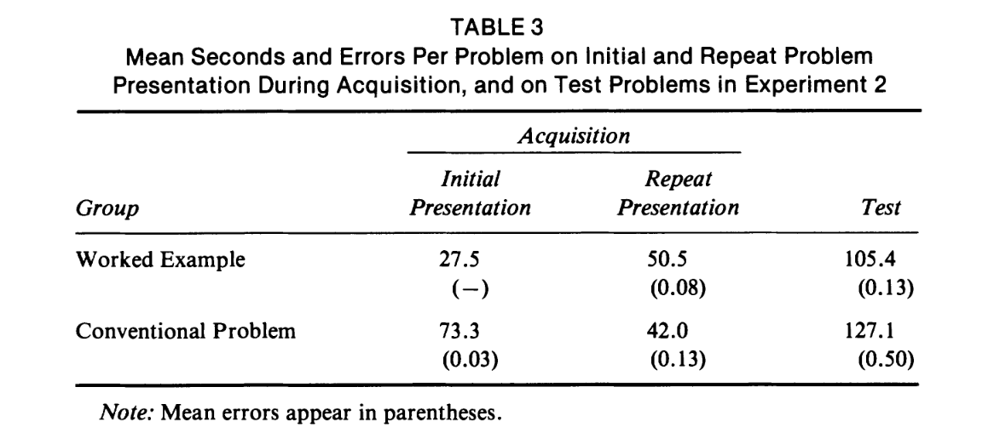
Study: Math with worked examples
John Sweller & Graham A. Cooper (1985): The Use of Worked Examples as a
Substitute for Problem Solving in Learning Algebra, Cognition and Instruction, 2:1, 59-8
Notes:
9-year olds from Sydney
First worked example, then practicing phase with/without worked example
Compare to hacking skill learnt or learnt AND practiced with it.
Normal group 2 minutes, Worked example 20 s faster
You can argue if watching ippsec is equivalent to a worked example but i think this still holds because you practice with help
Btw, i also practiced the OSCP buffer overflows with a worked example and a self-made step-by-step guide.
Ofc OSCP just a certification and not a representitive of “hacking”. However, it's prominent and the slogan is so prominant that i had to mention it.
How else does practicing hacking work?

Slide 10
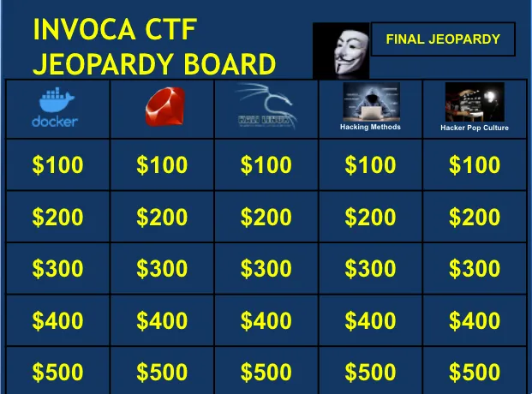
Jeopardy-style CTF's
https://engineering.invoca.com/invoca-capture-the-flag-ctf-2022-83155dfabfc4
How the Best Hackers Learn Their Craft, David Brumley, 2018: https://www.youtube.com/watch?v=6vj96QetfTg
List of CTF's to practice: https://challengethecyber.nl/links/
Notes:
Tasks increasingly difficult, with hints
Educationally very good!
Example: defcon, Challenge the cyber
Also: links list with ctf's to practice
These ctf's are Real practice!
limit:
no self-awareness, you're not aware of what you're practicing
you train being good at CTF's, but there's more to security than CTF's
Let's have a look at a broader spectrum

Slide 11
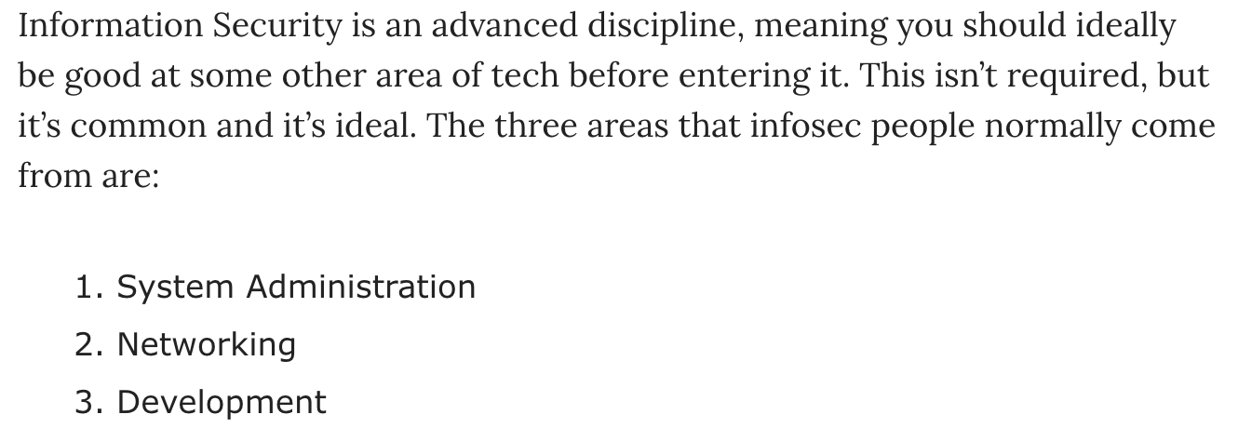
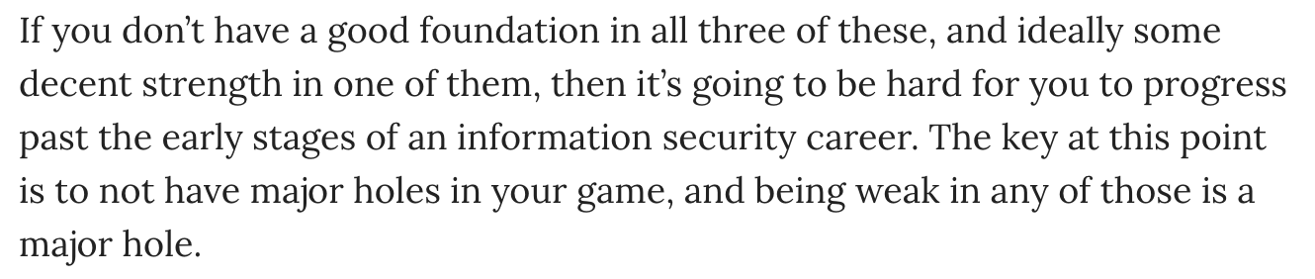
The broader spectrum
https://danielmiessler.com/p/build-successful-infosec-career/
Notes:
slide
Compare with playing soccer. CTF=playing with an empty goal
But you'd also practice pure muscle strength. In security we have three pillars
I've been dev, so i'll focus on dev here. And i'll focus on the brain so we can understand how we can best practice deliberately.

Slide 12

Programming and the brain
https://freecontent.manning.com/felienne-hermans-the-programmers-brain/
Notes:
Rest of talk heavily base on “the programmer's brain” by felienne hermans, highly recommend
Focus now on reading code and thinking about code
((For more entrance level:
You want to read code quickly, e.g. Python exploits, so you know what the code does (and don't run malware)
For advanced depends on your specialization:
Met a person who found Kernel exploit found by “just reading the code"))

Slide 13
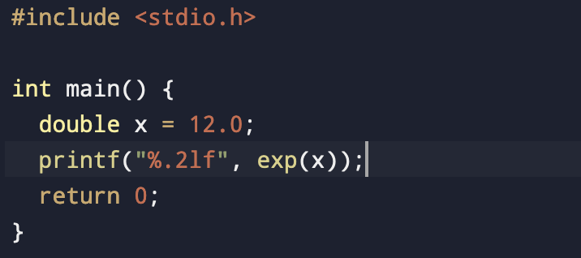
Reading code
Lack of knowledge
Lack of information
Lack of processing power
Notes:
When you don't understand code, why don't you?
What does this code do? (Which language?)
Reasons for not understanding:
Knowledge, correlates to long-term memory: syntax of language
The code actually doesn't compile since math import is missing
Information, short-term memory: inner workings of function
What does exp do?
Processing power, working memory: math
Eˆ12 in your head is hard
When struggling with code, check which of these is the issue.

Slide 14
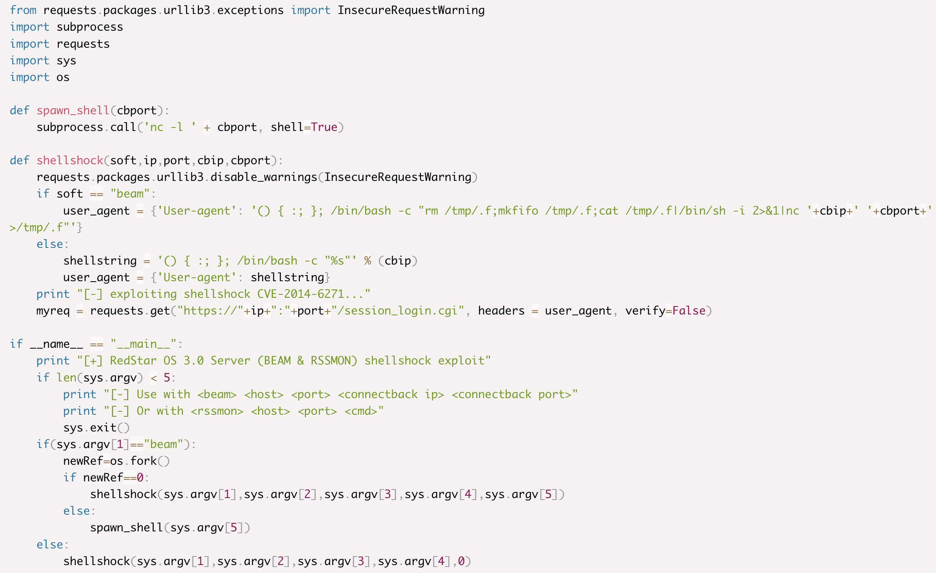
Iconic memory example
https://www.exploit-db.com/exploits/40938
Notes:
Now, I'll briefly show you some code, tell me what you remember.
Clickclick
What do you remember?
Python Shellshock example from
https://www.exploit-db.com/exploits/40938
Iconic memory already when seeing sth 50 ms
-> Read code more efficiently by first looking at it and reflecting
Tip: regularily use iconic memory
Claim: the more prog exp the more you remember after a glimpse. Why is that?

Slide 15
Memory test
https://www.exploit-db.com/exploits/40938
Notes:
Now, I'll briefly show you some code, tell me what you remember.
Clickclick
What do you remember?
Python Shellshock example from
https://www.exploit-db.com/exploits/40938
Turns out read code more efficiently by first looking at it and reflecting
Claim: the more prog exp the more you remember after a glimpse. Why is that?

Slide 16
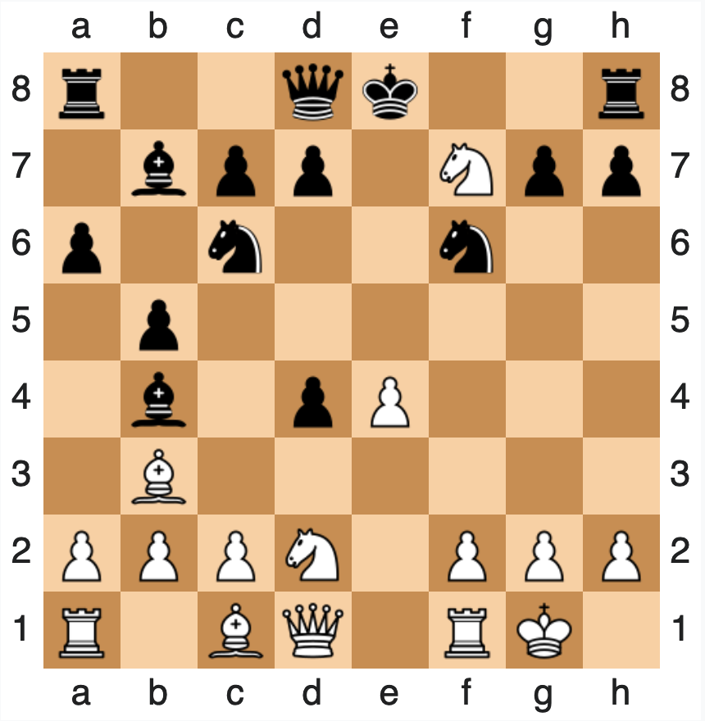
Chunking
process by which small individual pieces of a set of information are bound together to create a meaningful whole later on in memory
https://en.wikipedia.org/wiki/Chunking_(psychology)
https://de.wikipedia.org/wiki/Schach
DE GROOT. A. Thought and choice in chess,1965
Notes:
Studies showed that the better you master chess the more you can recall from a setup when shown for a short period of time.
Not true if pieces placed randomly
Turns out chess players don't see three pawns, a tower and a king but simple “castling
Chunking!
Similarily, programmers recognize patterns
“Experience” helps since bigger chunks -> study concepts, data structures and syntax

Slide 17
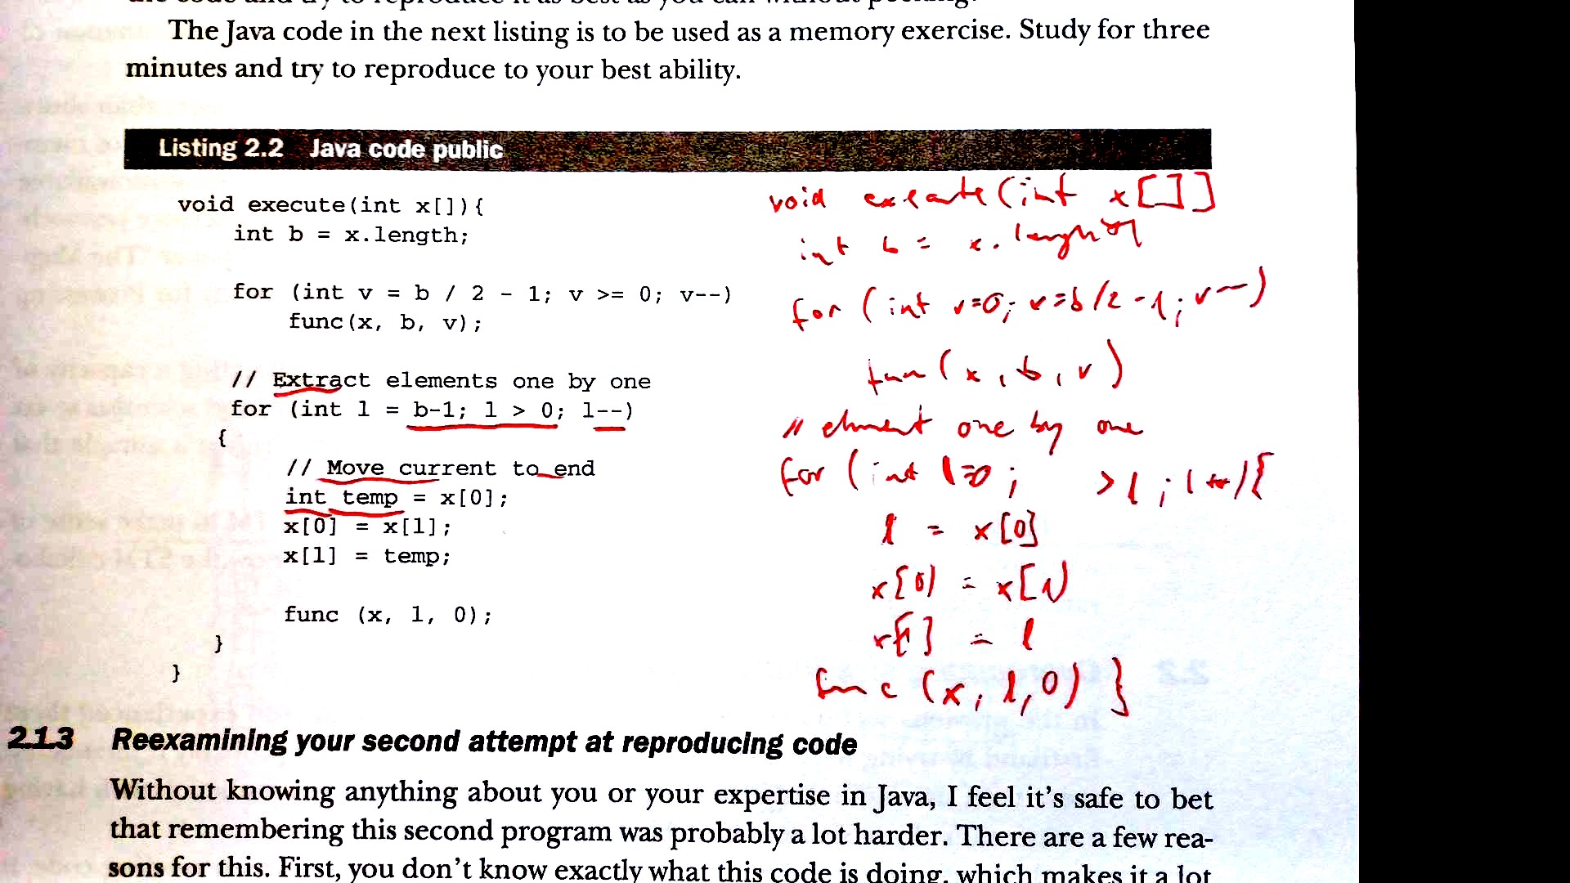
Deliberate training session
Exploit-db or GitHub
Memory test
Lack of what?
Chunking
(Worked
example)
Notes:
Deliberate training could look like this:
1. Take somewhat familiar exploit code (e.g. Shellshock where you know it's what it's doing)
2. Pen and paper. Study the code for one minute, then reproduce everything you remember on paper.
3. Compare what you got right/wrong, categorize, look up.
For loop processing power problem. Also practice.
Open in IDE for syntax highlighting.
4. Back to code, look for possible chunks.
5. It's worth making your own worked example! Or guide how to approach
Now, how do you make sure to remember?

Slide 18
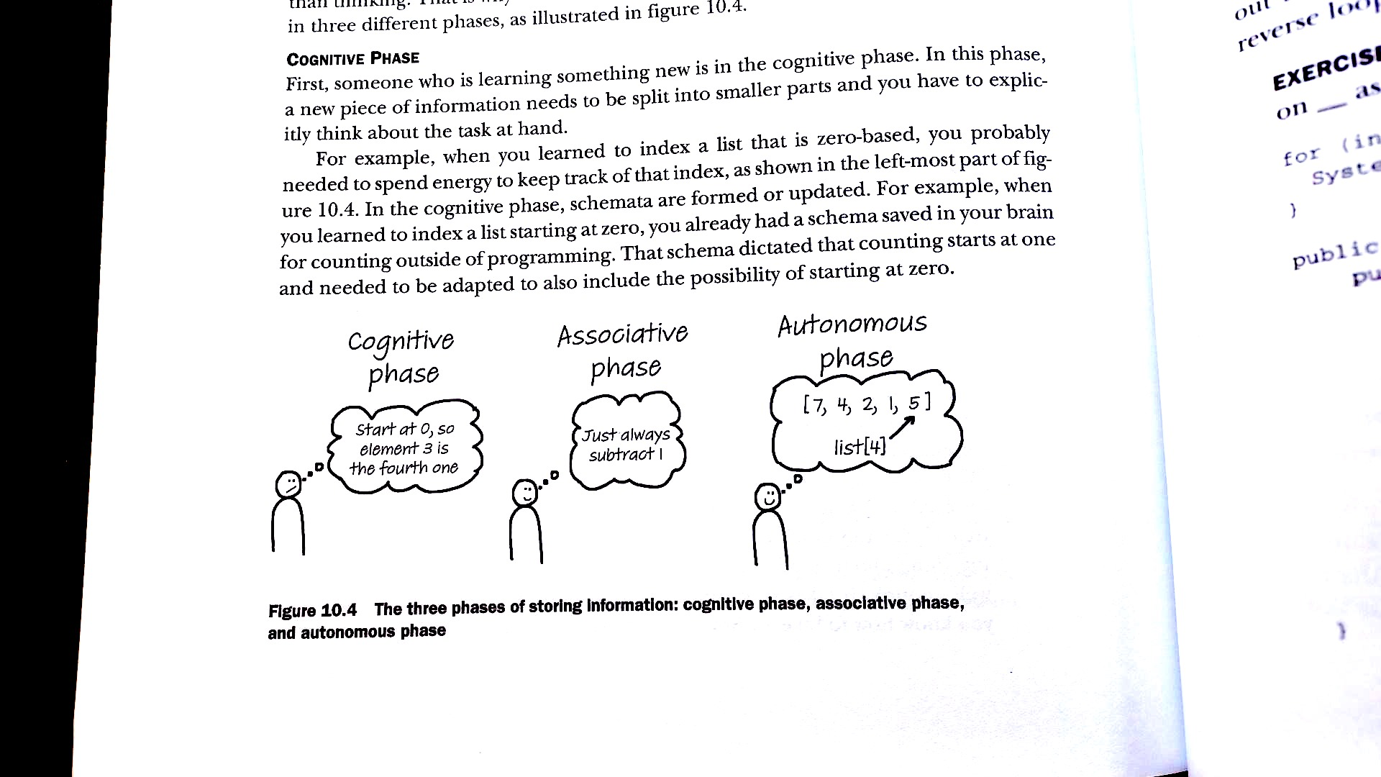
Implicit memories
The Programmer's Brain by Felienne Hermans
Notes:
Memories throughout time
cognitive phase (think and reason to come to conclusion),
associative phase (shortcut),
autonomous phase (you “just know”)
brings me to point: how not to forget

Slide 19
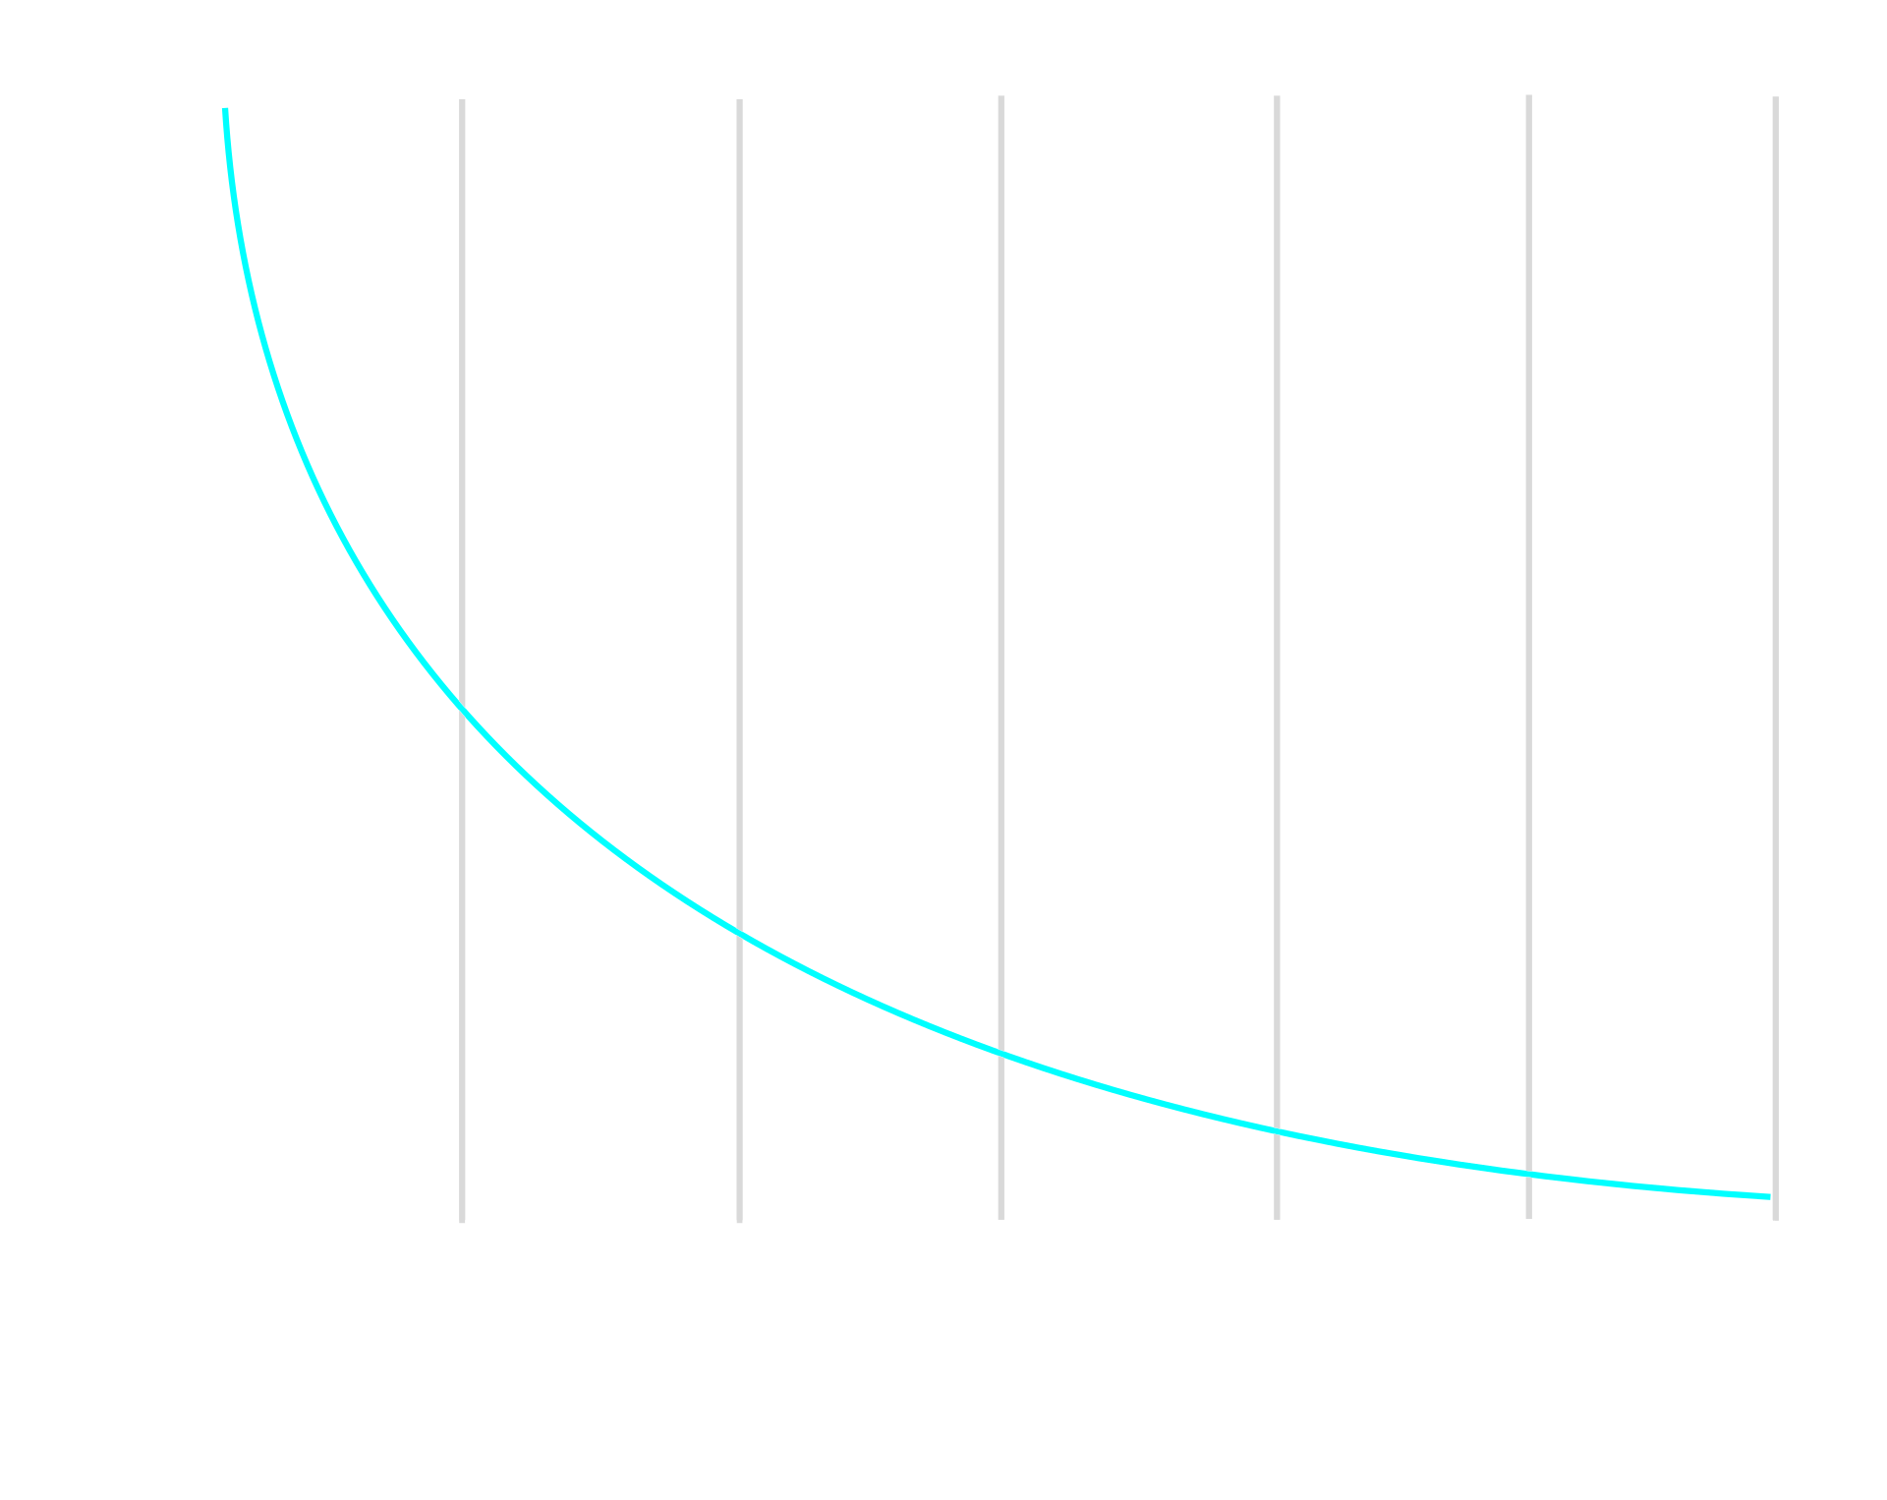

How not to forget
Simplified Ebbinghaus formula :)
https://en.wikipedia.org/wiki/Forgetting_curve
Notes:
Ebbinghaus's formula
R is retrievability (a measure of how easy it is to retrieve a piece of information from memory), S is stability of memory (determines how fast R falls over time in the absence of training, testing or other recall), and t is time

Slide 20
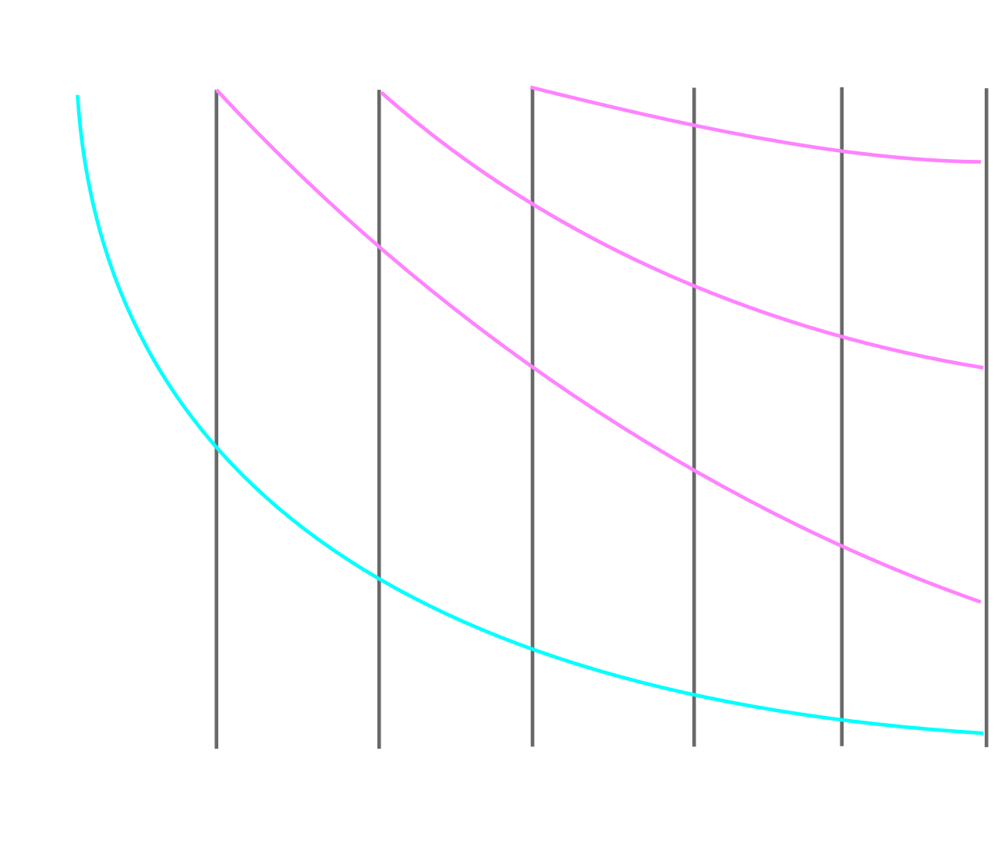
How not to forget
Simplified Ebbinghaus formula :)
https://en.wikipedia.org/wiki/Forgetting_curve
Notes:
Repetitions spaced over a long period (6-8 w stretch)
Train retrieval strength (think before you google)
Extra: When studying think about what you want to remember, relate with existing knowledge
source repetitions: Maintenance of Foreign Language Vocabulary and the Spacing Effect, Bahrik, 1993
https://sci-hub.se/https://www.jstor.org/stable/40063054

Slide 21
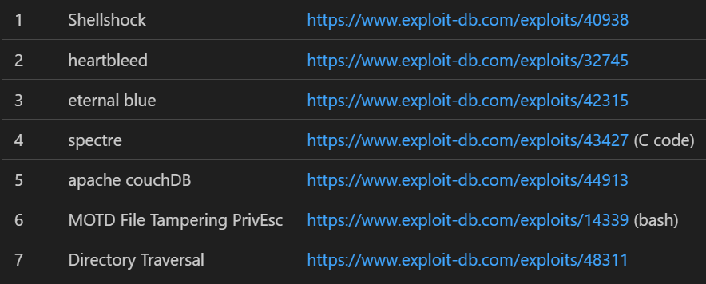
Weekly Training schedule
Step 0: If you haven't done so, take a programming course and learn python or C.
Mo | Tu | We | Th | Fr
Code OR Systems OR Networking |  |  | CTF
First time:
Make a worked example. Stick roughly with the approach.
Notes:
- Step 0: Learn basics.
- The training schedule:
One week? Yes, and be consistent.
- Big difference with sports: You play a match every day. It's your job. This is a work week. This is on purpose.
- CTF on Thursday. CTF is example, this is the place of practicing your core skill.
- Then there's Monday with code OR systems OR networking. The 3 pillars for info sec. If you do 1 a week, you cycle in 3 weeks.
- Skill strengthening in 6-8 weeks but of course you don't repeat exactly the same thing...
What to do during the session? Pattern discussed earlier.
- Take time to setup a worked example for your dedicated study.
Maybe make a list. Work through the list one at a time.
- And you don't have to do this alone. Get a coach!

Slide 22
Coach
Possible approaches:
A real person you know
A mentorship programme
Online communities
Notes:
.Find someone who's willing to coach you in a specific matter and see if it works. Or just a buddy to team up with.
The best soccer player is not necessarily the best coach. So neither will the best hacker perse be the best coach. It has to work for you.
Mentoring programme:
Brucon has mentor/mentee program: https://www.brucon.org/2020/mentor-mentee/
Apparently, also https://www.wicys.org/initiatives/mentor/mentor-mentee-program/
Or:
- join online communities (discord, slack, twitter, real forum), possibly anonymous

Slide 23
Summary
CTF's to practice hacking
Regular practice basics / pillars (sys, net, dev)
Deliberate practice and worked examples!
Notes:
Summary wat if hacking were a sport? Or how does training sport work and how can we train hacking?

Slide 24
Thank you...
For your attention
For being here
For having me

Slide 25
Questions
So are we really doing fine with learning security with CTF's?
If hacking were a sport, what nutrition advice would you have?
Who are you anyway?

Slide 26
Sources
The programmer's brain by Felienne Hermans
How the Best Hackers Learn Their Craft, David Brumley, 2018
https://danielmiessler.com/p/build-successful-infosec-career/
DE GROOT. A. Thought and choice in chess,1965
John Sweller & Graham A. Cooper (1985): The Use of Worked Examples as a Substitute for Problem Solving in Learning Algebra, Cognition and Instruction, 2:1, 59-8
https://www.sciencedirect.com/science/article/abs/pii/S0165176521002202
https://en.wikipedia.org/wiki/Chunking_(psychology)
https://en.wikipedia.org/wiki/Forgetting_curve
https://www.gobeyondexercise.com/club-soccer-program
https://www.offsec.com/wp-content/uploads/2010/03/TryHarderFlamesWebPageBannerSmaller.png
https://commons.wikimedia.org/wiki/File:Rubik%27s_cube.svg by Booyabazooka
https://www.exploit-db.com/exploits/40938
https://de.wikipedia.org/wiki/Schach
Notes:
Also about hacking as sport: https://www.youtube.com/watch?v=6vj96QetfTg

