Slide 1
Syslog notes

Slide 2

Algemeen nog eens de boektip
https://www.oreilly.com/library/view/practical-monitoring/9781491957349/
Notes:
Fijn want eerste gedeelte over principes (anti-patterns, patterns). Klein boekje, met 3 pagina’s per dag in de 6 weken cursus ben je er.

Slide 3
Monitoring pillars
Metrics
Traces
Logs
New: Streaming Telemetry
https://www.chaossearch.io/blog/three-pillars-of-observability-logs-metrics-traces#:~:text=While%20monitoring%20is%20simply%20watching,%3A%20Logs%2C%20metrics%20and%20traces.
Notes:
Metrics, getallen, hoe veel te laat, grafiekje, counter vs gauge (point-in-time value)
push vs pull model. SNMP+Nagios+/health pull, syslog (irregular) en collectd (scheduled) push, schaalbaar
Trace RFID tag, kamer naar kamer, load balancer, server, mail
-> alerting
Logs, machine-generated data, met inhoud, troubleshooting/audit
Str telemetry: push model, near real-time toegang tot statistieke

Slide 4
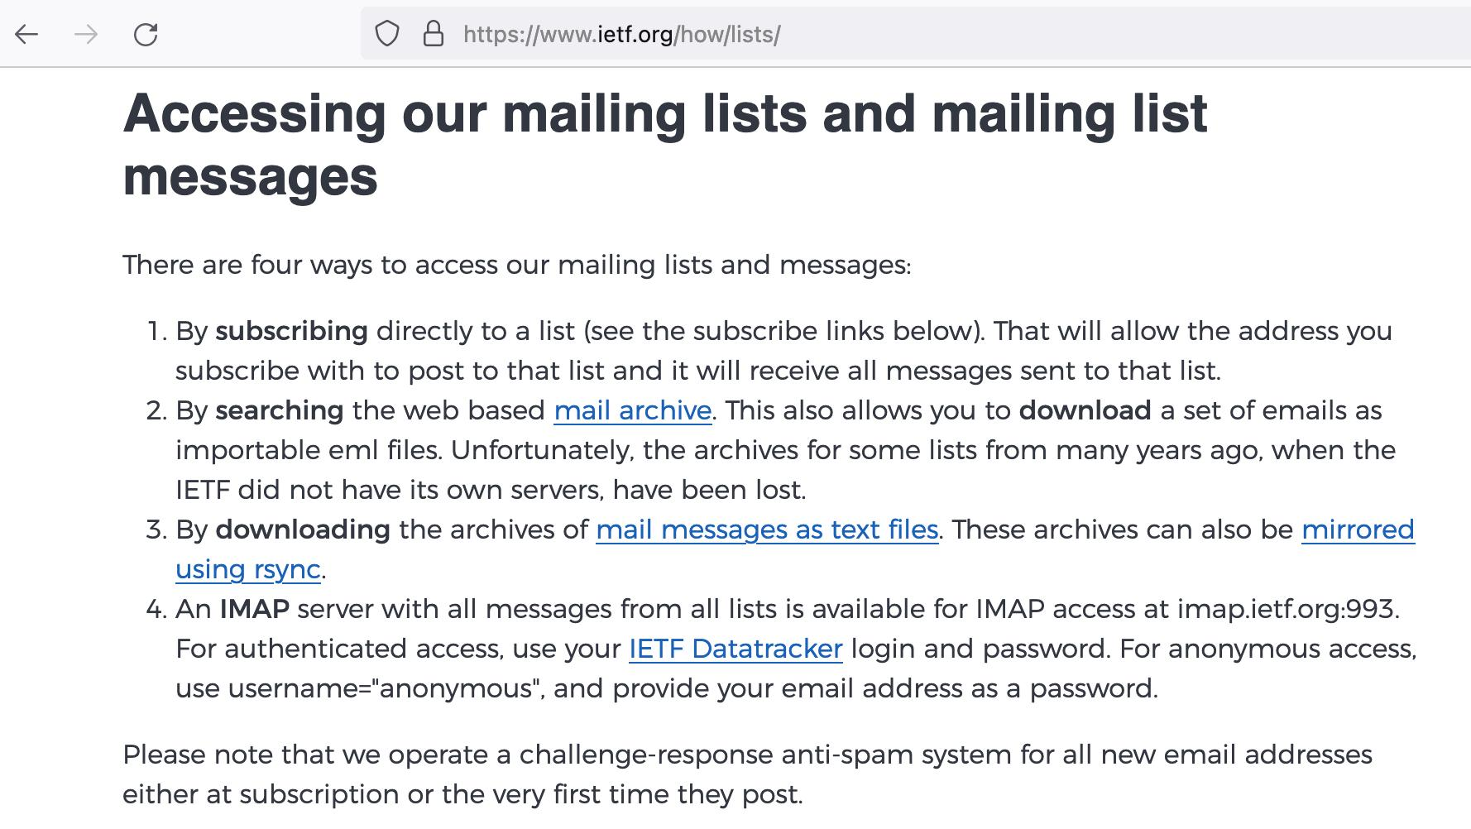
RFC’s ontwikkeling
Notes:
Anonoymous access (item 4 hier)

Slide 5
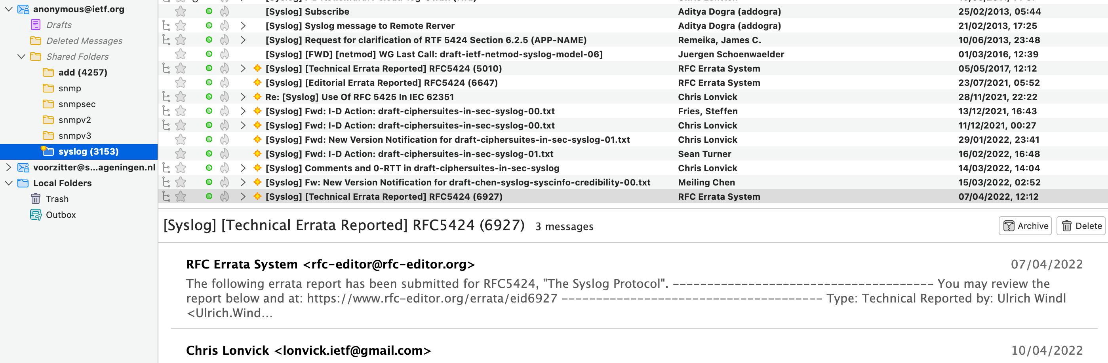
Like and subscribe ;)

Slide 6
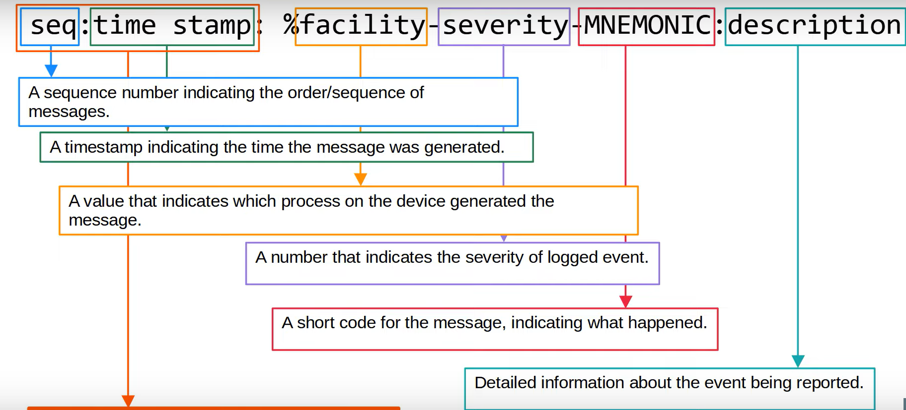
Syslog message
Jan 29 15:49:48.699: %BGP-3-NOTIFICATION: sent to neighbor 10.0.1.101 4/0 (hold time expired) 0 bytes
https://www.youtube.com/watch?v=RaQPSKQ4J5A (hier komt de screenshot vandaan)
https://docs.vmware.com/en/VMware-Smart-Assurance/10.1.0/npm-config-guide-101/GUID-8C2608FC-EBAC-4026-948F-3E54687E968C.html

Slide 7
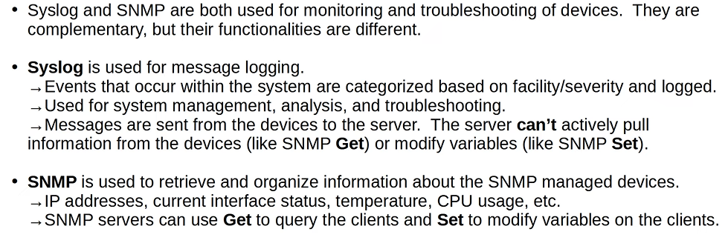
Syslog vs SNMP
https://www.youtube.com/watch?v=RaQPSKQ4J5A
Notes:
Samen gebruikt voor network monitoring

Slide 8
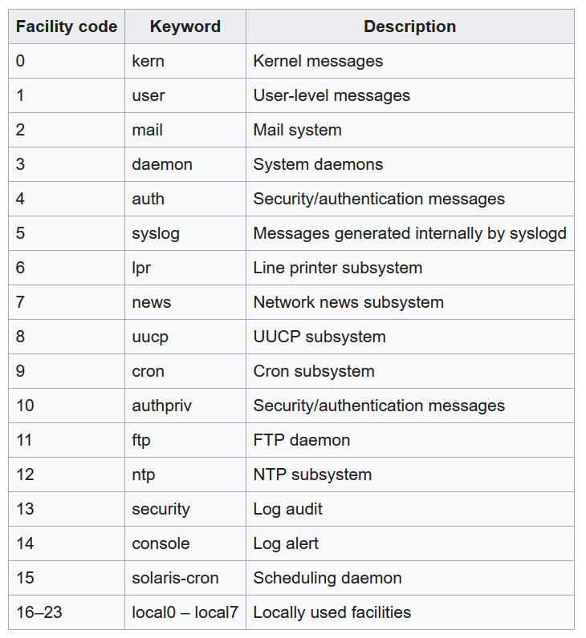
Facility codes
https://en.wikipedia.org/wiki/Syslog

Slide 9
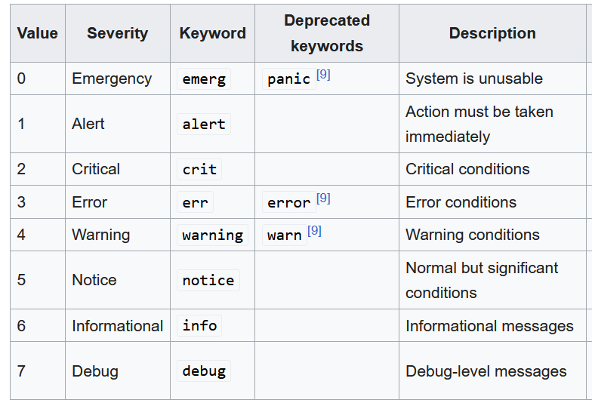
Severity levels
https://en.wikipedia.org/wiki/Syslog
“Every awesome Cisco Engineer will need icecream daily.

Slide 10
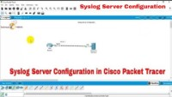
How to Configure Syslog Server in Cisco Packet Tracer
Technical Hakim #SyslogConfiguration CCNA
Voor goed syslog uitleg:
Free CCNA | Syslog | Day 41 | CCNA 200-301 Complete Course
Notes:
Syslog Explained | Cisco CCNA 200-301
https://www.youtube.com/watch?v=BMVHHX02T4Q
Free CCNA | Syslog | Day 41 | CCNA 200-301 Complete Course
https://www.youtube.com/watch?v=RaQPSKQ4J5A

