Slide 1
Helm: Competitive Landscape
& Category Analysis
The Executive Agent Platform Opportunity
February 2026

Slide 2
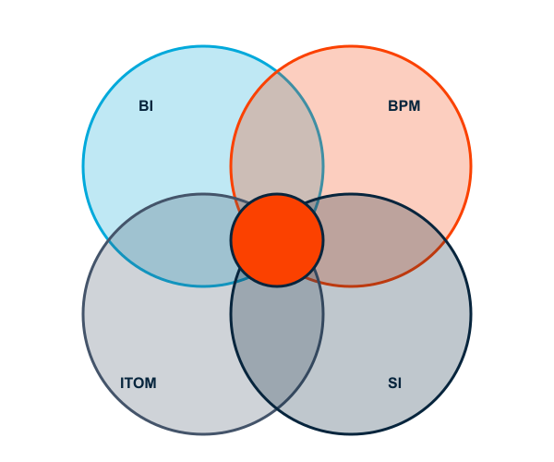
The Category Thesis
Executive Agent = BI + BPM + ITOM + SI Convergence
Business Intelligence: Decision support & analytics
BPM: Process optimization & automation
ITOM: Operations monitoring & management
SI: Strategic consulting & transformation
Helm sits at the intersection - the Executive Command Layer

Slide 3
Why These Categories Are Converging
Agent Era Demands Unified Intelligence
Each Category Solves Part of Problem
AI agents need coordinated oversight across systems, processes, operations, and strategy.
BI: insights, no action. BPM: optimizes, no visibility. ITOM: monitors, no business context. SI: advises, doesn't scale.
Executive Decision Layer Missing
Market Validation
95% of AI pilots fail because no one has "Full Command" across domains and horizons.
McKinsey: 88% use AI, only 39% see EBIT impact. The 49-point gap is Helm's market.
THE GAP: No one owns the Executive Command Layer
Helm positions as the Decision Intelligence layer above operational tools.

Slide 4
Category 1: Business Intelligence (BI)
Key Players
Enterprise: Power BI, Tableau, Qlik, SAP
Modern: Looker, Domo, ThoughtSpot, Sisense
Emerging: Mode, Hex, Lightdash
Market Size (2025)
$33B
What BI Does Well
Data visualization, dashboards, historical reporting
CAGR
What's Missing
12%
No process context, backward-looking, no action path
Helm: Forward-looking decision intelligence with process context
2030 Projection
$58B

Slide 5
Category 2: BPM (Business Process Management)
Key Players
Process Mining: Celonis, Apromore, SAP Signavio
BPM Suites: Pega, Appian, IBM, Camunda
RPA: UiPath, Automation Anywhere, Blue Prism
Process Mining TAM
$23B
Evolution: BPM → BOAT → Hyperautomation
What's Missing
RPA TAM
Enterprise-only pricing ($100K+), no executive decision layer
$36B
Helm: Mining is free, SMB-first pricing, executive command layer
Combined CAGR
30%+

Slide 6
Category 3: ITOM & Observability
Sub-Categories & Key Players
ITSM Market
ITSM: ServiceNow, BMC, Freshworks
Cloud: VMware, CloudHealth, Flexera
$15B
APM: Datadog, Dynatrace, Splunk
AIOps: Moogsoft, BigPanda, PagerDuty
Observability
What's Missing
$22B
Tech-focused, no process mining, lacks executive support
Helm: Business-outcome focused, ops + process intelligence
AIOps
$8B
CAGR
15%

Slide 7
Category 4: Systems Integration / Consulting
Key Players
Big 4: Accenture, Deloitte, PwC, EY, KPMG
Strategy: McKinsey, BCG, Bain
Tech: IBM GBS, Capgemini, Cognizant
Global Consulting TAM
$300B+
Consulting as Software: AI delivers insights that required $500K+ engagements
What's Missing
Digital Transformation
High cost ($500-1000/hr), doesn't scale, knowledge walks out
$120B
Helm: Consulting-grade at software prices, fleet learning
AI/Automation Consulting
$45B

Slide 8
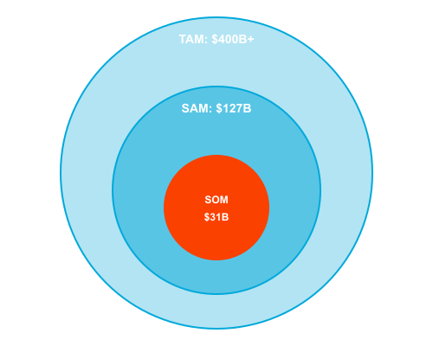
Combined TAM Opportunity
Combined Adjacent TAM (2030)
$400B+
BI/Analytics: $58B
BPM + RPA: $59B
ITOM + Observability: $45B
Digital Transformation: $165B+
Helm SAM: $31B (US/UK/EU)

Slide 9
Public Company Comparables
Company | Category | Market Cap | Revenue | Growth | EV/Rev
ServiceNow | ITSM | $185B | $10.5B | 23% | 17.6x
Salesforce | CRM/BI | $290B | $35B | 11% | 8.3x
Datadog | Observability | $42B | $2.5B | 26% | 16.8x
Dynatrace | APM | $15B | $1.4B | 22% | 10.7x
Pega | BPM | $5.2B | $1.5B | 8% | 3.5x
Appian | Low-Code/BPM | $2.8B | $600M | 15% | 4.7x
Splunk | Observability | $28B* | $4.2B | 12% | 6.7x
New Relic | Observability | $6.5B* | $950M | 14% | 6.8x
* Acquired - shown at acquisition valuation

Slide 10
Private Company Comparables
Company | Category | Last Valuation | Total Funding | Stage | Key Investors
Celonis | Process Mining | $13B | $1.4B | Series D | Accel, Arena
UiPath | RPA/BPM | $7.2B* | $2.1B | Public | Coatue, Sequoia
Camunda | BPM | $1.2B | $400M | Series C | Insight, Highland
Automation Anywhere | RPA | $6.8B | $840M | Series C | Softbank, NEA
Workato | Integration | $5.7B | $450M | Series E | Altimeter, Redpoint
Monte Carlo | Data Observability | $1.6B | $236M | Series D | Accel, GGV
Cribl | Observability | $2.5B | $400M | Series D | CRV, Sequoia
Observe Inc | Observability | $500M | $154M | Series B | Sutter Hill
* IPO valuation shown for reference

Slide 11
Comparable M&A Transactions
Target | Acquirer | Date | Deal Value | Revenue | Multiple
Figma | Adobe | 2022 | $20B | $400M | 50x
Splunk | Cisco | 2023 | $28B | $4.2B | 6.7x
Alteryx | Clearlake | 2023 | $4.4B | $900M | 4.9x
New Relic | Francisco Partners | 2023 | $6.5B | $950M | 6.8x
Signavio | SAP | 2021 | $1.2B | $100M | 12x
Apromore | TBD | 2025 | TBD | ~$20M | TBD
Tableau | Salesforce | 2019 | $15.7B | $1.2B | 13x
Looker | Google | 2020 | $2.6B | $150M | 17x
Note: Multiples shown are EV/Revenue at time of transaction

Slide 12
Key Takeaways
1
2
Unique Category Intersection
Massive Combined TAM
Helm sits at BI + BPM + ITOM + SI convergence - the Executive Command Layer no one else owns
$400B+ combined adjacent markets, $31B SAM focused on SMB-mid market
3
4
Compelling Valuation Benchmarks
The Opportunity
Public comps: 8-15x revenue. M&A deals: 10-20x for high-growth assets
12-month window. SMB market (150K companies) unaddressed by legacy vendors
Helm: The Executive Agent Platform for Service Leaders

