Slide 1

2016년 Fall 인공지능과 정보보호 프로젝트
머신러닝기반 IDS
2014110916
정보보호학과
최수연

Slide 2




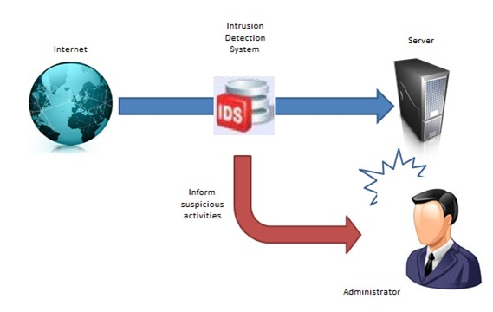





IDS란?
An intrusion detection system (IDS) is a device or software application that monitors a network or systems for malicious activity or policy violations.

Slide 3
목차
Training Data
시연
발전 방향

Slide 4
Training data - 출처
총 41개의 독립적인 필드와 라벨
22개의 공격 패턴
Traingin set 5,000,000 connections
*Data format
Ex) 0, u에, private, SF, 105, 146, …1.00, 0.00, 0.00, 255, 254, 1…0.00, normal
0, ICMP, ecr_i, SF, 1032,0,0, 504, 504, 1…., 0.00, 255,255, …1, 0.00, smurf
660개의 training data from KDD Cup 1999 Data
https://github.com/defcom17/NSL_KDD
Notes:
데이터셋을 이용한 Learning contest하기위해, MIT 링컨 랩과 미 국방부 국방과학연구소 에서 9주동안 raw data dump했음.
그 데이터를 좀더 가공한 데이터가 바로 kdd 1999 dataset
네트워크상의 다름 컴퓨터를 공격하는 rootkit 까지 사실 총

Slide 5
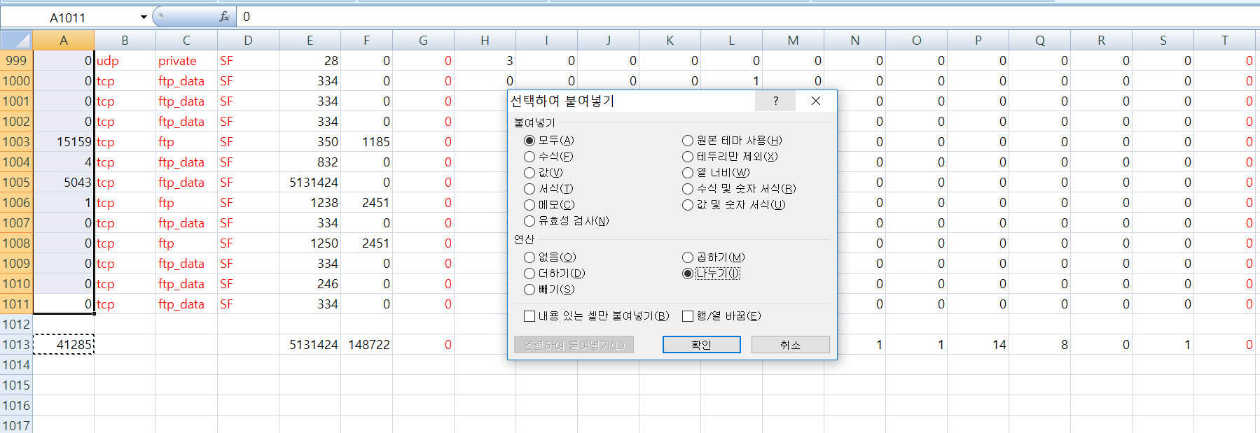
Training data - 가공
32개 필드로 축소
→문자열 인식 문제
총 12개 패턴 탐지
엑셀로 각 열의 최대값 구한 후, 셀 값 나눈다
buffer_overflow
guess password
Ipsweep
Loadmodule
Nmap
normal
Portsweep
rootkit
Satan
Smurf
Teardrop
warezclient
Notes:
네트워크상의 다름 컴퓨터를 공격하는 rootkit 까지 사실 총

Slide 6
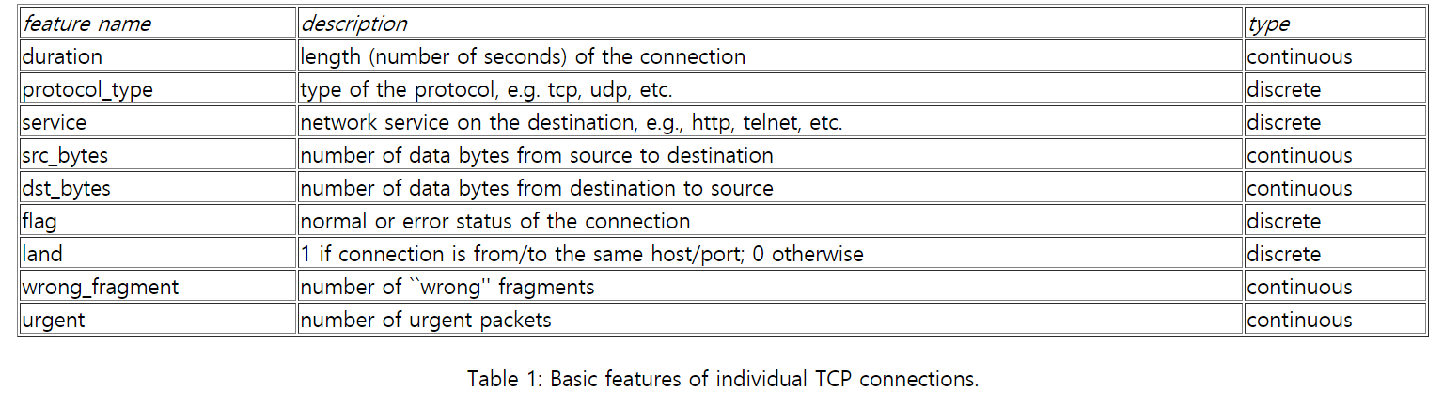



Training data – 총 32개의 features
각 열의 필드 이름 1
25,320
1,825
204,200

Slide 7
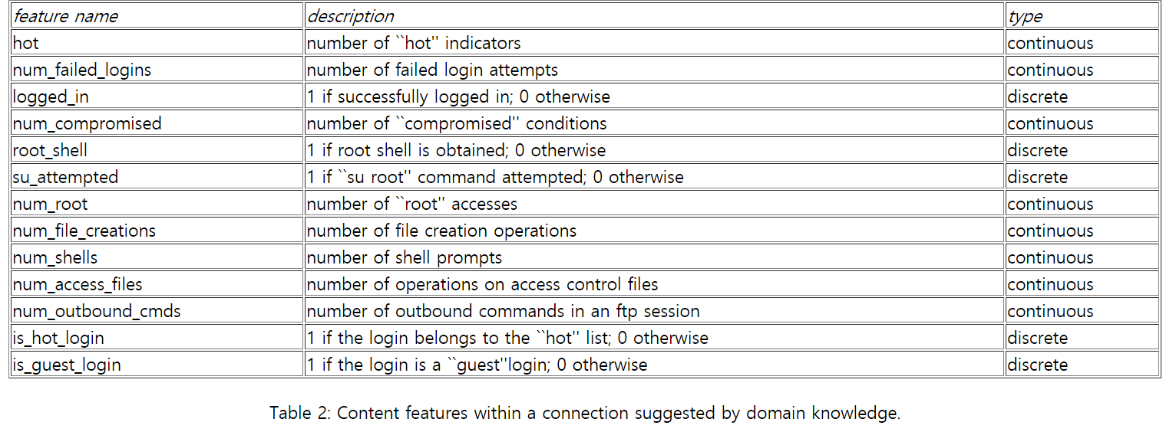
Training data – 총 32개의 features
각 열의 필드 이름 2
25,320
1,825
204,200

Slide 8
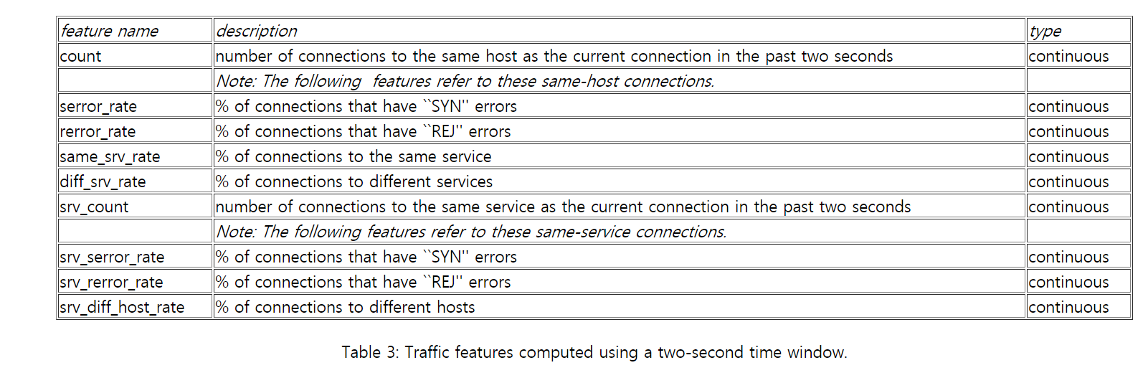
Training data – 총 32개의 features
각 열의 필드 이름 3
25,320
1,825
204,200

Slide 9
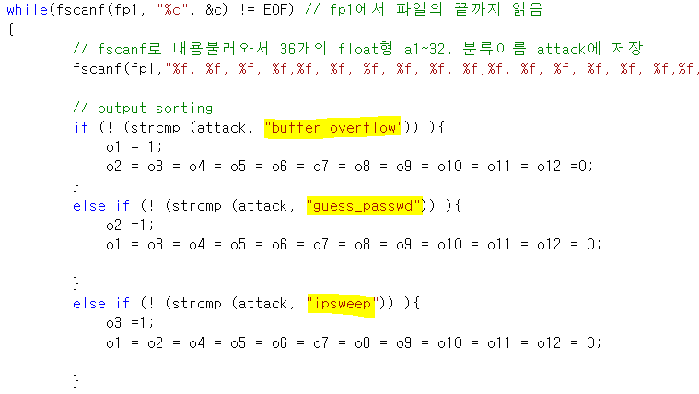
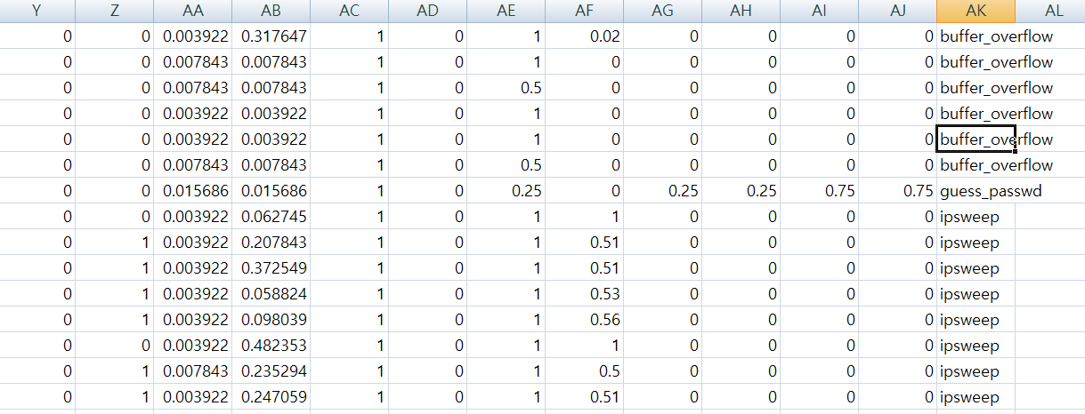
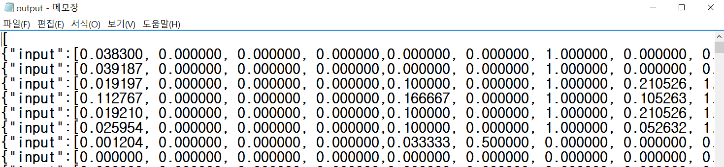
Csv 파일 → json 파일로

Slide 10
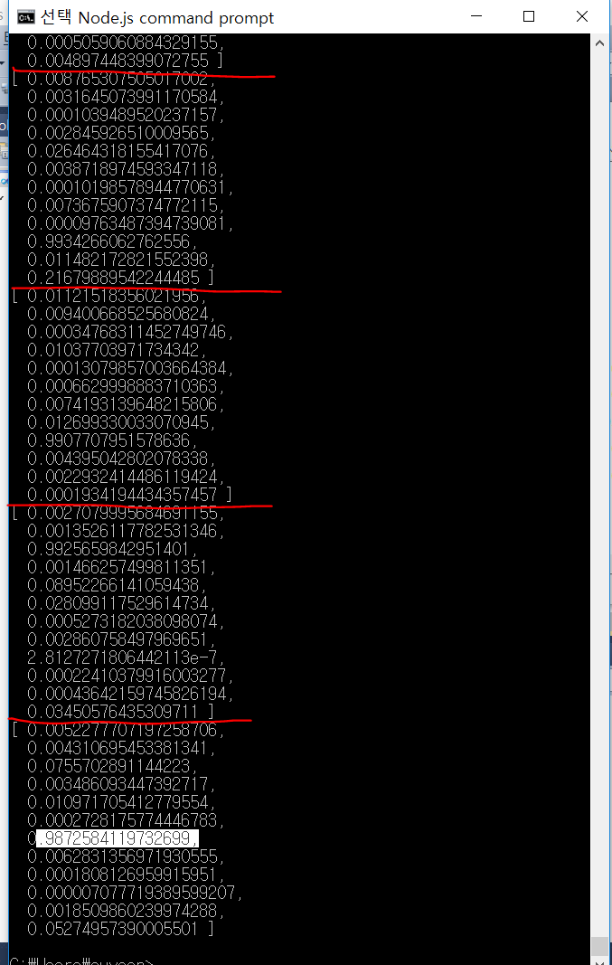
시연
console . log (net.run([0.017400676,0,0,0,0,0,1,0,0,0,0,0,0,0,0,0,0,0.007827789,0.007827789,0,0,0,0,1,0,0,0.607843137,1,1,0,0.01,0.03,0.01,0,0,0])); //normal (6번째)
console . log (net.run([0,0,0,0,0,0,0,0,0,0,0,0,0,0,0,0,0,0.39334638,0.39334638,0,0,0,0,1,0,0,1,1,1,0,1,0,0,0,0,0])); //smuf(10번째)
console . log (net.run([0,0,0,0,0,0,0,0,0,0,0,0,0,0,0,0,0,0.806262231,0.001956947,0.15,0,0.83,1,0,1,0,1,0.003921569,0,0.96,0,0,0.1,0,0.89,1])); //satan(9번째)
console . log (net.run([0,0,0,0,0,0,0,0,0,0,0,0,0,0,0,0,0,0.001956947,0.001956947,0,0,0,0,1,0,0,0.003921569,0.196078431,1,0,1,1,0,0,0,0])); //ipsweep(3번째)
console . log (net.run([0,0,0,0,0,0,0,0,0,0,0,0,0,0,0,0,0,0.001956947,0.001956947,0,0,1,1,1,0,0,0.521568627,0.003921569,0.01,0.65,0.64,0,0,0,0.65,1])); //portsweep (7번째)

Slide 11
발전방향
1. 탐지할 패턴 늘리기
DOS | R2L(Remote to Local) | U2R(User to Root) | Probing
Smurf, Pod, Apache2, Udpstorm, Processtable, Neptune, Back, land, Mailbomb, teardrop | SnmapGetAttack, Named, Xlock, phf, Xsnoop, worm, Sendmail, Guess_passwd, Warezmaster, Imap, Httptunnel, ftp_write, snmpguess | Buffer_overflow, Perl, ps, Xterm, rootkit, Sqlattack, Loadmodule, multihop | Nmap, saint, satan, portsweep, ipsweep, mscan

Slide 12
발전방향
2. KDD Cup 1999 data의 한계
Protocol types
Only TCP, UDP, ICMP → ARP Spoofing 탐지 불가
TCP, UDP, ICMP과 같은 문자열을 어떻게 float형으로 표현?
3. Real time IDS
실시간으로 training data를 생성하자마자 곧바로 learning 하는 IDS

Slide 13
Thank you for your attention
감사합니다

