Slide 1

Sales Conference 2026
Innovative strategies for future business growth
Notes:
AI-generated content may be incorrect. ---

Slide 2
Sales Conference 2026 Overview
Notes:
Welcome and Conference Introduction, Conference Agenda and Key Themes, Overall Sales Performance Summary, Regional Sales Highlights, Closing Remarks and Next Steps

Slide 3

Welcome and Conference Introduction
Conference Purpose
The conference aims to align leadership, sales teams, and stakeholders on performance and growth strategy.
Business Context 2026
Market volatility, customer expectations, and digital transformation shape the sales execution environment.
Strategic Focus
Emphasizes adaptability, resilience, innovation, and data-driven decision-making for future success.
Conference Significance
A forum for recognition, learning, shared accountability, and clear priority setting.
Notes:
The Sales Conference 2026 presentation opens with a formal welcome and introduction designed to set the tone for a strategic, forward-looking business discussion. This opening slide establishes the purpose of the conference, which is to align leadership, sales teams, and regional stakeholders around the company’s performance, priorities, and growth strategy for the coming year. It emphasizes the importance of collaboration between sales, marketing, and operations to drive sustainable revenue growth in an increasingly competitive market environment. The introduction also highlights the broader business context in which the organization is operating in 2026. Market volatility, evolving customer expectations, and digital transformation are positioned as key external factors shaping sales execution. By acknowledging these realities upfront, the presentation signals that the conference will focus not only on results, but also on adaptability, resilience, and innovation. This framing helps attendees understand why strategic alignment and data-driven decision-making are critical. Additionally, this section reinforces the significance of the annual sales conference as a forum for recognition, learning, and shared accountability. It underscores that the insights presented are intended to inform leadership decisions, motivate sales teams, and provide clarity on priorities. By clearly defining the scope and objectives at the outset, the introduction ensures that all participants are aligned and prepared to engage meaningfully with the content that follows throughout the presentation.

Slide 4
Conference Agenda and Key Themes
Clear Conference Roadmap
The agenda provides a structured roadmap guiding participants through the conference's key topics and flow.
Focused Key Themes
Key themes include sales analysis, market dynamics, customer trends, and upcoming strategic initiatives.
Balanced Retrospective and Planning
The agenda balances review of past performance with future planning and actionable insights.
Notes:
The agenda section outlines the structure of the Sales Conference 2026 and provides participants with a clear roadmap of the topics to be covered. It is designed to help attendees understand the logical flow of the presentation, from high-level performance review to detailed regional insights and forward-looking strategic priorities. This clarity is especially important for senior stakeholders who rely on concise, well-organized information to inform decision-making. Key themes highlighted in the agenda include sales performance analysis, regional market dynamics, customer engagement trends, and strategic initiatives for the upcoming fiscal year. By grouping related topics together, the agenda demonstrates a cohesive narrative rather than a collection of disconnected data points. This approach reinforces the idea that sales outcomes are influenced by a combination of market conditions, operational execution, and strategic choices. The agenda also signals a balance between retrospective analysis and future planning. While reviewing past performance is essential, equal emphasis is placed on lessons learned and opportunities ahead. This balance ensures that the conference is not merely a reporting exercise, but a strategic planning forum. As a result, attendees can anticipate a focused discussion that is both informative and actionable.

Slide 5

Overall Sales Performance Summary
Revenue Trends Overview
This summary highlights recent revenue trends and year-over-year growth to assess business momentum.
Performance Against Targets
Compares actual sales results against forecasted targets, identifying overperforming and underperforming areas.
Key Performance Drivers
Examines factors like customer acquisition, deal size, and sales cycle efficiency influencing sales outcomes.
Notes:
The overall sales performance section provides a consolidated view of how the organization performed during the most recent sales period leading into 2026. This slide synthesizes revenue trends, growth patterns, and attainment against targets to give leadership a clear snapshot of business health. Rather than overwhelming the audience with excessive detail, the focus is on key indicators that reflect overall momentum and execution effectiveness. This section typically highlights year-over-year growth, comparisons against forecasted targets, and notable variances that require explanation. Positive performance areas are positioned as proof points of successful strategy and execution, while underperforming segments are framed as opportunities for improvement. This balanced perspective supports transparent discussion and informed decision-making. Beyond raw numbers, the performance summary also emphasizes the underlying drivers behind the results. Factors such as customer acquisition, deal size, sales cycle efficiency, and cross-selling effectiveness are discussed to provide context. By connecting outcomes to behaviors and processes, this section helps stakeholders understand not just what happened, but why it happened, setting the stage for more detailed regional and strategic analysis.

Slide 6
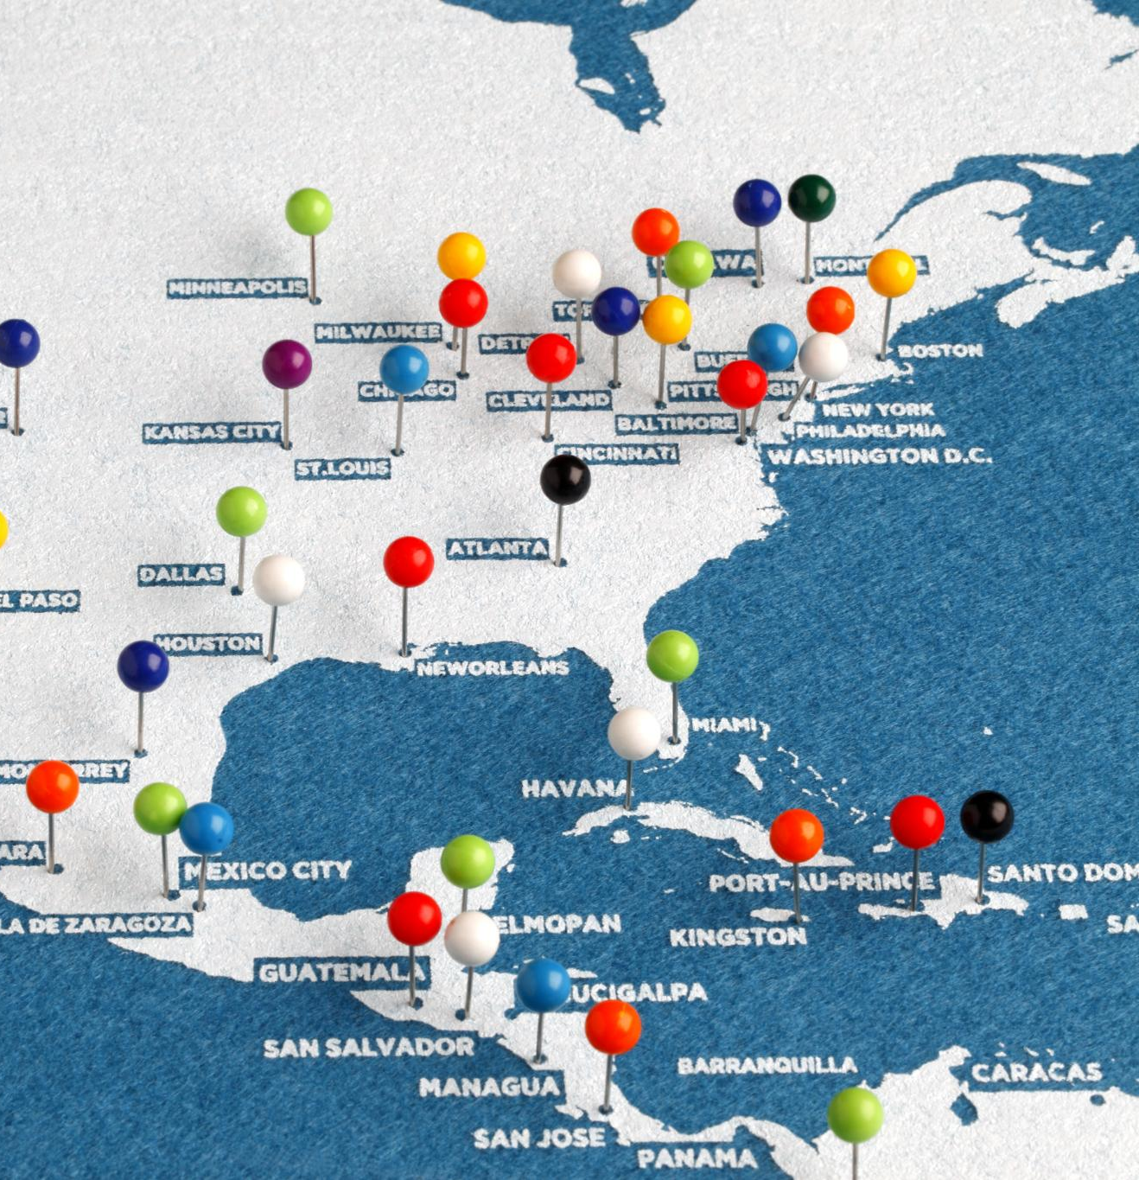
Regional Sales Highlights
Geographic Sales Analysis
Sales performance varies by region due to factors like customer demand and competitive intensity, requiring localized insights.
Highlighting Successful Regions
Strong-performing markets demonstrate best practices and effective strategies that serve as benchmarks for other regions.
Addressing Regional Challenges
Challenges such as resource constraints and pricing pressure are identified with strategic mitigation plans to improve outcomes.
Notes:
The regional sales highlights section breaks down overall performance into geographic segments to provide deeper insight into market-specific trends. This slide recognizes that sales performance is rarely uniform across regions and that localized factors such as customer demand, competitive intensity, and regulatory environments can significantly influence results. By examining regions individually, leadership can identify both high-performing markets and areas that require targeted intervention. This section typically compares regional revenue growth, market penetration, and pipeline strength. Strong-performing regions are highlighted to showcase best practices, successful go-to-market strategies, and effective team execution. These insights can be leveraged as benchmarks or models for other regions seeking to improve performance. Conversely, regions facing challenges are discussed in a constructive and data-driven manner. The focus is on understanding root causes rather than assigning blame. Issues such as resource constraints, pricing pressure, or shifting customer needs are identified, along with initial mitigation strategies. This regional lens enables more nuanced planning and supports the development of tailored strategies that reflect local market realities.

Slide 7

Closing Remarks and Next Steps
Summary of Key Messages
This section consolidates core themes like accountability, strategic focus, and execution excellence from the conference.
Immediate and Medium-Term Actions
Outlines expected next steps for sales leadership, including strategy refinement and resource reallocation.
Collaboration and Continuous Improvement
Emphasizes ongoing teamwork and a forward-looking approach to sustain growth and commitment.
Notes:
The closing section of the Sales Conference 2026 presentation brings together the key messages and translates insights into clear next steps. This slide reinforces the central themes discussed throughout the conference, including performance accountability, strategic focus, and the importance of execution excellence. By summarizing the most critical takeaways, it ensures that participants leave with a shared understanding of priorities. This section also outlines immediate and medium-term actions expected from sales leadership and regional teams. These actions may include refining sales strategies, reallocating resources, strengthening customer engagement efforts, or improving forecasting discipline. Clearly articulated next steps help bridge the gap between analysis and execution, which is essential for driving tangible business outcomes. Finally, the closing remarks emphasize collaboration and continuous improvement. They position the conference not as a one-time event, but as part of an ongoing dialogue aimed at driving sustained growth. By ending on a forward-looking and motivational note, this section reinforces commitment across the organization and sets a positive tone for the execution phase that follows the conference.

