Slide 1

Adventure Works
A brief presentation

Slide 2

What we are?

Slide 3
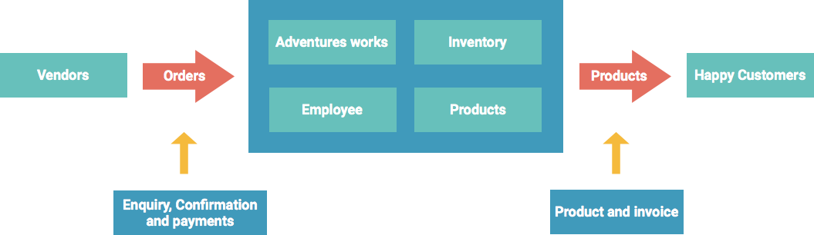
Our business model

Slide 4
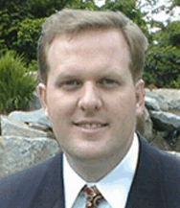
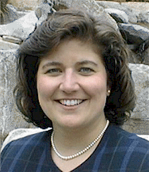
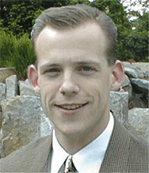
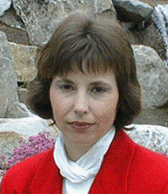
Our team
Name: Andrew Fuller
Title: Vice President
Name: Nancy Davolio
Title: Sales Representative
Name: Andrew Fuller
Title: Vice President
Name: Steven Buchanan
Title: Sales Manager
Name: Steven Buchanan
Title: Sales Manager
Name: Steven Buchanan
Title: Sales Representative

Slide 5
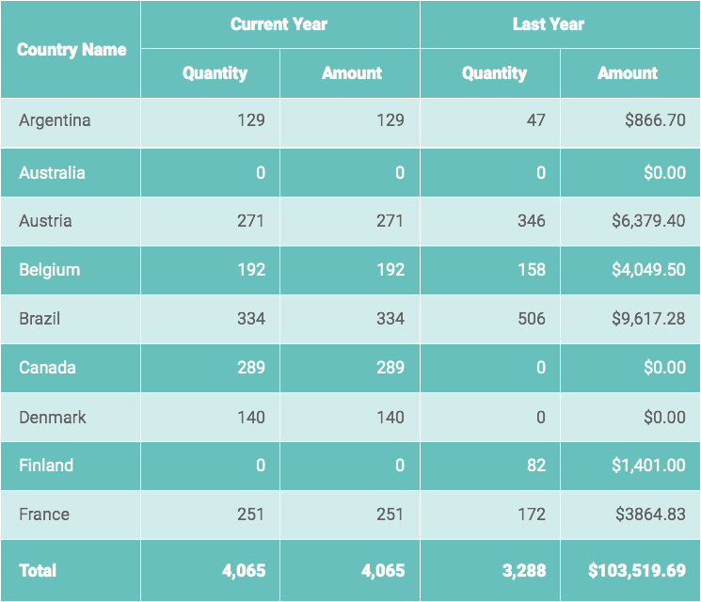
How much we are in this business ?

Slide 6
How much we target in next year?

Slide 7
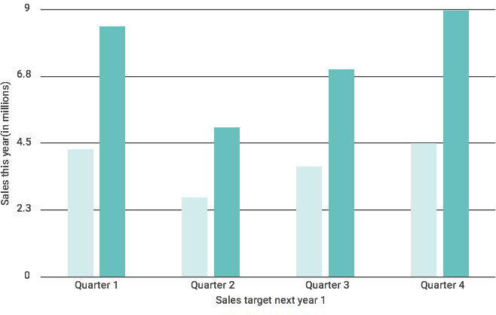
Target Vs Growth Rate
Target Vs Achievements

Slide 8
Contact Us
To place an order, you may order online, by phone, or by fax. We also accept purchase orders. For details on ordering options, please visit our Sales FAQ. If you need any assistance, please email us at adventureworks@nhwd.com. We will be available 24 X 7

