Slide 1

Support Analysis

Slide 2
RTL (right to left) conversion support
RTL (right to left) text
יישומונים 80 ועוד
دعم الزاوي على أساس
Bidirectional text
עיצובים מובנים bidirectional אישית
Hebrew text with Left to Right
עיצובים מובנים וניתנים להתאמה אישית
הדגמה זמינה ב
http://js.syncfusion.com/demos/web/

Slide 3
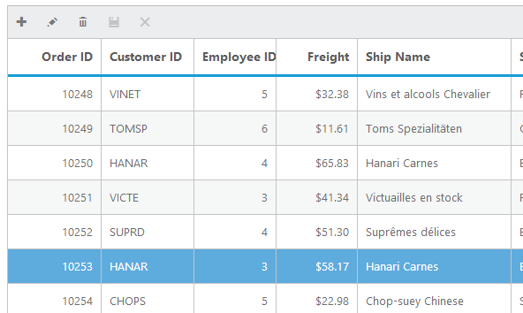
Grid
v

Slide 4
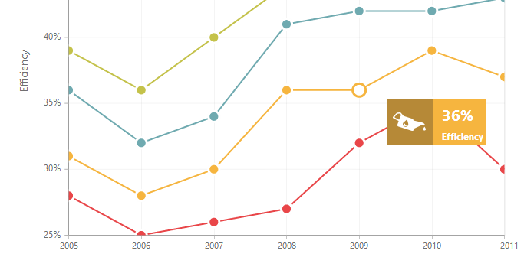
Chart
20 chart types

Slide 5
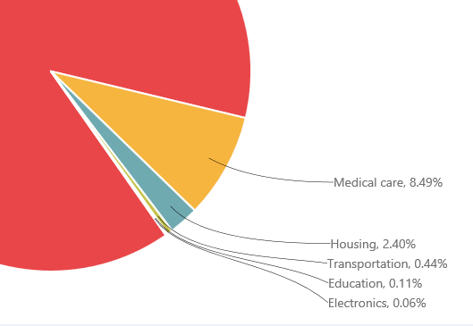
Chart smart labels
i

Slide 6
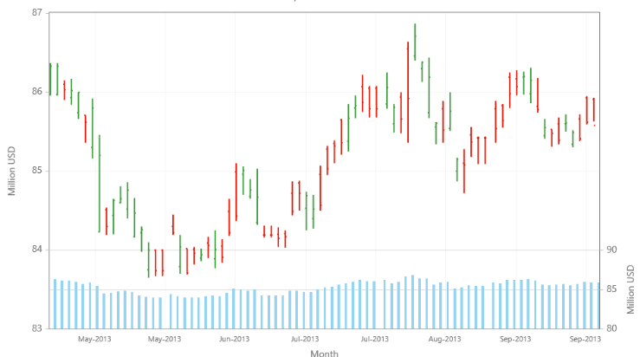
Chart Rows

Slide 7
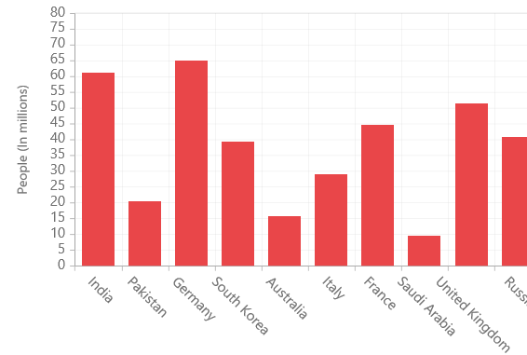
Chart Rotate labels

Slide 8
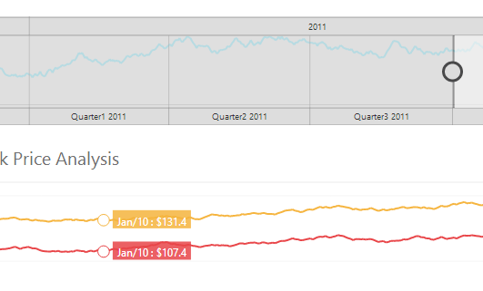
Range Navigator

Slide 9
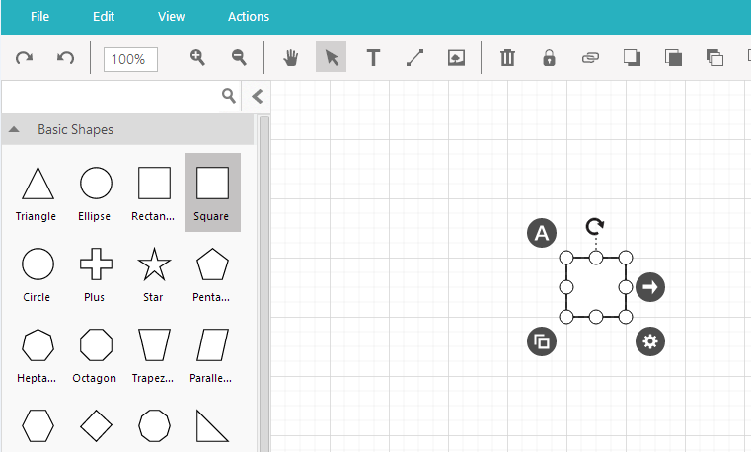
Diagram

Slide 10
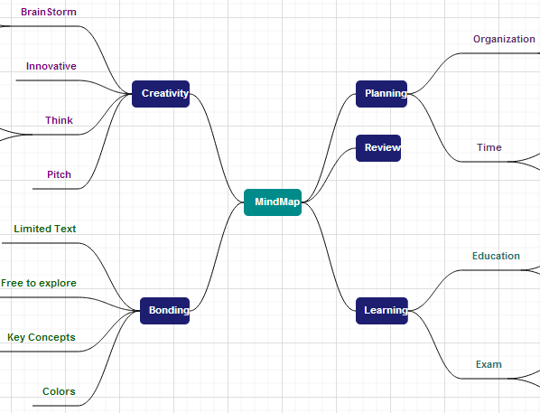
Diagram Mindmap

Slide 11
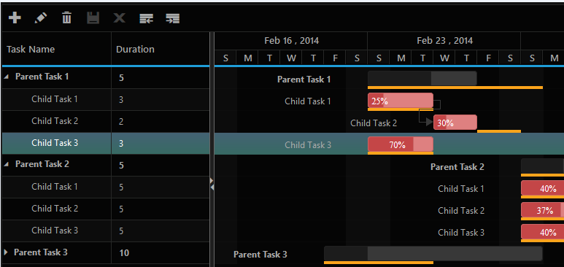
Gantt

Slide 12
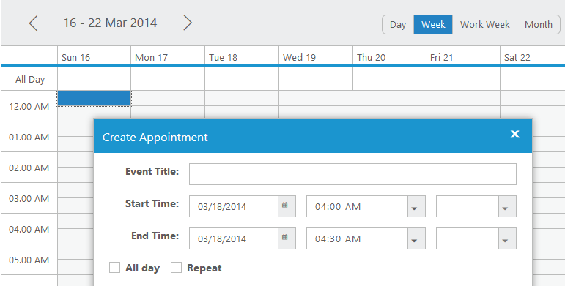
Schedule

Slide 13
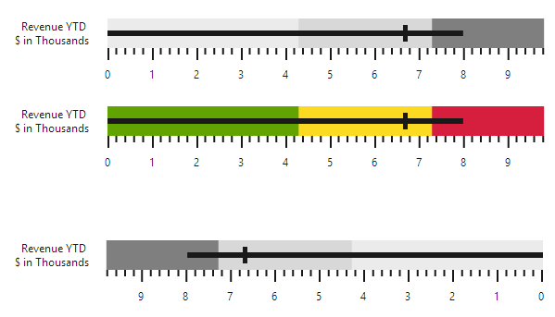
Bullet Graph

Slide 14
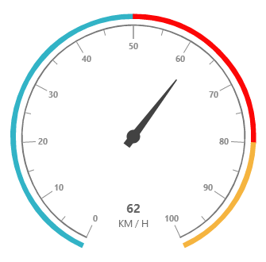
Bullet Graph

Slide 15
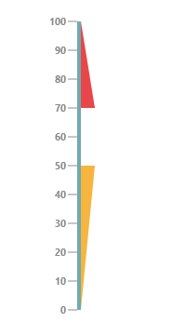
Linear Gauge

Slide 16

Linear Gauge

Slide 17

Maps

Slide 18
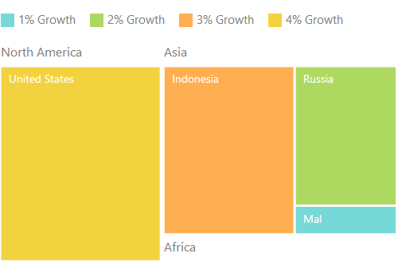
Treemap

Slide 19
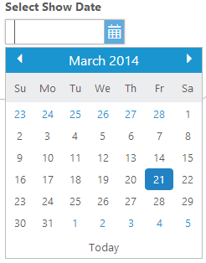
Date Picker

Slide 20
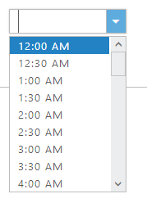
Time Picker

Slide 21
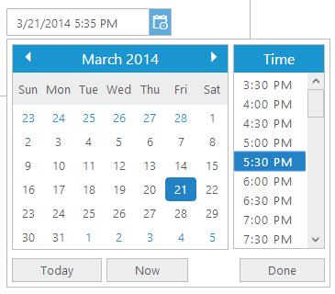
Time Picker

Slide 22
Date Time Picker

Slide 23
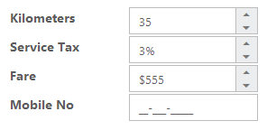
Text Boxes

Slide 24
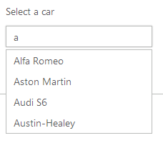
Auto Complete

Slide 25
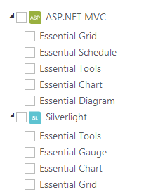
Tree View

Slide 26
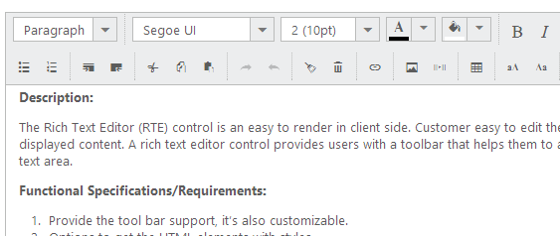
Rich Text Box

Slide 27

Rotator

Slide 28

Tabs

Slide 29

Menu

Slide 30
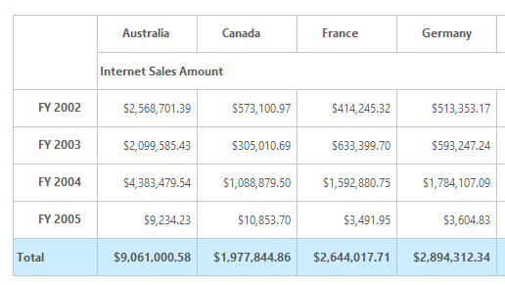
Olap Grid

Slide 31
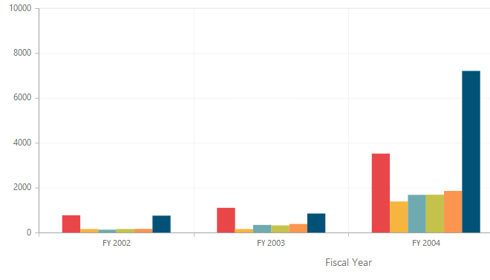
Olap Chart

Slide 32
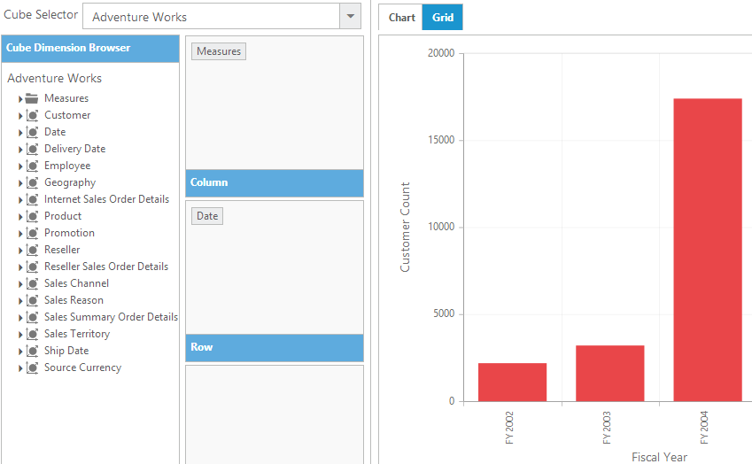

Olap Client

Slide 33
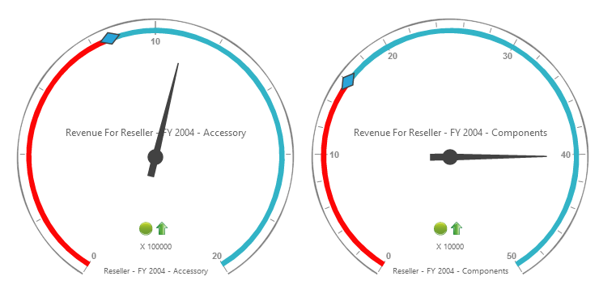
Olap Gauge

Slide 34
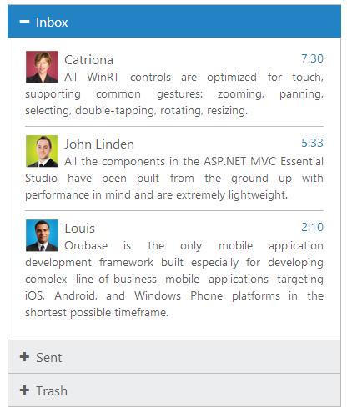
Accordion

Slide 35

Progress Bar

Slide 36

Rating

Slide 37
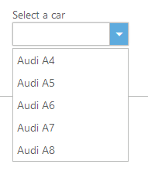
Drop DownList

Slide 38
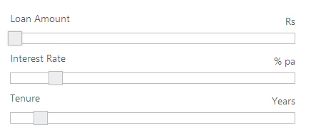
Slider

Slide 39
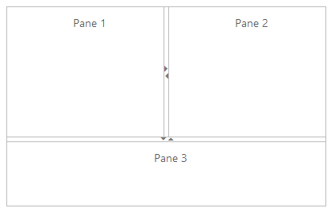
Splitter

Slide 40
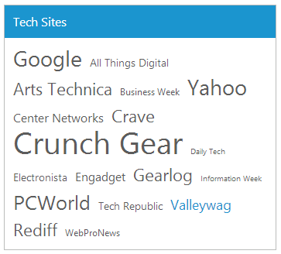
Tag Cloud

Slide 41
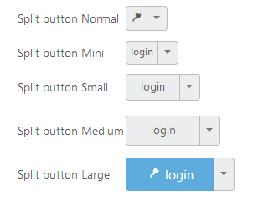
Button

Slide 42

Toolbar

Slide 43


Waiting Popup

Slide 44
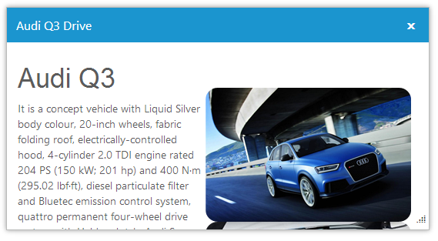
Dialog

Slide 45
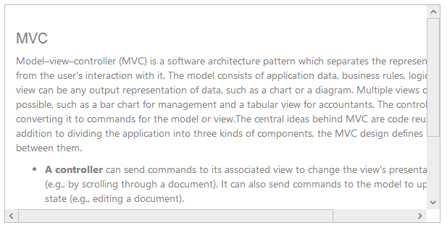
Scrollbar

Slide 46

Barcode

Slide 47
Demo
Essential JS Demo
http://js.syncfusion.com/demos/web/
Contact Us
sales@syncfusion.com

