Slide 1
CI/CD
By Stephen Bold
Continuous Integration / Continuous Deployment

Slide 2
What does it mean ?
CI - Continuous Integration
CD - Continuous Deployment
A development practice in which developers commit and merge code to a shared repository on a frequent basis – potentially even multiple times a day.
Code changes are then checked, validated and verified by automated testing jobs minimising manual intervention
Builds on CI by taking the committed code and performing more automated testing before deployment to testing, development and even production environments in a completely automated fashion

Slide 3
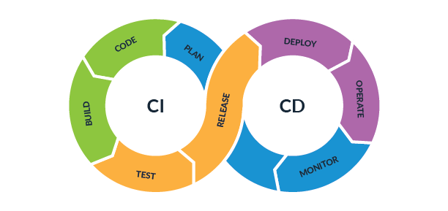
The cycle of CI/CD

Slide 4
Why should we embrace CI/CD ?
Benefits
Faster time to production
Smaller code changes
Easier to trace and pinpoint errors
Less errors to production
Higher quality code
All of which contributes to cost savings and delivering value to customers !

