Slide 1
Intro to Kubernetes and Serverless
Two Sides of the Deployment Coin
Wes Rolnick, Nick Prusko

Slide 2
Introduction
Who this talk is intended for

Slide 3
Introduction
If you want to follow along:
Create a free Google Cloud account
Log into: https://labs.play-with-k8s.com/

Slide 4
Introduction
How we used to deploy
The container revolution

Slide 5
Introduction
Kubernetes: Deploy containerized applications across managed infrastructure
Serverless: Deploy code to cloud infrastructure which will handle resource management

Slide 6
Kubernetes and Serverless
Kubernetes | Serverless
+ Highly configurable | + Quick Implementation
+ Complete control of data | + Low cost start
+ Control of resources | + Scales easily
- Implementation Complexity | - May be more expensive at scale
- High up-front cost | - Platform dependent

Slide 7
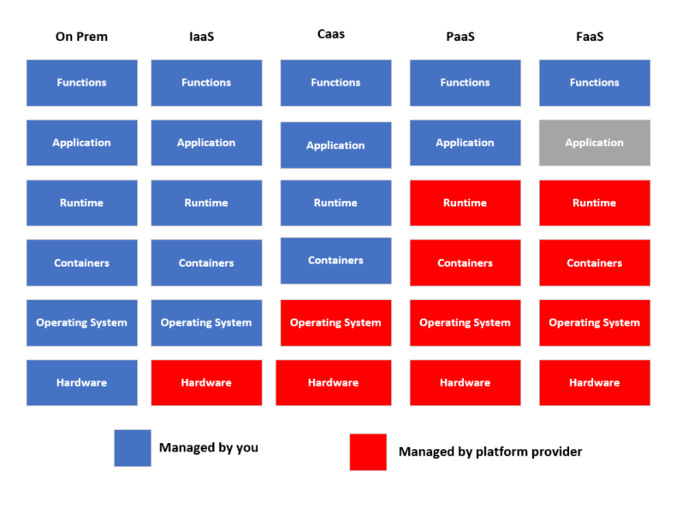
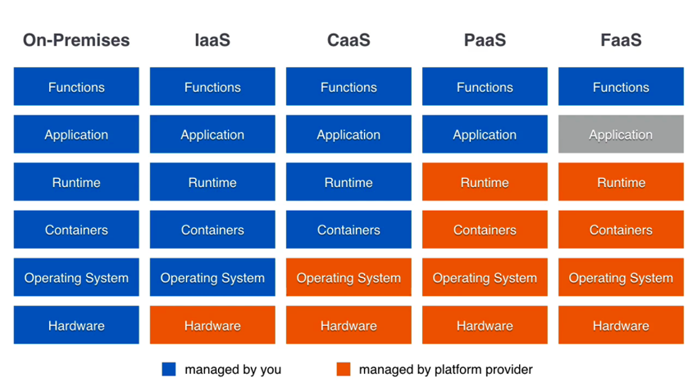
On Prem -> FAAS

Slide 8
The demo project
We will be using a simple Python REST API.
MySQL database for storing data.
Google Cloud Serverless for serverless deployment (sign up for a trial account if you want to follow along)
http://sharksareawesome.com is the demo site.
Also log into https://labs.play-with-k8s.com/
Code is available on Github: https://github.com/syncrisis/kubernetesdemo

Slide 9
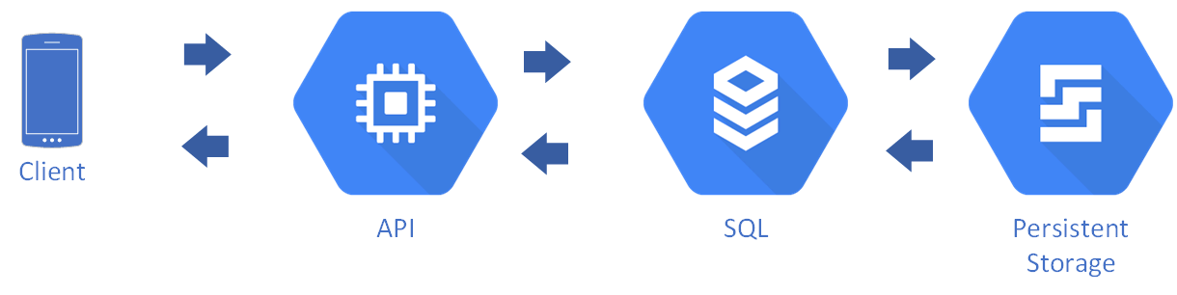

Slide 10
What is Kubernetes
Production ready container management
Manages container lifecycles
Manages updates and deployments

Slide 11
Kubernetes Terms
Cluster: A collection of nodes that are being managed by Kubernetes
Node: A VM or physical machine that contains one or more containers
Master Node: The node that coordinates everything in the cluster.

Slide 12
Kubernetes Objects
Pod: A running process on the cluster. Can be an application container (sometimes multiple containers).
Service: Defines policies for accessing Pods.
Deployment: Describes the desired state for how pods should be deployed across a cluster.

Slide 14
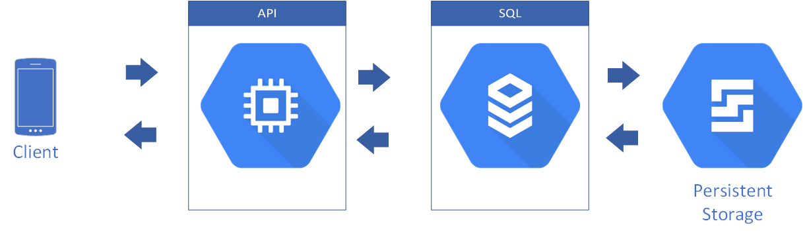

Slide 15
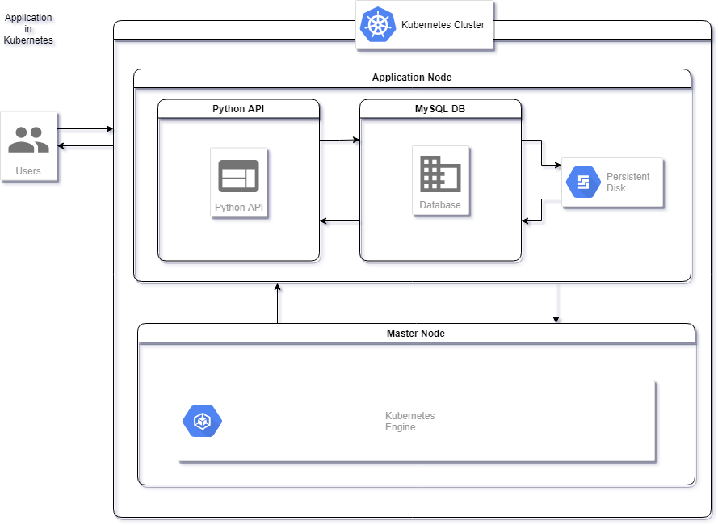

Slide 16
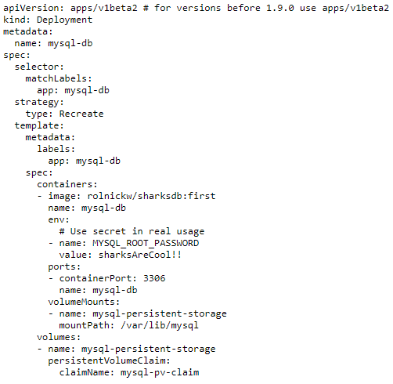
YAML!

Slide 17
Demo

Slide 19
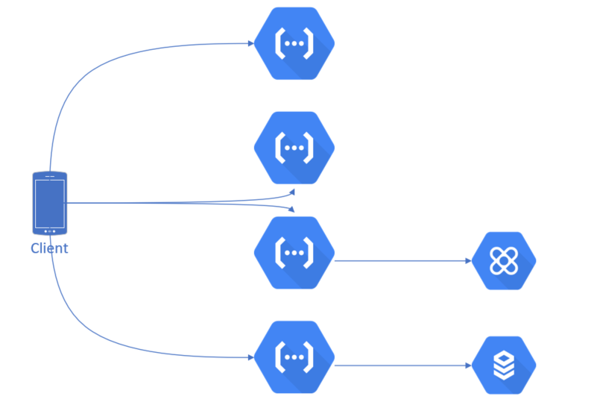
What is ServerLess?
Allows your code to run without the headache of server management, maintenance, scaling strategies. Back end infrastructure becomes invisible
Notes:
concept not technology
Google: Cloud Functions
AWS: Lamda
Alibaba: Function Compute

Slide 20
Why would I?
Allows developers to focus on development rather than infrastructure, small teams can do big things
Speeds up timelines to bring ideas to market
Reduction in cost
Notes:
Product to market: Time / money, does not need to be spent developing scaling polices, load balancing, fail over strategies, or worse then spending time guessing at how this should be implemented
Reduction in Cost: You only pay for what you need, some applications / endpoints have unpredictable traffic patterns that could result in added costs(paying for idle servers) or even worse being unable to scale accordingly resulting in outages.

Slide 21
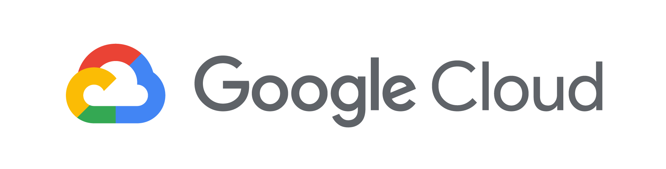
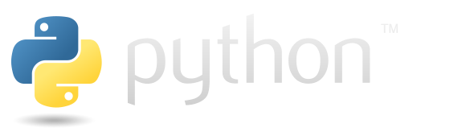

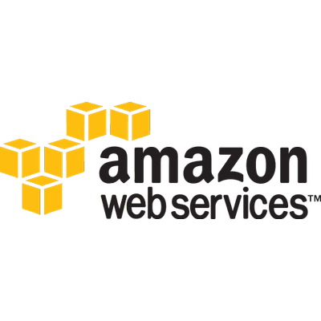
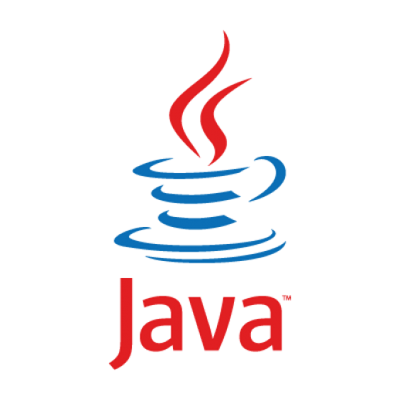
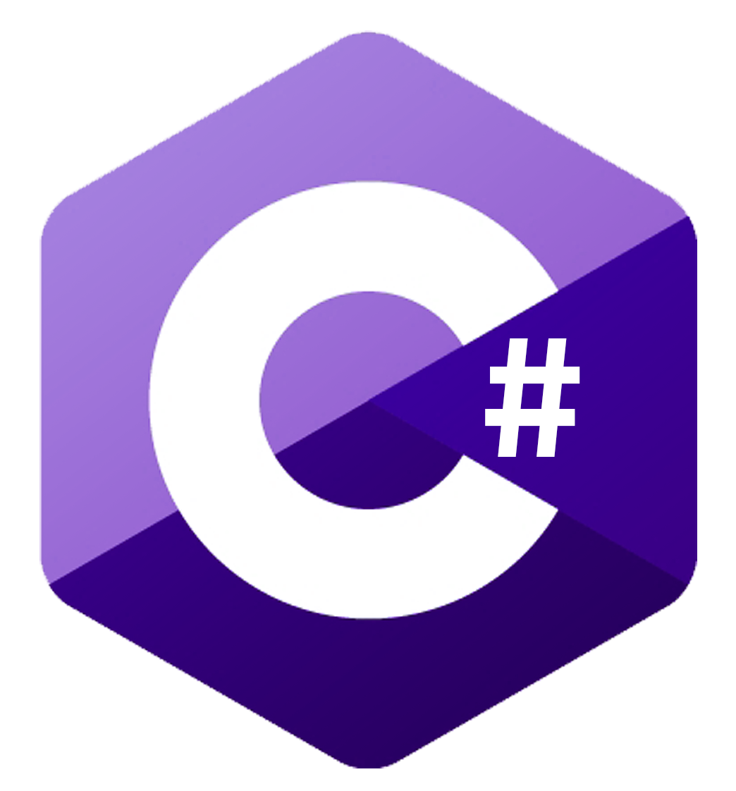
Languages
Notes:
Easy to use UI allows developers to focus on writing code in languages they are familiar with

Slide 22
Events & Triggers
Events & triggers provide hooks into your cloud environment
HTTP – GET / POST / PUT / PATCH / DELETE
Storage – Event Driven functions from your platform
Pub / Sub -
Firebase events
Notes:
Events: hooks in events on your cloud platform, bucket uploads, subscriptions, polished content
The functions you write can respond to events generated by these other Firebase and Google Cloud features:
Cloud Firestore Triggers
Realtime Database Triggers
Firebase Authentication Triggers
Google Analytics for Firebase Triggers
Crashlytics Triggers
Cloud Storage Triggers
Cloud Pub/Sub Triggers
HTTP Triggers
5-8 min

Slide 23
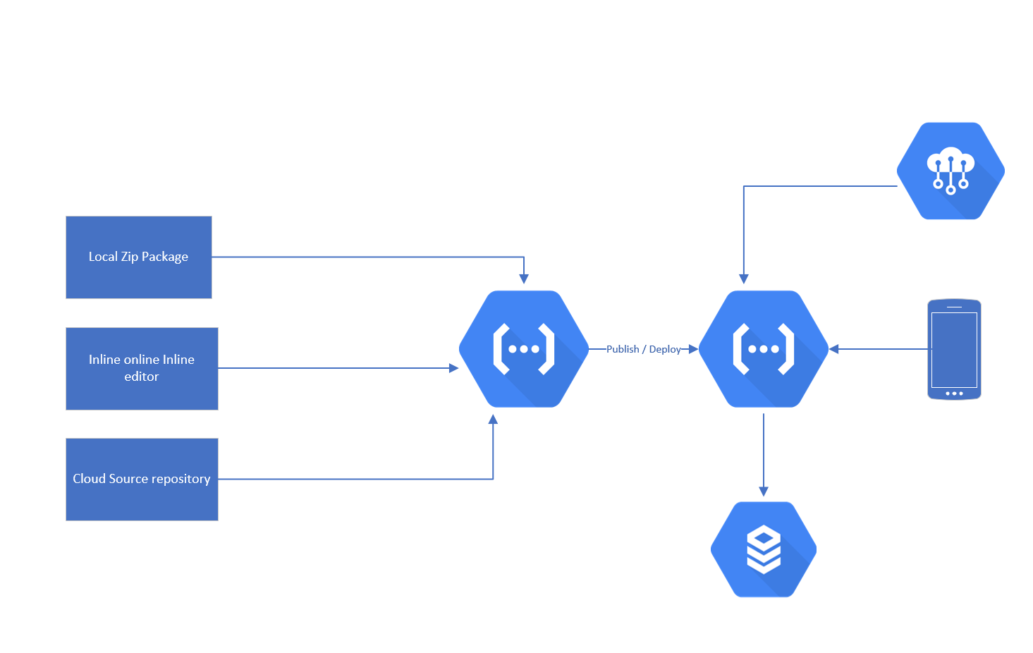
How Does it all work?

Slide 24
Demo

Slide 25
The Future
Kubernetes + Serverless!

Slide 26
Conclusion
It really depends…

Slide 27
Kubernetes playground demo

Slide 28
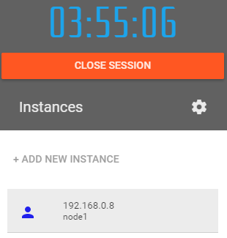
Go To https://labs.play-with-k8s.com/
1. Click Add New Instance:

Slide 29
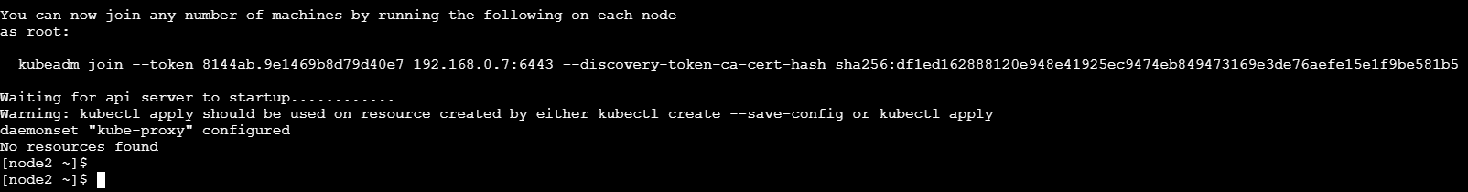
https://labs.play-with-k8s.com/
Copy the “Initializes cluster master node:” line:
kubeadm init --apiserver-advertise-address $(hostname -i)

Slide 30
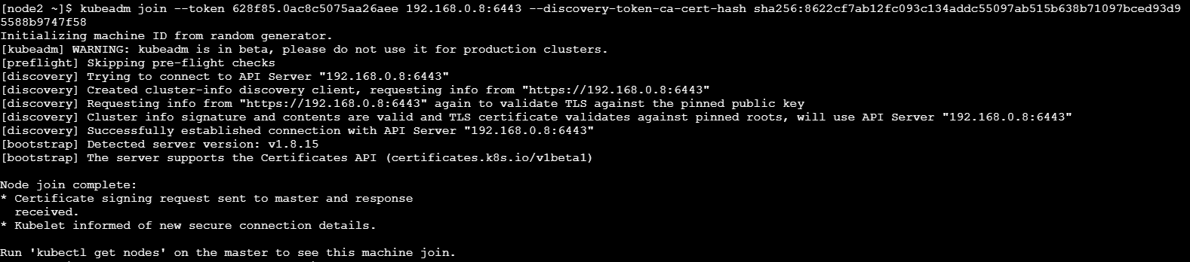
https://labs.play-with-k8s.com/
Copy the entire line that starts kubeadm join –token dkfjkldjfkdj
Click Add New Instance Again
In the second instance paste the copied kubeadm join line:

Slide 31
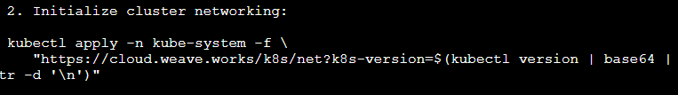
https://labs.play-with-k8s.com/
Switch back to your first instance (the master)
Copy the “Initialize cluster networking command:

Slide 32
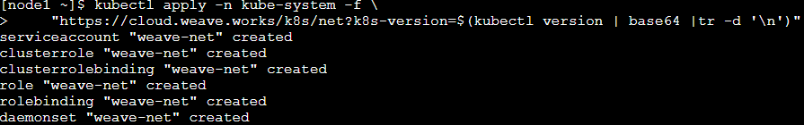
https://labs.play-with-k8s.com/
Paste and run this in the master instance (the first instance):
Kubectl apply –n kube-system –f \
“https://cloud.weave.works/k8s/net?k8s-version=$(kubectl version | base64 |tr -d ‘\n’)”

Slide 33
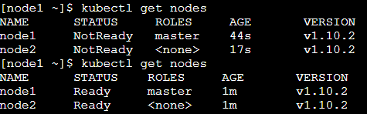
https://labs.play-with-k8s.com/
Verify that the nodes are configured and “Ready” by running:
Kubectl get nodes

Slide 34
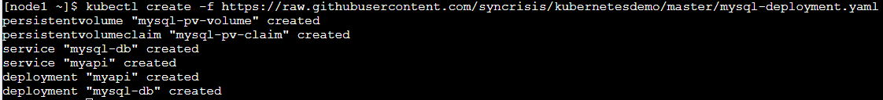
https://labs.play-with-k8s.com/
In the master node enter:
kubectl create –f https://raw.githubusercontent.com/syncrisis/kubernetesdemo/master/mysql-deployment.yaml

Slide 35

https://labs.play-with-k8s.com/
Wait for the pods to finish creating and run
kubectl get pods

Slide 36
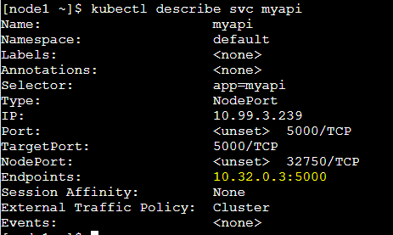
https://labs.play-with-k8s.com/
12. Find the exposed API port by typing:
kubectl describe svc myapi

Slide 37
https://labs.play-with-k8s.com/
Send a curl request to the API at the endpoint:
curl 10.32.0.3:5000/api/sharks (the service endpoint for the IP address)

