Slide 1

Testing: hands-on
philosophy & Nodejs & fun

Slide 2
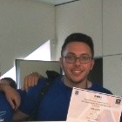
Who am I? MEET DANIEL...
💼 Backend Developer @ MoD
🎓 B.Sc. in Computer Science @ Bar-Ilan University
🤾 Handball & 🏋 Weightlifting
🤖 Tech Enthusiast
👨‍💻️ Backend Technologies
Testing
Open Source Projects
Anomaly Detection
🍻 Meetups

Slide 3
Agenda
What?
Why?
How?
Test Runners
Mocha
Assertion Libraries
Chai
Sinon
Rewire
Mockery
Tips & Tricks
A spoiler
Personal Note
Meme

Slide 4
What is software testing?
Software testing is defined as an activity to check whether the actual results match the expected results and to ensure that the software system is Defect free.
01
It involves execution of a software component or system component to evaluate one or more properties of interest.
02

Slide 5

philosophy
Much like we gain knowledge about the behavior of the physical universe via the scientific method, we gain knowledge about the behavior of our software via a system of assertion, observation, and experimentation called “testing.”
The purpose of a test is to deliver us knowledge about the system, and knowledge has different levels of value. For example, testing that 1 + 1 still equals two no matter what time of day it's doesn’t give us valuable knowledge. However, knowing that my code still works despite possible breaking changes in APIs.
There are many ways to gain knowledge about a system, and testing is just one of them. We could also read its code, look at its documentation, talk to its developers, etc., and each of these would give us a belief about how the system behaves. However, testing validates our beliefs, and thus is particularly important out of all these methods.

Slide 6
Why should I bother?
In April 2015, Bloomberg terminal in London crashed due to software glitch affected more than 300,000 traders on financial markets. It forced the government to postpone a 3bn pound debt sale.
Nissan cars have to recall over 1 million cars from the market due to software failure in the airbag sensory detectors. There has been reported two accident due to this software failure.
Starbucks was forced to close about 60 percent of stores in the U.S and Canada due to software failure in its POS system. At one point store served coffee for free as they unable to process the transaction.
Some of the Amazon’s third party retailers saw their product price is reduced to 1p due to a software glitch. They were left with heavy losses.
Vulnerability in Window 10. This bug enables users to escape from security sandboxes through a flaw in the win32k system.
In 2015 fighter plane F-35 fell victim to a software bug, making it unable to detect targets correctly.
China Airlines Airbus A300 crashed due to a software bug on April 26, 1994, killing 264 innocent live
In 1985, Canada's Therac-25 radiation therapy machine malfunctioned due to software bug and delivered lethal radiation doses to patients, leaving 3 people dead and critically injuring 3 others.
In April of 1999, a software bug caused the failure of a $1.2 billion military satellite launch, the costliest accident in history
In may of 1996, a software bug caused the bank accounts of 823 customers of a major U.S. bank to be credited with 920 million US dollars.
Notes:
Testing is important because software bugs could be expensive or even dangerous. Software bugs can potentially cause monetary and human loss, and history is full of such examples.

Slide 7
ok daniel we get it – code can kill

Slide 8

Writing tests vs schedule
“Quality is the ally of schedule and cost, not their adversary. If we have to sacrifice quality to meet schedule, it’s because we are doing the job wrong from the very beginning.” – James A. Ward
“The bitterness of poor quality remains long after the sweetness of meeting the schedule has been forgotten.” – Anonymous
“Quality is free, but only to those who are willing to pay heavily for it.” – T. DeMarco and T. Lister

Slide 9
How can we test our code?
Test Runner
Tests
Assertions Libraries

Slide 10
Test runners
A test runner is the library or tool that picks up an assembly (or a source code directory) that contains tests, and a bunch of settings, and then executes them and writes the test results to the console or log files.
there are many runners for different languages.
Each has its own syntax and behavior

Slide 11
Mocha syntax
BDD (MOST COMMON):
describe() (Alias context)
it() (Alias specify)
before() & beforeEach()
after() & afterEach()
TDD:
suite()
test()
suiteSetup()
suiteTeardown()
setup()
teardown()

Slide 12
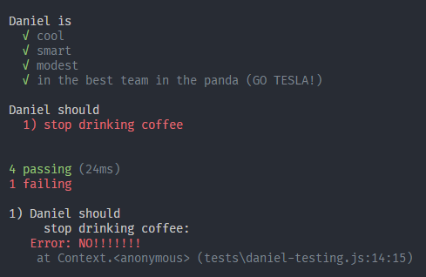
Mocha console output

Slide 13

Syntax.test.js
THIS IS WHERE THE FUN BEGINS

Slide 14
Mocha cli
All you need to know about test running is explained in
mocha --help (for global installation)
node .\node_modules\mocha\bin\_mocha --help (for local installation)
Let's cover some of its features together!

Slide 15
Assertion libraries
Assertion libraries are tools to verify that things are correct. This makes it a lot easier to test your code, so you don't have to do thousands of if statements.
Provides the way to write custom assertions closer to the business language.

Slide 16

chai
Chai is a BDD / TDD assertion library for node and the browser that can be delightfully paired with any javascript testing framework.

Slide 17
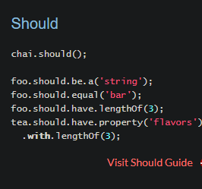
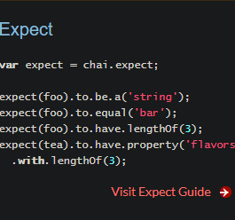
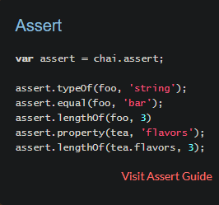
Chai syntax samples
Notes:
More syntax example and documantation can be found on chaijs website.

Slide 18

Mocha + chai = love
Having Mocha and Chai combined easies your pain writing tests.
Let's see it in action.
HERE WE GO
Mocha-chai.test.js

Slide 19
Sinon + rewire
"Sinon. JS - Standalone test fakes, spies, stubs and mocks for JavaScript. " - Sinon official website
Works with any unit testing framework.
Documentation can be found here @ https://sinonjs.org/releases/v7.5.0/
"Rewire.js - Easy monkey-patching for node.js unit tests"
Rewire adds a special setter and getter to modules so you can modify their behavior for better unit testing.
inject mocks for other modules or globals like process
inspect private variables
override variables within the module.

Slide 20
Sinon-game.test.js

Slide 21
Mockery
Mockery lets you work more easily with your framework of choice (or no framework) to get your mocks hooked in to all the right places in the code you need to test.
Mockery is used more for stubs since it replaces the module

Slide 22
Mockery-sinon.test.js

Slide 23
nock
HTTP server mocking and expectations library for Node.js
Nock can be used to test modules that perform HTTP requests in isolation.
For instance, if a module performs HTTP requests to a Elasticsearch server or makes HTTP requests to the Amazon API, you can test that module in isolation.

Slide 24
Nock-request.test.js

Slide 25
supertest
Small progressive client-side HTTP request library, and Node.js module with the same API, supporting many high-level HTTP client features

Slide 26
Supertest-express.test.js

Slide 27
TIPS & tRICKS

Slide 28
SPoiler alert

Slide 29
Personal Note

Slide 30
Agenda
✔️ What?
✔️ Why?
✔️ How?
✔️ Test Runners
✔️ Mocha
✔️ Assertion Libraries
✔️ Chai
✔️ Sinon
✔️ Rewire
✔️ Mockery
✔️ Nock
✔️ Supertest
✔️ Tips & Tricks
✔️A spoiler
✔️Personal Note
❌ Meme

Slide 31
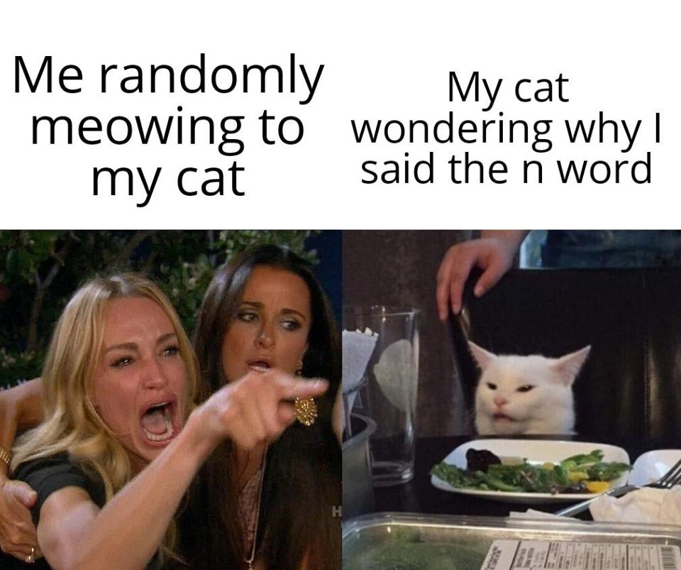

Slide 32
Agenda
✔️ What?
✔️ Why?
✔️ How?
✔️ Test Runners
✔️ Mocha
✔️ Assertion Libraries
✔️ Chai
✔️ Sinon
✔️ Rewire
✔️ Mockery
✔️ Nock
✔️ Supertest
✔️ Tips & Tricks
✔️ A spoiler
✔️ Personal Note
✔️ Meme

Slide 33
MUST READ
best practices for spies stubs and mocks in sinonjs
Excelling with Sinon.js
Sinon.js Tutorial - How to Write Unit Tests Using Sinon.js (Video)
How to Stub Dependencies with Sinon | JavaScript Testing Tutorials (Video)

Slide 34
More on testing....
How to Unit Test with NodeJS?
Node.js & JavaScript Testing Best Practices (2019)
Advanced Node.js testing: beyond unit & integration tests (2019) (Video)
Mocking HTTP requests with Nock
NodeJS Best Practices
Google it!

Slide 35

Thank You
daniel hermon
Danielhermonsync@gmail.com
Daniel hermon @ linkedin
Syncush @ github
Syncush @ kaggle

