Slide 1
Syndicate
A CDN-powered Distributed Read/Write Filesystem
Jude Nelson
General Exam
May 2012
Larry Peterson
Academic Adviser

Slide 2

File I/O in Distributed Systems
ROLES: reader, writer, origin server
Origin Server
R/W I/O
Network
Readers
and
Writers
Scalability Challenges
Amount of data to store
Amount of data to transfer
Number of reads and writes
Notes:
Roles: Reader, Writer, Origin Server
HOST scalable dataset—a collection of files
R/Writers only need access some of them at once
Writers add/remove/update files
This basically applies to the whole Internet
* scientific computing (XSEDE has ~50PB storage)
* repositories (Debian is ~600GB)
Scalable:
* number of readers and writers
* amount of data to transfer at a given time
* amount of data to store

Slide 3
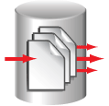
Content Distribution Network (CDN)
Federation of network caches that temporarily store content replicas from an origin server
Origin Server
CDN Service
Readers
Scalability Solutions
Amount of data to store
Amount of data to transfer
Number of reads and writes
Notes:
Content delivery/distribution network
* Caches are surrogate origin servers
* clients get redirected to the best cache
Network service that lives in the wide-area
* degree of client and origin server involvement may vary, but it can be transparent
What do they do?
* mitigate load on the origin server
* increase aggregate bandwidth of origin server
* decrease client latency
* increase total number of concurrent clients

Slide 4
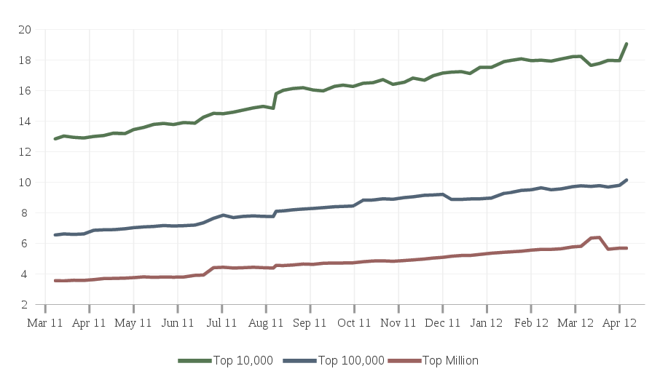
CDN Deployment, April 2012
%
Source: http://trends.builtwith.com/CDN/Content-Delivery-Network
Notes:
CDNs are increasingly popular
* suggests that website I/O is read-mostly
Types of CDNs:
* proprietary, origin server-specific (fbcdn)
* leased; origin server-oriented (CacheFly, Akamai)
* ISP-oriented CDN (Verivue Hypercache)
* semi-open proxies (CoBlitz)

Slide 5
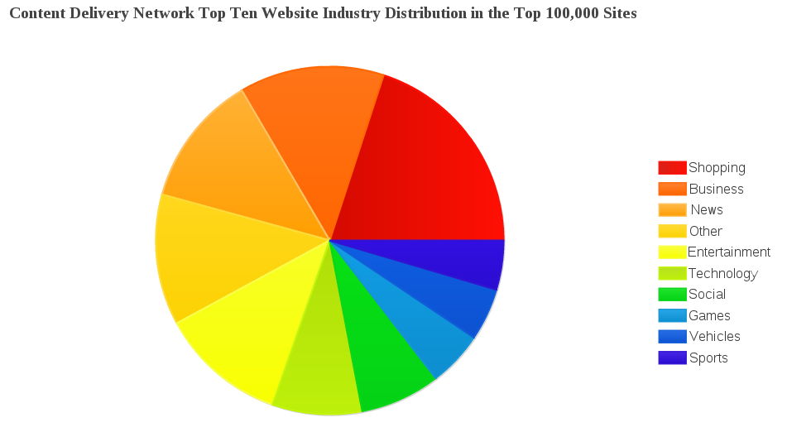
Sites using CDNs, by Category
Source: http://trends.builtwith.com/CDN/Content-Delivery-Network
Notes:
* Suggests CDNs are good for largely static, large-ish data (like images and video)
* Universally useful for web content

Slide 6
CDNs are becoming a common part of the Internet infrastructure
...but how do they handle writes?

Slide 7


Writes with a CDN
No cheap way to detect writes
  Infer writes through hints
  Caches achieve eventual consistency
What happens before caches are consistent?
  Reads give invalid data

Slide 8
Avoiding Cache Inconsistency

Slide 9
Avoiding Cache Inconsistency
Explicit cache invalidation? Do not want!
  Expensive; hard to secure

Slide 10

Avoiding Cache Inconsistency
Explicit cache invalidation? Do not want!
  Expensive; hard to secure
Change URL atomically on write()? Works!
  Special storage system
  Readers learn new URL

Slide 11
Avoiding Cache Inconsistency
Explicit cache invalidation? Do not want!
  Expensive; hard to secure
Change URL atomically on write? Works!
  Special storage system
  Readers learn new URL
Organize content URLs with Syndicate
  Close-to-open consistency despite the CDN

Slide 12
Filesystem as a Service
Feature | CDN | Syndicate
READS
Service many concurrent reads
Reduces read latency
Increases read bandwidth
Reduces reads on origin server
Reduces data transfer from origin server
WRITES
Writes allowed | Not always
Readers can tell if a file changed
Close-to-open consistency
STORAGE
Scalable amount of data
Notes:
* Can't handle writes because of:
* cache coherency
* cache consistency
* cache write-back not allowed
* Not to say that write support can't be done, but instead, you have to explicitly deal with the CDN
* WANT: CDN-agnosticism (better yet—we don't know it's there, and don't care)

Slide 13
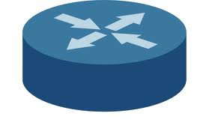
Distributed Filesystems Today
Internet
Cloud Storage
Provider
Readers
and
Writers
Ingress/Egress routers
Notes:
DEDICATED; HUGE STORAGE PROVIDER
MULTI-TENANT
SERVICE-ORIENTED; BSS;
BONUS: COMMON WEB PROTOCOLS; GENERIC
Cloud service provider: HPC filesystem internally
* Merges part of the older model
* High-throughput links to peering points; PoPs
* May or may not have a CDN helping deliery
* Client is a web application
* Cloud storage provider has its own protocols, but they tend to be web-oriented (HTTP(S))
* MS SkyDrive, Google Drive, DropBox, Box.net, S3

Slide 14
Distributed Filesystems Today
Internet
Cloud Storage
Provider
Readers
and
Writers
Ingress/Egress routers
Virtues
Scalable storage
Scalable I/O
Composability Problems
Stale data possible
Non-uniform interfaces
Notes:
DEDICATED; HUGE STORAGE PROVIDER
MULTI-TENANT
SERVICE-ORIENTED; BSS;
BONUS: COMMON WEB PROTOCOLS; GENERIC
Cloud service provider: HPC filesystem internally
* Merges part of the older model
* High-throughput links to peering points; PoPs
* May or may not have a CDN helping deliery
* Client is a web application
* Cloud storage provider has its own protocols, but they tend to be web-oriented (HTTP(S))
* MS SkyDrive, Google Drive, DropBox, Box.net, S3

Slide 15
Syndicate Contributions
Close-to-open consistency
  ...with arbitrary CDNs
  ...composed with arbitrary origin servers
Decouple persistence from read performance
  Prior work: one caused the other

Slide 16
Syndicate Components
CDN
Client
  Present Read/Write FS interface to local applications
  Origin server for locally-created data
Metadata Server
  Bind paths to URLs and metadata
Replica Server
  Translate between Syndicate and arbitrary storage

Slide 17
Architecture Overview
Metadata Servers
M
Applications
M
M
Replica Server
C
R
Client
Cloud Storage
CDN
C
Client
Notes:
LEVERAGE SERVICES
COMPOSE SERVICES WITH OURS
FUNDAMENTAL WIDE-AREA SERVICE?
* Decouple persistence from read performance
* CDN handles read performance
* Replica Server and client handle persistence
* Use arbitrary CDNs
* Client is a mash-up of web-services
* Replica Server
* CDN
* Metadata Server
All coalesce at the client
* Client decides the policies for its data and metadata

Slide 18
CDN
C
Serve cached data
Replica
Scratch Storage
Notes:
U_CDN can be used by a client to resolve cached data; the CDN makes this happen
T is an injective function that is publicly known that transforms the original URL U_origin into U_CDN
No-cache so the CDN won't cache data if we tell it so

Slide 19
CDN
C
Serve cached data
C
Request uncached data
Replica
Scratch Storage
Notes:
U_CDN can be used by a client to resolve cached data; the CDN makes this happen
T is an injective function that is publicly known that transforms the original URL U_origin into U_CDN
No-cache so the CDN won't cache data if we tell it so

Slide 20
CDN
C
Serve cached data
C
Request uncached data
R
Request uncached data
Replica
Scratch Storage
Notes:
U_CDN can be used by a client to resolve cached data; the CDN makes this happen
T is an injective function that is publicly known that transforms the original URL U_origin into U_CDN
No-cache so the CDN won't cache data if we tell it so

Slide 21
CDN
C
Serve cached data
C
Request uncached data
R
Request uncached data
Request uncached data
Replica
Scratch Storage
Notes:
U_CDN can be used by a client to resolve cached data; the CDN makes this happen
T is an injective function that is publicly known that transforms the original URL U_origin into U_CDN
No-cache so the CDN won't cache data if we tell it so

Slide 22
CDN
C
Serve cached data
C
Request uncached data
R
Request uncached data
Request uncached data
Cache Semantics
Exactly one replica URL UCDN
T(Uorigin) = UCDN
“No-cache” hint
Replica
Scratch Storage
Notes:
U_CDN can be used by a client to resolve cached data; the CDN makes this happen
T is an injective function that is publicly known that transforms the original URL U_origin into U_CDN
No-cache so the CDN won't cache data if we tell it so

Slide 23

Client
R
Replication
C
Stable Storage
Notes:
This is the SPECIFICATION!
Client is an interface to the replica server and metadata server, but will download data through the cache.
The client “mashes up” the metadata server (which defines the hierarchy) and replicas
The client hosts its local files for the CDN to get (and puts them into replica servers as desired)
The client must knows T and uses it
SSL only for Syndicate; the CDN is unencrypted
Composable clients for scalable amount of data

Slide 24
Client
R
Replication
CDN serve and request
C
Stable Storage
Notes:
This is the SPECIFICATION!
Client is an interface to the replica server and metadata server, but will download data through the cache.
The client “mashes up” the metadata server (which defines the hierarchy) and replicas
The client hosts its local files for the CDN to get (and puts them into replica servers as desired)
The client must knows T and uses it
SSL only for Syndicate; the CDN is unencrypted
Composable clients for scalable amount of data

Slide 25
Client
R
Replication
CDN serve and request
M
Metadata I/O
C
Stable Storage
Notes:
This is the SPECIFICATION!
Client is an interface to the replica server and metadata server, but will download data through the cache.
The client “mashes up” the metadata server (which defines the hierarchy) and replicas
The client hosts its local files for the CDN to get (and puts them into replica servers as desired)
The client must knows T and uses it
SSL only for Syndicate; the CDN is unencrypted
Composable clients for scalable amount of data

Slide 26
Client
R
Replication
CDN serve and request
M
Metadata I/O
C
Stable Storage
A
Service application FS requests
Notes:
This is the SPECIFICATION!
Client is an interface to the replica server and metadata server, but will download data through the cache.
The client “mashes up” the metadata server (which defines the hierarchy) and replicas
The client hosts its local files for the CDN to get (and puts them into replica servers as desired)
The client must knows T and uses it
SSL only for Syndicate; the CDN is unencrypted
Composable clients for scalable amount of data

Slide 27
Client
R
Replication
CDN serve and request
M
Metadata I/O
C
Stable Storage
A
Service application FS requests
Duties
Preserve and serve locally-created data
Create FS hierarchy from local and remote files
Translate FS operations to data and metadata I/O
Notes:
This is the SPECIFICATION!
Client is an interface to the replica server and metadata server, but will download data through the cache.
The client “mashes up” the metadata server (which defines the hierarchy) and replicas
The client hosts its local files for the CDN to get (and puts them into replica servers as desired)
The client must knows T and uses it
SSL only for Syndicate; the CDN is unencrypted
Composable clients for scalable amount of data

Slide 28
Namespace and Metadata
i-nodes in RAM
i-nodes have local or remote URL
A
B
C
D
E
F
Primary Replicas
Notes:
FIRST STEP: METADATA MUST BE IN SYNC
A-F are i-nodes
* There are “local” and “remote” files
* client-hosted files are primary replicas
* can convert between; more on that later
* Metadata includes
* per-file URLs,
* owner ID,
* metadata server ID
that identify where the data is, who created the data, and which server this metadata came from.
* refresh is per-directory; only refresh changed dirs
* A client can only remove its own files; replacement or unlink() on a remote file only removes the name from the FS

Slide 29
Namespace and Metadata
i-nodes in RAM
i-nodes have local or remote URL
A
A'
B
C
D
B
C
D
Refresh
E
F
E
F
(1) A changed
A → A'
Primary Replicas
Notes:
FIRST STEP: METADATA MUST BE IN SYNC
A-F are i-nodes
* There are “local” and “remote” files
* client-hosted files are primary replicas
* can convert between; more on that later
* Metadata includes
* per-file URLs,
* owner ID,
* metadata server ID
that identify where the data is, who created the data, and which server this metadata came from.
* refresh is per-directory; only refresh changed dirs
* A client can only remove its own files; replacement or unlink() on a remote file only removes the name from the FS

Slide 30
Namespace and Metadata
i-nodes in RAM
i-nodes have local or remote URL
A
A'
B
C
D
B
C'
D
Refresh
E
F
E
F
(1) A changed
A → A'
(2) C changed
C → C'
Primary Replicas
Notes:
FIRST STEP: METADATA MUST BE IN SYNC
A-F are i-nodes
* There are “local” and “remote” files
* client-hosted files are primary replicas
* can convert between; more on that later
* Metadata includes
* per-file URLs,
* owner ID,
* metadata server ID
that identify where the data is, who created the data, and which server this metadata came from.
* refresh is per-directory; only refresh changed dirs
* A client can only remove its own files; replacement or unlink() on a remote file only removes the name from the FS

Slide 31
Namespace and Metadata
i-nodes in RAM
i-nodes have local or remote URL
A
A'
B
C
D
B
C'
D
Refresh
E
F
E
(1) A changed
A → A'
(2) C changed
C → C'
(3) F unlinked remotely
Safety: only local unlink() removes primary replica data
Primary Replicas
Notes:
FIRST STEP: METADATA MUST BE IN SYNC
A-F are i-nodes
* There are “local” and “remote” files
* client-hosted files are primary replicas
* can convert between; more on that later
* Metadata includes
* per-file URLs,
* owner ID,
* metadata server ID
that identify where the data is, who created the data, and which server this metadata came from.
* refresh is per-directory; only refresh changed dirs
* A client can only remove its own files; replacement or unlink() on a remote file only removes the name from the FS

Slide 32
Namespace and Metadata
i-nodes in RAM
i-nodes have local or remote URL
A
A'
B
C
D
B
C'
D'
Refresh
E
F
E
(1) A changed
A → A'
(2) C changed
C → C'
(3) F unlinked remotely
(4) D written remotely
D → D'
Safety: only local unlink() removes primary replica data
Primary Replicas
Notes:
FIRST STEP: METADATA MUST BE IN SYNC
A-F are i-nodes
* There are “local” and “remote” files
* client-hosted files are primary replicas
* can convert between; more on that later
* Metadata includes
* per-file URLs,
* owner ID,
* metadata server ID
that identify where the data is, who created the data, and which server this metadata came from.
* refresh is per-directory; only refresh changed dirs
* A client can only remove its own files; replacement or unlink() on a remote file only removes the name from the FS

Slide 33
Reads
  Refresh metadata, then read
    Get latest URLs
    Local → underlying storage
    Remote → Given Uorigin, download T(Uorigin) = UCDN
  If a file changes, stop replicating it if we are
Writes
  On close(), republish the file
    Make new URL for next version
    Upload to metadata server
  Stop ongoing replications, if any
  Start replicating on last close()
Notes:
* Reads are normally synchronous with CDN
* Optimization: async. download smaller files to RAM or disk and cache them until fully closed or written to
Republish:
(1) Generate new URL, record new mtime
(2) Upload metadata to metadata server
(3) Keep data, even if metadata server rejects
But don't keep the name in the FS
If you write to a remote file, then download it first, store it locally (make it a local file), perform the write, and republish
Republishing replaces the existing metadata remotely
Client chooses how to refresh/republish (sync./async.)

Slide 34
A
B
M
App
C
C
write()
read()
Refresh /foo
Write to /foo/bar
Cache miss
Read /foo/bar
Corrupt data
(cache miss)
no-cache
Republish /foo/bar
Notes:
Synchronous metadata read: refresh directory metadata each time you perform a read operation
Synchronous metadata write: don't close the file until it's been replublished
Result: close-to-open consistency! B only is guaranteed to read the right data once A closes the file completely

Slide 35
A
B
M
App
C
C
write()
Write to /foo/bar
read()
Republish /foo/bar
Refresh /foo
Read /foo/bar
Redirect
Latest data
Notes:
Synchronous metadata read: refresh directory metadata each time you perform a read operation
Synchronous metadata write: don't close the file until it's been replublished
Result: close-to-open consistency! B only is guaranteed to read the right data once A closes the file completely

Slide 36
A
B
M
App
C
C
write()
Write to /foo/bar
Republish /foo/bar
read()
Refresh /foo
Cache miss
Cache Hit
Read /foo/bar
Latest data
Notes:
Synchronous metadata read: refresh directory metadata each time you perform a read operation
Synchronous metadata write: don't close the file until it's been replublished
Result: close-to-open consistency! B only is guaranteed to read the right data once A closes the file completely

Slide 37
Relaxed Consistency?
Don't always need close-to-open consistency
  The Web doesn't have it now
Lots of reads? Lots of writes?
  Asynchronous refresh/republish
GOAL: Only allow stale data on cache hit

Slide 38
A
B
M
App
C
C
write()
Cache miss
read()
Write to /foo/bar
Read /foo/bar
no-cache
Corrupt data
Notes:
Asynchronous metadata read: only refresh periodically for performance reasons; stale data possible even for synchronous writers
Asynchronous metadata write: buffer up and republish files in batches for performance reasons; stale data possible even for synchronous readers
Eventually, B sees the new data (but A's app closed before B sees the new data)

Slide 39
A
B
M
App
C
C
write()
Write to /foo/bar
read()
Cache hit
Read /foo/bar
Stale data
Republish /foo/bar
read()
Cache hit
Read /foo/bar
Stale data
Notes:
Asynchronous metadata read: only refresh periodically for performance reasons; stale data possible even for synchronous writers
Asynchronous metadata write: buffer up and republish files in batches for performance reasons; stale data possible even for synchronous readers
Eventually, B sees the new data (but A's app closed before B sees the new data)

Slide 40
A
B
M
App
C
C
write()
Write to /foo/bar
Republish /foo/bar
Cache miss
read()
Read /foo/bar
Redirect
Latest data
Notes:
Asynchronous metadata read: only refresh periodically for performance reasons; stale data possible even for synchronous writers
Asynchronous metadata write: buffer up and republish files in batches for performance reasons; stale data possible even for synchronous readers
Eventually, B sees the new data (but A's app closed before B sees the new data)

Slide 41
A
B
M
App
C
C
write()
Write to /foo/bar
Republish /foo/bar
Refresh /foo
Cache miss
Cache hit
read()
Read /foo/bar
Latest data
Notes:
Asynchronous metadata read: only refresh periodically for performance reasons; stale data possible even for synchronous writers
Asynchronous metadata write: buffer up and republish files in batches for performance reasons; stale data possible even for synchronous readers
Eventually, B sees the new data (but A's app closed before B sees the new data)

Slide 42
Metadata Server
M
Metadata replication
M
Master Copy
Notes:
Master copy—defines a Syndicate Volume
* unique GID field
* hierarchical representation of the FS metadata
Paxos for metadata replication—atomic writes, concurrent reads
Metadata entries are small-ish (~32K max)
POSIX-type access control with clients and replica servers
Authentication over SSL-encrypted channel
Metadata I/O encrypted or in the clear (user preference)

Slide 43
Metadata Server
M
Metadata replication
R
Replica validation; I/O
M
Master Copy
Notes:
Master copy—defines a Syndicate Volume
* unique GID field
* hierarchical representation of the FS metadata
Paxos for metadata replication—atomic writes, concurrent reads
Metadata entries are small-ish (~32K max)
POSIX-type access control with clients and replica servers
Authentication over SSL-encrypted channel
Metadata I/O encrypted or in the clear (user preference)

Slide 44
Metadata Server
M
Metadata replication
R
Replica validation; I/O
C
M
Client validation; I/O
Master Copy
Notes:
Master copy—defines a Syndicate Volume
* unique GID field
* hierarchical representation of the FS metadata
Paxos for metadata replication—atomic writes, concurrent reads
Metadata entries are small-ish (~32K max)
POSIX-type access control with clients and replica servers
Authentication over SSL-encrypted channel
Metadata I/O encrypted or in the clear (user preference)

Slide 45
Metadata Server
M
Metadata replication
R
Replica validation; I/O
C
M
Client validation; I/O
Duties
Order I/O from clients, replica servers
Authoritative FS state
CRUD semantics on metadata entries
Master Copy
Notes:
Master copy—defines a Syndicate Volume
* unique GID field
* hierarchical representation of the FS metadata
Paxos for metadata replication—atomic writes, concurrent reads
Metadata entries are small-ish (~32K max)
POSIX-type access control with clients and replica servers
Authentication over SSL-encrypted channel
Metadata I/O encrypted or in the clear (user preference)

Slide 46
A
B
M
C
C
MC
X
X
X
Y
Z
Y
Z
Y
Z
Notes:
Use reliable transport and loosely-synchronized clocks on clients and metadata server (e.g. ntpd)
Reject writes from outside a given window (+/- skew)
Total ordering of events up to a certain granularity—ensure that events from clients are tagged with the timestamp at which they occur, and re-order them at the metadata server.
Last-received-wins on concurrent write conflict
Concurrent writes are rare in practice—we have user studies to back it up
* users tend to write to only their own files
* users tend to prevent others from even reading their files, let alone writing to them

Slide 47
A
B
M
C
C
MC
X
X
X
Y
Z
Y
Z
Y
Z
Write Y
t1
At t1: Publish Y1
Notes:
Use reliable transport and loosely-synchronized clocks on clients and metadata server (e.g. ntpd)
Reject writes from outside a given window (+/- skew)
Total ordering of events up to a certain granularity—ensure that events from clients are tagged with the timestamp at which they occur, and re-order them at the metadata server.
Last-received-wins on concurrent write conflict
Concurrent writes are rare in practice—we have user studies to back it up
* users tend to write to only their own files
* users tend to prevent others from even reading their files, let alone writing to them

Slide 48
A
B
M
C
C
MC
X
X
X
Y
Z
Y
Z
Y
Z
Write Y
t1
At t1: Publish Y1
Reject if:
Access Denied
Too old or too new
Invalid primary replica
Notes:
Use reliable transport and loosely-synchronized clocks on clients and metadata server (e.g. ntpd)
Reject writes from outside a given window (+/- skew)
Total ordering of events up to a certain granularity—ensure that events from clients are tagged with the timestamp at which they occur, and re-order them at the metadata server.
Last-received-wins on concurrent write conflict
Concurrent writes are rare in practice—we have user studies to back it up
* users tend to write to only their own files
* users tend to prevent others from even reading their files, let alone writing to them

Slide 49
A
B
M
C
C
MC
X
X
X
Y
Z
Y
Z
Y
Z
Write Y
t1
Write Y
t2
At t2: Publish Y2
At t1: Publish Y1
Reject if:
Access Denied
Too old or too new
Invalid primary replica
Notes:
Use reliable transport and loosely-synchronized clocks on clients and metadata server (e.g. ntpd)
Reject writes from outside a given window (+/- skew)
Total ordering of events up to a certain granularity—ensure that events from clients are tagged with the timestamp at which they occur, and re-order them at the metadata server.
Last-received-wins on concurrent write conflict
Concurrent writes are rare in practice—we have user studies to back it up
* users tend to write to only their own files
* users tend to prevent others from even reading their files, let alone writing to them

Slide 50
A
B
M
C
C
MC
X
X
X
Y
Z
Y
Z
Y
Z
Write Y
t1
Write Y
t2
At t2: Publish Y2
At t1: Publish Y1
Reject if:
Access Denied
Too old or too new
Invalid primary replica
MC
X
Y2
Z
  “Adaptive Consistency—patterns of sharing in a networked world”
  “Filesystem usage in Windows NT 4.0”
TIE: last received wins
Notes:
Use reliable transport and loosely-synchronized clocks on clients and metadata server (e.g. ntpd)
Reject writes from outside a given window (+/- skew)
Total ordering of events up to a certain granularity—ensure that events from clients are tagged with the timestamp at which they occur, and re-order them at the metadata server.
Last-received-wins on concurrent write conflict
Concurrent writes are rare in practice—we have user studies to back it up
* users tend to write to only their own files
* users tend to prevent others from even reading their files, let alone writing to them

Slide 51
Replica Server
C
Receive replica, metadata, args
R
Metadata
for Replicas
Notes:
Client-controlled replication
Publish replica URL to metadata server like a client
* access control and timeliness enforced
* prevents stale replicas or invalid replicas
Forward user creds and args to storage driver
* storage driver is an extended CGI program
* storage driver can set replication policies for a particular back-end in addition to the back-end itself
All-in-all, not very different from an HTTP server
* except it has to talk to the metadata server

Slide 52
Replica Server
C
Receive replica, metadata, args
Serve replica to CDN
R
Metadata
for Replicas
Notes:
Client-controlled replication
Publish replica URL to metadata server like a client
* access control and timeliness enforced
* prevents stale replicas or invalid replicas
Forward user creds and args to storage driver
* storage driver is an extended CGI program
* storage driver can set replication policies for a particular back-end in addition to the back-end itself
All-in-all, not very different from an HTTP server
* except it has to talk to the metadata server

Slide 53
Replica Server
C
Receive replica, metadata, args
Serve replica to CDN
Upload/download replica data
R
Metadata
for Replicas
Notes:
Client-controlled replication
Publish replica URL to metadata server like a client
* access control and timeliness enforced
* prevents stale replicas or invalid replicas
Forward user creds and args to storage driver
* storage driver is an extended CGI program
* storage driver can set replication policies for a particular back-end in addition to the back-end itself
All-in-all, not very different from an HTTP server
* except it has to talk to the metadata server

Slide 54
Replica Server
C
Receive replica, metadata, args
Serve replica to CDN
Upload/download replica data
M
R
Replica republish
Metadata
for Replicas
Notes:
Client-controlled replication
Publish replica URL to metadata server like a client
* access control and timeliness enforced
* prevents stale replicas or invalid replicas
Forward user creds and args to storage driver
* storage driver is an extended CGI program
* storage driver can set replication policies for a particular back-end in addition to the back-end itself
All-in-all, not very different from an HTTP server
* except it has to talk to the metadata server

Slide 55
Replica Server
C
Receive replica, metadata, args
Serve replica to CDN
Upload/download replica data
M
R
Replica republish
Storage Gateway Service
One or more storage drivers for back-end policy
Client picks which driver; provides args and credentials
Client may cancel ongoing replications
Metadata
for Replicas
Notes:
Client-controlled replication
Publish replica URL to metadata server like a client
* access control and timeliness enforced
* prevents stale replicas or invalid replicas
Forward user creds and args to storage driver
* storage driver is an extended CGI program
* storage driver can set replication policies for a particular back-end in addition to the back-end itself
All-in-all, not very different from an HTTP server
* except it has to talk to the metadata server

Slide 56
R
M
C
REPLICATE
- driver
- driver args
- path
- metadata
- data
Notes:
Keep metadata for each replica around
* need to translate request for data into specific back-end request and forward data
* modification time, etc.
* needs to respond to metadata server revalidation

Slide 57
R
M
C
REPLICATE
- driver
- driver args
- path
- metadata
- data
VALIDATE
Notes:
Keep metadata for each replica around
* need to translate request for data into specific back-end request and forward data
* modification time, etc.
* needs to respond to metadata server revalidation

Slide 58

R
M
C
REPLICATE
- driver
- driver args
- path
- metadata
- data
VALIDATE
CGI
...ongoing upload...
...cloud-specific
upload protocol...
Notes:
Keep metadata for each replica around
* need to translate request for data into specific back-end request and forward data
* modification time, etc.
* needs to respond to metadata server revalidation

Slide 59
R
M
C
REPLICATE
- driver
- driver args
- path
- metadata
- data
VALIDATE
CGI
...ongoing upload...
...cloud-specific
upload protocol...
Republish
UPDATE
Notes:
Keep metadata for each replica around
* need to translate request for data into specific back-end request and forward data
* modification time, etc.
* needs to respond to metadata server revalidation

Slide 60
Failures Tolerated with Persistence
Client failure
Metadata server failure
Replica server failure
CDN failure
Optimization: periodic re-validation
    Promote secondary replicas
Notes:
Client: try a different replica
* can replicate to get around NATs
Metadata server: as long as you hold quorum...
* if quorum lost, then FS becomes R/O
Replica failure: try a different replica
Driver failure: try a different replica
Cloud failure: try a different replica server
CDN failure: contact replica host directly

Slide 61
Performance Goals
Remote reads match CDN performance
Fast write propagation with heavy reads
Acceptable local I/O

Slide 62
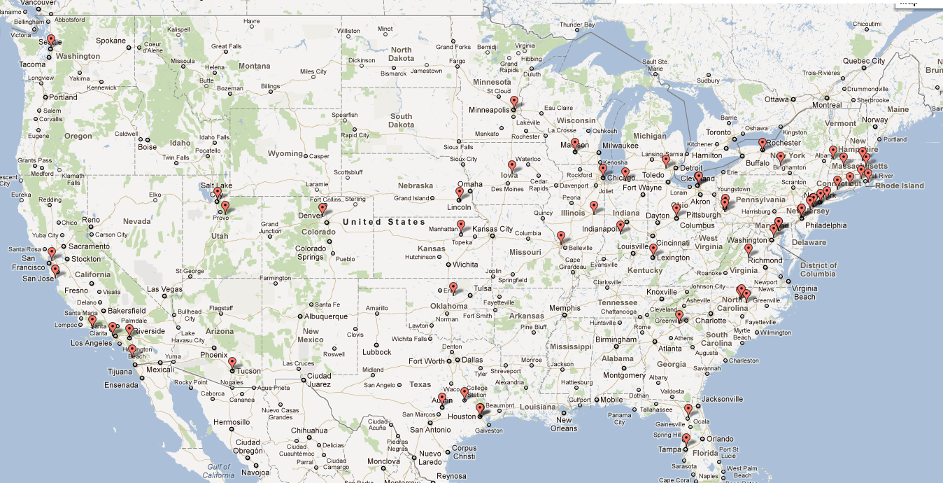


~100 PlanetLab nodes
40 VICCI nodes running CoBlitz HPC
1 VICCI node running CoBlitz RR
1 VICCI node for metadata server
Notes:
WHAT KINDS OF HARDWARE HAVE WE?
FUSE filesystem, 12,000 lines C/C++
Metadata server, 7,000 lines C/C++
Replica server, 2,000 lines C/C++
CoBlitz CDN in VICCI:
* 40 nodes; 10 at each site
* One DNS redirector; empty redirection map
Clients in PlanetLab: 100 nodes; all in the US
1-3 metadata servers (we'll vary it)
10 replica servers in VICCI

Slide 63
Remote Read Experiment
Size: 1M, 5M, 10M, 50M, 100M, 500M, 1000M
  Download each 5 times
  Record (start time, duration, size)
  Compare to curl
Stagger reads
  Wait 1 second between reads
  Start up to 60 seconds after mount
No secondary replicas

Slide 64
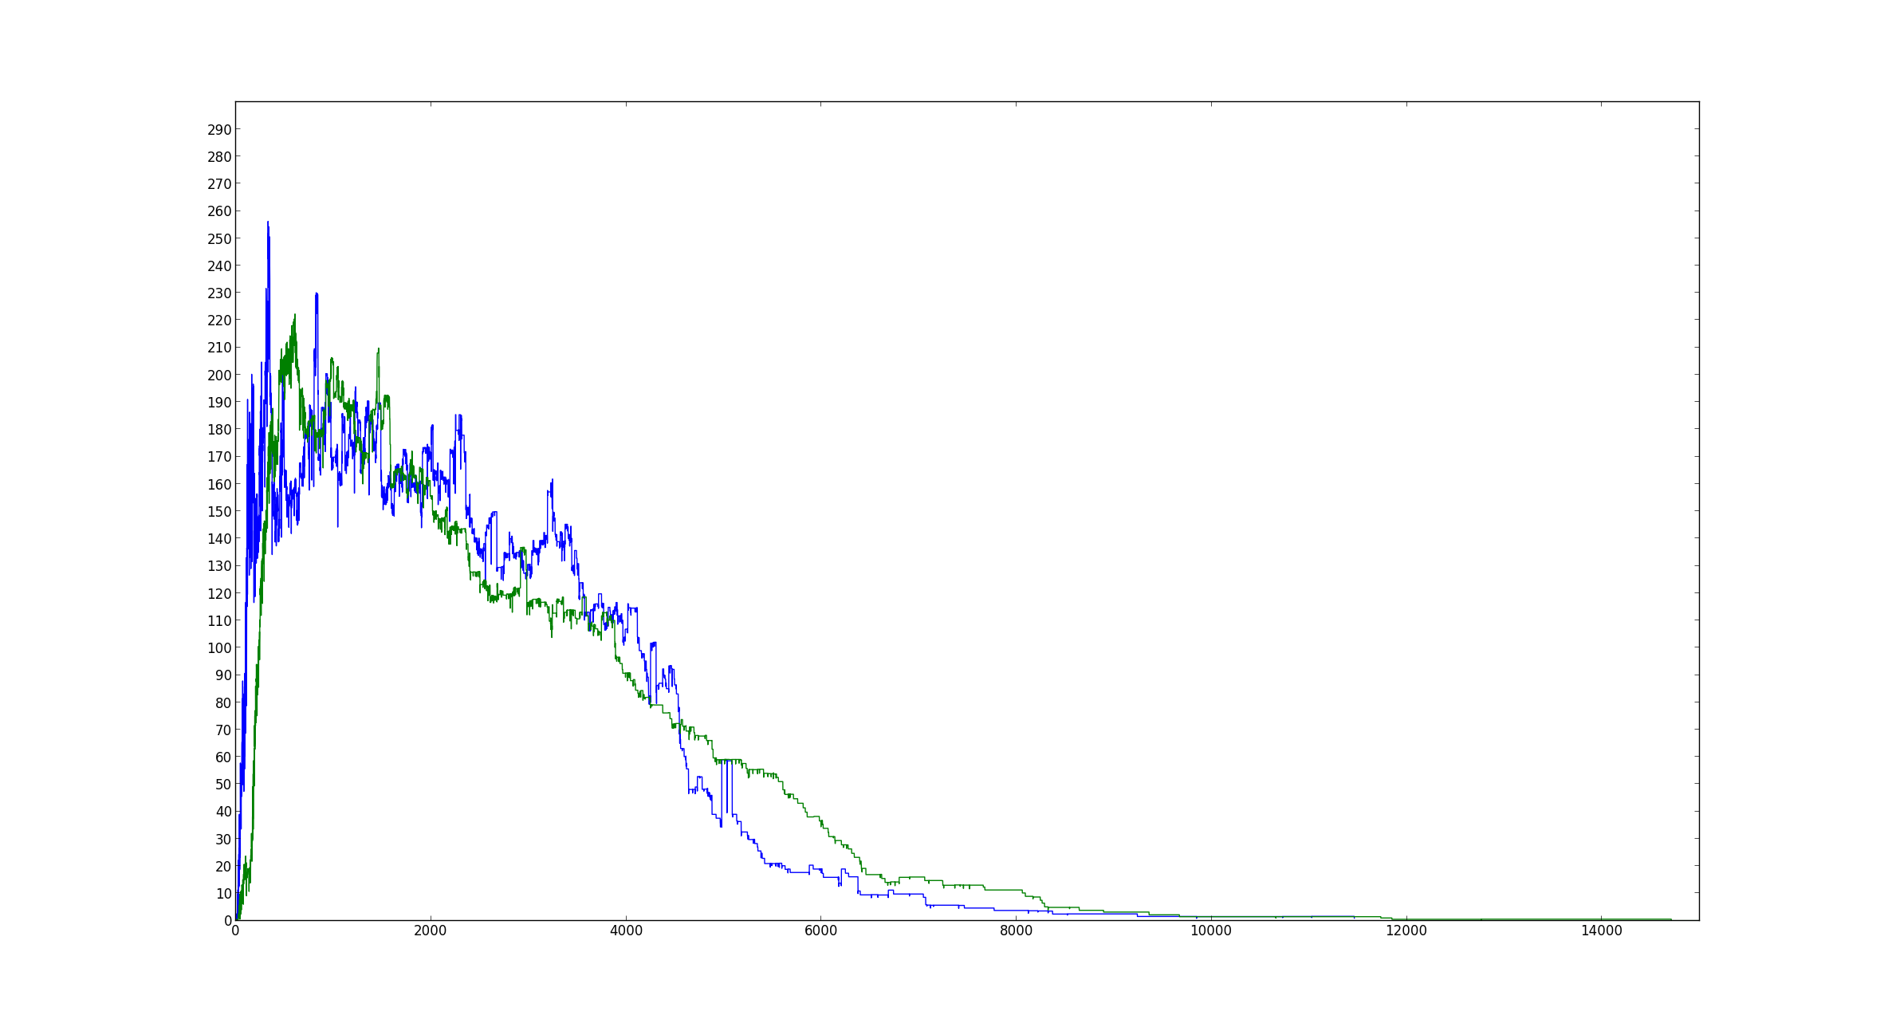
Experiment Aggregate Bandwidth
curl peak bandwidth (256.2 MB/s)
Syndicate peak bandwidth (222.2 MB/s)
Bandwidth (MB/s)
Origin server theoretical peak bandwidth (1 Gbps = 125 MB/s)
Recommend using a CDN for reads
curl
Syndicate

Slide 65
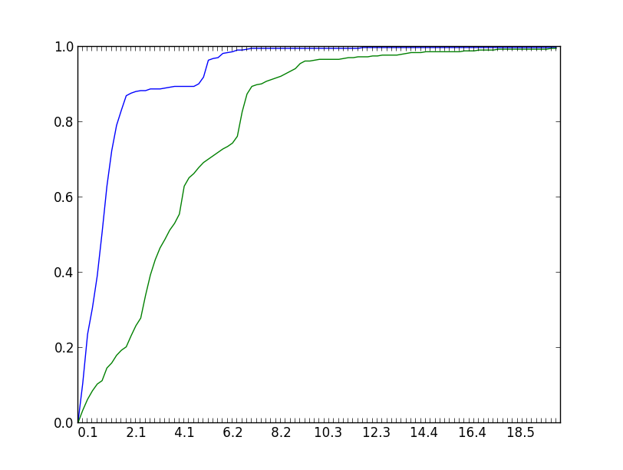
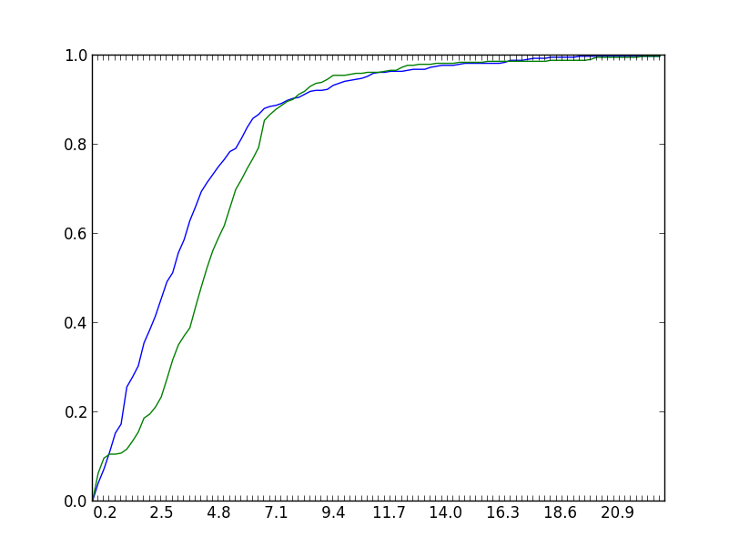
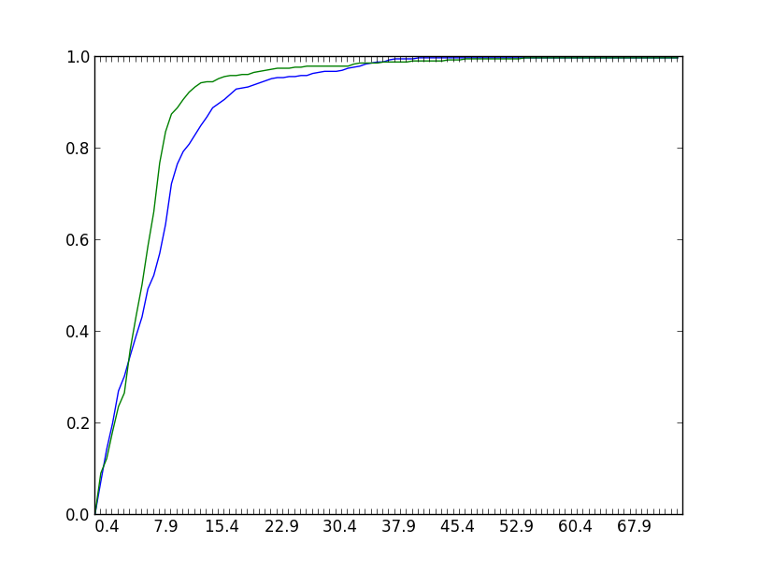
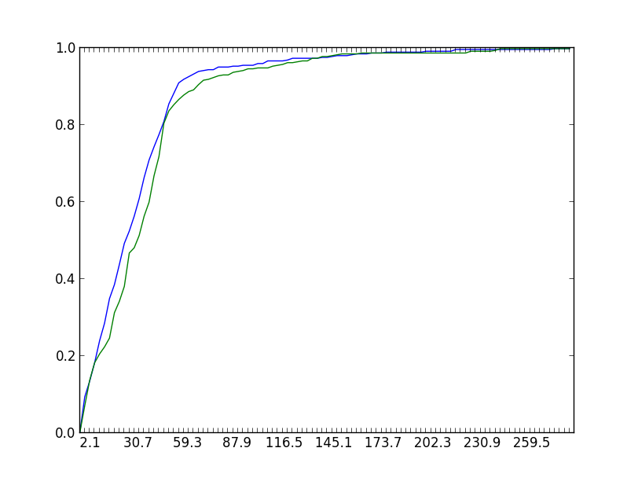
1 MB file
5 MB file
% complete before x
% complete before x
Time (s)
curl
Time (s)
Syndicate
50 MB file
10 MB file
% complete before x
% complete before x
Time (s)
Time (s)

Slide 66
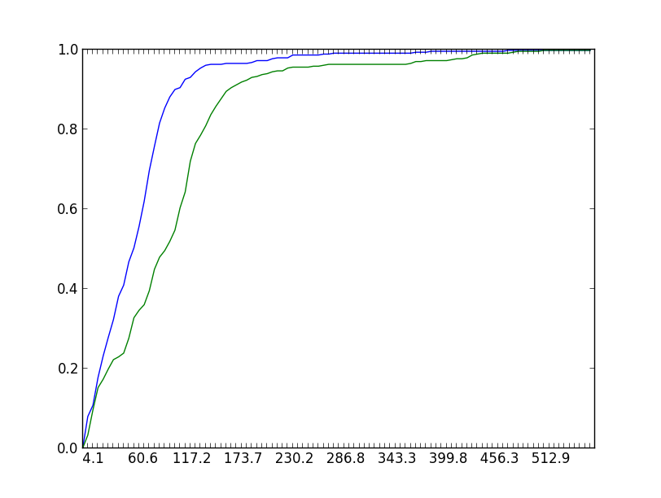
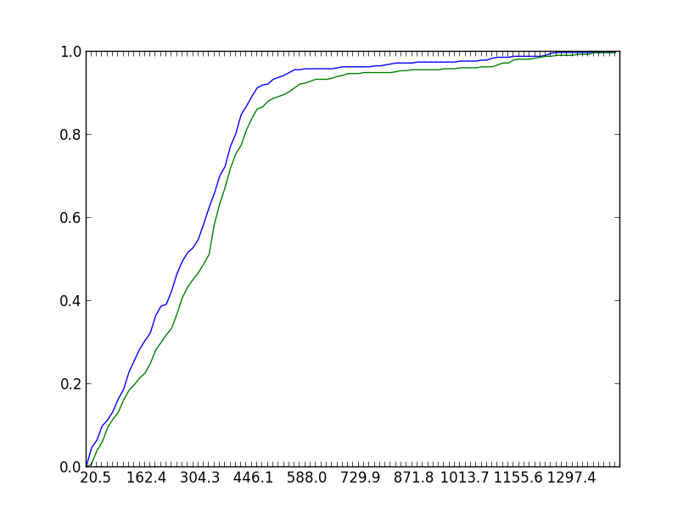
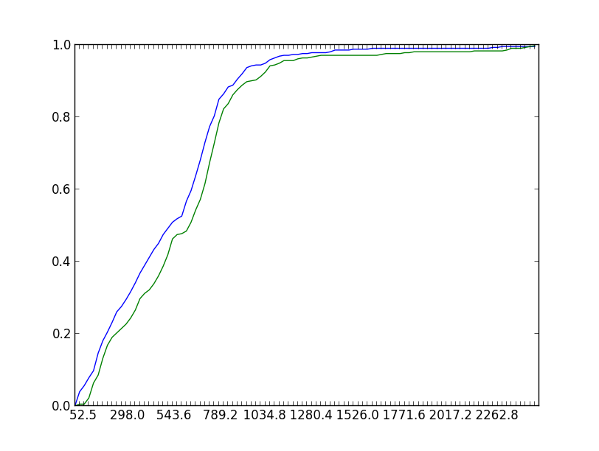
100 MB file
500 MB file
% complete before x
% complete before x
Time (s)
curl
Time (s)
Syndicate
1000 MB file
Aggregate remote read performance matches the underlying CDN read performance
% complete before x
Long tails caused by the
same set of bad nodes
Time (s)

Slide 67
Write Propagation Experiment
Republish a file 3x every second
100 readers check the file's URL every 100ms
  Requires 1x getattr() and 2x getxattr()
  Report times between observed changes
Count number of read, write ops per second

Slide 68
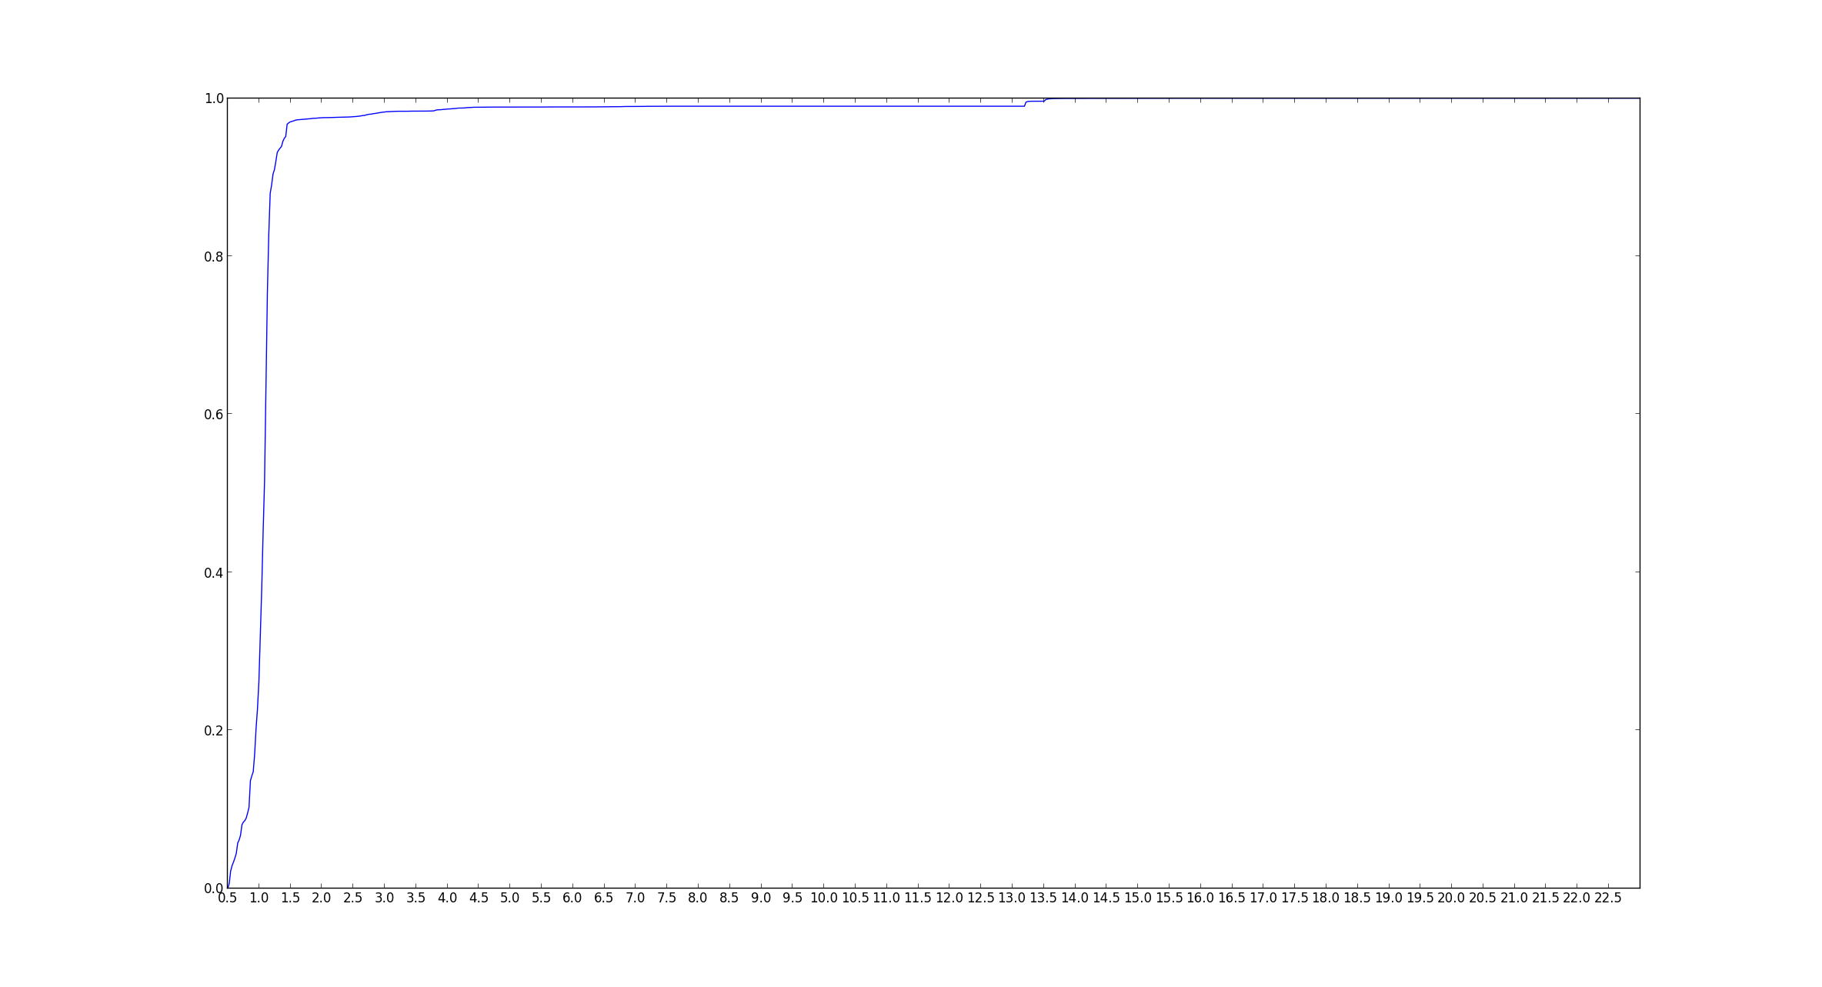
Reader-reported File Modification Intervals
The same bad
nodes as before
50th percentile: < 1.03s
90th percentile: < 1.25s
99th percentile: < 20.28s
Maximum 369 reads, 3 writes per second; ~10% CPU
Writes detected quickly;
Consider asynchronous I/O
% < x
Time (s)

Slide 69
Drag-and-Drop I/O Performance
TOOL: filebench create: 50,000 files, 16 threads
SIZE: Gamma distribution; mean size = 16K;
METADATA: asynchronous propagation
Operation | Num. Ops | Ops/sec | MB/s | ms/op | μs/op-cpu
creat | 50000 | 1190 | -- | 1.0 | 3554
write | 49986 | 1190 | 18.5 | 10.1 | 548
close | 49985 | 1990 | -- | 0.1 | 406
SyndicateFS client is about as fast as an SD card

Slide 70
Read/Write I/O Performance
TOOL: filebench copyfiles: 50,000 files, 16 threads
SIZE: Gamma distribution; mean size = 16K;
METADATA: asynchronous propagation
Operation | Num. Ops | Ops/sec | MB/s | ms/op | μs/op-cpu
creat | 50000 | 194 | -- | 5.5 | 160
open | 50016 | 194 | -- | 0.2 | 80
read | 50016 | 194 | 3.0 | 70.8 | 6047
write | 50000 | 194 | 3.0 | 5.4 | 482
close | 100000 | 194 | -- | 0.0 | 52
Do local I/O elsewhere; use client for publishing and downloading

Slide 71
Conclusions
Use a CDN for reading files whenever possible
Can get close-to-open consistency
Performance is separable from persistence
Unify storage through Filesystem as a Service

Slide 72
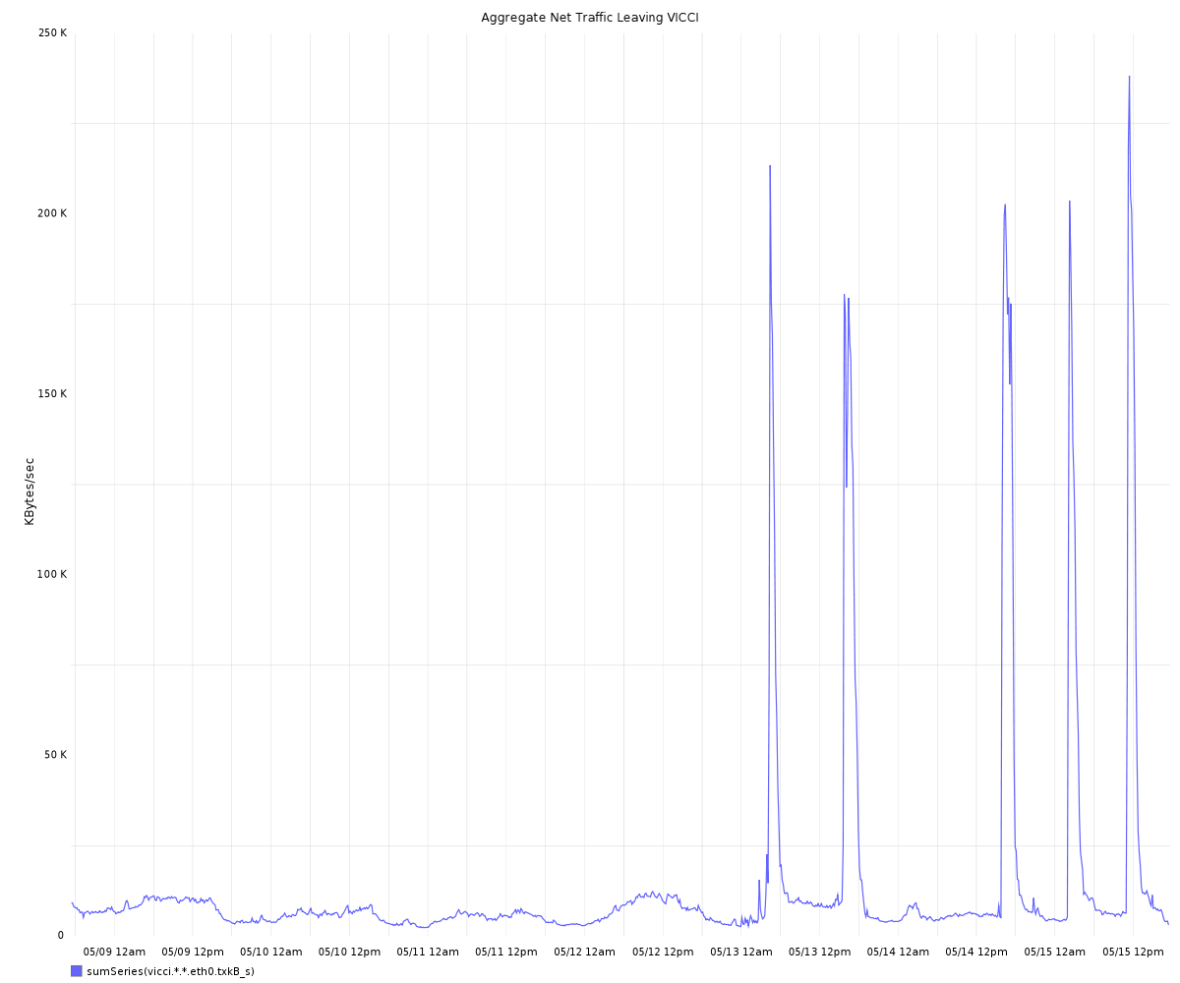
My experiments

Slide 73
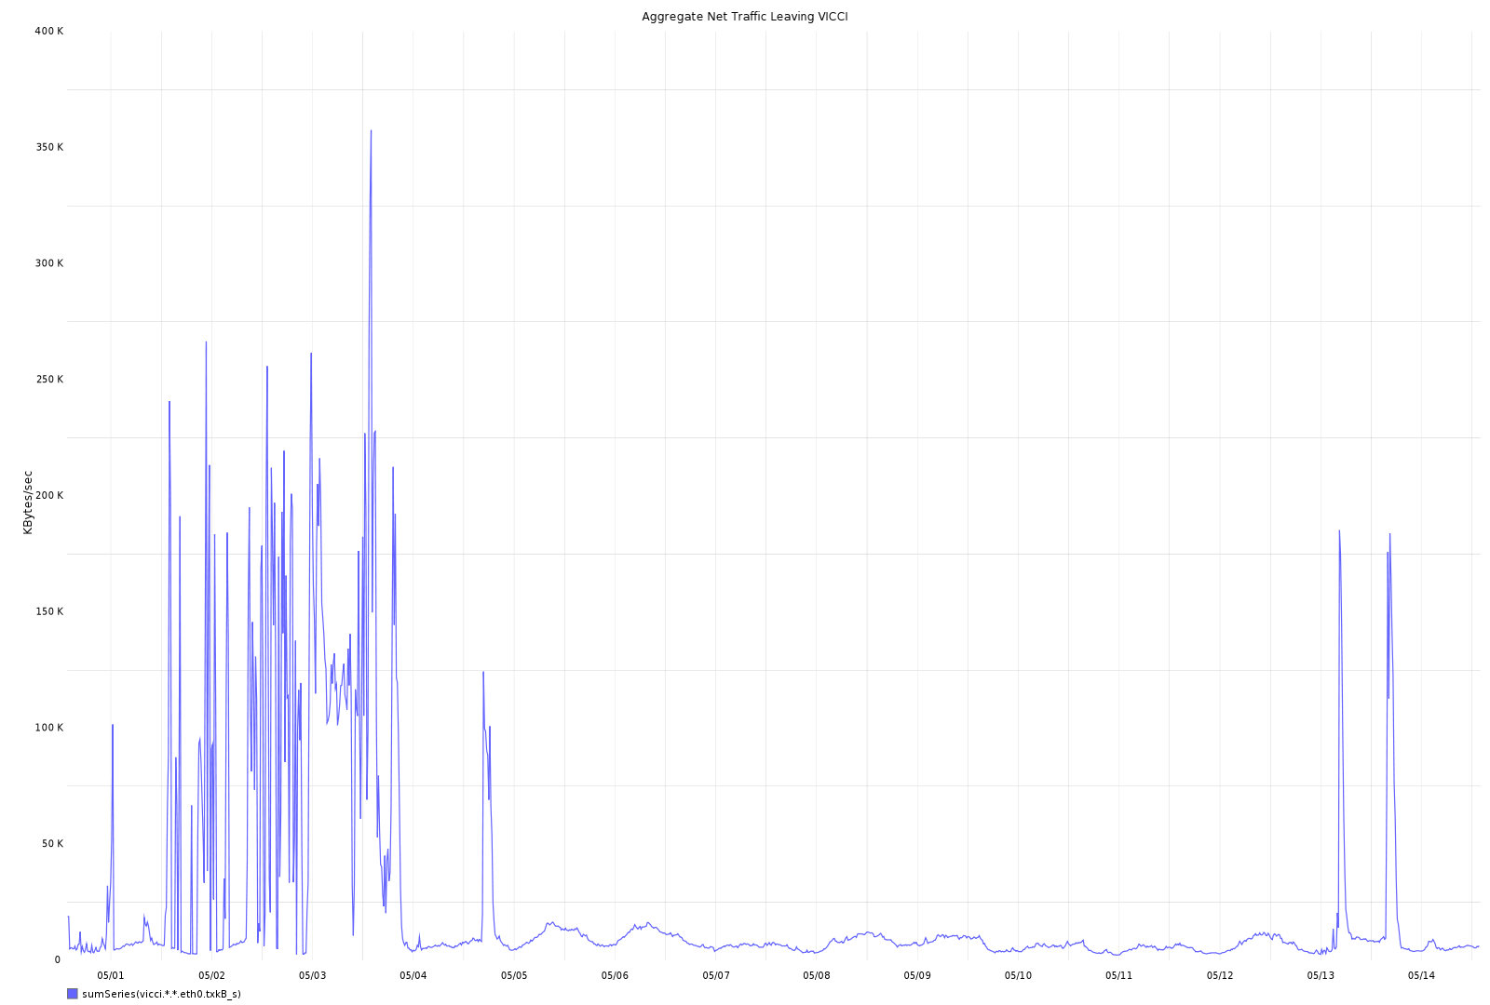
Testing CoBlitz
Syndicate experiments

