Slide 1
Desktop App
(Electron JS)
Client Side (Inside Browser)
ReactDOM
REACT
COMPONENT
Mobile Application
(React Native)
Server Side (Node JS)
ReactDOMServer
.Net App
(React .Net)

Slide 2
REACT COMPONENT
View (UI) – JSX
Styles – JSX/CSS/SCSS
Data
Inside (State)
Outside (Props)
Behavior - Interaction
Click Me
Button
UI – Rectangular/Square
Style – Grey Background
Caption (Data)
OnClick

Slide 3
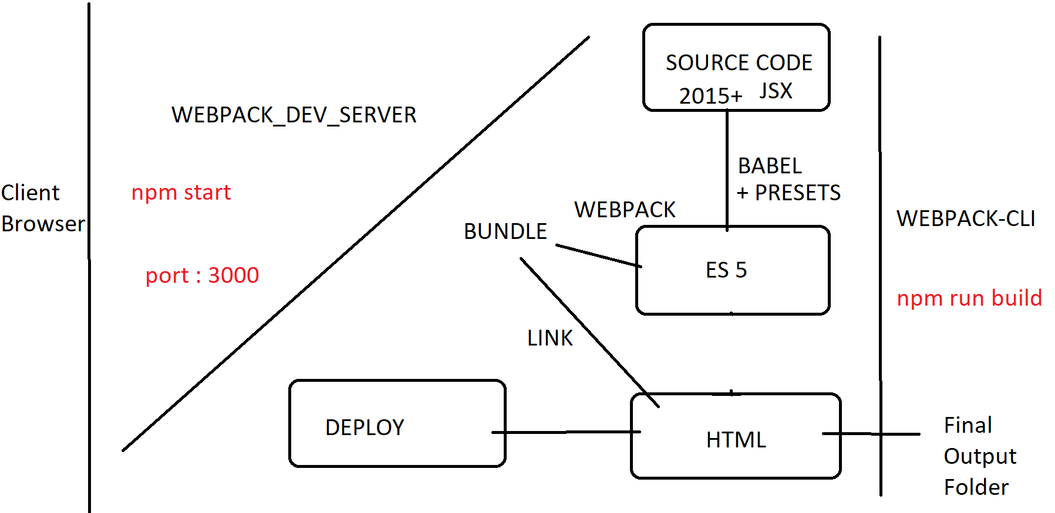

Slide 4
ROOT COMPONENT
MENU BAR
SIDE NAVIGATION
Display Area
Details Area

Slide 5
BROWSER
APPLICATION SERVER
localhost:3000
HTTP + URL
NAV BAR
HTML + CSS + JS
API SERVER
localhost:8000
AJAX POST + Username & Password
Username & Password
verified to generate token
Code Stores token in
session storage of Browser
JSON (Token)
AJAX Get + Token
Token is verified to provide
access to API
JSON

Slide 6
Root
DATA STORE
C1
C2

Slide 7
1
ACTION TYPES
Constants (string/symbol)
Will use action types to Identify
an action which is dispatched
Will use action types to
create an action object
3
R1
R2
R3
ACTION CREATOR
A function which creates and returns an Action object
ROOT REDUCER
REDUX STORE
Application State
2
4
ACTION OBJECT
Plain JavaScript Object
{
type: ActionType,
payload: data
}
5
CONTAINER COMPONENT
Dispatch
Action
PRESENTATIONAL COMPONENT (s)
6
Data Flow
mapDispatchToProps
mapStateToProps
Connect to Action Creator
Connect to Reducer

Slide 8
1
ACTION TYPES
Constants (string/symbol)
Will use action types to Identify
an action which is dispatched
Will use action types to
create an action object
3
R1
R2
R3
ACTION CREATOR
A function which creates and returns an Action object
Dispatch Action
ROOT REDUCER
REDUX STORE
Application State
API SERVER
2
REDUX THUNK MIDDLEWARE
Function
AJAX
4
ACTION OBJECT
Plain JavaScript Object
{
type: ActionType,
payload: data
}
5
CONTAINER COMPONENT
Dispatch
To Function
PRESENTATIONAL COMPONENT (s)
6
Data Flow
mapDispatchToProps
mapStateToProps
Connect to Action Creator
Connect to Reducer

