Slide 1
BROWSER
SERVER
HTTP + URL
NAVIGATION
HTML PAGES
CSS
HTML + CSS
HTTP + URL
HTML + CSS

Slide 2
BROWSER
SERVER
HTTP + URL
NAVIGATION
Server PAGES
CSS
HTML + CSS + JS
AJAX - HTTP + URL
JS
PARTIAL HTML
<table>
<thead>
<tr>
<th>ID</th>
</tr>
</thead>
<tbody>
<tr>
<td>1</td>
</tr>
</tbody>
</table>
ASP
ASP .Net
JSP
PHP
Ruby
Express JS
ASP .Net MVC
Spring MVC
Ruby On Rails
Laravel
DB

Slide 3
SPA – Single Page Application
SERVER
SERVER PAGES
CSS
BROWSER
HTTP + URL
NAVIGATION
JS
HTML + CSS + JS
(Client Side Code)
ASP
ASP .Net
JSP
PHP
Ruby
ASP .Net MVC
Spring MVC
Ruby On Rails
Express JS
Sails JS
<table>
<thead>
<tr>
<th>ID</th>
</tr>
</thead>
<tbody>
<tr>
<td>1</td>
</tr>
</tbody>
</table>
SERVER
AJAX - HTTP + URL
RESTful API
ASP .Net Web API
JWS
Express JS
Loopback
Python
DB
JSON to HTML on Client Side
JSON
{
“id”:1
}
Vanilla JS, jQuery, KO, BB, Angular 1
Angular 2 and above, React JS, Vue JS

Slide 4
SPA – Single Page Application
SERVER
SERVER PAGES
CSS
BROWSER
HTTP + URL
NAVIGATION
JS
HTML + CSS + JS
(Client Side Code)
ASP
ASP .Net
JSP
PHP
Ruby
ASP .Net MVC
Spring MVC
Ruby On Rails
Express JS
Sails JS
<table>
<thead>
<tr>
<th>ID</th>
</tr>
</thead>
<tbody>
<tr>
<td>1</td>
</tr>
</tbody>
</table>
API
GATEWAY
SERVICE
AJAX - HTTP + URL
DB
JSON
{
“id”:1
}
SERVICE
JSON to HTML on Client Side
DB
Vanilla JS, jQuery, KO, BB, Angular 1
Angular 2 and above, React JS, Vue JS
SERVICE
DB

Slide 5

JavaScript FullStack Application
 | Database | Application FW API FW | Client Side | Hosting / Runtime
MEAN | MongoDB | Express JS | Angular | Node
MERN | MongoDB | Express JS | React JS | Node
MEVN | MongoDB | Express JS | Vue JS | Node

Slide 6
NODE EXE (NODE PROCESS)
V8 Engine
Node JS Built-in API’s
Access the OS
Resources
Application
(JavaScript)
NATIVE CODE
O. S.

Slide 7
require(Path)
Module Loader will search for a file on the path specified
Y
N
Load and cache the file on the memory
Module Loader will search for a folder on the path specified
Y
N
Search inside folder, file with the name ‘package.json’
Error Loading Module
Y
N
N
In ‘package.json’, read ‘main’ key
Search inside folder, file with the name ‘index.js’
N
Y
Y
Search file mentioned in ‘main’
N
Load and cache the file on the memory
Y
Load and cache the file on the memory
NODE Module Resolution

Slide 8
Built In Modules
Module | Description
assert | Provides a set of assertion tests
buffer | To handle binary data
child_process | To run a child process
cluster | To split a single Node process into multiple processes
crypto | To handle OpenSSL cryptographic functions
dgram | Provides implementation of UDP datagram sockets
dns | To do DNS lookups and name resolution functions
events | To create and handle events
fs | To handle the file system
http | To make Node.js act as an HTTP server
https | To make Node.js act as an HTTPS server.

Slide 9
Built In Modules Continued
Module | Description
net | To create servers and clients
os | Provides information about the operation system
path | To handle file paths
querystring | To handle URL query strings
readline | To handle readable streams one line at the time
stream | To handle streaming data
string_decoder | To decode buffer objects into strings
timers | To execute a function after a given number of milliseconds
tls | To implement TLS and SSL protocols
tty | Provides classes used by a text terminal
url | To parse URL strings

Slide 10
Built In Modules Continued
Module | Description
util | To access utility functions
v8 | To access information about V8 (the JavaScript engine)
vm | To compile JavaScript code in a virtual machine
zlib | To compress or decompress files

Slide 11
ReadStream
HTTP responses, on the client
HTTP requests, on the server
fs read streams
zlib streams
crypto streams
TCP sockets
child process stdout and stderr
process.stdin

Slide 12
WriteStream
HTTP requests, on the client
HTTP responses, on the server
fs write streams
zlib streams
crypto streams
TCP sockets
child process stdin
process.stdout, process.stderr

Slide 13
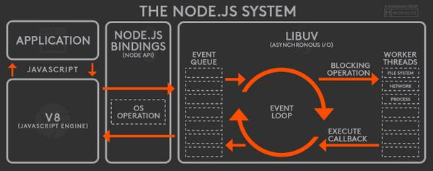

Slide 14
BankAccount Class
withdraw(amount)
deposit(amount)
Create BankAccount class with withdraw, deposit and other methods if needed.
Withdraw should show error if amount is greater than balance in account
Show message after withdraw and deposit call, showing current balance
Send a SMS after withdraw or deposit is called
Send an Email after withdraw or deposit is called
Follow SOLID principal’s of writing code
SMS Class
send(msg)
EMAIL Class
send(msg)
WhatsApp Class
send(msg)

Slide 15
N
Module Loader will search node_modules folder of your application
N
require(ModuleName)
Module Loader will search in built in modules
Y
Y
Module Loader will search for a file inside node_modules
Error Loading Module
Load the module on the memory
Y
N
Load and cache the file on the memory
Module Loader will search for a folder inside node_modules
Y
N
Search inside folder, file with the name ‘package.json’
Error Loading Module
Y
N
N
In ‘package.json’, read ‘main’ key
Search inside folder, file with the name ‘index.js’
N
Y
Y
Search file mentioned in ‘main’
N
Load and cache the file on the memory
Y
NODE Module Resolution
Load and cache the file on the memory

Slide 16
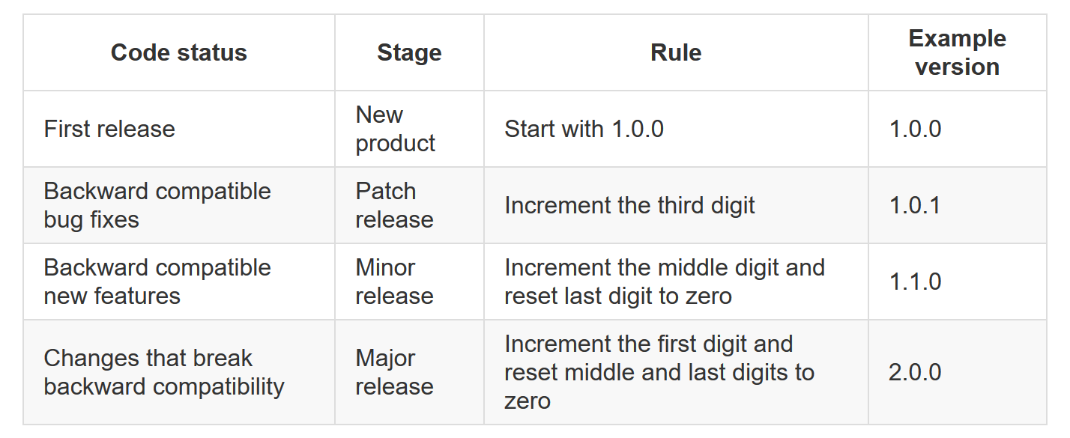

Slide 17
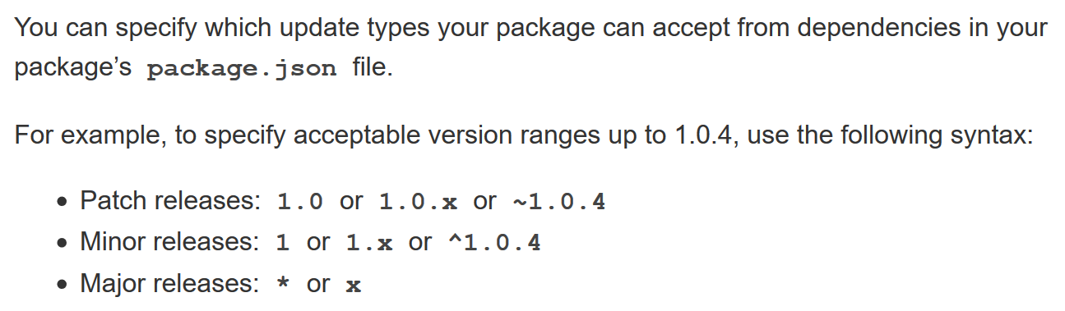

Slide 18
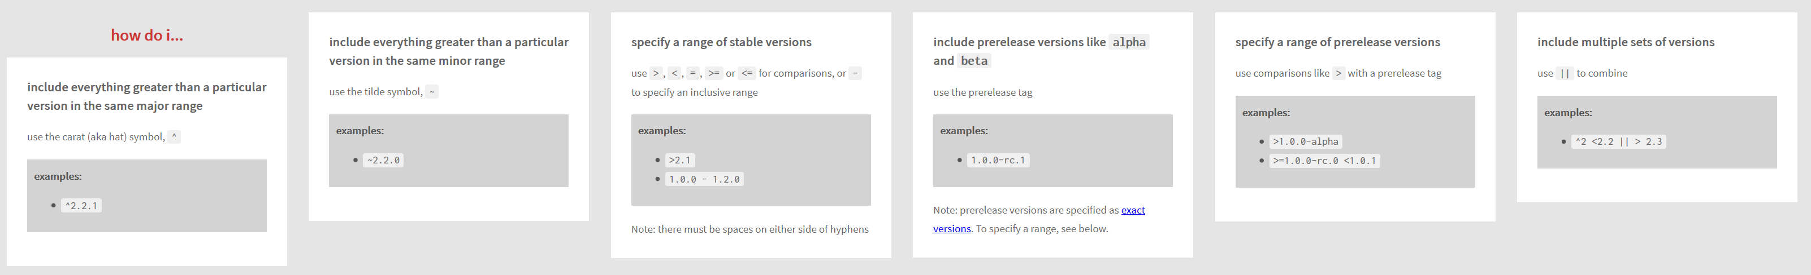

Slide 19
To install and uninstall production packages
npm install --save <package_name>
npm i <package_name>
npm i <package_name>@version
Eg
npm i chokidar@2
npm i chokidar@2.0
npm i chokidar@2.0.5
npm uninstall <package_name>
npm un <package_name>

Slide 20
To install and uninstall development packages
npm install --save-dev <package_name>
npm i –D <package_name>
npm i –D <package_name>@version
npm uninstall --save-dev <package_name>
npm un –D <package_name>

Slide 21
To install and uninstall global packages
npm install --global <package_name>
npm i –g <package_name>
npm i –g <package_name>@version
npm uninstall --global <package_name>
npm un –g <package_name>

Slide 22
WebSocket
WebSocket is a computer communications protocol, providing full-duplex communication channels over a single TCP connection.
The WebSocket protocol was standardized by the IETF as RFC 6455 in 2011
The WebSocket API in Web IDL is being standardized by the W3C.
WebSocket uses HTTP as the initial transport mechanism but keeps the TCP connection alive after the HTTP response is received so that it can be used for sending messages between client and server.

Slide 23
WebSocket
NODE SERVER
BROWSER
HTTP + URL
HTML + JS
I want WebSocket Communication (WS Request)
WebSocket Handshake
Accept the WS request
Acknowledgement

Slide 24

Express JS
Fast, unopinionated, minimalist web framework for Node.js
Express is a minimal and flexible Node.js web application framework that provides a robust set of features for web and mobile applications.
With a myriad of HTTP utility methods and middleware at your disposal, creating a robust API is quick and easy.

Slide 25
Express and Middleware
Express is a routing and middleware web framework that has minimal functionality of its own.
An Express application is essentially a series of middleware function calls.
Middleware is a subset of chained function called by the Express app before the user-defined handler is invoked.
Middleware functions have full access to the request and response objects and the next middleware function in the application’s request-response cycle.
Middleware functions can perform the following tasks:
Execute any code.
Make changes to the request and the response objects.
End the request-response cycle.
Call the next middleware function in the stack.

Slide 26
Request Processing Pipeline
REQUEST
RESPONSE
Middleware (Logging, Authentication, Authorization e.t.c.)

Slide 27
Types of middleware
An Express application can use the following types of middleware:
Application-level middleware
Router-level middleware
Error-handling middleware
Built-in middleware
Third-party middleware

Slide 28
DAL
2
1. REQUEST
3
ROUTER
6 . RESPONSE
4
5
VIEWS

Slide 29
DAL
3
4
1. REQUEST
ROUTER
2
CONTROLLER
8 . RESPONSE
7
5
6
VIEWS

Slide 30
Express-generator
npm install -g express-generator (Once)
To Create application
express --view=pug <app-name>
cd <app-name>
npm install
npm i -D nodemon
Change the start script in package.json to use nodemon
npm start

