Slide 1
BROWSER
SERVER
HTTP + URL
NAVIGATION
HTML PAGES
CSS
HTML + CSS
HTTP + URL
HTML + CSS

Slide 2
BROWSER
SERVER
HTTP + URL
NAVIGATION
Server PAGES
CSS
HTML + CSS + JS
AJAX - HTTP + URL
JS
PARTIAL HTML
<table>
<thead>
<tr>
<th>ID</th>
</tr>
</thead>
<tbody>
<tr>
<td>1</td>
</tr>
</tbody>
</table>
ASP
ASP .Net
JSP
PHP
Ruby
ASP .Net MVC
Spring MVC
Ruby On Rails
Laravel
DB

Slide 3
SERVER
SERVER PAGES
CSS
BROWSER
HTTP + URL
NAVIGATION
JS
HTML + CSS + JS
ASP
ASP .Net
JSP
PHP
Ruby
ASP .Net MVC
Spring MVC
Ruby On Rails
Express JS
<table>
<thead>
<tr>
<th>ID</th>
</tr>
</thead>
<tbody>
<tr>
<td>1</td>
</tr>
</tbody>
</table>
SERVER
AJAX - HTTP + URL
RESTful API
ASP .Net Web API
JWS
Express JS
Python
DB
JSON to HTML on Client Side
JSON
{
“id”:1
}
Vanilla JS, jQuery, KO, BB, Ng1, Ng2 & Above, React JS, Vue JS

Slide 4
BROWSER
SERVER
HTTP + URL
NAVIGATION
WEB APPLICATION
WEB APPLICATION
HTML + CSS + JS
(Angular / React / Vue)
<table>
<thead>
<tr>
<th>ID</th>
</tr>
</thead>
<tbody>
<tr>
<td>1</td>
</tr>
</tbody>
</table>
WEB API
AJAX - HTTP + URL
DB
JSON to HTML on Client Side
JSON
{
“id”:1
}
Vanilla JS, jQuery, KO, BB, Ng1, Ng2 & Above, React JS, Vue JS

Slide 5

FullStack Application
 | Database | Application FW / API FW | Client Side | Hosting / Server
MEAN | MongoDB | Express JS | Angular | Node
MERN | MongoDB | Express JS | React JS | Node
MEVN | MongoDB | Express JS | Vue JS | Node

Slide 6
Library vs Framework
Library | Framework
Collection of API’s, targeted to do one specific task | Collection of API’s, targeted for application creation. FW is a piece of code that dictates the architecture of your project.
You are in Full control when you call a method from a library and the control is then returned. | The code never calls into a FW, instead the FW uses your code. We can only follow a FW.
It can be integrated seamlessly into an existing project. | FW cannot be integrated, we have to re-write the code.
jQuery – DOM Manipulation & Ajax Date – Moment JS Data Visualization – D3 JS | Vue, Angular

Slide 7
Refer Vue FW on HTML Page
and compile everything on
Client Side
CLIENT SIDE BUILD
ES 2015 +
(Multiple Files)
Manual Configuration
Node JS
Webpack
Babel
Babel + Vue +
Preset (Env) +
Polyfill (core-js)
WEBPACK-DEV-
SERVER
ES5
(Multiple Files)
WEBPACK
CLI
Auto Configuration
Vue CLI
Bundling
(Webpack)
BROWSER
WEBPACK
ES5 (Single File)
Local
HTTP Server
HTML PAGE
Deploy
Inject Bundles

Slide 8
NAVIGATION
SIDE NAVIGATION
LIST AREA
DETAILS AREA
STATUS

Slide 9
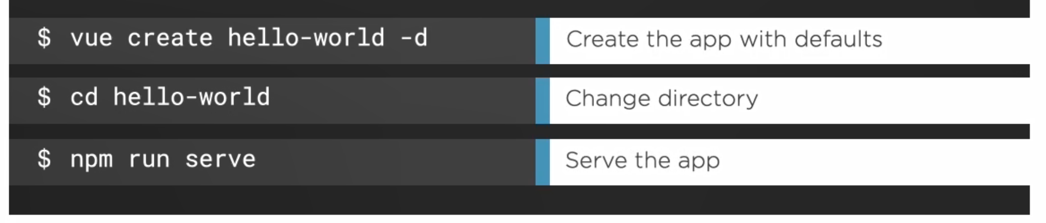
Vue CLI
Npm install –g @vue/cli
CLI
CLI Service (Built on top of Webpack & Webpack-dev-server)
CLI Plugins

Slide 10
<counter/> - Custom Components
VUE COMPONENT
UI – Template – HTML / JSX / PUG
STYLE (CSS) – CSS / JSX
BEHAVIOR – Methods – Interaction
DATA (Inside) – data()
DATA (Outside) – props

Slide 11
PARENT
PARENT
PARENT
Parent
Method
Reference
props
$emit
CHILD
CHILD
CHILD

Slide 12
Parent Component
CHILD Component
CHILD Component

Slide 13
CHILD Component
Parent Component
CHILD Component
$root.$emit + $root.$on
CHILD Component
EventBus
CHILD Component

Slide 14
Prop Type Checks
String
Number
Boolean
Array
Object
Date
Function
Symbol

Slide 15
Built In Directives
A directive is some special token in the markup that tells Vue to do something to a DOM element.
Built in Directives in Vue
v-text
v-html
v-show
v-if
v-else
v-else-if
v-for
v-on
v-bind
v-model
v-slot
v-pre
v-cloak
v-once

Slide 16
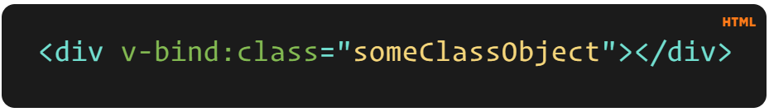
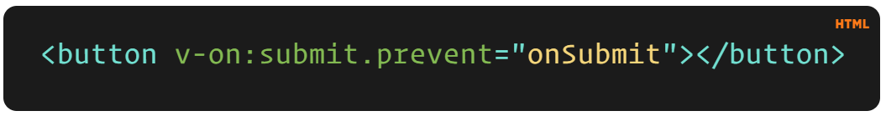
v-example="value" – this will pass a value into the directive, and the directive figures out what to do based off of that value.
v-example="'string'" – this will let you use a string as an expression.
v-example:arg="value" – this allows us to pass in an argument to the directive.
v-example:arg.modifier="value" – this allows us to use a modifier.

Slide 17
Directive Hooks
There are a few hooks available to us, and each one has the option of a few arguments. The hooks are as follows:
bind – This occurs once the directive is attached to the element.
inserted – This hook occurs once the element is inserted into the parent DOM.
update – This hook is called when the element updates, but children haven’t been updated yet.
componentUpdated – This hook is called once the component and the children have been updated.
unbind – This hook is called once the directive is removed.

Slide 18
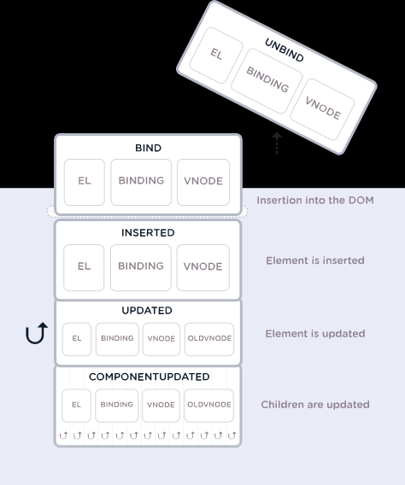

Slide 19
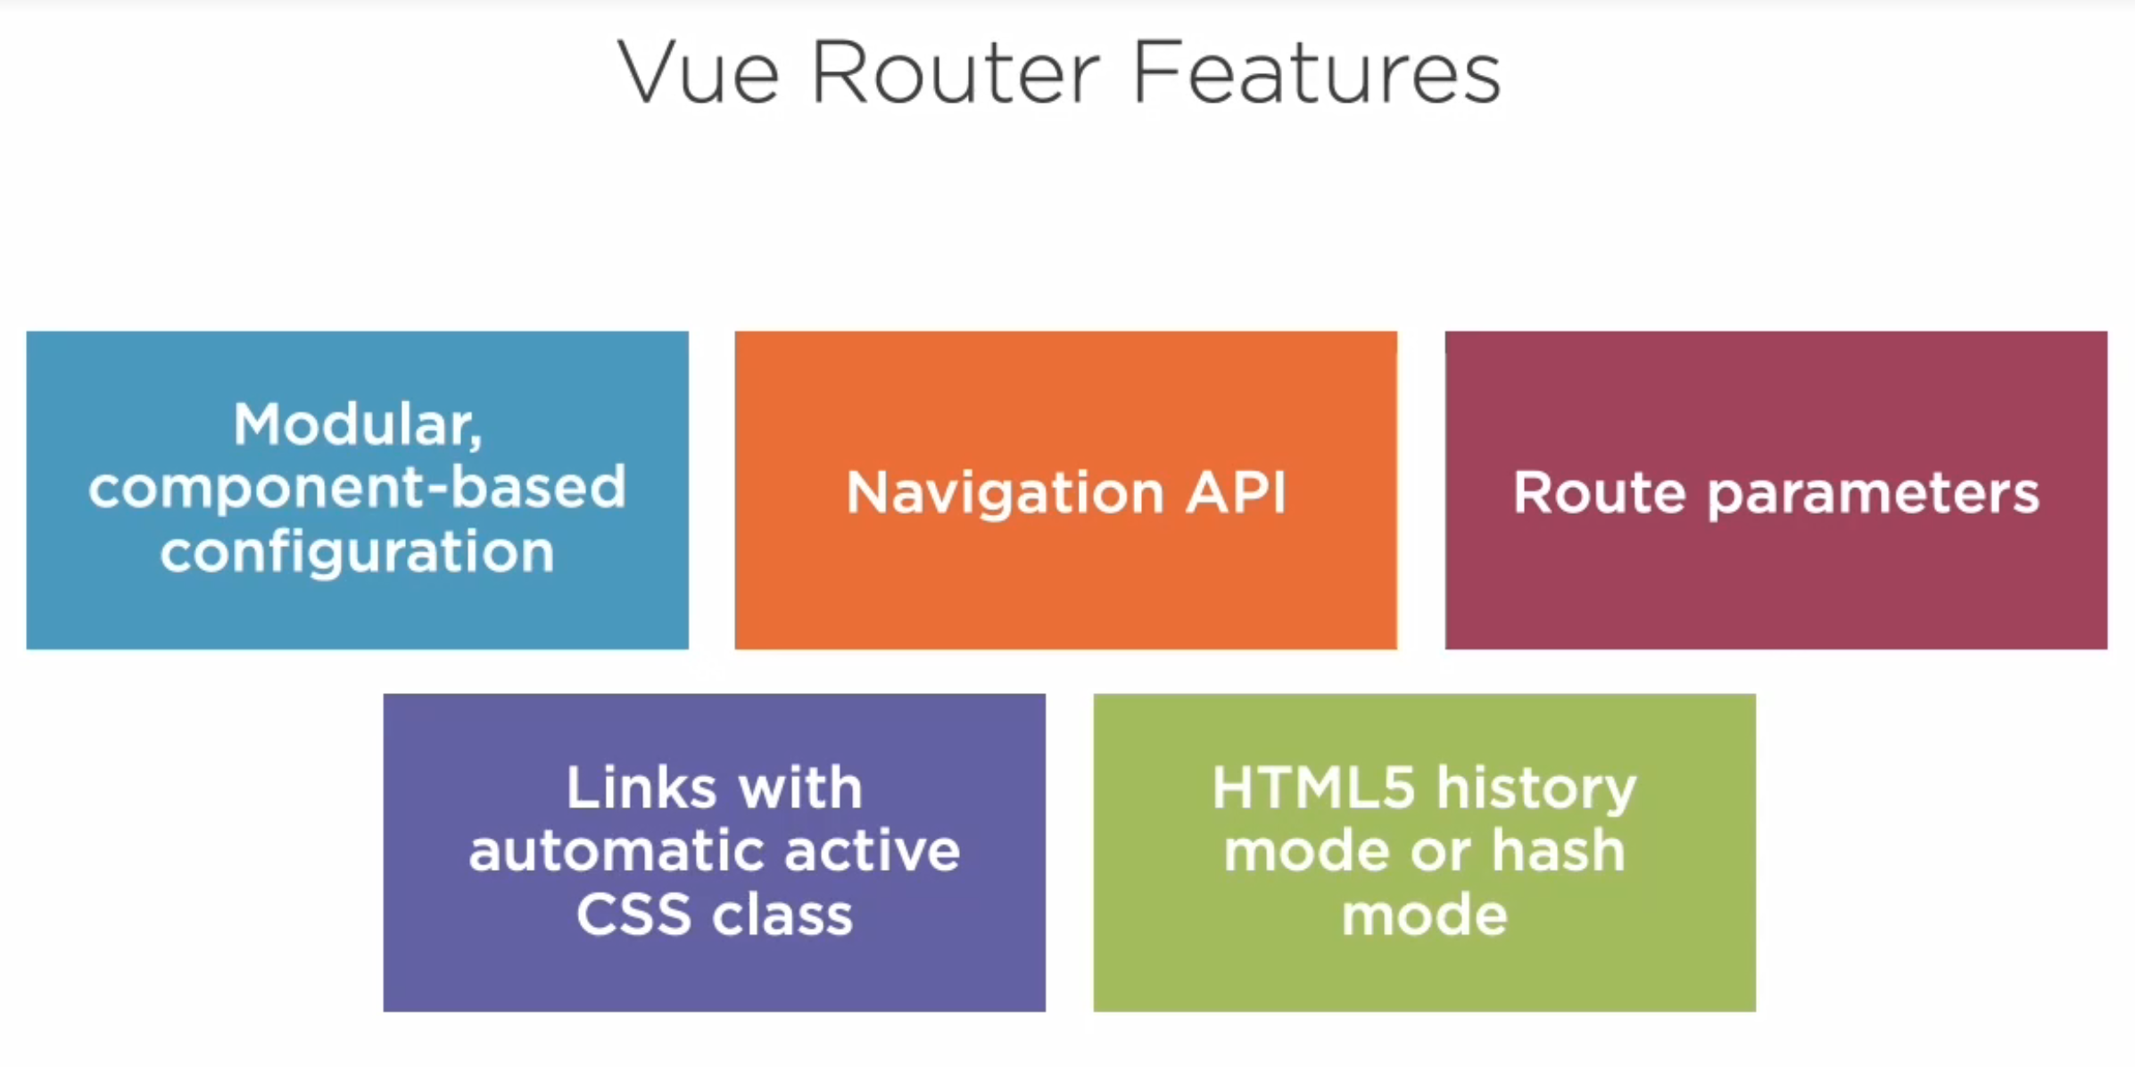

Slide 20
NODE SERVER
BROWSER
HTTP + URL (localhost:3000)
NAVIGATION
React Application
HTML Page + JS (Vue App)
NODE SERVER
EXPRESS JS
Web API
AJAX – localhost:8000/api/products
Database
JSON

Slide 21
NODE SERVER
BROWSER
HTTP + URL (localhost:3000)
NAVIGATION
React Application
Click on Admin link,
Will Verify token in
sessionStorage,
If not, you will be redirected
to Login
HTML Page + JS (Vue App)
HTTP + URL (AJAX) + Username & Password
NODE SERVER
Login Submit
EXPRESS JS
Web API
Store Token in Session
Storage of the browser
Send the same token to
Access data from the
Server using interceptor
JSON with Token
{“token”:”___”}
AJAX – localhost:8000/api/products
Database
JSON

Slide 22
Vue Router Guards
Global guards – These are called each time the URL changes
beforeEach, beforeResolve, afterEach
Route guards – These are only called when the associated ROUTE is matched
beforeEnter
Route Component guards – These are only called when a ROUTE COMPONENT is used/unused
beforeRouteEnter, beforeRouteUpdate, beforeRouteLeave

Slide 23
Vuex
Vuex is a state management pattern + library for Vue.js applications.
It serves as a centralized store for all the components in an application, with rules ensuring that the state can only be mutated in a predictable fashion.
It also integrates with Vue's official devtools extension to provide advanced features such as zero-config time-travel debugging.
By defining and separating the concepts involved in state management and enforcing rules that maintain independence between views and states, we give our code more structure and maintainability.
This is the basic idea behind Vuex, inspired by Flux, Redux and The Elm Architecture.

Slide 24
Actions
State
View

Slide 25
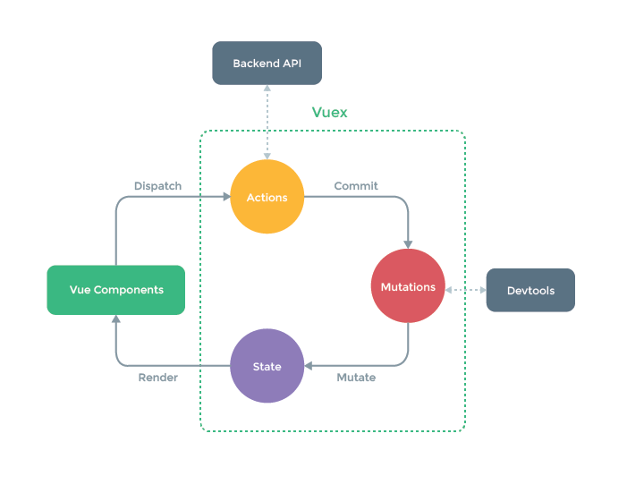

Slide 26
ACTIONS
VIEW
VIEW
STATE
ACTIONS

Slide 27
API
VUEX
ACTIONS
DISPATCH
COMMIT + DATA
VIEW
COMPONENTS
MUTATIONS
STORE
STATE
RENDER
MUTATE

Slide 28
Contact Me
Manish Sharma | Gmail
Manish Sharma | WhatsApp
Manish Sharma | Facebook
Manish Sharma | LinkedIn

