Slide 1

Vue JS
The Progressive JavaScript Framework

Slide 2
BROWSER
SERVER
HTTP + URL
NAVIGATION
HTML PAGES
CSS
HTML + CSS
HTTP + URL
HTML + CSS
Page
Reload!

Slide 3
BROWSER
SERVER
HTTP + URL
NAVIGATION
HTML + CSS
Server PAGES
CSS
HTTP + URL
ASP
ASP .Net
JSP
PHP
Ruby
HTML + CSS
Page
Reload!
DB

Slide 4
BROWSER
SERVER
HTTP + URL
NAVIGATION
Server PAGES
CSS
HTML + CSS + JS
AJAX - HTTP + URL
JS
Partial
Page
Reload!
PARTIAL HTML
<table>
<thead>
<tr>
<th>ID</th>
</tr>
</thead>
<tbody>
<tr>
<td>1</td>
</tr>
</tbody>
</table>
ASP
ASP .Net
JSP
PHP
Ruby
ASP .NET MVC
Spring MVC
Ruby On Rails
DB

Slide 5
SERVER
SERVER PAGES
CSS
BROWSER
HTTP + URL
NAVIGATION
JS
HTML + CSS + JS
(Client Side JS App)
ASP
ASP .NET
JSP
PHP
Ruby
ASP .NET MVC
Spring MVC
Ruby On Rails
<table>
<thead>
<tr>
<th>ID</th>
</tr>
</thead>
<tbody>
<tr>
<td>1</td>
</tr>
</tbody>
</table>
SERVER
AJAX - HTTP + URL
RESTful API
ASP .NET Web API
JWS
Express JS
Python
DB
JSON to HTML on Client Side
JSON
{
“id”:1
}
Vanilla JS, jQuery, KO, BB, NG 1,
NG 2 and Above, React, Vue

Slide 6
SERVER
SERVER PAGES
CSS
BROWSER
HTTP + URL
NAVIGATION
JS
HTML + CSS + JS
(Client Side JS App)
ASP
ASP .NET
JSP
PHP
Ruby
ASP .NET MVC
Spring MVC
Ruby On Rails
<table>
<thead>
<tr>
<th>ID</th>
</tr>
</thead>
<tbody>
<tr>
<td>1</td>
</tr>
</tbody>
</table>
Account
Service
AJAX - HTTP + URL
API GATEWAY
JSON
{
“id”:1
}
Inventory
Service
JSON to HTML on Client Side
Vanilla JS, jQuery, KO, BB, NG 1,
NG 2 and Above, React, Vue
Shipping
Service

Slide 7
JavaScript Full Stack Application
 | Database | Application FW API FW | Client Side | Runtime
MEAN | MongoDB | Express JS | Angular | Node
MERN | MongoDB | Express JS | React JS | Node
MEVN | MongoDB | Express JS | Vue JS | Node

Slide 8
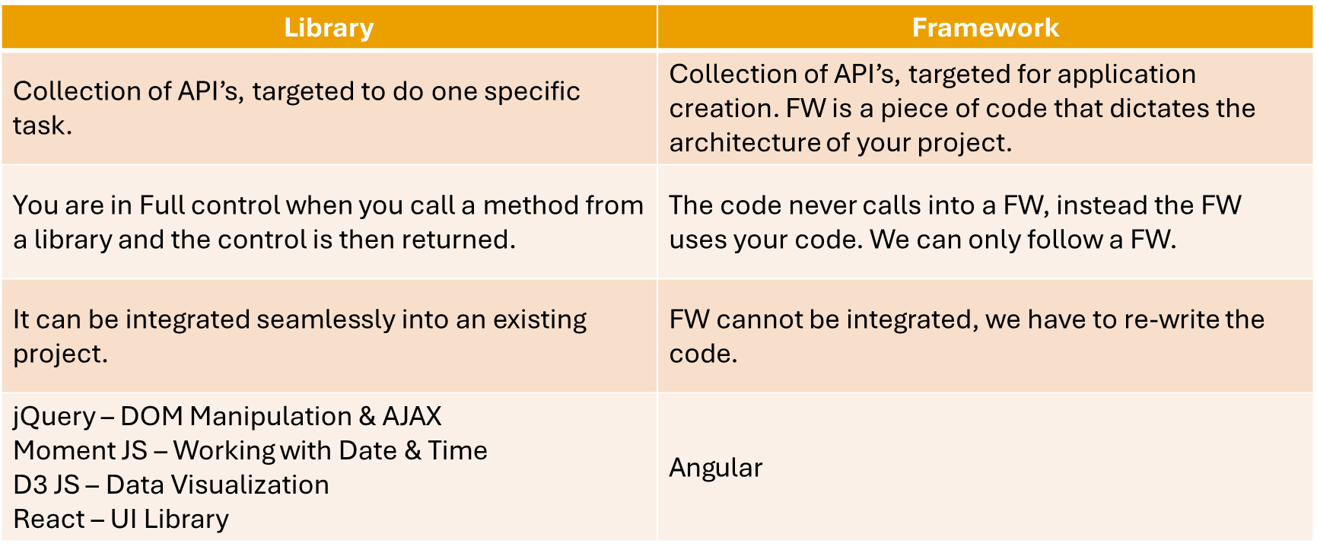
Library vs Framework

Slide 9
Vue JS
Vue is a progressive framework for building user interfaces.
Vue is designed from the ground up to be incrementally adoptable.
Vue is easy to pick up and integrate with other libraries or existing projects.
Vue is also perfectly capable of powering sophisticated Single-Page Applications when used in combination with modern tooling and supporting libraries.
Like Vue Router and Vuex

Slide 10
Installation
Install Node 14 LTS version - https://nodejs.org/en/
Install / Update Visual Studio Code to Latest Release - https://code.visualstudio.com/
Extensions of VS Code
AutoFileName
vscode-icons
JavaScript (ES6) code snippets
CSS Formatter
IntelliSense for CSS class names in HTML
Vetur
Vue VSCode Snippets
Extension for Chrome
Vue.js DevTools - https://chrome.google.com/webstore/detail/vuejs-devtools/nhdogjmejiglipccpnnnanhbledajbpd

Slide 11
Create Application
Refer Vue Framework JS file, on HTML Page and compile everything on the Client Side
If you want to create SPA
Manual Webpack + Babel Configuration
Auto Configuration
Vue CLI

Slide 12
ES 2015 +
(Multiple Files)
CLIENT-SIDE BUILD USING WEBPACK
Babel + Vue +
Preset (Env) +
Polyfill (core-js)
Build & Deploy your
Project on Local Server
Build your project
Browser Based Compatible Files
(Multiple Files)
WEBPACK-DEV-
SERVER
WEBPACK
CLI
Bundling
(Webpack)
BROWSER
WEBPACK
Single File / Set of Files
Local
HTTP Server
HTML PAGE
Inject Bundles

Slide 13
Vue CLI
Vue CLI is a full system for rapid Vue.js development, providing:
Interactive project scaffolding via @vue/cli.
Zero config rapid prototyping via @vue/cli + @vue/cli-service-global.
A runtime dependency (@vue/cli-service) that is:
Upgradeable;
Built on top of webpack, with sensible defaults;
Configurable via in-project config file;
Extensible via plugins
A rich collection of official plugins integrating the best tools in the frontend ecosystem.
A full graphical user interface to create and manage Vue.js projects

Slide 14
Components of Vue CLI
The CLI (@vue/cli) is a globally installed npm package and provides the vue command in your terminal. It provides the ability to quickly scaffold a new project via vue create, or instantly prototype new ideas via vue serve
The CLI Service (@vue/cli-service) is a development dependency. It's a npm package installed locally into every project created by @vue/cli.
CLI Plugins are npm packages that provide optional features to your Vue CLI projects, such as Babel/TypeScript transpilation, ESLint integration, unit testing, and end-to-end testing.

Slide 15
Install and Use Vue CLI
npm install -g @vue/cli
Check the installation using
vue --version
To Create a Vue Project
vue create vue-app (Will prompt for options)
cd vue-app
npm run serve
OR
vue create vue-core -d (With default options automatically picked)
cd vue-core
npm run serve

Slide 16
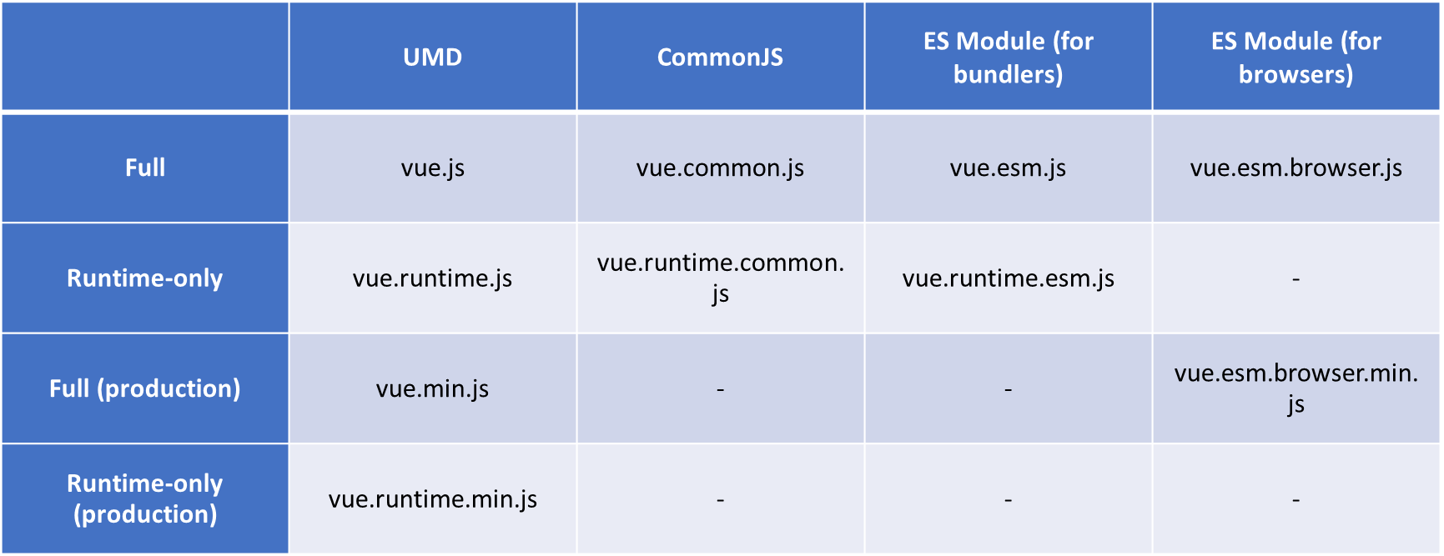
Vue Builds
In the dist/ directory of the NPM package you will find many different builds of Vue.js. Here’s an overview of the difference between them:

Slide 17
Vue JS App Builds
Compiler
code that is responsible for compiling template strings into JavaScript render functions.
Builds of Vue JS
Full Build
builds that contain both the compiler and the runtime.
Runtime Only (Pre-Compiled Templates)
code that is responsible for creating Vue instances, rendering and patching virtual DOM, etc. Basically everything minus the compiler.
UMD
UMD builds can be used directly in the browser via a <script> tag.
CommonJS:
CommonJS builds are intended for use with older bundlers like browserify or webpack 1.
ES Module: starting in 2.6 Vue provides two ES Modules (ESM) builds:
ESM for bundlers: intended for use with modern bundlers like webpack 2 and above or Rollup.
ESM for browsers (2.6+ only): intended for direct imports in modern browsers via <script type="module">.

Slide 18
Composite UI
NAV COMPONENT + CSS
SIDE NAV COMPONENT
+ CSS
LIST COMPONENT
+ CSS
DETAILS COMPONENT
+ CSS
STATUS COMPONENT + CSS

Slide 19
Component
VUE COMPONENT
UI
Template – HTML / JSX / PUG
STYLE – CSS / JSX
DATA (State)
Inside – data(), computed
Outside – props
BEHAVIOR – Methods (Interaction)

Slide 20
Style/CSS Loading
Element Inline Style
Scoped CSS
CSS Module
<style module>
Using external css file (create your files ending with .module.css)

Slide 21
Vue Configuration Object
Data
data
props
propsData
computed
methods
watch
DOM
el
template
render
renderError

Slide 22
Vue Configuration Object
Lifecycle Hooks
beforeCreate
created
beforeMount
mounted
beforeUpdate
updated
activated
deactivated
beforeDestroy
destroyed
errorCaptured
Assets
directives
filters
components

Slide 23
Vue Configuration Object
Composition
parent
mixins
extends
provide / inject
Misc
name
delimiters
functional
model
inheritAttrs
comments

Slide 24
Directives
Vue.js Directives are special HTML attributes that allow us to manipulate the DOM elements based on the multiple parameter or conditions.
Directives are very powerful, and they can be used for day-to-day development activities like hiding/show elements, adding/removing elements, and so on.
Common directives are v-if, v-for and v-model.

Slide 25
Built In Directives
A directive is some special token in the markup that tells Vue to do something to a DOM element.
Built in Directives in Vue
v-text
v-html
v-show
v-if
v-else
v-else-if
v-for
v-on
v-bind
v-model
v-slot
v-pre
v-cloak
v-once

Slide 26
Prop Type props: { propName: { type: ?, default: ?, required: ?, validator: ? } }
String
Number
Boolean
Array
Object
Date
Function
Symbol

Slide 27
Event Modifiers
.stop - stopPropagation
.prevent - preventDefault
.capture - for event capturing
.self - only when the element is used
.once - Fire Only Once
.passive - don't want to prevent the default behavior of the event

Slide 28
Key Modifiers
.enter
.tab
.ctrl
.alt
.shift
.meta
.delete (captures both “Delete” and “Backspace” keys)
.esc
.space
.up
.down
.left
.right
.exact

Slide 29
Mouse Button Modifiers
.left
.right
.middle

Slide 30
Data Binding
Data Binding is a automatic process of Synchronizing Data between two parties (Source and Target)
Source
State (data)
Props
Computed
Target
Template
Elements
{{Interpolation}} or directives (v-bind) – One Way
(v-on) Event Arguments – One Way to Source
v-model – Two Way

Slide 31
v-model – Two Way Binding
v-model
Create a two-way binding on a form input element or a component.
Limited to:
<input>
<select>
<textarea>
components
Modifiers
.lazy
.number
.trim

Slide 32
Parent Child Communication
PARENT
PARENT
PARENT
Props
$refs
Parent
Method
Reference
$emit
CHILD
CHILD
CHILD
Anti Pattern
Via Events

Slide 33
Sibling Communication
Parent Component
$emit
props
CHILD Component
1
CHILD Component
2

Slide 34
Sibling Communication
$emit
props
CHILD Component
1
Parent Component
CHILD Component
2
$emit
props
GRANDCHILD Component
1.1
GRANDCHILD Component
2.1

Slide 35
Sibling Communication – via Root
Root Component
CHILD Component
1
Parent Component
CHILD Component
2
GRANDCHILD Component
1.1
$root.$emit()
$root.$on()
GRANDCHILD Component
2.1

Slide 36
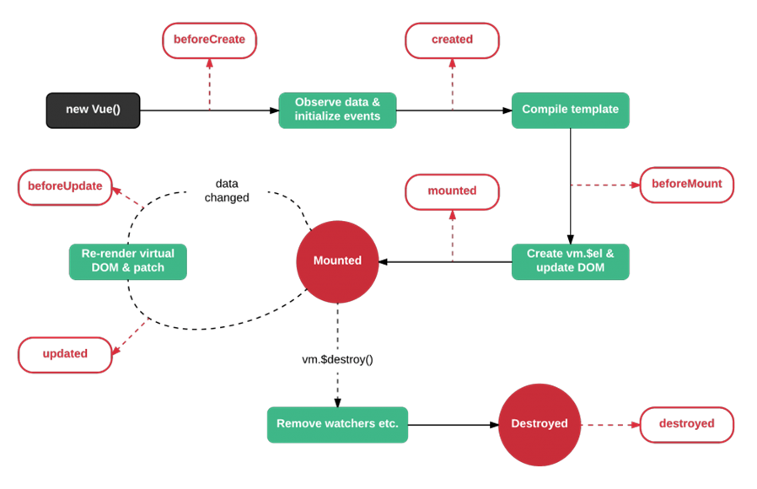
Vue Lifecycle methods

Slide 37
Sibling Communication – via EventBus
CHILD Component
1
Parent Component
CHILD Component
2
GRANDCHILD Component
1.1
GRANDCHILD Component
2.1
$emit
$on
EVENT BUS
Vue()

Slide 38
Slots
Oftentimes you will need to allow your parent Vue components to embed arbitrary content inside of child components. Vue provides a way to accomplish this with slots.
Vue implements a content distribution API inspired by the Web Components spec draft, using the <slot> element to serve as distribution outlets for content.

Slide 39
Filters
Vue.js allows you to define filters that can be used to apply common text formatting.
Filters are usable in two places: mustache interpolations and v-bind expressions.
Filters should be appended to the end of the JavaScript expression, denoted by the “pipe” symbol

Slide 40
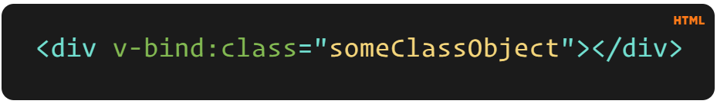
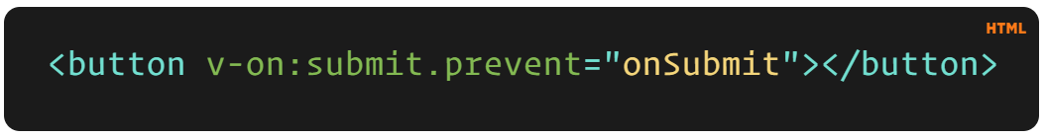
v-example="value" – this will pass a value into the directive, and the directive figures out what to do based off of that value.
v-example="'string'" – this will let you use a string as an expression.
v-example:arg="value" – this allows us to pass in an argument to the directive.
v-example:arg.modifier="value" – this allows us to use a modifier.

Slide 41
Directive Hooks
There are a few hooks available to us, and each one has the option of a few arguments. The hooks are as follows:
bind – This occurs once the directive is attached to the element.
inserted – This hook occurs once the element is inserted into the parent DOM.
update – This hook is called when the element updates, but children haven’t been updated yet.
componentUpdated – This hook is called once the component and the children have been updated.
unbind – This hook is called once the directive is removed.

Slide 42
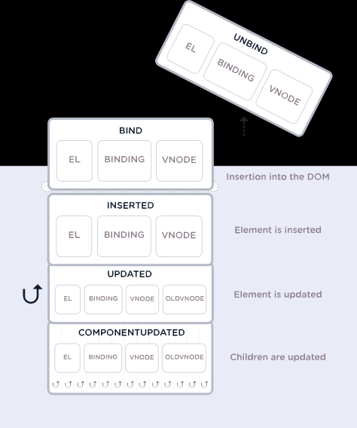

Slide 43
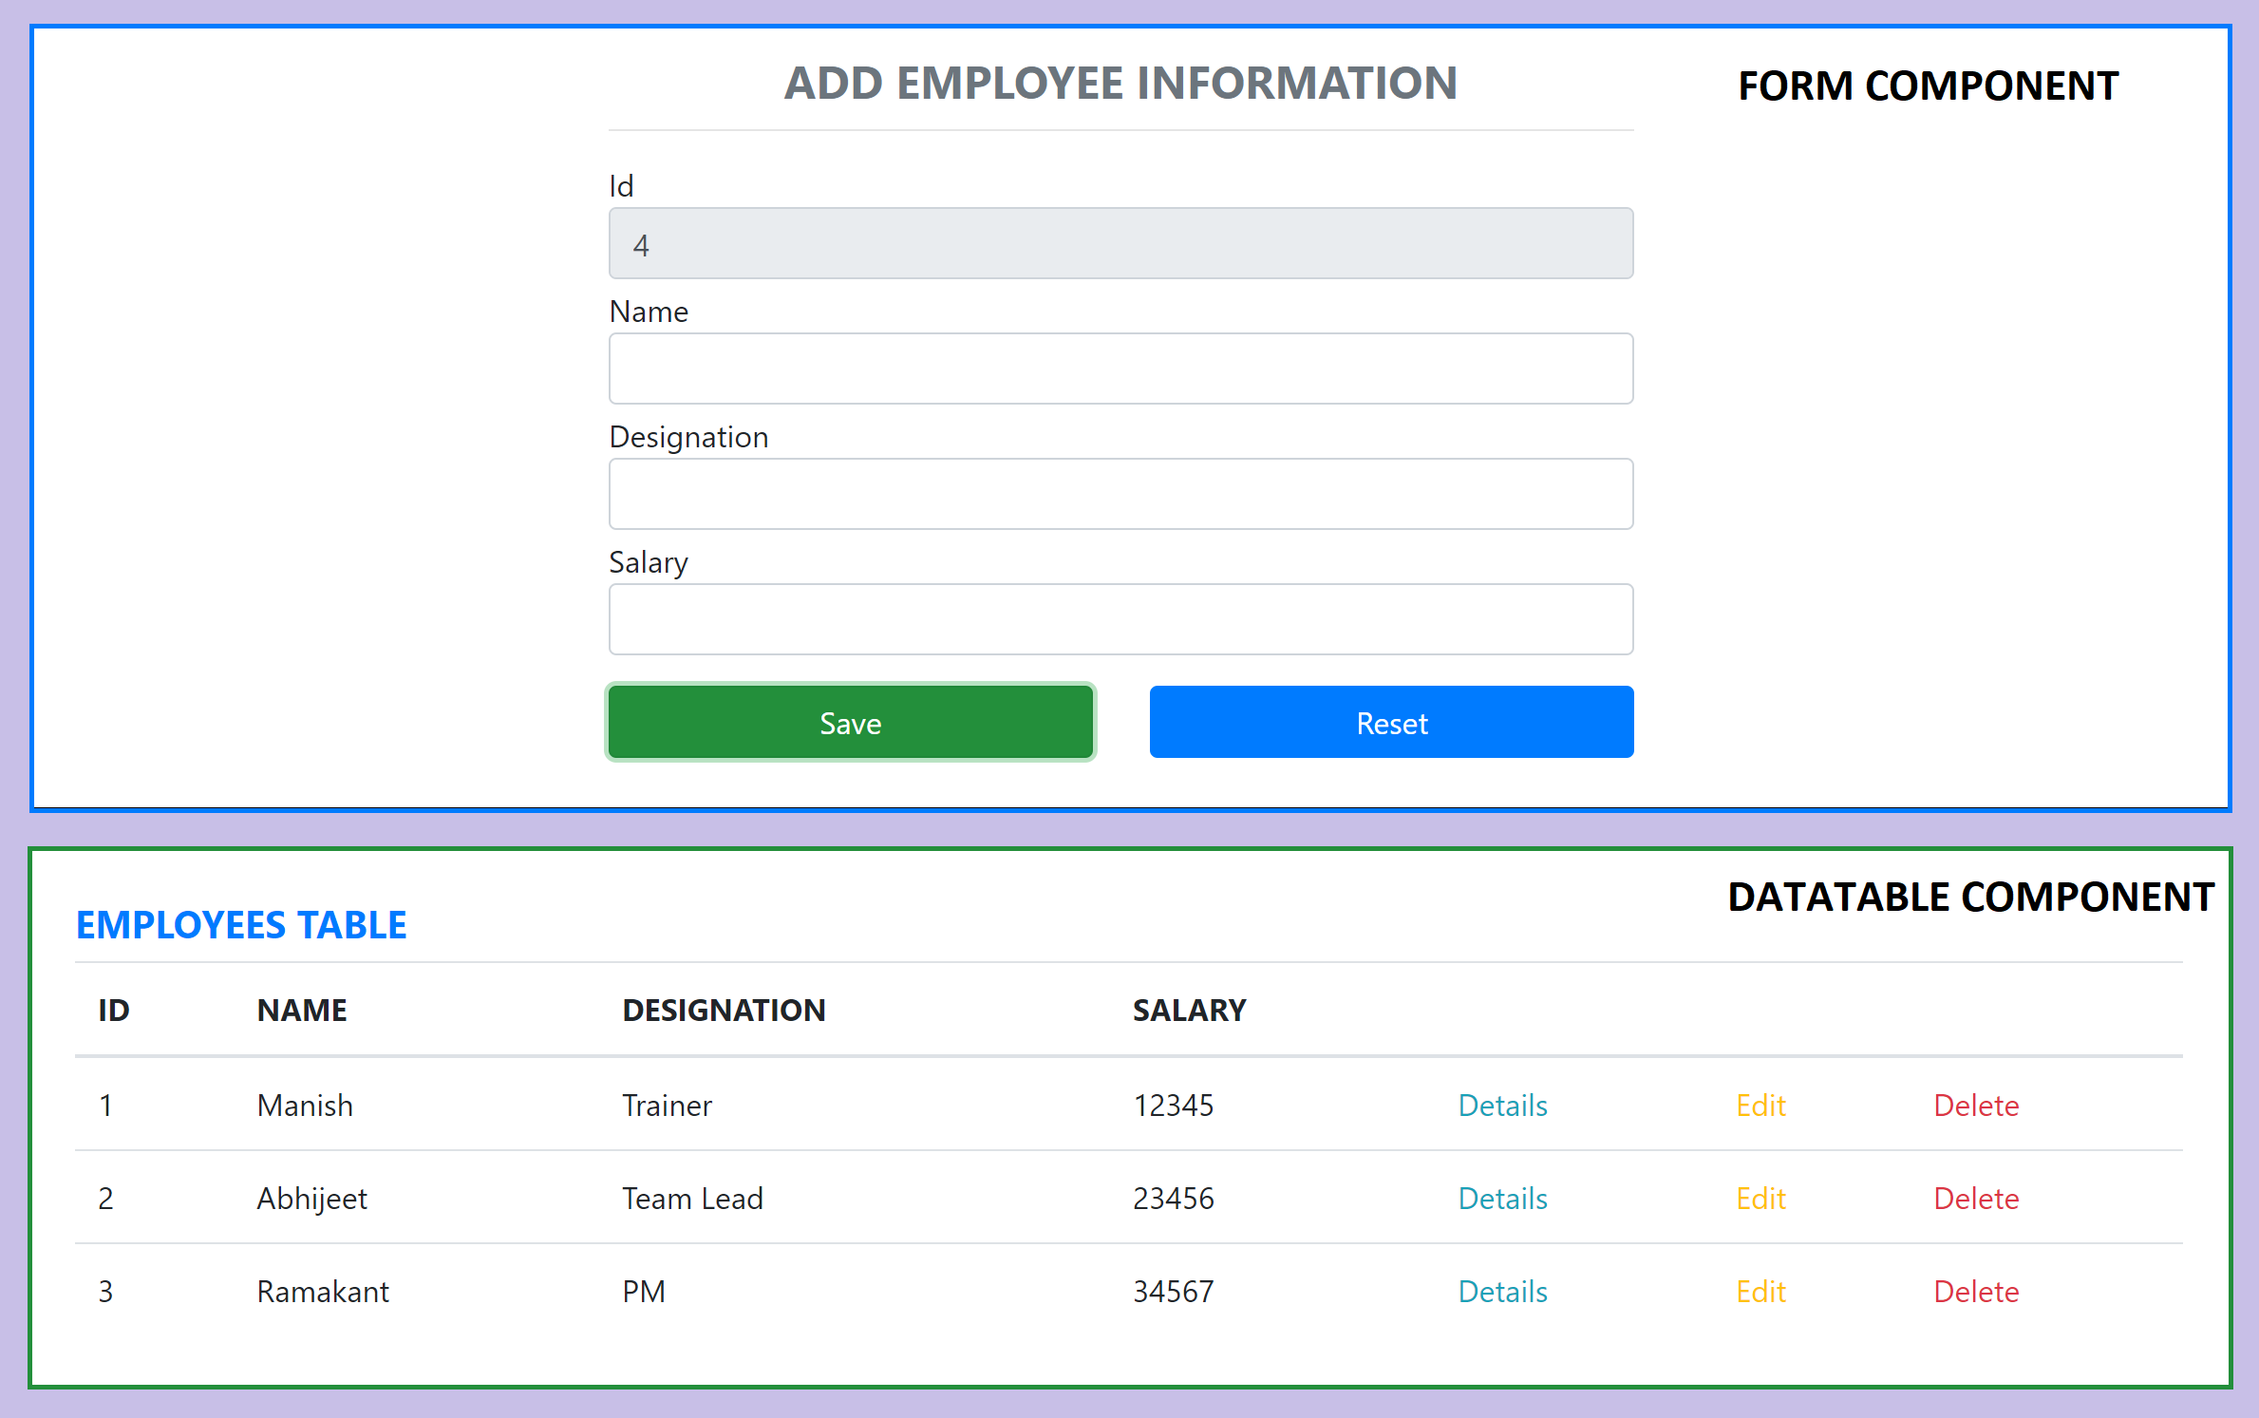
Assignment

Slide 44
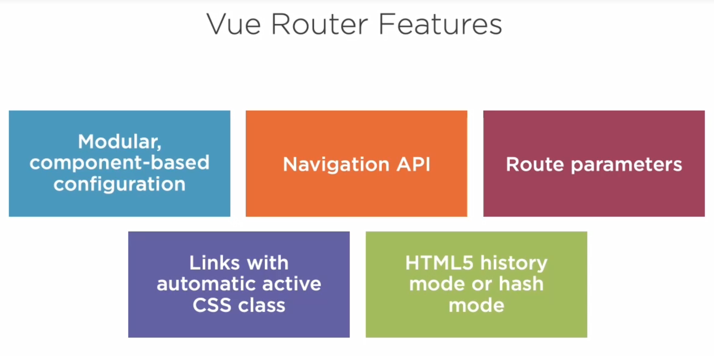

Slide 45
Install Router
npm i vue-router
vue add router

Slide 46
NODE SERVER
BROWSER
HTTP + URL (localhost:3000)
NAVIGATION
Vue Application
HTML Page + JS (Vue App)
NODE SERVER
EXPRESS JS
Web API
AJAX – localhost:8000/api/products
Database
JSON

Slide 47
NODE SERVER
BROWSER
HTTP + URL (localhost:3000)
NAVIGATION
Vue Application
Click on Admin link,
Will Verify token in
sessionStorage,
If not, you will be redirected
to Login
HTML Page + JS (Vue App)
HTTP + URL (AJAX) + Username & Password
NODE SERVER
Login Submit
EXPRESS JS
Web API
JSON with Token
{“token”:”___”}
Store Token in Session
Storage of the browser
Send the same token to
Access data from the
Server using interceptor
AJAX – localhost:8000/api/products + Token
Database
JSON

Slide 48
Vue Router Guards
Global guards – These are called each time the URL changes
beforeEach, beforeResolve, afterEach
Route guards – These are only called when the associated ROUTE is matched
beforeEnter
Route Component guards – These are only called when a ROUTE COMPONENT is used/unused
beforeRouteEnter, beforeRouteUpdate, beforeRouteLeave

Slide 49
Vuex
Vuex is a state management pattern + library for Vue.js applications.
It serves as a centralized store for all the components in an application, with rules ensuring that the state can only be mutated in a predictable fashion.
It also integrates with Vue's official devtools extension to provide advanced features such as zero-config time-travel debugging.
By defining and separating the concepts involved in state management and enforcing rules that maintain independence between views and states, we give our code more structure and maintainability.
This is the basic idea behind Vuex, inspired by Flux, Redux and The Elm Architecture.

Slide 50
Methods
State
View
Methods
State
View

Slide 51
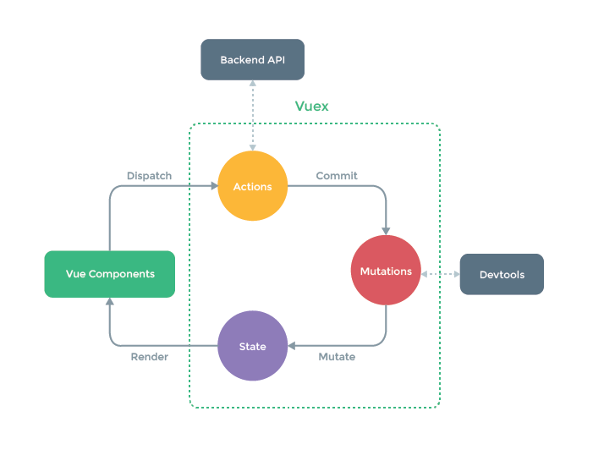
Vuex

Slide 52
Contact Me
Manish Sharma | Gmail
Manish Sharma | WhatsApp
Manish Sharma | Facebook
Manish Sharma | LinkedIn

